Slide 1
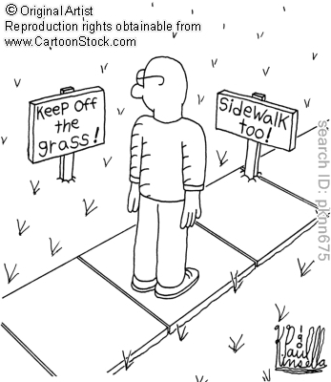

Slide 2
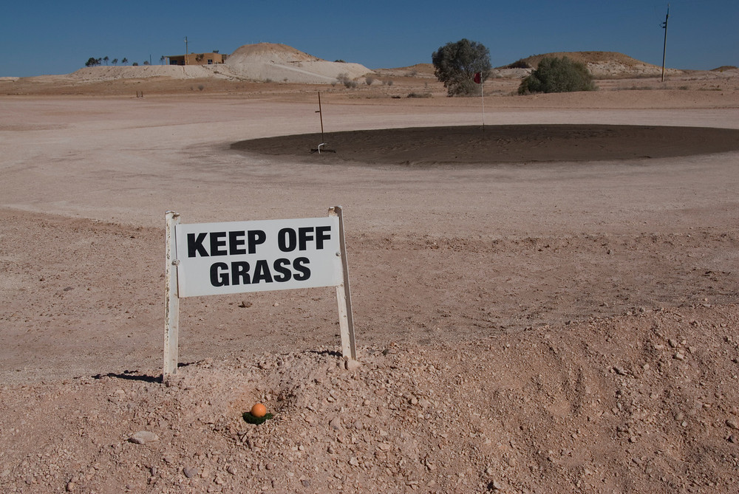

Slide 3
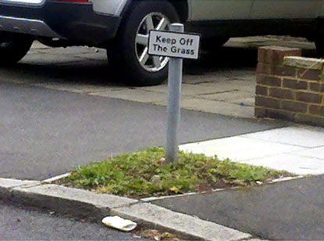

Slide 4
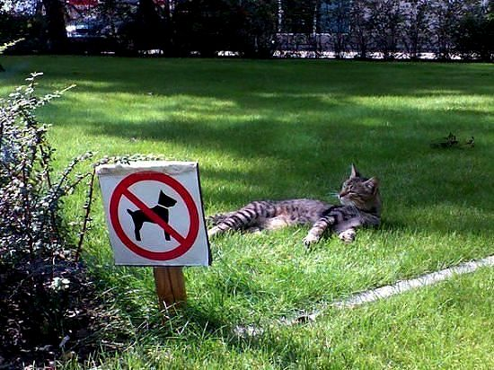

Slide 5


Slide 6


Slide 7


Slide 8
“Law and Economics”
Interdisciplinary social science
To reduce the ‘dogmatic’ nature of the law
Use economics to analyse:
  Why does it exist?
  Does it induce efficiency?
  If not, how can the law be improved?
  Is there any contradiction with justice?
  Is the judicial economy justified?
Economic Analysis of Law

Slide 9

Means/Ends Analysis
Ends: the goal
Means: how to get to that goal
Different means can get to the same end
  What is different?
  The difference is the mean itself
  Economically speaking…????
“The end does not (always) justify the means”
St Thomas Aquinas, Summa Theologica

Slide 10
Ex Ante vs Ex Post
Consider a certain point in time
Something happens at that time – incident
Things happened before that incident is called ex ante
Things happening after that incident is called ex post

Slide 11
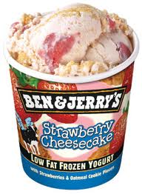




Ex Ante vs Ex Post: Some examples
Low-Fat Product
Car’s Safety Equipments
Cigarettes

