Slide 1
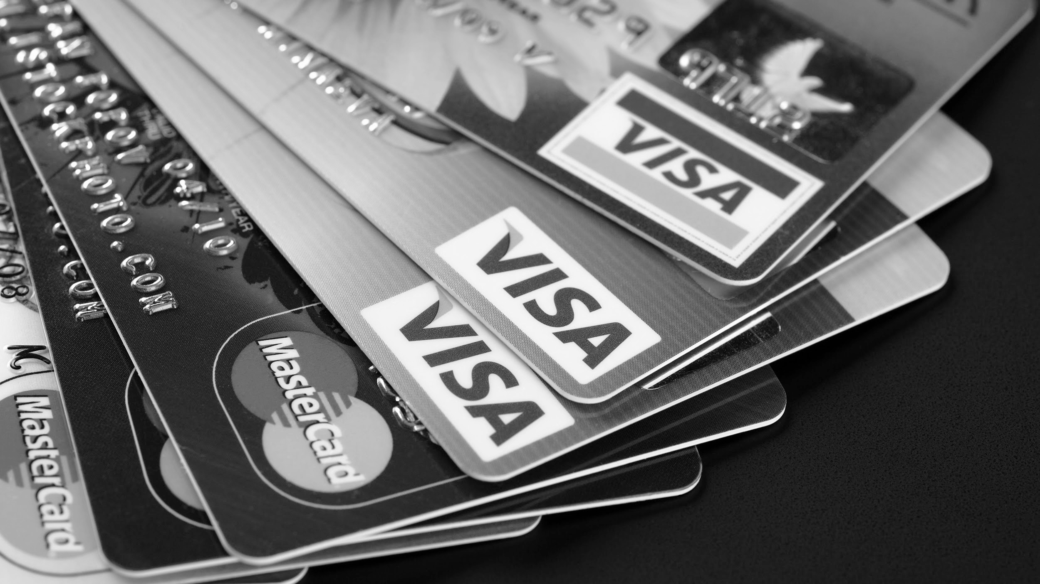
DEBIT CARD
AND
CREDIT CARD
FN 323 CREDIT MANAGEMENT
Juthamard Jirapongmatte 5804640026
Wasawat Sumneing 5804640349
Phanthitra Boonyawiwat 5804640703
Sirapob Asawachaisuvikom 5804640737
Tunwarat Pruksarnukul 5804641172
Kittitat Chunjitsavakon 5804641438

Slide 2

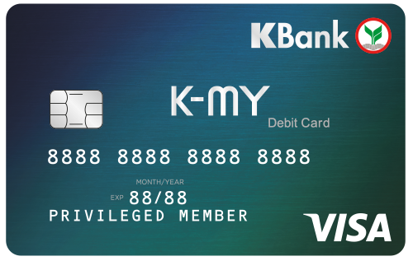
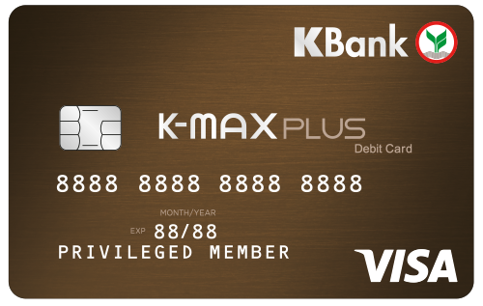
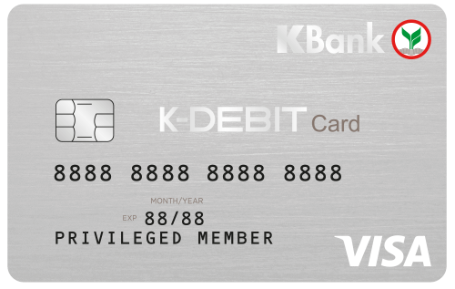
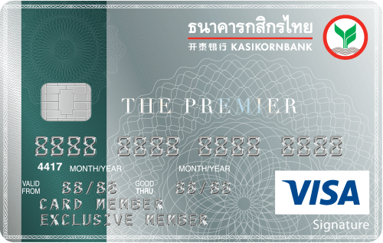
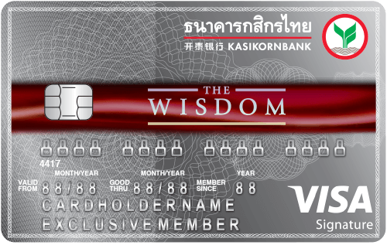
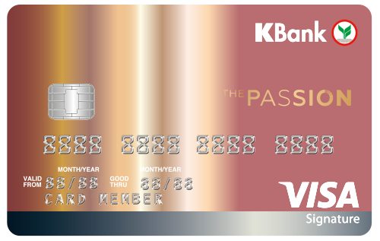
WHAT IS DEBIT CARD AND CREDIT CARD?
These two sound similar but yet different in their functionality.
Debit Card
Credit Card
Draw money directly from your checking account when you make the purchase
Allow you to borrow money against
a line of credit
SOURCE: thebalance.com
INTRODUCTION
FEATURES
BENEFITS
BUSINESS MODEL
EXAMPLES
Q&A

Slide 3
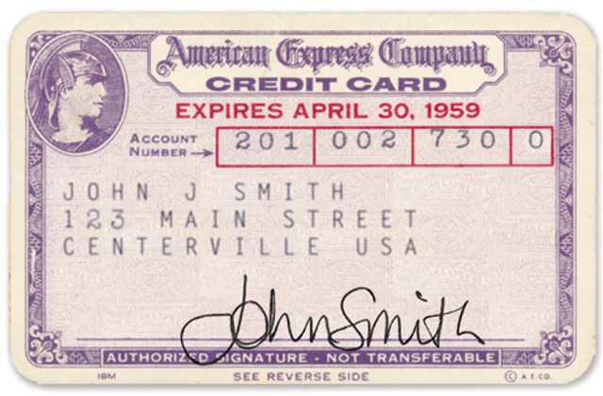

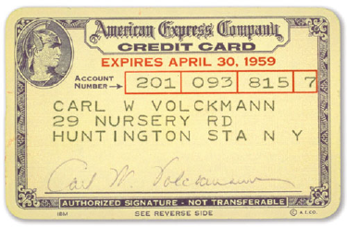

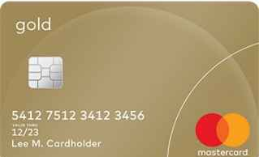
FORM OF FINANCIAL CARD
Across generation, the card has been 80 years of using.
1946
THE FIRST BANK CARD
called "Charg-it"
was introduced in 1946
by John Biggins. (Biggin's Bank)
1959
AMERICAN EXPRESS UNVEILS ITS FIRST PLASTIC CARD
which required payments in full amount at the end of the month
1970
IBM UNVEILS MAGNETIC STRIPE
Driven by the prevalence of
credit card fraud in the 60s
A SMART CARD
1994
A form of strong security authentication
for single sign-on within large companies
and organizations.
SOURCE: creditcards.com, Wikipedia, timetoast.com
INTRODUCTION
FEATURES
BENEFITS
BUSINESS MODEL
EXAMPLES
Q&A

Slide 4





CARD COMPONENTS
One little card hold more insight than you think.
Issuing Bank Logo
Smart Chip
Card Number
Expiry Date
Member
Name
Card Network Logo
Credit card networks are the bridge between merchants — the shops that accept your credit card — and the banks that issue the credit cards themselves.
SOURCE: finder.com
INTRODUCTION
FEATURES
BENEFITS
BUSINESS MODEL
EXAMPLES
Q&A

Slide 5


FEATURES OF DEBIT CARD AND CREDIT CARD
Debit cards and credit cards are world widely accepted, They both offer convenience and eliminate the need to carry cash. They even look similar, but in fact they provide different features.
Features | Debit Card | Credit Card
Function | A mean to access the funds in your personal bank account | A tool to allow you to suddenly borrow money from a bank to make purchases within a credit line
Qualifications | Open an saving account + At least 15 years old | Income per month (mostly at least 15,000 Baht) + Between 20-65 years old
Credit Score |  | Yes, banks will examine your score via National Credit Bureau (NCB)*
Fees | Entrance Fee (mostly 100 Baht) + Annual Fee (from 0 - 999 Baht) | Annual Fee (0-50,000 Baht)
* NCB is a center to exchange the data of the clients of commercial banks
to reduce the risk of giving a loan and prevent the damages that may happen
SOURCE: sanook.com, kasikornbank.com, krungsri.com, ncb.co.th
INTRODUCTION
FEATURES
BENEFITS
BUSINESS MODEL
EXAMPLES
Q&A

Slide 6

FEATURES OF DEBIT CARD AND CREDIT CARD
The Bank of Thailand makes it harder to get a credit card, cut each card's limits - but lower the interest rate on payments to 'only' 18%.
(CONTINUE)
Features | Debit Card | Credit Card
Spending limit | Depends (up to 200,000 Baht) | 2-5 times of your income
Repayment |  | Full amount or partial, but must be at least Max (10% of the amount used, 500 Baht)
Installment |  | 0% interest for 3 - 36 months for joint-promotional items
Grace period |  | 45-55 days
Interest charged in case of default |  | Not exceed 18%
SOURCE: kasikornbank.com, krungsri.com, bot.or.th, 1213.or.th, gobear.com, bangkokpost.com
INTRODUCTION
FEATURES
BENEFITS
BUSINESS MODEL
EXAMPLES
Q&A

Slide 7





FEATURES OF DEBIT CARD AND CREDIT CARD
Nowadays, many additional services have been added into both financial cards to provide more convenient and serve the customers’ need.
(CONTINUE)
Features | Debit Card | Credit Card
Fine charged in case of default |  | 0 - 250 Baht
Reward, Points, Cash Back | Depends (Usually no) | Depends (Mostly every 25 Baht = 1 point and 1000 points = 100 Baht)
Additional Services | Accident Insurance, Travel Insurance, Rabbit Card etc. | Accident Insurance, Travel Insurance, Rabbit Card etc.
Security/ Pin | Usually no need to enter the pin for Visa Card and Mastercard but 6-digit pin is required for Unionpay card. | Usually no need to pin the password for Visa, Mastercard and JCB but 6-digit pin is required for Unionpay card.
SOURCE: kasikornbank.com, krungsri.com, bangkokbank.com, bot.or.th, 1213.or.th, gobear.com, bangkokpost.com
FEATURES
BENEFITS
BUSINESS MODEL
EXAMPLES
Q&A
INTRODUCTION
Notes:
https://www.sanook.com/money/482549/

Slide 8





BENEFIT OF CREDIT CARD - ISSUERS
The issuer of the credit card get the profit from issuing the credit card.
FEES
MERCHANT FEES
users pay fees for using credit card each year
merchants pay fees around 3% each time when using EDC machine
FINE INTEREST
INCENTIVE BENEFITS
for a delay payment user have to pay fine around 18% (use now, pay later)
create incentive to customer to purchase something and get benefit for each time they spend via card
ISSUERS
SOURCE: pocketsense.com
INTRODUCTION
FEATURES
BENEFITS
BUSINESS MODEL
EXAMPLES
Q&A
Notes:
https://pocketsense.com/issuing-banks-benefit-credit-cards-17201.html

Slide 9







BENEFIT OF CREDIT CARD - USERS
The user also get advantage from using the credit card.
LIQUIDITY
CONVENIENCE
easy to purchase something via credit card
not necessary to hold that much cash and coin
LOANS
REWARD POINTS
not necessary to pay full amount in one time, use future money
purchase via credit card receive reward point and can exchange for some reward
USERS
SERVICES
for further information can call call center for 24/7
PRIVILEGE
upgrade seat, lounge, priority line, parking lot
DISCOUNTS
INSURANCE
some restaurant and shop give some discount for credit user
provide insurance on top
SOURCE: discover.com
INTRODUCTION
FEATURES
BENEFITS
BUSINESS MODEL
EXAMPLES
Q&A
Notes:
https://www.discover.com/credit-cards/resources/what-are-the-advantages-of-credit-cards/

Slide 10

BENEFIT OF DEBIT CARD - ISSUERS & USERS
The issuer of the debit card get the profit from launching the debit card.
CONVENIENCE
FEES
not necessary to hold that much cash and coin
users pay fees for using credit card each year
LIQUIDITY
MERCHANT FEES
easy to purchase something via credit card
merchant pay fees around 3% each time (EDC)
USERS
DISCOUNTS
NO LOANS
some restaurant and shop give some discount for credit user
limited purchasing power according to amount of cash in saving account (wealth), easy to control your purchasing
ISSUERS
REWARD POINTS
SERVICES
purchase via debit card receive reward point and can exchange for some reward
for further information can call call center for 24/7
SOURCE: discover.com, northcountrysavings.com
INTRODUCTION
FEATURES
BENEFITS
BUSINESS MODEL
EXAMPLES
Q&A

Slide 11





PROS AND CONS FOR CARDHOLDERS
Cardholders may receive different types of feature and benefit for holding
different types of card
Credit card customers
Merchants
Debit card customers
Credit card
Function
Debit card
Credit score
Authorization
Personal wealth
Future money
Time value of money
Present money
Interest and fees
Cost
Annual fees
An easy short-term loan with no question asked
Advantages of holding
Easy and safe access to your personal wealth
Cardholders have more purchasing power
Merchants gain more sales volume
More liquidity in the market
Better money management since we can
track historical transactions
Gain saving interest (no cash needed)
Privileges of being cardholder
Merchants are subjected to fees on sales of goods and services
Cardholders are subjected to fees charged
by the issuing bank
Requiring money in the saving account
unlike credit card
No defer payment
SOURCE: Euromonitor, twocents.lifehacker.com
INTRODUCTION
FEATURES
BENEFITS
BUSINESS MODEL
EXAMPLES
Q&A

Slide 12










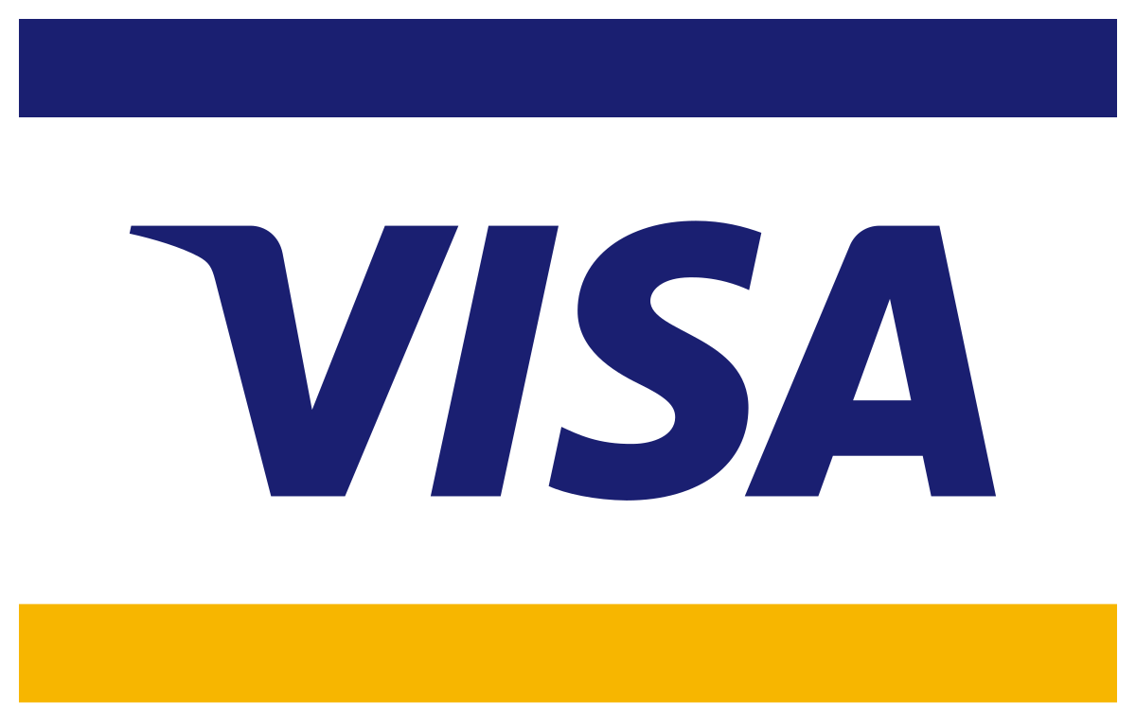
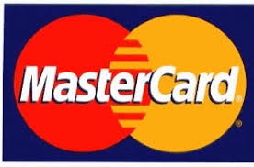





BUSINESS MODEL: CREDIT CARD SYSTEM
Cardholders are subjected to authorization to prevent potential risk of fraud
and bad debts that rely on credit score
Acquiring banks
Merchants
Cardholders
Transaction amount + card information
Credit card payment
Result of authorization
Goods & Services
Issuing banks
Credit Card
Companies
Authorization response
Approve or deny the transaction
Transaction amount + request of authorization
Authorization Request
SOURCE: revenuesandprofits.com
INTRODUCTION
FEATURES
BENEFITS
BUSINESS MODEL
EXAMPLES
Q&A

Slide 13

BUSINESS MODEL: DEBIT CARD SYSTEM
The debit card mechanism is almost the same as credit card except the type of payment
Acquiring banks
Merchants
Cardholders
Transaction amount + card information
Personal wealth
Result of authorization
Goods & Services
Issuing banks
Credit Card
Companies
Authorization response
Approve or deny the transaction
Transaction amount + request of authorization
Authorization Request
SOURCE: revenuesandprofits.com
INTRODUCTION
FEATURES
BENEFITS
BUSINESS MODEL
EXAMPLES
Q&A

Slide 14
BUSINESS MODEL: THE MONEY MECHANISM
What happen when one transaction occur in the credit and debit card system?
Acquiring banks
Credit Card Companies
Issuing banks
Pay $98.09 to acquirer
Pay $98.2
Charge Visa assessment fees $0.11
Pay interchange fees
Issuing bank Acquiring bank Credit card company Total fees | $1.80 $0.33 $0.11 $2.24
Pay merchant discount fees
$0.33
Merchants
Debit cardholder’s account
Cardholders
Pay $97.76 to merchant
Pay $100
Interchange fees $1.80
Goods & Services
SOURCE: revenuesandprofits.com
INTRODUCTION
FEATURES
BENEFITS
BUSINESS MODEL
EXAMPLES
Q&A

Slide 15
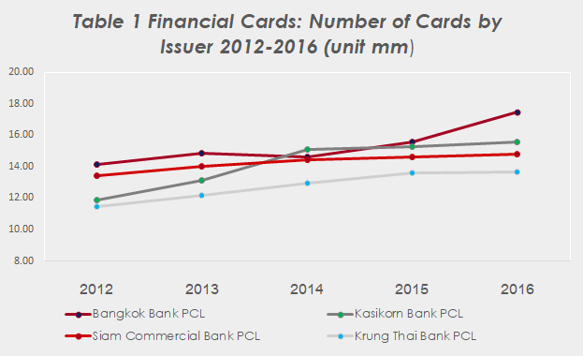
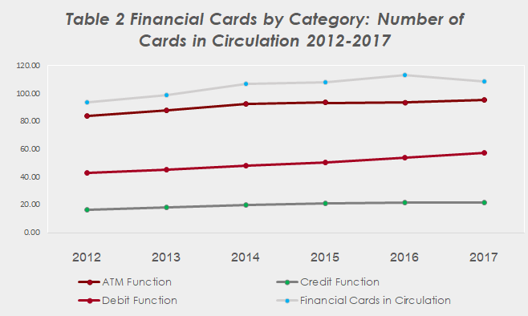
BUSINESS MODEL: TRENDS OF FINANCIAL CARDS
Historical trends of financial cards in the circulation 2012-2017
CAGR
CAGR
5.4%
3.1%
2.6%
7.1%
2.5%
6.0%
4.5%
5.3%
“
”
Trends of card issuing from the bank tend to increase over time
Bangkok Bank PCL issued the most financial cards in 2016
Kasikorn Bank PCL yield the highest CAGR of 7.1%
Cards in the circulation of each function tend to be either a little bit higher or relatively stable
ATM Function is most widely used function since its can combine with other function
Debit Function yield the highest CAGR of 6.0%
SOURCE: Euromonitor
*CAGR is Compound Annual Growth Rate
INTRODUCTION
FEATURES
BENEFITS
BUSINESS MODEL
EXAMPLES
Q&A

Slide 16
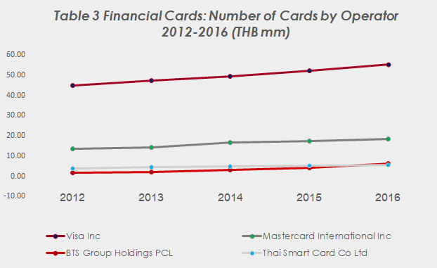
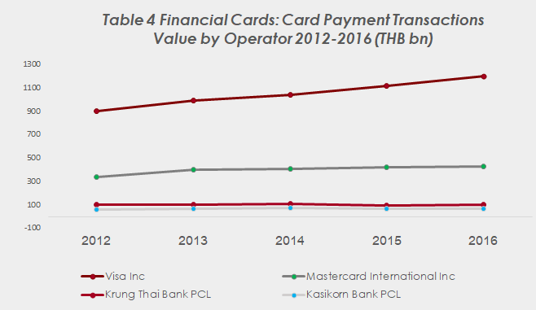
BUSINESS MODEL: TRENDS OF FINANCIAL CARDS
Historical trends of financial cards in the circulation 2012-2016
CAGR
CAGR
5.5%
7.4%
7.9%
6.2%
36.9%
-0.3%
10.3%
3.3%
“
”
Financial cards by operator tend to increase over time as well
Visa Inc operated the most financial cards from the past few years
BTS Group Holdings PCL yield the highest CAGR
Card operator that are MNCs capture the highest transaction value from the past few years
Visa Inc operated the highest transaction value and also the highest CAGR of 7.4% from the past few years
SOURCE: Euromonitor
*CAGR is Compound Annual Growth Rate
INTRODUCTION
FEATURES
BENEFITS
BUSINESS MODEL
EXAMPLES
Q&A

Slide 17
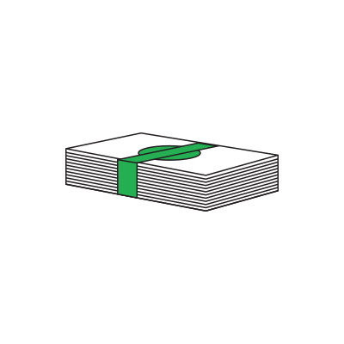
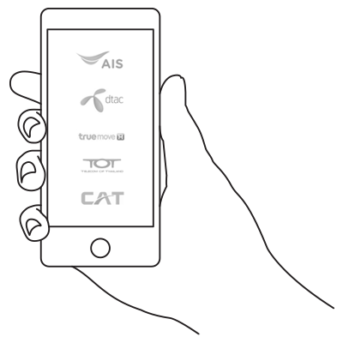


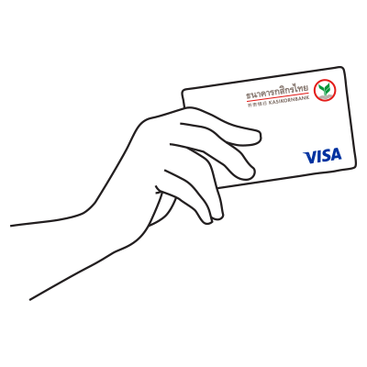
EXAMPLE OF DEBIT CARD
K-DEBIT Card - BENEFITS
Money Matters, Make Easy
Withdraw cash
Up to 200,000 baht per day
Top up mobile
With unlimited amount and no fee
Transfer fund
Up to 1,000,000 baht per day
Pay bills at ATMs
To over 3,000 companies
Make purchases
Up to 200,000 baht
SOURCE: Kasikorn Bank
INTRODUCTION
FEATURES
BENEFITS
BUSINESS MODEL
EXAMPLES
Q&A

Slide 18

EXAMPLE OF DEBIT CARD
K-DEBIT Card - ELIGIBILITY and FEES
Money Matters, Make Easy
HOW TO APPLY ?
WHAT TO PAY ?
Qualifications
Age 15 or above
Have a savings and (or) current account, whether an individual account or joint account that allows either owner to withdraw funds, or a merchant account with a single owner account
Entrance fee/replacement fee = 100 baht
Annual fee = 200 baht
SOURCE: Kasikorn Bank
INTRODUCTION
FEATURES
BENEFITS
BUSINESS MODEL
EXAMPLES
Q&A

Slide 19

EXAMPLE OF CREDIT CARD
KBank THE WISDOM card - BENEFITS
The Symbol of your Pleasure
THE WISDOM Exclusive Experience
Privileges at Leading Hotels
Personal Concierge Service 24 hours a day
THE WISDOM Park and Wash
The Symbol of your Journey
THE WISDOM Lounge
Priority Pass Lounges
Global Customer Assistance Services
The Symbol of your Visionary
Wealth Management Advisory
K-Econ Analysis
Fee exemptions and preferential rates for financial services
The Symbol of your Wellness
Annual health checkup at leading hospitals
Special Offers from BDMS Hospital Group
SOURCE: Kasikorn Bank
INTRODUCTION
FEATURES
BENEFITS
BUSINESS MODEL
EXAMPLES
Q&A

Slide 20
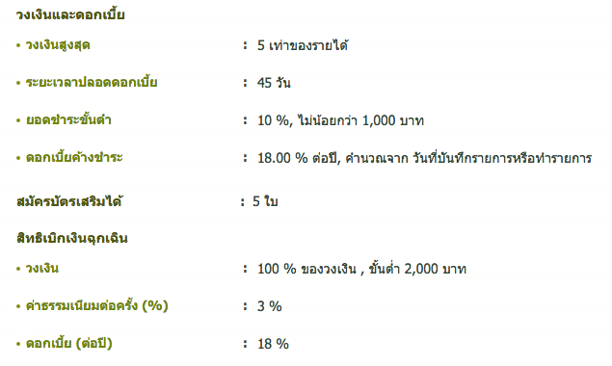
EXAMPLE OF CREDIT CARD
KBank THE WISDOM card - ELIGIBILITY and FEES
HOW TO APPLY ?
WHAT TO PAY ?
Qualifications
Main Card Applicants
20 - 80 years of age
Deposit / invest at least 10 million baht for an average of 6 months or according to the conditions set by the bank
Supplementary Card Applicants
15 - 80 years of age
Entrance fee = exempted
Annual fee = 30,000 baht/ year (will be exempted if a person deposit or invest at some amount specified by
the bank)
Interest rate = 18% per year
Minimum installment rate = 10% of the amount specified
in statement or 1,000 baht per billing cycle
Cash withdrawal fee = 3% of the amount of cash withdrawal, with at least 2,000 baht for each withdrawal
SOURCE: Kasikorn Bank
INTRODUCTION
FEATURES
BENEFITS
BUSINESS MODEL
EXAMPLES
Q&A

Slide 21
DEBIT CARD AND CREDIT CARD
Q
&
A
INTRODUCTION
FEATURES
BENEFITS
BUSINESS MODEL
EXAMPLES
Q&A

