Slide 1
Product line decisions
MK 202 Additional Slides

Slide 2
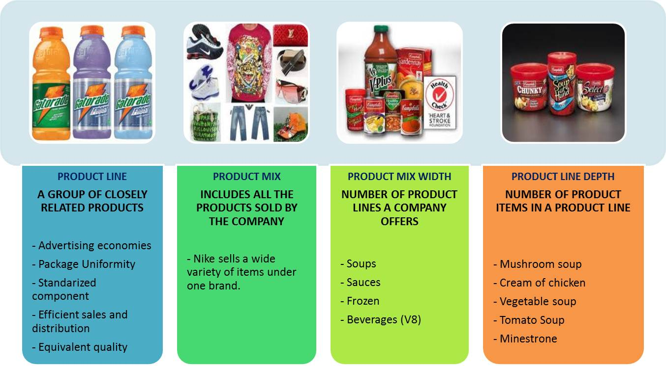
By definition…

Slide 3
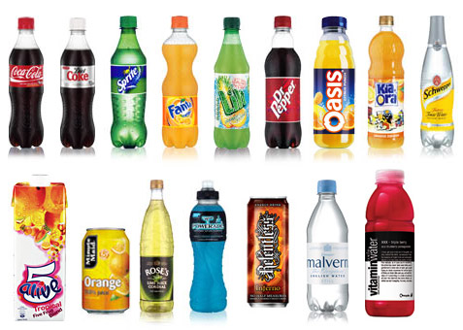
Product Line Extension from Coca Cola

Slide 4
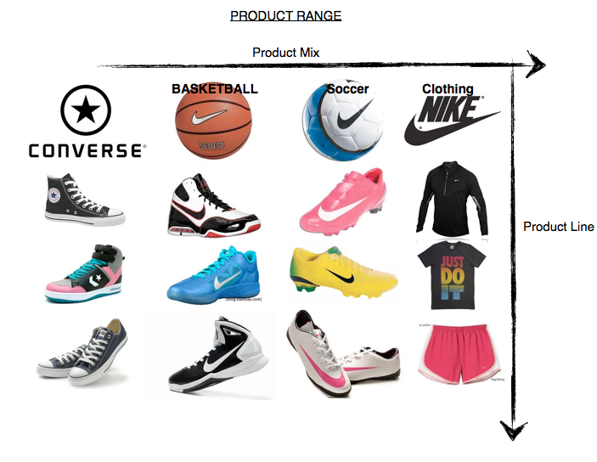
Nike Product Mix

