Slide 1

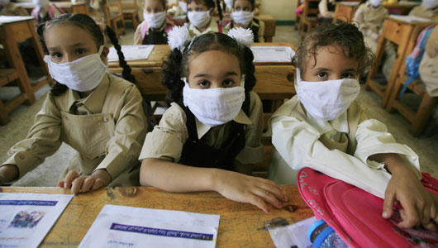
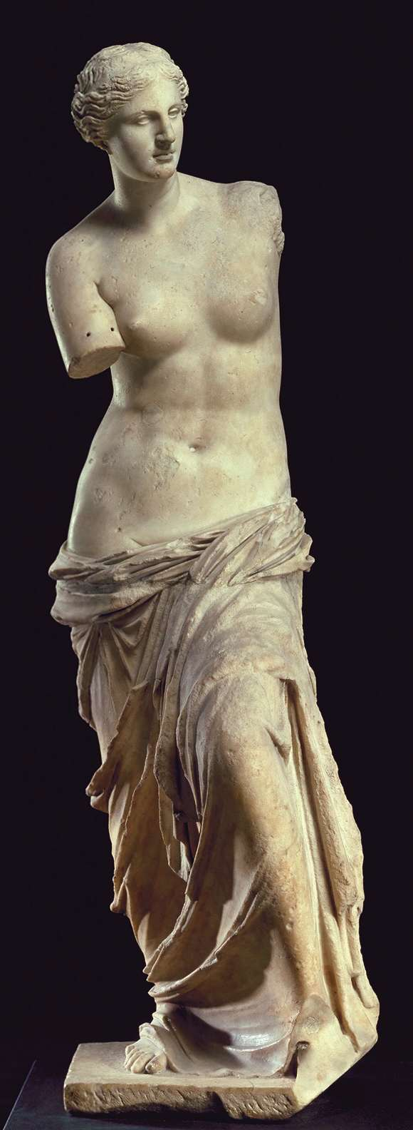

Article XX GATT General Exceptions
By
Assistant Prof. Dr. Jaruprapa Rakpong

Slide 2
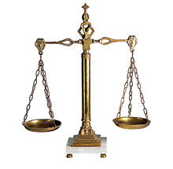
General Exceptions : Article XX GATT
What is it?
“An opt-out clause” for CPs’ governments
The drafters of GATT realised that although trade liberalisation is important , the WTO CPs need to pursue other policy goals as well.
Thus, they agreed that a departure from WTO obligations (MFN, NT, non-discrimination) is justifiable in certain situations where there is a greater policy goal to outweigh them.
Thus, the burden of proof would be on the parties seeking to use the exceptions.
By adding the general exceptions, the WTO has to balance its policy goals (esp. trade liberisation) with “other legitimate concerns” of the CPs. → trying to respect the CPs’ sovereignty (i.e. their autonomy to construct their own laws, regulations in the pursuant of their policy goals).

Slide 3
Other paragraphs of Article XX
Subject to the requirement that such measures are not applied in a manner which would constitute a means of arbitrary or unjustifiable discrimination between countries where the same conditions prevail, or a disguised restriction on international trade, nothing in this Agreement shall be construed to prevent the adoption or enforcement by any contracting party of measures:
(a) necessary to protect public morals;
(b) necessary to protect human, animal or plant life or health;
(c) relating to the importations or exportations of gold or silver;
(d) necessary to secure compliance with laws or regulations which are not inconsistent with the provisions of this Agreement, including those relating to customs enforcement, the enforcement of monopolies operated under paragraph 4 of Article II and Article XVII, the protection of patents, trade marks and copyrights, and the prevention of deceptive practices;
(e) relating to the products of prison labour;
(f) imposed for the protection of national treasures of artistic, historic or archaeological value;

Slide 4
Other paragraphs of Article XX
E.g. Import ban on child labour, blood diamonds, alcoholic beverages (Muslim countries), pornography, sex-toys etc.
Subject to the requirement that such measures are not applied in a manner which would constitute a means of arbitrary or unjustifiable discrimination between countries where the same conditions prevail, or a disguised restriction on international trade, nothing in this Agreement shall be construed to prevent the adoption or enforcement by any contracting party of measures:
(a) necessary to protect public morals;
(b) necessary to protect human, animal or plant life or health;
(c) relating to the importations or exportations of gold or silver;
(d) necessary to secure compliance with laws or regulations which are not inconsistent with the provisions of this Agreement, including those relating to customs enforcement, the enforcement of monopolies operated under paragraph 4 of Article II and Article XVII, the protection of patents, trade marks and copyrights, and the prevention of deceptive practices;
(e) relating to the products of prison labour;
(f) imposed for the protection of national treasures of artistic, historic or archaeological value;
Can ban imports produced by prisoners
Can ban imports of historical artefacts

Slide 5
Text of Article XX
(g) relating to the conservation of exhaustible natural resources if such measures are made effective in conjunction with restrictions on domestic production or consumption;
(h) undertaken in pursuance of obligations under any intergovernmental commodity agreement which conforms to criteria submitted to the CONTRACTING PARTIES and not disapproved by them or which is itself so submitted and not so disapproved;*
(i) involving restrictions on exports of domestic materials necessary to ensure essential quantities of such materials to a domestic processing industry during periods when the domestic price of such materials is held below the world price as part of a governmental stabilization plan; Provided that such restrictions shall not operate to increase the exports of or the protection afforded to such domestic industry, and shall not depart from the provisions of this Agreement relating to non-discrimination;
(j) essential to the acquisition or distribution of products in general or local short supply; Provided that any such measures shall be consistent with the principle that all contracting parties are entitled to an equitable share of the international supply of such products, and that any such measures, which are inconsistent with the other provisions of the Agreement shall be discontinued as soon as the conditions giving rise to them have ceased to exist. The CONTRACTING PARTIES shall review the need for this sub-paragraph not later than 30 June 1960.

Slide 6
The Nature and Functions of Article XX
Article XX will be invoked and come into play only when the measure of the CP found to be inconsistent with another GATT provisions.
Regularly used (attempted in the majority of cases )
It will be invoked to justify a GATT- inconsistent measure.
In theory, these are limited and conditional exceptions
In practice→ Not always the case!
Construed narrowly?

Slide 7
The Nature and Functions of Article XX
In other words, Yes! The measure is inconsistent with GATT but it is justifiable.
Article XX will be invoked and come into play only when the measure of the CP found to be inconsistent with another GATT provisions.
Regularly used (attempted in the majority of cases )
It will be invoked to justify the GATT inconsistent measure.
In theory, these are limited and conditional exceptions
Exception (s) usable when certain conditions are fulfilled
Exhaustive list
In Practice→ Not always the case!
Construed narrowly?

Slide 8
Specific Exception under Art. XX GATT: Article XX (b):
“measures necessary to protect human, animal or plant life or health”
(b) necessary to protect human, animal or plant life or health;
Two tier test (Thailand-Cigarettes) :
The policy respect of the measure was designed to protect human, animal plant life or health
2) The inconsistent measures for which the exception was invoked were necessary to fulfil the legitimate objective

Slide 9
Specific Exception under Art. XX GATT: Article XX (b):
“measures necessary to protect human, animal or plant life or health”
(b) necessary to protect human, animal or plant life or health;
(low) means-end rationality test
Two tier test (Thailand-Cigarettes) :
The policy respect of the measure was designed to protect human, animal plant life or health
2) The inconsistent measures for which the exception was invoked were necessary to fulfil the legitimate objective
The necessity test

Slide 10
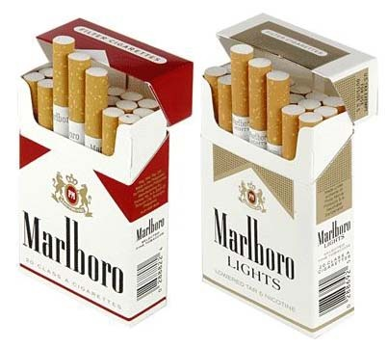
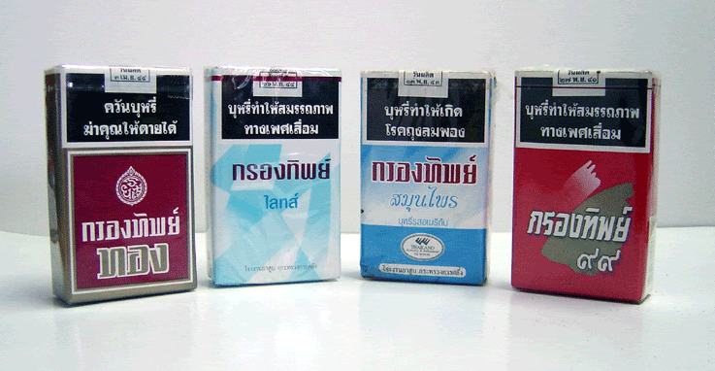
GATT (Art. XX(b)): Thailand-Cigarettes
Thailand-Cigarettes (1990)- The Old Cigarette Case
Thailand’s 1966 (2509) Tobacco Act, inter alia, prohibited the importation of cigarettes and other tobacco preparations, but allowed the sale of domestic cigarettes.
S. 27 of the Tobacco Act = the importation or exportation of tobacco seeds, tobacco plants, tobacco leaves, plug tobacco, shredded tobacco and tobacco is prohibited except by licence of the Director-General of the Excise Department or a competent officer authorised by him.
S. 4 of the said Act defines tobacco as "cigarettes, cigars, other tobacco rolled for smoking, prepared shredded tobacco including chewing tobacco".
Licences have only been granted to the Thai tobacco monopoly, which has imported cigarettes only on 3 occasions since 1966; namely in 1968-70, 1976 and 1980.

Slide 11
GATT (Art. XX(b)): Thailand- Cigarettes (cont’)
The US complained that the import restrictions were inconsistent with GATT Article XI, and that they were unjustifiable under Article XX(b).
Thailand argued, inter alia, that the import restrictions were justified under Article XX(b) for many public health reasons because:
- the chemicals and other additives contained in US cigarettes might make them more harmful than Thai cigarettes.
- Opening the import cigarette market would interfere with Thailand’s attempt to reduce domestic cigarette consumption
Thailand requested the panel to consult with experts from the WHO).

Slide 12
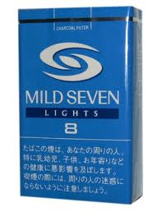
GATT (Art. XX(b)) Thailand- Cigarettes cont’
The WHO evidence supported Thailand’s claim:
- It indicated there were sharp differences between
cigarettes manufactured in developing countries such
as Thailand and those available in developed countries
as the latter used additives and flavourings.
- The locally grown tobacco leaf was harsher than the American one. Consequently, smoking western cigarettes had become easier for some groups who might not otherwise smoke (women and adolescents).
- There were a false illusion among many smokers that imported brands were safer than the native brands (whereas, in fact, they could equally create adverse effects on health).
- But the WHO could not provide any scientific evidence that cigarettes with additives were more harmful to health than cigarettes without the additives.
Watch the space! compare with SPS Agreement later

Slide 13
GATT (Art. XX(b)) Thailand –Cigarettes cont’
Held: This = breach of Art XI as Thailand had not granted licences for the importation of cigarettes during the past 10 years.
Art. XI 1. No prohibitions or restrictions other than duties, taxes or other charges, whether made effective through quotas, import or export licences or other measures, shall be instituted or maintained by any contracting party on the importation of any product of the territory of any other contracting party or on the exportation or sale for export of any product destined for the territory of any other contracting party.

Slide 14
GATT (Art. XX(b)) Thailand –Cigarettes cont’
Held: This = breach of Art XI as Thailand had not granted licences for the importation of cigarettes during the past 10 years.
Art. XI 1. No prohibitions or restrictions other than duties, taxes or other charges, whether made effective through quotas, import or export licences or other measures, shall be instituted or maintained by any contracting party on the importation of any product of the territory of any other contracting party or on the exportation or sale for export of any product destined for the territory of any other contracting party.
Prohibition of import licenses

Slide 15
GATT (Art. XX(b)) Thailand- Cigarettes cont’
Whether Thailand’s measure was justifiable under Art. XX (b)
Not an issue that Thailand’s measure contributes to the protection of human life/health
But it became an issue whether Thailand’s measure was necessary
(para 73) Art. XX (b) clearly allowed CP to prioritise human health over trade liberalisation, provided the measure was "necessary”.
= Necessity Test (no less trade restrictive alternatives)
The measure would not be necessary and consistent with Article XX
“if an alternative measure which it could reasonably be expected to employ and which is not inconsistent/less inconsistent with other GATT provisions is available to it”
(para 76) Thailand’s measures could be seen as intended to (i) ensure the quality and (ii) reduce the quantity of cigarettes sold in Thailand

Slide 16
GATT (Art. XX(b)) Thailand- Cigarettes cont’
Held: Thailand was in breach of Art. XX (b) as the measures were not necessary to protect human health, because....
As to the quality→ (bad chemicals etc.)
- Thailand could have introduced a labelling scheme to inform consumers about the cigarettes’ ingredients
As to the quantity → (esp. Amongst the adolescent and female smokers)
- Thailand could have an advertisement ban.

Slide 17
GATT (Art. XX(b)) Thailand- Cigarettes cont’
Held: Thailand was in breach of Art. XX (b) as the measures were not necessary to protect human health, because....
As to the quality→ (bad chemicals etc.)
Thailand could have introduced a labelling scheme to inform consumers about the cigarettes’ ingredients
As to the quantity → (esp. Amongst the adolescent and female smokers)
Thailand could have an advertisement ban.
What do you think?

Slide 18
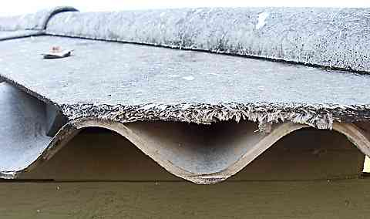
GATT (Art. XX(b)) EC-Asbestos
EC- Asbestos (2001)
Facts:
French decree banned the sale, use and import of all Asbestos fibres but not other kinds of insulated fibres
Aimed to protect public health
Canada which produced & exported a lot of Asbestos fibres claimed the violation of Article III:4, arguing that Asbestos fibres and other kind of fibres were “like products”

Slide 19
GATT (Art. XX(b)) EC- Asbestos cont’
AB: Agreed.
Although WTO members have a right to determine the level of health protection they consider appropriate in a given situation (here a total ban on Asbestos) (para 168), it has to also be established that there is no alternative to the measure at issue that the member could reasonably be expected to employ’.
Canada argued that a controlled use would be possible and = a less trade restrictive alternative.
But the AB held that this would not be possible to achieve the level of protection that EC wanted. (para 174-178)
Thus, the measure ( a total import ban) would be necessary to protect human health.

Slide 20
GATT (Art. XX(b)) EC- Asbestos cont’
AB: Agreed.
Although WTO members have a right to determine the level of health protection they consider appropriate in a given situation (here a total ban on Asbestos) (para 168), it has to also be established that there is no alternative to the measure at issue that the member could reasonably be expected to employ’.
Canada argued that a controlled use would be possible and = a less trade restrictive alternative.
But the AB held that this would not be possible to achieve the level of protection that EC wanted. (para 174-178)
Thus, the measure ( a total import ban) would be necessary to protect human health.
What do you think? Why is it different from Thai Cigarettes?

Slide 21
Article XX (g): relating to the conservation of exhaustible natural resources
Relating to the conservation of exhaustible natural resources.
Similar/ different from necessary to?
Prima facie, what do you think are exhaustible natural resources
Shrimp/ Turtle Case

Slide 22
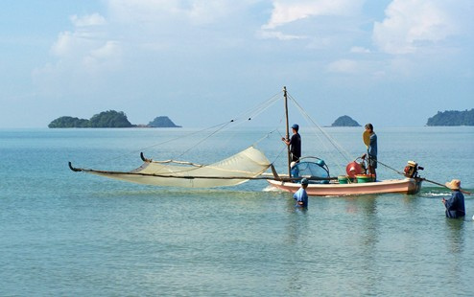
Article XX (g) Shrimp/Turtle Case
Malaysia, Pakistan, India, Thailand v US
US has already had a law which regulate the taking of turtles by commercial fishing → using Turtle Excluder Devices (TED).
US’s Section 609 of Public Law also prohibited:
- The importation of shrimp from other countries harvested with commercial fishing technology that may adversely affect sea turtles, except from some CPs which had been certified.
The certified countries would have had adopted regulatory programmes governing the taking of the sea turtles comparable to that of the US. (must use the same technology and methods i.e. TED ) + had the number of turtles’ mortality rates comparable to that of U.S. vessels.

Slide 23
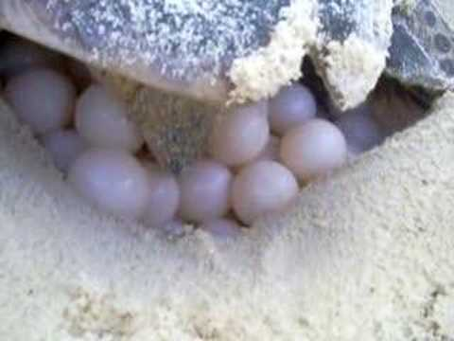
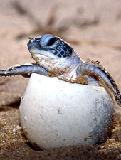

Article XX (g) Shrimp/ Turtle (cont’)
After the Panel’s report → US measure was held to have violated Article XI GATT and that it could not invoke Art. XX (g). US only appealed on the latter.
AB:
The term natural resources in Article XX (g) included living resources such as sea turtles.
But this is unconventional as … they are renewable ( the complaining members stressed on this point).

Slide 24
Article XX (g) Shrimp/Turtle (cont’)
AB referred to the drafting history of Article XX (g), there were discussion of mineral resources but AB said the wording of “natural resources ” had to be read “by a treaty interpreter in the light of contemporary concerns of the community of nations about the protection & conservation of the environment”. i.e. Long gone the day where the term natural resources could only refer to exhaustible minerals or other non-living natural resources. (para 129-31)
For an evidence that sea turtles = exhaustible natural resources, AB looked to the inclusion of sea turtles in Appendix I (Species threatened with extinction) under CITES (Convention on International Trade in Endangered Species of Wild Fauna and Flora)
AB declined to comment on the “extra-territorial” application of the US law, stating that the US was able to do so because sea turtles at issue were migrating to and from U.S. water.

Slide 25
Article XX (g) Shrimp/Turtle (cont’)
What is a minimum limit there
the natural resources must partly exist/stay in the countries making the claim
can be other species , energies, forests?? What else?
What is the maximum limit
→ Where the species do not migrate ?

Slide 26
Article XX (g) Shrimp/Turtle (cont’)
Whether Section 609 related to the conservation of exhaustible natural resources.
This means “primarily aimed at” i.e. Must contribute to the end pursued.
AB said Section 609 = primarily aimed at protecting sea turtles. (although this was rather indirectly as Section 609 actually aimed at changing other states’ policy relating to sea turtles).
AB established that in order to use Article XX, the CP also needed to satisfy the chapeau of Article XX.
Means-end rationality Test

Slide 27
Article XX (g) Shrimp/Turtle (cont’)
Chapeau of Article XX
It is necessary to prevent the abuse of Article XX.
Balance the right of the MS with their duties as WTO member. i.e. can invoke and exception but needs to do so under certain conditions.
AB stated that there were criteria in the chapeau that must be fulfilled
i) No arbitrary discrimination between countries where the same conditions prevails
ii) No unjustifiable discriminations between countries where the same conditions prevail
iii) No disguised restriction on international trade.

Slide 28
Article XX (g) Shrimp/Turtle (cont’)
Unjustifiable discrimination เป็นเลือกปฏิบัติอย่างไม่สมเหตุสมผลหรือปราศจากเหตุผลดีๆรองรับ
- Section 609 in effect = required all exporting members to adopt the essentially same policies/ methods in conserving sea turtled as enforced in the US. No consideration that different courtries would be subject to different conditions.
The measures adopted by the complaining members had been endorsed by numerous international agreements, but the US didn’t recognised these. It would be essential that the protection of highly migratory species like sea turtles would require co-operative efforts from many countries.
US concluded serious bilateral /multilateral agreements with certain CPs but not the complaining members, esp. the Inter-American Convention for the protection of turtles. + 14 countries in Western Atlantic had a grace period of 3 years whereas others did not have this.
= unjustifiable discrimination

Slide 29
Article XX (g) Shrimp/Turtle (cont’)
Arbitrary discrimination เป็นการเลือกปฏิบัติตามอำเภอใจ
AB held that rigidity and inflexibility of the measures also constituted arbitrary discretionary as other countries wishing to export shrimps to the US had to adopt essentially the same measures as the US although these might not be appropriate to their local conditions.
Lack of transparency: no formal reasons given if rejected, no appeal procedures available
= arbitrary discrimination

Slide 30
Article XX (g) Shrimp/Turtle Case cont’
Disguised Restriction on international trade?
- Later in Shrimp/ Turtles II (Article 21.5-Malaysia para 5.138-5.144) took the approach in Japan-Alcohols to consider whether the “design, architecture and revealing structure of the measure” to see whether the measures tried to pursue the legitimate policy objective claimed or to in fact, merely pursue trade-restrictive, protectionist objectives”
- But it was not an issue in Shrimp/Turtles I, since the measure was already found to be inconsistent with the chapeau of Art. XX GATT.

Slide 31
Article XX (g) Shrimp/Turtle Case cont’
Although the US’s measure satisfy the condition under Article XX (g), it did not pass the requirement in the chapeau.
In other words, the US’s measures related to the conservation of exhaustible natural resources but they constituted arbitrary and unjustifiable discriminations.

Slide 32
Breach of other GATT provisions
Invoke Article XX
Which para?
Chapeau (Shrimp/Turtle)
What does the measure aimed to protect?
Life + health (Cigarettes, Asbestos)
Law & enforcement (Beef)
Natural resources (evolutionary) (Shrimp/Turtle)
Public morals,
Other within the list?
NB: low means-end rationality
Necessary or relating to?
No Arbitrary discrim
Measure must be discriminatory for objective reasons
No Unjustifiable discrim
The implementation of the measure must not be discrim.
No disguised discrim
(design, architecture & revealing structure) Shrimp II referring
Japan Al
Necessary = no less trade restrictive alternatives. (Cigarettes, Beef)
+ Weighing and balancing test (Beef, cf. Asbestos)
Relating to = primary aimed at (means-end rationality)
Shrimp/Turtle

Slide 33

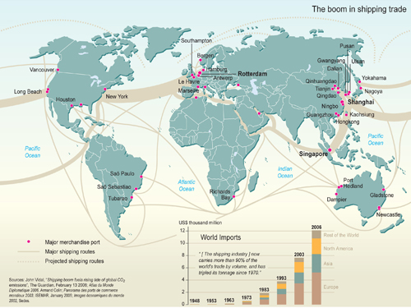
Balancing Trade and…
Thank you for Attending this Class!
WTO

