Slide 1
The Global Financial Crisis
Causes, Consequences, and Lessons
Bhanupong
Lecture 8

Slide 2
Outline
1. Global financial crisis in 2008
2. Impact on Thailand
3. Recovery in Asia
4. Lessons
5. Minsky moment
6. The shape of things to come

Slide 3
1. The global financial crisis
While it was brewing in 2007
March 16, 2007
Bear Stearns (an investment bank) was bought by JPMorgan Chase & Co. in a deal orchestrated by and backed up by the government following a sharp decline in shares and a collapse in confidence in the company.
July 11, 2007
Federal regulators seized IndyMac Bank after it succumbed to the pressures of tighter credit, tumbling home prices and rising foreclosures.
IndyMac is the largest thrift ever to fail in the U.S.

Slide 4
Timeline of the crisis
The crisis took some years in the making
September 7, 2007.
In a bid to stabilize the nation's troubled housing market, the US government seized control of Fannie Mae and Freddie Mac
These two publicly traded companies together hold or guarantee about half the mortgage loans in USA.

Slide 5
Lehman Brothers Debacle
September 15, 2008: Lehman Brothers filed for bankruptcy
Lehman Brothers International (Europe)—LBIE, the London subsidiary of Lehman Brothers Holdings, New York—closed for business, leaving 839,000 failed transactions totaling billions of dollars hanging in the air.
PricewaterhouseCoopers (PWC), the administrator, was still trying to sort out most of them, which relate to over 100 separate units of LBIE.
It has managed to pay claims of around $13 billion (£8 billion) but wants the American parent to settle up to $100 billion more.

Slide 6
The period of low interest rates
In 2002, to spur US economy which was experiencing a mild recession as a result of the bursting of the dot.com bubble and the terrorist attack in 2001, the Fed decided to lower interest rates.
Cheap credit and lax lending policies encouraged consumers to purchase new homes and take out additional mortgage loans for personal consumption like buying a new car or going on vacation.

Slide 7
The Fed Monetary easing began in 2002
Notice the interest rate differential

Slide 8
How the subprime mortgage market was created
Banks provided loans even to borrowers who had questionable ability to repay such loans.
Thus, the subprime mortgage market was created.
Subprime mortgage loans carry adjustable mortgage rates where borrowers initially pay interest below the market rate for a pre-determined period and pay market rates for the rest of the period of the mortgage.

Slide 9
Securitization
The aggressive expansion of the subprime market in years 2003-2005 was fueled by securitization.
It is the process of taking an illiquid asset, or group of assets, and through financial engineering, transforming them into a security.

Slide 10
Collateralized Debt Obligations( CDOs)
A typical example of securitization is a mortgage-backed security, which is a type of asset-backed security that is secured by a collection of mortgages.
Investment banks, such as Bear Sterns came up with CDO’s (Collateralized Debt Obligations) which are sophisticated financial tools that repackage individual loans into a product that can be sold on the secondary market.

Slide 11
In financial laboratories, there are financial engineering processes
These sophisticated financial packages consist of auto loans, credit card debt, or corporate debt.
They are called collateralized because they have some types of collateral behind them.
CDOs are in effect a financial WMD.

Slide 12
CDOs and market liquidity
CDOs were created to provide more liquidity in the economy.
It allows banks and corporations to sell off debt, which frees up more capital to invest or loan.
The creation of CDOs is one reason why the U.S. economy has been so robust in the last five years.

Slide 13
Downside risks
However, the downside of CDOs is that it allows the originators of the loans to avoid having to collect on them when they become due, since the loans are now owned by other investors.
This may make them less disciplined in adhering to strict lending standards.
Another downside is that they are so complex that often the buyers aren't really sure what they are buying.

Slide 14
Buyers beware
They often rely on their trust of the bank selling the CDOs without doing enough research to be sure the package is really worth the price.
Some Thai banks did not buy them because they did not understand their complexity.

Slide 15
Liquidity crisis in 2007
CDOs became widely popular (thus contributing further to the expansion of mortgage loans) among investors who were attracted by their high return.
The opaqueness and complexity of CDOs can cause a market panic if something happens to make sellers lose their trust in the product.
This then makes the CDOs difficult to resell.
This difficulty helped cause the 2007 banking liquidity crisis.

Slide 16
Credit Default Swap (CDS)
CDS is an insurance policy against a bond default, a financial instrument for swapping the risk of debt default.
The widespread availability of CDS written by issuers, primarily AIG, enhanced CDO’s appeal.

Slide 17
The buyer of CDS
Credit default swaps may be used for emerging market bonds, mortgage backed securities, corporate bonds and local government bonds.
The buyer of a credit default swap pays a premium for effectively insuring against a debt default.
The buyer receives a lump sum payment if the debt instrument is defaulted.

Slide 18
The seller of CDS
The seller (AIG) of a credit default swap receives monthly payments from the buyer.
If the debt instrument defaults, AIG has to pay the agreed amount to the buyer of the credit default swap.
AIG wrote more than $2.7 trillion in derivatives contracts. Investors used one kind-CDS—to hedge against bonds going bad.

Slide 19
Triple A rating?
Banks bought the swaps, reassured by AIG’s AAA debt rating to manipulate capital requirements.
When the bonds AIG insured against started to tank and the issuer’s own rating was cut, it all came crushing down.
AIG has $300 billion in potential CDS losses. Yet AIG has book value of only $50 billion. If AIG has to pay out on those contracts, it will go bankrupt six times over.

Slide 20
A perfect recipe for the financial crisis
Subprime mortgage
Housing loans for low income households
CDOs
Bundled toxic assets, Flawed incentive system
CDS
Insurance for CDOs
Provided by AIG
Excessive lending
Low interest policy
Global excess saving
Enhanced bank Liquidity
Housing bubble
Greed and lax supervision

Slide 21
Causes of the financial crisis:
Imports or homemade?
(1) a U.S. monetary policy that remained expansionary for too long after the 2002 recession, or
(2) excess saving outside the United States that drove down global interest rates to levels that fueled the speculation.
While both of these hypotheses could serve to explain the consequent bubble in U.S. asset prices, they do not provide an immediate explanation as to why defaults in a relatively small portion of the credit markets (sub-prime mortgages) had such catastrophic system-wide consequences.

Slide 22
Who is to blame?
Purchasers of the mortgage-backed securities in the secondary market also failed to accurately evaluate the quality of the underlying assets and to understand the risks involved.
The complexity and lack of transparency of the instruments contributed to the problem.
Similar mistakes were made by the rating agencies (Standard & Poors, Moody)

Slide 23
Before the bubble burst
Residential estate price-income ratio
(% change between 1997 and 2007)
UK 93.9
USA 23.4
Spain 67.3
Sweden 62.0
Ireland 86.1
Japan -28.4

Slide 24
Flawed incentives and regulations
A low level of global interest rates may have helped create the conditions for the asset price boom in housing markets and the speculative excesses.
However, the flawed incentives and regulatory structure within the United States were far more fundamental.

Slide 25
The real WMD
The promotion of new financial innovations without a rigorous effort to evaluate their implications for systemic risk, a compensation system that emphasized high immediate returns, and a compliant financial regulatory structure all stand out as important direct contributors.

Slide 26
Distorted incentive system
Low real interest rates were a global phenomenon, and a large number of European economies experienced housing price increases of greater magnitude than the United States.
But the distorted incentives of the private securitized mortgage market were largely American.
It is difficult to explain the crisis in terms of macroeconomic conditions without reference to the microeconomic distortions in the U.S. financial system.

Slide 27
Too big to fail
Years of unregulated and risky deals exposed AIG to catastrophic losses.
It paid $165 million in retention bonuses to executives to the same people who helped created the mess, which cost the U.S tax payers $170 billion—and counting.
In the case of Thailand, “Ministry of Finance cannot allow banks to go bankrupt” said Permanent Secretary of the Ministry of Finance (September 2007)

Slide 28
House price bubbles and the financial panic
The housing price bubble burst in mid-2006 and both housing prices and housing starts began a long period of contraction.
With declining home prices, borrowers were unable to refinance their loans and default rates soared.

Slide 29
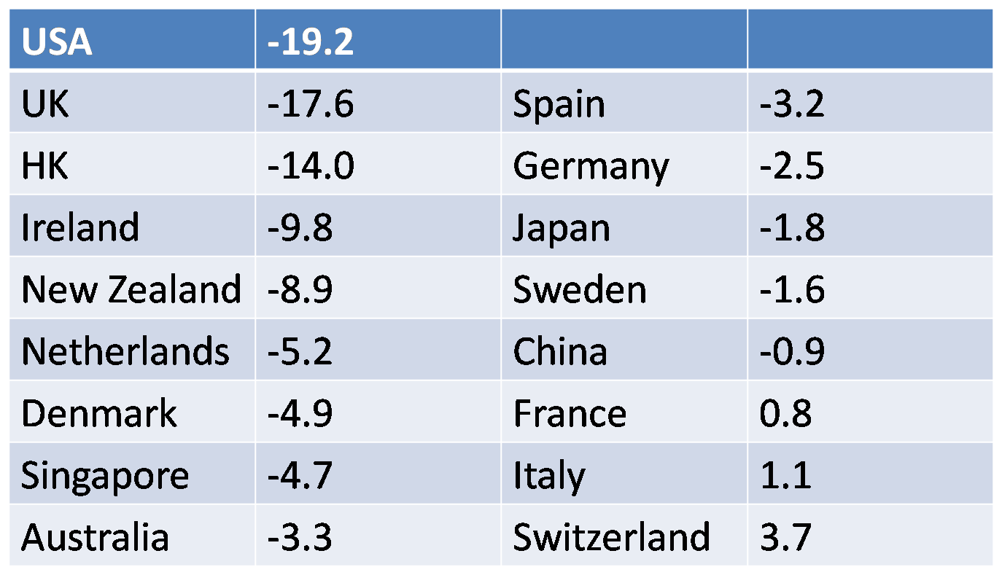
Economist’s house price indicator
Minsky moment: March 2009 (%y-o-y)

Slide 30
Bank credit and asset prices in Japan

Slide 31
Stock market crash in China

Slide 32
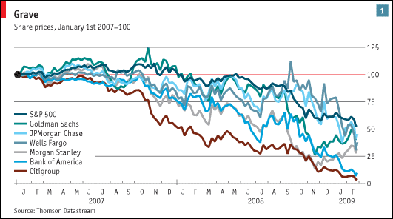
Stock market crash in the US

Slide 33
Global implications
An end to the consumption binge of the last decade should be good news for the U.S. economy.
Realignment away from a focus on domestic consumption would imply a shift of resources toward the export sector and a gradual reduction in the U.S. current account imbalance to more sustainable levels.

Slide 34
2. Impact on Thailand
The impact of US financial crisis and the ensuing economic recession on Thailand is evident
Negative economic growth: According to Thailand’s Finance Ministry, the Thai economy might contract by as much as 3% in 2009 if no additional stimulus is implemented. What is the actual growth figure?
Lower exports: The US is Thailand’s number one export market accounting for a total 18% of total exports. With the US economy in recession, demand for Thai products declined.

Slide 35
Impact on Thai banks
Although the US financial crisis has led to a world wide recession and also affected other financial markets elsewhere, Thailand’s financial sector remained stable.
Thai banks have minimal exposure to the US toxic assets (in the form of CDO’s).

Slide 38
What you don’t know may not hurt you
Some banks like Bangkok Bank, BankThai , Krung Thai Bank and Bank of Ayudhya purchased CDO’s in the amounts of US$101 million , US$ 260 million, US$160 million and US$ 85 million respectively.
US banks have limited presence in Thailand where only Citibank and JP Morgan Chase have full branch operations.
These foreign banks have less than one percent share of total bank loans in Thailand in 2007.

Slide 39
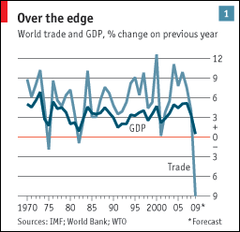
Shrinking world trade

Slide 40
Collapse of output
Trend of manufacturing output

Slide 41
Rising unemployment
Higher unemployment: With lower demand, manufacturing activities slowed resulting in a number of companies to reduce or shut-down their operations.
It was estimated that, in 2009, in the worst case, there will be 1.5 million unemployed in Thailand or 2.5% of the total workforce, an increase from 1.5% from previous year.

Slide 42
3. The V-shaped recovery in Asia: 2009
Asia’s emerging economies probably grew at an average annualized rate of over 10% in the second quarter 2009, while America’s GDP fell by 1%.
The second-quarter GDP figures showed an impressive bounce.
Comparing the second quarter with the first at an annualized rate, China’s GDP grew by 15%, South Korea’s by almost 10%, Singapore’s soared by 21% and Indonesia’s managed a respectable 5%.

Slide 43
Average growth figures conceal big differences within Asia over the past year.
China, India and Indonesia were among the few economies in the world that continued to expand throughout the global downturn (though China’s virtually stalled late last year).
But the smaller, more open Asian economies were badly hit.
Between September and March real GDP fell by an average annualized rate of 13% in Hong Kong, Malaysia, South Korea, Singapore, Taiwan and Thailand.

Slide 44
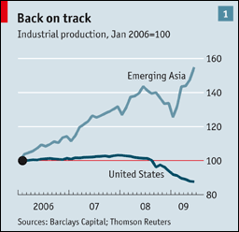
On the rebound
Aug 13th 2009
From The Economist print edition

Slide 45
Widening gap
In 2009 as a whole, recent forecasts suggest that emerging Asia could grow by at least 5%, while the G7 economies contract by 3.5%
The growth gap between the two has never been wider.
How have these export-dependent economies managed to decouple from the developed world?
Can the recovery last?

Slide 46
Monetary policy challenge
How to sustain a robust recovery without blowing up bubbles?
There are growing concerns that a flood of liquidity is fuelling asset-price bubbles, which could destabilize economies when they burst.

Slide 47
5. Hyman Minsky
Long periods of economic stability trick people into taking on more risk, borrow excessively and overpay for assets
Five stages in Minsky model
1. Displacement: investors are excited about significant change in economic policy, an invention such as internet, or oil discovery.
2. Boom: investors borrow excessively for expected high returns (Tulip mania)

Slide 48
From euphoria to panic
3. Euphoria: excessive lending and credit extension to ever more untrustworthy borrowers and the creation of many types of financial instruments.
4. Profit taking: smart traders start to cash in their profits at the top of the market.
5. Panic

Slide 49
5. Panic
Uncertainty occurs;
Property & stock prices fall;
Liquidity in financial markets drops;
4. Value of securities sinks sharply,
5. Purchasing power disappears,
6. Unemployment rises.
7. Then came Ponzi borrowers

Slide 50

Ponzi borrowers
During the panic stage, many people become Ponzi borrowers,
They are the borrowers who can repay neither the interest nor the original debt.
They rely entirely on rising asset prices to allow them to keep on refinancing their debt.
They borrow more in order to pay old debts.
Substituting new debts for old debts.

Slide 51
Minsky Moment
All 5 stages eventually lead to Minsky moment - the time when ‘over-indebted investors’ are forced to sell their securities even the good ones in order to pay off the mountains of debt they took on to acquire those investments, resulting in sharp declines in financial markets, lack of liquidity and a call for government’s help
This is exactly what happened to the U.S. economy during the sub-prime crisis

Slide 52
Review questions
“Both financial crises in Thailand and the US stemmed from similar causes” State whether you agree or disagree with the above statement. Give brief reasons.
Will the Thai economy soon experience Minsky moment?

Slide 53
Conclusions
Although the 1997 and 2009 crises are different, some Asian countries were able to rebound in a V-shaped recovery.
Asian countries have learned their lessons well from the 1997 financial meltdown.
The global financial crisis in 2009 affected Thailand indirectly through export shortfall.
Fiscal policies can be an effective means of influencing government popularity (e.g. Democratic Party of Japan), but its sustainability is in question.
Overindulgence has a price.

Slide 54
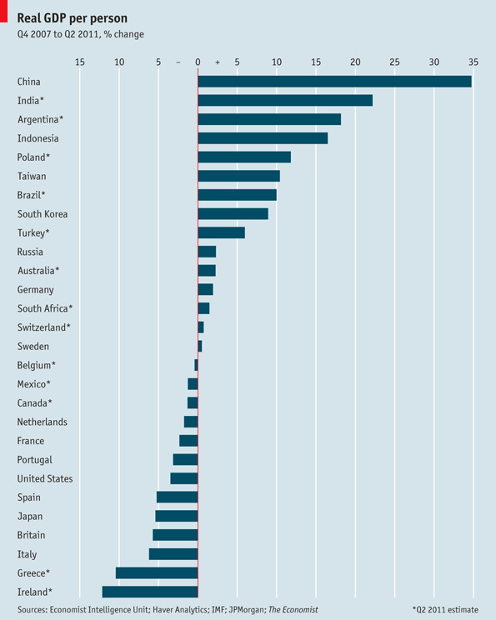
Impact of the GFC: Q42007 to Q2 2011

Slide 56
Keep calm, carry on

