Slide 1
The Brief

Slide 2
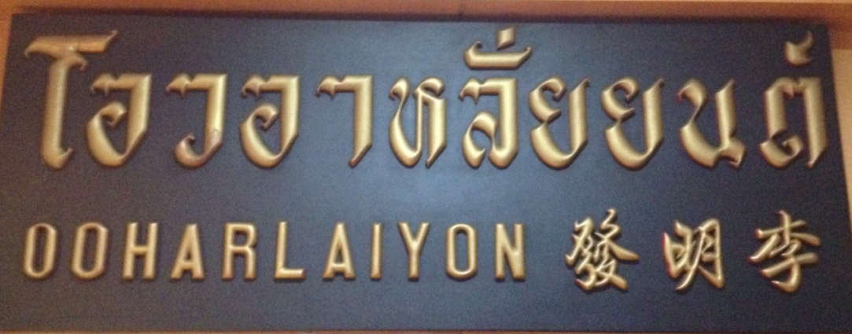
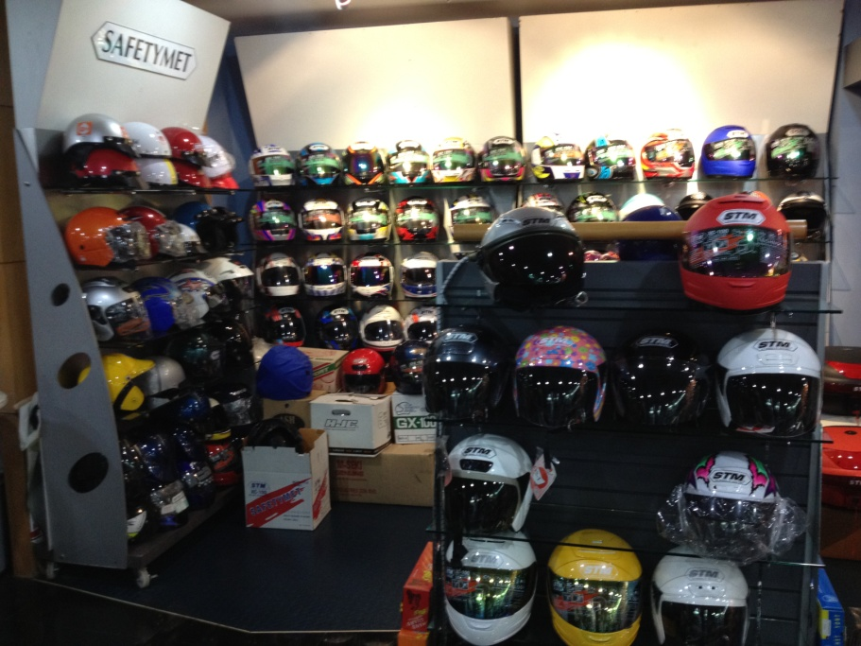
Background
40s years old company
One of the first Motorcycle Helmet Manufacturer in Thailand
Used to be The Market Leader in early days
Helmets sales declined by nearly half over the past years, while the market is growing

Slide 3
Business Objectives
Gain back market share in domestic
Increase volume from export market
Improve profit margin
Goal
Successful Product Launch
Rejuvenate & Modernize the Brand
Increase Brand Equity

Slide 4
Who is our Target?

Slide 5
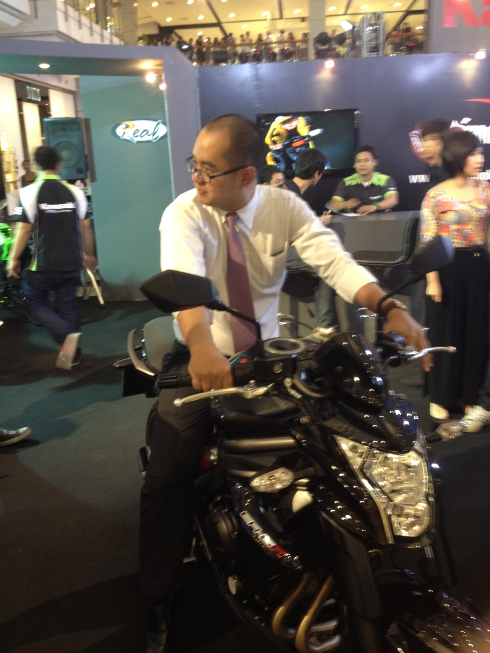
Target A
Mr. Teeraphong
Age: 39
Occupation: I.T. Manager
Monthly Income: 80,000
Hobby: Travel, Hang out with friend, modify his bike
Personality: Adventurous, Love speed

Slide 6
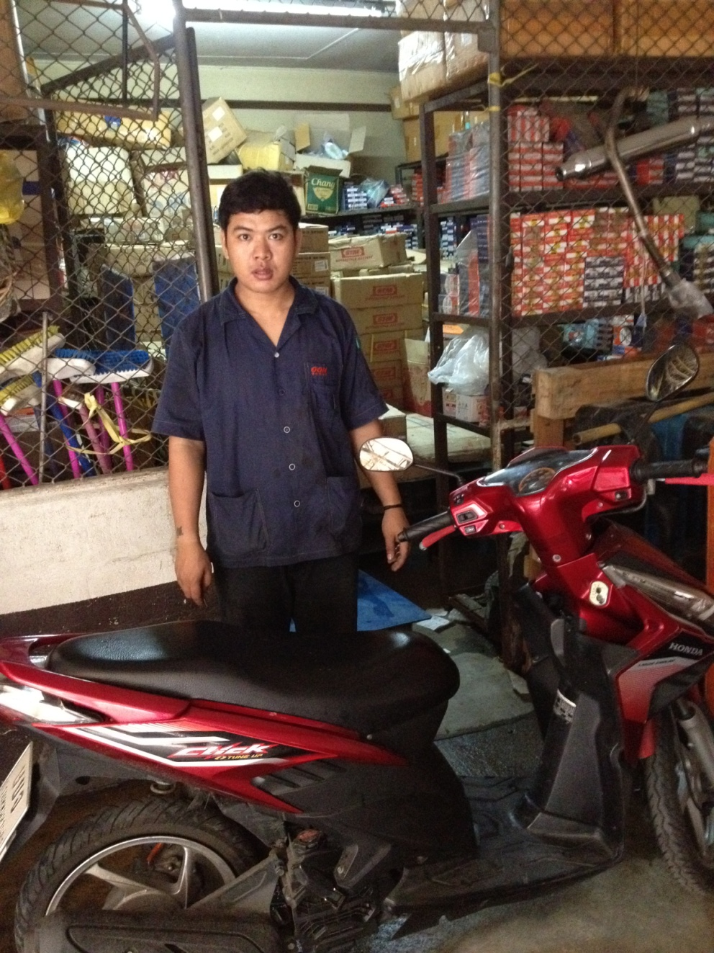
Target B
Mr. Manus
Age: 28
Occupation: Factory Worker
Monthly Income: 7,000
Hobby: Football, Watch TV

Slide 7
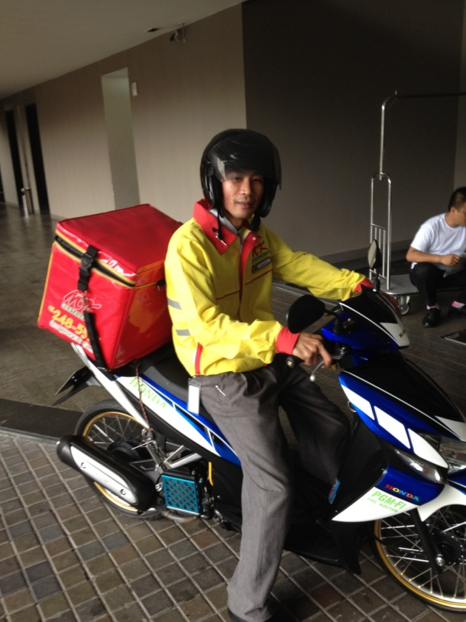
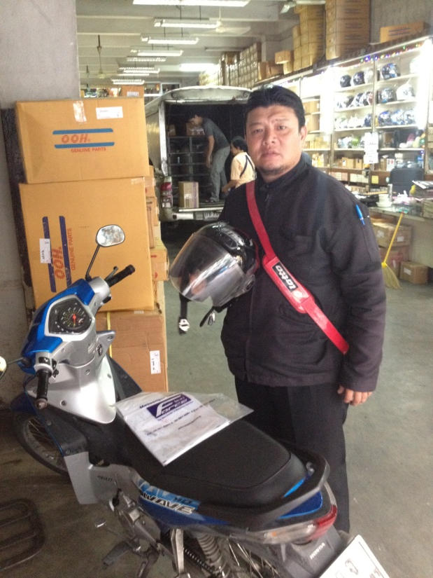
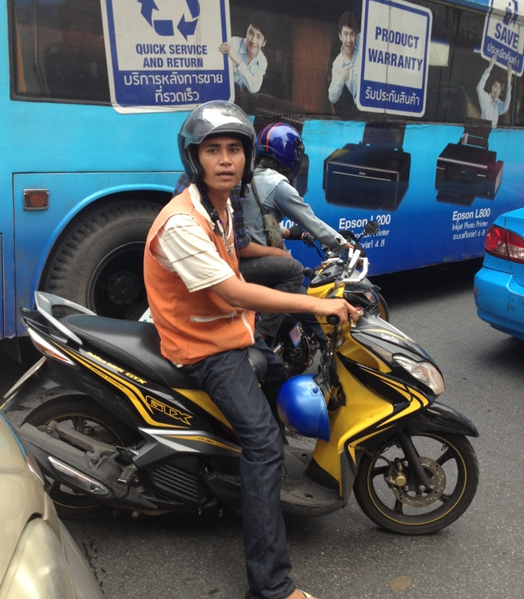
Target C
Mr. Chairat
Age: 35
Occupation: Messenger
Monthly Income: 8,500
Hobby: Play with his kids
Mr. Somkiat
Age: 32
Occupation: Motor Taxi
Monthly Income: 11,000
Hobby: Thai Chess, Watch TV
Mr. Mongkol
Age: 24
Occupation: MK delivery person
Monthly Income: 8,000
Hobby: Watch TV

Slide 8
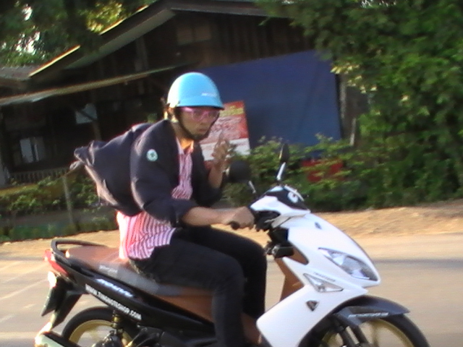
Target D
Mr. Veerachon
Age: 19
Occupation: Student
Monthly Income: None
Hobby: Hang out with friends, Modify his bike

Slide 9
The assignment
Describe how does your target go through their decision making process
Identify the appropriate communication channel in each process
Problem recognition
Information search
Purchase decision
Alternative evaluation
Post-purchase evaluation

Slide 10
Limitation
Very Limited Budget, avoid high cost media
Be creative and innovative
Take into account that we’re trying to improve the brand image

Slide 11
Email: warut@oohalai.com

