Slide 1
Tutorial on Using GTAP
Nattapong Puttanapong, Ph.D.
EE 459
Semester 2 / 2013

Slide 2
STEP 1 : GTAP - Installation

Slide 3
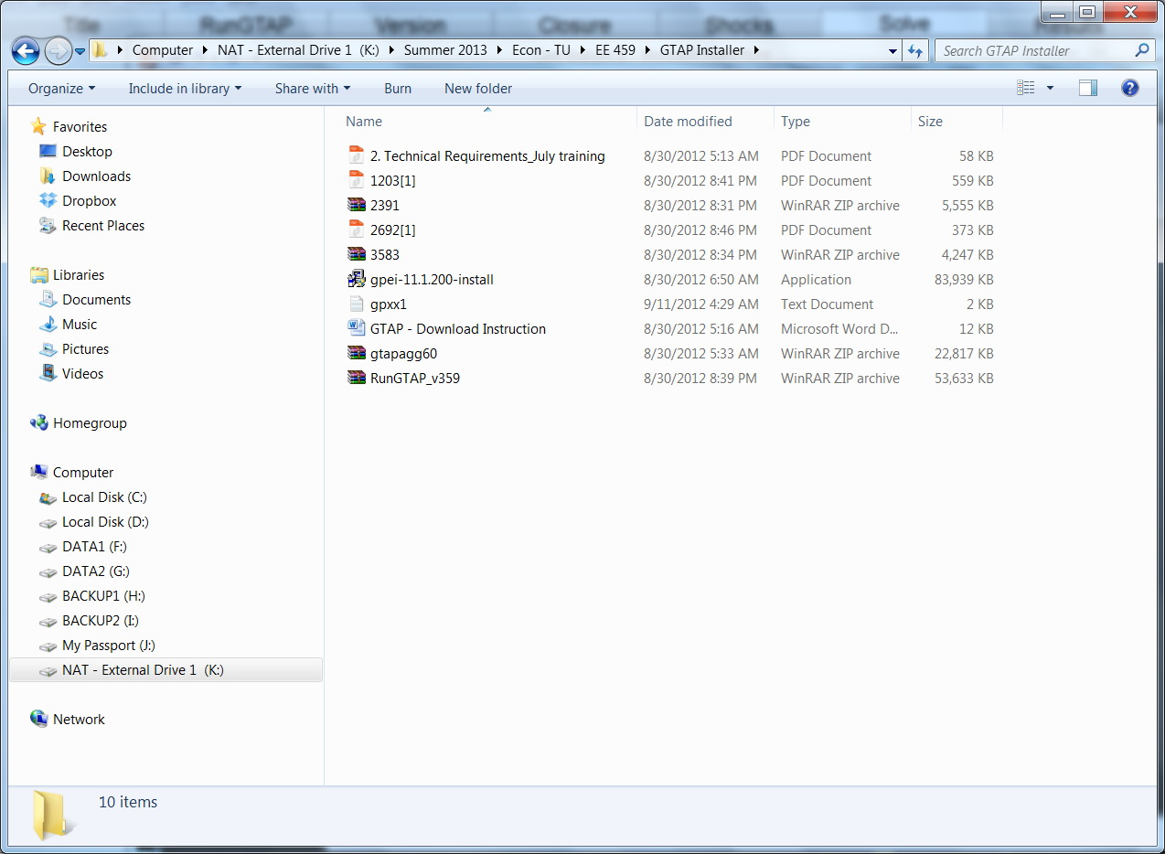
Unzip and install GTAPAgg version 6.0
Unzip and install RunGTAP version 3.59
Note: Indeed we use only 2 programs in GTAP’s package to analyze the impact of FTA

Slide 4
STEP 2 : Using GTAPAgg to Re-arrange Global Trade Data

Slide 5
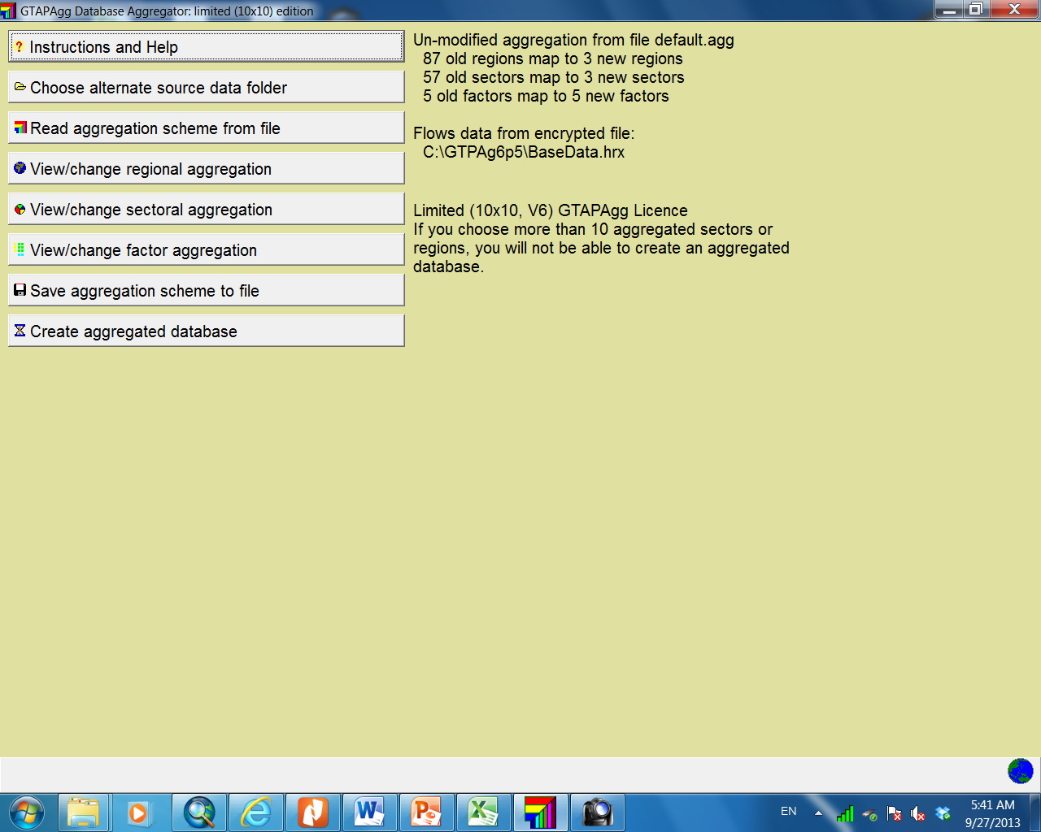
In this FTA analysis, we will set the new aggregation of regions and that of sectors. The aggregation process can be started by clicking on these buttons.
Note : Since we are using the student version, there is a limitation on the size of data that we can use for GTAP’s simulation. Specifically, we can modify the database to:
(1) Not more than 10 categories of products
(2) Not more than 10 sectors of products

Slide 6
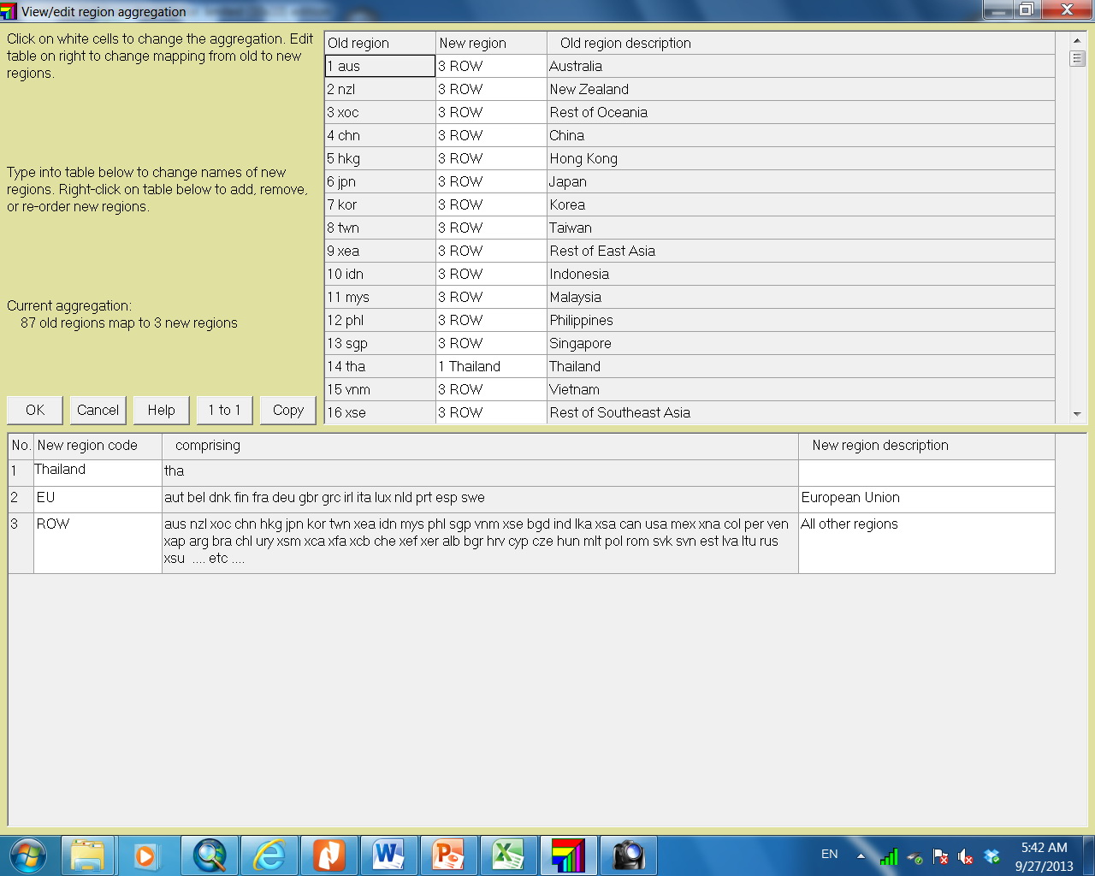
Set up the group of countries : in this example, we classify countries into 3 groups (Thailand, EU and Rest of the World)

Slide 7
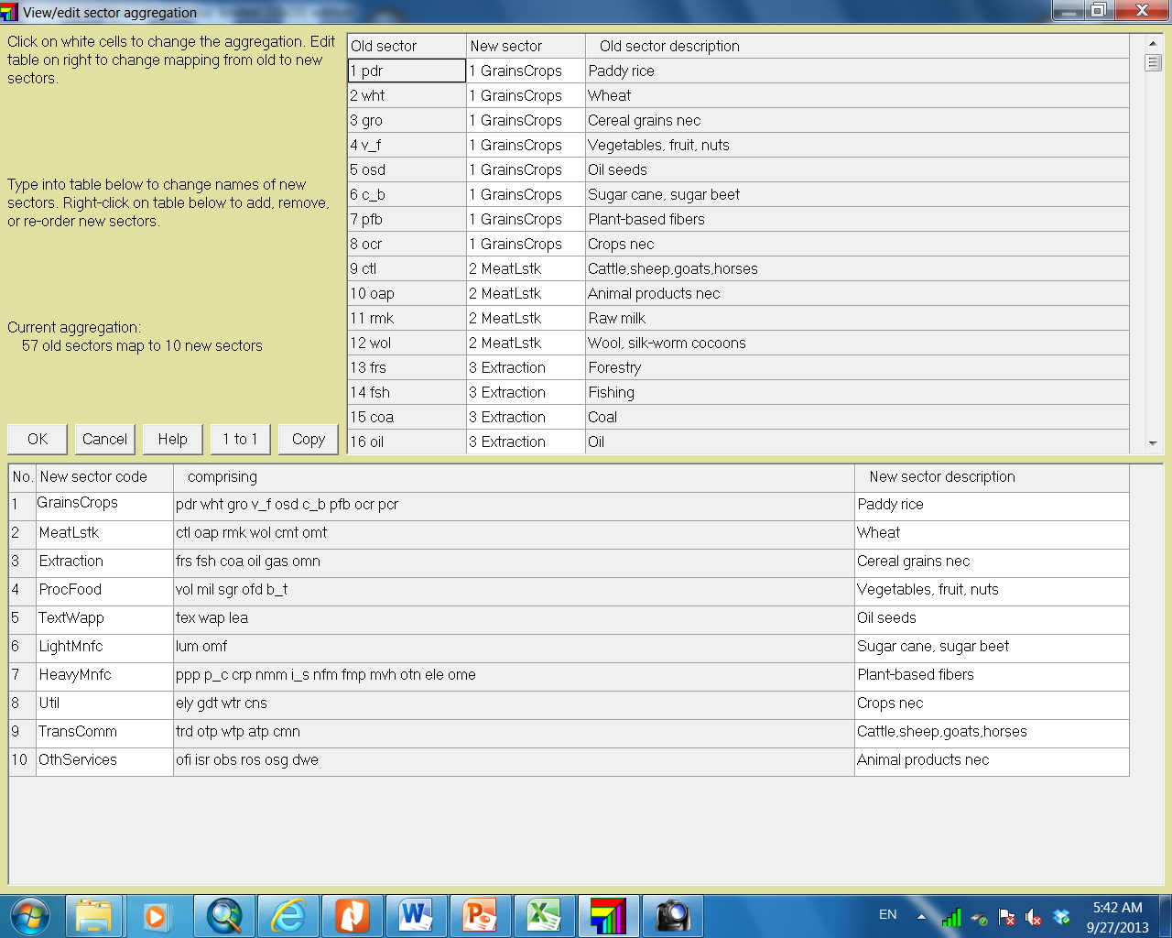
Set up the group of sectors: in this analysis, we classify sectors of production into 10 groups (see the details of creating new groups in the following slides)

Slide 8
Sector Aggregation
Original List of Sectors |  | New List of Sectors
Number | Name of Sector | Number | Name of Sector
1 | Paddy rice | 1 | Grains and Crops
2 | Wheat | 1 | Grains and Crops
3 | Cereal grains nec | 1 | Grains and Crops
4 | Vegetables, fruit, nuts | 1 | Grains and Crops
5 | Oil seeds | 1 | Grains and Crops
6 | Sugar cane, sugar beet | 1 | Grains and Crops
7 | Plant-based fibers | 1 | Grains and Crops
8 | Crops nec | 1 | Grains and Crops
9 | Bovine cattle, sheep and goats, horses | 2 | MeatLstk
10 | Animal products nec | 2 | MeatLstk
11 | Raw milk | 2 | MeatLstk
12 | Wool, silk-worm cocoons | 2 | MeatLstk
13 | Forestry | 3 | Extraction
14 | Fishing | 3 | Extraction
15 | Coal | 3 | Extraction
16 | Oil | 3 | Extraction
17 | Gas | 3 | Extraction
18 | Minerals nec | 3 | Extraction
19 | Bovine meat products | 2 | MeatLstk
20 | Meat products nec | 2 | MeatLstk

Slide 9
Sector Aggregation (Cont’d)
Original List of Sectors |  | New List of Sectors
Number | Name of Sector | Number | Name of Sector
21 | Vegetable oils and fats | 4 | ProcFood
22 | Dairy products | 4 | ProcFood
23 | Processed rice | 1 | Grains and Crops
24 | Sugar | 4 | ProcFood
25 | Food products nec | 4 | ProcFood
26 | Beverages and tobacco products | 4 | ProcFood
27 | Textiles | 5 | TextWapp
28 | Wearing apparel | 5 | TextWapp
29 | Leather products | 6 | LightMnfc
30 | Wood products | 6 | LightMnfc
31 | Paper products, publishing | 6 | LightMnfc
32 | Petroleum, coal products | 7 | HeavyMnfc
33 | Chemical, rubber, plastic products | 7 | HeavyMnfc
34 | Mineral products nec | 7 | HeavyMnfc
35 | Ferrous metals | 7 | HeavyMnfc
36 | Metals nec | 7 | HeavyMnfc
37 | Metal products | 7 | HeavyMnfc
38 | Motor vehicles and parts | 7 | HeavyMnfc
39 | Transport equipment nec | 7 | HeavyMnfc
40 | Electronic equipment | 7 | HeavyMnfc

Slide 10
Sector Aggregation (Cont’d)
Original List of Sectors |  | New List of Sectors
Number | Name of Sector | Number | Name of Sector
41 | Machinery and equipment nec | 7 | HeavyMnfc
42 | Manufactures nec | 6 | LightMnfc
43 | Electricity | 8 | Util
44 | Gas manufacture, distribution | 8 | Util
45 | Water | 8 | Util
46 | Construction | 10 | Util
47 | Trade | 9 | TransComm
48 | Transport nec | 9 | TransComm
49 | Water transport | 9 | TransComm
50 | Air transport | 9 | TransComm
51 | Communication | 9 | TransComm
52 | Financial services nec | 10 | OthServices
53 | Insurance | 10 | OthServices
54 | Business services nec | 10 | OthServices
55 | Recreational and other services | 10 | OthServices
56 | Public Administration, Defense, Education, Health | 10 | OthServices

Slide 11
After finishing the new regional and sectoral aggregation, save the new setting.
Then click on this button to create the aggregated database for GTAP.

Slide 12
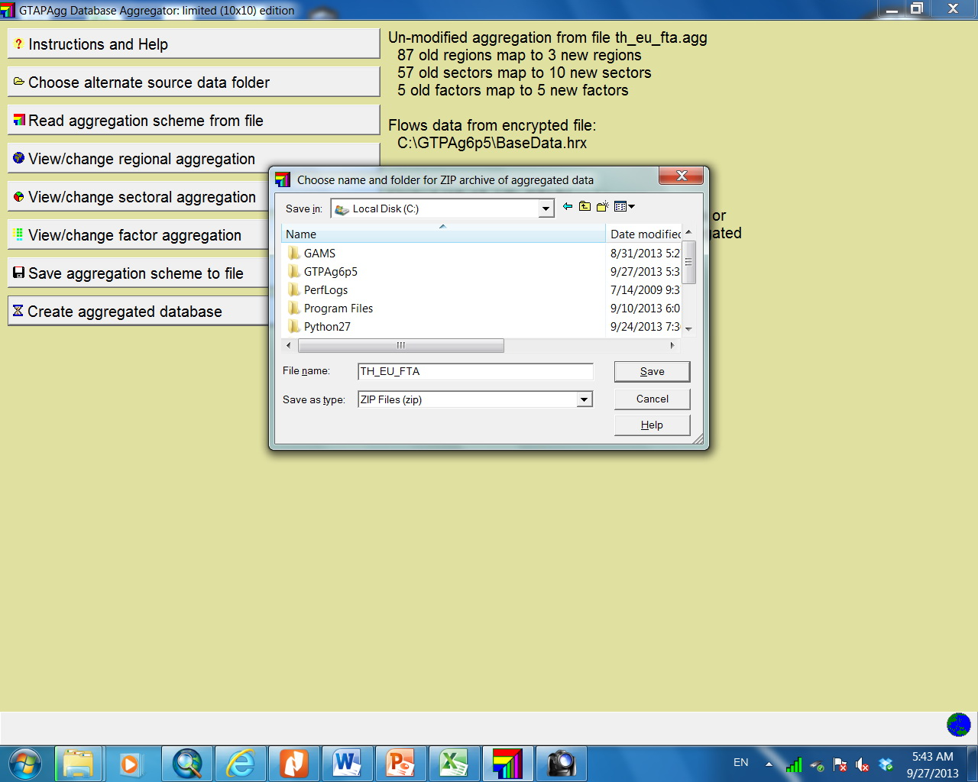
Save the new database (it will be created in the zip-file format)

Slide 13
STEP 3 : Opening the New Database in RunGTAP

Slide 14
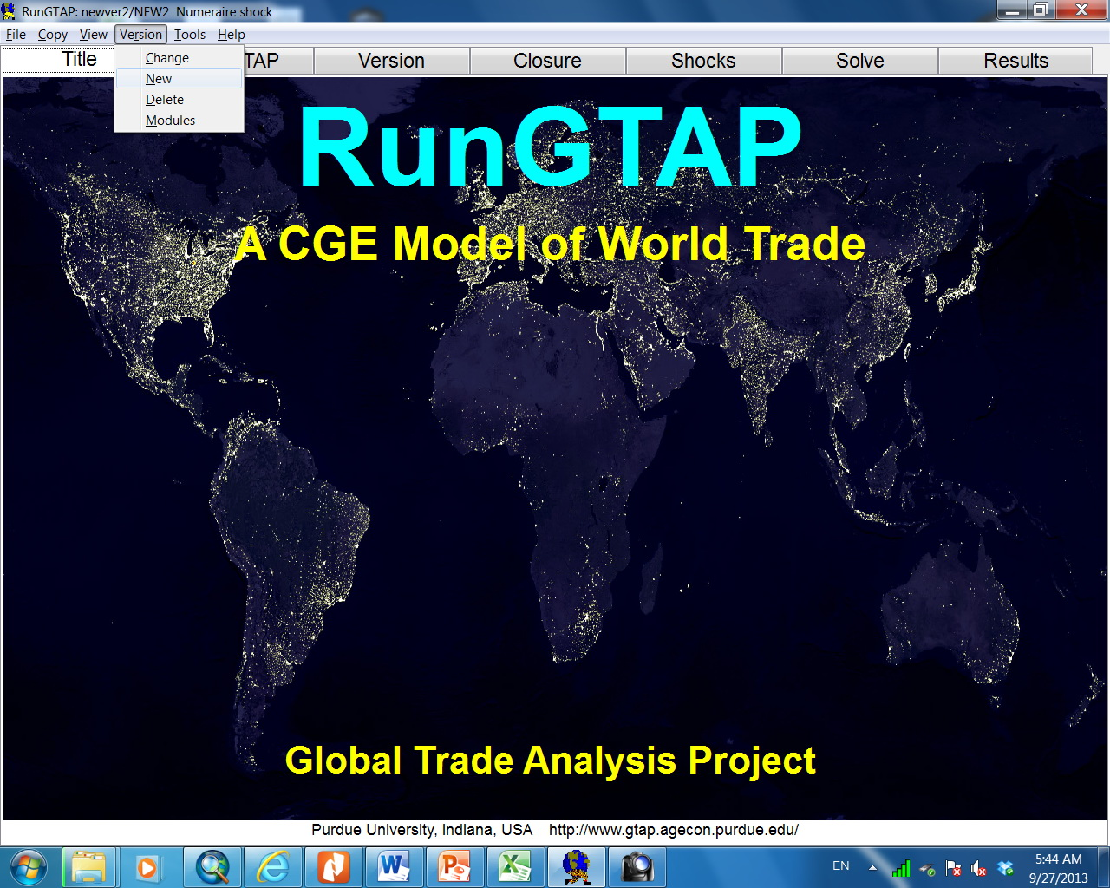
On the top menu, select “Version → New”

Slide 15
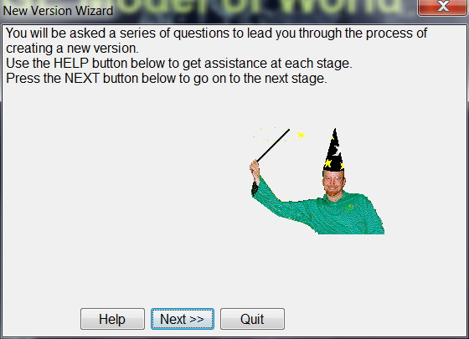
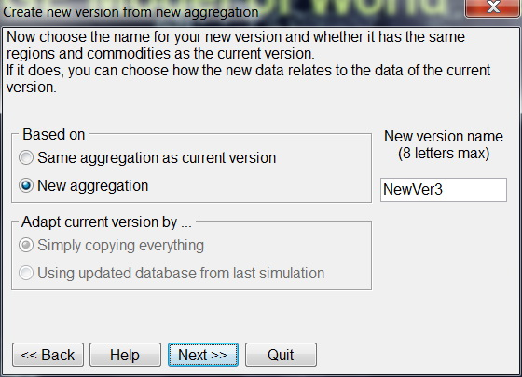
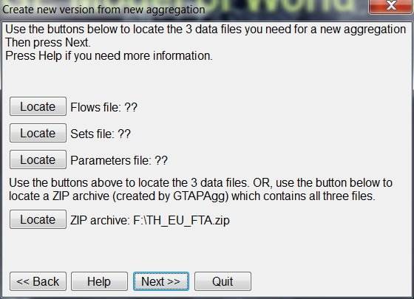
To start this process, click on “Next”
Then, select “New aggregation” and click “Next”
Click on “Locate ZIP” to identify the location of the new aggregated database which we have just create.
Then, click on “Next”

Slide 16
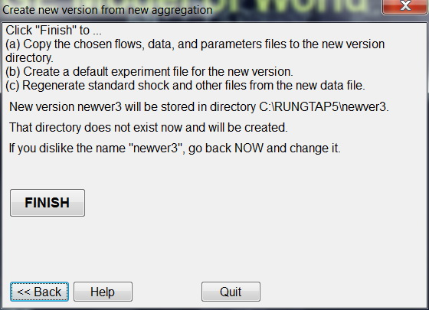
The last step is to confirm to use the new database. Click on “FINISH” button.

Slide 17
STEP 4 :Running the Simulation

Slide 18
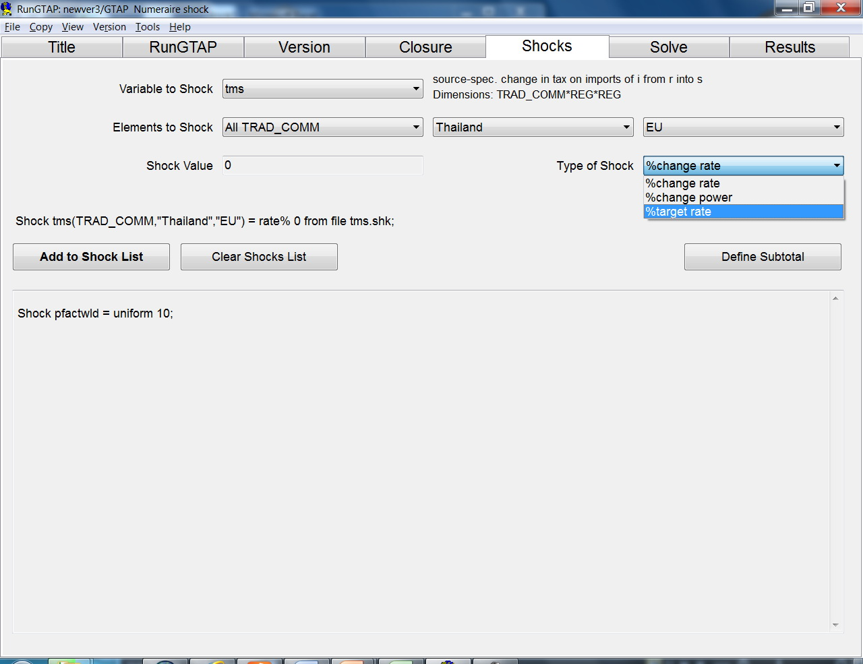
Example : zero tax due to the free trade agreement between Thailand and EU
1. Select “tms” (the import tax)
2.Specify that this will be applied to all commodities that are exported from Thailand to EU
3.Specify that the new rate of import tax is 0.0
4. Add this set up as a shock to the model

Slide 19
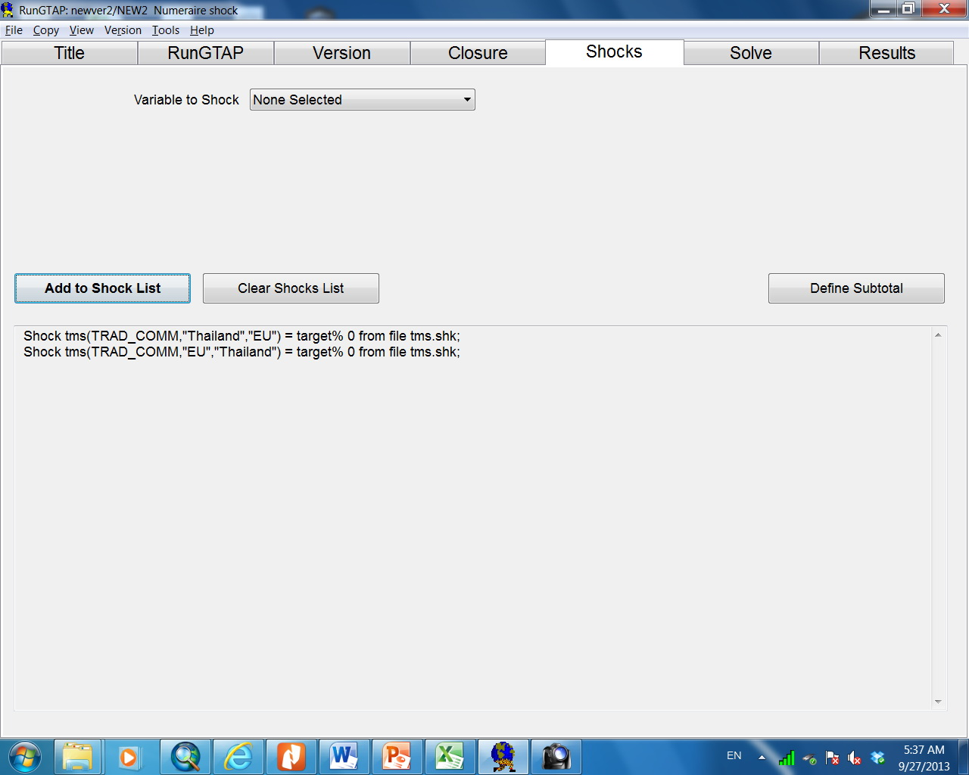
Example : zero tax due to the free trade agreement between Thailand and EU
Repeat the same steps to specify the shock of zero tariff rate on all commodities that Thailand imports from EU
Then, there are 2 shocks in the list that are ready to be applied to the model.

Slide 20
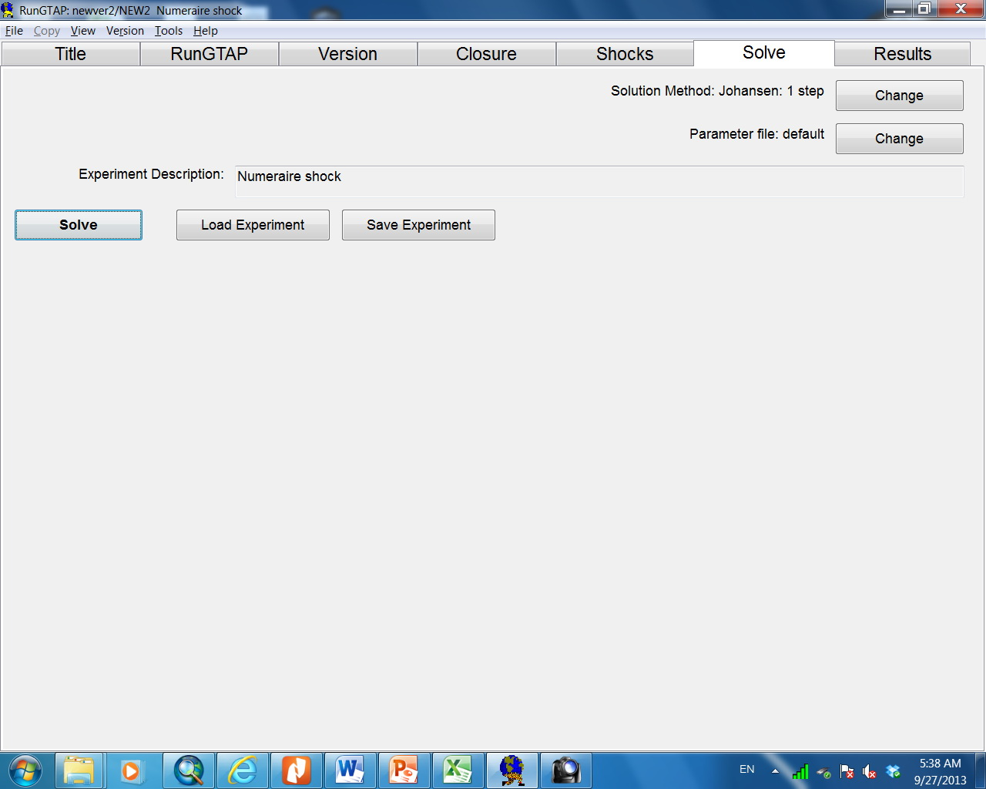
Example : zero tax due to the free trade agreement between Thailand and EU
Click on ‘Solve’ tab
Then click on ‘Solve’ button to start the simulation

Slide 21
STEP 5 : Reading the Simulation Results

Slide 22
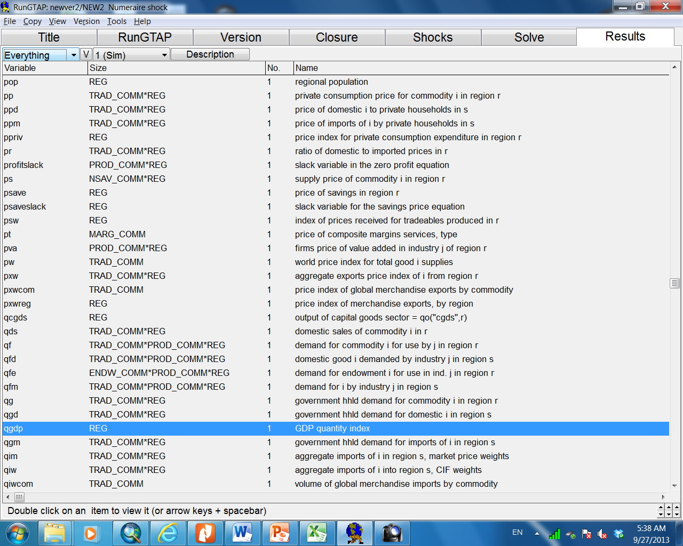
Click on ‘Results’ tab
All macro variables are listed on this page. For example, the Real GDP of all countries can be shown be clicking on this line. Hence, read the values of “qgdp” (Real GDP) and “pgdp” (Aggregate Price Index). These values have to be included in your analysis.

Slide 23
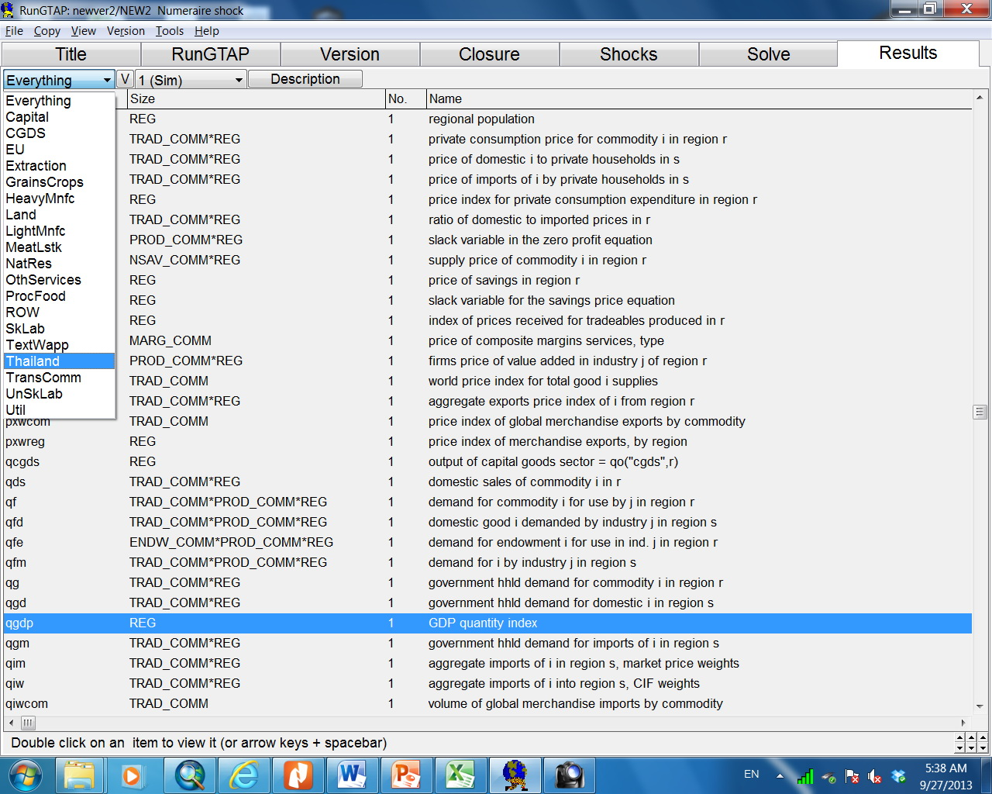
To read the detailed result of a specific country, click on this drop-down menu and then select the country. For example, if we select “Thailand”, the program will then show the list of sectoral variables of Thailand

Slide 24
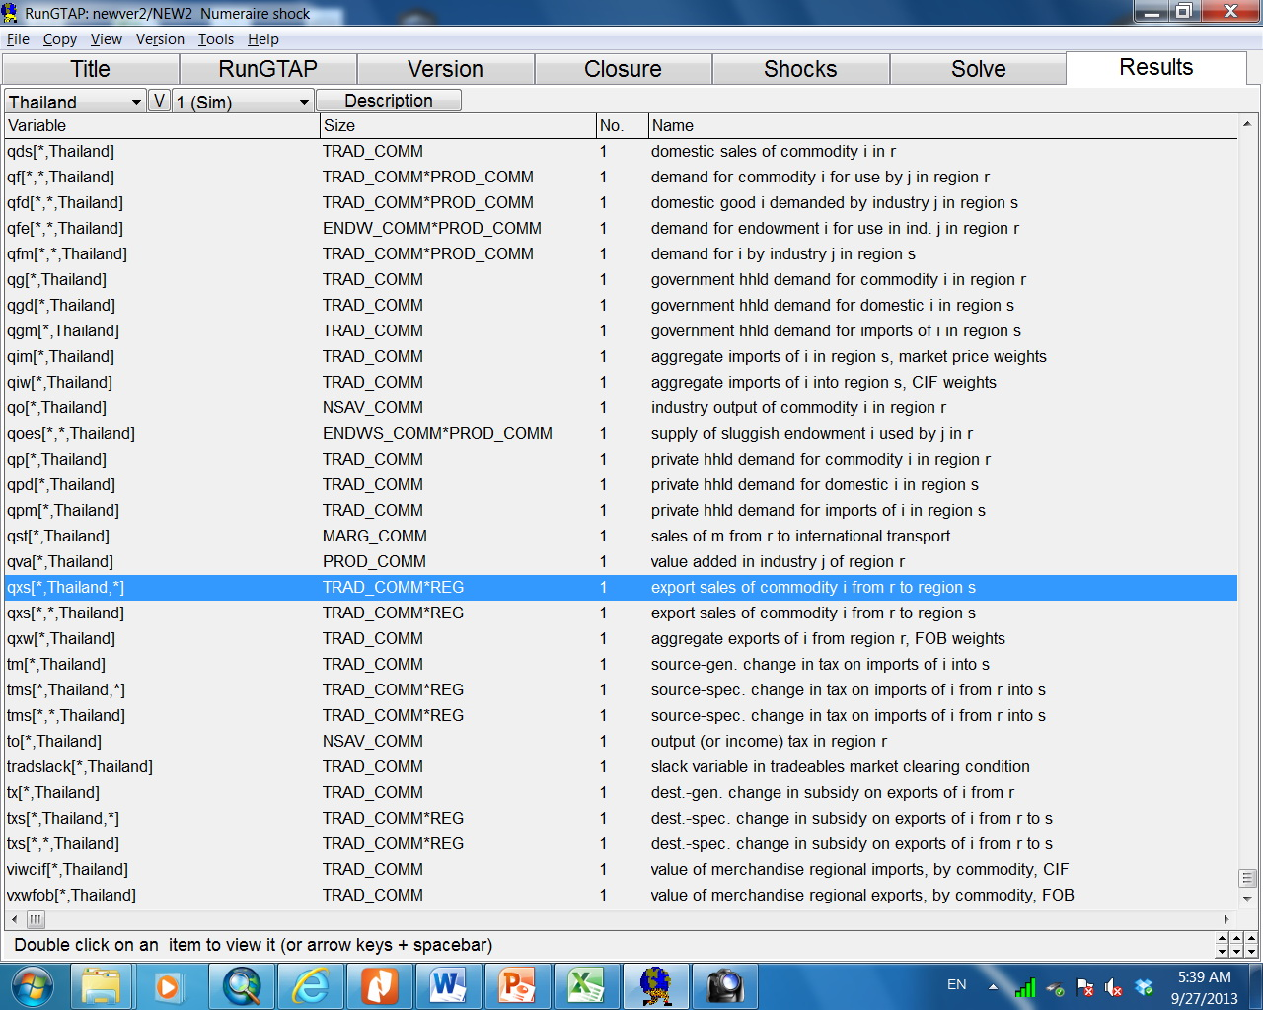
In this analysis, we want to see the impacts on the export of each sector. Click on “qxs”.

Slide 25
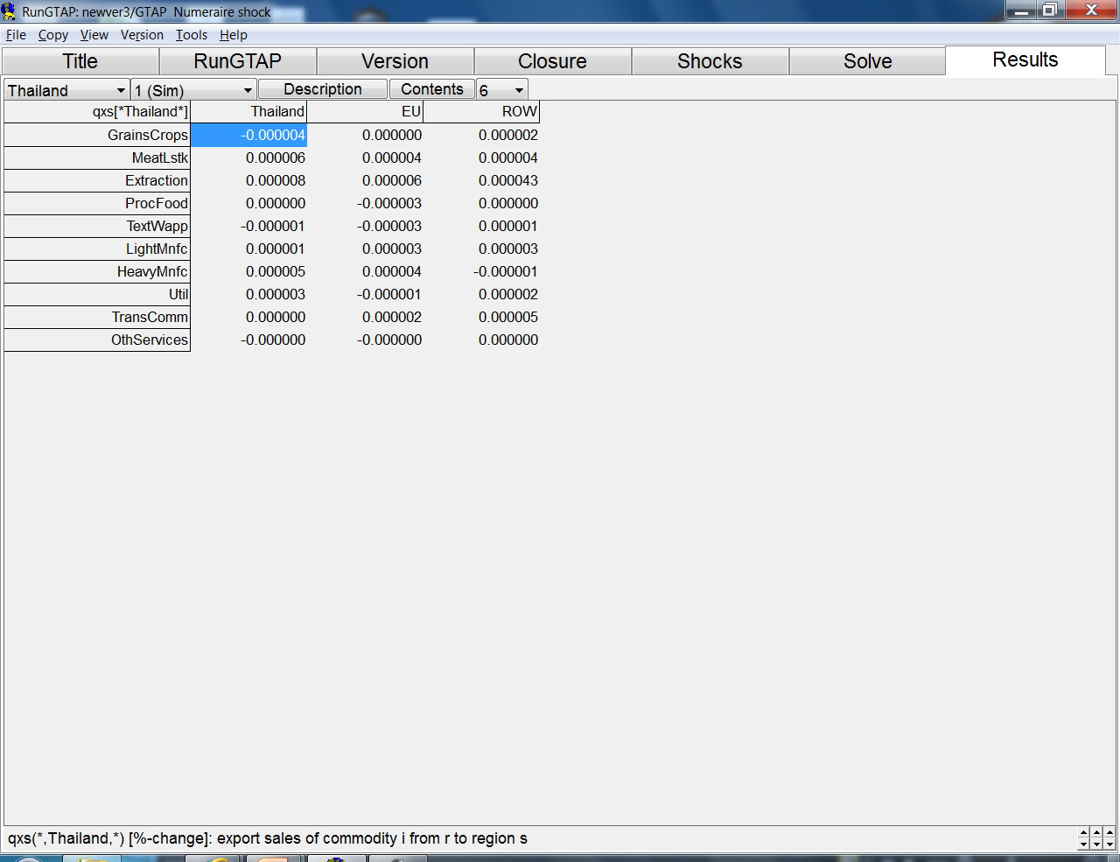
To see the simulation result in 6 decimal places, select “6”
In this analysis, we want to see the impacts on exports from Thailand to EU. Therefore, the % change of sectoral exports from Thailand to EU is shown in this column. [Note : the above simulation result is not the correct answer to this analysis]
The bottom frame shows the definition of this variable

