Slide 1



Innovation Project Feasibility
Module 4.3
Pivoting
May 23rd , 2016
Notes:
No need to add the course number or your name. Your name will be added on the VDO as soon as you start speaking on slide #2
Keep the 16:9 slide format
Each session (week) can be composed of multiple modules Module 1.0 (intro) Module 1.1, Module 1.2 etc ….
Try to avoid referencing to referential dates like “last week”, “last year”, “next month” but rather mention in June 2015, so the VDO content/VDOs doesn’t get outdated rapidly!
Do not refer to class event or class assignment during the main modules. Create a special module that refers to your current assignments or class events so the so the VDO content doesn’t get outdated rapidly!
Thank you for your help!

Slide 2


Slide 3
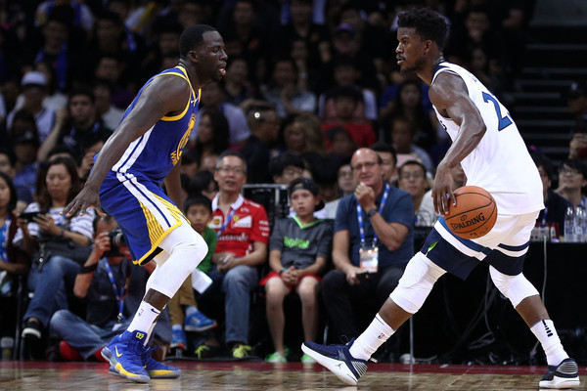
Pivoting
Rotation or change of direction
Notes:
In the next few classes, we're going to learn how to evaluate our ideas for new products, services, and businesses
Why are we doing this?

Slide 4
Pivoting
A fundamental change in the innovation concept
based on learnings from experiments/MVPs
Notes:
In the next few classes, we're going to learn how to evaluate our ideas for new products, services, and businesses
Why are we doing this?

Slide 5
2005 example
Original
Upload a video of you describing yourself and who you’re looking for
Review other peoples videos
Find dates!
Notes:
In the next few classes, we're going to learn how to evaluate our ideas for new products, services, and businesses
Why are we doing this?

Slide 6
2005 example
Learning
Nobody uploaded dating videos
People did upload videos of visiting the zoo, family events, etc.
Notes:
In the next few classes, we're going to learn how to evaluate our ideas for new products, services, and businesses
Why are we doing this?

Slide 7
Pivoting
Pivot
Targeting everybody
Upload anything you want
Share with everybody!
Notes:
In the next few classes, we're going to learn how to evaluate our ideas for new products, services, and businesses
Why are we doing this?

Slide 8

Notes:
In the next few classes, we're going to learn how to evaluate our ideas for new products, services, and businesses
Why are we doing this?

Slide 9
Never stop experimenting
No guarantee that the pivot will be better than the original innovation... without doing experiments/MVPs
Always seek pivoting opportunities... even if you're "successful"
Notes:
Whether the ideas are worth developing, worth investing people and money in

Slide 10
Types of pivots (1/2): value prop.
Zoom-in to specific/different customer segment
Zoom-out to wider segment
Zoom-in to a specific/different feature
Zoom-out to more features
Zoom-in to a specific/different need
Zoom-out to holistic needs
Notes:
Whether the ideas are worth developing, worth investing people and money in

Slide 11
Types of pivots (2/2): value deliv. & capture
Change competencies (e.g., technology, partners)
Change distribution channel
Change business model
From a standalone business to platform for other businesses, or vice versa
Change growth strategy
Notes:
Whether the ideas are worth developing, worth investing people and money in

Slide 12
When to pivot
When you've persevered and optimized and improved
… but the business still isn't sustainable
Or, when your innovation is sustainable, but you see an even more attractive opportunity
Notes:
Whether the ideas are worth developing, worth investing people and money in

Slide 13
Evaluating a pivot
Which metrics are improved compared to the original experiment/MVP?
  That means something works about the pivot
Which metrics are worse?
  That means something still has to be adjusted... keep on pivoting!
Notes:
Whether the ideas are worth developing, worth investing people and money in

Slide 14
Practical tasks
Evaluate your experiment/MVP learnings
Identify potential value prop. pivots

Slide 15



THANK YOU
Notes:
Closing slide

