Slide 1


TU100
Civic Education

Slide 2
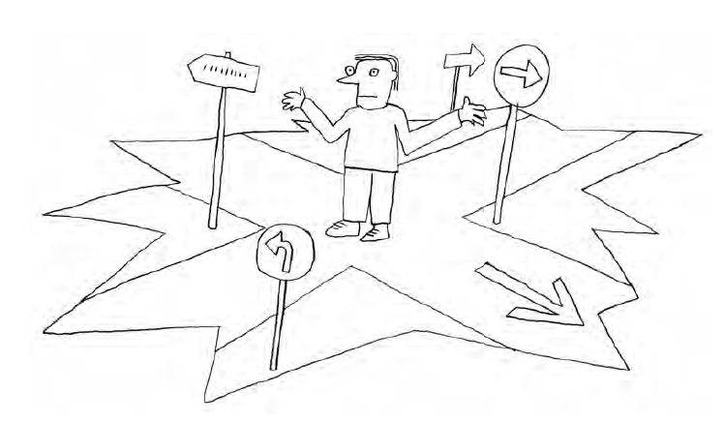
TU100 Civic Education

Slide 3
TU100 Civic Education
We may – and we must – choose the values that we think are important and meaningful for us.
In making such choices, we are using our freedom of person, thought and belief and also our freedom of expression when we confess to our views in public.

Slide 4
TU100 Civic Education
“Rights”
the freedom of person or the individual

Slide 5
TU100 Civic Education
Human rights
are fundamental rights, which means no authority needs to grant these rights or is in a position
to take them away from

Slide 6
TU100 Civic Education
From a different point of view, from the needs of society as a whole,
we find that freedom of the individual will lead to a pluralistic society,
with its members adhering to different values and beliefs.

Slide 7
TU100 Civic Education
which values our community rely on?
In a democratic community,
no individual or authority has the right to define values for all

Slide 8
TU100 Civic Education
Pluralism can be a source of
conflict

Slide 9
TU100 Civic Education
In a democratic society, argument and controversy, even quarrel and
conflict, are nothing to be feared but should be seen as something normal, even useful in democratic
decision making

Slide 10
TU100 Civic Education
Controversy and conflict are not harmful if set in and supported by a culture of argument, conflict
resolution and compromise

Slide 11
TU100 Civic Education
citizens will negotiate a minimum agreement on certain values.
it is not someone’s business to define values in terms of political correctness or a particular party, belief or ideology

Slide 12
TU100 Civic Education
if the members of a society succeed in agreeing on the rules of
peaceful, non-violent
argument and decision making,
they can deal with a lot of controversy in their views and interests

Slide 13
TU100 Civic Education
Democratic Attitude
keep the windows and doors open

Slide 14
TU100 Civic Education
“Everyone has the right to be heard.”
“We have a responsibility to listen.”

Slide 15
TU100 Civic Education
Rights may be violated, and therefore need to be protected by laws and means of enforcement

Slide 16
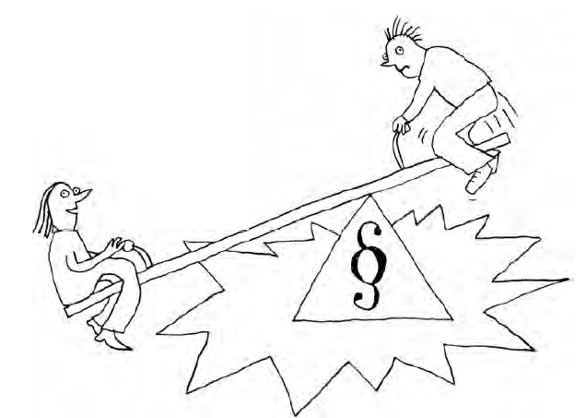
TU100 Civic Education

Slide 17
TU100 Civic Education
Who has made the rules of this game? The official symbol of the law refers to the state and the rule of law.
The state may consist of institutions sharing power and controlling each other in a system of checks and balances – parliament, government and law courts.

Slide 18
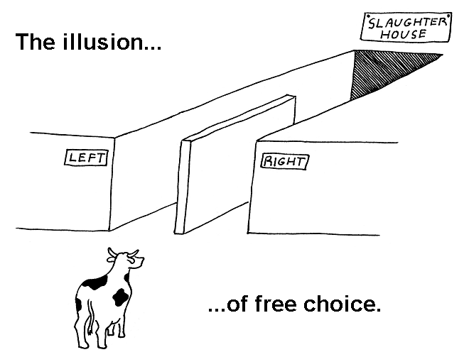
TU100 Civic Education

Slide 19
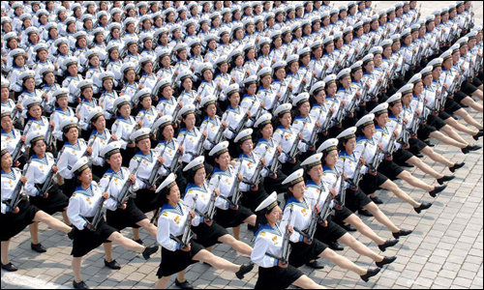
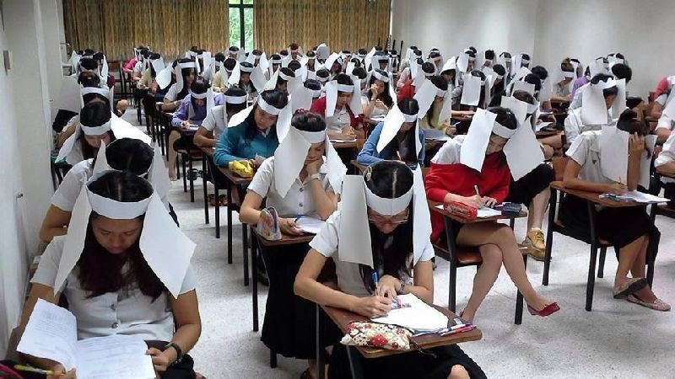
TU100 Civic Education
Dictatorship?

Slide 20
TU100 Civic Education
Are the rules fair enough?
however, human rights may be
violated by fellow citizens or even by
an unfair law itself
Making Justice Work!
Whose human rights are protected by the law? Are anybody’s human rights being violated – and by whom?

Slide 21
TU100 Civic Education
the law must strike a balance between the rights of the individual citizens and define the limits of an individual’s human rights to protect the rights of others

Slide 22
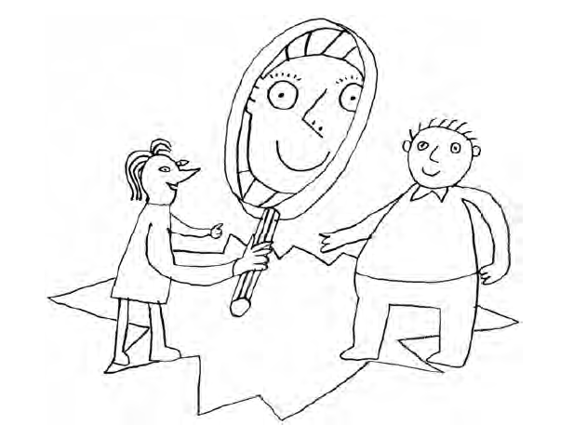
TU100 Civic Education
Perceiving others

Slide 23
TU100 Civic Education
We all direct our magnifying glasses at other people and store their images in our minds.
“Stereotypes”
We judge people by these mental images

Slide 24
TU100 Civic Education
It may be wrong or true
the differences between perception
and reality do not seem to present a problem

Slide 25
TU100 Civic Education
stereotypes turn into prejudices, particularly negative ones,
they may sow disruption and hostility in society
Discrimination

Slide 26
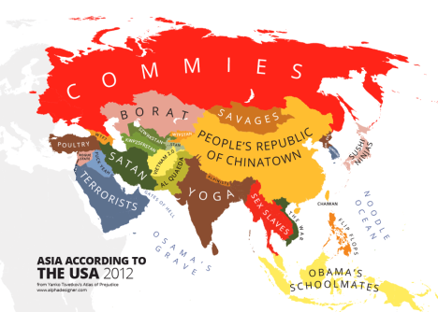
TU100 Civic Education

Slide 27
TU100 Civic Education
How can we aware our own prejudices?

Slide 28
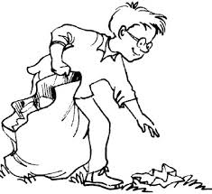
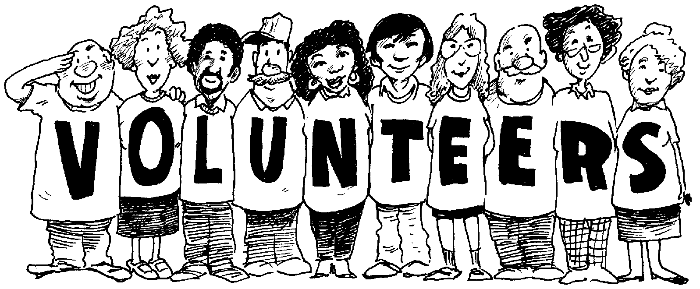
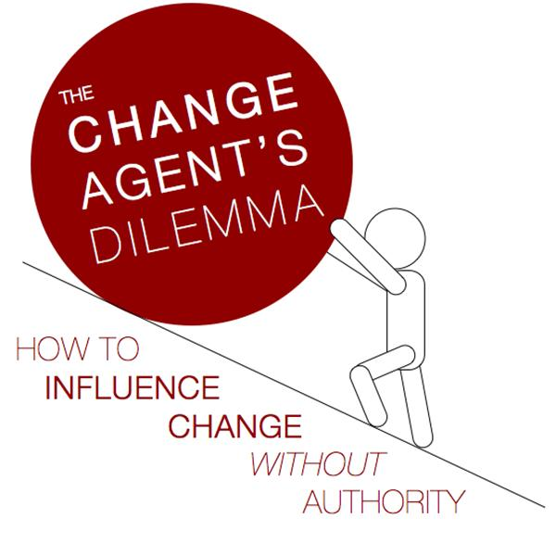
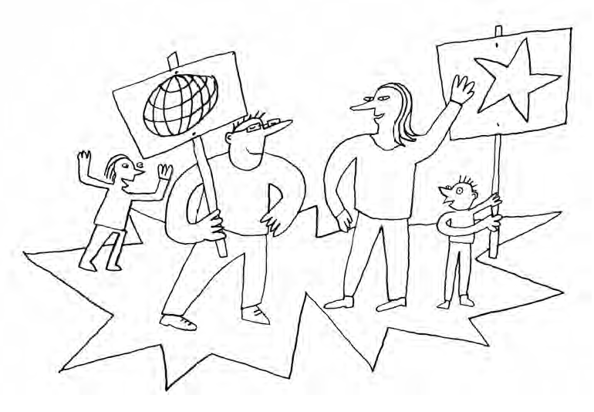
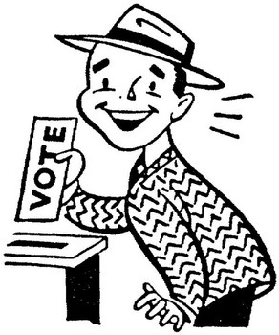
TU100 Civic Education
Taking a part in a society?

Slide 29
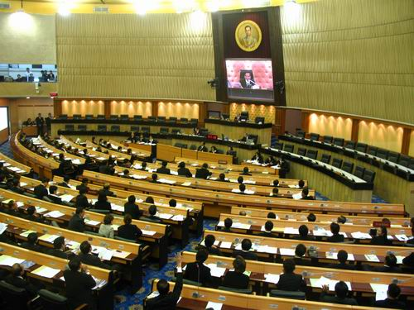
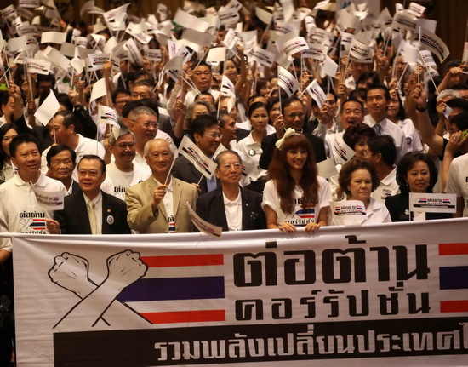
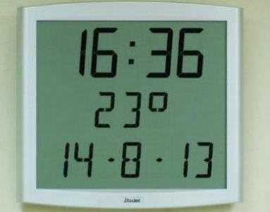
TU100 Civic Education
Taking a part in a society?

Slide 30
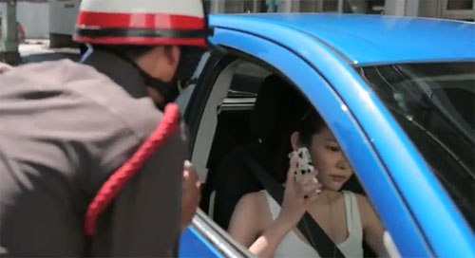
TU100 Civic Education
Taking a part in a society?

Slide 31
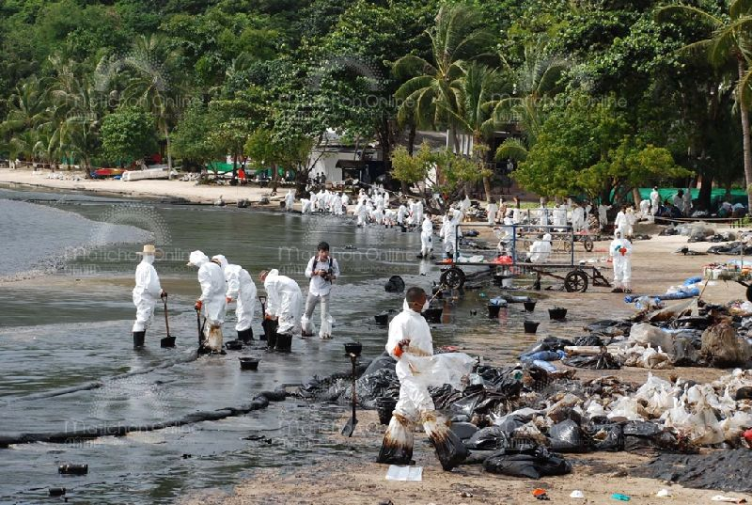
TU100 Civic Education
Social responsibility?

Slide 32
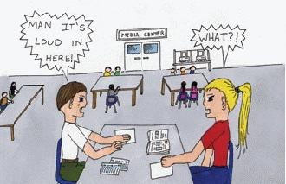
TU100 Civic Education
Social responsibility?

Slide 33

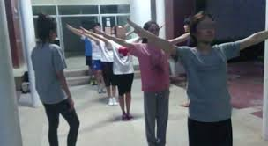
TU100 Civic Education
Social responsibility?

Slide 34
TU100 Civic Education
Think critically
Listen sincerely
Discuss respectfully
Argue logically
Make a change creatively
Act collectively

Slide 35
TU100 Civic Education
democracy begins with me and you...

Slide 36
TU100 Civic Education
the micro-society of a school class
and in society as a whole

