Slide 1
Chapter 10: Analysis of Financial Statements
Analysis of Investments &
Management of Portfolios
10TH EDITION
Reilly & Brown

Slide 2
Major Financial Statements
Corporate shareholder annual and quarterly reports must include
  Balance sheet
  Income statement
  Statement of cash flows
Reports filed with Securities and Exchange Commission (SEC)
  10-K
  10-Q

Slide 3
Generally Accepted Accounting Principles (GAAP)
Formulated by the Financial Accounting Standards Board (FASB)
Provides some choices of accounting principles
Financial statements footnotes must disclose which accounting principles are used by the firm

Slide 4
Balance Sheet
Shows resources (assets) of the firm and how it has financed these resources
Indicates current and fixed assets available at a point in time
Financing is indicated by its mixture of current liabilities, long-term liabilities, and owners’ equity
Exhibit 10.1 shows the balance sheet for Walgreen Co. for 2006 through 2010

Slide 5
Income Statement
Contains information on the profitability of the firm during some period of time, in contrast to the balance sheet at a fixed point in time
Indicates the flow of sales, expenses, and earnings during the time period
Exhibit 10.2 shows the income statement for Walgreen Co. for years 2006 through 2010

Slide 6
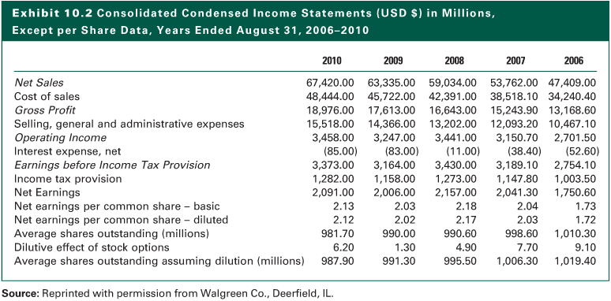
Exhibit 10.2

Slide 7
Statement of Cash Flows
Shows the effects on the firm’s cash flow of income flows and changes in various items on the balance sheet (See Exhibit 10.3)
  Cash Flow from Operating Activities: the sources and uses of cash that arise from the normal operations of a firm
  Cash Flow from Investing Activities: change in gross plant and equipment plus the change in the investment account
  Cash Flow from Financing Activities: financing sources minus financing uses

Slide 8
Measures of Cash Flow
Cash flow from operations
  Traditional cash flow equals net income plus depreciation expense and deferred taxes
  Also adjust for changes in operating assets and liabilities that use or provide cash
Free cash flow recognizes that some investing and financing activities are critical to ongoing success of the firm and the following:
  Capital expenditures
  Disposition of properties and equipment

Slide 9
Measures of Cash Flow
EBITDA: The widely-used EBITDA (earnings before interest, taxes, depreciation, and amortization) measure of cash flow is extremely liberal
  It does not consider any adjustments noted previously, specifically the following:
    Depreciation and amortization
    Interest expense
    Taxes
    working capital
    capital expenditures

Slide 10
Purpose of
Financial Statement Analysis
It seeks to evaluate the current management performance and to provide insights that will help project future management performance, specifically in the following three areas:
  Profitability
  Efficiency
  Risk

Slide 11
Analysis of Financial Ratios
Ratios are more informative that raw numbers
  Ratios provide meaningful relationships between individual values in the financial statements
Importance of relative financial ratios: Compare a firm’s financial ratios to other entities
  The aggregate economy
  Its industry or industries
  Its major competitors within the industry
  Its past performance (time-series analysis)

Slide 12
Analysis of Financial Ratios
Comparison to the Aggregate Economy
  Most firms are influenced by economic expansions and contractions in the business cycle
  Analysis helps you estimate the future performance of the firm during subsequent business cycles
Comparison to the Industry
  Most popular comparison
  Different industries affect the firms within them differently, but the relationship is always significant
  The industry effect is strongest for industries with homogenous products

Slide 13
Analysis of Financial Ratios
Comparison to its Major Competitors
  Industry averages may not be representative
  Select a subset of competitors to compare to using cross-sectional analysis, or
  Construct a composite industry average from industries the firm operates in
Comparison to its Own Historical Records
  Determine whether it is progressing or declining
  Helpful for estimating future performance
  Consider trends as well as averages over time

Slide 14
Computation of Financial Ratios
The Five Categories
  Common size statements
  Internal liquidity (solvency)
  Operating performance
    Operating efficiency
    Operating profitability
  Risk analysis
    Business risk
    Financial risk
    External liquidity risky
  Growth analysis

Slide 15
Common Size Statements
Normalize balance sheets and income statement items to allow easier comparison of different size firms
Common size statements also give insight into a firm’s financial condition
A common size balance sheet expresses accounts as a percentage of total assets (Exhibit 10.4 for Walgreen Co. from 2006 to 2010)
A common size income statement expresses all items as a percentage of sales (Exhibit 10.5 for Walgreen Co. for 2006 through 2010)

Slide 16
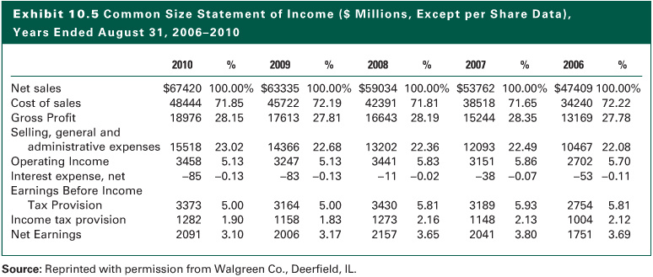
Exhibit 10.5

Slide 17
Evaluating Internal Liquidity
Internal liquidity (solvency) ratios indicate the ability to meet future short-term financial obligations
They compare near-term financial obligations, such as accounts payable or notes payable, to current assets or cash flows that will be available to meet these obligations.
Current Ratio: Examines the relationship between current assets and current liabilities
Current
Assets
Current Ratio
=
Current Liabilities

Slide 18


Evaluating Internal Liquidity
Quick Ratio: Adjusts current assets by removing less liquid assets
Cash Ratio: The most conservative liquidity ratio

Slide 19


Evaluating Internal Liquidity
Receivables Turnover: Examines the quality of accounts receivable
Receivables turnover can be converted into an average collection period

Slide 20


Evaluating Internal Liquidity
Inventory Turnover: Relates inventory to sales or cost of goods sold (CGS)
Given the turnover values, you can compute the average inventory processing time

Slide 21

Evaluating Internal Liquidity
Cash Conversion Cycle: Combines information from the receivables turnover, inventory turnover, and accounts payable turnover.

Slide 22
Evaluating Operating Performance
Ratios that measure how well management is operating a business
  Operating Efficiency Ratios: Examine how the management uses its assets and capital, measured in terms of sales dollars generated by asset or capital categories
  Operating Profitability Ratios: Analyze profits as a percentage of sales and as a percentage of the assets and capital employed

Slide 23

Operating Efficiency Ratios
Total Asset Turnover: The total asset turnover ratio indicates the effectiveness of a firm’s use of its total asset base (net assets equals gross assets minus depreciation on fixed assets)

Slide 24


Operating Efficiency Ratios
Net Fixed Asset Turnover: Reflects utilization of fixed assets
Equity turnover examines turnover for capital component

Slide 25
Operating Profitability Ratios
Operating profitability ratios measure
  The rate of profit on sales (profit margin)
  The percentage return on capital

Slide 26


Operating Profitability Ratios
Gross Profit Margin: Measures the rate of profit on sales (gross profit equals net sales minus the cost of goods sold)
Net profit margin relates net income to sales

Slide 27

Operating Profitability Ratios
Operating Profit Margin: Measures the rate of profit on sales after operating expenses (operating profit is gross profit minus sales, general and administrative (SG + A) expenses)

Slide 28


Operating Profitability Ratios
Return on Total Capital: Relates the firm’s earnings to all capital in the enterprise
Return on Owner’s Equity (ROE): Indicates the rate of return earned on the capital provided by the stockholders

Slide 29


Operating Profitability Ratios
The DuPont System: It divides the ROE ratio into several component ratios that provide insights into the causes of a firm’s ROE and any changes in it
Profit Total Asset Financial
Margin Turnover Leverage
x
x

Slide 30
Operating Profitability Ratios
An extended DuPont System provides additional insights into the effect of financial leverage on the firm and pinpoints the effect of income taxes on ROE
We begin with the operating profit margin (EBIT divided by sales) and introduce additional ratios to derive an ROE value
As shown on the next page, it involves four equations to “reach” ROE

Slide 31
Operating Profitability Ratios

Slide 32
Operating Profitability Ratios
In summary, there are five components of return on equity (ROE)

Slide 33
Risk Analysis
Risk analysis examines the uncertainty of income flows for the total firm and for the individual sources of capital
  Debt
  Preferred stock
  Common stock

Slide 34
Risk Analysis
Total risk of a firm has two components:
  Business risk
    The uncertainty of income caused by the firm’s industry
    Generally measured by the variability of the firm’s operating income over time
  Financial risk
    Additional uncertainty of returns to equity holders due to a firm’s use of fixed obligation debt securities
    The acceptable level of financial risk for a firm depends on its business risk

Slide 35
Business Risk
Two factors contribute to the variability of operating earnings
  Sales variability
    Sales variability is the prime determinant of operating earnings variability
    The variability of sales is mainly caused by a firm’s industry and is largely outside the
    control of management
  Operating leverage
    Greater operating leverage (caused by a higher proportion of fixed production costs) makes the operating earnings series more volatile relative to the sales

Slide 36
Financial Risk
Bonds interest payments come before earnings are available to stockholders
These are fixed obligations
Similar to fixed production costs, these lead to larger earnings during good times, and lower earnings during a business decline
This debt financing increases the financial risk and possibility of default

Slide 37
Financial Risk
Relationship between business risk and financial risk
  Acceptable level of financial risk for a firm depends on its business risk
The three sets of financial ratios to measure financial risk
  Balance sheet ratios
  Earnings and Cash Flow Coverage Ratios
  Cash Flow–Outstanding Debt Ratios

Slide 38
Balance Sheet Ratios
Proportion of Debt (Balance Sheet) Ratios: Indicate what proportion of the firm’s capital is derived from debt compared to other sources of capital, such as preferred stock, common stock, and retained earnings
Debt-Equity Ratio

Slide 39
Balance Sheet Ratios
Proportion of Debt (Balance Sheet) Ratios: Indicate what proportion of the firm’s capital is derived from debt compared to other sources of capital, such as preferred stock, common stock, and retained earnings
Debt-Equity Ratio

Slide 40
Balance Sheet Ratios
Long-Term Debt/Total Capital Ratio: Indicates the proportion of long-term capital derived from long-term debt capital

Slide 41
Balance Sheet Ratios
Total Debt-Total Capital Ratios: Compare total debt (current liabilities plus long-term liabilities) to total capital (total debt plus total equity)

Slide 42
Earnings or Cash Flow Ratios
Earnings or Cash Flow Ratios: Relate the flow of earnings or cash available to meet the required interest and lease payments
Interest Coverage Ratio

Slide 43
Earnings or Cash Flow Ratios
Cash Flow Coverage Ratios: Relate the flow of cash available from operations to either interest expense, total fixed charges, or the face value of outstanding debt

Slide 44
Cash Flow–Outstanding Debt Ratios
Cash Flow–Long-Term Debt Ratio
Cash Flow–Total Debt Ratio

Slide 45
External Market Liquidity
External Market Liquidity Defined
  External market Liquidity is the ability to buy or sell an asset quickly with little price change from a prior transaction assuming no new information
  External market liquidity is a source of risk to investors

Slide 46
External Market Liquidity
Determinants of Market Liquidity
  The most important determinant of external market
  liquidity is the number of shares or the dollar value of shares traded
  Trading turnover (percentage of outstanding shares traded during a period of time)
  A measure of market liquidity is the bid-ask spread
  Certain corporate variables
    Total market value of outstanding securities
    Number of security owners

Slide 47
Analysis of Growth Potential
Importance of Growth Analysis
  Sustainable growth potential analysis examines ratio that indicate how fast a firm should grow.
  Creditors are interested in the firm’s ability to pay future obligations
  Value of a firm depends on its future growth in earnings and dividends

Slide 48
Analysis of Growth Potential
Determinants of Growth
  Resources retained and reinvested in the entity
  Rate of return earned on the resources retained
  = RR x ROE
  where:
  g = potential growth rate
  RR = the retention rate of earnings
  ROE = the firm’s return on equity
g
=
Percentage
of
Earnings
Retained
×
Return
on
Equity

Slide 49
Comparative Analysis of Ratios
Internal liquidity
  Current ratio, quick ratio, and cash ratio
Operating performance
  Efficiency ratios and profitability ratios
Risk Analysis
Growth analysis

Slide 50
Analysis of
Non-U.S. Financial Statements
Statement formats will be different
Differences in accounting principles
Ratio analysis will reflect local accounting practices

Slide 51
The Quality of Financial Statements
High-quality balance sheets typically have
  Conservative use of debt
  Assets with market value greater than book
  No liabilities off the balance sheet
High-quality income statements reflect
  Repeatable earnings
  Uses of conservative accounting principles
Footnotes
  Provide information on how the firm handles balances sheet and income items

Slide 52
The Value of
Financial Statement Analysis
Financial statements, by their nature, are backward-looking
An efficient market will have already incorporated these past results into security prices, so why analyze the statements?
Analysis provides knowledge of a firm’s operating and financial structure
This aids in estimating future returns

Slide 53
Specific Uses of Financial Ratios
Stock Valuation Models
Estimating the Ratings on Bonds
Predicting Insolvency (Bankruptcy)
Limitations of Financial Ratios

Slide 54
Stock Valuation Models
Valuation models attempt to derive a value based upon one of several cash flow or relative valuation models
All valuation models are influenced by:
  Expected growth rate of earnings, cash flows, or dividends
  Required rate of return on the stock
Financial ratios can help in estimating these critical inputs

Slide 55
Stock Valuation Models
Financial Ratios
  1. Average debt/equity
  2. Average interest coverage
  3. Average dividend payout
  4. Average return on equity
  5. Average retention rate
  6. Average market price to book value
  7. Average market price to cash flow
  8. Average market price to sales

Slide 56
Stock Valuation Models
Variability Measures
  1. Coefficient of variation of operating earnings
  2. Coefficient of variation of sales
  3. Coefficient of variation of net income
  4. Systematic risk (beta)
Nonratio Variables
  1. Average growth rate of earnings

Slide 57
Estimating the Ratings on Bond
Financial Ratios
  1. Long-term debt/total assets
  2. Total debt/total capital
  3. Net income plus depreciation (cash flow)/long term senior debt
  4. Cash flow/total debt
  5. Net income plus interest/interest expense (fixed charge coverage)
  6. Cash flow/interest expense
  7. Market value of stock/par value of bonds
  8. Net operating profit/sales
  9. Net income/owners’ equity (ROE)
  10. Net income/total assets
  11. Working capital/sales
  12. Sales/net worth (equity turnover)

Slide 58
Estimating the Ratings on Bond
Variability Ratios
  1. Coefficient of variation (CV) of net earnings
  2. Coefficient of variation of return on assets
Nonratio variables
  1. Subordination of the issue
  2. Size of the firm (total assets)
  3. Issue size
  4. Par value of all publicly traded bonds of the firm

Slide 59
Predicting Insolvency (Bankruptcy)
Financial Ratios
  1. Cash flow/total debt
  2. Cash flow/long-term debt
  3. Sales/total assets
  4. Net income/total assets
  5. EBIT/total assets
  6. Total debt/total assets
  7. Market value of stock/book value of debt
  8. Working capital/total assets
  9. Retained earnings/total assets
  10. Current ratio
  11. Working capital/sales

Slide 60
Limitations of Financial Ratios
Accounting treatments may vary among firms, especially among non-U.S. firms
Firms may have have divisions operating in different industries making it difficult to derive industry ratios
Results may not be consistent
Ratios outside an industry range may be cause for concern

Slide 61
The Internet Investments Online
http://www.walgreens.com
http://www.cvs.com
http://www.riteaid.com
http://www.longs.com
http://www.sec.gov
http://www.hoovers.com
http://www.dnb.com

