Slide 1




Marketing Planning 312
Chapter 4
SWOT Analysis
By Ajarn Suwalya K.

Slide 2

Figure 1.1: The stages of building a
marketing plan

Slide 3

RBV vs. MOV
The Resource Based View (RBV) is an inside-out perspective
The Market Orientation View (MOV) is an outside-in perspective as illustrated below

Slide 4
Ch. 4 - Learning objectives
After studying this chapter you should be able to:
■ explain how a SWOT analysis can capitalize on a company’s internal and external issues
■ understand the reasons for matching strengths and opportunities, and converting weaknesses and threats
■ discuss the importance of doing some research as the basis for SWOT analysis
■ discuss the barriers to and benefits of conducting SWOT analyses
■ explain the reasons for preparing multilevel SWOT analyses.

Slide 5
SWOT-Driven Strategic Planning
Marketing information collected via a situation analysis
  Identifies the key factors that should be tackled by the firm
  Organizes them within a system that will monitor and distribute information on these factors on an ongoing basis
Role of SWOT analysis
  Synthesize wide array of information and aid in transition of the firm's strategic focus

Slide 6
Potential Issues to Consider in a SWOT Analysis
Potential internal strengths | Potential external opportunities
Abundant financial resources | Rapid market growth
Well-known brand name | Mishap of a rival firm
Economies of scale | Government deregulation
Proprietary technology | New technology
Better marketing skills | Demographic shifts
Potential internal weaknesses | Potential external threats
Lack of strategic direction | Entry of foreign competitors
Limited financial resources | Product life cycle in decline
Weak spending on R&D | Changing customer needs/tastes
Very narrow product line | Economic boom/downturn
Internal political problems | New technology

Slide 7
The SWOT Matrix
Four-cell array used to visually evaluate elements of SWOT analysis
Should be based on customer perceptions, not perceptions of the manager
Elements with the highest total ratings should have the greatest influence in developing the strategy
Focus on competitive advantages by matching strengths with opportunities

Slide 8
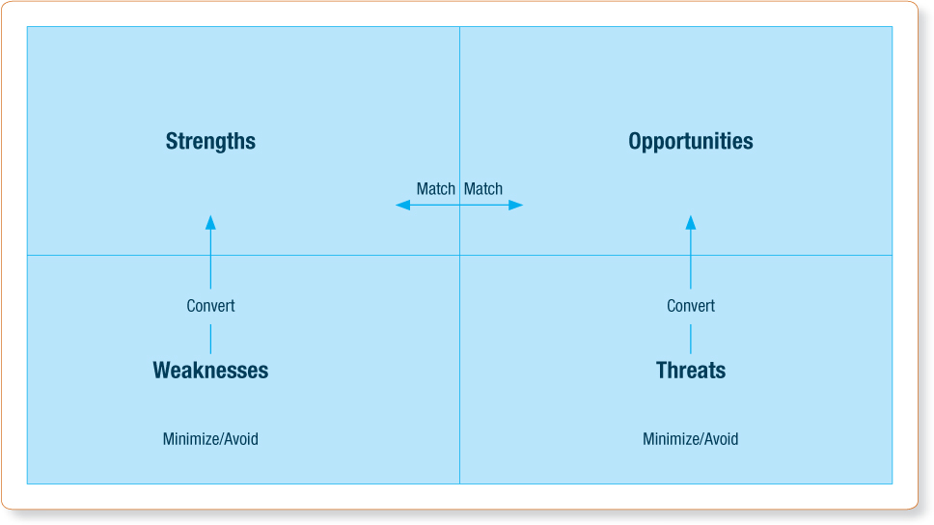
Exhibit 4.5 - The SWOT Matrix
Source: Adapted from Nigel Piercy, Market-Led Strategic Change (Oxford, UK: Butterworth-Heineman, 2002).

Slide 9
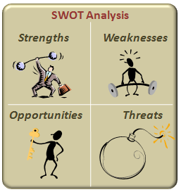
SWOT analysis
Successful SWOT analysis is fundamentally a process of finding the optimum fit between the firm’s controllable strengths and weaknesses and the uncontrollable opportunities and threats posed by the environment in which the firm operates.

Slide 10

SWOT analysis
A good SWOT profile facilitates the development of a strategy that capitalizes on a company’s strengths, minimizes any weaknesses, exploits emerging opportunities and avoids, as far as possible, any threats.

Slide 11

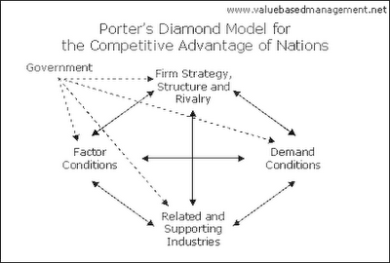
SWOT analysis
The SWOT framework became popular during the 1970s because of its assumption that managers can plan the alignment of a firm’s resources with its environment. Subsequently, during the 1980s, Porter’s (1980) introduction of the industrial organization paradigm, with his five forces/diamond models, gave primacy to a firm’s external environment, overshadowing the popularity of SWOT analysis. In the 1990s, Barney reinvented SWOT as the foundation framework linking the firm’s resources to sustained competitive advantage (Barney, 1991)

Slide 12
The development of a SWOT-analysis – The structure of Chapters 2, 3 and 4:

Slide 13
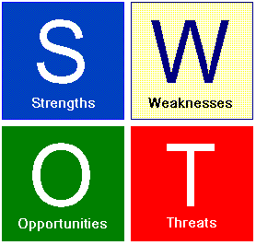
Elements of the SWOT analysis
Strengths
  Determine your organization’s strong points, from an internal perspective as well as from the perspective of external customers. Do not be humble, be a pragmatic as possible
Weaknesses
  Determine your organization’s weaknesses not only from internal point of view, but also from customers.
Opportunities
  Another major factor is to determine how your organization can continue to grow within the marketplace. After all, opportunities are everywhere, such as changes in technology, government policies, social patterns, etc.
Threats
  It is vital to be prepared and face up to threats

Slide 14
SWOT analysis
The following are the strategic options suggested by the SWOT-matrix:
1 Make a match between strengths and opportunities
2 Convert weaknesses to strengths
3 Convert threats to opportunities
4 Minimize, if not avoid, weaknesses and threats.

Slide 15
Application of the SWOT matrix
The four combinations that could result from SWOT analysis are called:
Maxi-Maxi (strengths/opportunities): In essence, an organization should strive to maximize its strengths to capitalize on new opportunities
Maxi-Mini (strengths/threats): In essence, an organization should strive to use its strengths to parry or minimize threats.

Slide 16
Application of the SWOT matrix
The four combinations that could result from SWOT analysis are called (cont.):
Mini-Maxi (weaknesses/opportunities): It encourages the organization to conquer its weaknesses by making the most of any new opportunities
Mini-Mini (weaknesses / threats): This is most definitely a defensive strategy: to minimize an organization’s internal weaknesses and avoid external threats.

Slide 17
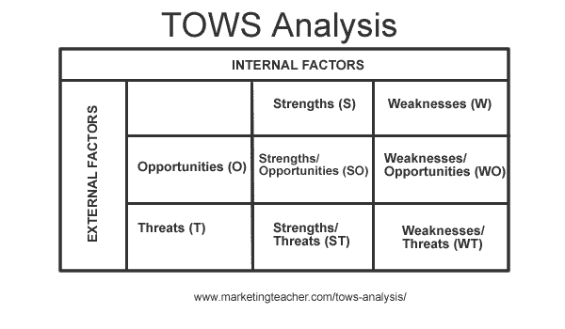
Application of the SWOT matrix
TOWs

Slide 18
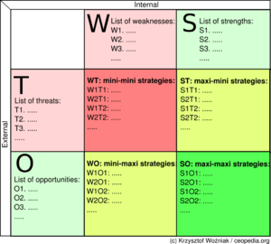
Application of the SWOT matrix
TOWs

Slide 19
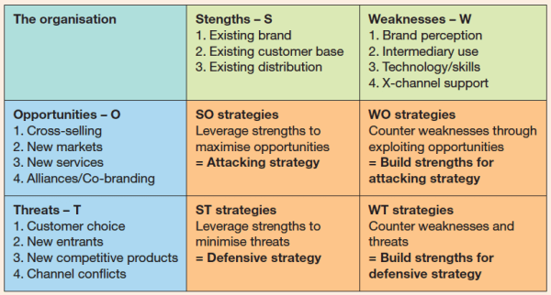
Application of the SWOT matrix
TOWs

Slide 20
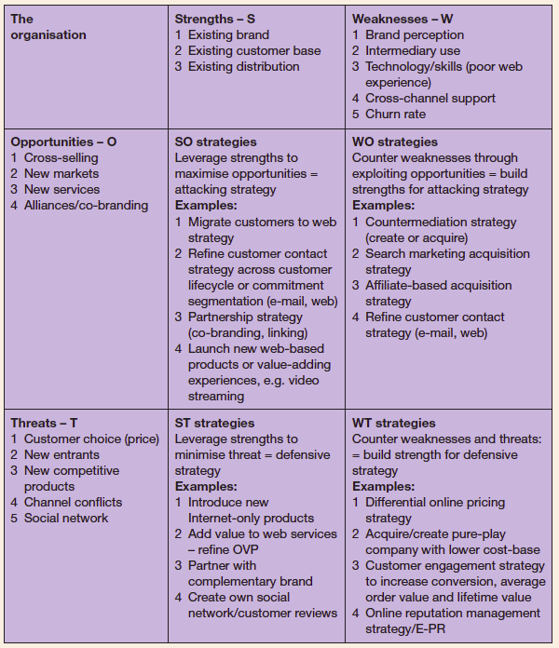
Application of the SWOT matrix
TOWs

Slide 21
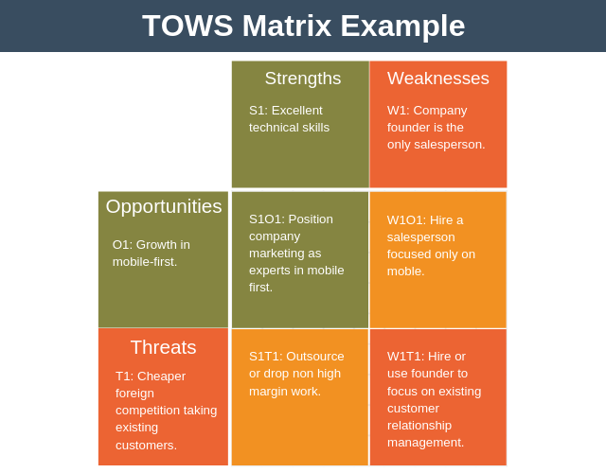

Slide 22

Internal analysis
An internal (company) analysis involves a comprehensive appraisal of company strengths and weaknesses.
Every aspect of the business should be assessed.
For example, coverage should include financial capabilities, technical abilities, location, plant and equipment, personnel, distributor relationships, customer relationships, and so on.
In particular, the firm should try to identify its core competencies compared to its competitors

Slide 23

Analyzing competitors
The main questions to ask about competitors are as follows.
■ What is their (marketing mix) offer?
■ What is their competitive advantage?
■ How well are they performing?
■ What does their SWOT profile look like?
■ How are they likely to compete in future?

Slide 24

Benefits of and barriers to conducting a SWOT Analysis
The reasons why so many organizations take the ‘ask the manager’ approach and not a more analytical path in form of a SWOT analysis are numerous.
They include the following(Jenster and Hussey, 2001; Hussey 2002)

Slide 25
Benefits of and barriers to conducting a SWOT Analysis
Lack of guidance on how to do it: There are very few books that attempt to explain how to undertake and integrated company analysis
Better management information systems: Managers today have access to better more comprehensive and more up-to-date management information systems than was the case in the past.
Pressure on managers: It is certainly much quicker to ask them to define corporate strengths and weaknesses than to spend precious time on special analysis.
The complexity of many companies: Many companies are very large and complex which can make the task of carrying out a comprehensive appraisal seem rather daunting, and with the decline of large strategic staff departments the task of organizing such a study is devoted to busy line managers.

Slide 26

Exhibit 4.1 SWOT Analysis of Honda Motor Company corporate level

Slide 27
Exhibit 4.1 SWOT Analysis of Honda Motor Company corporate level

Slide 28


Multilevel SWOT Analysis
SWOT analysis may be undertaken on different organizational levels.
  Product 1 and Market 1
  Product 1 and Market 2
  Product 2 and Market 1
  Product 2 and Market 2

Slide 29
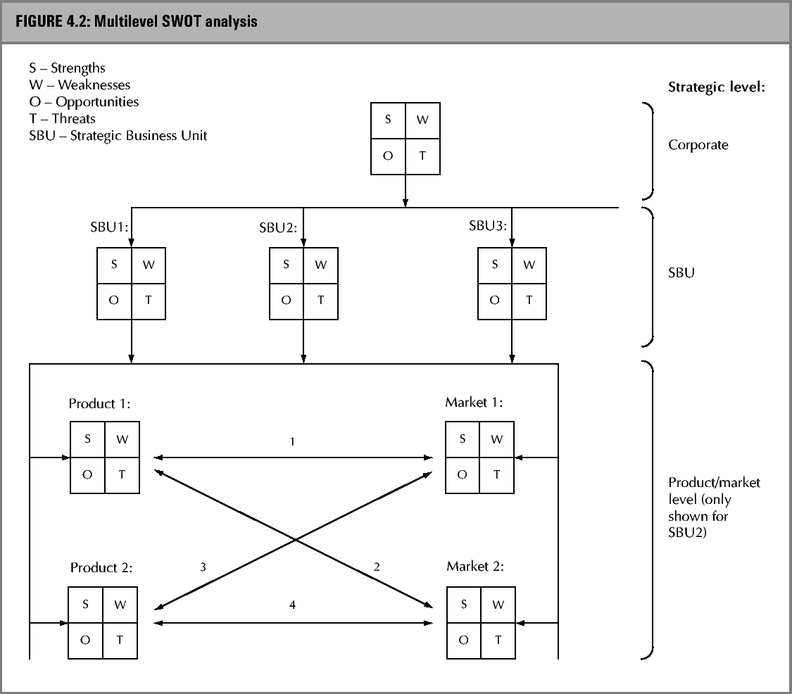

Slide 30
Individual Homework #3- due next week
1. You are to find current, most up-to-date information on the internet that does not relate to your project but should be based on individual interests.
2. Your assignment should be no more than 1 page.
3.It must have source or reference from the information researched..
4.It could include charts, graphs, photos etc
You are to choose a country of your preference.
Then conduct a SWOT analysis of your chosen country.
Expain how would you increase the number of tourists in your chosen country

