Slide 1
ASEAN Integration and Border Trade
Pariwat Kanithasen
pariwatk@bot.or.th
BE Summer School—International Economics EE551
Faculty of Economics, Thammasat University, Thaprachan
25 July 2019
Disclaimer: Views expressed in this presentation are those of the speaker

Slide 2
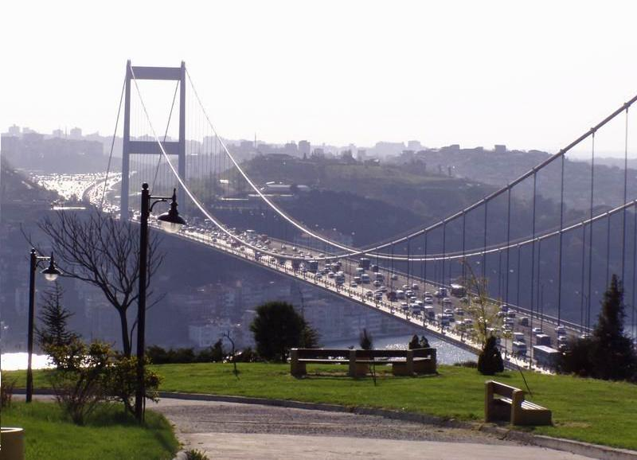
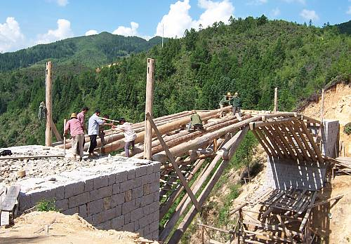
Imagined ASEAN Economic Community
AEC:
What we imagine it to be
AEC:
What it actually is

Slide 3
Themes for today
AEC From Above
“Imagined” integration through international agreements
AEC From Below
Real-life integration through cross-border activities

Slide 4
Intro: ASEAN Economic Community
1967
Establishment
1981
Preferential Trade Agreement
1992
ASEAN Free Trade Area
1995
ASEAN Framework Agreement on Services
1999
ASEAN Investment Agreement
2007
AEC Blueprint
2009+
ASEAN+1 FTA
2005-09
Skilled Labor
MRA
ASEAN Economic Community Blueprint (2007)

Slide 5
Intro: ASEAN Economic Community
The AEC is a work in process, moving in “baby steps”.
Loose and flexible integration due to diversity
ASEAN: Most diverse economic grouping
Population
and Markets
From Brunei (0.4 mil) to
Indonesia (237 mil)
Income
Sixty times’ difference in
per-capita GDP between richest and poorest country
Development Stages
One advanced economy,
six emerging market and three low-income developing economies
Economic Infrastructure
From nascent capital markets to regional financial centers

Slide 6
Five Areas of ASEAN Integration
2. Services
3. Investment
4. Labor
5. Capital
1. Goods

Slide 7
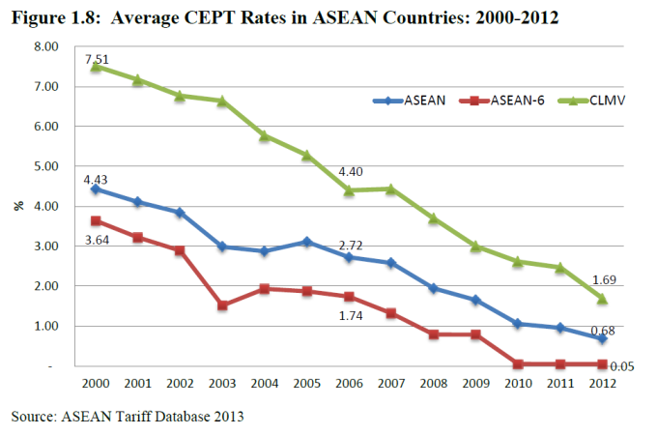
1. Goods
Tariffs eliminated for ASEAN5, underway for CLMV...
Goal: eliminate tariffs for ASEAN-6 in 2010 and for CLMV in 2015 except for a very few sensitive items
Tariff reductions progressing as planned
Tariff reductions
2010
0%
2015
0%
ASEAN6
CLMV
ERIA (2014) ASEAN Rising and UNCTAD/ESCAP (2013) Addressing Non-tariff Measures in ASEAN, TDRI (2554)
ASEAN Economic Community Blueprint (2007)

Slide 8
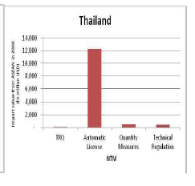
1. Goods
…but non-tariff barriers remain important obstacles.
Not much progress in eliminating NTBs.
Used in place of tariffs!
NTBs scattered across countries’ laws and regulations
Goal: Eliminate non-tariff barriers such as quotas, or any measure which restrict trade
Round 1 | Round 2 | Round 3
Remove by 1 Jan 2008 | Remove by 1 Jan 2009 | ASEAN 5 : Remove by 1 Jan 2010
 |  | Philippines : Remove by 1 Jan 2012
 |  | CLMV : Remove by 1 Jan 2015
ERIA (2014) ASEAN Rising and UNCTAD/ESCAP (2013) Addressing Non-tariff Measures in ASEAN, TDRI (2554)

Slide 9
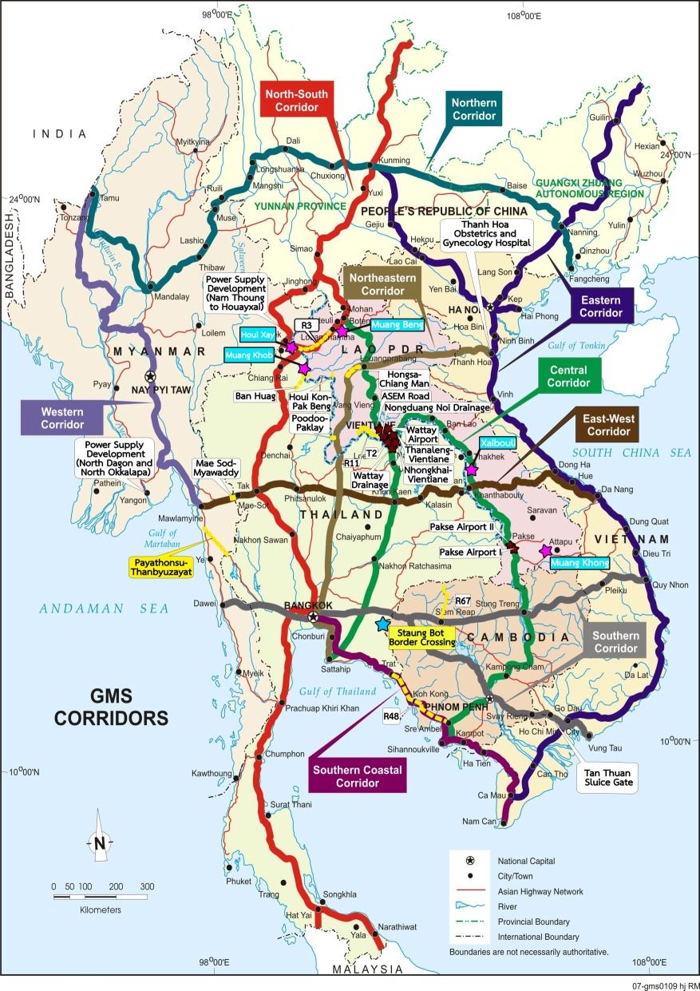
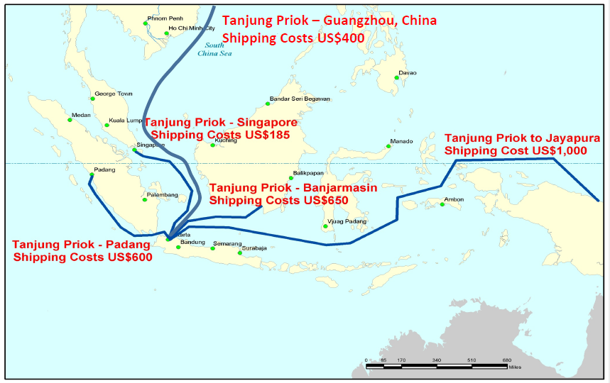
1. Goods
Trade facilitation done through logistics networks.
ASEAN Connectivity
Logistical advantages for peninsular ASEAN
Island countries face enormous costs
Shipping costs for 20ft container
Bangkok-Singapore
US$250
Bangkok-Guangzhou
US$400
Sources: World Bank Indonesia (2013), Profreight (2012), NEDA (2013)

Slide 10
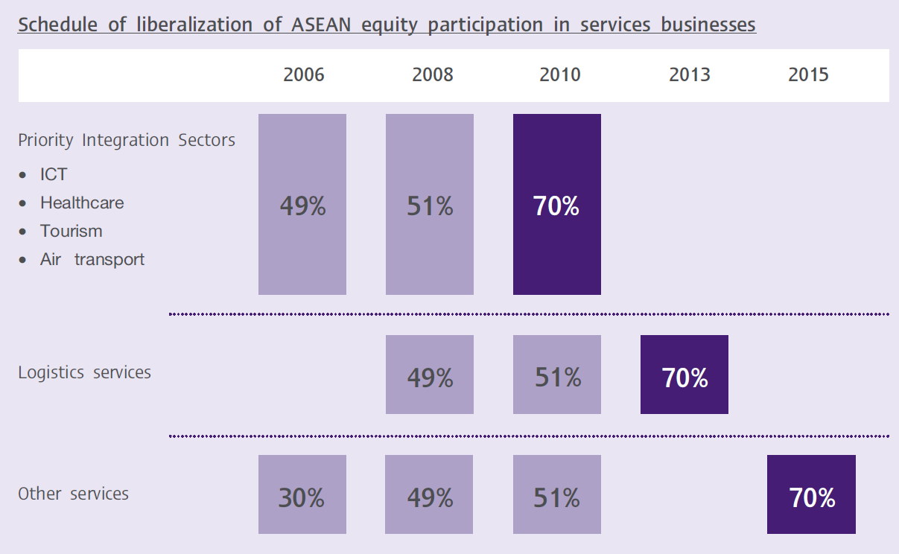
2. Services/Investment
ASEAN’s (overly) ambitious liberalization goals…
Goal: Gradual relaxation of ASEAN foreign ownership in services according to schedule
ASEAN Economic Community Blueprint (2007), SCB Intelligence

Slide 11





2. Services
…which lead to slow progress
Committed ASEAN shareholding in selected services
Services Subsector | Goal 2013 | THA | IDN | MAL | PHI | SIN
IT (Mobile Phone Services) | 70 | 49 | 49 | 70 | 40 | 74
Health (Hospital Services) | 70 | 49 | 70 | 70 | 40 | 51
Tourism (Hotel Services) | 70 | 49 | 50 | 70 | 40 | 100
Logistics (Freight Services) | 70 | 49 | 49 | 51 | 40 | 100
Not much progress in services integration—even in Priority Integration Sectors which are supposed to be liberalized before other sectors
Source: ASEAN Framework Agreement on Services—8th Package (2010)

Slide 12
3. Investment
Only up to domestic laws, most of it comes from abroad
Intra- and extra-ASEAN net foreign direct investment flows
Members liberalize only to the extent their domestic laws, e.g. Thailand’s Foreign Businesses Act which prohibits or restricts foreigners to invest in land acquisition, farming, etc.
Other countries reserve their own sensitive sectors e.g. oil/gas production for Malaysia/Brunei/Indonesia
But: Intra-ASEAN FDI, while rising, is still low compared with FDI from outside ASEAN (e.g. Japan)
ACIA

Slide 13

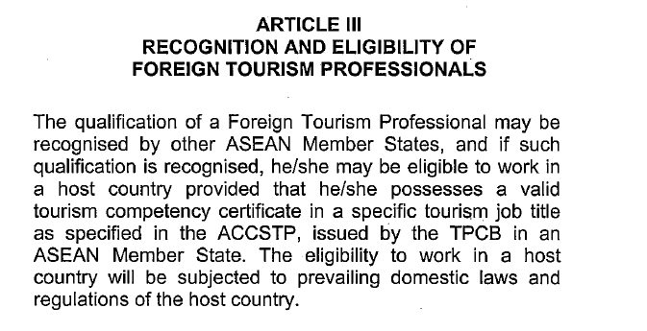
4. Labor
Shallow commitments in skilled professional labor…
Mutual Recognition Arrangements (MRAs) signed for 8 professions (medical practitioners, dentists, architects, surveyors, tourism professionals)
Source: http://www.asean.org/communities/asean-economic-community/item/asean-mutual-recognition-arrangement-framework-on-accountancy-services-3

Slide 14
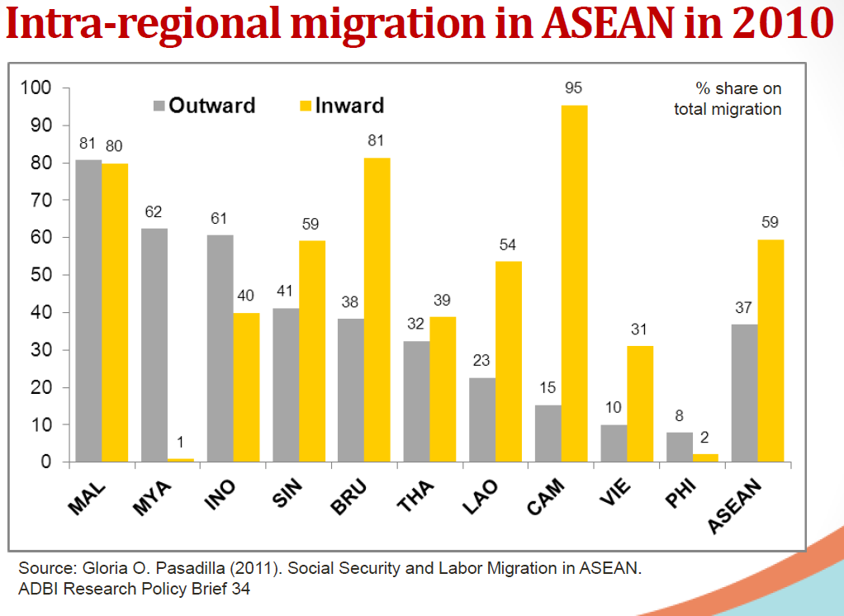
4. Labor
…though most labor movements are non-skilled or semi-skilled
Foreign Labor
in Thailand
1,430,000+
Number of ASEAN labor force in Thailand
=92%
of the foreign labor force in Thailand
=3.6%
of the Thai labor force
390
Number of ASEAN Labor force in MRA professions
Capanelli (ADBI) (2013)
Source Office of Foreign Labor Statistics

Slide 15


5. Capital:
“Freer” flows because members are at different stages of liberalization but no plans for a single currency
Stage 5
DEGREE OF RISK
Stage 4
Other flows
(e.g. loans)
Stage 3
Stage 2
Portfolio outflows
Stage 1
Portfolio inflows
(Stock and bonds)
Current Account
(Goods and services)
Direct
Invest-
ment
(FDI)
Source: ASEAN Working Committee on Capital Account Liberalization 2010

Slide 16
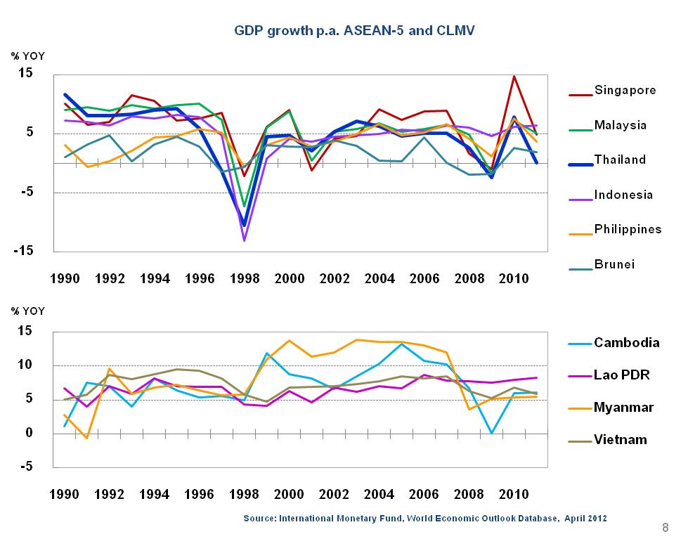
5. Common Currency in ASEAN?
ASEAN does not currently fulfill optimum currency area conditions
“Optimum currency area” conditions:
  Free movement of capital
  Free movement of labor
  Fiscal transfers
  Synchronized business cycles
Mundell, “A Theory of Optimum Currency Areas”, 1961

Slide 17
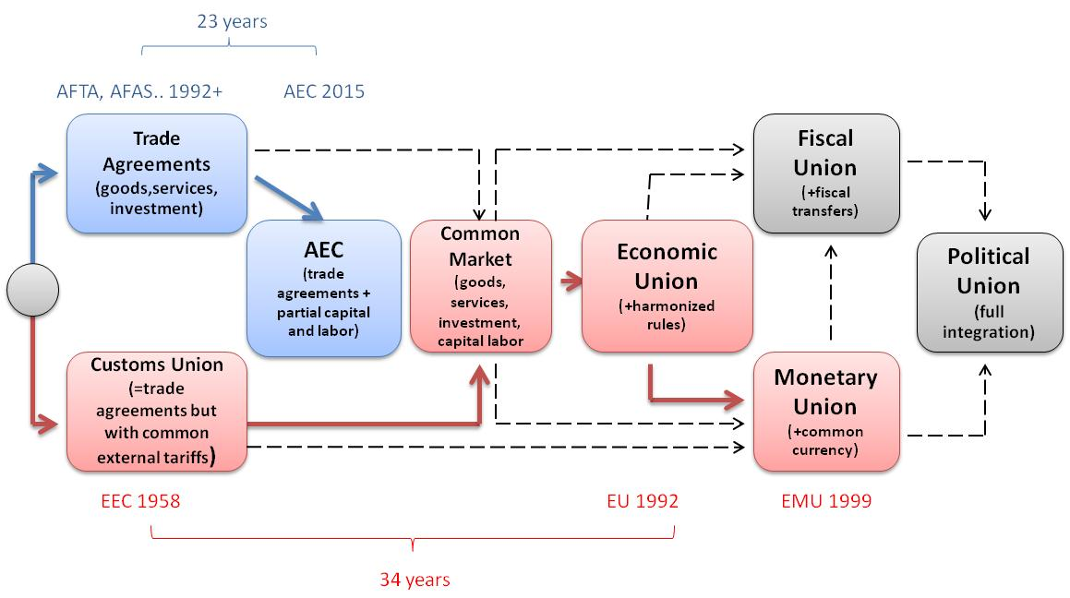
AEC and EU: Different Paths of Integration
ASEAN and the EU have different integration paths
Balassa: Theory of Economic Integration (1961, 1996)
Crowley: “Institutional Implications of the EMI”, (2001)

Slide 18
Themes for today
AEC From Above
“Imagined” integration through international agreements
AEC From Below
Real-life integration through cross-border activities

Slide 19
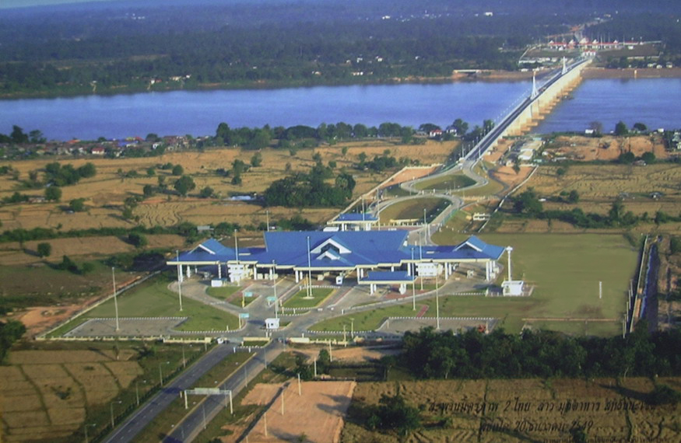
1. Cross-border trade in goods
International Trade
Border Trade
Informal Border Trade
-What is being traded?
-Who are buyers and sellers?
-What is the final desination:?
-What are the barriers to trade?

Slide 20
1. How much is being traded?
Thai-Lao Trade
Source: Krungsri Research, 2019

Slide 21
1. How much is being traded?
Source: Krungsri Research, 2019

Slide 22
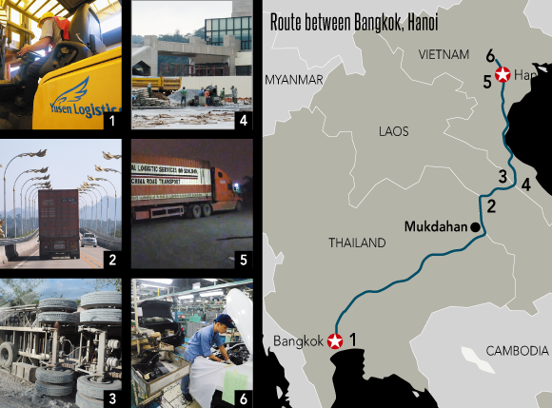
Goods: Where are the goods headed to?
Direct: Border area consumption
Intermediate domestic: Laos
Beyond: vietnam

Slide 23
Goods: Where are the goods headed to?
Source: Krungsri Research, 2019

Slide 24
Goods: What are barriers to trade?
Tariffs
Non-Tariff Barriers
Facilitation
Tariffs: Thai side—eliminated since 2010
  Myanmar side—almost zero
Non-tariff barriers: Fees collected by checkpoints
Facilitation/Logistics: Conditions of roads

Slide 25
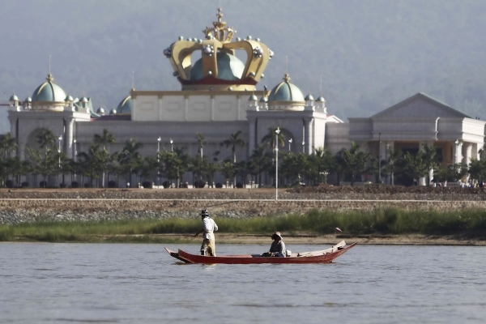
2. / 3. Services and Investment
-Who are the service providers?
-What are the key investments in the border area?
-What services/investment are available on only one side of the border?
Kings Roman Casino, Lao PDR

Slide 26
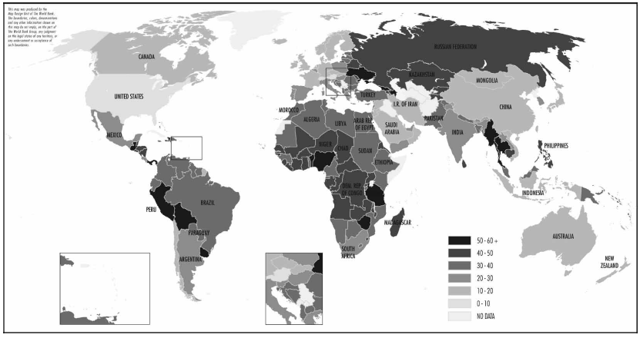
Shades of Gray in Shadow Economies
Formal
Informal/
Gray
Illegal/
Black
Casino
Schneider et al. (2010): New Estimates for the Shadow Economies all over the World, Intl Econ Journal

Slide 27
4. Movements of people
Mae Sai-Tachilek Border Crossings
-What kind of movements of people take place across borders? Tourists? Workers?
-Skilled/unskilled? Day workers? Migrants?
Immigration?
Requirements and restrictions for crossing the border?
Thai Immigration Office, 2015

Slide 28
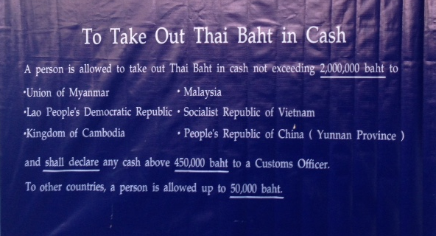
5. Movements of Capital
-Which currencies are used for trade?
-What are the restrictions on in- and outflows of capital?
Capital Flow Measures, Sign at Mae Sai-Tachilek Border

Slide 29
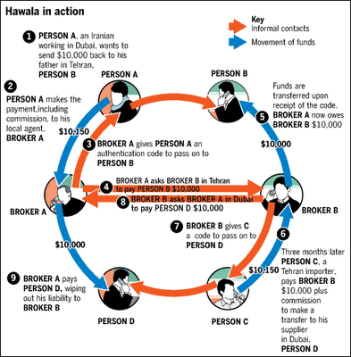
5. Movements of Capital
-How are funds transferred?
- Informal system: Hawala/Poy Guan

Slide 30
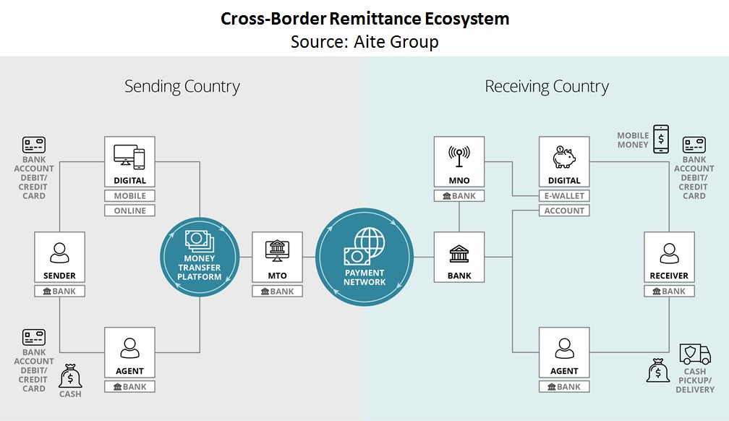
5. Movements of Capital
Using Fintech for Remittances

Slide 31
Issues for Discussion/Post-Field Work
What are the cross-border activities in the context of the AEC. What are the key differences between AEC “from above” and AEC “from below”
What are the real-life economic activities along the border in the context of shadow economies
Discuss longer-term implications of cross-border activities on longer-term issues such as development, sustainability etc.

