Slide 1
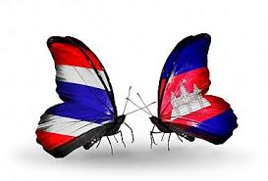
CAMBODIA-THAILAND Bilateral Relations
Picture of Prime Ministers Here

Slide 2
BIOGRAPHY
Bachelor and Master Degree from 1999-2005.
Now Pursuing PhD at Chulalongkorn University.
MoFA since 2008, Bilateral Affairs between Cambodia with Thai, Lao PDR and Vietnam, CLMV and ACMECS
Diplomacy courses in USA, Germany, Belgium, Netherland, Singapore, Brunei Darussalam and Thailand
Counsellor & Deputy Head of Mission at Royal Embassy of Cambodia in charge of Political Affairs & Bilateral Relations ,ASEAN and ESCAP

Slide 3
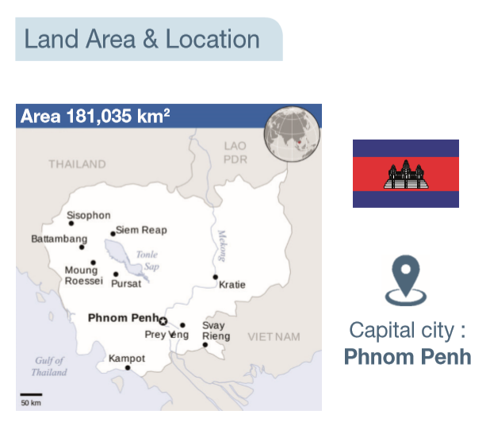
Cambodia Profile
Government: Constitutional Monarchy under a Multiparty Democracy
King: His Majesty Preah Bat Samdech Preah Bat Norodom Sihamuni
Prime Minister: Samdech Akka Moha Sena Padei Techo HUN SEN

Slide 4
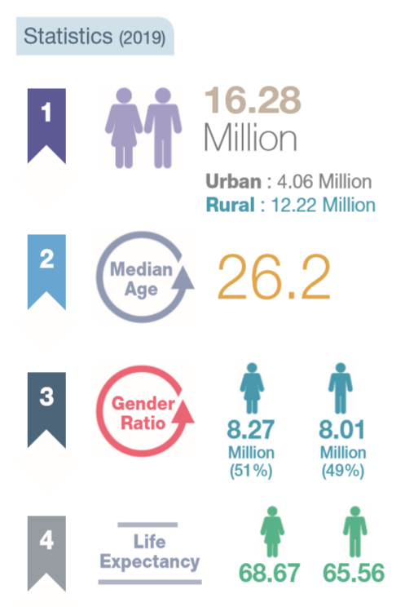
Cambodia Profile
Government: Constitutional Monarchy under a Multiparty Democracy
King: His Majesty Preah Bat Samdech Preah Bat Norodom Sihamuni
Prime Minister: Samdech Akka Moha Sena Padei Techo HUN SEN
Population: 16.28 Million (2019)
Urban: 4.06 million, Rural: 12.22 million
More than half of population is under 25 years old-the workforce is increasingly well educated, and eager to learn and work with global companies

Slide 5
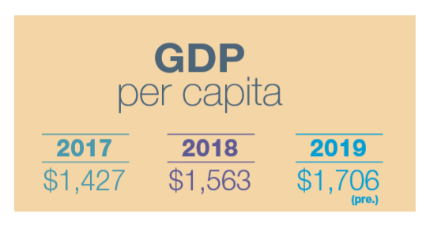
Religion: 90% is Buddhism, 10%: Others
Neighboring countries: Thailand, Lao PDR and Vietnam
Economy: Cambodia has seen steady growth of around 7% per year from 1995 to 2018 and is now the sixth fastest growing economy in the world

Slide 6
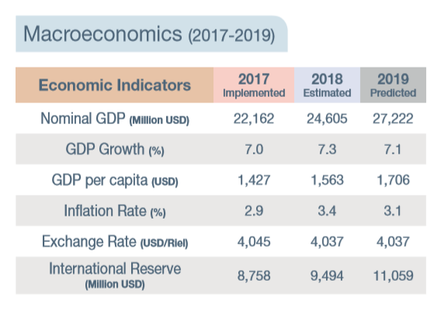

Slide 7

Diplomatic Relations with Thailand
19 December 1950
2020: the 70th Anniversary of the establishment of Diplomatic Relations between Cambodia and Thailand
Excellent Relations in all fields
Similarity: Culture, Traditions, Religion

Slide 8
Official Visits of Leaders
Since the first election in 1993, Cambodia and Thailand have enjoyed their bilateral relations by exchanging the official visits in all levels
Royal Visits
Top Leaders Visits
Ministerial Level: Many meetings
People to People: Along the borders and other mechanisms

Slide 9
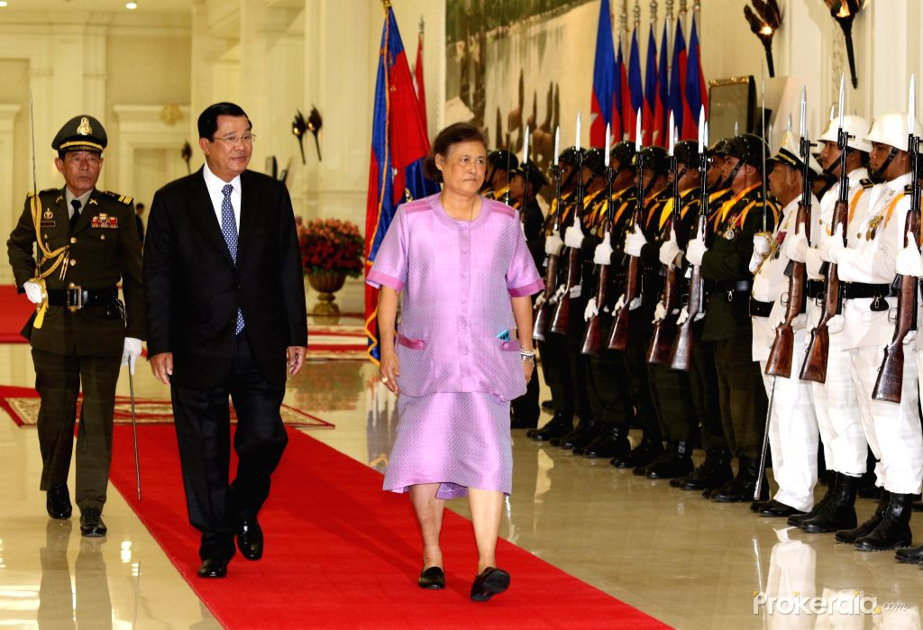

Slide 10
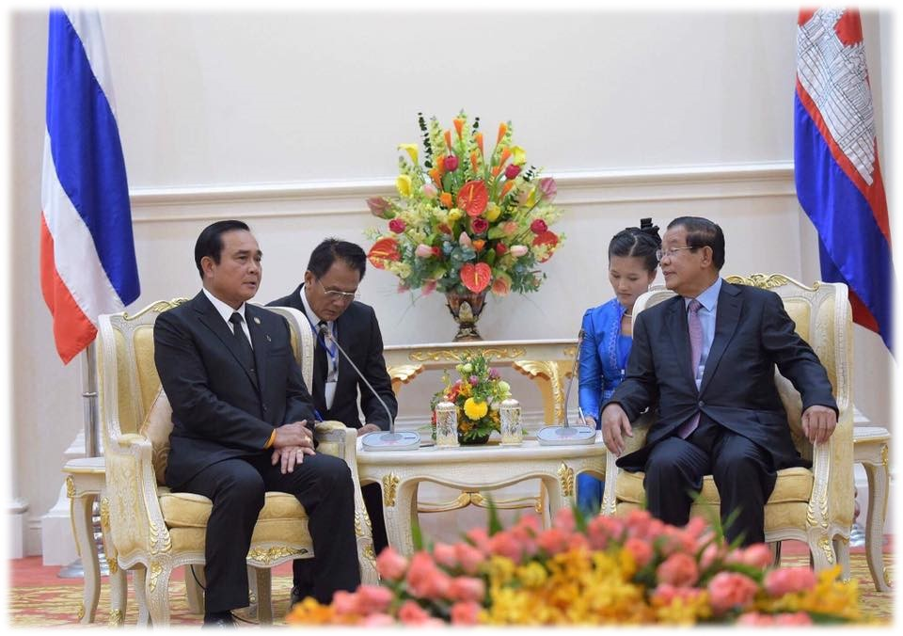
Royal Visits (Since 1992)
Visits of HRH Sirindhorn |  | 13
Visit of HRH Chulabhorn |  | 1
Top Leaders Visits stared since 1994
Thai | Prime Ministers | 20 | 7 PMs
 | Foreign Ministers | 19 | 8 FMs
Cambodia | Prime Ministers | 15 | 1 PM
 | Foreign Ministers | 6 | 3 FMs

Slide 11
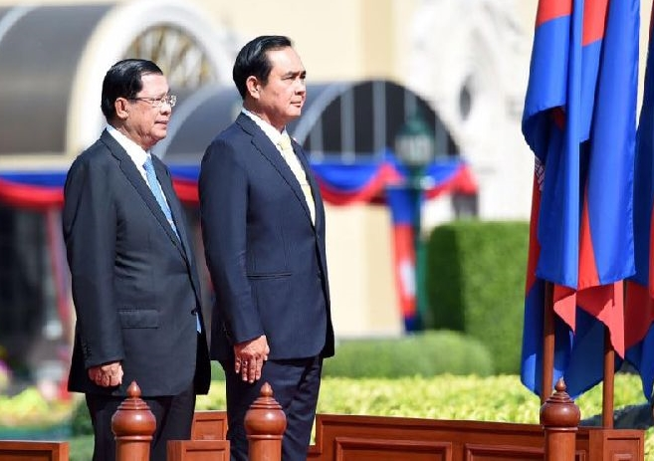
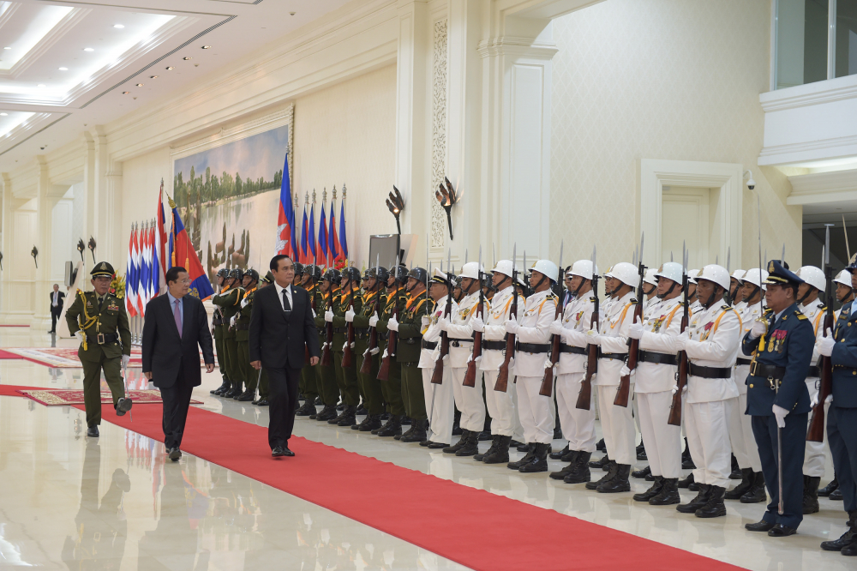
Prime Ministers official visit to both Countries

Slide 12
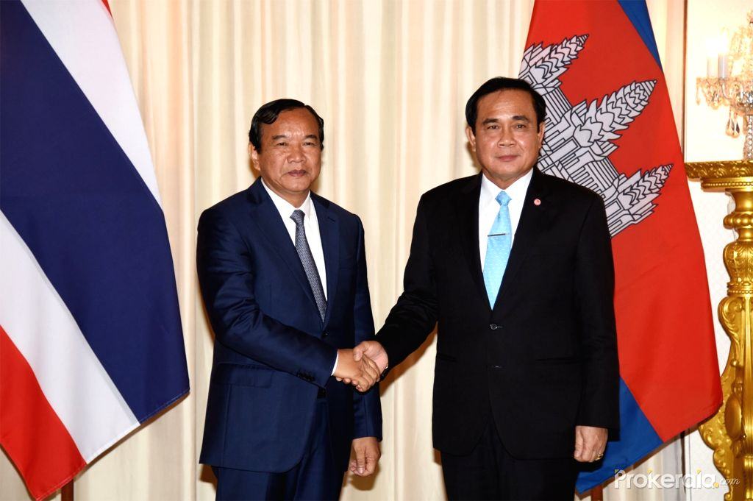
Prime Minister Prayut Chan-O-Cha and DPM FM Prak Sokhonn

Slide 13
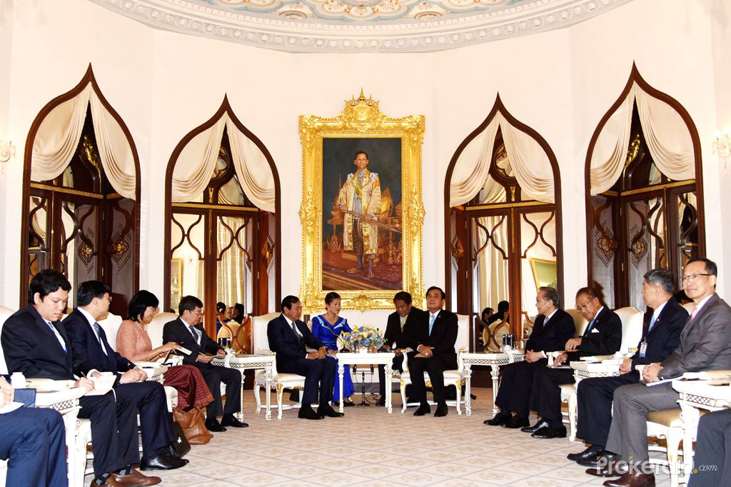
Prime Minister Prayut Chan-O-Cha and DPM FM Prak Sokhonn Official Visit to Thailand

Slide 14
Bilateral Mechanisms
Joint Commission on Bilateral Cooperation-JC: Bilateral cooperation in all fields such as economic, social, culture, education, tourism Etc.
First meeting in Phnom Penh in 1995 for 10 times
The next JC will be the 11st JC, in Cambodia after forming New Thai government
General Border Committee-GBC: the meeting between Minister of Defense of both countries: the 14th meeting was held on 15 February 2019 in Phnom Penh
The Governor of Cambodia-Thai Border Provinces meeting
Joint Cabinet Retreat (JCR)
Joint Border Commission Meeting (JBC)

Slide 15
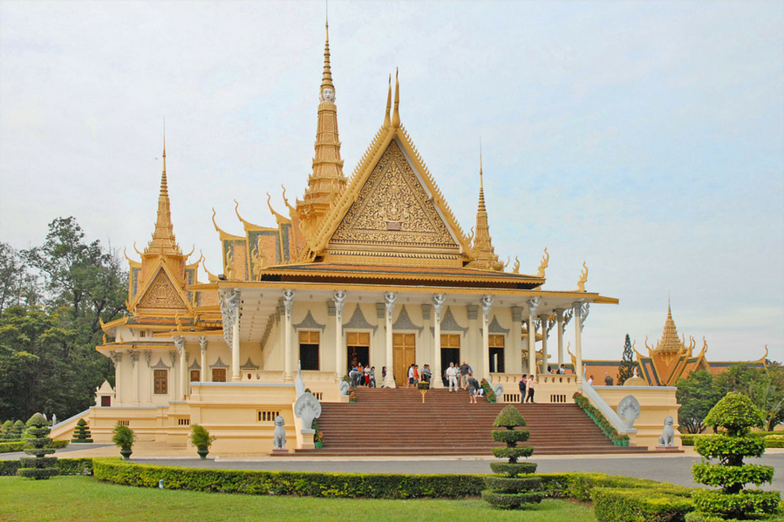
Thai Tourists visit Cambodia
2015 | 349,908
2016 | 398,081
2017 | 394,934
2018 | 382,317

Slide 16
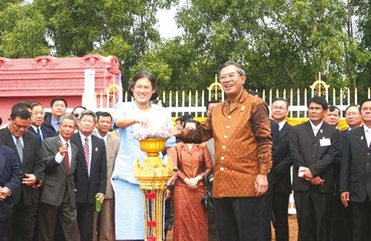
Education Cooperation
Since 2001: assistance in education
Renovated Kompong Chheuteal school in Kompong Thom province and then in 2015, this school has upgraded to Kampong Chheuteal Institute of Technology
In 2015: Kampong Speu Institute of Technology has constructed on 200 hectares’ land
Since 2005-2019: 2124 scholarships and 1,201 have graduated and 900 still studying in Thailand
Scholarship provided Thai government for either officials and students under TICA framework

Slide 17
Cooperation in Education at Border Provinces
Banteay Meanchey-Sakoew
Preah Vihear-Srisaket
Uddor Meanchey-Surin
Pailin-Chanthaburi
Pursat-Trat
Battambang-Chanthaburi
Koh Kong- Trat

Slide 18
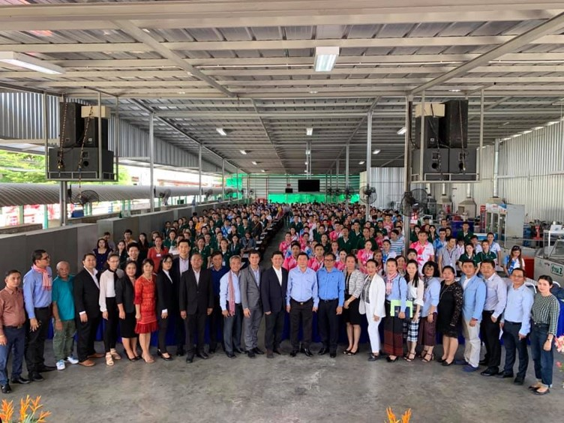
Labour Cooperation
Since 1970 till 1991, Cambodia had internal conflict which caused many Cambodian people escaped from country to live along Cambodia-Thai border
The large populations from Cambodia, started migration to Thailand during the 1990s to escape poverty and political conflict, which many young Cambodian workers are seeking to work in Thailand (IOM, 2010).

Slide 19
Country | Process | 2018 | 2019 (Feb)
Cambodia | NV | 112,359 | 95,334
 | MOU | 312,714 | 312,206
 | Seasonal/Daily | 33,827 | 32,825
 | Total | 458,900 | 440,365

Slide 20
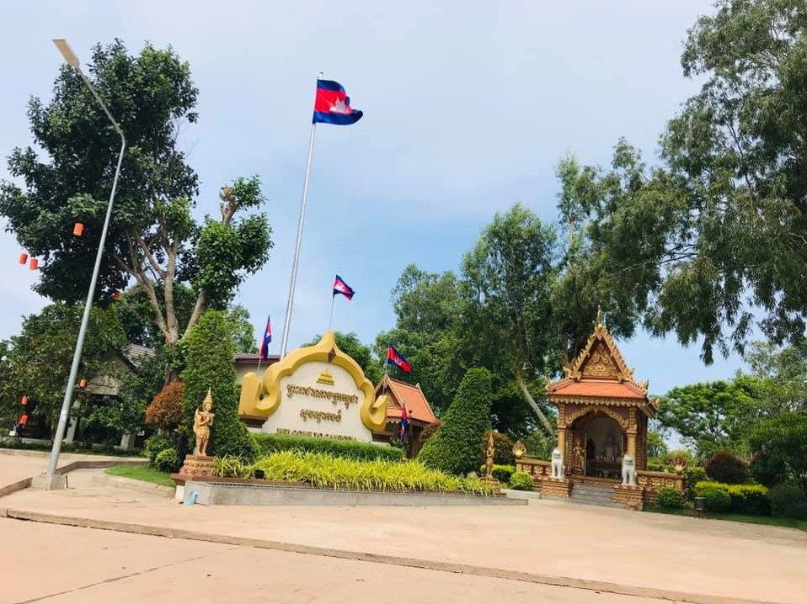
Checkpoints
International Border Checkpoints
07 (Cambodia) | 5 Provinces
07 (Thailand) | 6 Provinces
Bilateral Border Checkpoints
10 (Cambodia) | 4 Provinces
10 (Thailand) | 5 Provinces

Slide 21

International Checkpoints
1 | Chorm | Uddor Meanchey | Sa- Ngam | Srisaket
2 | O’Smach | Uddor Meanchey | Chong Chorm | Surin
3 | Poi Pet | Banteay Meanchey | Ban Klong Leuk | Sakoew
4 | Daung | Battambang | Ban Laem | Chanthaburi
5 | Prum | Pailin | Ban Pak Kad | Chanthaburi
6 | Cham Yeam | Koh Kong | Hat Lek | Trat
7 | Phnom Dey | Battambang | Ban Khaw Din | Sakoew

Slide 22
Bilateral Checkpoints
1 | Boeng Trokoun | Banteay Meanchey | Ban Tapaya | Sakoew
2 | Malai | Banteay Meanchey | Ban Nong Preu | Sakoew
3 | O- Romdoul | Battambang | Ban Saptaree | Chanthaburi
4 | O- Anlouk | Battambang | Ban Suan Som | Chanthaburi
5 | Svay Veng | Battambang | Ban Boon Chnang Lang | Chanthaburi
6 | Sen Chaw | Battambang | Ban Muen Dan | Trat
7 | Chork Rokar | Battambang | Ban MakMaung | Trat

Slide 23
Economy and Investment

Slide 24
Trade Volume of Cambodian world wide
Year | Exports | Imports | Trade Volume
2017 | 11,224 | 15,502 | 26,725
2018 | 12,768 | 17,606 | 30,374
2019 | 14,144 | 19,307 | 33,450
2020 | 15,532 | 21,179 | 36,710
2021 | 17,036 | 23,205 | 40,241
(Million USD)

Slide 25
Agreement on Investment Promotion and Protection
Signed with 29 countries
ASEAN: Laos PDR, Malaysia, Philippines, Singapore, Thailand, Vietnam

Slide 26
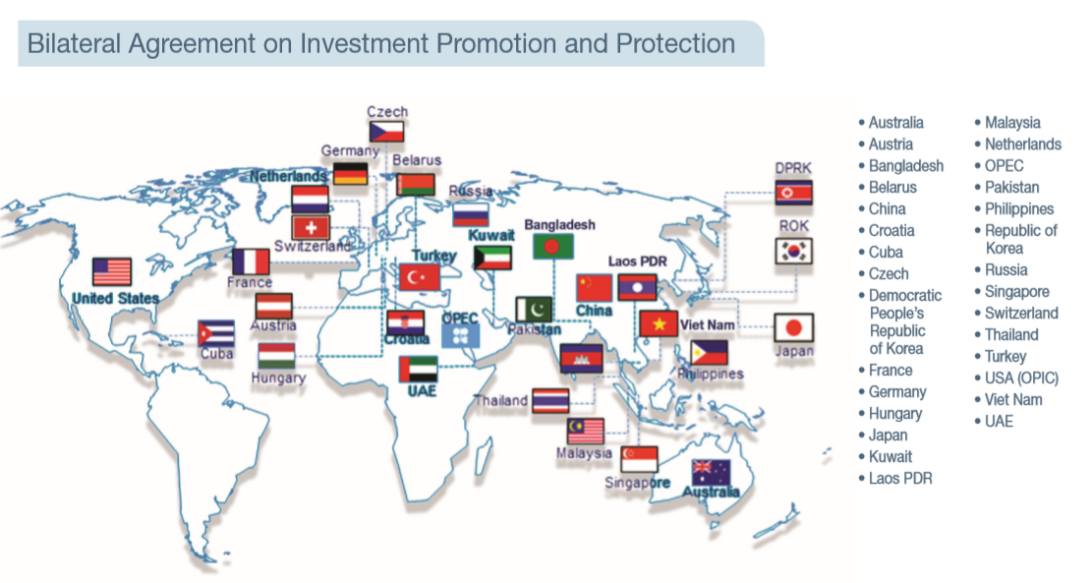

Slide 27
Bilateral Trade
Year | 2016 | 2017 | 2018 | 2019 (Jan-June)
Import | 4,672 | 5,270 | 7,621 | 1,039
Export | 937 | 895 | 767 | 208
Total | 5,609 | 6,188 | 8,388 | 1,247
(Million USD)

Slide 28
Thai Investment in Cambodia
2016 | 166 Million USD
2017 | 15.8 Million USD
2018 | 30.9 Million USD

Slide 29
 | Checkpoints | 2017 |  | 2018
 |  | Import | Export | Import | Export
1 | Poi Pet-Sakoew | 1,922.6 | 501.6 | 2,461.8 | 462.39
2 | Koh Kong-Trat | 941.1 | 137.6 | 1,023.6 | 158.73
3 | Pailin/Battambang-Chanthaburi | 374.4 | 39.7 | 355.19 | 42.91
4 | Uddor Meanchey-Surin | 28,17 | 68.98 | 108.02 | 63.48
5 | Uddor Meanchey-Srisaket | 15.9 | 11.44 | 19.66 | 7.24
6 | Preah Vihear-Ubonrachathani | 0.28 | 0.00 | 0.15 | 0.00
(Million USD)

Slide 30
SEZs: Special Economic Zone
Phnom Penh | 2
Kandal | 3
Svay Reang | 8
Kampot | 1
Preah Sihanouk | 2 | Thailand
Koh Kong | 1 | Thailand
Banteay Meanchey | 3 | Thailand
Kratie | 1

Slide 31
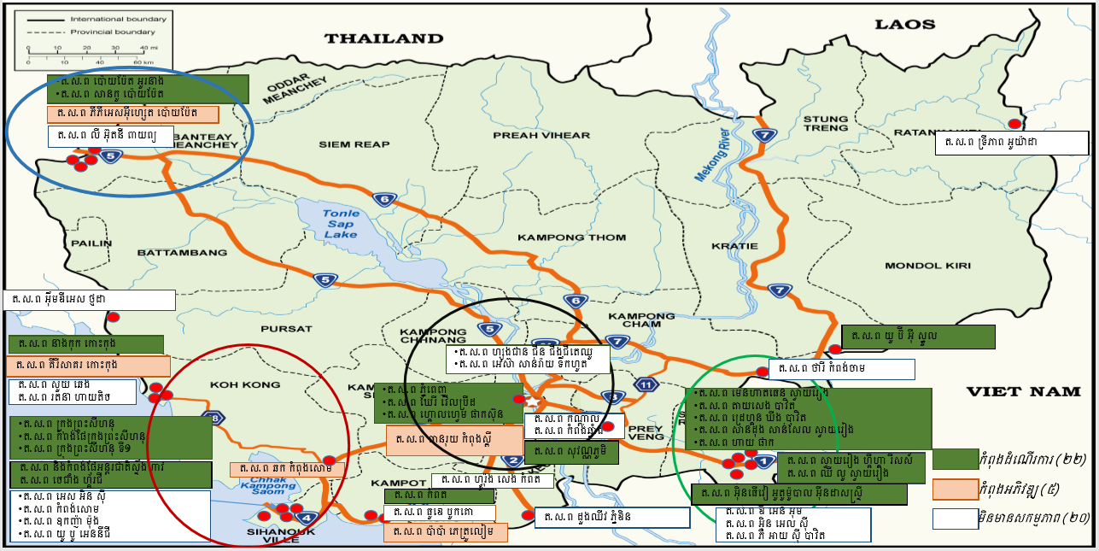
SEZs of Cambodia with Neighboring countries

Slide 32
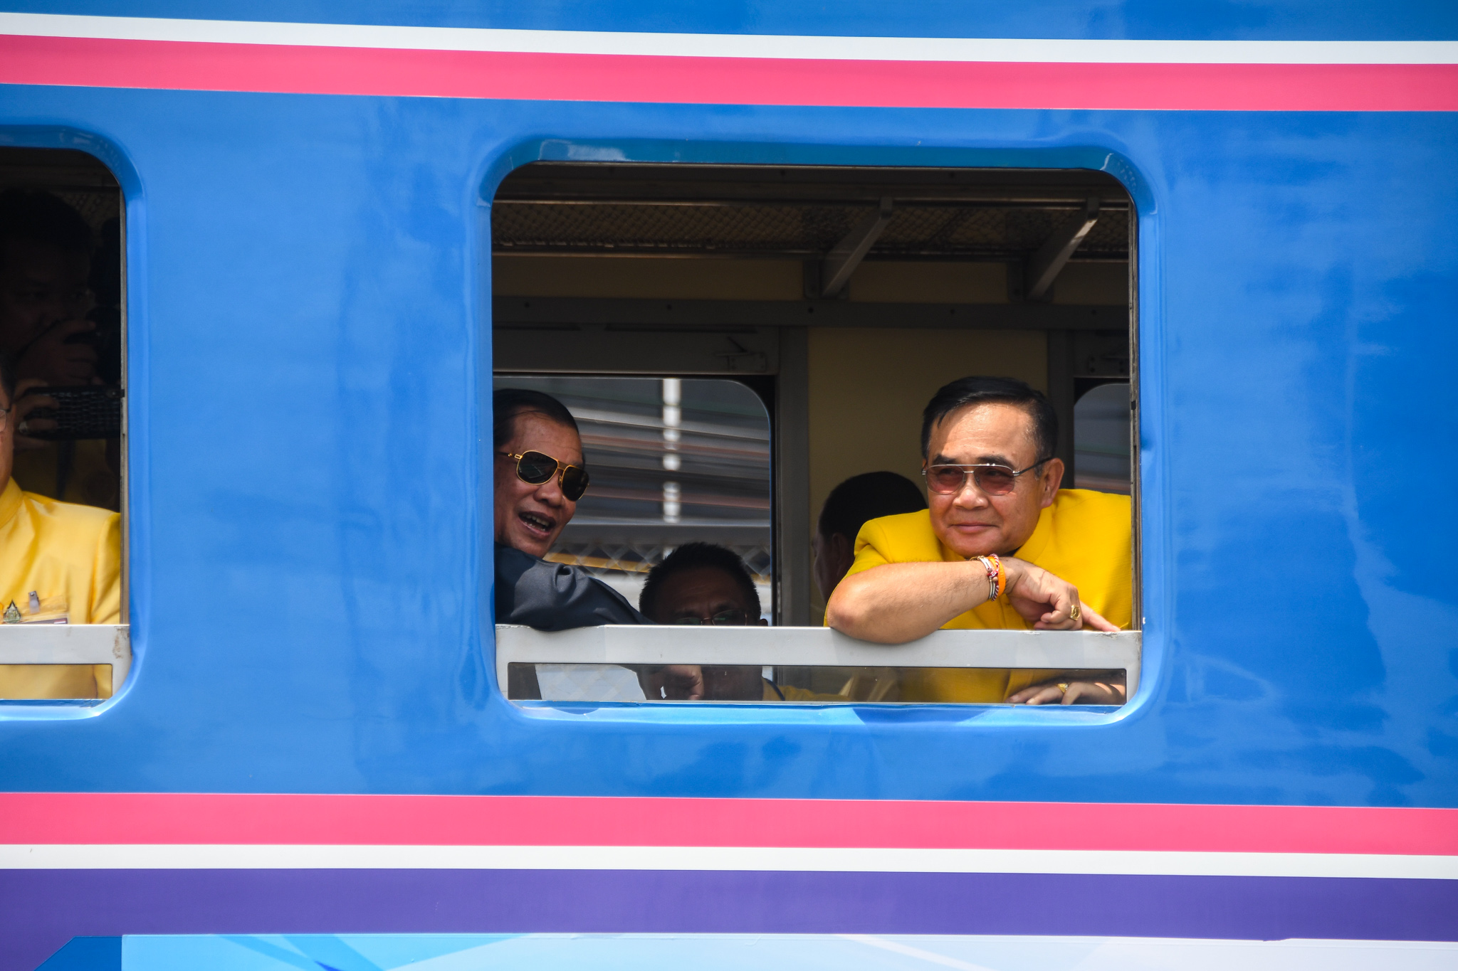
Connectivity
Inauguration first missing link train at Poi Pet and Aranyaprathet
Bridge in Stung Bot-Ban Nong Ian to connect border trade to push border trade volume

Slide 33
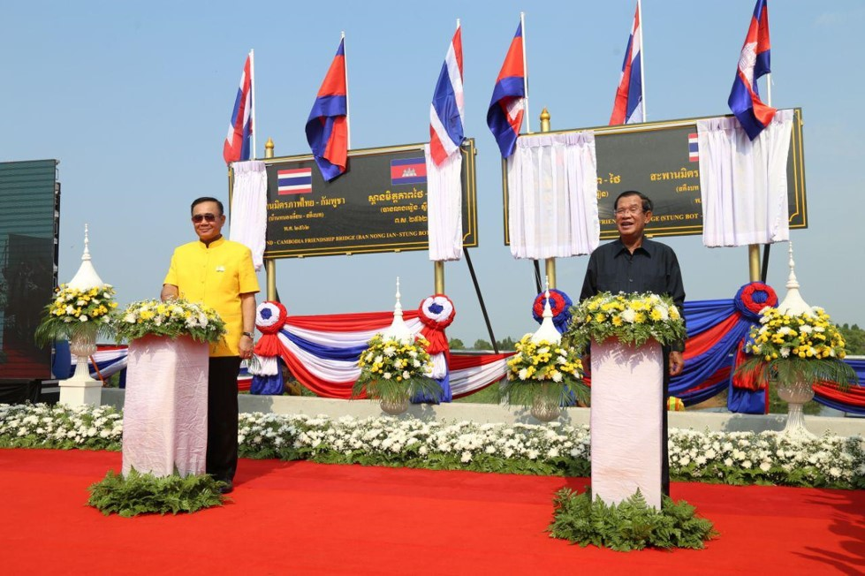

Slide 34

ASEAN
CLV / CLMV
ACMECS / CLMVT
ASEAN Summit on 22-23 June 2019: 10 Leaders from ASEAN Countries will come for the 34th ASEAN Summit and Related Meetings

Slide 35


Slide 36
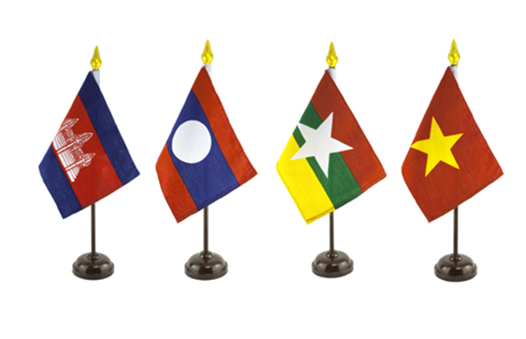
CLMV Mechanism
CLMV framework has set up for decrease the gap of development initiated by Lao PDR which have 4 members Cambodia, Lao PDR, Myanmar and Vietnam
9 Priorities: Investment and trade, Agriculture, Industry, Energy, Transportation, Information Technology and Telecommunication, Tourism and Human Resource Development

Slide 37
1st CLMV | Lao PDR | Chair: PM Lao PDR | 28 November 2004
2nd CLMV | Malaysia | Chair: PM Cambodia | 11 December 2005
3rd CLMV | Philippines | Chair: Myanmar | 12 January 2007
4th CLMV | Vietnam | Chair: PM Vietnam | 06 November 2008
5th CLMV | Cambodia | Chair: PM Cambodia | 16 November 2010
6th CLMV | Lao PDR | Chair: PM Lao PDR | 12 March 2013
7th CLMV | Myanmar | Chair: President Myanmar | 22-23 June 2015
8th CLMV | Vietnam | Chair: PM Vietnam | 26 October 2016
9th CLMV | Thailand | Chair: PM Cambodia | 14-16 June 2018

Slide 38
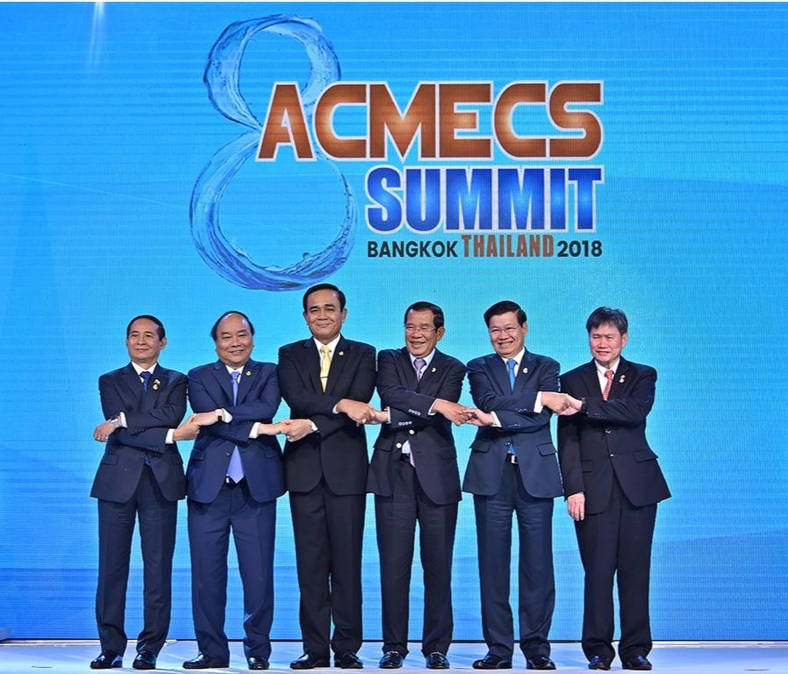

Slide 39
ACMECS
The Ayeyawedy-Chao Phraya-Mekong Economic Cooperation Strategy (ACMECS) was established by the four founding member countries namely Cambodia, Laos, Myanmar and Thailand, at their First Summit on 12th November 2003 in Bagan, the Union of Myanmar.
The objectives of ACMECS are to complement economic gap among the five countries and to further promote sustainable growth of this Sub-region.

Slide 40
8 priority areas
Transport Linkages (Laos is a chair)
Investment and Trade Facilitation (Thai is a chair)
Industrial and Energy sector (VN is a chair)
Agricultural sector (Myanmar is a chair)
Human Resource Development (VN is a chair)
Tourism Sector (Cambodia is a chair)
Public Heath(Thai is a chair)
Environmental Cooperation

Slide 41
1st ACMECS | Myanmar | 12 November 2003
2nd ACMECS | Thailand | 3 November 2005
3rd ACMECS | Vietnam | 7 November 2008
4th ACMECS | Cambodia | 17 November 2010
5th ACMECS | Lao PDR | 12-13 March 2013
6th ACMECS | Myanmar | 22-23 June 2015
7th ACMECS | Thailand | 24-26 October 2016
8th ACMECS | Thailand | 15-16 June 2018

Slide 42
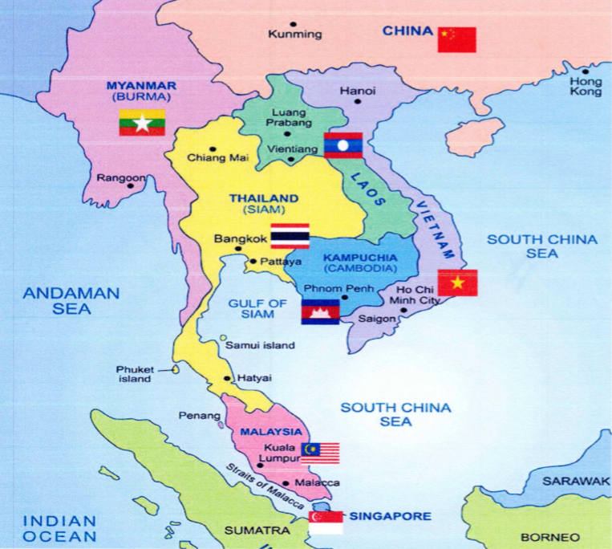

Slide 43

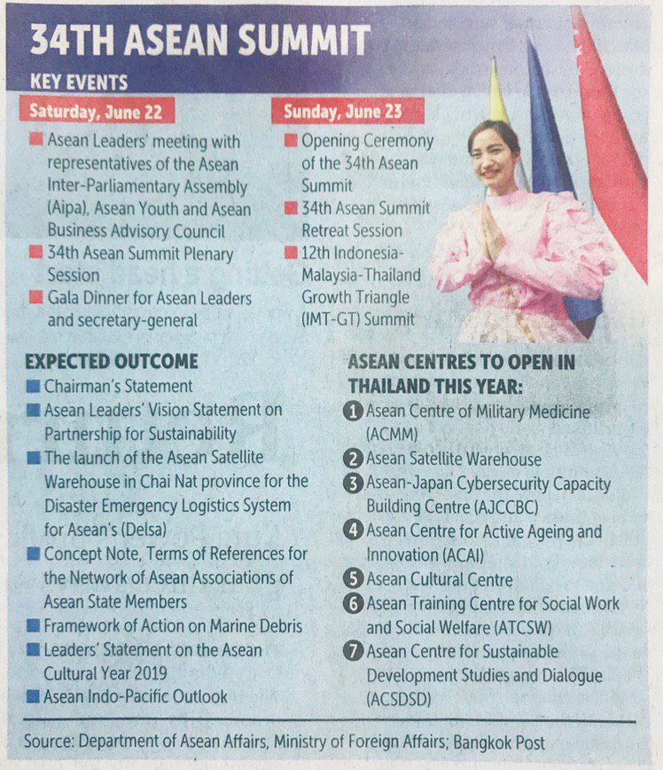
ASEAN Summit on 22-23 June 2019: 10 Leaders from ASEAN Countries will come for meeting
SOM and Ministerial Meeting since 20 June 2019 at Anthenee Hotel

Slide 44
THANK YOU!
😉

Slide 45
Q & A
😉

