Slide 1




Marketing Planning 312
Chapter 2
By Ajarn Suwalya K.

Slide 2
Chapter 2
Strategic Marketing Planning

Slide 3

Figure 1.1: The stages of building a
marketing plan

Slide 4
Chapter Outline
Introduction
The strategic planning process
The marketing plan
Maintaining customer focus and balance in strategic planning

Slide 5
Situation Analysis and Marketing Plan
Situation analysis
  In-depth analysis of firm’s internal and external environments
Marketing plan
  Written document providing the blueprint of a firm’s marketing activities
    Explains how the organization will achieve its goals and objectives

Slide 6
Situation Analysis and Marketing Plan (Continued)
    Serves as a road map for implementing marketing strategies
    Informs employees about their roles and functions
    Provides specifics regarding allocation of resources and marketing activities

Slide 7
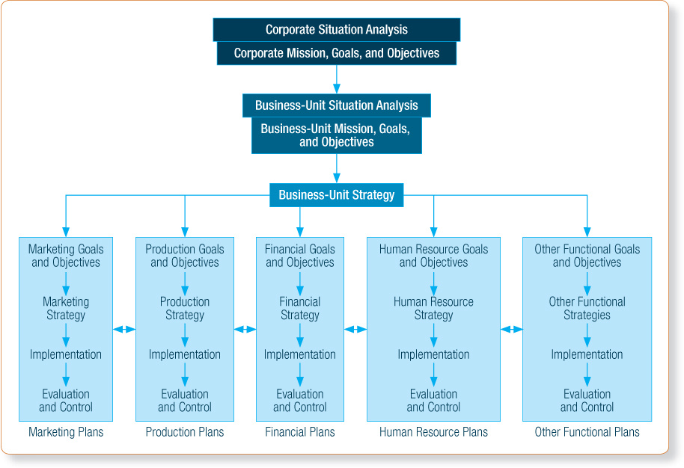
Exhibit 2.1 - The Strategic Planning Process

Slide 8

The mission and vision statement
The foundation of any marketing plan is the firm’s mission and vision statement, which answers the question, ‘What business are we in and where should we go?’

Slide 9
Strategic Planning Process: Organizational Mission versus Organizational Vision
Mission statement
  Clear and concise
  Explains the organization’s reason for existence
Vision statement
  Tends to be future-oriented
  Represents where the organization is headed and where it wants to go

Slide 10


Slide 11
Elements of the Mission Statement
Five basic questions to be answered
  Who are we?
  Who are our customers?
  What is our operating philosophy?
  What are our core competencies or competitive advantages?
  What are our responsibilities with respect to being a good steward of our human, financial, and environmental resources?

Slide 12
The Mission Statement
Mission width and stability
  Width
    Broad statements can help establish plans in areas with limited strength
    Narrow mission can limit a firm’s vision
  Stability of a statement depends on the frequency of modifications

Slide 13


Slide 14


Slide 15


Slide 16


Slide 17


Slide 18
The Mission Statement (Continued)
Customer-focused mission statements
  Benefit both non-profit and for-profit firms
  Examples
    Ben and Jerry’s 3-part mission statement
    Tylenol
    The American Red Cross

Slide 19
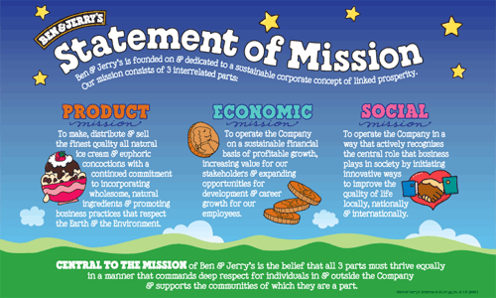
The Mission Statement (Continued)

Slide 20

The Mission Statement (Continued)
We believe our first responsibility is to the patients, doctors and nurses, to mothers and fathers and all others who use our products and services. In meeting their needs everything we do must be of high quality. We must constantly strive to provide value, reduce our costs and maintain reasonable prices.
Johnson & Johnson

Slide 21

The Mission Statement (Continued)

Slide 22

Strategic Planning Process: Corporate or Business-Unit Strategy
Is a central plan to:
  Utilize and integrate organization’s resources
  Carry out organization’s mission
  Achieve desired goals and objectives
Determines the nature and future direction of each business unit

Slide 23

Strategic Planning Process: Corporate or Business-Unit Strategy (Continued)
Leverages the firm’s capabilities that give it a competitive or differential advantage
  Firms should be capable of convincing customers of the superiority of their advantages

Slide 24

Strategic Planning Process: Functional Objectives
Requirements
  Expressed in clear, simple terms
  Written to enable accurate measurement of accomplishments
  Reconsidered for each planning period

Slide 25
Strategic Planning Process: Functional Strategy
Integrates efforts focused on achieving the area’s stated objectives
Requirements
  Fits the needs and purposes of the functional area
  Realistic with available resources and environment
  Consistent with organization’s mission, goals, and objectives
Should be evaluated to determine its effect on sales, costs, image, and profitability

Slide 26
Strategic Planning Process: Implementation
Involves activities that execute the functional area strategy
All functional plans have two target markets
  External market - Customers, investors, suppliers, and society
  Internal market - Employees, managers, and executives
Firms must rely on their internal market for a functional strategy to be implemented successfully

Slide 27


Slide 28
Strategic Planning Process: Evaluation and Control
Designed to keep planned activities on target with goals and objectives
Coordination among functional areas can be maintained with an open line of communication
Serve as an ending and a beginning
  Occurs after a strategy has been implemented
  Serves as the beginning point for planning in the next cycle

Slide 29


Slide 30
The Marketing Plan
Handbook for marketing implementation, evaluation, and control
Not the same as a business plan
Requires well-organized information from different sources
Qualities of a good marketing plan
  Comprehensive, flexible, consistent, and logical

Slide 31

The Marketing Plan

Slide 32
Structure of a Marketing Plan
Executive Summary
  Synopsis
  Major aspects of the marketing plan
Situation analysis
  Analysis of internal environment
  Analysis of customer environment
  Analysis of external environment

Slide 33

Structure of a Marketing Plan (Continued 1)
SWOT analysis
  Strengths
  Weaknesses
  Opportunities
  Threats
  Analysis of the SWOT matrix
  Developing competitive advantages
  Developing a strategic focus

Slide 34

Structure of a Marketing Plan (Continued 2)
Marketing goals and objectives
  Marketing goals
  Marketing objectives

Slide 35
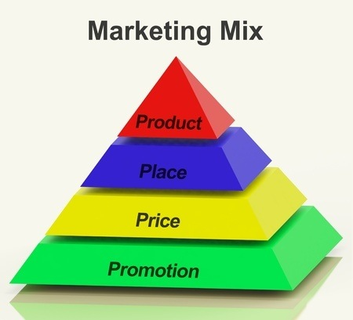
Structure of a Marketing Plan (Continued 3)
Marketing strategy
  Primary (and secondary) target market
  Overall branding strategy
  Product strategy
  Pricing strategy
  Distribution/supply chain strategy
  Integrated marketing communication (promotion) strategy

Slide 36

Structure of a Marketing Plan (Continued 4)
Marketing implementation
  Structural issues
  Tactical marketing activities

Slide 37

Structure of a Marketing Plan (Continued 5)
Marketing implementation
  Frontline employees are important assets in developing and implementing marketing strategy

Slide 38
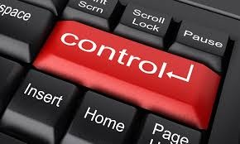
Structure of a Marketing Plan (Continued 6)
Evaluation and control
  Formal controls
  Informal controls
  Implementation schedule and timeline
  Marketing audits

Slide 39
Tips for Using the Marketing Plan Structure
Plan ahead
Revise, then revise again
Be creative
Use common sense and judgment
Be mindful of how the plan will be implemented
Update regularly
Communicate to others

Slide 40
Purposes and Significance of the Marketing Plan
Good marketing plans:
  Explain the present and future situations of the organization
  Specify expected outcomes
  Describe specific actions that should take place
  Identify required resources
  Permit monitoring of each action and its results
Communicating the strategy to top executives

Slide 41

Organizational Aspects of the Marketing Plan
Plans are often prepared by marketing managers, brand managers, or product managers
Authority to approve the plan is vested in the upper-level executives
Final approval of the plan lies with the President, Chairperson, or CEO

Slide 42
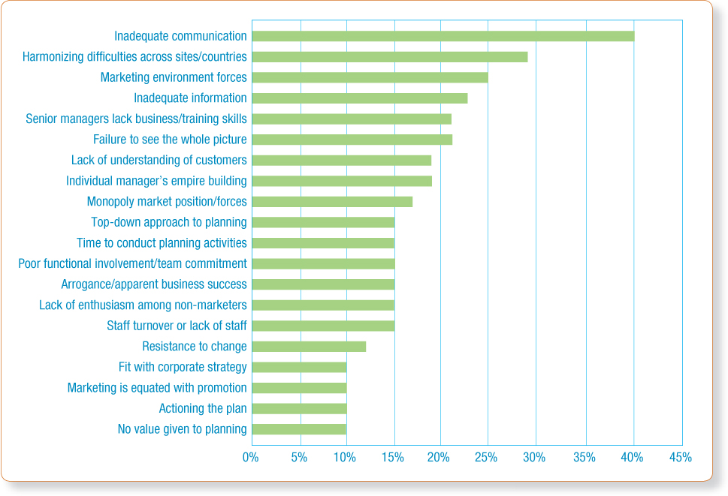
Exhibit 2.4 - Major Obstacles to Developing and Implementing Marketing Plans

Slide 43
Maintaining Customer Focus and Balance in Strategic Planning
Focus and content of strategic plans have changed over the last two decades
  Renewed emphasis on the customer
  Advent of balanced strategic planning
Changes require shift in focus from:
  Products to requirements of specific target market segments
  Customer transactions to customer relationships
  Competition to collaboration

Slide 44
RBV vs MOV
The Resource Based View (RBV) or Traditional Planning is an inside-out perspective
The Market Orientation View (MOV) or Customer - Focused Planning is an outside-in perspective as illustrated below

Slide 45

RBV vs. MOV
The Resource Based View (RBV) is an inside-out perspective
The Market Orientation View (MOV) is an outside-in perspective as illustrated below

Slide 46
Customer-Focused Planning
MOV
Prioritizes customer needs and wants
Focuses on long-term, value-added relationships
Market-oriented firms:
  Generate, disseminate, and respond to market information
  Focus on understanding customers in ways that enhance sustainable competitive advantage

Slide 47

Customer-Focused Planning (Continued)
  Instill a corporate culture that places customers at the top of the organizational hierarchy
  Focus on cooperative efforts that place market needs ahead of competitive interests

Slide 48
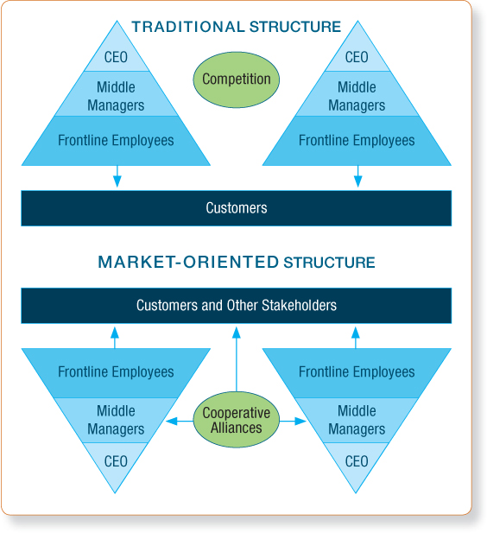
Exhibit 2.5 – Traditional (RBV) versus Market-Oriented Organizational Structures

Slide 49
Balanced Strategic Planning
Traditional planning (RBV) approaches fail to capture value created by firm’s intangible assets
  Assets include relationships, processes, human resources, innovation, and information
Kaplan & Norton created the balanced performance scorecard to counter this problem

Slide 50

Balanced Strategic Planning (Continued)
  Aligns four complementary perspectives
    Financial
    Customer
    Internal process
    Learning and growth

Slide 51
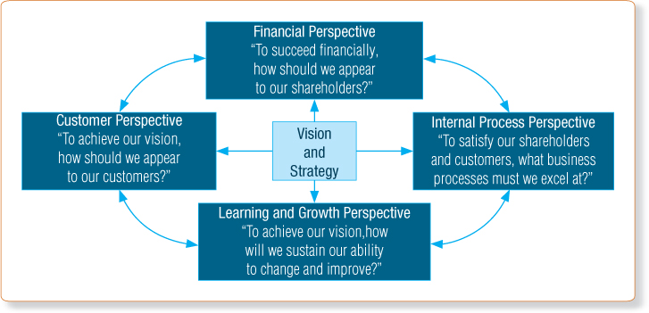
Exhibit 2.6 - The Balanced Performance Scorecard

Slide 52
How Successful Firms use Balanced Scorecards
Translate strategy into operational terms
Align the organization to strategy
Make strategy an everyday job for everyone
Make strategy a continual process
Mobilize change through executive leadership

Slide 53
RBV vs. MOV
The Resource Based View (RBV) is an inside-out perspective
The Market Orientation View (MOV) is an outside-in perspective as illustrated below

Slide 54
Figure 1.1: The stages of building a
marketing plan

Slide 55
Discussion Question 3
Individual Assignment –due next week
What are some of the potential difficulties in approaching strategic planning from a balanced perspective? Isn’t financial performance still the most important perspective to take in planning? Explain.
  Please note: no more than one A4 page, please feel free to include charts, graphs or illustrations

Slide 56
Group Homework #2- due next week
-Find the corporate mission for your focal company and one main competitor
- Prepare 2 ppt slides and vdo clips(if any)
- Print 4 slide b/w handouts for me
The foundation of any marketing plan is the firm’s mission and vision statement, which answers the question, ‘What business are we in and where should we go?’

Slide 57


