Slide 1

TRUSTEE and CUSTODIAN Services
Team Hybrid
Notes:
Good noon? Everyone we are team Hybrid my name is Chosita.
Before going any further let me introduce my colleagues start from my left hand side - Sakulrat, Pattamaporn, Nutnaree, Onmanee, Panatsaya
Today we will present to you about two important the financial institution services namely Trustee and Custodian

Slide 2

4 main parties involved in a fund
Investors
Fund Manager
Trustee
Custodian
Notes:
http://www.youtube.com/watch?v=U8363dfQkFU&feature=youtu.be
In general, a fund will involve many parties.
But here to give you big picture of how it works we select only the main ones.
First we have investors who have excess cash
Second we have fund manager who make investment decision
Then we have custodian to safeguard the assets including cash and securities certificate
and we have trustee which we will explain to you in a moment

Slide 3
TRUSTEE

Slide 4


Trustee ensures that investors’ interest is protected.
Definition
Oversee / Monitor
Performance of fund
Compliance
Approve
Fees paid to investment advisors
Ongoing supervision of compliance with the investment policies.
Ongoing checks on compliance with laws and regulations.
Independent calculations of purchase price and sales price.
Exceptions log administration
An independent person or firm that holds or administers property or assets for the benefit of a third party (e.g. Shareholders, Unit holders, Investors). A trustee may be appointed for a wide variety of purposes, such as in the case of bankruptcy, for a charity, a trust fund or for certain types of retirement plans or pensions.
Mutual Fund
Mortgage-Backed Securities
Bond
Trustee cannot be involved with day-to-day management
Notes:
So in general. Trustee is an independent party who oversees the management and operations of the fund on behalf of the fund’s shareholders.
Normally, they are financial institutions who have the qualifications as prescribed by the Office of the SEC.
One important note is that Trustee cannot be involved with day-to-day management or have no significant relation with the management company such as holding shares.
Next, we will show you three examples that has trustee in the process

Slide 5
Trustee ensures that investors’ interest is protected.
Duties
Ensure that the fund is managed in accordance with the objective specified in the prospectus
Ongoing checks on compliance with laws and regulations
Take legal actions on behalf of investors in case of frauds committed by asset management company
Track the value and number of units in circulation
Approve the fees paid to investment advisors
Notes:
First start with duties of trustee in mutual fund.

Slide 6
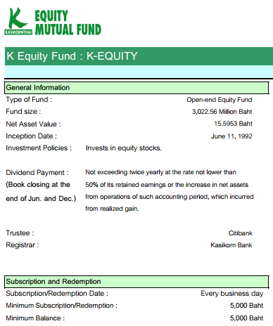
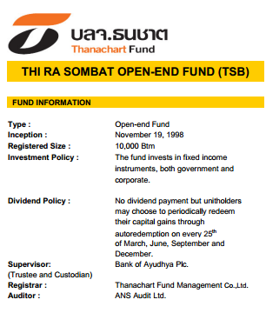
Real world example of trustee in Mutual Fund

Slide 7
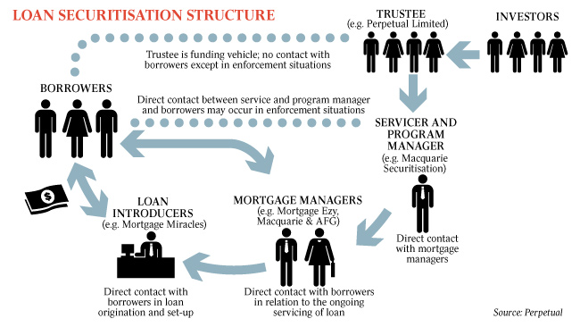
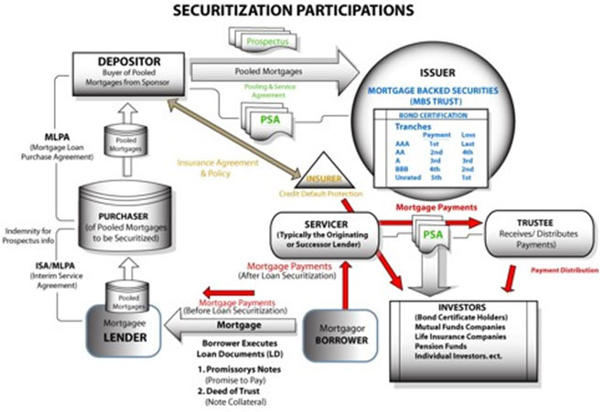
In Mortgage-Backed Securities, trustee acts as a representative of the investors.
Notes:
An independent party, responsible for administering the trust for the benefit of investors. The trustee is the owner of the mortgage solely for the benefit of the investors in the mortgage backed securities, who are the true beneficial owners of the mortgages. The Trustee holds a security interest in the mortgaged property by having the mortgage loans assigned in the name of the trustee for the benefit of the trust (e.g. U.S. Bank as Trustee for the MBS Trust) or in the name of MERS, a Mortgage Electronic Recording System used by many of the largest financial institutions. The duties of the trustee are administrative in nature, are clearly spelled out in the MBS transaction documents, and generally are non-discretionary in nature.
https://www.usbank.com/pdf/community/Role-of-Trustee-Sept2013.pdf

Slide 8
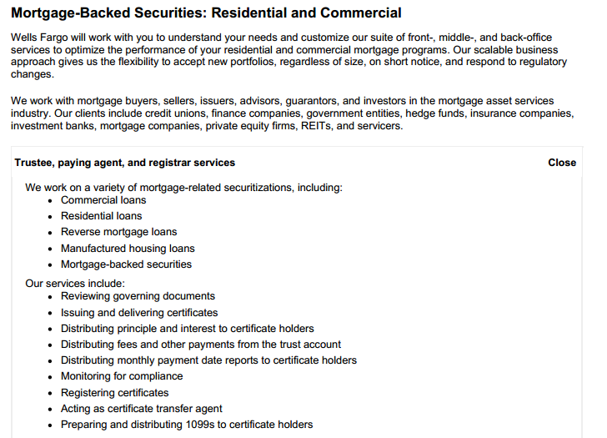

Real world example of trustee in Mortgage-Backed Securities

Slide 9
Trustee is responsible for administering the trust for the benefits of investors.
Do’s
Don'ts
Maintains investors/securities holder records
Collects payments from the Servicer
Distributes payments to the investors/ securities holder
Does not initiate, nor has any discretion or authority in the foreclosure process
Does not have responsibility for overseeing mortgage servicers
Does not manage or maintain properties in foreclosure
Is not responsible for the approval of any loan modifications
Notes:
https://www.usbank.com/pdf/community/Role-of-Trustee-Sept2013.pdf
http://1analysis.com/mortgage-securitization/

Slide 10
Fiduciary role of trustee in bond issues
Bondholders
Monitor issuer,
act as advocate
Purchase bonds
Bond repayment
Interest
Principle
Trustee
Registration,
Transfer
Issuer

Slide 11
Duties of trustee benefit both the issuer and the bondholder
Duties
On behalf of the bond issuer
On behalf of the bondholder
Register the issue with the appropriate regulatory agency
Collect payment from investors when they purchase the bond
Create the account information
Monitor the current status of the document which related to the bond
Ensure that the bond meets governmental requirements
Issue periodic statements to bondholders
Act as an advocate, if bond issuer does not follow the agreement

Slide 12
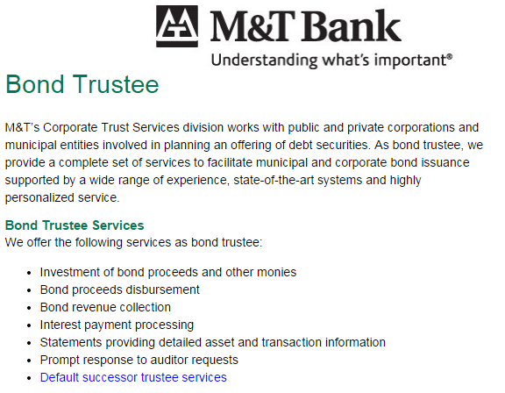
Real world example of trustee in Bond

Slide 13
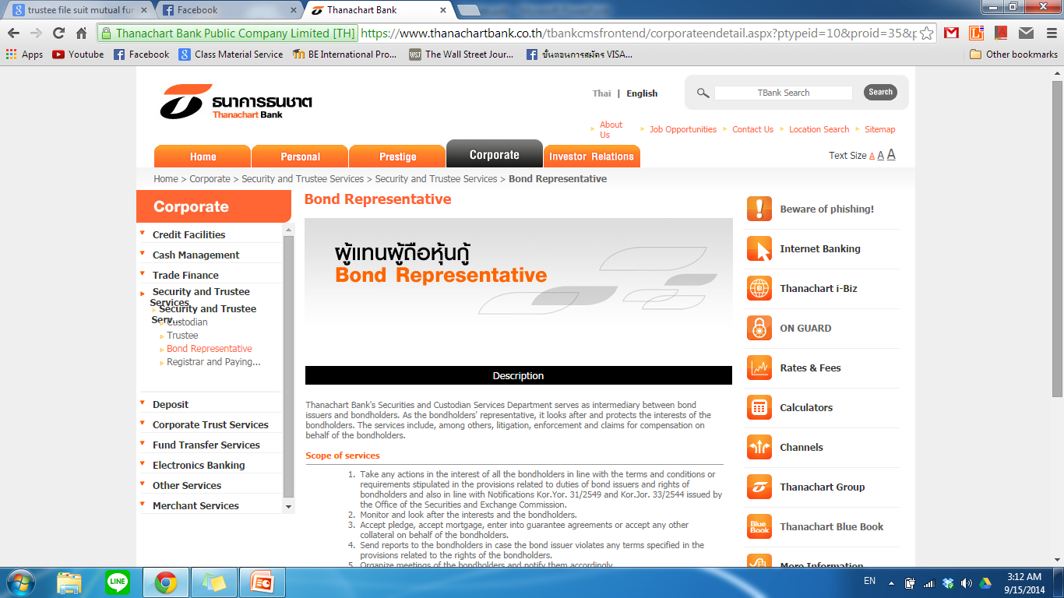
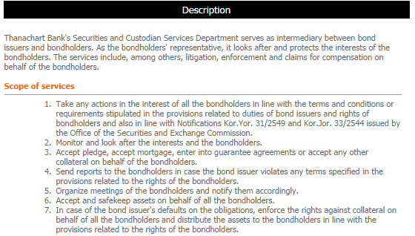
Real world example of trustee in Bond

Slide 14
CUSTODIAN

Slide 15
Custodian Services
Definition
A financial institution that holds customers' assets/securities for safekeeping so as to minimize the risk of their theft or loss.
Generally tends to be a large and reputable firm
Asset/Securities form:
  Electronic form
  Physical form

Slide 16
Custodian Services
Duties
Duties
Hold asset/securities for safekeeping (e.g. stock, bond, jewelry, etc.)
Collect dividends and interest payments
Settle purchases/sales and delivering in/out of such securities
Provide information on the securities and their issuers such as annual general meetings
Perform foreign exchange transactions

Slide 17
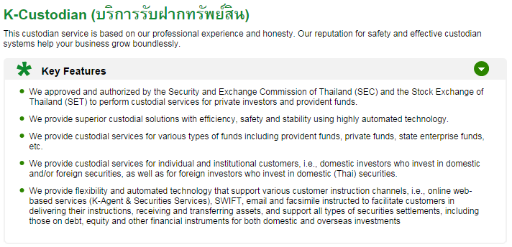
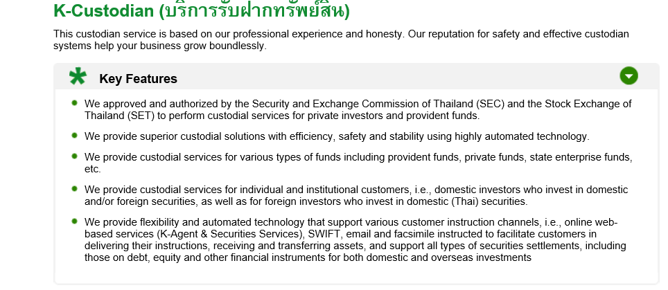
There are certain characteristics that any custodian must meet.

Slide 18
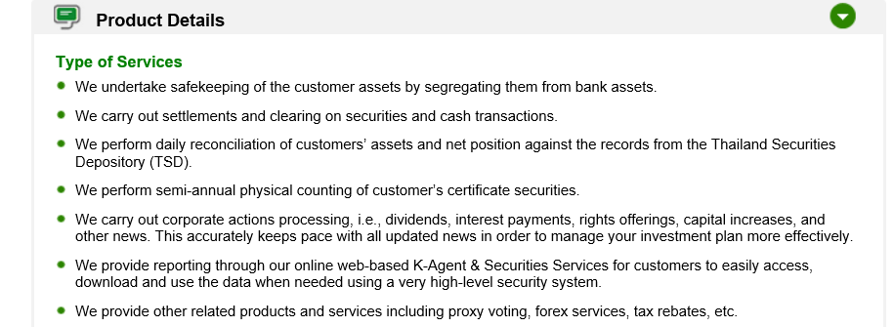
Custodian provides many types of services.

Slide 19
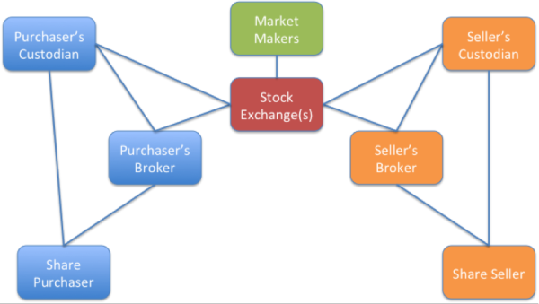

Custodians take care of the assets of share purchasers and share sellers.

Slide 20
Thank you
Q
A
&

Slide 21
Team members
5402640311 Chosita Ploychankul
5402640816 Onmanee Floro
5402640824 Panatsaya Kaewphap
5404640954 Sakulrat Bovornsantisuth
5404640731 Pattamaporn Rewprasong
5404640632 Natnaree Jurukul

