Slide 1
Introduction to economics

Slide 2
What is economics?
The study of how resources are allocated
Microeconomics:
  The study of how people make decisions, e.g. consumption by households and production by firms.
Macroeconomics:
  The study of how the economy as a whole works, e.g. roles of the government and macroeconomic objectives.

Slide 3
Basic economic problem
There are finite resources but infinite needs and wants.
In other words, there is SCARCITY.
Economics concern how people attempt to respond to scarcity.

Slide 4
10 principles of economics
Principle 1
People face trade-offs
“There is no such thing as a free lunch”
To get one thing that we like, we usually have to give up another thing that we also like.
e.g. trade-off between efficiency and equity

Slide 5
10 principles of economics
Principle 2
The cost of something is what you give up to get it
Opportunity cost: value of the next best alternative forgone.
e.g. what is your opportunity cost when you choose to come to this camp?

Slide 6

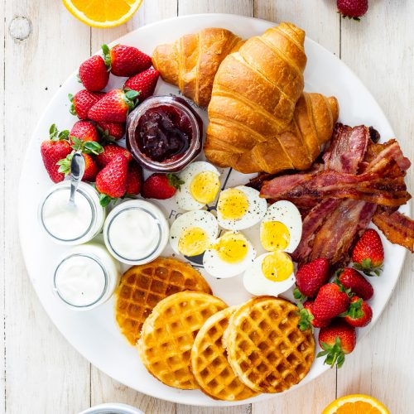


your opportunity cost?

Slide 7
10 principles of economics
Principle 3
Rational people think at the margin
“To think at the margin” is to look at the small increment adjustments to a plan of action.
A rational person takes an action if and only if the marginal benefit of the action exceeds the marginal cost.

Slide 8

Marginal Thinking
1st Glass YES!
2nd Glass NO!

Slide 9
10 principles of economics
Principle 4
People responds to incentives
People make decisions by comparing costs and benefits.
Their decision may change when the costs or benefits change.

Slide 10

Incentives

Slide 11
10 principles of economics
Principle 5
Trade can make everyone better off
People and countries are different in terms of what they are good at.
That is why people and countries specialize and trade.

Slide 12
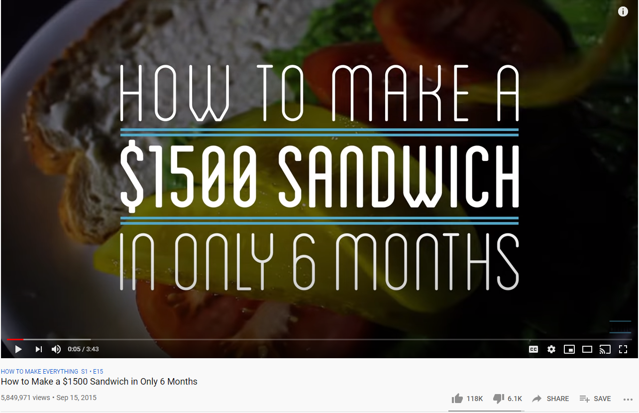
Specialization and trade
https://www.youtube.com/watch?v=URvWSsAgtJE

Slide 13
10 principles of economics
Principle 6
Markets are usually a good way to organize economic activity
Market economy: resources are allocated through decentralized decisions of many buyers and sellers, all of whom are primarily interested in their own well-being

Slide 14
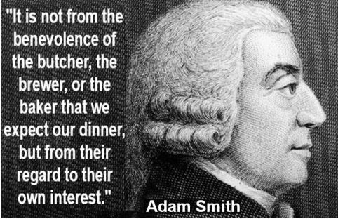
Invisible Hands

Slide 15
10 principles of economics
Principle 7
Governments can sometimes improve market outcomes
Market failure: a situation where a free market fails to achieve efficient allocation of resources.

Slide 16
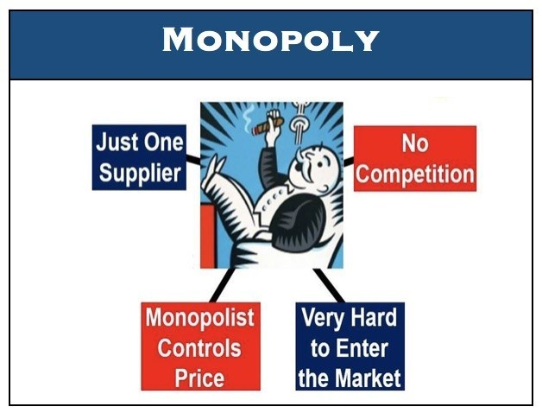
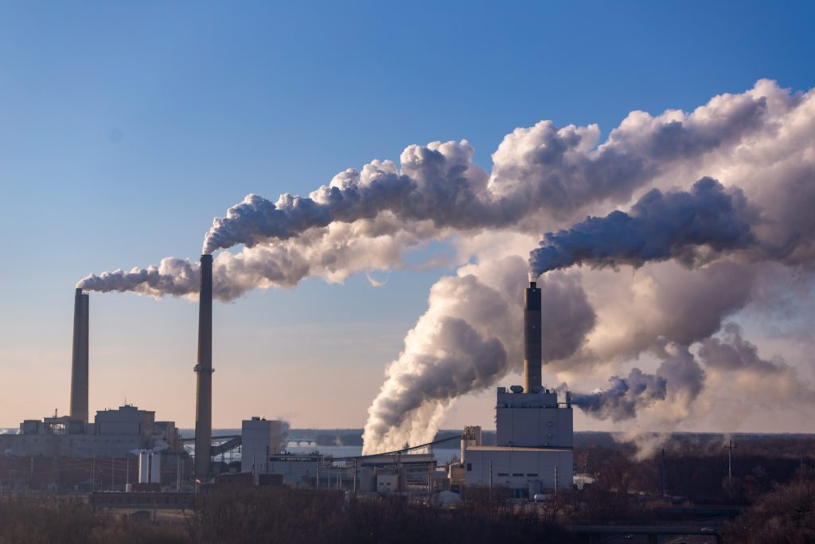
Sources of market failure

Slide 17
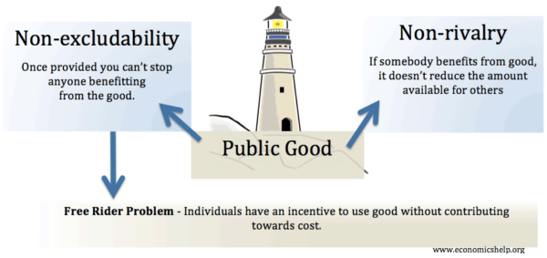
Sources of market failure

Slide 18
10 principles of economics
Principle 8
An economy’s standard of living depends on its ability to produce goods and services
GDP or Gross Domestic Product: market value of all goods and services produced within a country in a given period of time

Slide 19
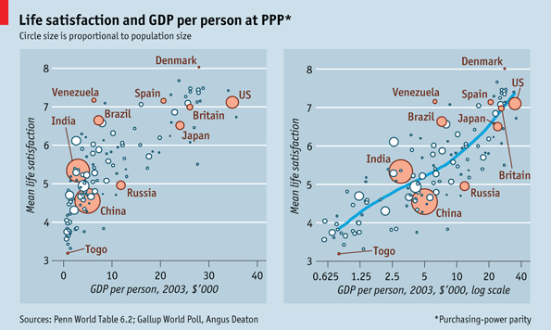
Output and Happiness

Slide 20
10 principles of economics
Principle 9
Prices rise when the government prints too much money
Inflation: an increase in the overall level of prices in the economy

Slide 21
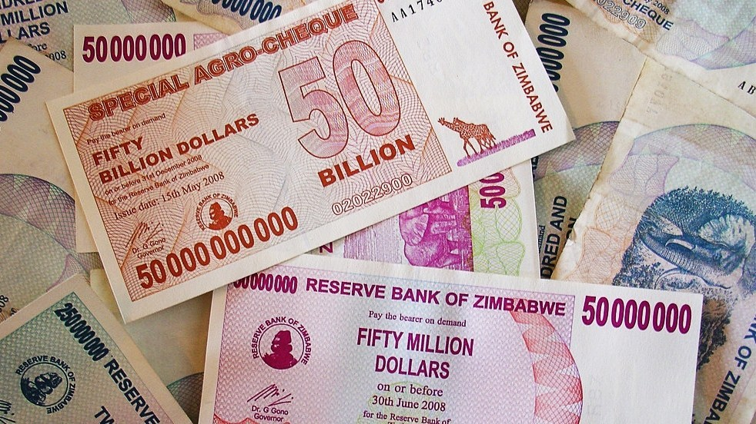
Money and Inflation

Slide 22
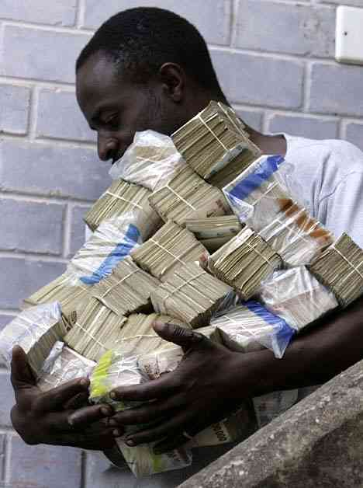
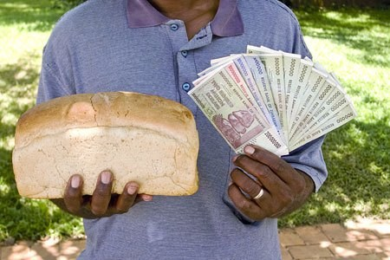
Money and Inflation

Slide 23
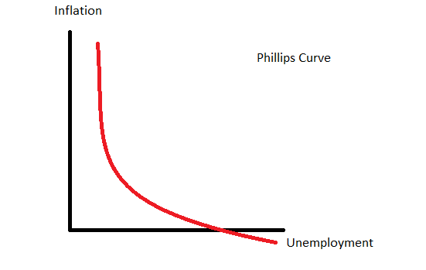
10 principles of economics
Principle 10
Society faces a short-run trade-off between inflation and unemployment

Slide 24
tips for studying econ
Definitions are important
Models can make things easier
Economists use a lot of assumptions

