Slide 1



Innovation Project Feasibility
Module 4.10
Market Sizing
May 23rd , 2016
Notes:
No need to add the course number or your name. Your name will be added on the VDO as soon as you start speaking on slide #2
Keep the 16:9 slide format
Each session (week) can be composed of multiple modules Module 1.0 (intro) Module 1.1, Module 1.2 etc ….
Try to avoid referencing to referential dates like “last week”, “last year”, “next month” but rather mention in June 2015, so the VDO content/VDOs doesn’t get outdated rapidly!
Do not refer to class event or class assignment during the main modules. Create a special module that refers to your current assignments or class events so the so the VDO content doesn’t get outdated rapidly!
Thank you for your help!

Slide 2


Slide 3
Why size the market
Are all sources of revenue considered?
How significant is the opportunity (will it “move the needle”)?
Is investment worthwhile?
Notes:
Sustaining innovator develops technologies that increase performance for new products faster than most customers can utilize, leaving most users underutilizing the performance
- Disruptive innovator develops a product that has a feature that meets an unmet need of the market, while delivering performance that is less than the sustainer
- The disrupter captures the low-end of the market from the sustainer, since the low-end can tolerate lower performance, and appreciates the feature that meets their unmet need
- The sustainer ignores the disrupter, since the disrupter has captured their least attractive customers
- However, if the distupter can improve their performance over time, they'll gradually capture more and more of the sustainer's market, all the while the sustainer persists on ignoring the disrupter

Slide 4
Two methods of market sizing
1. Bottom-Up: Estimate each component and sub-component of revenue
2. Top-Down: Evaluate size of comparable businesses, and make adjustments

Slide 5
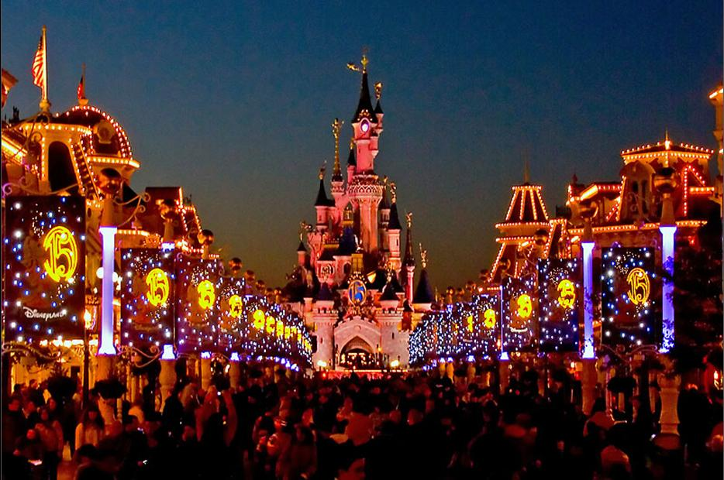


Slide 6
Bottom-Up
Admission
Hotel
Revenue
+
Food
Merchandise

Slide 7
Bottom-Up
Number of visitors
Admission
x
Price charged
Hotel
+
Food
Merchandise

Slide 8
Bottom-Up
Admission
Number of visitors
Hotel
f
% of visitors staying at Disney hotel
+
Food
Merchandise

Slide 9
Bottom-Up
Admission
Number of visitors
Hotel
Length of stay
f
% of visitors staying at Disney hotel
f
Travel time to competing hotels or residence
+
Food
Merchandise

Slide 10
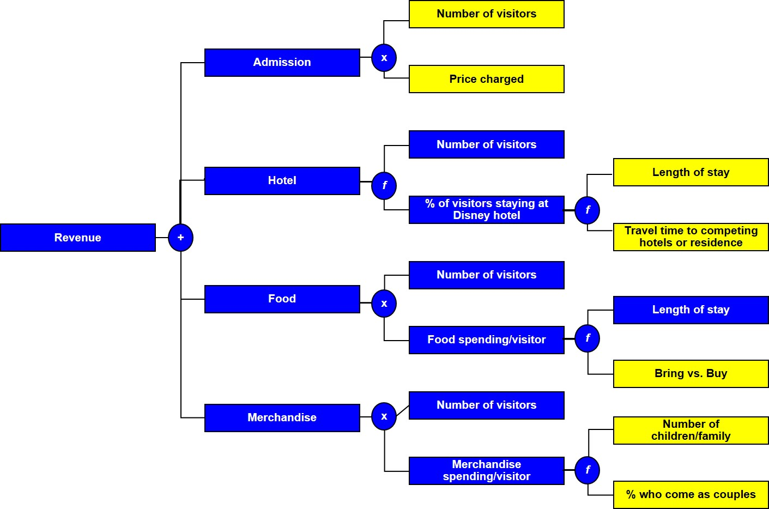
Bottom-Up

Slide 11
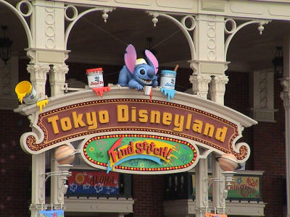

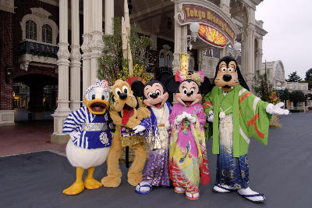
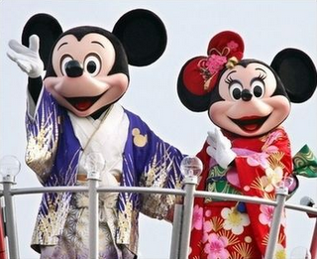
Top-Down
Calculate revenue at similar parks, and adjust for population, income, etc.

Slide 12
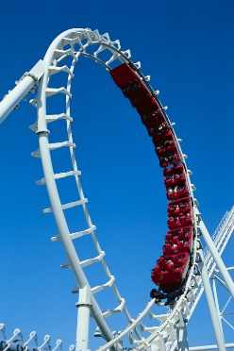
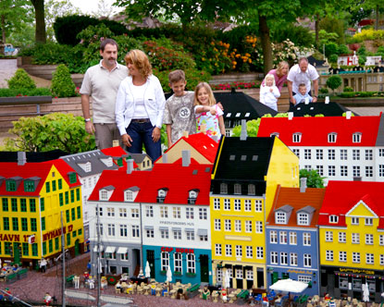
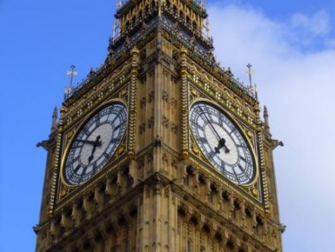
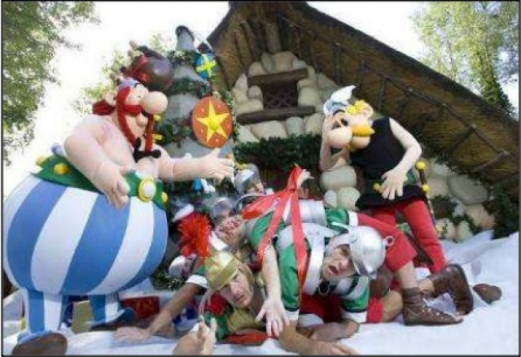
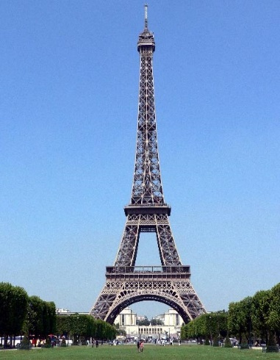
Top-Down
Estimate revenue at similar attractions, and adjust for appeal, admission fee, etc.

Slide 13
Practical questions
What are your major sources of revenue
What drives those sources of revenue?
What businesses have comparable revenue to your opportunity?

Slide 14



THANK YOU
Notes:
Closing slide

