Slide 1
Consequence of Breach
Breach imposed the cost on the innocent party since the expected benefit is not materialised.
One is better off; another is worse off.
However, it is not naturally a breaching party’s fault because the decision is rational (maximising own utility)
One’s benefit is earned at the other’s expense
Internalisation of other’s cost of breach – another role of contract law

Slide 2
4 Roles of Contract
Induce the efficient relocation of resource by ensuring the transfer of ownership (solving the problem of resource allocation) – efficient allocation of resource
Induce efficient use of resource without transfer of property rights or ownership by creating various types and forms of contract – efficient utilisation of resource

Slide 3
4 Roles of Contract
Induce the contracting parties to perform according to the contract by imposing the burden (compensation) on parties
Induce the efficient breach if there is a significant change in the circumstance by internalising the cost borne by innocent party to the breaching party

Slide 4
Concept of Efficient Breach
Breach is efficient if and only if it is ‘potentially’ Pareto improvement
Pareto improvement means ‘at least one better off AND no one worse off’
Clearly, breach of contract made innocent party worse off but breaching party better off
Potential of Pareto improvement implies the ‘better off’ must be sufficiently larger than ‘worse off’
Thus, potentially, the breaching party can compensate the innocent party; therefore, both are better off or at least the innocent is not worse off
Kaldor-Hicks Efficiency

Slide 5
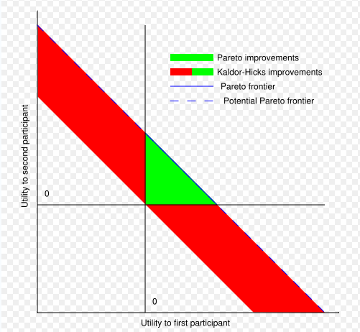

Slide 6
Compensation: To breach or not to breach…
Compensation is an instrument to internalise the cost of innocent party to the decision making process of the breaching party
Breaching party will decide to breach or not to breach by observing the benefit of breaching and the cost of compensation
Breach if
  Benefit of breaching > Benefit of performing
  Cost of performing > Cost of breaching
Perform if
  Benefit of breaching < Benefit of performing
  Cost of performing < Cost of breaching

Slide 7
What does the breaching party know..?
✓Benefit of performing
✓ Benefit of breaching
✓ Cost of performing
The only thing that the breaching party does not know is
  Cost of breaching
The task of contract law is to determine the cost of breaching

Slide 8
Determination of Compensation
Compensation is the cost of breaching imposed on the breaching party
Compensation that induce the efficient breach is optimal
Social perspective: breach should occur if
  Cost of performing (by a breaching party) > Benefit of performing (to an innocent party)
Private perspective:
  Cost of performing (by a breaching party) > Cost of breaching  breach by a breaching party

Slide 9
Determination of Compensation
Both will happen simultaneously if
Cost of breaching (by breaching party)
= Benefit of performing (to innocent party)
Thus, the compensation that contract law requires the breaching party to pay to the innocent party equal to the benefit earned by the innocent party if the breaching is not occurred.

Slide 10
What is the Benefit of Innocent Party?
Benefit that the innocent get if the contract had been performed (as if no breach has even occurred)
Should the law gives ‘immunity’ to the innocent always?
Breach of contract induces breaching party to find better alternative than existing contract. Even without compensation, it implies that the resource is always being allocated to the higher valuation
Dilemma of Efficiency: Allocative efficiency vs Distributive efficiency

Slide 11
Remedies/Compensation for Breach
Specific Performance
Perfect Expectation Damages
  Liquidated damages
Reliance Damages
  Negative damages
Opportunity Cost Damages

Slide 12
Perfect Expectation Damages
Restore the innocent to the status as if the breach had never occurred.
Full value of expectation the innocent would get if the contract has been performed.
The innocent is indifferent between
  Breach of contract and receive the compensation
  Performance
Breach is irrelevant for the innocent

Slide 13
Reliance Damages
Reliance
  Costs incurred to the innocent party by relying on the fact that the contract would be performed
  i.e., build the garage by believing that the seller would eventually sell the car; resign from the job by relying on the fact that she would marry a chap.
The innocent is indifferent between
  Original contract had never been formed
  Breach of contract

Slide 14
Opportunity Cost Damages
Engaging in a particular contract implies the contracting party losses an opportunity to be in other contracts.
Damage is the opportunity cost of the best alternative forgone
The innocent is indifferent between
  Engage in the next best contract (not the one actually engaged)
  Breach of contract

Slide 15
Example I
p₁
p₂
p₃
Agreed price p₁
The seller breached, the buyer has to buy from somewhere else at p₂
Perfect expectation damages: p₂ – p₁

Slide 16
Example II
p₁
p₂
p₃
Agree Price: p₂
The seller bought at wholesale price: p₁
The buyer breaches
Reliance damages: p₁

Slide 17
Example III
p₁
p₂
p₃
Agreed Price: p₁
There is an alternative seller sells at p₂
The seller breached, the buyer has to buy at p₃
Opportunity Cost Damages is p₃ – p₂

