Slide 1
Economics of Selected Asian Countries
EE 362
Introduction to East Asia and Tools.

Slide 2
Countries of Interest
Northeast Asia
  China(includes Hong Kong)
  Japan
  South Korea
  Taiwan
Southeast Asia
  Cambodia
  Indonesia
  Laos
  Malaysia
  Myanmar
  Philippines
  Singapore
  Thailand
  Vietnam

Slide 3
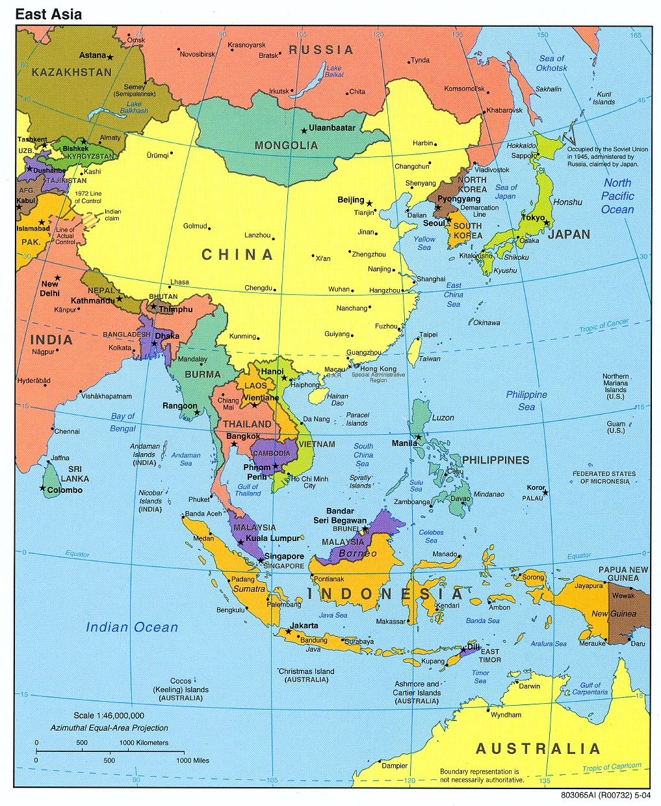
Map
Source: www.mappery.com

Slide 4
 | Per capita GNI ($ in 2004) | Population (million)
High income
Japan | 37050 | 128
Hong Kong | 26660 | 7
Singapore | 24760 | 4
Taiwan | 14707 | 23
South Korea | 14000 | 48
Lower-Middle- Upper Income
Malaysia | 4520 | 25
Thailand | 2490 | 64
China | 1500 | 1296
Philippines | 1170 | 82
Indonesia | 1140 | 218
Vietnam | 540 | 82
Laos | 390 | 6
Cambodia | 350 | 14
Myanmar | NA | 50

Slide 5
 | Per Capita GDP annual Growth($2000) | Political Regime
High income
Japan | 5.3 in 1960-1990 | Consolidated Democracy
Hong Kong | 5.2 in 1960-2005 | Special Admin region
Singapore | 5.6 in 1960-2005 | Authoritarian Democracy
Taiwan | NA | Consolidated Democracy
South Korea | 5.7 in 1960-2005 | Consolidated Democracy
Lower-Middle- Upper Income
Malaysia | 4.1 in 1970-2005 | Authoritarian Democracy
Thailand | 4.5 in 1970-005 | Formal ?????Democracy
China | 8.5 in 1980-2005 | Authoritarian
Philippines | 1.2 in 1970-2005 | Formal Democracy
Indonesia | 4.0 in 1970-2005 | Formal Democracy
Vietnam | 5.0 in 1985-2005 | Authoritarian
Laos | 3.2 in 1985-2005 | Authoritarian
Cambodia | 4.7 in 1993-2005 | Authoritarian Democracy
Myanmar | NA | Authoritarian

Slide 6
Why are they interesting?
Economic Development
  What should be the indicators for development?
Economic Growth
  GDP
  What should be the determinants of growth?

Slide 7
Why are they interesting?
Economic Policy
  Fiscal and Monetary
  Trade Policy
  Industrial, Innovations, and Technology Policy
Reflection on other countries’ economy

Slide 8
Tools
Neoclassical Economic Theory
  Growth Theory
    Exogenous Growth Theory(Solow Growth Model)
    Endogenous Growth Theory
    Maximize something subject to constraints
Political Economy
  Dynamic Interaction between State(politics) and Economy
  Institutions

Slide 9
Political Economy
Politics
  is fundamentally about participation, justice and _______ of resources, involving rights and duties.
Economy
  deals primarily about __________ creation and efficiency.
Institutions

Slide 10
Institutions
Rational Choice Approach
  Rules, procedures, norms, or conventions designed self-consciously to decide “ who has the power to do what and when”

Slide 11
Institutions
Historical Institutionalism
  Origin of Institutions and Path Dependence
  “The formal or informal procedures, routines, norms and conventions embedded in the organization structure of the polity in the Economy.”

Slide 12
Institutions
Sociological Approach
  Cultural practices
  Symbol
  Morality

Slide 13
Japanese System of Political Economy
What happened after WWII?
  Economics
  Politics
  Embedded Mercantilism or What?
What happened after 1991?
  Economics
  Politics
  Embedded Mercantilism or What?

Slide 14
South Korea
What is now for South Korea?
What happened after 1961?
What model?
What is consequences?

Slide 15
Taiwan and Singapore
Tales of two Islands
Similarities
Results

Slide 16
China
Why did China adopt economic reform in 1970s?
Why did it success?
Economic reform without political reform?

Slide 17
Southeast Asian NICs
Malaysia
  Compromise between ethnicity and growth
Thailand
  Good example of “Zippo or lighter theory”
Vietnam
  Open economy with socialist policy
Philippines
  One bad leader
Indonesia
  Islam and Democracy
  Chinese and Local

Slide 18
The last group: Rising Stars with a______?
Laos
Cambodia
Myanmar
North Korea

