Slide 1
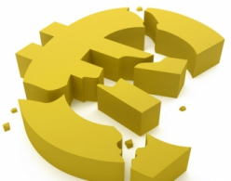
Greece and the Euro Crisis
Arsal Khanani 5704930030
Jonathan Green 5704930121
Vorachart Tangkijngamwong 5404641440
Nutt Mongkol 5404640640
Tanthai Sermsirimanont 5404641275
Surapat Klovuttisatien 5404641200

Slide 2
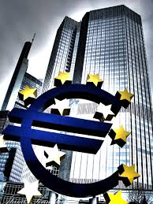
Table of Content
What is the Euro Crisis
Key Issues (Myth & Truth)
What have been done so far
Critique on Course of Action
What could have been done to revert the situation
Conclusion

Slide 3
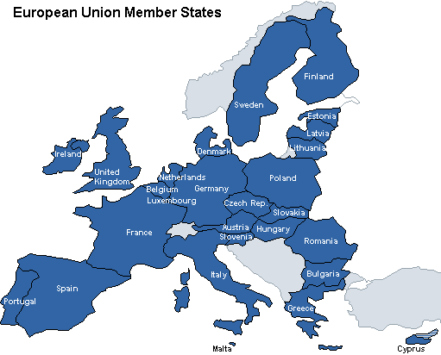
What is the Euro Crisis ?
A period of time where several European countries faced the collapse of their financial institutions, high government debt, and rapidly rising bond yield spreads in government securities

Slide 4
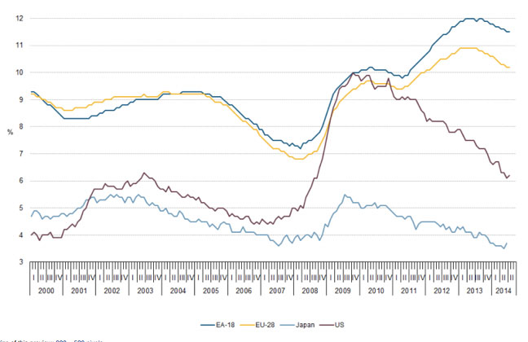
Unemployment Compared to the World Economies
Notes:
Eurozone jobless total is a little over 18 million which is the highest it has ever been since records began.
http://www.economicshelp.org/blog/1247/economics/european-unemployment-2/

Slide 5
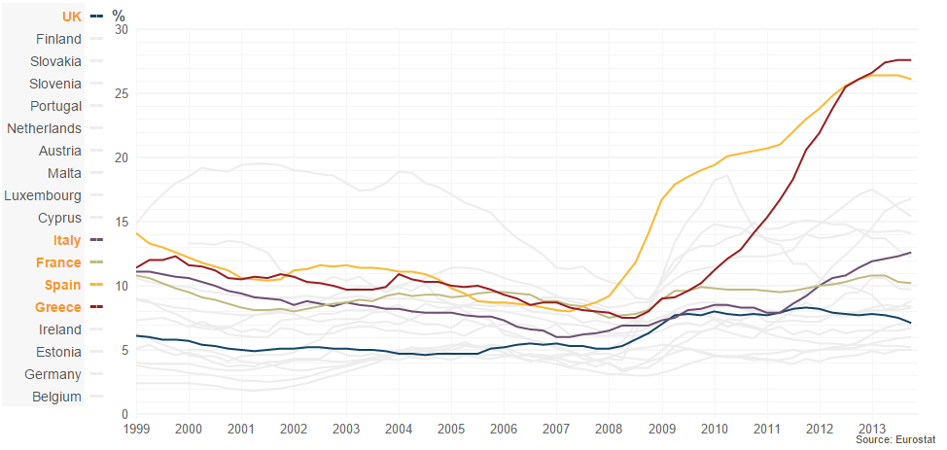
Unemployment in Europe
Notes:
The number of people living in poverty or social exclusion has been increasing. At 25% in 2012, it included one quarter of the population of the EU27. The currently available statistics suggest that this represented 124.4 million people, an increase of approximately 4 million in one year
http://www.caritas.eu/sites/default/files/caritascrisisreport_2014_en.pdf

Slide 6
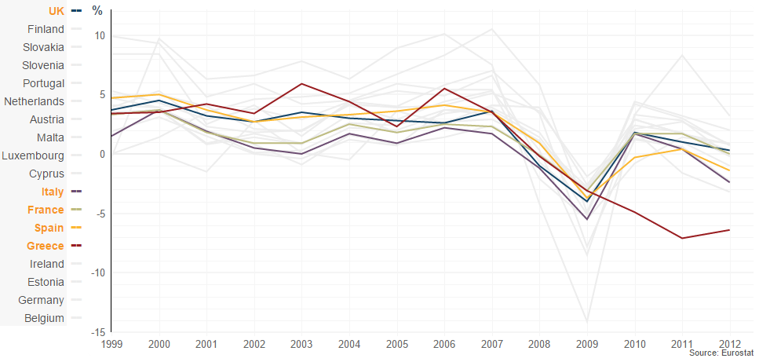
Annual GDP growth
Notes:
http://www.bbc.com/news/business-13361934

Slide 7
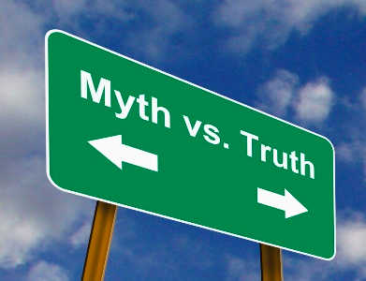
Key Issues

Slide 8
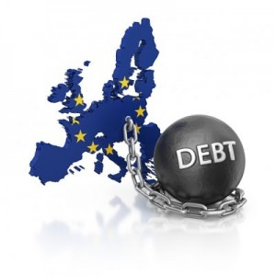

Fiscal Policy Myth
Nothing wrong with initial design of the Eurozone
Countries not respecting fiscal policy in the Stability and Growth Pact
This created the Sovereign Debt Crisis

Slide 9
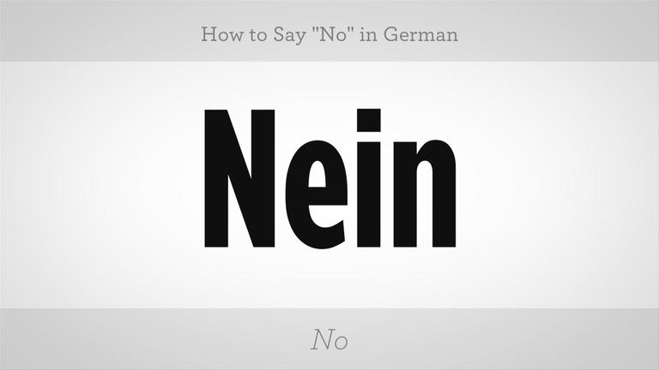
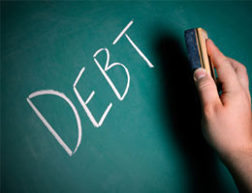
Fiscal Policy Myth
In 2003-2004 Germany/France did not respect the pact.
Spain and Ireland respected fully until 2007
No uniform increase in overall government debt during the first years of the common currency in the countries that are now unders sovereign stress.

Slide 10
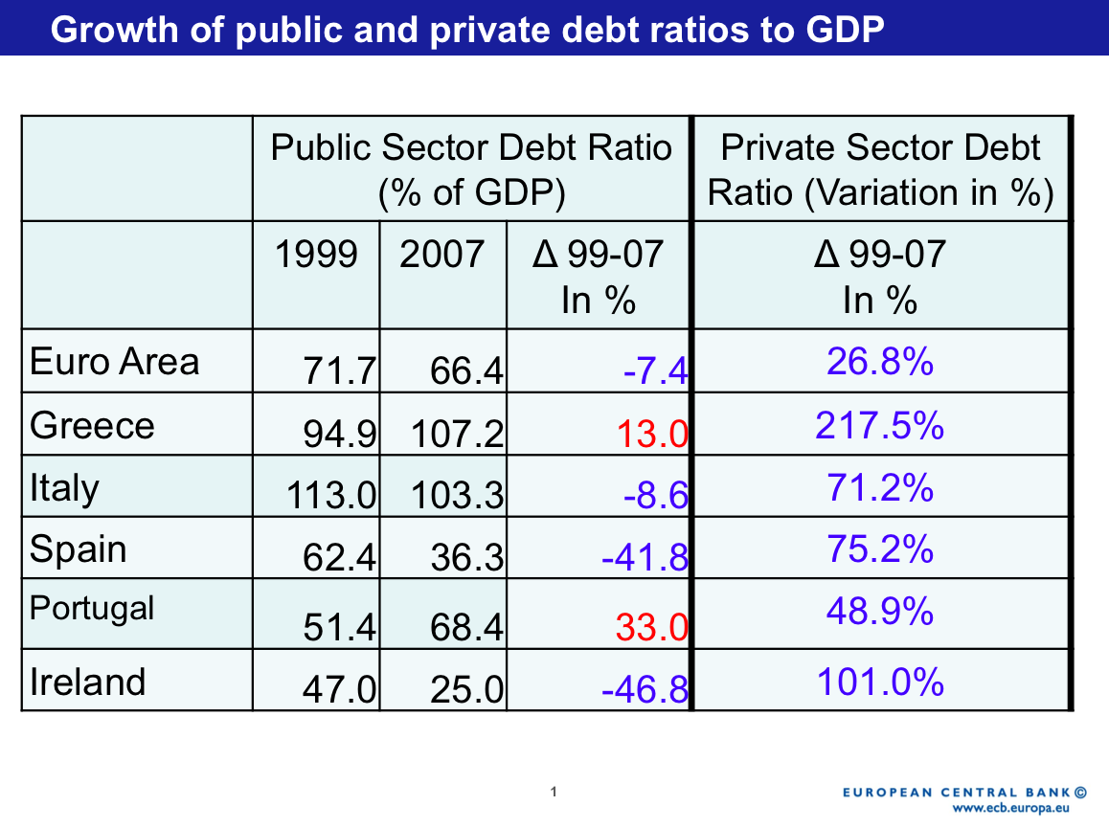
Private Debt
Private sector expenditures, which were in turn financed by banking sectors of lending countries

Slide 11
What is Real ?

Slide 12

Real Cause of the Euro Crisis
Liquidity Crisis (Tip of the iceberg)
  Failure of mortgages
  Complex derivatives (CDO)
  Uncertainty froze the market

Slide 13
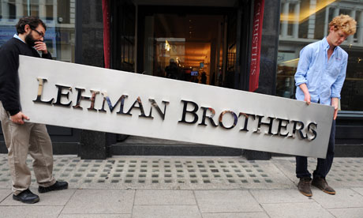

Real Cause of the Euro Crisis
Collapse of Lehman Brothers 2008
  abrupt repricing of risks globally
  intensified financial crisis
European Banks intertwined with US banks
European banks intertwined within Eurozone
  non-stress testing banks

Slide 14
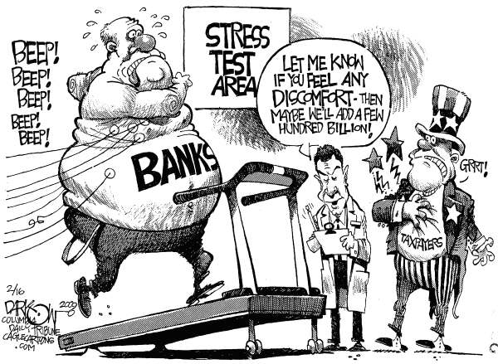
Stress Testing
Stress Test: A simulation technique used on asset and liability portfolios to determine their reactions to different financial situations.
Market Risk: The possibility for an investor to
experience losses due to factors that affect the overall
performance of the financial markets.
Default/Credit Risk: The risk of loss of principal
or loss of a financial reward stemming from a borrower's
failure to repay a loan or otherwise meet a contractual
obligation.
Notes:
Certain banks were stress testing while others were not but since the European Union was connected so intricately. The lack of preparation from different banks affected those that were prepared.
European banks intertwined with non-stress testing banks in EU

Slide 15
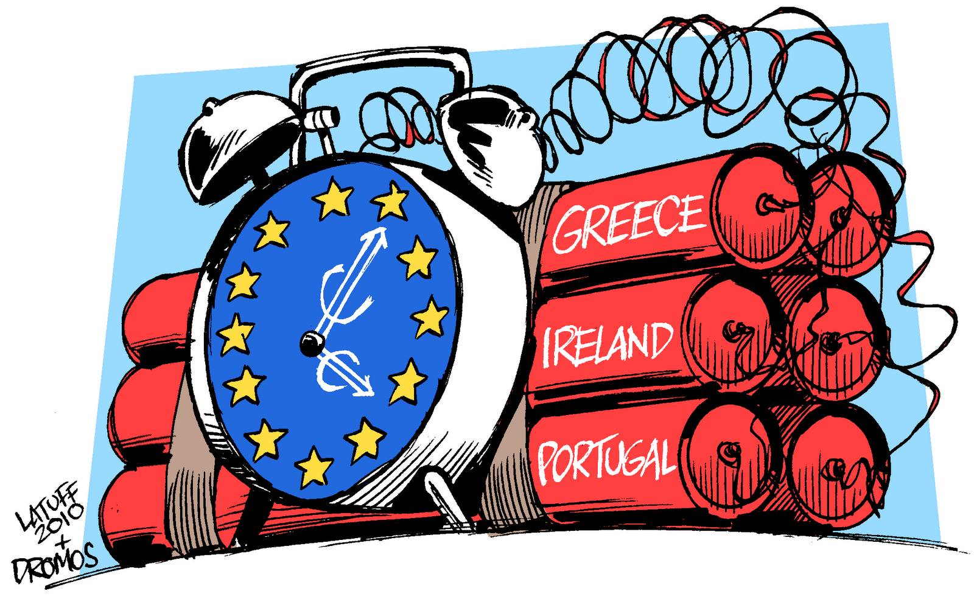
Real Cause of Euro Crisis
Sovereign Debt Crisis
Adverse Feedback loop
  Bank liquidity strains force sovereign to bailout banks
  Increased sovereign debt
  Value of sovereign debt decreases
  Banks creditworthiness depends on sovereign debt
Notes:
Important take away: This is a loop between Sovereign and Banks. Where bad condition of the banks hurts the economy, need to be bailed out, bail out stops government from investing in the economy, can’t borrow money from the banks

Slide 16
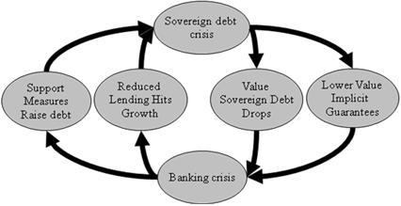
Adverse Feedback Loop

Slide 17
Greece in the Euro Crisis

Slide 18
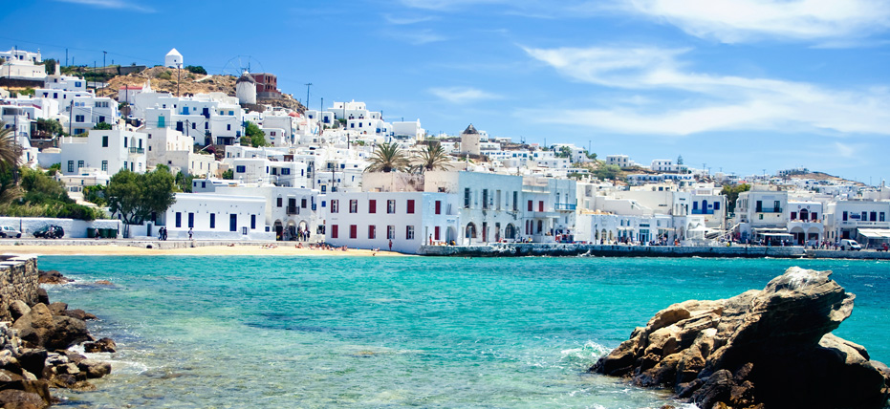
Eurozone Crisis effect on Europe
Example of Greece
Notes:
As from previous slide, you can see that The Euro zone problem is very large and affect many parties. However, most of news and analysis from time to time seem to greatly focus on what happened in Greece as the got severely affected than the other because their economic is relatively vulnerable than the other.

Slide 19
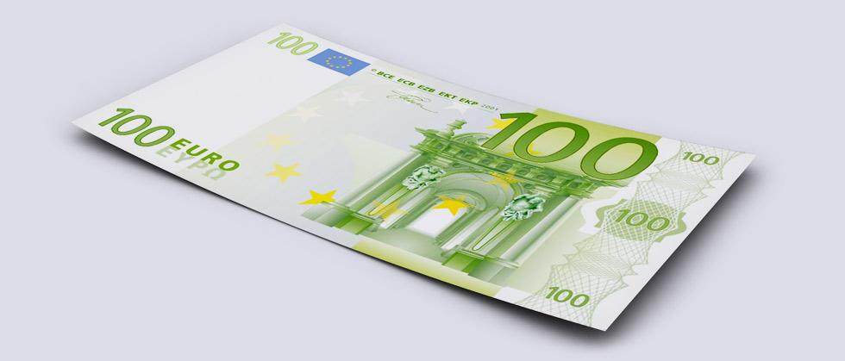
€100

Slide 20
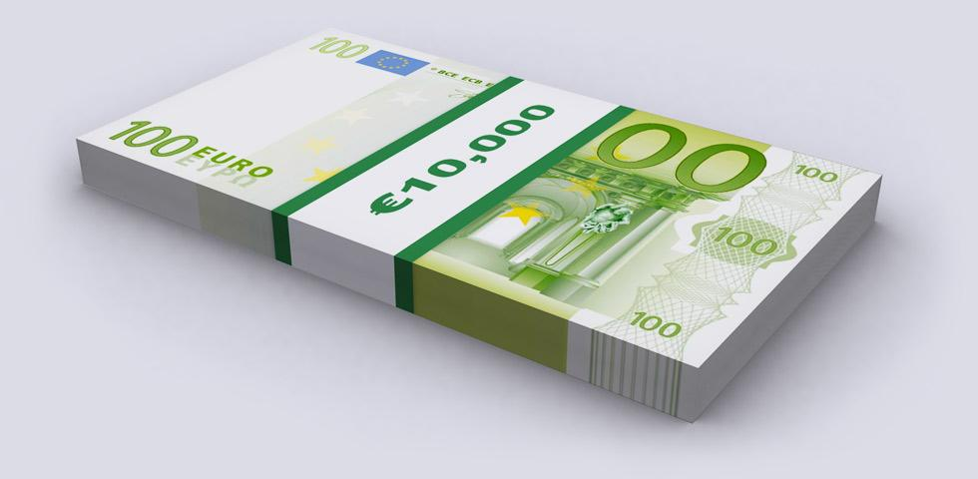
€10,000

Slide 21
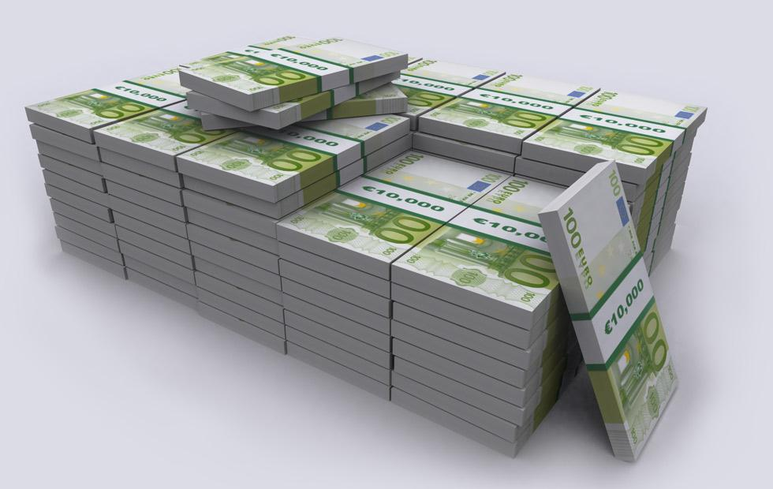
€1 Million

Slide 22
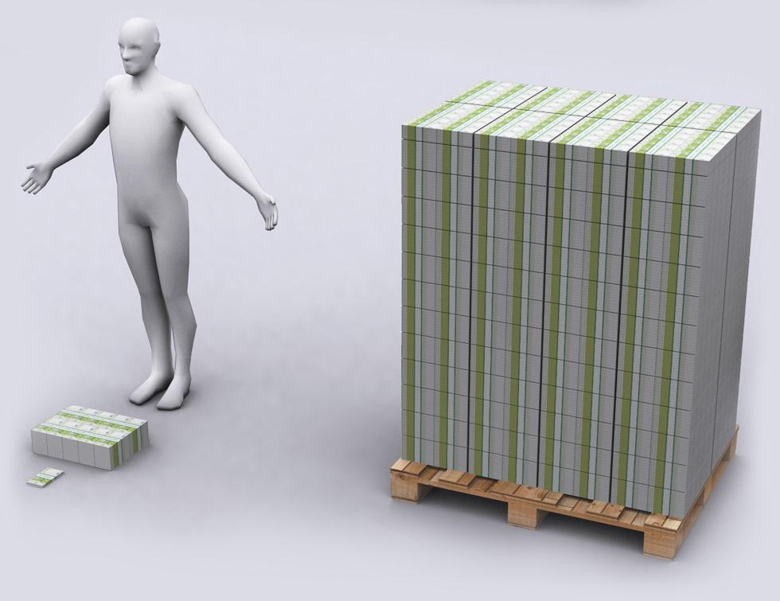
€100 Million

Slide 23
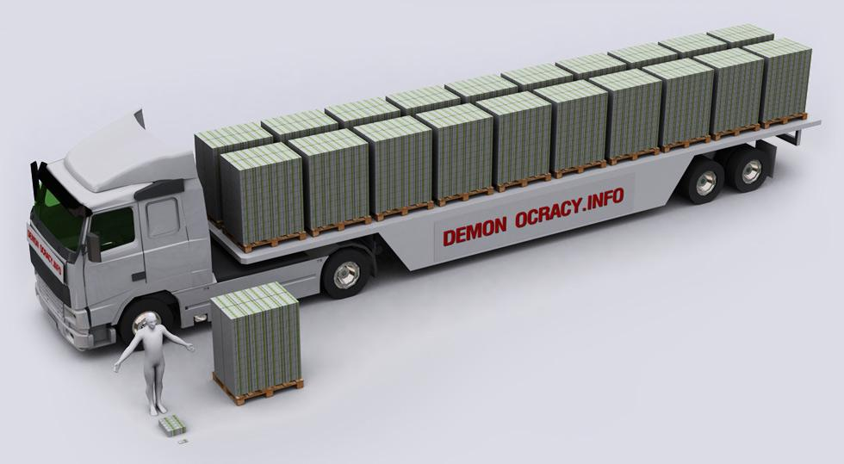
€2 Billion

Slide 24
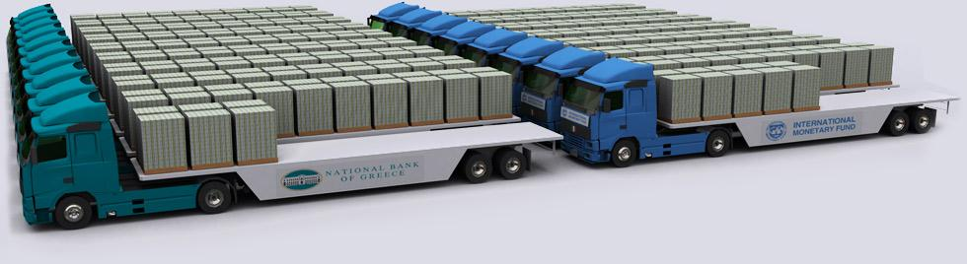
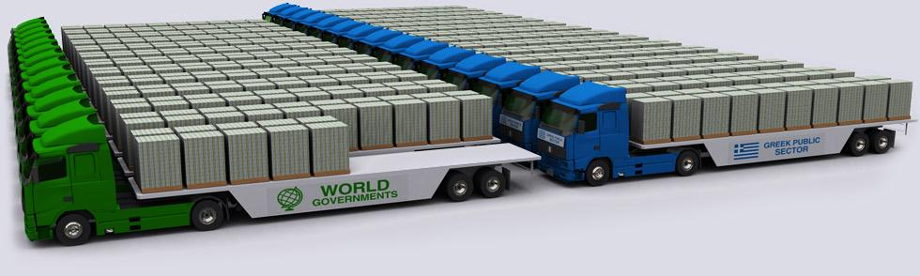
€18.6 Billion €15 Billion
€25 Billion €30 Billion

Slide 25
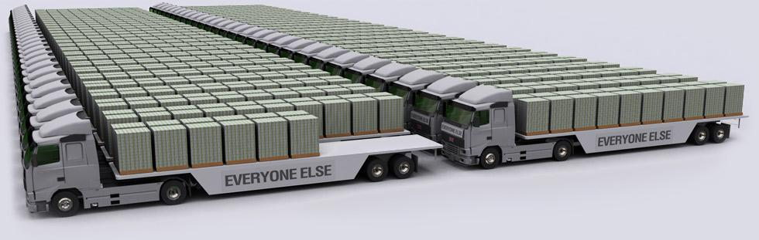
€110.9 Billion

Slide 26
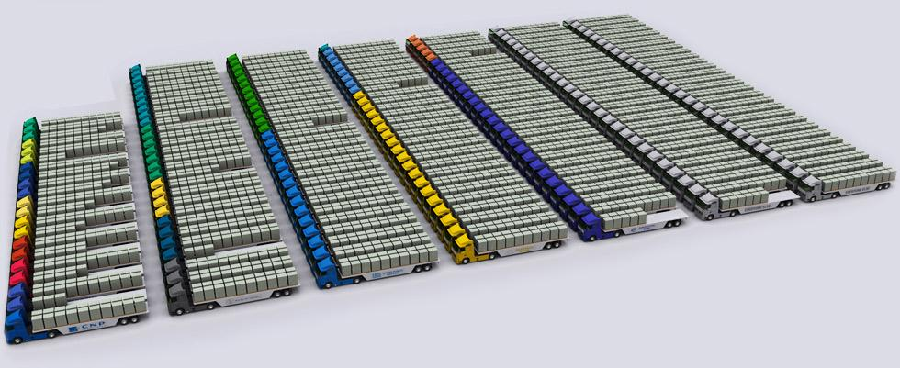
€360 Billion - Greece Total Debt

Slide 27
What have been done so far?

Slide 28
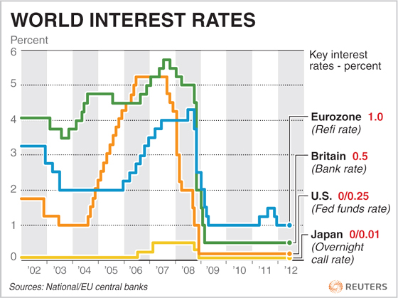
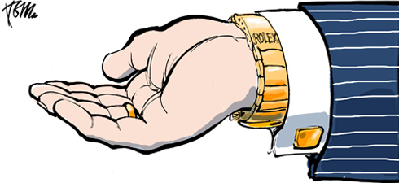
What have been done so far
Bailout and Debt write-off
Austerity measure and stress test
Reducing the EURO zone interest rate
Notes:
After the global financial crisis hit. Greek government’s debt became the first to gain attention. There have been several strategies that already implemented.
First, a Bailout program from every corner of the world but, mostly from ECB. In May, ECB and IMF giving loan package to greece for €110 billion. (Rescue package, first attempt to help) Under Austerity measure. Greece's private-sector creditors agreed to write off about three-quarters of the debts owed to them by Athens. They also agreed to replace existing loans with new loans at a lower rate of interest
Then, the bailout is not a free lunch. Greece has to promise to restrict their budget spending and increase their tax so that they could later generate more tax revenue and thus pay back the debt in the future.
For banking, After the fall of Lehman brother which lead many banks to revaluation their assets for safety. Which they do so by using stress test that was mentioned earlier
Eurozone has a unity monetary policy. One way that ECB can minimize the interest rate charged on Greece debt. And they do is by deducing the key rate by 325 basis point, which is a lot.
3.

Slide 29
Critiques on Actions taken

Slide 30
Critique on course of action
Causality dilemma
Bailout and stress test problem
Government Debt
Notes:
Problem of bailout and austerity measure. Causality dilemma
To help greece, ECB and IMF require Greece government to come-up with a restric measure which anger the people of Greece and thus destroy the economy as a whole because, as angry people destroy the lively environment for traveling [Through civil unrest, strike ] and thus highly affect Greece since they are have been heavily rely on tourism [18 percent of GDP]. Which reduce the ability of Greece to pay back the loan.
cut spending, cuts jobs = decreased tax,
Bailout and stress test problem
France and Germany, along with many government are using their bank to help bail out the loan in Greece. That basically mean less fund to be used to provide loans to other. Along with the fact that they just had a stress-test and reevaluate their asset with regarding to the fall of Lehman-brother and Global financial crisis. All of these has made Bank reluctant to lend more money out and thus could lead to less consumption and investment, lead to recession in the whole EU at the end. Which is the case now.
Banks began facing losses on their assets, so they were forced to rebalce their portfolios to meet capital standards. They did this by increasing their holdings on “safe” government debts aka risk-free assets. It should have been the correct way to handle the situation, but in many areas public finances were strained to the limit by the recession induced collapse in tax revenues and by the necessity to recaptilase failing banks. So banks were becoming more exposed to their sovereigns at precisely the moment when sovereign creditworthiness was declining- lead to “bank-sovereign loop”

Slide 31
What could have been done to revert the situation?

Slide 32
What could have been done better to revert the situation?
1. Strict banking standard on Regional Level
Regulation of the banking sector
Stress-Test
Creating a foundational Standard for all banks
Notes:
European banks suffer a lot from global financial crisis and thus has become more stricter on their investment and asset evaluation. However, in 2009,not every bank in EU has been evaluated by Stress-test and thus, does not have the same standard as those who did. And because Bank in EU is highly integrated and a complexity in financial sector, saf-banks are unintentionally related to unsafe-bank and thus is a problem. The There should be some authority that could impose a great control on EU banks, an ability to force every EU bank to take on same standard. ECB does not particular have this power yet.

Slide 33
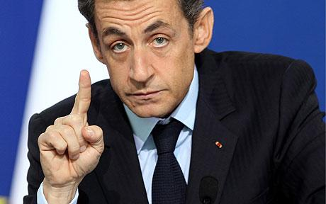
What could have been done better to revert the situation?
Highly integrated fiscal policy
‘ You cannot make a single currency without economic convergence and integration, it is impossible.’
Notes:
You cannot make a single currency without economic without economic convergence and integration, it is impossible. Said by Mr NICOLAS Sarkozy. On November 8th for a two-speed Europe: a “federal” core of the 17 members of the euro zone, with a looser “confederal” outer band of the ten non-euro members. We will not going to much on the issue of core members or looser members But, the bottom line of what he said is very important. When countries using same a same currency with one another, or similar monetary policy. It would also be important that each country would collaborate on their spending. Or else, to make a balance in budget spending,some country might need to always restrict to trade-off with some that always spend. Which is economically and politically not possible. Please be aware that, unlike other solution, this would not directly solve the EURO zone problem as we mentioned earlier that Fiscal imbalance is not the cause of it. However, if eurozone had a integrated fiscal policy from the beginning, the situation will not be this bad.

Slide 34

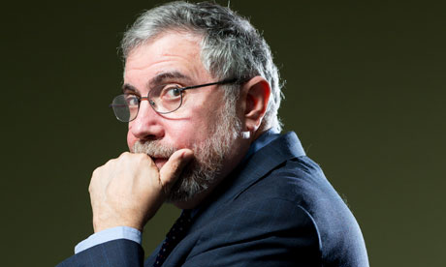
What could have been done better to revert the situation?
Just let it go
Notes:
Instead of creating Causality dilemma, Creating a debt the Greece will never be able to pay-out . Both Greece and Eu might be better-off just let go of each other. According to Paul-Krugman, a leading economist these day, By leaving the union, the EU members does not need to spend the money that they don't to loan out the money to people that unlikely to pay them back. Greece can also benefit from using their own-currency, which could easily be assume that will be relatively a lot weaker than Euro, make things, especially tourism, become very cheap. Not to mentioned that Greece can also not be too harsh on budget cut, at least they can cut it more gradually and thus not ager many people. Social unrest will be less severe and thus, Greece and bounce back that way.
We do aware that, to let Greece out of EU would also mean to let go some of their loan repayment, afterall, it is EU member, especially France and Germany that lend a lot of money to Greece over the past decade. Forgo on Greece debt would mean a serious liquidity problems for the banks, and thus could lead to Bank-run at the end. However, from the fact that EU already lend out loads of money already and Greece does not seem to come close to payoff their debt, actually, as we already talked a lot previously, the ability to pay-back is even worsen and the future ahead of Greece is default anyway. Thus, better consolidat when it is possible to do so.

Slide 35
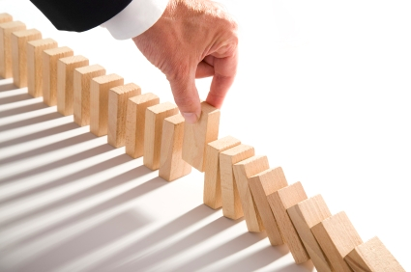
Conclusion
The crisis is not just about sovereign debt.
Bailout has created vicious cycle.
A call for a better bank regulation.
Notes:
First of all, the euro zone crisis is not all about sovereign debt but largely to do with Banking-sectors. Which is why we lead to the second conclusion, continuing bailout would more or less create a vicious cycle. In debt country like Greece does not have enough money to pay-off their debt but, by receiving a help from other that came with a cost of austerity measure. Which, for a economic structure like Greece, doing so is even worsen the situation. Is also important to mentioned here that, because of unity currency, Euro zone members has thightenhen their bold more than any other region in the world and thus, vulnerable to domino effect. The problem is, to fixing each of a domino require different method as they have different interest and thus, it would be really difficult to come up with a solution that is ‘good’ for every party. Lastly, a wake-up call from US that nothing is too big to fail, European banks have to have a better risk-evaluation criteria to prevent any downside risk from this world which is highly integrated economically and financially but, also highly asymmetric information.

Slide 36
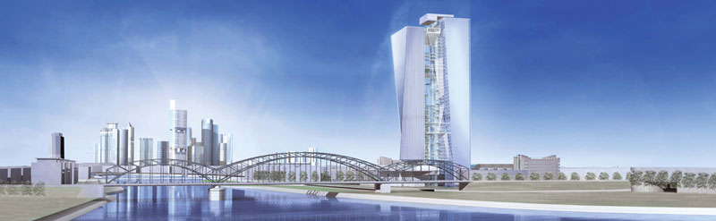
THANK YOU

