Slide 1
Psychological Disorders
PY211/ PY200 General Psychology

Slide 2
Class Activity
Is he/ she normal?
Does he/ she need to see a doctor?

Slide 3
Jim – The ?? Student??
Jim was vice president of the freshman class at a local college and played on the school's football team. Later that year he dropped out of these activities and gradually became more and more withdrawn from friends and family. Neglecting to shave and shower, he began to look dirty and unhealthy. He spent most of his time alone in his room and sometimes complained to his parents that he heard voices in the curtains and in the closet. In his sophomore year he dropped out of school entirely. With increasing anxiety and agitation, he began to worry that the "Nazis" were plotting to kill his family and kidnap him.

Slide 4
Mary – The Single Teacher
Mary is a 30 year old musician who is very dedicated and successful in her work as a teacher in a local high school and as a part-time member of local musical groups. Since her marriage five years ago, which ended in divorce after six months, she has dated very few men. She often worries that her time is "running out" for establishing a good relationship with a man, getting married, and raising a family. Her friends tell her that she gets way too anxious around men, and that she needs to relax a little in general.

Slide 5
Larry – The Psychologist
Larry, a homosexual who has lived for three years with a man he met in graduate school, works as a psychologist in a large hospital. Although competent in his work, he often feels strained by the pressures of his demanding position. An added source of tension on the job is his not being able to confide in all his co-workers about his private life. Most of his leisure activities are with good friends who belong to the gay subculture.

Slide 6
Defining Abnormality
Behavior that causes people to experience distress and prevents them from functioning in their daily lives such as:
  Deviation from the average
  Deviation from the ideal
  Sense of personal discomfort
  Inability to function effectively
  Legal concept

Slide 7
Mental Illness and the Law
There is a difference mental illness and “insanity.”
Insanity is a legal term, not a psychological one. It is typically applied to defendants who were so mentally disturbed when they committed their offense that they either lacked substantial capacity to appreciate the criminality of their actions (to know right from wrong) or to conform to the requirements of the law (to control their behavior).
The person is aware of the consequences of his actions?
Can control his behavior?

Slide 8
Abnormal Behaviour
A problem or dysfunction in cognitive, emotional or behavioral functioning.
Typically, severe distress or severe impairment in basic areas of functioning (work, family, social areas).
A response that is not typical or culturally expected.

Slide 9
Historical Views of Psychological Disorders
Place and time also contribute to how we define mental disorders.
Thousands of years ago, mysterious behaviors were attributed to supernatural powers.
As late as the 18th century, the emotionally disturbed person was thought to be a witch or to be possessed by the devil.
By the late Middle Ages, there was a move away from viewing the mentally ill as witches and possessed by demons, and they were increasingly confined to public and private asylums.
The basic reason for the failed—and sometimes abusive—treatment of mentally disturbed people throughout history has been the lack of understanding of the nature and causes of psychological disorders.

Slide 10
Psychological Disorders:
Patterns of behavior or mental processes that are connected with emotional distress or significant impairment in functioning

Slide 11
Perspectives on Abnormality
Medical perspective
  Suggests that when an individual displays symptoms of abnormal behavior, the root cause will be found in a physical examination of the individual
    Hormonal imbalance
    Chemical deficiency
    Brain injury

Slide 12
Perspectives on Abnormality
Psychoanalytic perspective
  Abnormal behavior stems from childhood conflicts over opposing wishes regarding sex and aggression
Behavioral perspective
  Looks at the rewards and punishments in the environment that determine abnormal behavior
Cognitive perspective
  People’s thoughts and beliefs are a central component of abnormal behavior

Slide 13
Perspectives on Abnormality
Humanistic perspective
  Emphasizes the responsibility people have for their own behavior, even when such behavior is abnormal
    Work of Carl Rogers and Abraham Maslow
Sociocultural perspective
  People’s behavior, both normal and abnormal, is shaped by the society and culture in which they live

Slide 14
The Diathesis-Stress Model & Systems Theory
Each of the five major theories is useful in explaining the causes of certain types of disorders.
Recent developments emphasize the integration of the various theoretical models to discover specific causes and treatments for different mental disorders.
The diathesis-stress model suggests that a biological predisposition, called a diathesis, must combine with a stressful circumstance before the predisposition to a mental disorder is manifested.
The systems approach, also known as the biopsychosocial model, examines how biological risks, psychological stresses, and social pressures and expectations combine to produce psychological disorders.

Slide 15
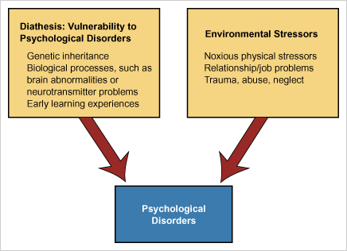
The Diathesis-Stress Model

Slide 16
Psychological Disorders
Bio-psycho-social Perspective
  assumes that biological, sociocultural, and psychological factors combine and interact to produce psychological disorders

Slide 17
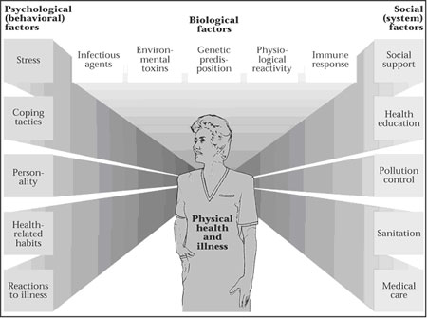

Slide 18
DSM-5: Determining Diagnostic Distinctions
Diagnostic and Statistical Manual of Mental Disorders, Fifth Edition (DSM-5)
  System devised by the American Psychiatric Association
  Used by most professionals to diagnose and classify abnormal behavior
Benefits
  Provides a descriptive system
  Allows communication between mental health professionals and theoretical approaches
  Enables researchers to explore the causes of a problem
  Provides a shorthand through which professionals can describe the behaviors that tend to occur together in an individual

Slide 19
DSM-5: Determining Diagnostic Distinctions
Conning the classifiers: The shortcomings of DSM
  David Rosenhan (1970s)
    Sought admission to mental hospitals based on statement that he or she was hearing voices
    Pseudo-patients acted in a normal way after that and the hospitals still diagnosed them as severely abnormal
  After an initial diagnosis, mental health professionals overlook other diagnostic possibilities
The stigma of labeling

Slide 20
Diagnosis Criteria: DSM-5
Neurodevelopmental disorders
Schizophrenia spectrum and other psychotic disorders
Bipolar and related disorders
Depressive disorders
Anxiety disorders
Obsessive-compulsive and related disorders
Trauma- and stressor-related disorders
Dissociative disorders
Somatic symptom and related disorders
Feeding and eating disorders
Sleep–wake disorders
Sexual dysfunctions
Gender dysphoria
Disruptive, impulse-control, and conduct disorders
Substance-related and addictive disorders
Neurocognitive disorders
Paraphilic disorders
Personality disorders

Slide 21
Anxiety Disorders

Slide 22
Anxiety Disorders
Occurrence of anxiety without an obvious external cause that affects daily functioning
Major types
  Phobic disorder
  Panic disorder
  Generalized anxiety disorder
  Obsessive-Compulsive Disorder
  Posttraumatic Stress Disorder

Slide 23
Anxiety Disorders
Generalized Anxiety Disorder (GAD) the feelings of anxiety and distress are free-floating. While sufferers may worry about their job, their finances, their health and their family, they may also worry over more common minor situations such as appointments, housework, haircuts and parking. Once developed, it is persistent and chronic with the sensations of anxiety and dread being experienced, essentially, constantly.
Notes:
Panic can lead to agoraphobia

Slide 24
GAD
Excessive worry about many events or activities with no specific threat which is accompanied by 3 or more symptoms of restlessness, fatigue, loss of concentration, muscle tension etc.

Slide 25
Anxiety Disorders
panic disorder (also called panic attack), the anxiety is very intense and debilitating, though it is confined to brief episodes. The sensations can be so severe that the sufferer may think they are having a heart attack. The attack can be triggered by a stressful situation, but often the attacks occur with no warning and for no apparent reason.

Slide 26
Panic Attacks
Panic disorder is an anxiety disorder characterized by recurring severe panic attacks
Panic attacks are periods of intense fear or apprehension that are of sudden onset and of variable duration from minutes to hours. Panic attacks usually begin abruptly, may reach a peak within 10 to 20 minutes, but may continue for hours in some cases. Panic attacks usually subside on their own over the next several hours

Slide 27
Panic Attack
DSM-5 Diagnostic Criteria for Panic Attack: A discrete period of intense fear or discomfort, in which four (or more) of the following symptoms developed abruptly and reached a peak within minutes:
Palpitations, and/or accelerated heart rate Sweating Trembling or shaking Sensations of shortness of breath or being smothered Feeling of choking Chest pain or discomfort Nausea or abdominal distress Chills or hot flashes | Feeling dizzy, unsteady, lightheaded, or faint De-realization (feelings of unreality) or depersonalization (being detached from oneself) Fear of losing control or going insane Sense of impending death Paresthesias (numbness or tingling sensations)

Slide 28
Anxiety Disorders
When the source of the anxiety can be identified, it can be a specific object or situation or to an idea or to a traumatic event.
Phobia: anxiety is triggered by a specific object or situation
In the case of a phobia, the fear is unreasonable and excessive, beyond the sufferers control to the point where it may interfere with daily life.
Simple/ Specific (fear of a single stimulus such as heights or dogs)
complex (a fear of a number of stimuli. In a fear of elevators, for example, fear of falling, being stuck between floors, tight enclosed places, losing self-control in front of others
social (fear of what might occur in the company of others; for example, fear of blushing, losing self-control, public speaking, trembling, making a mistake).

Slide 29
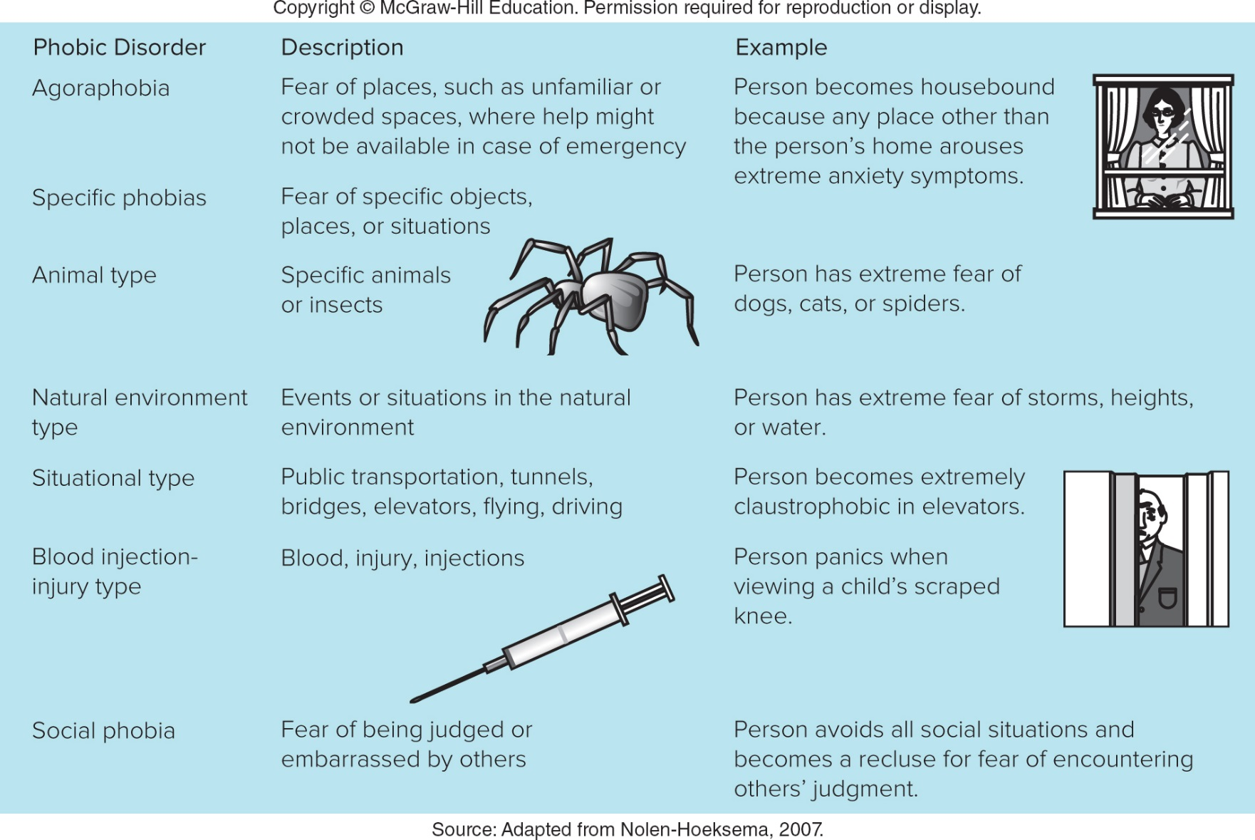

Slide 30
Anxiety Disorders
When the source or trigger of the fear is an idea, the disorder is often Obsessive-Compulsive Disorder (OCD).
In OCD, the sufferer experiences intrusive thoughts (the obsessions) which are the source of anxiety. However, the anxiety can only be relieved by performing an often ritualistic act (the compulsion).
Common obsessions include germs or losing things. The compulsions for each of those may include washing for germs or arranging and grouping objects for losing things.
However, the compulsion does not necessarily have to be logically related to the obsession. The only requirement is that, for whatever reason, it relieves the anxiety generated by the obsession.

Slide 31
Anxiety Disorders
When the anxiety source is related to a traumatic event in someone's life (Being in a war, natural disaster, car accident, house fire, the victim of a violent criminal attack) the categories are Posttraumatic Stress Disorder(PTSD) and Acute Stress Disorder (ASD).
The hallmark of PTSD is the experience of vivid memory flashbacks (so vivid the sufferer may appear to be reliving the event) that are unpredictable in their frequency and occurrence. Other symptoms can include insomnia, nightmares, depression, extreme vigilance, and emotional detachment.
ASD is a similar disorder, but while PTSD is a long-lasting disorder, capable of persisting for years, ASD is only diagnosed during one month after the traumatic event. Also, ASD includes symptoms such as amnesia for aspects of the event, emotional detachment and an emotional numbing and depersonalization.

Slide 32
Anxiety Disorders and Obsessive-Compulsive Disorder
Causes
  Genetic factors
  Overactive autonomic nervous system
  Biological causes
  Environmental factors
    Learned response to stress
  Cognitive perspective
    Inappropriate and inaccurate thoughts and beliefs about circumstances in a person’s world

Slide 33
Somatic Symptom Disorders

Slide 34
Somatic Symptom Disorders
Psychological difficulties that take on a physical (somatic) form, but for which there is no medical cause
Illness anxiety disorder: People have a constant fear of illness and a preoccupation with their health

Slide 35
Somatoform Disorders
Conversion disorder: Actual physical disturbance, such as the inability to use a sensory organ, or the complete or partial inability to move limbs
  Cause is purely psychological

Slide 36
Mood Disorders

Slide 37
Mood Disorders
Disturbances in emotional experience that is strong enough to intrude on everyday living
Major depressive disorder: Severe form of depression that interferes with concentration, decision making, and sociability.
Clinical depression is marked by a depressed mood most of the day, particularly in the morning, and a loss of interest in normal activities and relationships -- symptoms that are present every day for at least 2 weeks.
  Women more likely to experience major depression than men

Slide 38
Symptoms of Depression
Fatigue or loss of energy almost every day
Feelings of worthlessness or guilt almost every day
Impaired concentration, indecisiveness
Insomnia or hypersomnia (excessive sleeping) almost every day
Markedly diminished interest or pleasure in almost all activities nearly every day (called anhedonia, this symptom can be indicated by reports from significant others)
Restlessness or feeling slowed down
Recurring thoughts of death or suicide
Significant weight loss or gain (a change of more than 5% of body weight in a month)

Slide 39
Mood Disorders
  Mania: Extended state of intense, wild elation, euphoric states, extreme physical activity, excessive talkativeness, distractedness, and sometimes grandiosity.
  argumentative, over-excited, silly, poor judgment, giving away expensive things, abrasive, oversexed, can’t sit still, rapid speech.

Slide 40
Mood Disorders
  Bipolar disorder: Person alternates between periods of euphoric feelings of mania and periods of depression
    Formerly known as manic-depressive disorder
    Serious shifts in mood, energy, thinking, and behavior
    The cycles of bipolar disorder last for days, weeks, or months. And unlike ordinary mood swings, the mood changes of bipolar disorder are so intense that they interfere with your ability to function.
    May occur over a few days or over a period of years
    Periods of depression are usually longer than manic periods

Slide 41
Bipolar Disorder
  During a manic episode, a person might impulsively quit a job, charge up huge amounts on credit cards, or feel rested after sleeping two hours.
  During a depressive episode, the same person might be too tired to get out of bed, and full of self-loathing and hopelessness over being unemployed and in debt.
  Bipolar patients’ depressive episodes differ from the depressive episodes in major depression in that they tend to be more severe, are accompanied by higher suicide risks, and have a distinct pattern of brain activity during sleep.

Slide 42
Causes of Mood Disorders
Genetic and biological factors
Psychological causes
  Result of feelings of loss or of anger directed at oneself
Environmental factors
  Stresses of life produce a reduction in positive reinforcers
Cognitive and emotional factors
  Response to learned helplessness
  Faulty cognitions (Aaron Beck)

Slide 43
Depression in Women
Reasons
  Greater stress for women than men at certain times in life
    Such as simultaneously earning a living and being the primary caregiver for her children
  They are at higher risk for physical and sexual abuse
  Typically earn lower wages than men
  Biological factors
  Differences in brain structure may be related to gender differences in depression

Slide 44
Schizophrenia

Slide 45
Schizophrenia: Disturbances in Almost All Areas of Psychological Functioning
Characterized by severe impairment in thinking, including hallucinations, delusions, or loose associations
Diagnosed when symptoms persist for at least six months, are not due to some other condition, and cause significant impairment in daily functioning
Schizophrenics often cannot work, manage a home or apartment successfully, or care for their basic needs.

Slide 46
Symptoms of Schizophrenia
Positive symptoms are psychotic behaviors not seen in healthy people. People with positive symptoms often "lose touch" with reality. These symptoms can come and go. Sometimes they are severe and at other times hardly noticeable, depending on whether the individual is receiving treatment.
Hallucinations
Delusions
Thought Disorders
Movement Disorders

Slide 47
Hallucinations
Hallucinations: Imaginary sensations, such as seeing, hearing, or smelling things that do not exist in the real world
  Most common psychotic hallucination is hearing voices
  Note that olfactory hallucinations sometimes occur with seizure disorder (epilepsy)

Slide 48
Delusions
Delusions: False beliefs that psychotic individuals insist are true, regardless of overwhelming evidence against them
Common forms:
  Grandios: In this case, people suffer from the delusion that they have some great, unrecognized talent, knowledge, or insight. They may also believe that they have a special relationship with an important person or with God or that they are a famous person.
  Persecution: Delusions of persecution involve belief that you are being conspired against, cheated, spied on, followed, poisoned, maligned, or harassed.

Slide 49
Delusions
  Reference: Belief that objects, events, or other people have particular significance to them/ everything one perceives in the world relates to one's own destiny.
Identity: Belief that they are someone else, such as Jesus Christ
Guilt: Belief that they have committed a terrible sin
Control: Belief that their thoughts and behaviours are being controlled by external forces
Notes:
Belief that objects, events, or other people have particular significance to them

Slide 50
Class Exercise
What delusion is he/she suffering from?

Slide 51
Mary believes that she is the only one with the power to help space creatures take over the world.
David believes that the FBI is looking for him so that they can put him in jail.
Benito believes that headlines or stories in newspapers are written especially for him.
Declan is certain that his neighbors are controlling his behavior through magnetic waves.
Elizabeth was arrested last night while trying to get into the White House. She believes that she is the President of the Unites States and should be allowed to enter the house.
Notes:
Grandios
Persecution
Reference
Control
Identity

Slide 52
Thought Disorders
Unusual or dysfunctional ways of thinking
Disorganized thinking - when a person has trouble organizing his or her thoughts or connecting them logically and talk in a garbled way that is hard to understand.
Thought blocking - This is when a person stops speaking abruptly in the middle of a thought. When asked why he or she stopped talking, the person may say that it felt as if the thought had been taken out of his or her head.
Neologism - person with a thought disorder might make up meaningless words - "I'm going to the park to ride the wallywhoop."
Loose association – Rapidly shifting from topic to topic with no connection between one thought and the next
Notes:
unusual or dysfunctional ways of thinking. One form of thought disorder is called "disorganized thinking." This is when a person has trouble organizing his or her thoughts or connecting them logically. They may talk in a garbled way that is hard to understand. Another form is called "thought blocking." This is when a person stops speaking abruptly in the middle of a thought. When asked why he or she stopped talking, the person may say that it felt as if the thought had been taken out of his or her head. Finally, a person with a thought disorder might make up meaningless words, or "neologisms."

Slide 53
Disorganized Behaviour
Repeating the same activity (word or behavior) over and over again (perseveration).
Repeating exactly what someone else has done (echopraxia).
Dressing oddly, such as wearing many sets of clothing one over the other or wearing hats, gloves, and heavy coats in the summer.
Doing things in public that are usually done only in private. Urinating on a street corner is an example

Slide 54
Movement Disorders
Agitated body movements
  repeating certain motions over and over
Catatonic
  does not move/ does not respond to others
Notes:
Movement disorders may appear as agitated body movements. A person with a movement disorder may repeat certain motions over and over. In the other extreme, a person may become catatonic. Catatonia is a state in which a person does not move and does not respond to others. Catatonia is rare today, but it was more common when treatment for schizophrenia was not available.²
"Voices" are the most common type of hallucination in schizophrenia.

Slide 55
Symptoms of Schizophrenia
Negative symptoms are associated with disruptions to normal emotions and behaviors. These symptoms are harder to recognize as part of the disorder and can be mistaken for depression or other conditions. "Flat affect" (a person's face does not move or he or she talks in a dull or monotonous voice)
Lack of pleasure in everyday life
Lack of ability to begin and sustain planned activities
Speaking little, even when forced to interact.
Notes:
People with negative symptoms need help with everyday tasks. They often neglect basic personal hygiene. This may make them seem lazy or unwilling to help themselves, but the problems are symptoms caused by the schizophrenia.

Slide 56
Symptoms of Schizophrenia
Cognitive symptoms are subtle.
Detected only when other tests are performed.
Poor "executive functioning" (the ability to understand information and use it to make decisions)
Trouble focusing or paying attention
Problems with "working memory" (the ability to use information immediately after learning it).
Cognitive symptoms often make it hard to lead a normal life and earn a living. They can cause great emotional distress.
Notes:
Cognitive symptoms are subtle. Like negative symptoms, cognitive symptoms may be difficult to recognize as part of the disorder. Often, they are detected only when other tests are performed. Cognitive symptoms include the following:
Poor "executive functioning" (the ability to understand information and use it to make decisions)
Trouble focusing or paying attention
Problems with "working memory" (the ability to use information immediately after learning it).
Cognitive symptoms often make it hard to lead a normal life and earn a living. They can cause great emotional distress.

Slide 57
Schizophrenia
Solving the puzzle of schizophrenia: biological causes
  Genetic factors
  Biochemical imbalance
    Dopamine hypothesis
  Structural abnormalities
    Signs of cerebral damage
    Decreased brain weight
    Reduced numbers of neurons in the prefrontal cortex
    Decrease in volume of the limbic regions
    Abnormalities in the thalamus
    Enlarged ventricles or spaces in the brain

Slide 58
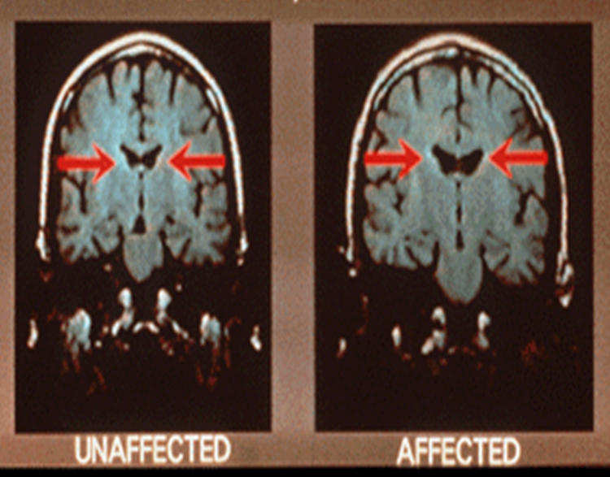
Ventricle Enlargement

Slide 59
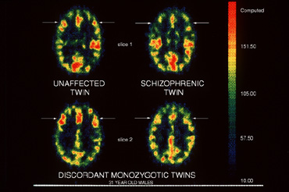
Hypofrontality

Slide 60
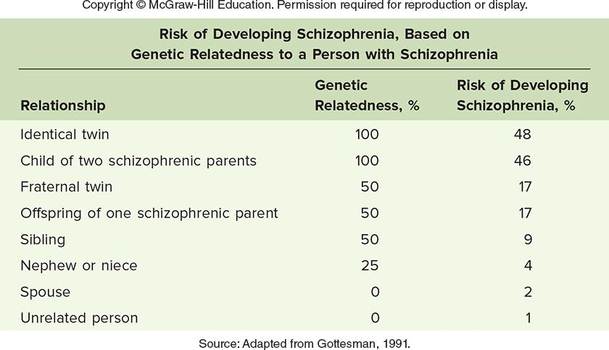
Genetic Factors Contributing to Schizophrenia

Slide 61
Schizophrenia
Situational causes of schizophrenia
  Emotional and communication patterns of the families of people with schizophrenia
    Expressed emotion - Interaction style characterized by high levels of criticism, hostility, and emotional intrusiveness within a family
  Cognitive perspective
    Overattention or underattention to stimuli in the environment

Slide 62
Schizophrenia
The multiple causes of schizophrenia
  Predisposition model of schizophrenia – Individuals inherit a predisposition or an inborn sensitivity to schizophrenia
  If stressors are strong, and are coupled with a genetic predisposition, they result in the appearance of schizophrenia

Slide 63
Personality Disorders

Slide 64
Personality Disorders
Characterized by a set of inflexible, maladaptive behavior patterns that keep a person from functioning appropriately in society
  Antisocial Personality Disorder
  Borderline Personality Disorder
  Narcissistic personality disorder

Slide 65
Personality Disorders
Antisocial personality disorder
  Individuals show no regard for the moral and ethical rules of society or the rights of others
    Sometimes called a sociopathic personality
  Lack guilt or anxiety about their wrongdoing
  Impulsive
  Lack the ability to withstand frustration
  Manipulative
  Deceptive
  May have excellent social skills

Slide 66
Antisocial Personality Disorder
APD is more common in men than in women.
In young boys, three traits are correlated with later diagnosis of APD: bedwetting, cruelty to animals and pyromania.
Not all children who exhibit these traits develop APD but they are more common in the history of those with APD than they are in the general population.
In severe cases of APD, it has been noted that the individuals seem to have no conscience, no guilt, no empathy or concern for others.
They can be thrill-seeking and impulsive but show little physiological signs of anxiety or arousal. They can sometimes show signs of conscience, remorse, concern for others and can be quite charming. But these are insincere and actually well-mimicked behaviors to gain the fulfillment of their wishes. Con-artists and serial killers are often diagnosed with APD.

Slide 67
Personality Disorders
Borderline personality disorder
  Characterized by problems with
    Regulating emotions and thoughts
    Displaying impulsive and reckless behavior
    Having unstable relationships with others
  Difficulty developing a secure sense of who they are
  Tend to rely on relationships with others to define their identity
  Emotional volatility leads to impulsive and self-destructive behavior

Slide 68
Personality Disorders
Narcissistic personality disorder
  Characterized by an exaggerated sense of self-importance
  Expect special treatment from others
  Inability to experience empathy for others

Slide 69
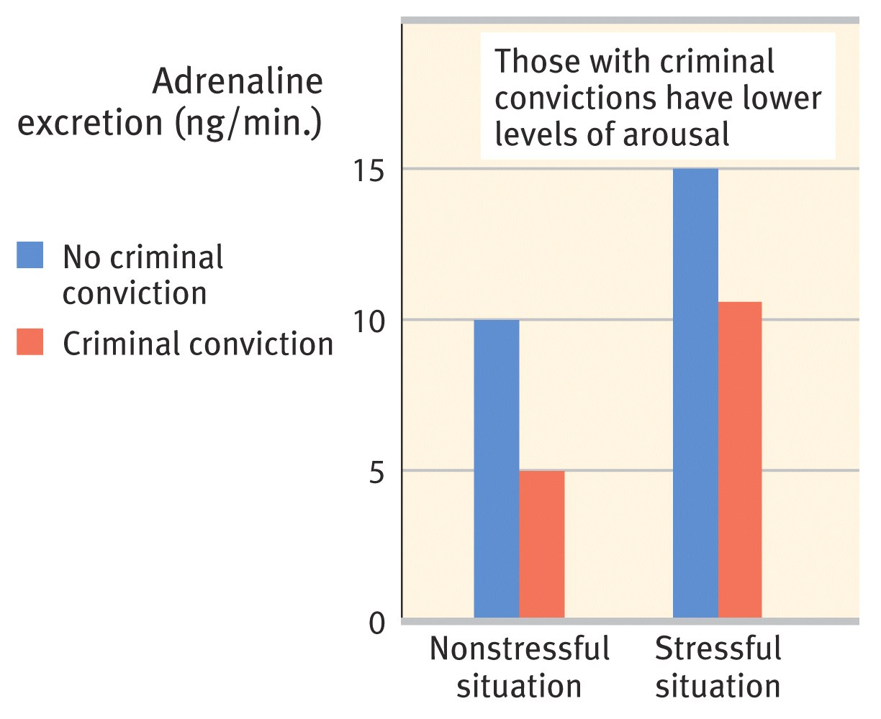
Personality Disorders
Boys who were later convicted of a crime showed relatively low arousal

Slide 70
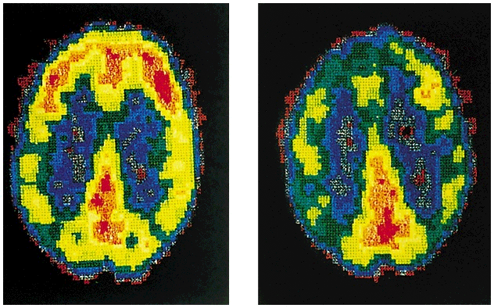
Personality Disorders
PET scans illustrate reduced activation in a murderer’s frontal cortex
Normal
Murderer

Slide 71
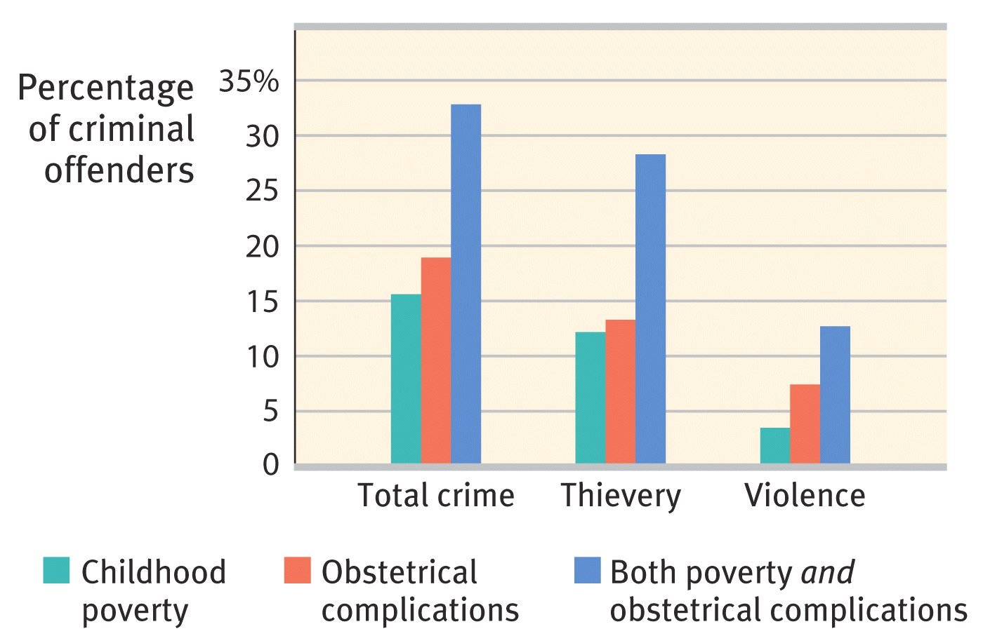
Personality Disorders

Slide 72
Dissociative Disorders

Slide 73
Dissociative Disorders
Dissociative Amnesia
Dissociative Fugue
Dissociative Identity Disorder
The common thread in all these disorders is psychological dissociation, in which certain thoughts, emotions or memories are separated from awareness.
Splitting of the consciousness

Slide 74
Dissociative Disorders
Dissociative amnesia - a significant, selective memory loss occurs.
Dissociative amnesia is unlike simple amnesia, which involves an actual loss of information from memory and typically results from a physiological cause.
In contrast, in cases of dissociative amnesia, the “forgotten” material is still present in memory—it simply cannot be recalled.
The term “repressed memories” is sometimes used to describe the lost memories of people with dissociative amnesia.

Slide 75
Dissociative Disorders
Dissociative fugue is a form of amnesia in which a person leaves home suddenly and assumes a new identity.
In this rare and unusual state, people take sudden, impulsive trips and adopt a new identity. After a period of time—days, months, or sometimes even years—they suddenly realize that they are in a strange place and completely forget the time they have spent wandering. Their last memories are those from the time just before they entered the fugue state.

Slide 76
Dissociative Disorders
Dissociative Identity Disorder (DID) (aka multiple personality disorder)
  manifests at least 2 or more personalities or identities, each with distinct traits.
  The identities or personalities recurrently take control of the person's behavior.
  Often there is an inability to recall or share memories between personalities that occur when another personality is in control.
  The formation of multiple identities is argued to be a coping mechanism for a severe and early childhood psychological trauma

