Slide 1
Multiple Regression Analysis: The Problem of Inference

Slide 2
Hypothesis Testing in Multiple Regression
Hypothesis Testing about Individual Regression Coefficients
Testing the Overall Significance of the Sample Regression
Testing the Equality of Two Regression Coefficients
Restricted Least Squares: Testing Linear Equality Restrictions
Testing for Structural or Parameter Stability of Regression Models: The Chow Test

Slide 3
Hypothesis Testing about Individual Regression Coefficients

Slide 4
Hypothesis Testing about Individual Regression Coefficients
State the hypothesis
t-value
critical value
Conclusion
Reject the null hypothesis if
Not Reject the null hypothesis if

Slide 5
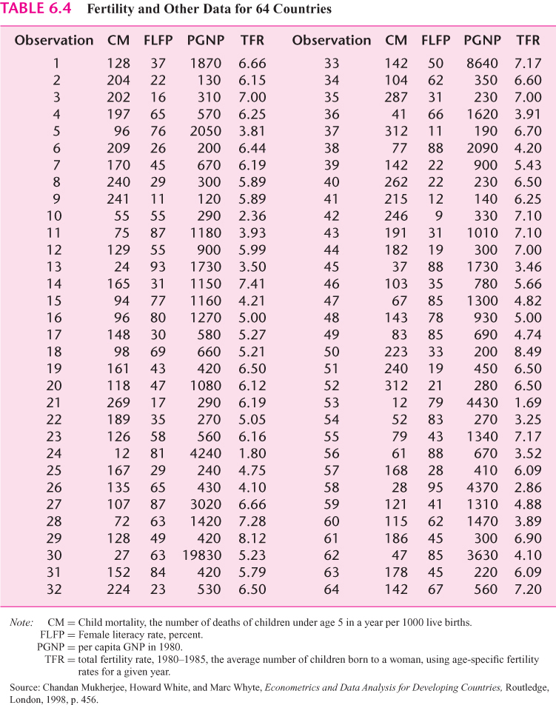
Example

Slide 7
The female literacy rate held constant, per capita GNP has a significant negative effect on child mortality

Slide 8
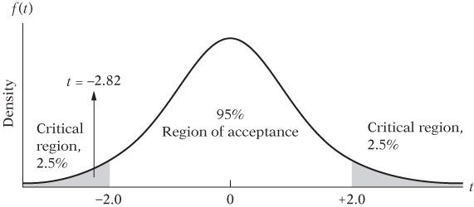

Slide 9
Since the interval does not include the null-hypothesized value of zero, we can reject the null hypothesis. The female literacy rate held constant, per capita GNP has a significant negative effect on child mortality

Slide 10
Testing the Overall Significance of the Sample Regression

Slide 11
Null hypothesis is a joint hypothesis that and are jointly or simultaneously equal to zero

Slide 12
Analysis of Variance (ANOVA)
Total Sum of Square (TSS) consists of Explained Sum of Squares (ESS) and Residual Sum of Squares (RSS)

Slide 13
F distribution with degree of freedom k-1, n-k

Slide 14
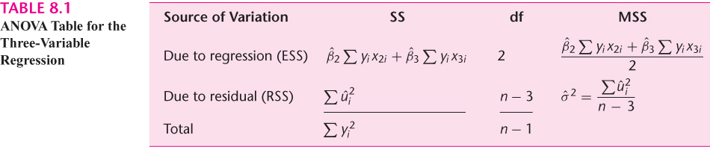

Slide 15
Example

Slide 16
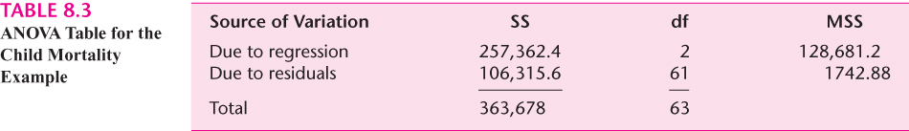
The critical F value for 2 df in the numerator and 61 df in the denominator is 3.15 (5 % level of significance) or 4.98 (1% level of significance). Reject null hypothesis. There is evidence that not all parameter is equal to zero.

Slide 17
Class exercise
Find the critical F value

Slide 18
Class exercise
Find the Critical F value

Slide 19
Testing the Overall Significance of the Sample Regression

Slide 20
Testing the Overall Significance of a Multiple Regression-The F Test
Given the k-variable regression model:
Not all slope coefficients are simultaneously zero

Slide 21
If F > critical region Reject
If F < critical region Not reject

Slide 22
An important relationship between R-squared and F
Assuming the normal distribution for the disturbances and the null hypothesis that
is distributed as the F distribution with 2 and n-3 df

Slide 23
k- variable case (including intercept)
Assuming the normal distribution for the disturbances and the null hypothesis that
is distributed as the F distribution with k-1 and n-k df

Slide 24
R-Squared and F

Slide 25
Testing the Overall Significance of a Multiple Regression in Terms of R-Squared
Given the k-variable regression model:
Not all slope coefficients are simultaneously zero

Slide 26
Example

Slide 27
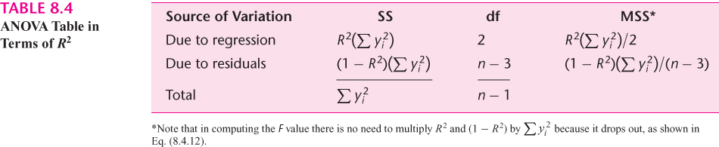

Slide 28
The critical F value for 2 df in the numerator and 61 df in the denominator is 3.15 (5 % level of significance) or 4.98 (1% level of significance). Reject the null hypothesis. There is enough evidence to say that at least one parameter is not equal to zero.

Slide 29
Class practice

Slide 31
There is evidence that not all parameter is equal to zero.

Slide 32
74.678 > Critical F-value
Reject null hypothesis.
There is evidence that not all parameter is equal to zero.

Slide 33
The “incremental” or Marginal contribution of an explanatory variable
In most empirical investigations the researcher may be completely sure whether it is worth adding an X variable to the model knowing that several other X variables are already present in the model
One does not wish to include a variable (s) that contributes very little toward ESS.
One does not want to exclude a variable (s) that substantially increases ESS
How does one decide whether an X variable significantly reduces RSS?

Slide 34
What is the marginal, or incremental, contribution of FLR, knowing that PGNP is already in the model and it is significantly related to CM?
Is the incremental contribution of FLR statistically significant?
What is the criterion for adding variables to the model?

Slide 35
F value is highly significant, suggesting that the addition of FLR to the model significantly increases ESS and hence the R-square value

Slide 39
Class practice
What is the marginal, or incremental, contribution of Experience and Experience squared, knowing that educ is already in the model and it is significantly related to log(wage)?
2. Is the incremental contribution of Experience statistically significant?

Slide 42
F value is highly significant, suggesting that the addition of Experience and Experience Squared to the model significantly increases ESS and hence the R-square value

Slide 43
Testing the Equality of Two Regression Coefficients

Slide 44
Testing the Equality of Two Regression Coefficients
Degree of freedom = n-k

Slide 46
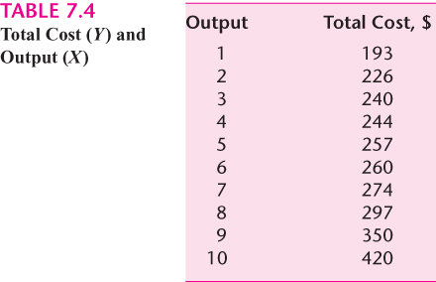
Example

Slide 49
Degree of freedom = n-k=10-4=6 Check critical value
Reject the null hypothesis
There is not enough evidence to say that

Slide 50
Restricted Least Squares: Testing Linear Equality Restrictions

Slide 51
Example
Cobb- Douglas production function
where
Is this restriction valid?

Slide 52
The t-test approach

Slide 53
The F-Test Approach: Restricted Least Squares
RSS of the unrestricted regression
RSS of the restricted regression
Number of linear restrictions
Number of parameters in the unrestricted regression
Number of observations

Slide 54
F distribution with degree of freedom m, n-k

Slide 55
F distribution with degree of freedom m, n-k

Slide 56
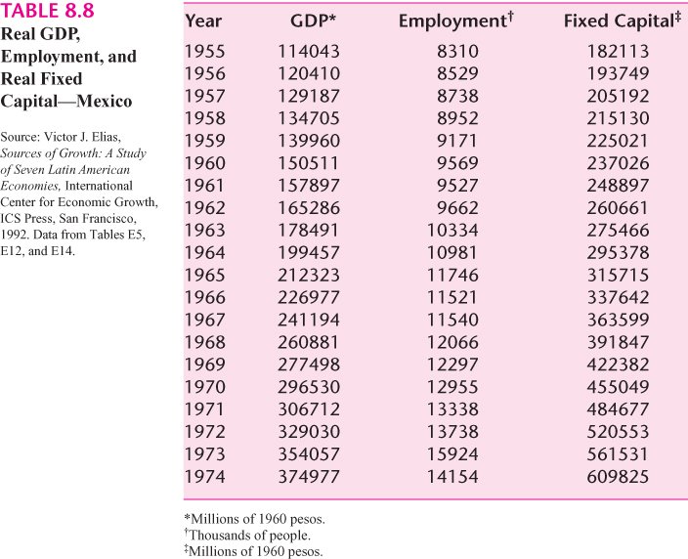
Example

Slide 58

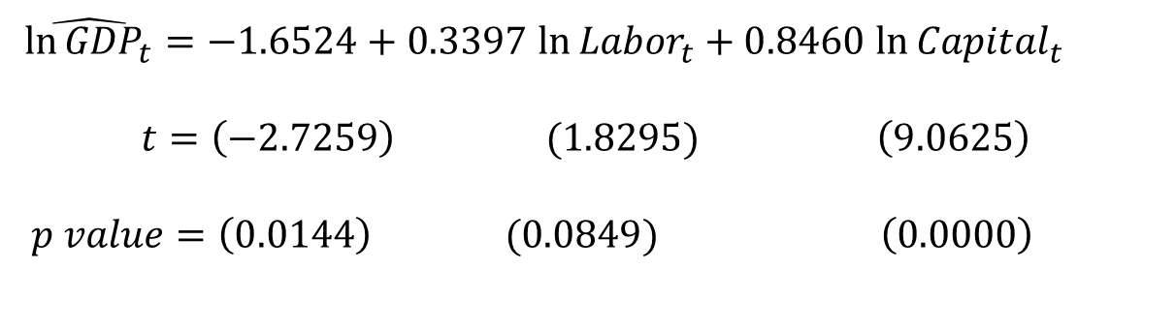

$\hat{{ln⁡GDP}_{t}}=−1.6524+0.3397$ ${ln⁡Labor}_{t}+0.8460$ ${ln⁡Capital}_{t}$
$$t=\left(−2.7259\right) (1.8295) \left(9.0625\right)$$
$$p value=\left(0.0144\right) (0.0849) \left(0.0000\right)$$
$$R^{2}=0.9951$$
$${RSS}_{UR}^{}=0.0136$$
As you can see, the output/labor elasticity is about 0.34 and the output/capital elasticity is about 0.85. If we add these coefficients, we obtain 1.19, suggesting that perhaps the Mexican economy during the stated time period was experiencing increasing returns to scale.

Slide 59
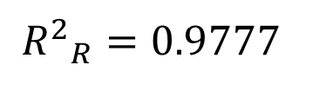
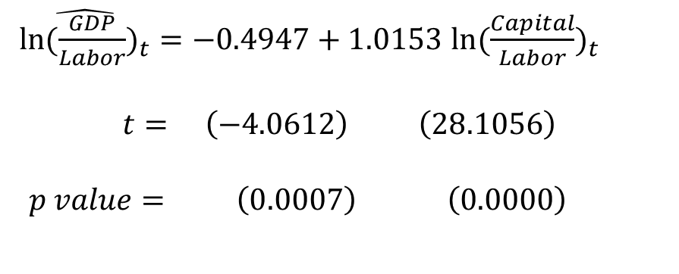
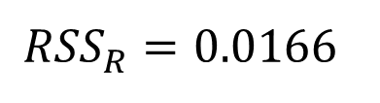
Let us impose the restriction of constant returns to scale
$\hat{{ln⁡(\frac{GDP}{Labor})}_{t}}=−0.4947+1.0153$ ${ln⁡(\frac{Capital}{Labor})}_{t}$
$$t= \left(−4.0612\right) \left(28.1056\right)$$
$$p value= \left(0.0007\right) \left(0.0000\right)$$
$${R^{2}}_{R}^{}=0.9777$$
$${RSS}_{R}^{}=0.0166$$

Slide 60
F-distribution with degree of freedom 1, 17
F-value is not significant at the 5% level
The conclusion is that the Mexican economy was probably characterized by constant returns to scale over the sample period and therefore there may be no harm in using the restricted regression

Slide 61
Example
The demand for Chicken in the United States, 1960-1982

Slide 63
Suppose someone maintains that chicken and pork and beef are unrelated products in the sense that chicken consumption is not affected by the prices of pork and beef.

Slide 64
Therefore, the constrained regression becomes

Slide 66
At 5 percent significance level, Critical F is 3.55.
Cannot reject the null hypothesis.
We can accept the constrained regression as representing the demand function for chicken.

Slide 67
Testing for Structural or Parameter Stability of Regression Models: The Chow Test

Slide 68
Testing for Structural or Parameter Stability of Regression Models: The Chow Test
“Structural Change” mean that the values of parameters of the model do not remain the same through the entire period

Slide 69
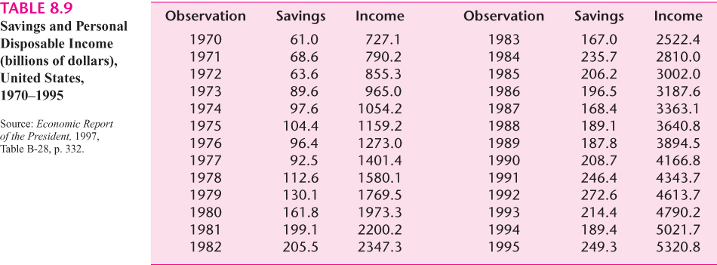

Slide 70
This table gives data on disposable personal income and personal savings, in billions of dollars, the U.S. for the period 1970-1995
We want to estimate a simple savings function that relates savings (Y) to disposable personal income DPI (X)
In 1982 the United States suffered its worst peacetime recession –unemployment rate reached 9.7%

Slide 71
Divide sample data into two time periods:
1970-1981 and 1982-1995
Three possible regressions:
Time period 1970-1981:
Time period 1982-1995:
Time period 1970-1995:

Slide 73
The slope in the preceding savings-income regressions represents the marginal propensity to save (MPS), the mean change in savings as a result of a dollar’s increase in disposable personal income

Slide 74
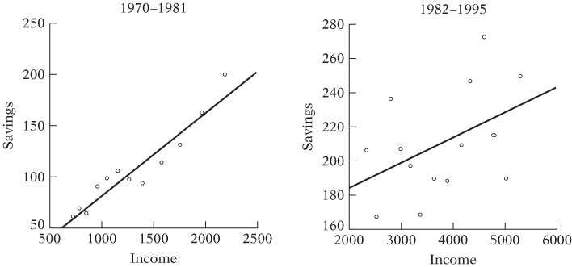

Slide 75
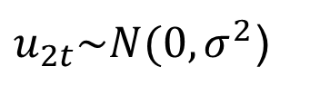
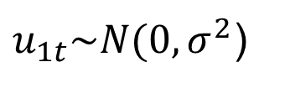
Chow test
Assumption
and - The error terms in the subperiod regressions are normally distributed with the same (homoscedastic) variance
The two error terms are independently distributed
$u_{1t}\sim N(0,σ^{2}$)
$u_{2t}\sim N(0,σ^{2}$)

Slide 76
The mechanics of the Chow test
Estimate , which is appropriate if there is no parameter instability, and obtain with df = . We call the restricted residual sum of squares
Estimate and obtain its residual sum of squares, , with df =
Estimate and obtain its residual sum of squares, , with df =

Slide 77
4. Since the two sets of samples are deemed independent, we can add and to obtain what may be called the unrestricted residual sum of squares

Slide 78
5. If there is no structural change, then the and
should not be statistically different.
then the Chow has shown that under the null hypothesis the regression
and are statistically the same

Slide 79
6. We find that for 2, 22 df the 1 percent critical F value is 5.72.
Therefore, the probability of obtaining F value of as much as or greater than 10.69. We reject the null hypothesis of parameter stability and conclude that the regressions and
are different

Slide 80
Source
Gujarati, D.N. (2009) Basic Econometrics. 5th ed. Singapore, McGraw-Hill.

