Slide 1

MK 202
Integrated Marketing Communications (IMC) I
By Ajarn Suwalya Khemvaraporn

Slide 2
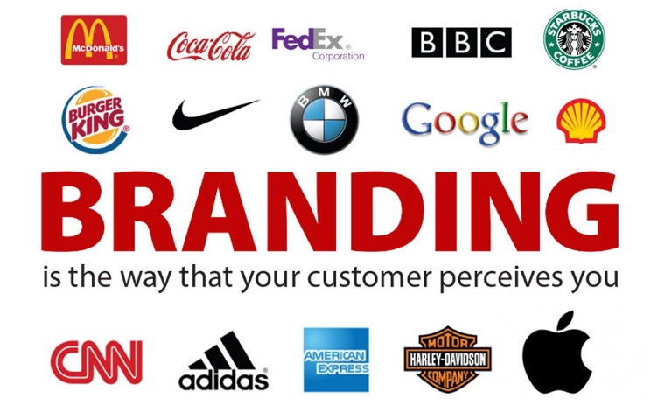
Branding Recap

Slide 3


Marketing Planning Overview

Slide 4
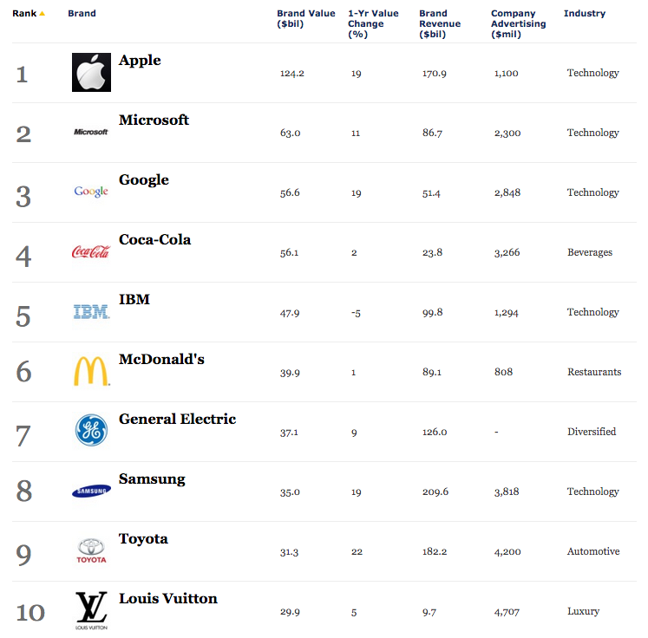
Forbes Top 10 Most Valuable Brands

Slide 5
Recipe for success
The 4P's must revolve around the
Positioning

Slide 6
The Marketing Mix for Successful Brands
4P's
Product – Clear Positioning?
Price $$$$$
Place/Distribution
Promotions- Effective communications?

Slide 7
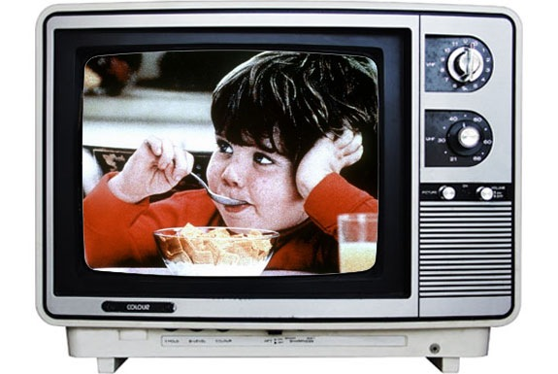

Words…What words come to your mind?
Feelings…How do you feel when watching the ad?

Slide 8
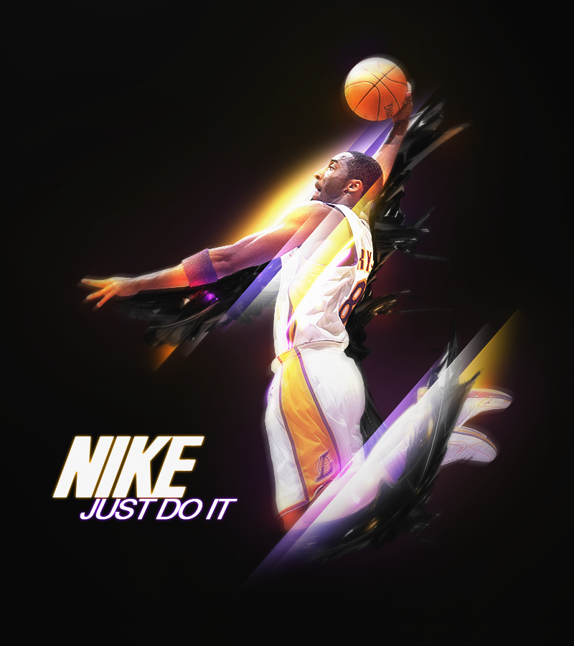
Brand Associations

Slide 9

Brand Associations

Slide 10
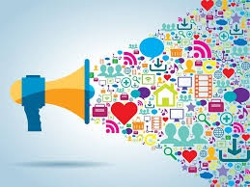
Promotional Mix
Marketing Communications Mix

Slide 11
Promotional Mix
The specific blend of promotional tools that the company uses to persuasively communicate customer value and build customer relationships.

Slide 12
Promotional Mix
Advertising
  Any paid form of non personal presentation and promotion of ideas, goods, or services by an identified sponsor.
Sales Promotion
  Short-term incentives to encourage the purchase or sale of a product or service.
Public Relations (PR)
  Building good relations with the company’s various publics by obtaining favorable publicity, building up a good corporate image, and handling or heading off unfavorable rumors, stories, and events.

Slide 13
Promotional Mix
Personal Selling
  Personal presentation by the firm’s sales force for the purpose of making sales and building customer relationships.
Direct Marketing & Digital marketing
  Direct connections with carefully targeted individual consumers to both obtain an immediate response and cultivate lasting customer relationships—the use of telephone, mail, fax, e-mail, the Internet, social media and other tools to communicate directly with specific consumers.

Slide 14
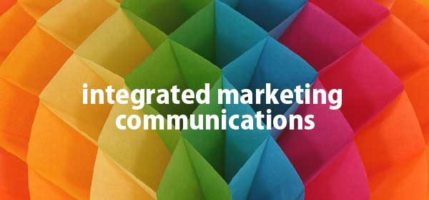
IMC

Slide 15
The Changing Communications Environment
Two factors are changing the face of today’s marketing communications:
As mass markets have fragmented, marketers
are shifting away from mass marketing
Vast improvements in information technology
are speeding the movement toward segmented
marketing

Slide 16
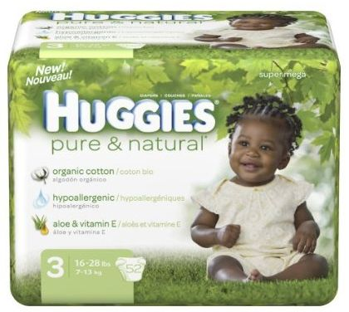
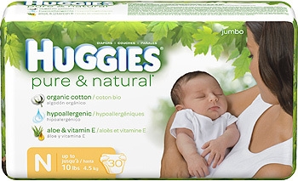
Kimberly-Clark:New IMC Approaches
Targets new and expectant mothers through mommy blogs, Web sites,
print and online ads, e-mail, in-store promotions and in-hospital TV programming.

Slide 17
Conflicting messages from different sources or promotional approaches can confuse company or brand images
The problem is particularly prevalent when functional specialists handle individual forms of marketing communications independently
The Need for IMC

Slide 18
The Need for IMC
Using IMC, the company carefully
integrates and coordinates its many
communication channels to deliver
a clear, consistent, and compelling
message about the organization
and its products

Slide 19
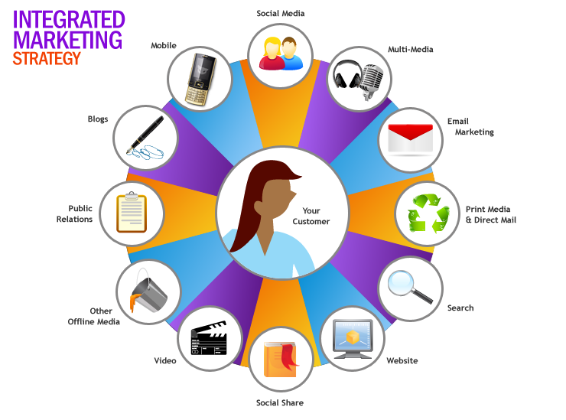
The Communication Channels

Slide 20

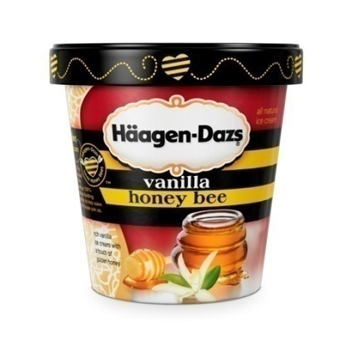
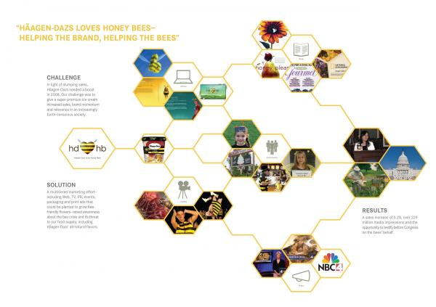
Haagen-Dazs: A Beautifully Integrated Marketing Communications Campaign
“Haagen-Dazs loves honey bees” integrated marketing campaign uses rich, well-coordinated blend of communications elements to successfully deliver Haagen –Dazs’ unique message and positioning.
“It’s the brand with heart and soul”, “We’re not only raising brand awareness, but making a difference in the world.”

Slide 21
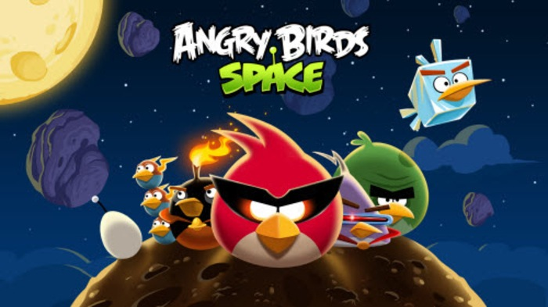
The new marketing communications model: Rovio Entertainment introduced the Angry Birds Space version of its popular game using only an online video campaign. The campaign reaped an astonishing 134 million views and 168,570 social shares.

Slide 22
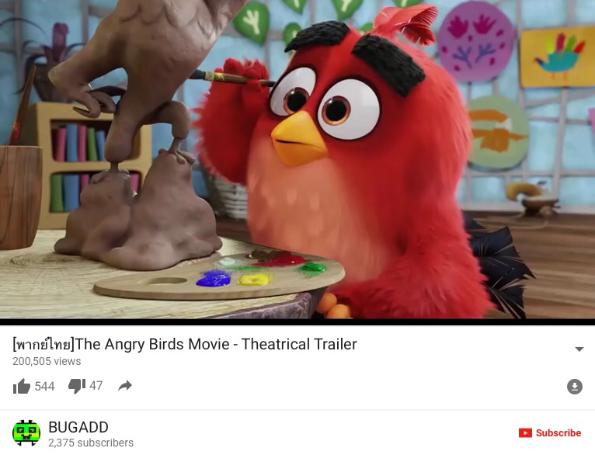

Slide 23
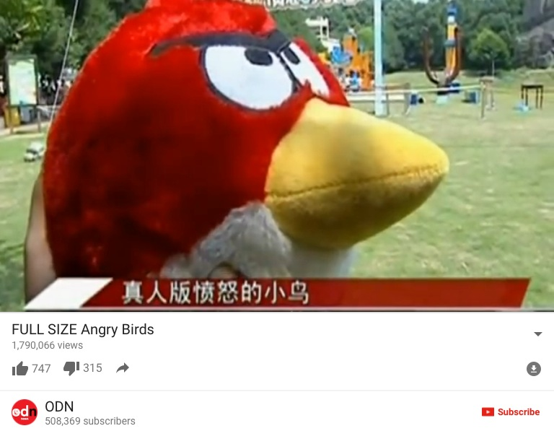

Slide 24
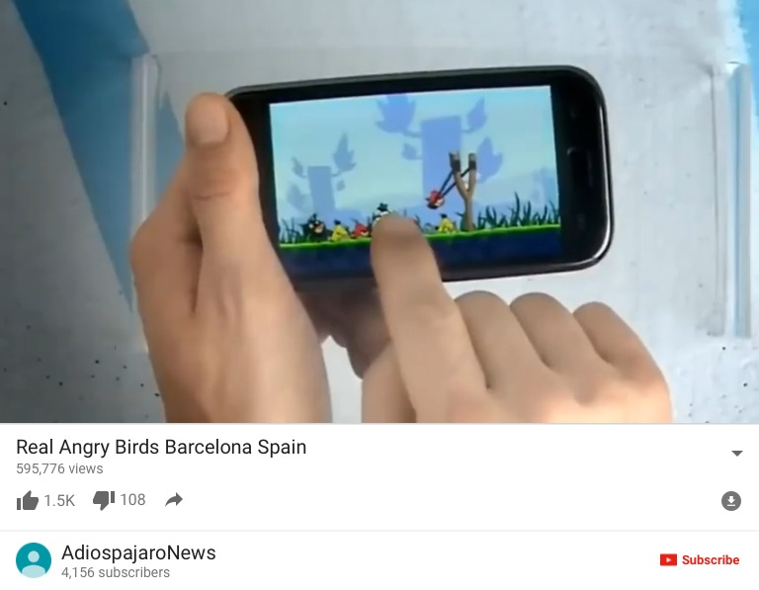

Slide 25
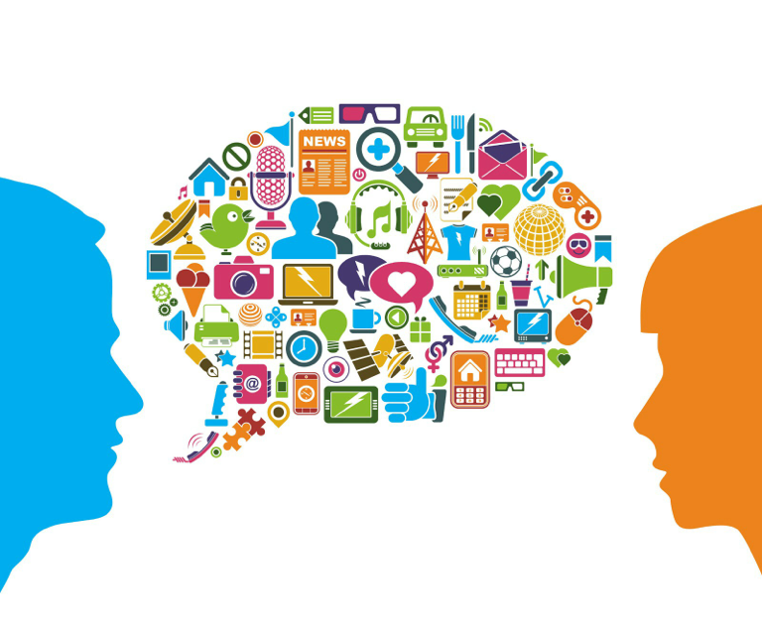
Developing Effective Communications

Slide 26
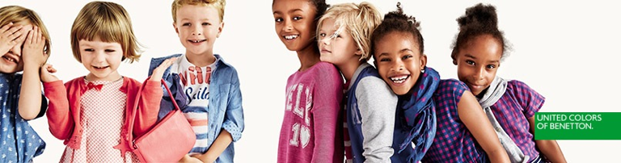
Developing Effective Communications
Step 1: Identifying the Target Audience
  Affects decisions related to what, how, when, and where message will be said, as well as who will say it

Slide 27
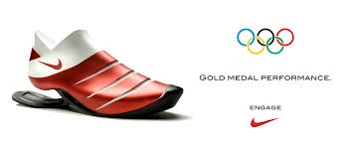
Developing Effective Communications
Step 2: Determining Communication
Objectives
  Six buyer readiness stages
Awareness
Knowledge
Liking
Preference
Conviction
Purchase

Slide 28
Developing Effective Communications
  Buyer readiness stages: the stages: The stages consumers normally pass through on the way to a purchase, including awareness, knowledge, liking, preference, conviction and finally the actually purchase.
A goal of marketing in general and of marketing
Communications in particular is to move target consumers
Through the buying process. Once again, it starts with understanding customer needs and wants
Believing this is the best
feeling
Awareness
Knowledge
Liking
Preference
Conviction
Purchase
Prefer over others

Slide 29
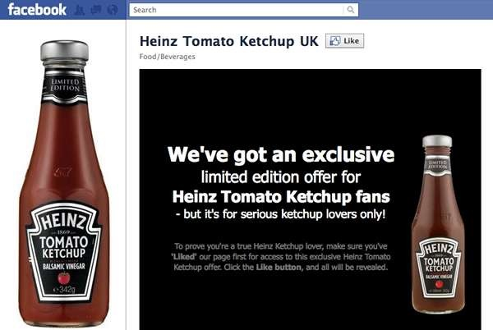
The new marketing communication model: Heinz introduced its new balsamic-vinegar-flavored ketchup using no traditional media, relying instead on its 825,000 Facebook followers to spread the word.

Slide 30
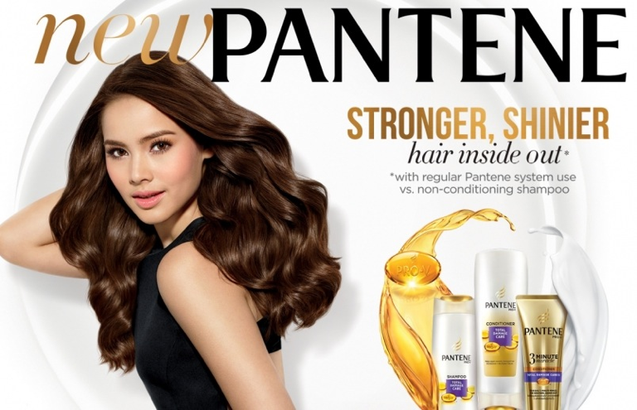
Developing Effective Communications
Step 3: Designing a Message
  Message content contains appeals or themes designed to produce desired results
    Rational appeals – Ex.Sunlight liquid Dishwash,shampoo?
    Emotional appeals – Ex. Jubilee Diamonds?
      Love, pride, joy, humor, fear, guilt, shame,excitement or Moral appeal

Slide 31
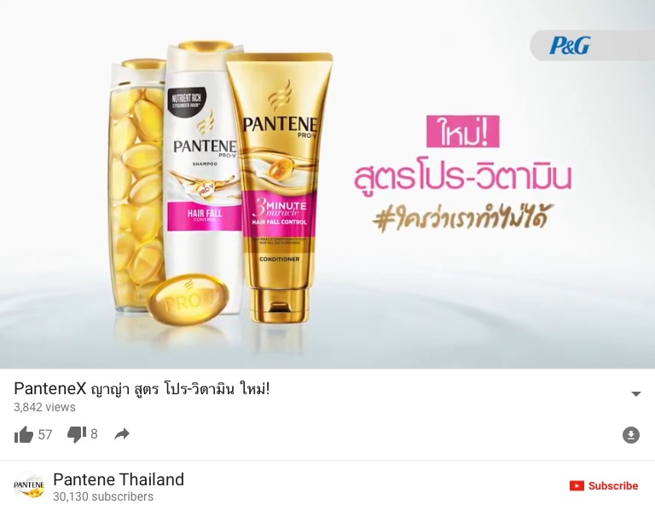

Slide 32
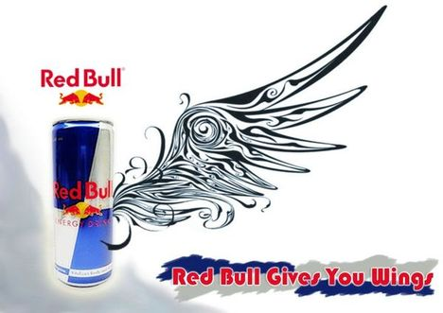

Slide 33
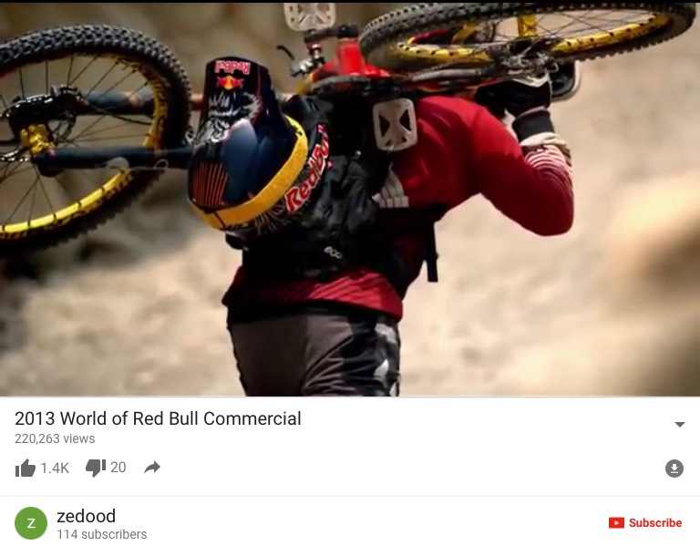

Slide 34
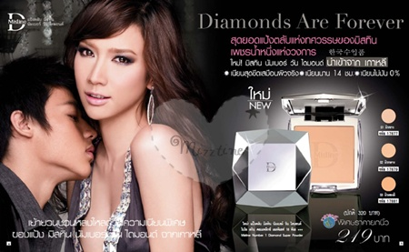
Developing Effective Communications
Step 3: Designing a Message
  Message Structure: Key decisions are required with respect to three message structure issues:
    Whether or not to draw a conclusion
    One-sided vs. two-sided argument
    Order of argument presentation
  Message Format: Design, layout, copy, color, shape, movement, words, sounds, voice, body language, dress, etc.

Slide 35

Developing Effective Communications

Slide 36
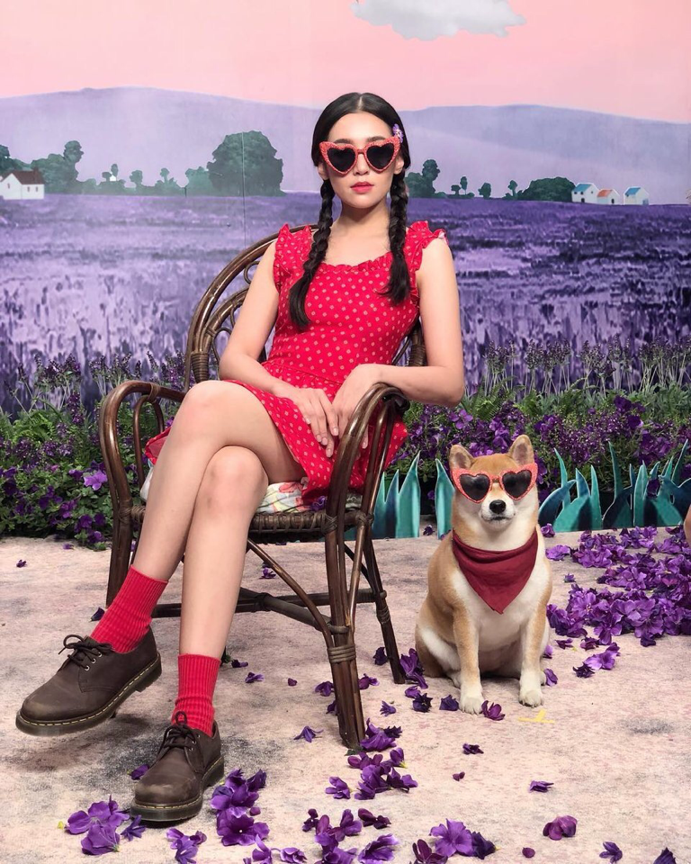
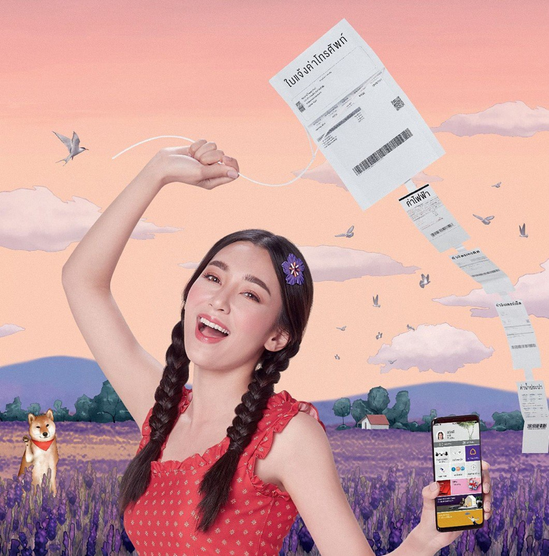
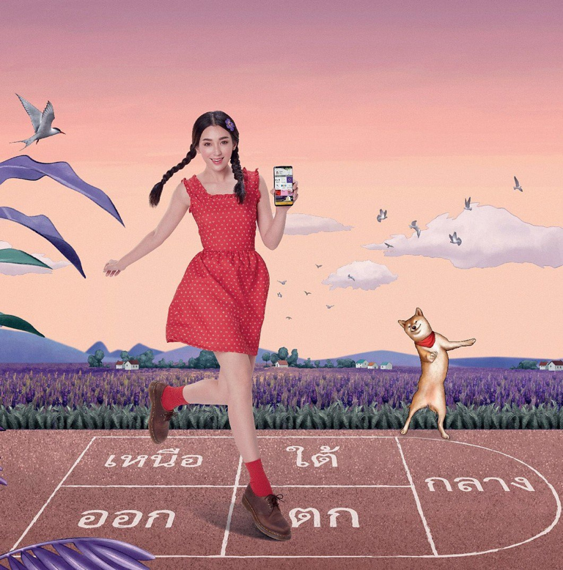
Developing Effective Communications

Slide 37


Slide 38
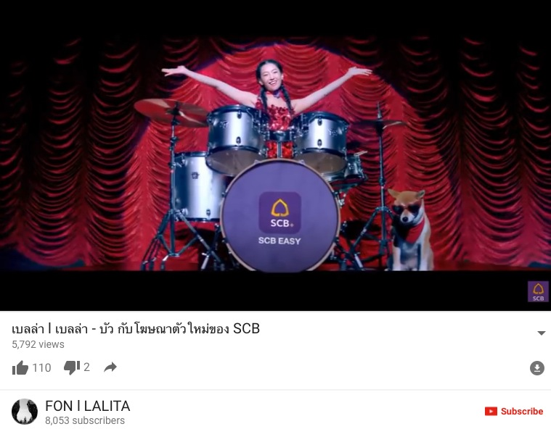

Slide 39
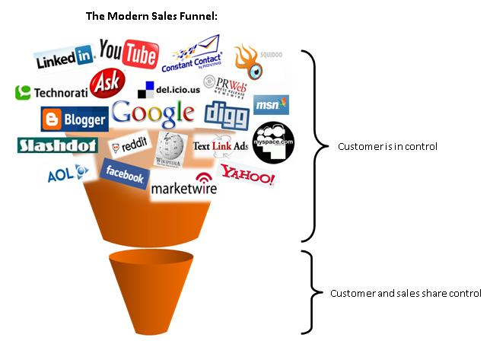

Developing Effective Communications
Step 4:
Choosing Media (Media Mix)
  Personal communication channels
    Includes face-to-face, phone, mail, internet chat communications, social media
    Word-of-mouth influence is often critical
    Buzz marketing cultivates opinion leaders
  Non-personal communication channels
    Includes media ie.TV, print ad, atmosphere, and events
    Selecting Media Source – celebrities, endorsers

Slide 40
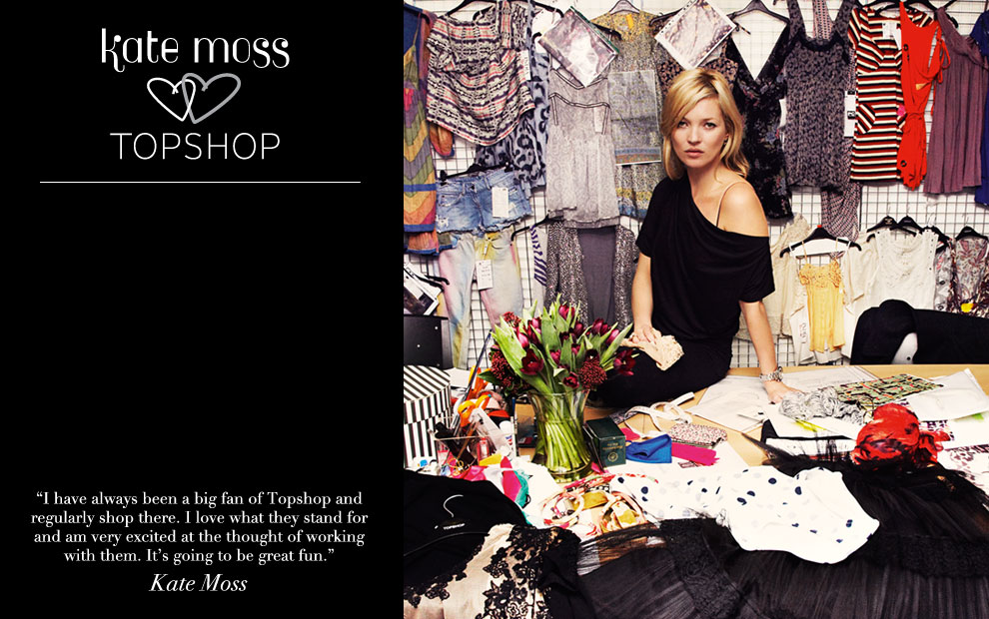
A range of clothing endorsed by model Kate Moss has been a huge selling point for retailer Topshop but allegations in her personal life could be damaging to their reputation and affect their sales.

Slide 41
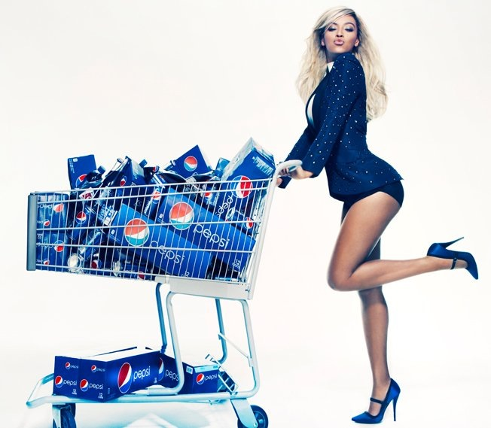
Using celebrity endorsers to represent brands-Beyoncé speaks for Pepsi.

Slide 42
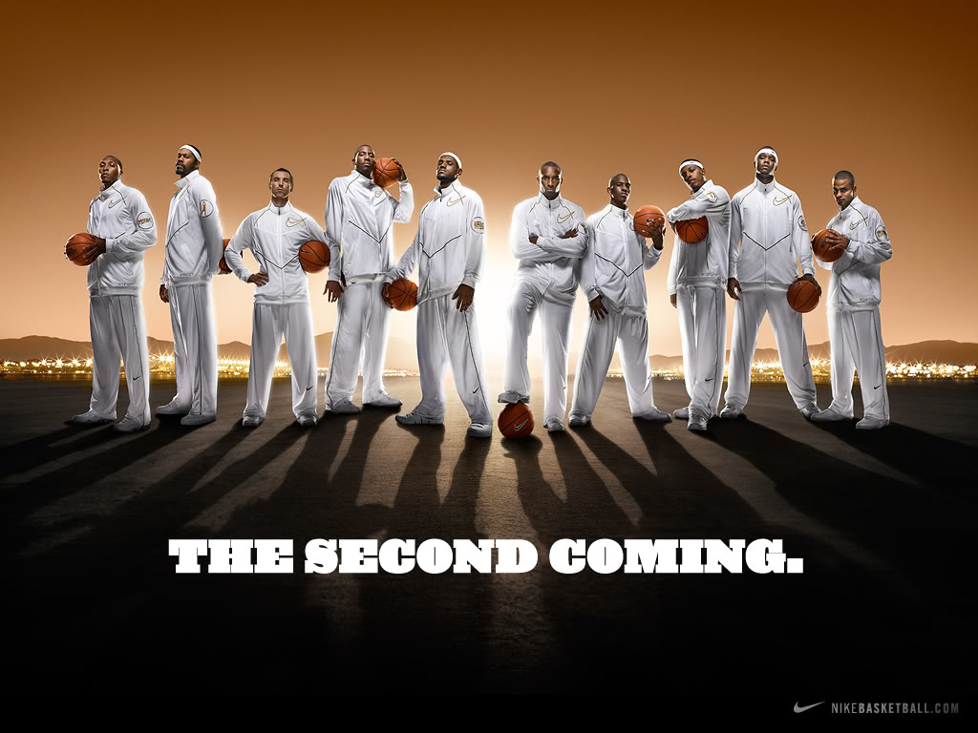
Celebrity endorsers: LeBron James, Kobe Bryant, and a host of other NBA superstars lend their images to Nike brands.

Slide 43
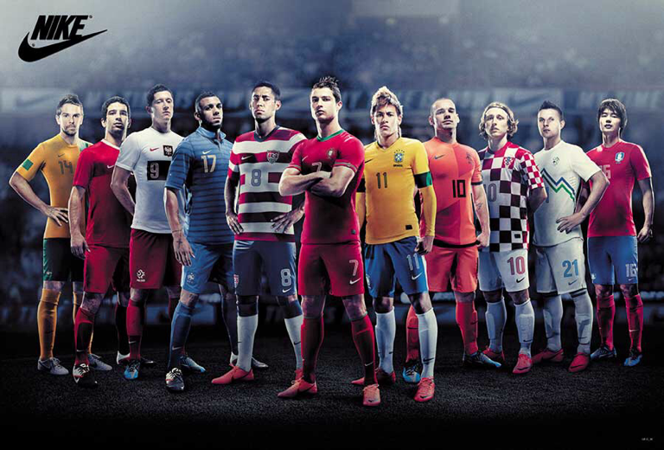

Slide 44
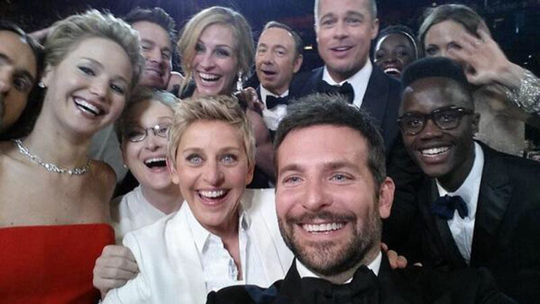
Celebrity Endorsers: Finding the Right Celebrity for the Brand
Celebrity endorsers: Academy Awards host Ellen DeGeneres used a Samsung Galaxy Note 3 phone to tweet out epic selfies to her 25 million followers.One was retweeted a record 2.7 million times, crashing the Twitter network.

