Slide 1
EE 460: Thai Economy
Early development theories
Rethinking growth strategies
The Middle Income Trap
Why Nations Fail by Acemoglu and Robinson
Thailand’s National Economic and Social Development Plans
Sources of Happiness
Fragile states
Bhanupong
Lecture 2

Slide 2
Main Themes
The Middle Income Trap (MIT)
Rethinking growth strategies
Why Nations Fail
National Economic and Social Development Plans
Sources of Happiness
Fragile state Index

Slide 3
Middle vs. Upper Income Countries
From $10,000 to $20,000
Robert Barro looked at countries that had at least doubled real per capita GDP since 1990. Within this group, he defined a middle-income success as having achieved a level of real per capita GDP in 2014 of at least $10,000.
An upper-income success requires a level of at least $20,000 (the numbers are in 2011 US dollars and factor in international adjustments for changes in purchasing power).

Slide 4
Countries which doubled real per capita GDP since 1990:
The world’s middle-income convergence success stories comprise China, Costa Rica, Indonesia, Peru, Thailand, and Uruguay (Uruguay is a surprise, apparently boosted by dramatic migration of human capital out of Argentina.)
The upper-income successes consist of Chile, Hong Kong, Ireland, Malaysia, Poland, Singapore, South Korea, and Taiwan.

Slide 5
Middle-Income Trap
A view that has gained recent popularity is the ‘middle-income trap’. The successful transition from low- to middle-income status is typically followed by barriers that impede a further transition to upper income.
The data suggest that this trap is a myth.
Moving from low- to middle-income status, as achieved recently by China, is difficult. Conditional on achieving middle-income status, the further transition to upper-income status is also difficult.
However, there is no evidence that this second transition is harder than the first one (Robert Barro).
If Barro is correct, how come Thailand has still stuck in the trap?

Slide 6
GDP per capita can be raised over the long term by means of:
  Capital deepening: an increase in the economy’s stock of capital—plant and equipment—relative to its workforce.
  Technological progress: the ability to produce more output without using any more inputs—capital or labor.
  This is about raising productivity
  (See Rodrick’s economics of growth
  on one page)

Slide 7
Rethinking growth strategy: new development theories
Growth is a complex process of economic, social, and political transformation.
New economic concepts were created to capture some of its dimensions.
Development strategies follow those new concepts in economic development theories.

Slide 8
Early Development Theories
Economic Backwardness
The big push
Dual economy and the unlimited supply of labor
The stages of economic growth
Dependency theory: Singer-Prebisch Hypothesis
The flying geese

Slide 9
Alexander Gerschenkron, Economic Backwardness in Historical Perspective: A Book of Essays. Cambridge, MA: Belknap Press of Harvard University Press, 1962. 456 pp.
The central notion is the positive role of relative economic backwardness in inducing systematic substitution for supposed prerequisites for industrial growth.
State intervention could, and did, compensate for the inadequate supplies of capital, skilled labor, entrepreneurship and technological capacity encountered in follower countries seeking to modernize.
England, the locus of the Industrial Revolution, could advance with free market guidance along the lines of Adam Smith.
France, beginning later, would need greater intervention to compensate for its limitations.
In Germany, the key innovation would be the formation of large banks to provide access to needed capital for industrialization, even as greater Russian backwardness required a larger and more direct state compensatory role.

Slide 10
Economic Backwardness
In Gerschenkron’s own hands, his propositions afforded an opportunity to blend ideology, institutions and the historical experience of industrialization, especially in the case of his native Russia, in a dazzling fashion.
For others, his approach has often proved a useful starting point for the historical discussion of other parts of the world, such as Henry Rosovsky did with Japan, and others, elsewhere.
Always, application of the backwardness approach requires close attention to detail, as well as a quantitative emphasis.

Slide 11
Gershcenkron: The more backwardness, the more intervention is required
(1) Relative backwardness creates a tension between the promise of economic development, as achieved elsewhere, and the continuity of stagnation. Such a tension takes political form and motivates institutional innovation, whose product becomes appropriate substitution for the absent preconditions for growth.
(2) The greater the degree of backwardness, the more intervention is required in the market economy to channel capital and entrepreneurial leadership to nascent industries. Also, the more coercive and comprehensive were the measures required to reduce domestic consumption and allow national saving.

Slide 12
Gershcenkron’s Historical Perspective
(3) The more backward the economy, the more likely were a series of additional characteristics: an emphasis upon domestic production of producers’ goods rather than consumers’ goods; the use of capital intensive rather than labor intensive methods of production; emergence of larger scale production units at the level both of the firm as well as the individual plant; and dependence upon borrowed,
(4) The more backward the country, the less likely was the agricultural sector to provide a growing market to industry, and the more dependent was industry upon growing productivity and inter-industrial sales, for its expansion. Such unbalanced growth was frequently made feasible through state participation.

Slide 13
Gerschenkron, Alexander.
Economic Backwardness in Historical Perspective.
The economic growth does not proceed as the stage of development theory suggested.
The economic backwardness plays an important role of the progress of one economy and that would decide whether such economy will evolve into other stages or not.
Is there any sign of economic backwardness in Thailand? Are we ready for Thailand 4.0 model of development?

Slide 14
Lewis( 1954): Dual economy, surplus labor
Economic Development with Unlimited Supplies of Labor.” Manchester School 22 (May): 139–191
W. Arthur Lewis, a British citizen, was awarded the Nobel Prize in 1979 along with Theodore Schultz for “pioneering research into economic development ... with particular consideration of the problems of developing countries.

Slide 15
Lewis’s Dual economy
A poor country’s economy can be thought of as containing two sectors, a small “capitalist” sector and a very large “traditional” (agricultural) sector.
Employers in the capitalist sector hire people to make money. Employers in the traditional sector, on the other hand, are not profit maximizing and, therefore, hire too many people so that their productivity is very low.

Slide 16
Transforming agriculture to manufacturing
Wage
Expansion of demand for labor due to the rise
of industrial output
Industrial profit rises as real wage rate remains constant
Until employment surpassing the L*
S^{L}
D^{L}
ω*
A
B
C
L
Lewis Turning
point
L*
labor

Slide 17
Lewis’ Strategy: Shift labor from agriculture to manufacturing
Lewis argued on this basis that the way to spur development in poor countries is to shift labor into manufacturing, where it is more productive.
The capitalists save out of their profit and use this saving to expand, which then adds to growth.
Has China (Cambodia) reached the Lewis turning point?

Slide 18
Rosenstein-Rodan (1961)
The Big Push Theory
The idea behind this theory is this that a big push or a big and comprehensive investment package can be helpful to bring economic development. In other words, a certain minimum amount of resources must be devoted for developmental programs, if the success of programs is required.
As some ground speed is required for the aircraft to airborne. In the same way, certain critical amount of resources be allocated for development activities. This theory is of the view that through 'Bit by Bit' allocation no economy can move on the path of economic development, rather a specific amount of investment is considered something necessary for economic development. Therefore, if so many mutually supporting industries which depend upon each other are started the economies of scale will be reaped.
Such external economies which are attained through specific amount of investment will become helpful for economic development.

Slide 19
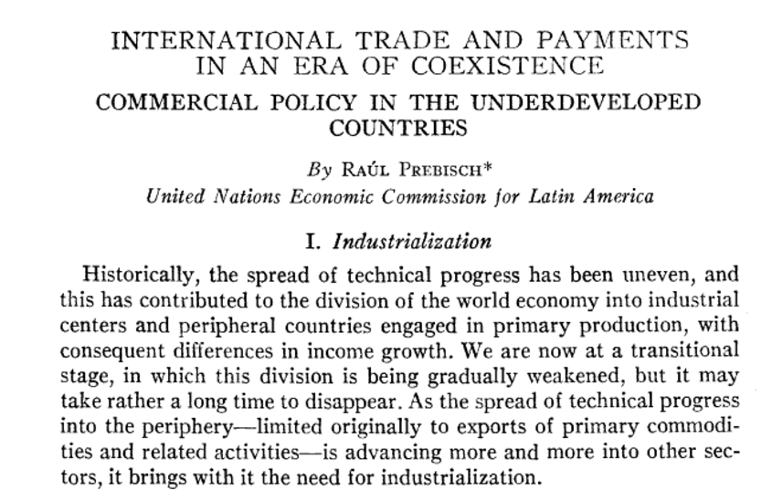
Raul Prebisch
The American Economic Review ( 1959)

Slide 20
The Singer-Prebisch thesis
It focuses on terms of trade between primary products (raw materials and resources used in the productive process - metals, agricultural products) and manufactured goods.
By examined data over a long period of time, Prebisch suggested that the terms of trade for primary commodities did have a tendency to decline since the income elasticity of demand for manufactured goods is greater than that for primary goods, especially food.

Slide 22
The Singer-Prebisch thesis
As income increases, the demand for manufactured goods increases more rapidly relative to demand for primary products.
As many developing countries tend to export primary products and import manufactured products, this implies the need to increase the volume of exports in order to keep importing the same level of manufactured and capital goods, or otherwise experience a deterioration of the trade balance.

Slide 23
The Singer-Prebisch thesis
Due to the declining terms of trade primary products face, they concluded that developing countries should strive to diversify their economies and lessen dependence on primary commodities export through developing their own manufacturing industry by structural change and industrialization.
Then came the idea of inward-looking strategy.

Slide 24
Rostow, W.W. The Stages of Economic Growth.
Cambridge: Cambridge University Press, 1971
Five stages of economic growth
Traditional society (lack of science, subsistence economy)
Preconditions for take-off (surplus from agriculture, extractive industries and transportation develop)
Take-off (rise of manufacturing, rapid infrastructure development, new leaders wishing for changes)
The drive to maturity (new technology and new industries, growth spread through out the country)
High Mass Consumption (Third wave of industrial revolution, automation, and welfare state)

Slide 25
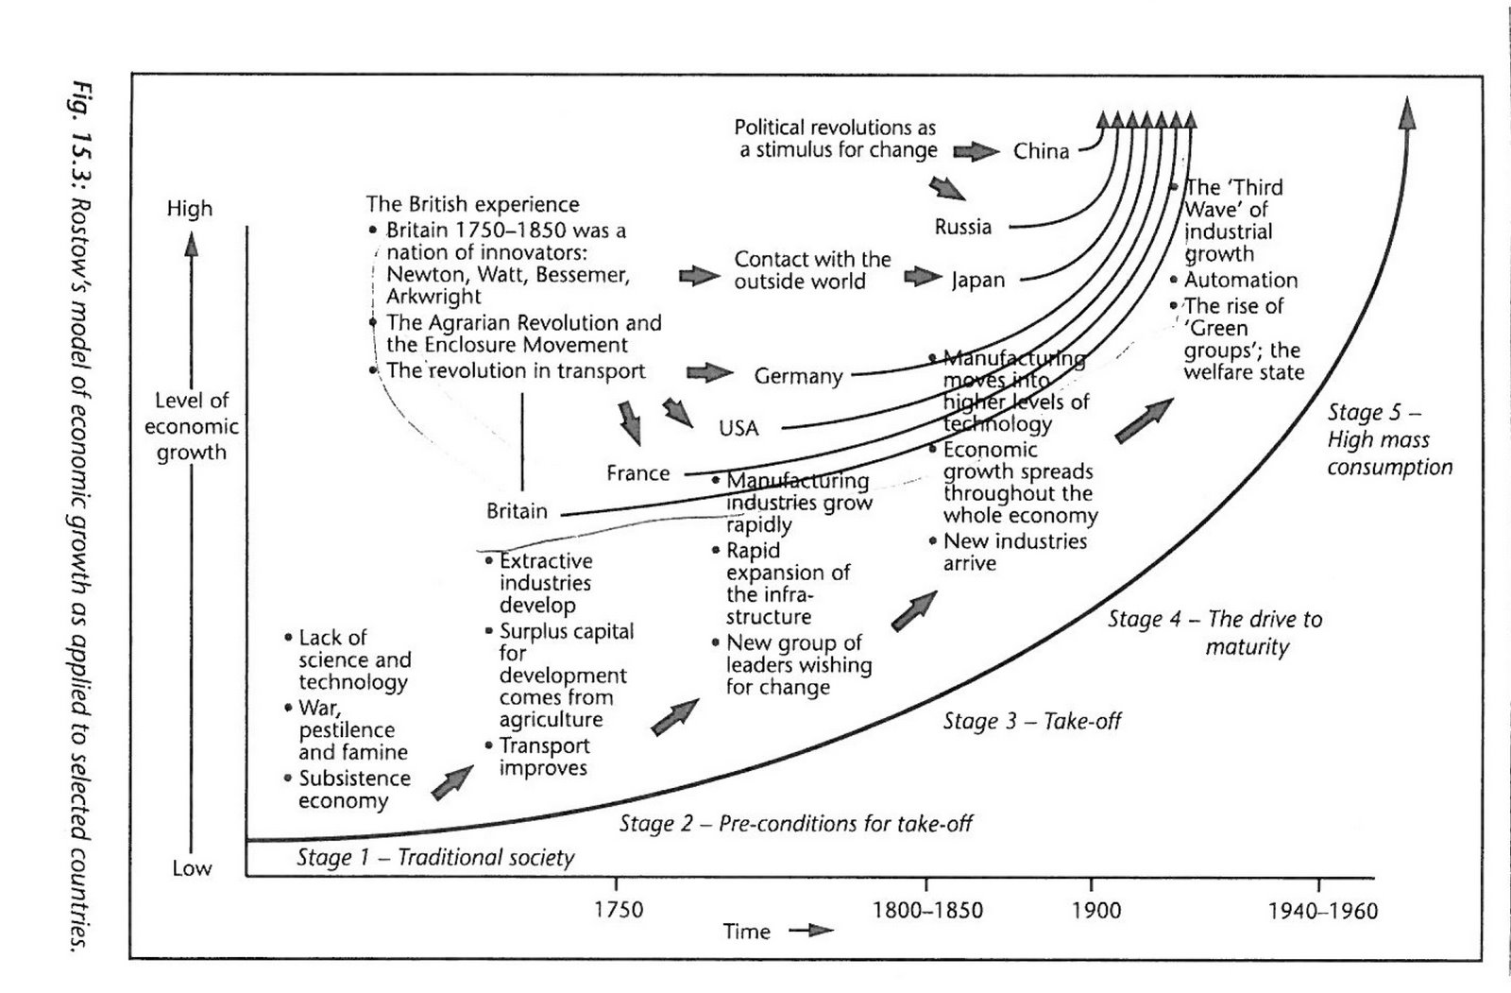
Rostow, W.W. The Stages of Economic Growth.

Slide 26
A HISTORICAL PATTERN OF ECONOMIC GROWTH IN DEVELOPING COUNTRIES
The Developing economies 1(1) 1962
Kaname Akamatsu
Akamatsu provides a model for international division of labor in East Asia based on dynamic comparative advantage.
The paradigm postulated that Asian nations will catch up with the West as a part of a regional hierarchy where the production of commoditized goods would continuously move from the more advanced countries to the less advanced ones.

Slide 27
Flying geese paradigm
“The underdeveloped nations aligned successively behind the advanced industrial nations in the order of their different stages of growth in a wild-geese-flying pattern.
"Depicting the catching-up process of post-war industrialization in Japan—a model successfully emulated by the East Asian ‘miracle’ economies, bringing hope to many other developing countries in Asia.

Slide 28
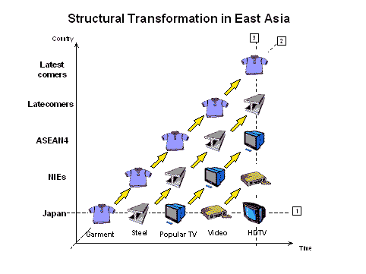
Myanmar
CLV
Newly Industrializing economies
NIEs
(NICs)

Slide 29
Kaname Akamatsu
The metaphor of flying wild geese
Sequential shifting of comparative advantage across economies, aided by factors such as foreign direct investment (FDI), structural change, infrastructure development, human capital formation, and industrial policy, unleashed trade-fueled economic development.

Slide 30
The FDI-driven economy
“FDI-driven economy” is the phrase used by many economists, meaning that foreign direct investment (FDI) is the major motive power for the national economy.

Slide 31
How many years would it take to double GDP?
The rule of 72
If an economy grows at x percent per year, output will double in 72/x years.
If Thailand has a 9 percent annual growth rate, then real GDP will take 8 years to double (72/9) = 8.
If would take 18 years to double GDP if it grows at 4 % annually, 24 years if 3%.
Thailand’s NESDB set 5% GDP growth target for 2017-21
Too pessimistic (optimistic)?

Slide 32
There's No Such Thing as an Economic Miracle
Most of the world’s wealthiest and best-governed countries got there without super-rapid bursts of growth.
Denmark, which has a per capita income of $ 52,000 and is frequently ranked as one of the happiest countries in the world, never experienced what anyone would call an economic miracle.

Slide 33
The ability to maintain steady growth
Denmark’s overall economic record is gloriously boring.
From 1890 to 1916, per capita growth averaged about 1.9 percent per year, and if in 1916 you had forecast that this pace would continue for another 100 years.
Denmark had positive growth about 84 percent of the time and no deep recessions

Slide 34
The lucky country: Australia’s long boom
The 2017 Quarterly GDP figures show that Australia now matches the Dutch record for the longest stretch of economic growth in a developed country: 103 recession-free quarters.
The roots of growth lie in reforms of the 1980s and 1990s—tariff cuts, a floating currency and central-bank independence.
Chinese-fuelled mining boom cushioned the financial crisis. Construction, immigration and a weaker currency have averted the kind of bust that followed earlier resource bonanzas.
But Australia will limp, not sprint, to the title. Household spending slackened along with wage rises in the first quarter, so growth is likely to be flat or even negative, the second time in three financial quarters.
The two consecutive shrinkages that would mark a recession are unlikely later this year, but not impossible. Politicians hope their luck continues.

Slide 35
Successful growers avoided downturns and kept growth steady
Number of years(1960-2002) which growth rate was:
 | negative | <1 | <2 | >2
LDCs | 14 | 19 | 24 | 18
Thailand | 5 | 8 | 16 | 27
OECD | 3 | 3 | 4 | 38

Slide 36
A Model of Asian Tigers
Slow growth doesn’t mean that the U.S. or Denmark were failures in the 19th century.
It’s hard for economies at or near the technological frontier to rapidly improve living standards, because invention is usually slower than playing catch-up by borrowing technologies from wealthier nations.
Such borrowing of know-how, along with exports and rapid investments in education and infrastructure, is what later allowed the Asian tigers of Japan, South Korea, Taiwan, Hong Kong, Singapore and China to achieve growth rates of 8 percent to 10 percent a year.

Slide 37
Timeline of Thailand’s development planning
1st Development Plan (1961-1966)
Import substitution
Infrastructure Investment
Promotion of private investment
Institutional establishment: Board of Investment(BOI) National Economic and Social Development Board (NESDB), Bureau of the budget ( BOB), Fiscal Policy Office (FPO)

Slide 38
Early economic plans: Objectives and Missions
2nd Development plan (1967-1971)
Export promotion
Growth was driven by public investment in infrastructure
3rd Economic and social development plan (1972-1976)
Investment in rural area and education

Slide 39
Economic and Social Development Plans
4th Plan (1977-1981)
Increasing security spending,
Reducing social gaps,
Restoring natural resources
5th plan (1982-1986)
Public and private cooperation,
Rural development and investment

Slide 40
Economic and Social Development Plans
6th plan (1987-1991)
Maintain economic growth
Upgrade quality of life
7th plan (1992-1996)
income distribution,
improve quality of live and environment

Slide 41
Trend of (indicative) economic plans
8th plan (1997-2001)
Human-centered development
Public participation
Sustainable development
9th plan (2002-2006)
Competitiveness
Financial immune system
Self-reliant and resilient society

Slide 42
A policy shift in the 10th plan
(2007-2011)
Sufficiency economy
Green growth
Sustainable development

Slide 43
The 11th National Economic and Social Development Plan (2012-2016)
To develop Thailand into a happy society with equity, fairness, and resilience.
Apart from promoting a peaceful society with good governance, the 11th Plan also aims to promote sustainable development through the restructuring of the economy, society, and politics, while nurturing natural resources and the environment.
Another objective is to prepare the people and the community to be resilient to changes.

Slide 44
Richard Layard
Happiness
New York: Penguin Press, 2005
Once subsistence income is guaranteed, making people happier is not easy.
If we want people to be happier, we really have to know what conditions generate happiness and how to cultivate them.

Slide 45
Sources of happiness
Proportion of people who say that other people can be trusted.
Proportion of people who belong to social organizations.
Divorce rate
Unemployment rate
Religious belief
Quality of government

Slide 46
What makes people happy
We are programmed to seek happiness.
Humans are social beings, wanting to trust each other.
People are deeply attached to the status quo.
Human beings are status conscious.
Human beings are very adaptable.
Extra income increases happiness less and less as people get richer.

Slide 47
Fragile States
The Fragile States Index, produced by The Fund for Peace, is a critical tool in highlighting not only the normal pressures that all states experience, but also in identifying when those pressures are pushing a state towards the brink of failure.
By highlighting pertinent issues in weak and failing states, The Fragile States Index makes political risk assessment and early warning of conflict accessible to policy-makers and the public at large.
The Fragile States Index is an annual ranking of 178 nations based on their levels of stability and the pressures they face.

Slide 48
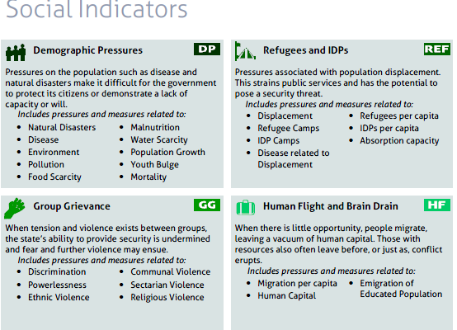

Slide 49
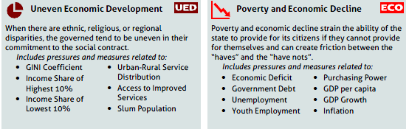
Economic Indicators

Slide 50
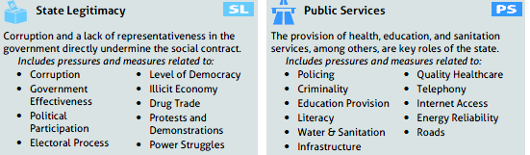
Political and Military Indicators

Slide 51
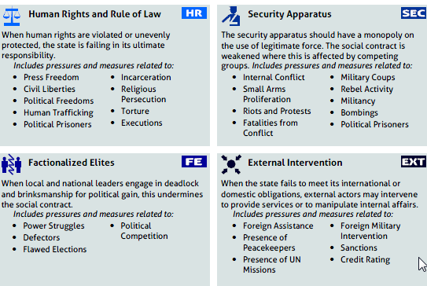
Political and Military Indicators

Slide 52
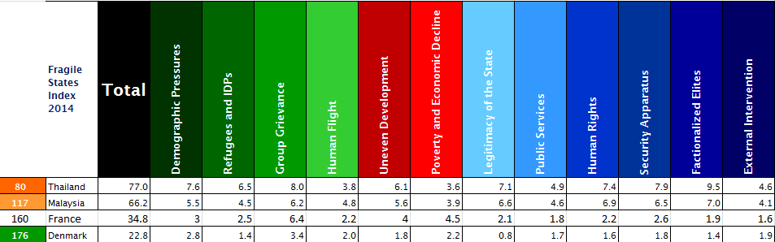
Thailand’s Fragile State Index in comparison (2014): 77.0
Fractionalized Elites: 9.5
Human right: 7.4
Legitimacy of state: 7.1

Slide 53
Why Nations Fail
Daron Acemoglu and James Robinson (AR)
Book Reviews by William A. McCleary in Thammasat Economic Journal, 31(1) March 2013
Rejection of three alternative explanations of why experiences of various countries has been different: Geography, culture, and ignorance of correct policies.

Slide 54
Extractive institutions
Nations are poor because they do not have institutions which allow them to generate growth potential.
Political institutions in which power is heavily concentrated.
The extractive institutions do not create an environment in which a large proportion of population can share in the benefits.

Slide 55
Inclusive institutions
Political institutions in which power is widely shared and many groups can participate in the decisions which affect their prosperity and access to public services.
Institutions that generate opportunities to invest, create new or better products, self-improvement.
By securing property rights, an objective system of law, and limited monopoly privileges.

Slide 56
Examples of inclusive and extractive institutions
England in the industrial revolution was an example of inclusive institutions
The Glorious Revolution (1688): the king could exercise power only with the consent of parliament and made the government more responsive to a wider set of groups in society.
Extractive societies of Soviet Russia and China which has experienced years of spectacular growth could slow down.
The slowdown is now occurring in Russia and China.

Slide 57
How to measure quality of government
Governance indicator
Press freedom index
Regulatory quality
Political stability
Voice and accountability
Rule of law
www.govindicators.org
The Worldwide Governance Indicators (WGI) provided by the World Bank

Slide 58
Can public policy make people happy?
Public policy can more easily remove misery than augment happiness.
To live happily is an inward power of the soul” Aristotle
Hence, happiness depends on your inner life as much as on your outer circumstances.

Slide 59
International suicide statistics
Over one million people die by suicide worldwide each year.
The global suicide rate is 16 per 100,000 population
On average, one person dies by suicide every 40 seconds somewhere in the world.
1.8% of worldwide deaths are suicides.
Global suicide rates have increased 60% in the past 45 years.

Slide 61
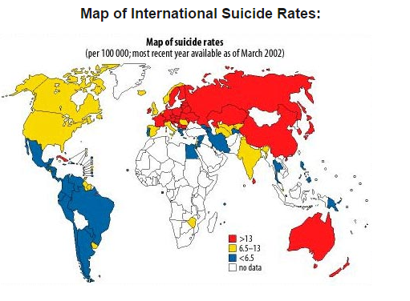
Source: www.suicide.org

Slide 62
The 12th National Economic and Social Development Plan (2017-2022)
Strengthen competitiveness
Reduce income inequality
Provide safety net for the ageing population
Infrastructure development and logistics
Special economic zones
Cooperation with neighboring countries for greater connectivity
Development of technology and innovation by increasing R&D expenditures (Thailand 4.0 Model)

Slide 63
Review questions
1. Explain how Thailand’s economic development plans evolved around development theories and changing socio-political environment.
2. Utilize Layard’s sources of happiness to examine the impact of economic development on happiness of the Thais over the past three decades.
3. Select two development plans that you think they had provided the most important contribution to the Thai economy. Provide evidence to support your arguments.
4. Can sufficient economy principle serve as immunization for a country under globalization?
5. Is Gross National Happiness (GNH)more superior than Gross National Product (GNP)?
6. Is there still any sign of economic backwardness in Thailand in 2017? Are we ready for Thailand 4.0 model of development? Is it a claptrap?

