Slide 1
Equity Analysis FN 451
- Banking sector analysis

Slide 2
Agenda
Balance sheet & Profit & Loss
Loans growth forecast
NIM forecast
Non-interest income forecast
Non-interest expense forecast
Risk Analysis
Forecast & Valuation

Slide 3
Balance Sheet Structure
Balance Sheet
Assets = Liabilities + Equity
Interbank lending Interbank borrowing
Loans Deposits
Investments Borrowing*
* Banks prefer to issues subordinated debentures as the subordinated debentures with years to maturity of over 5 years can be counted as Tier-2 capital.

Slide 4
Balance Sheet Structure
Balance Sheet
BBL case study: Calculate 1) average earnings assets
2) average sources of funds.

Slide 5
Profit & Loss
Interest Income
Interest Expense
Net Interest Income
Non-Interest Income
Non Interest Expenses
Pre-provisioning Operating Profit (PPOP)
Provisioning
Profit before taxes
Taxes
Net Profit
Total revenue = Net interest income + Non-interest income
BBL case study: Calculate 1) total revenue

Slide 6
Key P&L ratios
Interest Spread
= Interest yield - Interest cost
Net Interest Margin (NIM)
= Interest income – Interest expense
(Average earning assets)
BBL case study: Calculate 1) Interest spread
2) NIM

Slide 7
Key P&L ratios
Credit Cost
= Provision expense / Average loans
BBL case study: Calculate 1) Credit cost

Slide 8
NIM & Credit cost
Case study:
Bank A’s NIM was 3.50% and its normalized credit cost to loans in 2011 was 50bps.
Bank B’s NIM was 4.25% and its normalized credit cost to loans in 2011 was 155bps.
Which bank’s lending business is more profitable?

Slide 9
Agenda
Balance sheet & Profit & Loss
Loans growth forecast
NIM forecast
Non-interest income forecast
Non-interest expense forecast
Risk Analysis
Forecast & Valuation

Slide 10
Loans Growth Forecast
Correlation between Loan growth VS nominal GDP growth
Source: BoT, NESDB

Slide 11
Loans Growth Forecast
Nominal GDP Growth = Real GDP Growth + Inflation

Slide 12
Loans Growth Forecast
GDP = private consumption + gross investment + government spending + (exports - imports)

Slide 13
Loans Growth Forecast
Bottom up: Loans breakdown
Source: Companies presentation, Interview banks

Slide 14
Case study: Bottom up loans growth forecast
An analyst forecast GDP growth in 2012 of 5.0%. Estimated headline CPI is 3.5%. The key drivers for the GDP growth in 1H12 mainly come from private consumptions. Given banks’ loans structures provide below, which bank(s) should perform well in term of loans growth in 2012?

Slide 15
Agenda
Balance sheet & Profit & Loss
Loans growth forecast
NIM forecast
Non-interest income forecast
Non-interest expense forecast
Risk Analysis
Forecast & Valuation

Slide 16
NIM Forecast
Deposit Structure
Source: Financial statements
Which bank(s) should have the lowest cost of fund?

Slide 17
NIM Forecast
Assets & liabilities mismatch = Assets duration - Liability duration

Slide 18
Agenda
Balance sheet & Profit & Loss
Loans growth forecast
NIM forecast
Non-interest income forecast
Non-interest expense forecast
Risk Analysis
Forecast & Valuation

Slide 19
Non-interest income
Non interest income structure (System)
Source: BoT

Slide 20
Gain from Investment

Slide 21
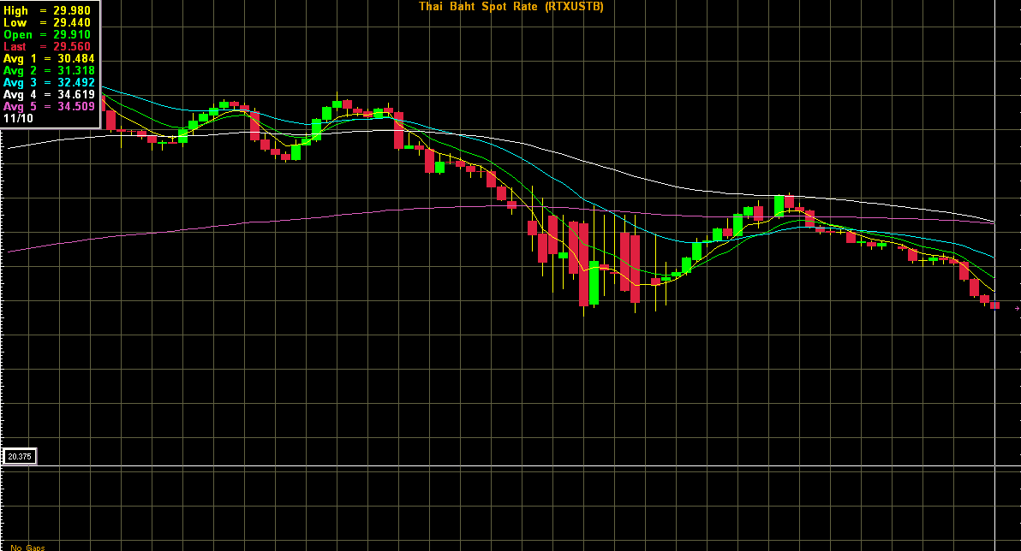
FX Gain
Source: Bisnews

Slide 22
Agenda
Balance sheet & Profit & Loss
Loans growth forecast
NIM forecast
Non-interest income forecast
Non-interest expense forecast
Risk Analysis
Forecast & Valuation

Slide 23
Non-interest expense
Source: Financial Statement

Slide 24
Non-interest expense
Number of ATM machine
Number of banks’ branches
Source: BoT, Company presentation, Interview banks

Slide 25
Agenda
Balance sheet & Profit & Loss
Loans growth forecast
NIM forecast
Non-interest income forecast
Non-interest expense forecast
Risk Analysis
Forecast & Valuation

Slide 26
Credit Risk
NPL = Non-performing loans
Asset quality ratios:
Credit cost = Provision expense / Average loans
NPL / Total loans
LLR / NPL
LLR / Total loans
LLR / BoT’s loans minimum requirement
Collateral / NPL
BBL case study: Calculation of asset quality ratios

Slide 27
Credit Risk
Classified loans
Outstanding debt after deduction of collateral value / NPV o f cash flow from debtors or sales of collateral
Loans & accrued
Interest receivables
Allowance for
Doubtful account
Pass | 918,078 | 312,391 | 1 | 3,124
Special Mention | 19,235 | 4,315 | 2 | 86
Sub-Standard | 4,673 | 1,693 | 100 | 1,693
Doubtful | 7,407 | 2,562 | 100 | 2,562
Doubtful of Loss | 23,004 | 13,234 | 100 | 13,234
Total | 972,397 | 334,195 |  | 20,699
Allowance established in
excess of BoT’s regulations | - |  |  | 10,298
Credit balance transaction | 2,078 |  |  | -
Loan from Life Insurance business | 5,291 |  |  | 122
Total | 979,766 |  |  | 31,119
Source: Footnote to financial statement

Slide 28
Liquidity Risk
Liquidity Risk = Risk of unable to meet financial obligations due to lacks of liquidity
Liquidity risk ratios:
Loans to deposits Ratio = Total loans / Total deposits
Loans to deposits & borrowings ratio = Total loans / (Total deposits + Total borrowings)
Net excess liquidity = Cash + Interbank assets – Interbank liabilities
BBL case study: Calculation of liquidity ratios

Slide 29
Liquidity reserve requirement
The BoT requires banks to maintain liquidity reserve of at least 6% of deposit plus BEs plus foreign borrowings due within one year.
Assets that can be counted as liquidity reserve:
Cash deposited at the BoT at least 0.8%
Cash at Central Bank Cash Center at least 1%
Deposits at other banks, combined with cash at Central Bank Center no higher than 2.5%
Government bonds, the BoT bonds, SoE bonds, bonds guaranteed by the BoT

Slide 30
Case study: Liquidity Risk
Case study:
Bank A’s loan to deposit and borrowing ratio is 85%.
Bank B’s loan to deposit and borrowing ratio is 95%.
- Which bank is more conservative in liquidity management?

Slide 31
Liquidity Risk
Liquidity analysis measure by duration gap
> The Gap analysis worksheet shows the maturity and repricing schedules for all of the earning assets and interest-bearing liabilities.
>Comparing the value of assets that mature or repriced at each point in time with the value of the liabilities that mature or reprice reveals the exposure of earnings to changes in interest rates.

Slide 32
Market Risk
Market risk = the risk of losses in positions arising from movements in market prices.
Types of market risk: Interest rate risk, Currency risk

Slide 33
Interest rate risk: GAP analysis

Slide 34
Capital Risk
Capital Risk = Risk of having insufficient capital to pay for liabilities.
Capital risk is measured by Capital Adequacy Ratio (CAR) CAR = Capital / Risk-weighted assets
BoT’s requirement for CAR:
Minimum Tier-1 CAR = 4.25%
Minimum Total CAR = 8.50%

Slide 35
Capital Risk
Tier 1 Capital: paid-up capital, share premium, warrants, legal reserve, other reserves, retained earnings, hybrid capital
Tier 2 Capital: revaluation, reserve for normal loans, subordinated debentures with maturity over 5 years
Risk-weighted assets: Pool of banks’ assets weighted by given risk factors.
BBL case study: Calculation of capital ratios

Slide 36
Capital ratio & Loan expansion ability
Loan expansion ability
=> Minimum capital adequacy ratio (CAR) = 8.5% (min Tier 1 CAR = 4.25%)
=> Maximum exposure to single client = 25% of equity
Source: Calculate from financial statements
Case study: Loan expansion ability

Slide 37
Basel II capital requirement:
Credit & Operational Risk
BASEL II capital requirement
1) Credit Risk
2) Operation Risk

Slide 38
Basel II: Credit risk
Risk base estimation base on Basel II
Standardised Approach (SA): Banks’ assets weighted by risk factors.
Foundation Internal Ratings-based (FIRB) Approach: Risks weight assigned for Probability of default (PD), Loss given default (LGD), Exposure at default (EAD), Maturity (M). Require banks’ historical statistics on the above factors. The PD is determined by banks, while the remaining factors determined by the BIS.
Advanced IRB Approach (AIRB) Risks weight assigned by banks, based on banks’ historical statistics, for Probability of default (PD), Loss given default (LGD), Exposure at default (EAD), Maturity (M). Require banks’ historical statistics on the above factors. The PD is determined by banks, while the remaining factors determined by the BIS.

Slide 39
Basel II: Operational Risk
1) Basic Indicator Approach (BIA)
Required capital = 3-years average income x 15%
2) Standardised Approach (SA)
Required capital = 3-years average income in each business division x capital weight for each business division
3) Advance Measurement Approaches (AMA)
Required capital = 3-years average income in each business division x capital weight for each business division assigned by banks based on each bank historical risk statistics.

Slide 40
Basel III: Capital Risk
Basel III is a global regulatory standard agreed upon by the members of the Basel Committee on Banking Supervision in 2010-11
Basel III covers three areas:
Bank capital adequacy
Stress testing
Market liquidity risk

Slide 41
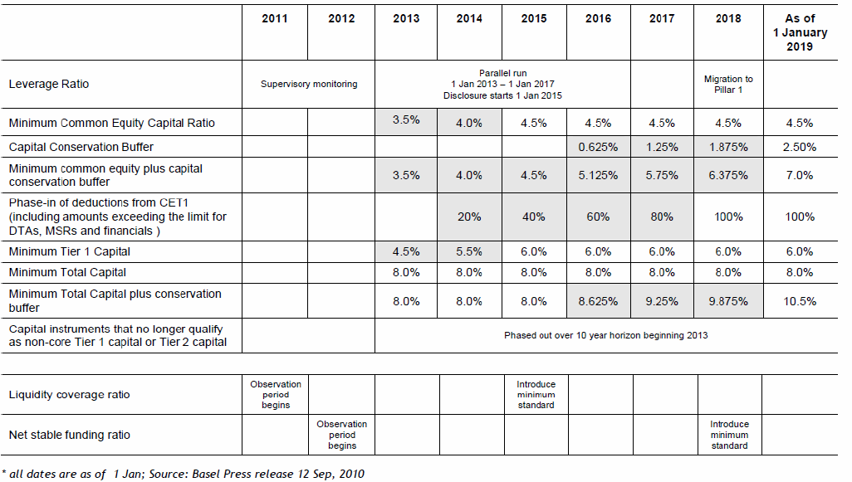
Capital Risk: Basel III
BASEL III Time line

Slide 42
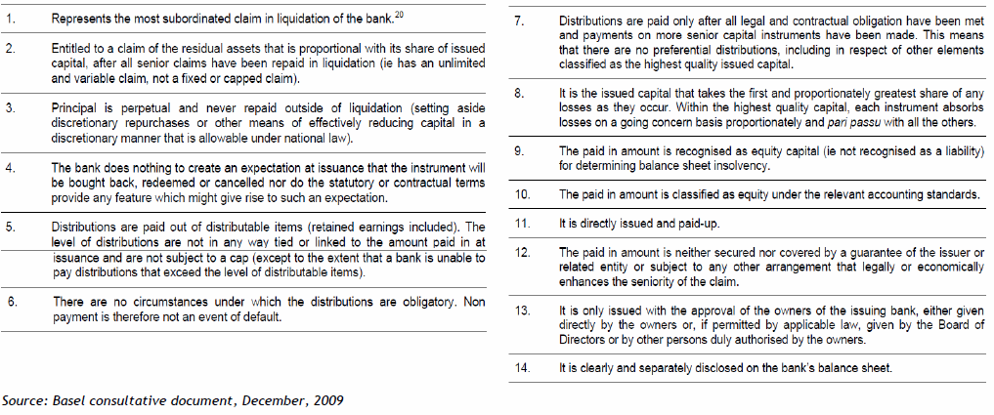
Capital Risk: Basel III

Slide 43
Tier 1 capital: Basel III
Tier I capital is capital that is available to absorb losses on a "going-concern" basis, or capital that can be depleted without placing the bank into insolvency or liquidation.
Tier I capital is comprised Common Equity Tier I capital and Additional Tier I capital.
Common Equity Tier I capital includes common shares and retained earnings.
Additional Tier I capital mainly consists of instruments issued by the bank which are able to meet specific criteria (and are not included in Common Equity Tier I capital).

Slide 44
Capital conservation buffer & Counter-cyclic capital buffer: Basel III
Capital conservation buffer intended to be available to be drawn down during periods of stress.
Counter-cyclic capital buffer: A separate counter-cyclical buffer has also been introduced to ensure that the banking sector's capital requirements take account of the macro-economic environment in which banks operate. This buffer be determined by the relevant regulator in each jurisdiction. The regulator will determine the level of the buffer according to its perception of the systemic risk that has built up in the banking system as a result of excess credit growth.

Slide 45
Agenda
Balance sheet & Profit & Loss
Loans growth forecast
NIM forecast
Non-interest income forecast
Non-interest expense forecast
Risk Analysis
Forecast & Valuation

Slide 46
Key Targets
Source: KBANK

Slide 47
Valuation: PBV
Commonly used methodology: P/BV
Banks make profit from both size of their balance sheet.
Ability to expand a balance sheet capped by leverage ratio.
Banks’ profit growth and ROE are relatively stable.
Determinations of PBV:
  PBV for a stable growth firm derived from DDM = [ROE * Payout ratio ] / [r - gn ] or [ROE – gn ] / [r - gn ]
  The higher ROE the higher PBV.
  The higher payout ratio the higher PBV.
  The higher net profit growth the higher PBV.
  The higher required rate of return the lower PBV

Slide 48
Valuation: PBV
Banks’ ROE are relatively stable
* Adjusted ROE (%) = ROE assume capital reduction or capital increase in order to make Tier1 CAR to be in par with the sector of 12%.
Close price as of 12 Nov, 2010
Source: Financial statements, Bisnews, KS estimate

Slide 49
Valuation: DDM
Commonly used methodology: DDM
Multi-stage DDM is the most preferred valuation method for valuing banks.
Banks pay steady dividend flows and the payout ratio is stable.
Banks’ CAPEX is small.
Dividend payments taken into account different provision level and tax rate.
Dividend payout ratio reflects different assets quality and capital adequacy profile.

Slide 50
Valuation: DDM
Key considerations: DDM
Critical assumptions of the model:
Reasonable future estimates of earnings
  Capital level
  Funding ability to support growth
  Clients segment focus
  Networks (branches, ATM)
  Market positioning and brand recognition
Appropriate discount rate
  Stock liquidity
  Size, risk, profitability
Determination of maximum payout ratio and sustainable growth rate
  Growth rate in the matured stage will we close to or below the economy growth.

