Slide 1
EE461
Development microeconomics
Chayanee Chawanote
Semester 2/2018 (Jan – May, 2019)
Office: Room 6, 4th Floor (computer lab building)
Email: chayanee@econ.tu.ac.th
Office hours: Tuesday & Thursday, 2:00-3:30 PM (or by appointment)

Slide 2
EE461
Economic inequality and income distribution
Agriculture in modern world
POVERTY
FIRM and development
HUMAN CAPITAL
Education
Consumption smoothing
Health
Saving behavior
Population
Gender
CREDIT
MARKET FAILURE in RURAL
AREA
POLITICAL ECONOMY
and Corruption
Insurance

Slide 3
Recommended Textbooks
Ray, Debraj. (1998). Development Economics, Princeton University Press. [HD75 .R39]
[MR] Meier, Gerald M., and Rauch, James E. (2005). Leading Issues in Economic Development, 8th Edition, Oxford University Press. [HD82 .M42 2005]
Todaro, Michael P., and Smith, Stephen C. (2012). Economic Development, 11th Edition.
Deaton, Angus. (1997). The Analysis of Household Surveys: A Microeconometric Approach to Development Policy, The Johns Hopkins University Press. [You can download The World Bank published version here: http://documents.worldbank.org/curated/en/1997/07/694690/analysis-household-surveys-microeconometric-approach-development-policy]

Slide 4
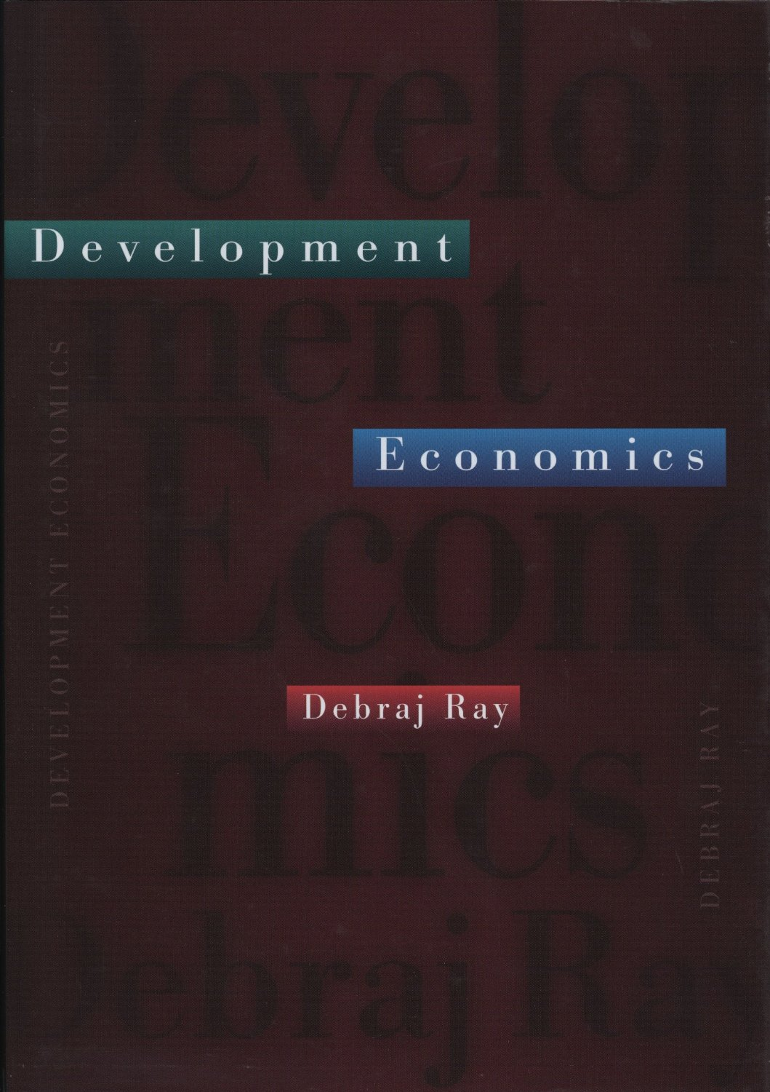
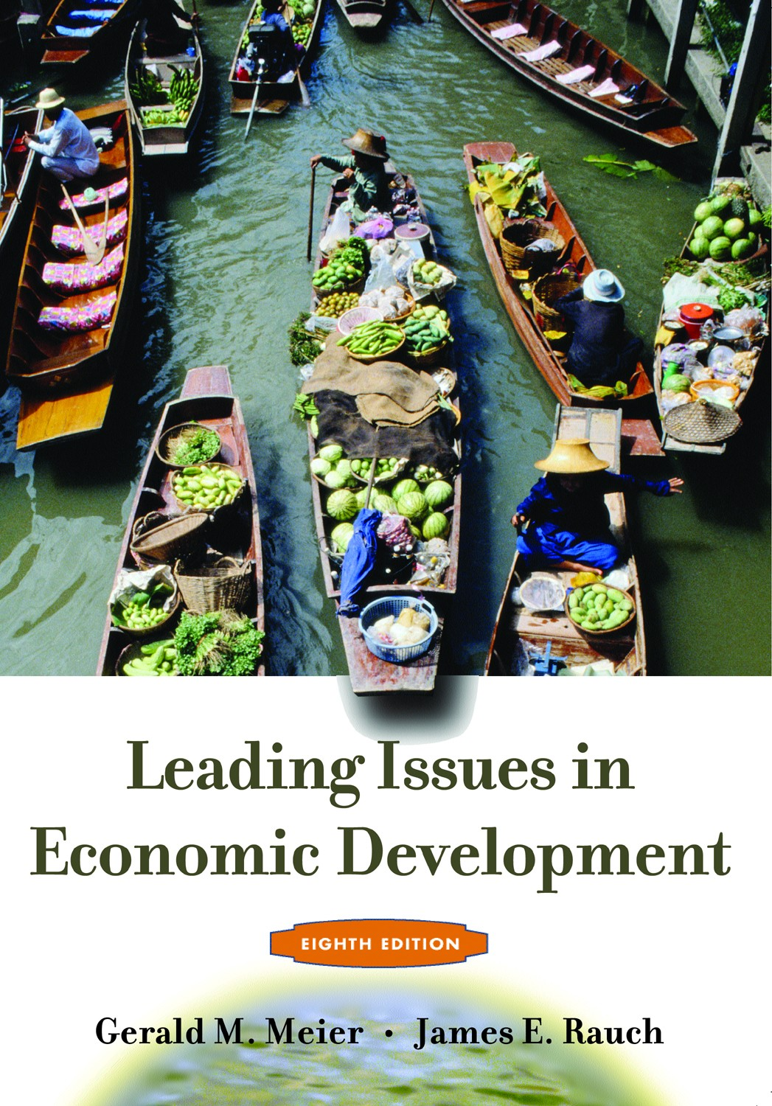
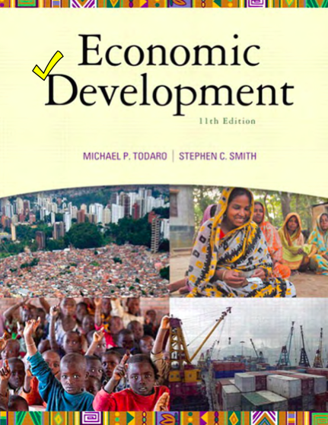
Recommended Textbooks

Slide 5
Semester plan
Date | Topics
Week 1 | 1. Economic Development: Overview & Data Basic
Week 2-3 *No class on Jan 24 But assignment on Econ Symposium | 2. Economic Inequality and Income Distribution - Measurement of income inequality - The U hypothesis relating income inequality and economic development - Inequality, savings, income, and growth - Inequality, capital markets, and development
Week 4-5 *Makeup class for Feb 19 (Makha Bucha) >> 17-19.30 for Watching Poverty Inc. | 3. Poverty - Conceptual issues and poverty measures - The economic lives of the poor; Poor but rational - Poverty and scarcity: a behavioral approach - Applying Behavioral Economics in Development Microeconomics

Slide 6
Semester plan
Date | Topic
Week 6-7 | 4.1 Human Capital: Education - The contribution of education to economic growth - Economic impact of education - Interpreting recent research on schooling in developing countries 4.2 Human Capital: Health - Health: impact of poor health on development
Week 8 (March 7) | 12.00-14.00: Midterm Exam
Week 9 *Makeup class for Mar 14 | 4.3 Human Capital: Population - Economic approaches to population growth 4.4 Human Capital: Gender and Development - Gender inequality at the start of the 21st century

Slide 7
Semester plan
Date | Topic
Week 10 *Field trip around end of March | 5. Agriculture - Overview of agriculture in a modern world - Rural-urban interaction - A World without agriculture? - Markets in Agriculture
Week 11-14 * Apr 12 - 18: Songkran week (no classes) | 6. Consumption Smoothing, Savings, Credit and Insurance - Consumption smoothing - Saving behavior and permanent income hypothesis - Rural credit markets - Formal credit and insurance rationing - Rural household’s risk management
Week 14 | 7. Firm and Labor - Entrepreneur’s characteristics in developing countries - Bottlenecks for entrepreneurship in developing countries - Transformations in the Thai labor market

Slide 8
Semester plan
Date | Topic
Week 15 | 8. Political Economy and Corruption - Corruption and monitoring
Week 16 | 9. Natural Resources, Environment, and Development - Poverty and environment - Climate change and the poor
Last day (May 9) *Makeup for Royal Ploughing Ceremony | Project presentation
May 14: 9.00-12.00 | Final Exam

Slide 9
Grading:
Participations & assignments 10%
Research project 10%
  Proposal due Apr 4 (after midterm)
  Final report
Discussions 10%
Midterm exam 30%
Final exam 40%

Slide 10
Participation includes discussions in class and exchanging interesting topics/stories related to course topics from reading articles (e.g. from The Economist, WSJ, ThaiPublica) or development blogs. You can find some interesting blogs:
  http://blogs.worldbank.org/ (There are many blogs under the World Bank blogs)
  http://blogs.adb.org/
  http://chrisblattman.com/
Students have to develop a research paper (option 1) using any dataset on any topic that they are interested and hand in infographic-type presentation, or (option 2) creating any innovation to help the poor with better living. The paper’s contents include research motivation, review literature, data analyses or problem analyses and discussion on the research questions. The draft proposal (1-2 pages) needs to be submitted by Apr 4, 2019. Final paper will be due at the end of the semester.

Slide 11
http://data.worldbank.org/
http://data.worldbank.org/data-catalog/world-development-indicators
http://blogs.worldbank.org/opendata/
http://blogs.worldbank.org/category/tags/dataviz

Slide 12
Discussions will use the following readings:
Topics | Readings
4.1 | To Learn (from More Than Good Intentions by Dean Karlan and Jacob Appel)
4.2 | Low-Hanging Fruit of Better (Global) Health (from Poor Economics by Banerjee and Duflo)
6 | To Save (from More Than Good Intentions by Dean Karlan and Jacob Appel)
6 | To Borrow (from More Than Good Intentions by Dean Karlan and Jacob Appel)
6 | Barefoot Hedge-Fund Managers (from Poor Economics by Banerjee and Duflo)
7 | Reluctant Entrepreneurs (from Poor Economics by Banerjee and Duflo)
- Each selects one reading to be a discussion leader: summarize the reading to your friend in class (20 mins), give your opinions or comments on the reading, and ask questions related to the reading. The leading group needs to submit a 2-3 pages review of the reading.
- Others need to also give opinions or comments, and answer your friends’ questions.

