Slide 1
Fiscal policy in Thailand
Notes:
1

Slide 2
Reference
Songtham Pinto, et. al., Assessing Fiscal Vulnerability in Thailand: Fiscal Risks and Policy Implication, an article presented at the Bank of Thailand Symposium 2007 http://www.bot.or.th/thai/EconomicConditions/Semina/symposium/symposium_docload/paper5_songtum.pdf

Slide 3
Reference
  “THAI ECONOMIC PERFORMANCE AND FISCAL SCENARIOS AFTER THE CRISIS” by Dr. Porametee Vimolsiri, in Facing the Aging Society in ASEAN Countries Symposium on the Emerging Middle Income Class and Social Safety Network, March 15, 2010 http://praipol.com/Thai%20Economic%20Performance%20Fiscal%20Scenerio%20After%20the%20Crisis_DrPorametee.pdf

Slide 4
เอกสารอ้างอิง
Surajit Luxanasut et.al. “Challenges of the Fiscal Policy” (สุรจิต ลักษณะสุต และคณะ “ความท้าทายของนโยบายการคลัง: สู่ความยั่งยืนและการขยายตัวทางเศรษฐกิจระยะยาว”) an article presented at the Bank of Thailand Symposium 2010 http://www.bot.or.th/Thai/EconomicConditions/Semina/symposium/Paper_Sym2553/Paper5.pdf
4

Slide 5
Outline
5
Policy Tools (Objectives, Revenue, Expenditure, Public Debt)
Future Issues (Fiscal Burden, Fiscal Decentralization, Crisis-related Issues)

Slide 6
Policy Tools
Policy Tools:
  Government revenue (taxes, charges, state enterprise profit)
  Government expenditure (fiscal budget, state enterprise spending)
  Public debt

Slide 7
Policy Tools
Responsible agencies:
  Directly: Ministry of Finance, Budget Bureau
  Indirectly: NESDB, Bank of Thailand, Local Government Organizations

Slide 8
Policy Tools
Objectives:
Macroeconomic stability [Management of aggregate demand affecting growth, employment, and inflation]
Efficient resource allocation (promoting savings, investment, export)

Slide 9
Policy Tools
Objectives:
Fair income distribution (progressive tax rate)
Poverty alleviation/eradication (free hospital, transfer payments)
public goods (law and order, environment protection)

Slide 10
Government Revenue
90% from taxes (value added, income, excise, import-export)
40% of total tax revenue derived from VAT (7% of sales value) and excise tax
  Relies more on indirect taxes
  Most important tax base: consumption
  Depends less on international trade

Slide 11
Government Revenue

Slide 12
Government Revenue 2004 - 2010
(Unit: Billion Baht) | 2004 | 2005 | 2006 | 2007 | 2008 | 2009 | 2010
Revenue Department | 772 | 937 | 1,057 | 1,119 | 1,276 | 1,139 | 1,265
Excise Department | 276 | 279 | 274 | 287 | 278 | 291 | 406
Customs Department | 106 | 110 | 96 | 91 | 100 | 80 | 97
Total for 3 departments | 1,154 | 1,327 | 1,428 | 1,497 | 1,654 | 1,510 | 1,768
Other revenues, Tax Rebates, and Allocations to Local Governments | (45) | (62) | (88) | (53) | (108) | (99) | (89)
Total Net Revenue | 1,109 | 1,265 | 1,340 | 1,444 | 1,546 | 1,411 | 1,679
Total Net Revenue as % of GDP | 17.1 | 17.8 | 17.1 | 16.9 | 17.0 | 15.6 | 16.6

Slide 13
Revenue from corporate income tax is greater than revenue from personal income tax (different from developed countries)

Slide 14
Notes:
14
14

Slide 15
Small collection of personal income tax because:
  Effective tax rate = 5% (compared with nominal rates of 0% - 37%)
  Out of more than 30 million labor force, only 5-7 million file income tax

Slide 16
Small collection of personal income tax because:
Two-thirds of income tax revenue are paid by rich earners (net income greater than 1 million baht), which account for only 3% of total taxpayers
  Room for more revenue?
16

Slide 17
Personal Income Tax, 2006
Net income class (baht) | Taxpayers |  | % of tax
 | Mill. | % | revenue
< 100,000 | 1.656 | 29% | 0%
100,001 - 500,000 | 3.528 | 62% | 13%
500,001 - 1 million | 0.375 | 7% | 21%
1 mill.- 4 mill. | 0.153 | 3% | 40%
> 4 million | 0.011 | 0.2% | 25%
Total | 5.723 | 100% | 100%

Slide 18
Government expenditure
Total budget about 18% of GDP : still lower than Asian developing countries (23%) and lower than developed countries (35%)

Slide 19
Government expenditure
More than 70% of total is “current expenditure” (salaries, transfer payments), 26% is “capital expenditure” (fixed assets e.g. buildings, vehicles)

Slide 20
Budget deficit and small investment
20

Slide 21
Pro-cyclical, rather than counter-cyclical
Classified by function:
    Education gets the biggest share (25%)
    Economic services (transport, agriculture and industry) high share in 1990s, but declining

Slide 22
Classified by function:
    “Defense” high in1970s and 1980s, but sharply reduced
    “Health and social security” increasing in recent years

Slide 23
Notes:
23
23

Slide 24
Expenditure by Functional Classification
 |  |  | Unit: million baht
Functional Classification | Budget Year
 | 2010 |  | 2011
 | Amount | % | Amount | %
General | 426,280 | 25.1 | 519,073 | 25.1
Defence | 153,544 | 9.0 | 168,319 | 8.1
Public order and safety | 110,557 | 6.5 | 122,566 | 5.9
Economic | 287,861 | 16.9 | 424,685 | 20.5
Environment | 4,171 | 0.2 | 2,761 | 0.1
Housing and communities | 28,839 | 1.7 | 46,486 | 2.2
Health | 178,432 | 10.5 | 208,093 | 10.1
Religion, Culture and Recreation | 13,195 | 0.8 | 16,373 | 0.8
Education | 379,125 | 22.3 | 422,240 | 20.4
Social Security and Welfare | 117,996 | 7.0 | 139,404 | 6.7
Total | 1,700,000 | 100.0 | 2,070,000 | 100.0

Slide 25
Budget Determination
    “Past-based budgeting” VS
    “performance-based budgeting”
    Total budget depends on forecast revenue + macroeconomic policy
    By law, deficits cannot exceed 20% of total expenditure → fiscal discipline

Slide 26
Budget Determination
  deficits during the two oil crises (1973 and 1979)
  later more discipline and budget surpluses during 1988 -1996

Slide 27
Budget Determination
  Budget deficits again after the 1997 crisis during 1999-2004
  balanced budget in 2005, and back to deficits again during 2006-2012

Slide 28
  Fiscal sustainability issue
    Government fiscal burden after the 1997 crisis to solve NPLs and stimulate economy
    Public debt increased from 12% of GDP in 1996 to 57% of GDP in 2001
28

Slide 29
Debt
/
GDP
Before FIDF
70
65
64
.
2
63
.
3
61
.
3
60
.
8
60
59
.
4
58
57
.
9
(%)
55
54
.
4
51
.
8
50
46
.
1
45
40
2000
2001
2002
2003
2004
2005
2006
2007
2008
2009
FY
Notes:
29
29

Slide 30
  Fiscal sustainability issue
    Loss of FIDF = 1.4 trillion baht, to be financed by government (Financial Institution Development Fund)

Slide 31
  Fiscal sustainability issue
    quasi-fiscal obligations: extrabudgetary “populist” spending mainly introduced by Thaksin Government e.g. housing for the poor, village fund, SME loans
    Could become budgetary burden

Slide 32
    Fiscal sustainability defined in 2004
      Public debt/GDP < 50%
      debt payment in budget <15%
      Balanced budget achieved from 2005 onwards
      Capital budget/ total budget >25%

Slide 33
    Fiscal sustainability problem if
      too many populist projects
      increase social security payments
      Low economic growth (< 4.5%)
      No tax reform

Slide 34
  Fiscal decentralization
    1997 constitution: fiscal decentralization from central to local government to promote democracy, grassroot participation

Slide 35
Fiscal decentralization
  Some functions are delegated to local government:
    infrastructure e.g. village roads, water supply
    protecting natural resources and environment

Slide 36
Fiscal decentralization
  Some functions are delegated to local government:
    education
    garbage collection
    tourism promotion
36

Slide 37
  Fiscal decentralization
    Target: total budget for local governments to be at least 35% of total central government revenue from FY2007 onwards

Slide 38
Revenue items | Mill. baht
1. Total LGO budget | 490,000
Own collection | 32,021
Joint collection | 114,728
VAT share | 64,300
Subsidy from central government | 278,949
2. Total central government revenue | 1,400,000
3. (1. / 2.) | 35.0 %

Slide 39
  Fiscal decentralization
    Problem: Lack of readiness of LGO to expedite spending
    In the 2007 constitution, LGO share was reduced to 25% of total central government revenue

Slide 40
Role of Fiscal Policy in the subprime crisis
    Economic “subprime” recession in 2008-9 reduced tax revenue
    Government adopted Keynesian policy by increasing spending to relieve suffering and stimulate economy

Slide 41
Role of Fiscal Policy in the subprime crisis
    Abhisit’s Government Mid-year 2009 budget increased by over 100 billion baht for (Stimulus Package 1 or SP1) :
      6 welfare measures: free electricity, water, buses, trains, and lower prices on oil products and LPG
      2,000 baht for income less than 20,000 ฿ /month

Slide 42
Role of Fiscal Policy in the subprime crisis
    Abhisit’s Government Mid-year 2009 budget increased by over 100 billion baht for (Stimulus Package 1 or SP1) :
      500 ฿ monthly allowance for the elderly
      Free education extended to 15 years
42

Slide 43
Role of Fiscal Policy in the subprime crisis
    SP2 “Strengthening Thailand” or “แผนปฏิบัติการไทยเข้มแข็ง” to spend 1.43 trillion baht in 3 years (2010 – 2012) to further stimulate the economy and increase competitiveness

Slide 44
Role of Fiscal Policy in the subprime crisis
    To invest mainly in economic infrastructure, e.g. transport, water supply, energy, education, health, etc. (including “creative economy”)
    Need to borrow 800 billion baht
    Actual spending much less than planned

Slide 45
Role of Fiscal Policy in the subprime crisis
    Budget deficits continued in 2010-2012 and beyond
    Public debts are expected to rise and could peak reaching 60% of GDP in 2013/14, and may decline if GDP growth of 5% can be achieved (Study by the Ministry of Finance)

Slide 46
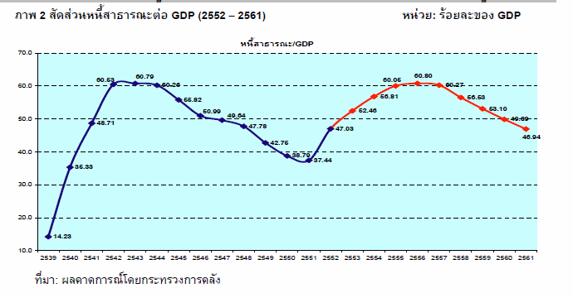

Slide 47
Role of Fiscal Policy in the subprime crisis
    Fiscal Sustainability Issue (Again) in the next 10 years:
      Public Debt/GDP < 50% (?)
      Debt repayments/ Budget < 15%
      Balance budget (?)
      Capital expenditure/ total budget not less than 25% (?)

Slide 48
Role of Fiscal Policy in the subprime crisis
    Study by Dr. Porametee Vimolsiri
    Fiscal Sustainability Issue in the future under three scenarios

Slide 49
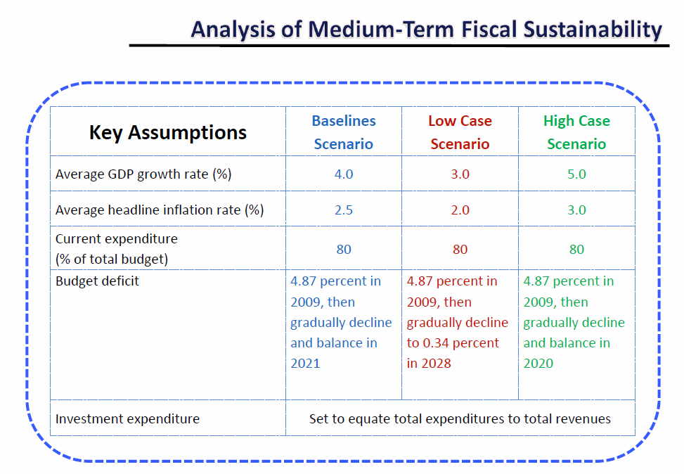

Slide 50
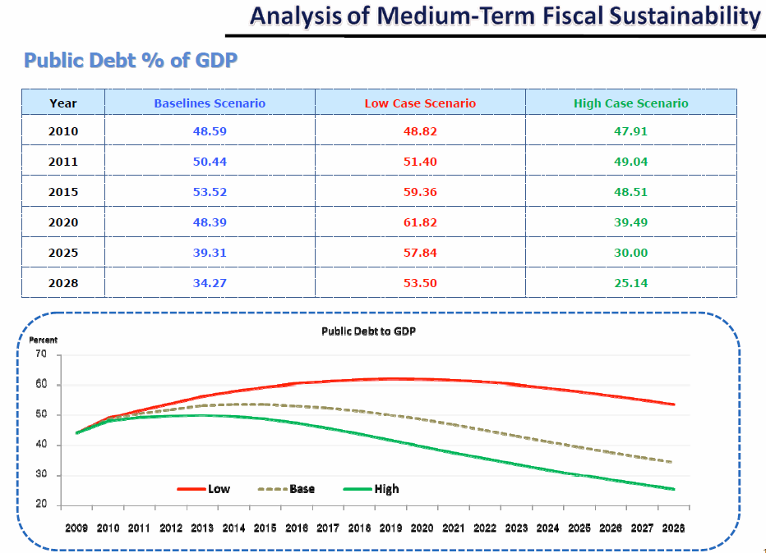

Slide 51
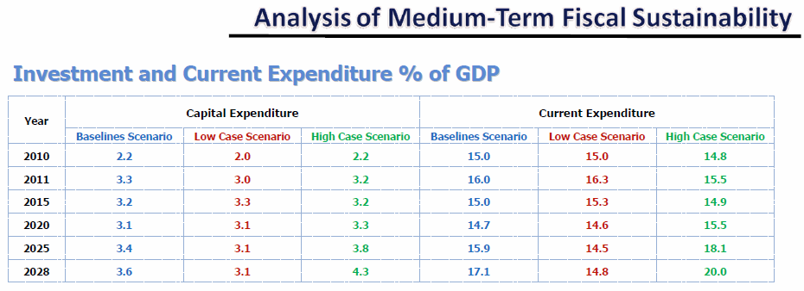
Thai capital expenditure as % of GDP
far below average of 7.7% for Asian developing
countries;
and below the Thai average of 4.31%
in 2000 - 2007

Slide 52
Role of Fiscal Policy in the subprime crisis
  Tradeoff between fiscal discipline and capital spending by government
  Policy suggestions:
    Use more “fiscal space”– more taxes
    More revenue collected by local administration

Slide 53
Role of Fiscal Policy in the subprime crisis
  Policy suggestions:
    increase expenditure efficiency
    More fiscal consideration for some medium-term issues, e.g. aging population, climate changes, and public service obligations

Slide 54
Fiscal Policy after the big flood in 2011
  Increasing budget burden from
    The big flood in 2011, remedy and prevention
    Populist policy by the Yingluck Gov’t
54

Slide 55
Fiscal Policy after the big flood in 2011
  No clear plan for tax reform
    The new land & building tax?
    Higher VAT rate?
    Excise taxes?
55

Slide 56
Fiscal Policy after the big flood in 2011
  No clear plan for tax reform
    Reduced corporate tax rates result in more tax income?
    Wider tax base for personal income tax?
56

