Slide 1
EE361 Economics of CLMV Countries
GMS Tourism Strategy and Lao Tourism Project
Guest Lecturer: Yasushi Negishi
Puey Ungphakorn School of Development Studies
Thammasat University

Slide 2
Table of contents
Brief introduction on GMS
GMS Tourism Strategy
ADB’s tourism project in Lao PDR

Slide 3
1. Brief introduction on GMS

Slide 4

About GMS
Established in 1992
Members: Cambodia, the People's Republic of China (Yunnan Province and Guangxi Zhuang Autonomous Region), Lao PDR, Myanmar, Thailand, and Viet Nam.
Coordinating Ministry: Ministries of Planning (in case of Thailand, NESDB )
Secretariat: ADB (in Manila)
Principle of agreement: One + One. If two countries agree to do on a certain project, the other members would endorse it.
Mr. Noritada Morita, former ADB Director General for Mekong Regional Department who supported the establishment of GMS
Notes:
Prime Minister Hun Sen told Mr. Morita that after civil wars now Cambodia can use its budget not for purchasing weapons but for building schools and hospitals. Mr. Morita said he was impressed by the wisdom of the people in this region. ADB volunteered to serve the GMS as secretariat. Most of multilateral development bank take country approach, they make program focusing specific countries and allocate budget to the country. Since the inception of GMS, ADB has been allocating both to national projects and regional projects. ADB replicated the regional cooperation to the other subregion in Asia and the Pacific. ADB is now called as a regional cooperation bank.

Slide 5
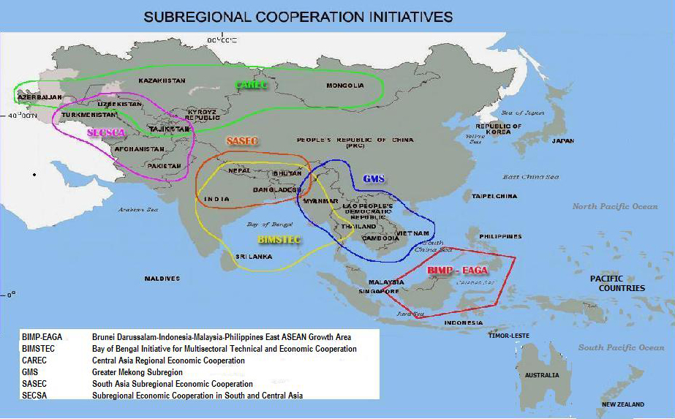
About ASEAN
Established in 1967 in Bangkok
Member countries: Indonesia, Malaysia, Philippines, Singapore and Thailand (five founding members), Brunei Darussalam (1984), Viet Nam (1995), Lao PDR and Myanmar (1997) and Cambodia (1999)
Coordinating Ministry: Ministries of Foreign Affairs
Secretariat: ASEAN secretariat (in Jakarta)
Principle of agreement: Member countries’ consensus basis.
IMT-GT

Slide 6
2. GMS Tourism Strategy

Slide 7






Global Tourism Trends 2015
Tourism is growing rapidly worldwide. International visitor arrivals surpassed 1.18 billion in 2015, a 40% increase compared to 2005. The tourism industry generates about 10% of global GDP.
Demographic changes: Millenniums (age 15 -29 years), seniors (age 60+), emerging middle class are increasing their shares among travelers.
About 43% of travelers purchase tourism services online. Social media provides consumer-generated content worldwide and allow SMEs to affordably connect with global markets.
(Source) 2017. Mekong Tourism Coordinating Office, Greater Mekong Subregion
Tourism Strategy 2016-2025, Bangkok.

Slide 8
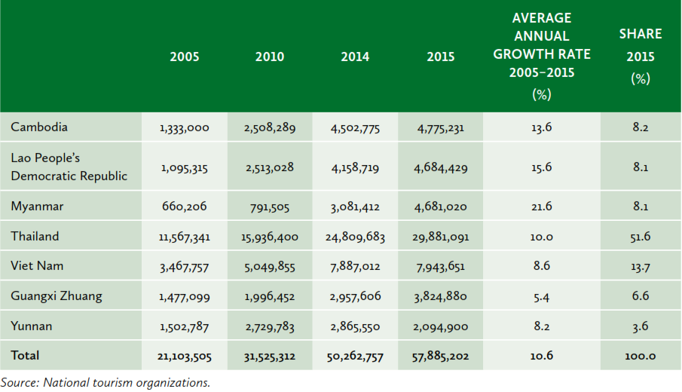

GMS International Visitor Arrivals 2005-2015
GMS international visitor arrivals are growing by 10.6% per year and reached 57.9 million in 2015.
Thailand receives the largest share. Myanmar’s average annual growth is highest, followed by the Lao PDR and Cambodia.

Slide 9
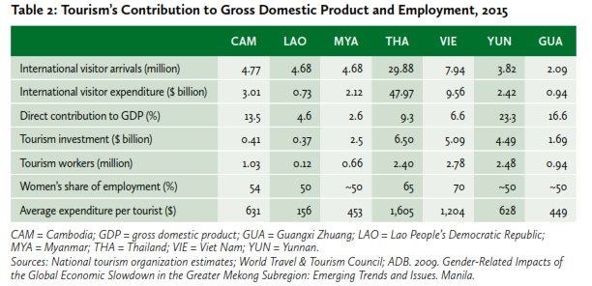


GMS Tourism Trends 2015
International visitor arrivals reached 44.8 million and generated $44.3 billion in receipts. Tourism supports 7 million jobs in the GMS.
About one-third of international arrivals visit at least two countries while travelling in the GMS and millions of residents cross borders each year for day trips.

Slide 10
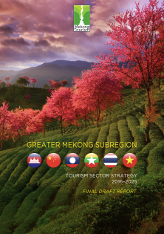
Visions of GMS Tourism Strategy
GMS countries have been working to strengthen subregional tourism cooperation since 2005.
Strategy envisions the GMS as a single destination.
Strategy delivers a truly unique Mekong brand of tourism that showcases the subregion’s incomparable beauty, diversity, and spirit, and brings its people a better quality of life.

Slide 11
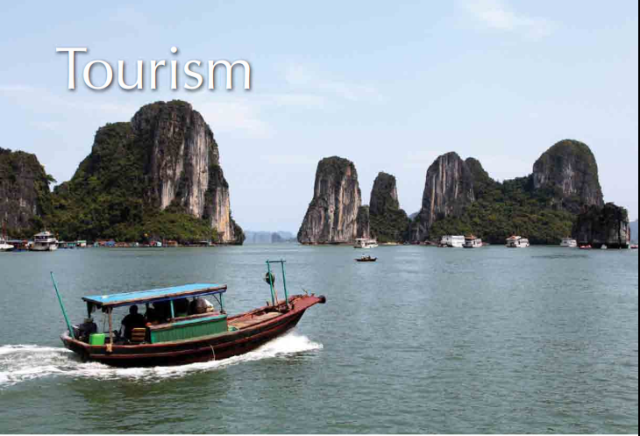
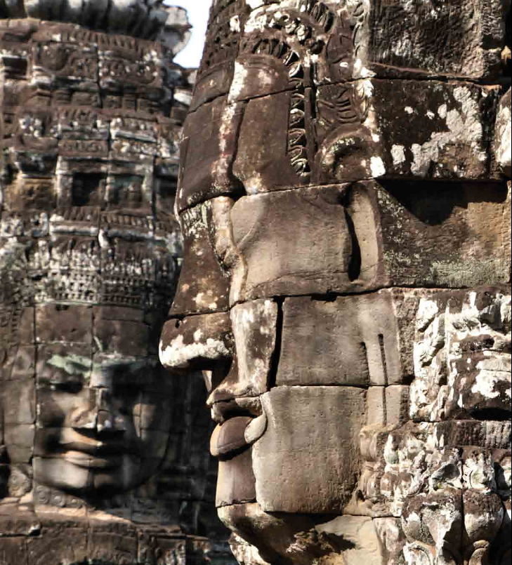

Strengths of GMS Tourism
GMS people’s custom of graciously welcoming guests
Outstanding tourism assets
Short travel times to and from major source markets
Excellent gateway connectivity
Robust private sector participation
Participation of local enterprises through IT
Affluence of developing Asia and its strong affinity for leisure travel
Ha Long Bay, Vet Nam
Angkor Wat,
Siem Reap
Cambodia
4,400 temples
Bagan Myanmar

Slide 12




Weaknesses of GMS Tourism Sector
Shortage of skilled tourism workers and destination managers Provide training and improve skills.
Underdeveloped transport and urban infrastructure in secondary destinations Build infrastructure to connect with tourist destinations and upgrade urban facilities.
Lack of integrated destination planning, and management Provide technical assistance to implement destination management.
Variable service standards Apply regional standards and upgrade the service to peers’ level.
Low awareness of private investment opportunities in secondary destinations Provide awareness raise events to private sector/individuals and facilitate investment.

Slide 13
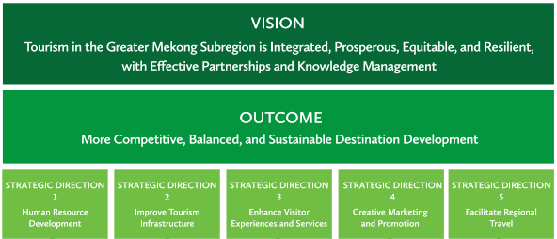
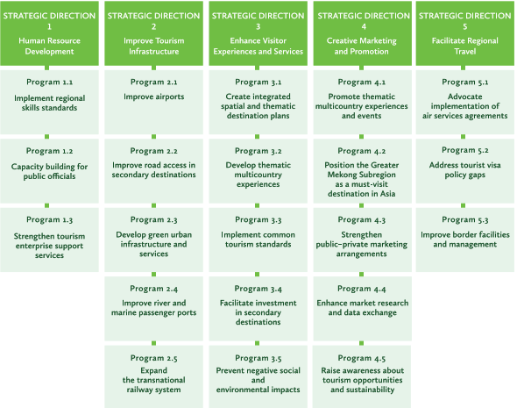
GMS Tourism Cooperation Strategic Framework
(Long-term goals)
(Immediate and direct results from below programs)
(Specific programs under each strategic direction)

Slide 14
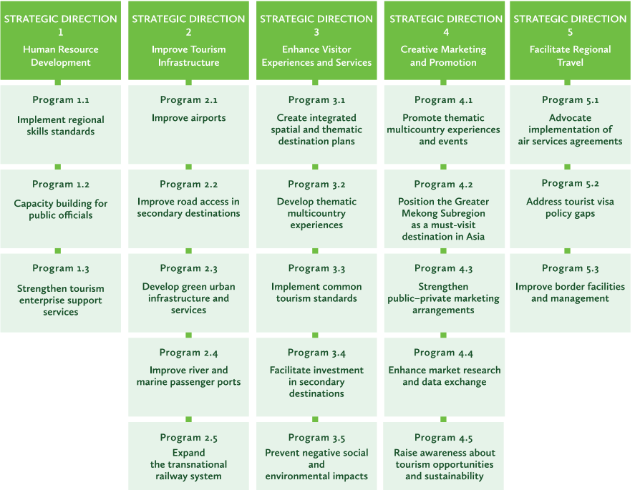
GMS Tourism Cooperation Strategic Directions and programs

Slide 15
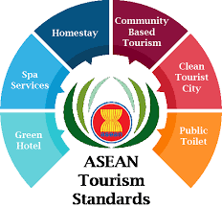

GMS Tourism: An Example of Regional Tourism Standards
The purpose of the ASEAN Clean Tourist City Standards (ASEAN Tourism Standards) is to provide ASEAN member countries with a tool that will improve the quality of tourism in their cities.
Application of ASEAN Tourism Standards is promoted under GMS Tourism Strategy to upgrade the member countries’ service standards.
Items for ASEAN FOOD AND BEVERAGE SERVICES STANDARD
Design and construction of food premise
Facilities
Food and utensils storage
Food processing
Food disposal
Health and hygiene of food handlers
Cleanliness
Maintenance
Quality level

Slide 16
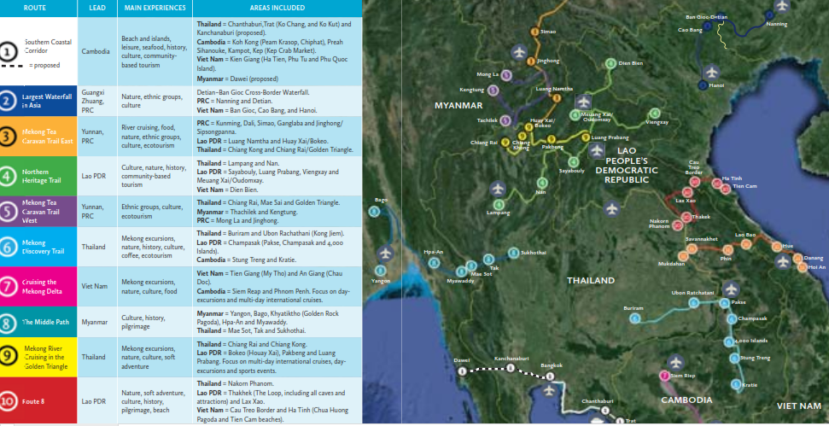
GMS Tourism: Multi-Country Tour Circuits

Slide 17

GMS Tourism: Coordination between
Governments and stakeholders
The Mekong Tourism Coordinating Office (MTCO) started operations in 2006. It came out the 16th meeting of the GMS Tourism Working Group and is composed of senior officials of the six GMS countries. MTCO activities are also supported by the ADB.
Over the years, the MTCO has been playing its in fostering and facilitating effective collaboration among the GMS governments, development partners, public enterprises, NGOs, private sector, academic institutions, and the media on the implementation of the GMS Tourism Sector Strategy.
Link to the MTCO’s website:
https://mekongtourism.org/o

Slide 18
2. Lao PDR’s Development Challenges

Slide 19

Development challenges
Highly concentrated production and export structure in mining (34%) and power generation (21%) are fueling economic growth
Half of exports go to Thailand and the PR China; while these sectors account for 20% of total GDP and 50% of total exports, they create only 1% of total employment

Slide 20
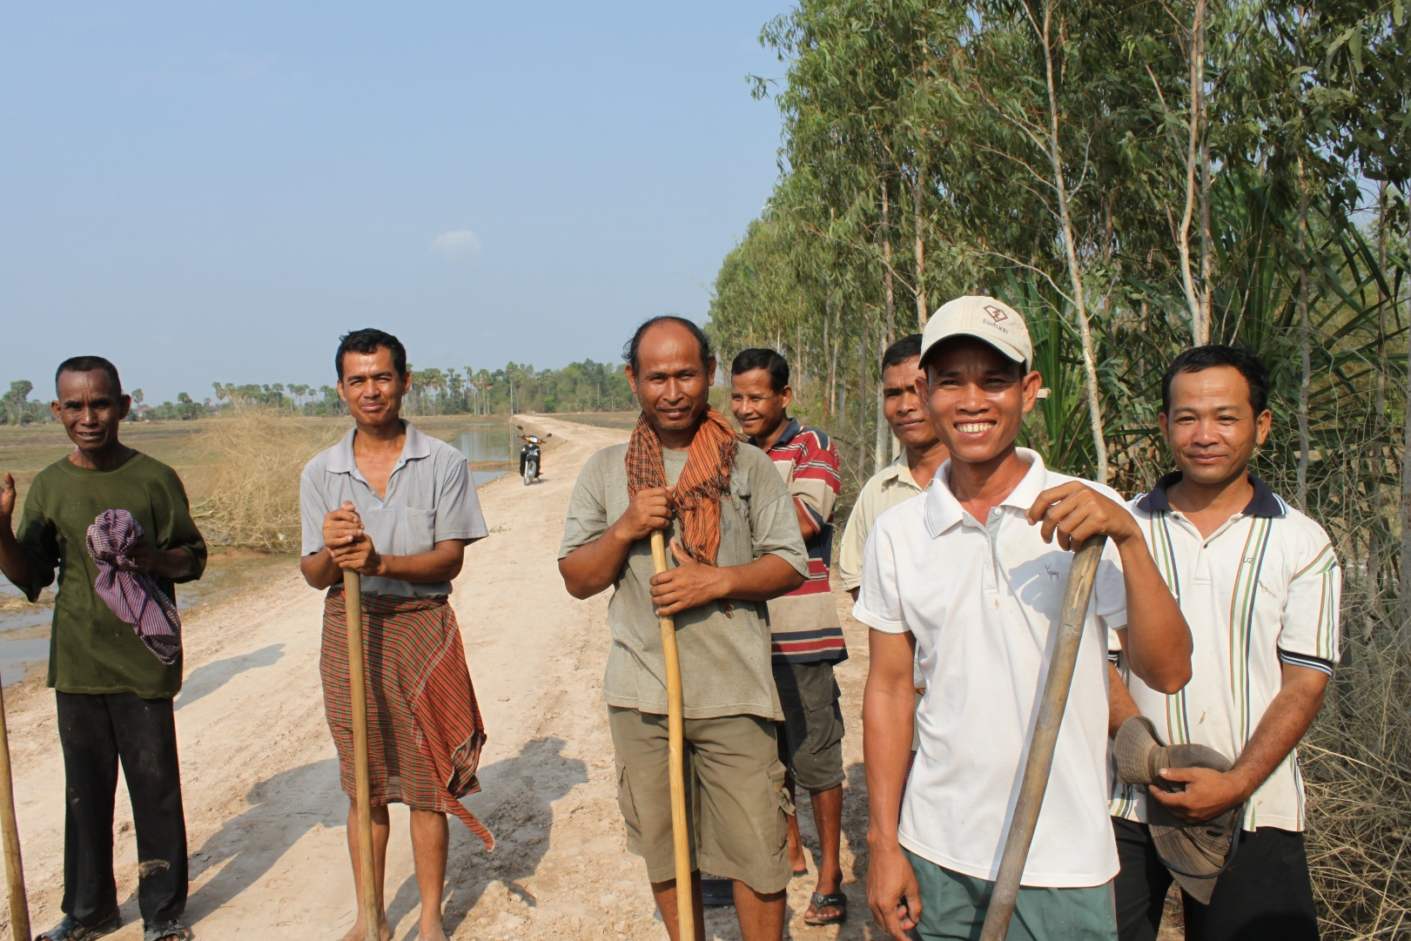
Development challenges
Investments in infrastructure is lacking
Quality and coverage of urban services have not kept up with rapid urbanization and urban growth
Rural productivity is low; irrigation and other productive rural infrastructure, rural electrification, and land transport must be strengthened

Slide 21
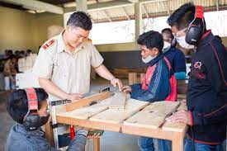
Development challenges
Inadequate education and skills and poor access to quality health services constrain business expansion
Governance and the business-enabling environment must be improved to attract more private investment
In 2016, the Lao PDR’s overall rank for ease of starting a business was 160 out of 190 countries assessed

Slide 22
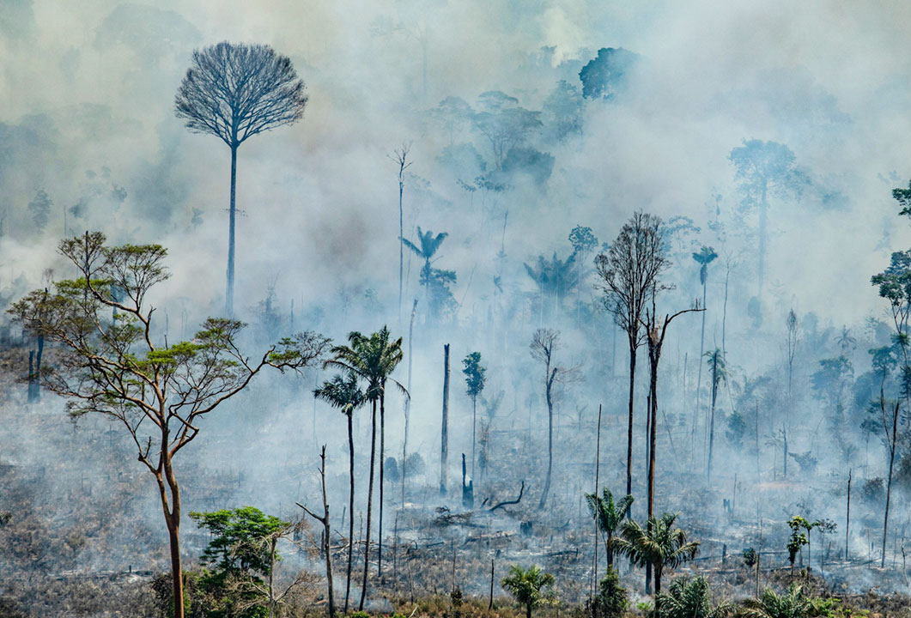
Development challenges
Environmental degradation disasters triggered by natural hazards
Changing climate patterns and extreme weather, such as floods and drought
Weak land use planning, inadequate legal framework for environment protection, and limited management capacity

Slide 23

Tourism projects serve to address Lao development challenges
Challenges
How tourism project works
Economic growth needs to be more inclusive and sustainable:
Lao PDR must diversify its resource-based economy and develop infrastructure to facilitate private investment
Tourism projects benefit local communities in the tourist destination through working at tourism jobs.
Road infrastructure investment through tourism projects benefit local people to access to social services and markets.
Promoting tourism projects helps the county to diversify its economy, promote private investment and reduce poverty.

Slide 24
3. ADB’s Lao PDR: GMS Tourism Infrastructure for Inclusive Growth Project

Slide 25
Lao PDR: GMS Tourism Infrastructure for Inclusive Growth Project
Borrowing Country: Lao People's Democratic Republic (Lao PDR)
Borrower: Ministry of Finance (MOF)
Executing Agency: National Tourism Authority of Lao PDR
Loan Amount: $40 million ($40,000,000=THB1,320,000,000)
Maturity: 32 years
Interest rate: 1.5%
Board Approval: September 2014
Loan Closing Date: 31 December 2021

Slide 26
Assessment on Tourism sector in Laos
Tourism is concentrated in Vientiane Capital, which accounts for 43% of international arrivals and 47% of hospitality investment.
Women comprise about half of tourism workers; however, many are employed in low-skill, low-wage jobs, and are underrepresented in tourism management.
The key impediments to more inclusive and geographically dispersed growth are
Insufficient last-mile transport infrastructure in secondary destinations;
Weak market linkages between the tourism industry and other economic sectors; At least 40% of tourism receipts leave the country.
Inadequate environmental infrastructure and low service standards suppress tourist length of stay, spending, and yield, resulting in average receipts per visitor of about $154 - the lowest in the GMS and much less than the benchmark of $1,390 in Asia and the Pacific.

Slide 27
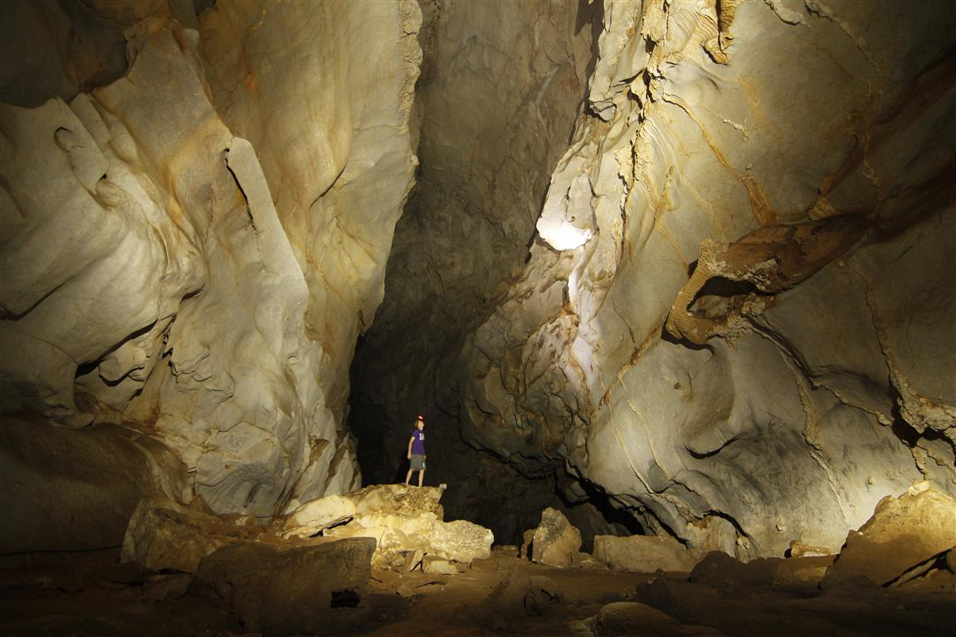
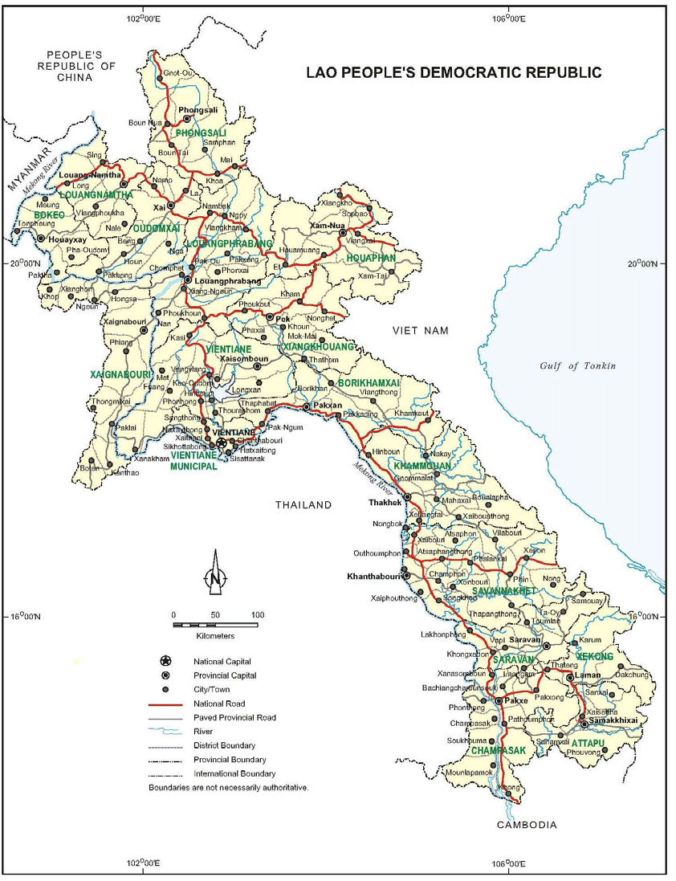
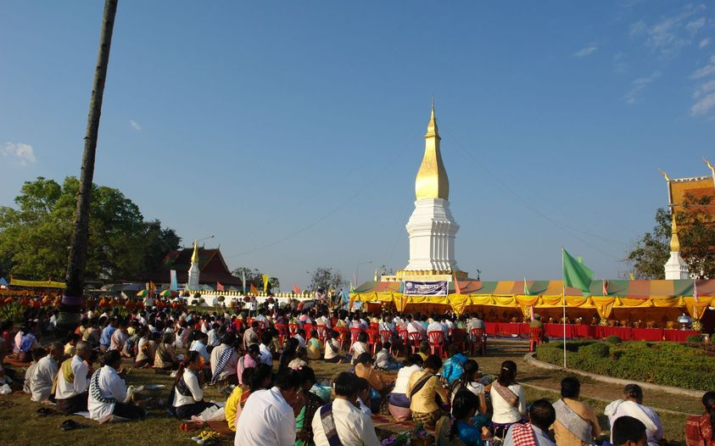
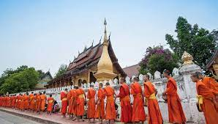
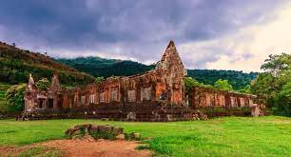
- Four provinces in Lao PDR -
Chom Ong Cave in Oudomxay
That Sikhottabong in Khammounane
Wat Xieng Thong inLuang Prabang
Wat Phou in Champasak

Slide 28
Project Outputs
Improved last-mile tourism access infrastructure (PG 2.2, PG 3.2)
Improved environmental services in cross-border tourism centers (PG 2.3, PG 3.2)
Strengthened institutional capacity to promote inclusive tourism growth (PG 1.3, PG 3.4, PG4.5 )
Effective project implementation and knowledge management (PG1.1, PG 1.3, PG3.4, PG3.3, PG3.5)

Slide 29
GMS Tourism Cooperation Strategic Directions and programs
④
④
④
①
①
②
③
②
④
③
③
④

Slide 30

Project Impact and Outcome
The impact: Increased tourism employment (The creation of 27,000 additional tourism-related jobs by 2025. 50% of these jobs will be held by women.)
The outcome: Increased tourism receipts in project provinces. (By 2019, aggregate annual tourism receipts in the project provinces will increase to $330 million)

Slide 31

GMS tourism: going forwards
Tourism sector has been hit since the pandemic. Tourism related sectors’ operators and workers have been still suffering. They are expecting quick recovery from 2023.
What would be opportunities and challenges for the GMS tourism sector going forward?

Slide 32

GMS tourism: going forwards
Opportunities
Challenges
The pandemic has accelerated some trends:
putting tourism on a more sustainable trajectory
enhancing digitalization
boosting community engagement and inclusion
Pandemic is unpredictable:
review the government measures during the pandemic and setting new social safety net to protect the industry from bankruptcy, unemployment.
In accelerating positive trends:
six counties share resources to pursuit such trends?
such trends benefit six countries equally?
what would be incentives to boost engagement with community?
Setting up new social safety net
Voters have strong voices to ask the government to review the measures during the pandemic?
Can we design such a safety net technically? Pandemic is unpredictable.

Slide 33

Thank you

