Slide 1
Cash Management
Jatuporn Jittapirom 5504640326
Lalipat Tachapattarawat 5504640607
Pemika Thitipermpong 5504641084
Sahawut Aunanant 5504641514
Tanyaporn Simasanti 5504641837
Tirawit Disphanurat 5504641985

Slide 2
Overview
What is Cash Management?
Why it has to be Cash?
Objective of Cash Management
Types of Cash Management
  Payment Management
  Collection Management
  Liquidity Management
  Electronic Information
  Deposit and Investment Solutions
Benefits of Cash Management Service

Slide 3

What is Cash Management?
Cash management is the service by the banks to facilitate their customers in assuring predictability in the cash flows of the customers by helping them adjust their balance sheets.

Slide 4

Why it has to be Cash?
Transaction Motive
Precautionary Motive
Speculative Motive
Compensating Motive

Slide 5
Objective of Cash Management
To avoid insolvency
To reduce days in account receivable
To increase collecting rates
To select appropriate short-term investment vehicles
To increase days cash on hand to improve a company's overall financial profitability

Slide 6
Benefits of Cash Management Service
Assured credit : Availability of cleared funds variable
Pooling of funds : Funds collected and deposited in Central Account
Control benefits : Corporate to maintain better control over its various Banking and treasury related activities

Slide 7
Types of Cash Management
Payment Management
Collection management
Liquidity Management
Electronic Information
Deposit and Investment Solutions

Slide 8
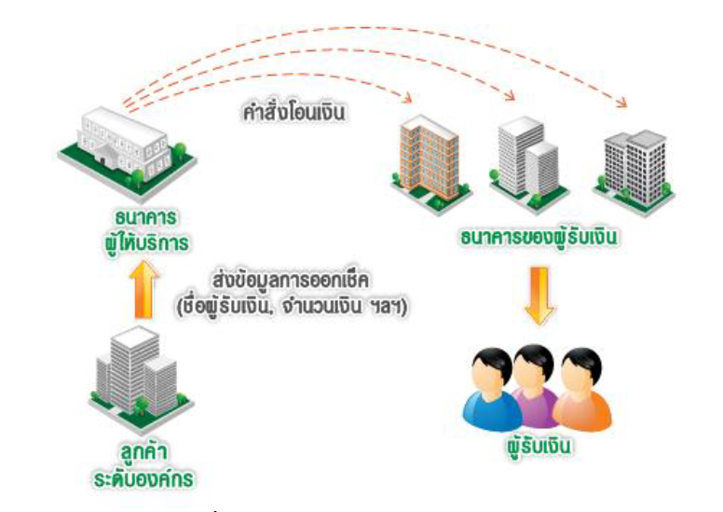
Payment Management
Order for money transfer
Banking Service
Payee’s Bank
Transfer information of issuing cheque (Payee’s name, amount of money, etc.)
Large Organization
Payee
Service for any payment

Slide 9
Payment Management
Payroll
Banks will pay salaries to employees by transferring money to employee’s deposit account automatically on time
Requirement:
Application Form
Copy of commercial registration issued within the last 3 months
Copy of national ID card of the director of the business

Slide 10


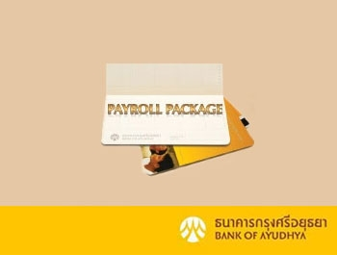
Payment Management
K-Payroll from
Kasikorn Bank
Payroll service
from KTB Bank
Payroll Package service
from Bank of Ayudhya

Slide 11
Payment Management
Third Party Funds Transfer
Bank will pay trading partner or the beneficiary that have deposit account with the serviced bank. The bank will credit the payee’s account instantly
Requirement:
Application Form
ID Card copy
Company’s Affidavit / License

Slide 12
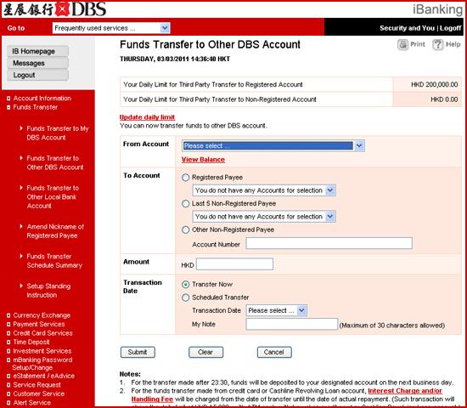
Payment Management
Third Party Funds Transfer
service from DBS Bank, Singapore

Slide 13


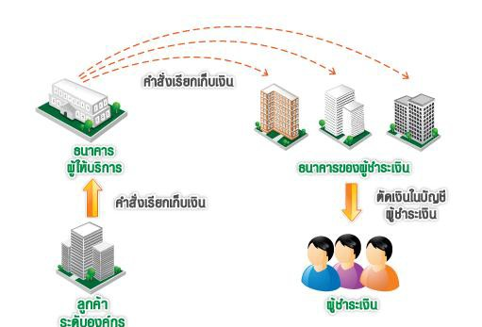
Collection Management
Send order for collection
Banking Service
Payer’s Bank
Send order for collection
Debit to payer’s account
Large Organization
Payer
Service for any receivable

Slide 14
Collection Management
Bill Payment
Bank will accept the bill payments from the customers for the company via numerous channels. The company can set criteria for collection such as start and stop date of transaction etc. For instance, paying tuition fees.
Requirement:
Bill payment service application form
Copy of the instrument for the establishment or license of establishment
Copy of ID card
Deposit account under the service bank

Slide 15
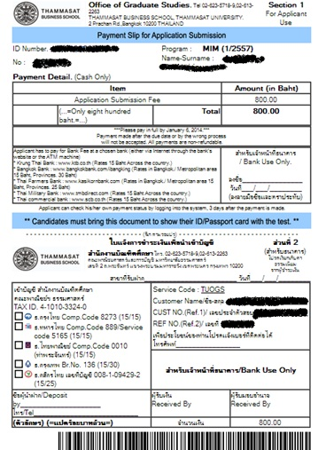
Collection Management
Thammasat’s Payment
Slip for Application Submission

Slide 16
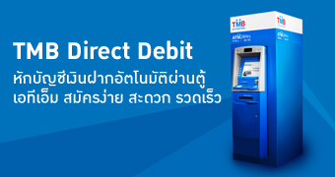
Collection Management
Direct debit
Bank helps the company to get cash more rapidly by debiting client’s deposit accounts automatically on recurring basic. For example, Phone Bill, Electronic Bill etc.
Requirement:
Application Form
Copy of license of establishment
Copies of national ID cards
note that company and clients must open account under
the serviced bank

Slide 17
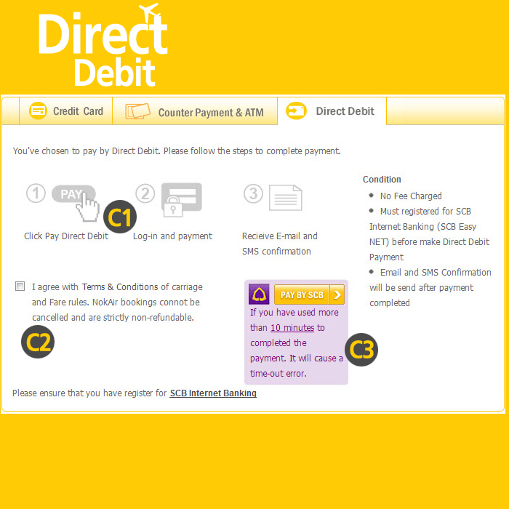
Collection Management
Direct Debit service from
Nok Air that cooperate
with SCB Bank

Slide 18
Liquidity Management
Helps enhancing the efficiency of the client’s fund by providing accurate reports and maximizing interest returns. The service links all of the client’s bank accounts so that the fund can flow freely in structural manner.
Service for using money efficiently

Slide 19
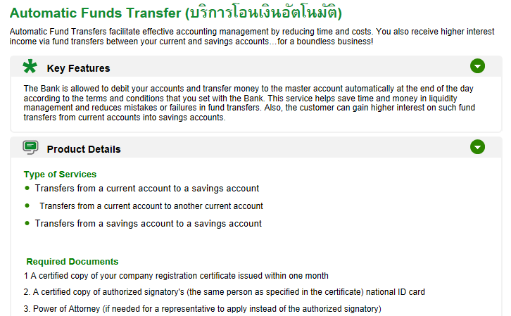
Liquidity Management
Automatic Funds Transfer
service from Kasikorn Bank
Bank helps the company to facilitate accounting management by reducing time and transaction costs

Slide 20
Electronic Information
This service provides a wide range of services that used to be available only at the bank’s branch via internet. For an instance, the client can access his own bank account information which includes the available balance, financial history, transaction records anywhere and anytime. The client can also make transaction online using electronic information service such as scheduling future dates for payment, fund transfer, and etc.
Provide information of market change and keep track of your finance online

Slide 21
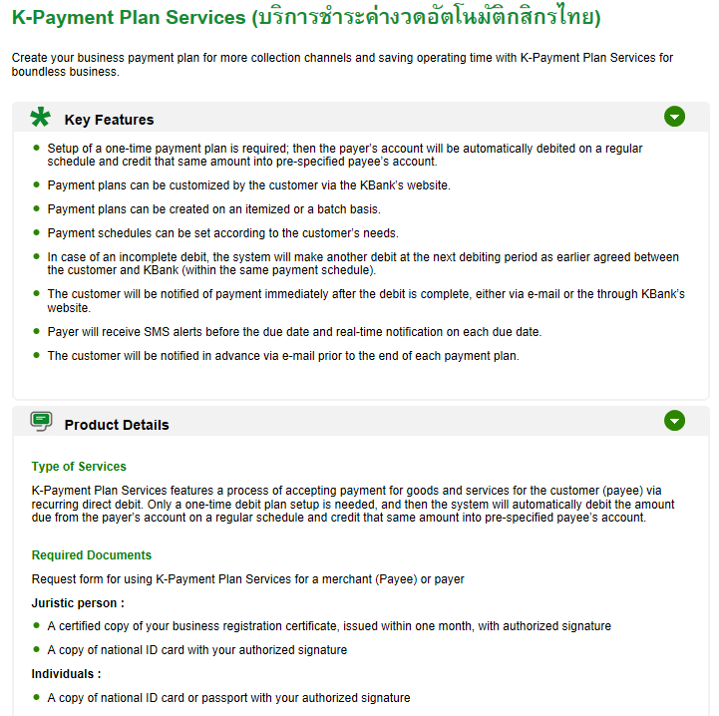
Electronic Information
K-Payment Plan Services
Bank helps the company to create business payment plan for more collections and saving operation and by providing any online information through via internet.

Slide 22
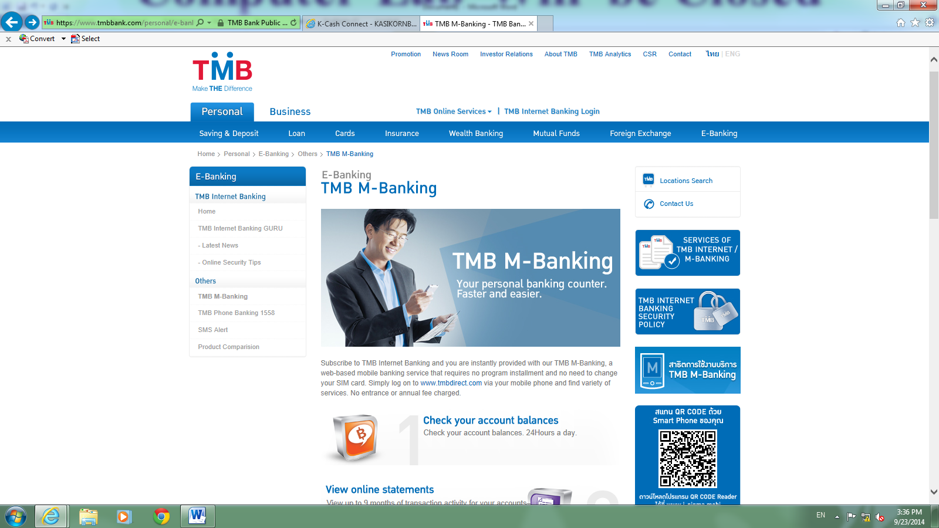
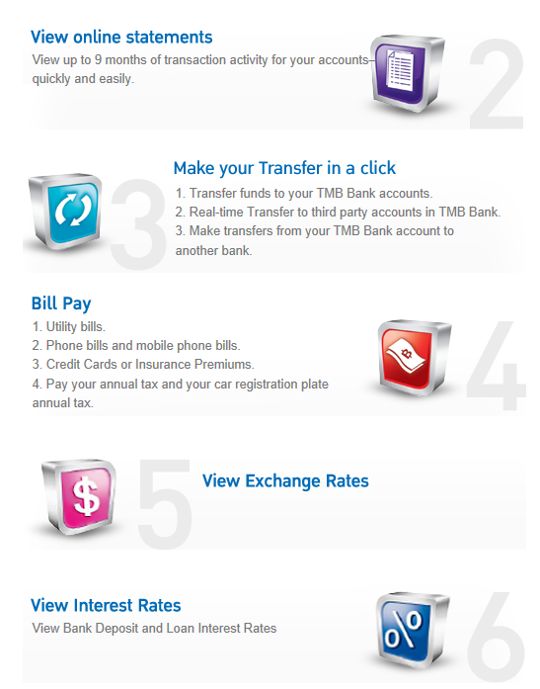
TMB M-Banking
service from TMB Bank
TMB M-Banking will not charge entrance (application) fee. Fee will be charged upon making transaction for inter-region transfer, inter-bank transfer and bill payment.
Internet connection fee (GPRS, Edge) will be charged to customer by a mobile phone operator at the rate set by each operator.

Slide 23
Deposit and Investment Solutions
This provides channel for clients to generate additional income from their deposit in terms of interest which is less risky than investing in equity market or etc.
Example: from Kasikorn Bank
  Savings Deposit Account
  Special Saving Deposit
  Fixed Deposit
  Current Deposit
  Business Deposit - FCD
Help managing business finance with a number of deposit service

Slide 24
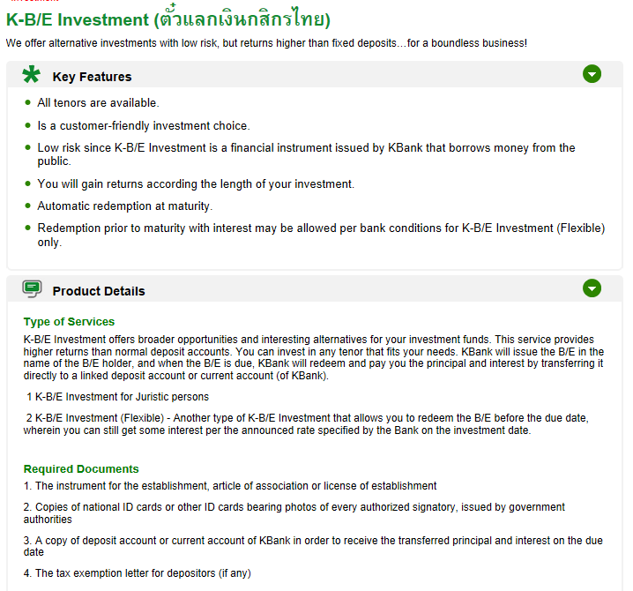
Deposit and Investment Solutions
K-B/E Investment service from Kasikorn Bank
Bank provides alternative investment for your company

Slide 25
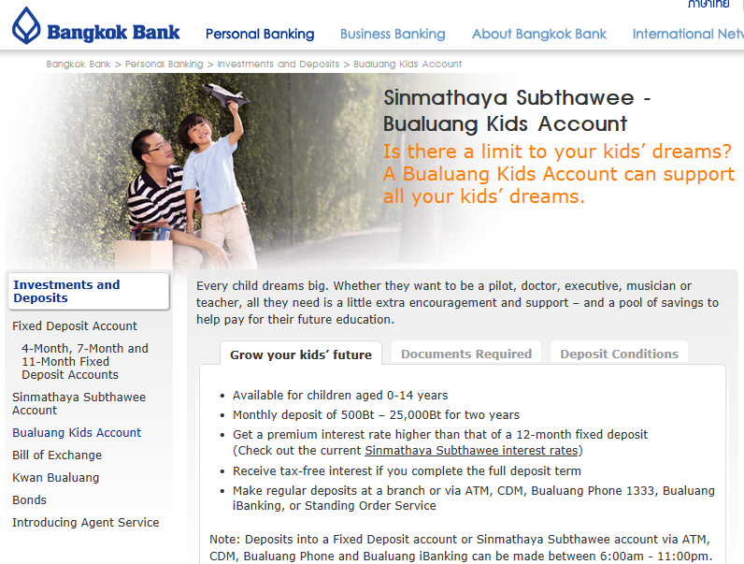
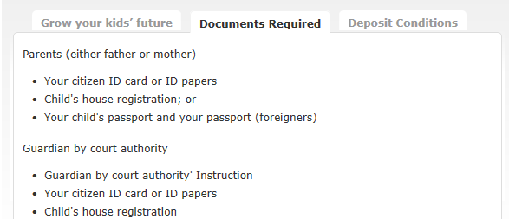
Deposit and Investment Solutions
Investments and Deposits
service from Bangkok Bank

Slide 26
Thanks you for your attention

