Slide 1
ASIAN FINANCIAL CRISIS
1997

Slide 2
Outline
Timeline
Prologue
Collapse
Economic impact
Social impact
Policy and Result

Slide 3

Timeline
The causes of the crisis
Upturn
The appreciation of Yen
Thailand become the production base and investment hub for foreigners
Financial Liberalization
The establishment of BIBF in 1993
Large amount of loan and investment from foreign countries
The speculative bubble in Thai property market

Slide 4

Timeline
The causes of the crisis
Downturn
The depreciation of Chinese Yuan
The capital account balance of Thailand become deficit due to the less export affected by the depreciation of Yuan
Investors lose confidence in Thai’s financial capability
Speculative Attack on Thai Baht
BOT used US dollar reserve to buy Thai Baht back into the system
Thai Baht depreciated (Approx. 50 Baht/US dollar)
The economic collapse and spread to the neighboring country

Slide 5
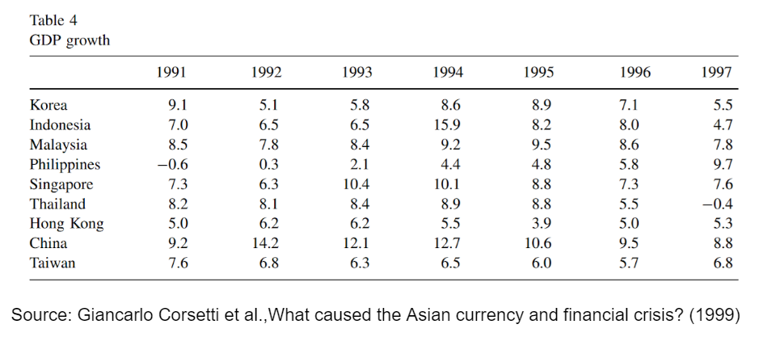
Prologue: Asian economic miracle
Notes:
“In such circumstances, an external shock that leads to a sudden change in expectations can cause a rapid reversal of capital flows and trigger a currency crash”

Slide 6
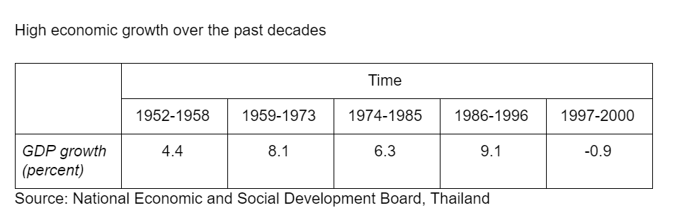
Prologue: Thai economic miracle
The high economic growth of Thailand from 1959 to 1996 created the expectation of good performance of thai economy

Slide 7
Prologue: Asian economic miracle
According to Krugman (1994), the miracle would not be sustained in long run since the growth in total factor productivity pay little role in the output growth and “the employment growth and investment were eventually bound to decline.”

Slide 8
Prologue: Financial liberalization
May 1990: Thailand relaxed foreign exchange control and reduced restriction on capital account for transactions.
April 1991: Residents were permitted to open foreign currency accounts if the funds originated from abroad.
May 1992: Allowing exporters to use foreign currency receipts to repay foreign debt without prior approval of Bank of Thailand

Slide 9
Prologue: Financial liberalization
March 1993: the BIBF was established to mobilize fund from overseas and extend credits only in foreign currencies.
April 1995: finance companies were allowed to issue bill of exchange to raise funds at home as well as abroad.

Slide 10
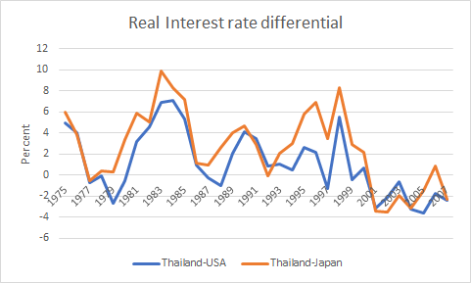
Prologue: Foreign fund dependency
High interest rate differential
Source: World Bank
Notes:
the financial liberalization mobilise the access to the foreign fund and the high real interest rate differential incentivise bank and financial companies to seek the foreign funds. this result in heavy dependence of Thai bank on foreign funds.

Slide 11
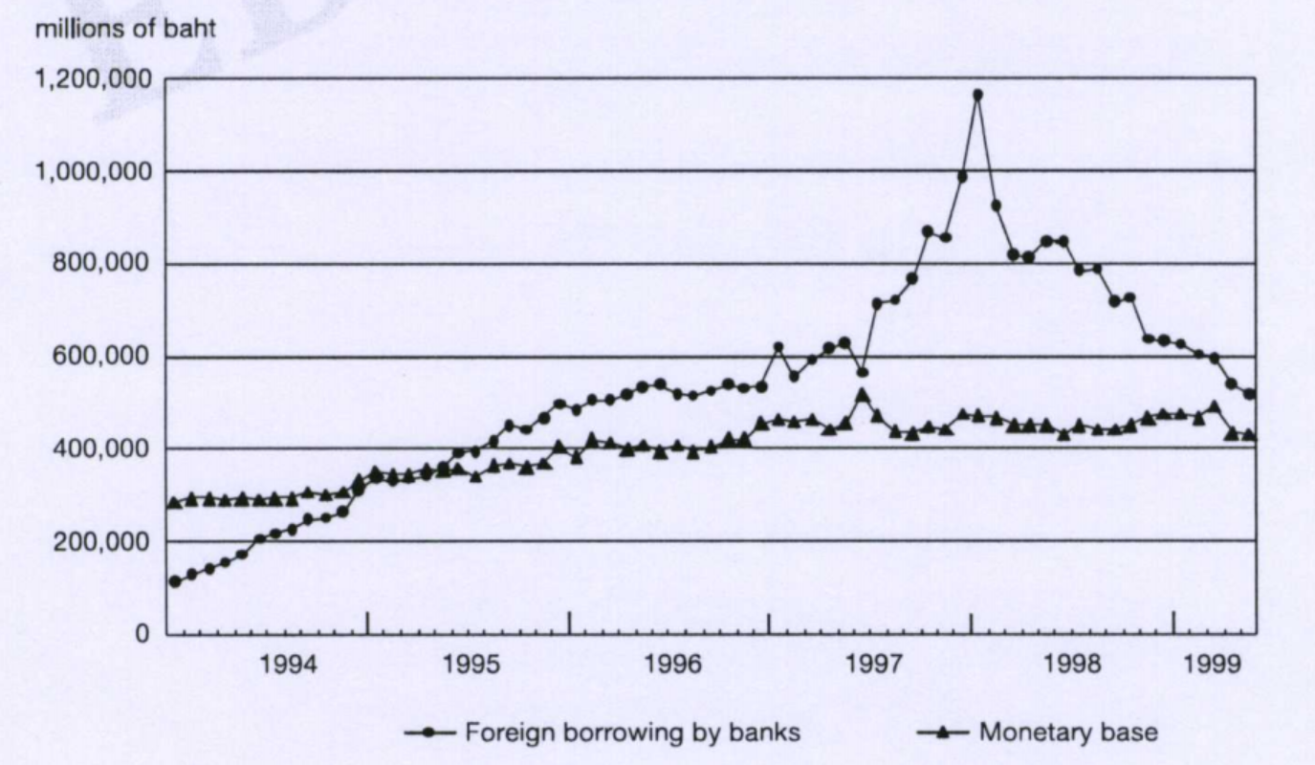
Prologue: Foreign fund dependency
External Indebtedness
Source: Financial Liberalization and the Economic Crisis in Asia (2002)

Slide 12
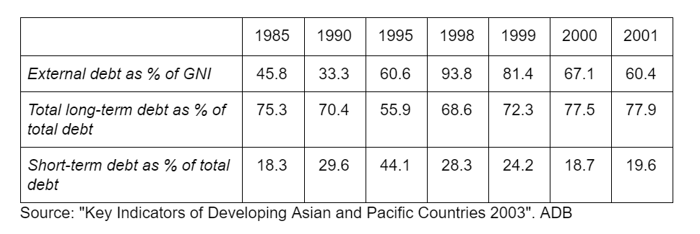
Prologue: Foreign fund dependency
External Indebtedness
Source: Financial Liberalization and the Economic Crisis in Asia (2002)

Slide 13
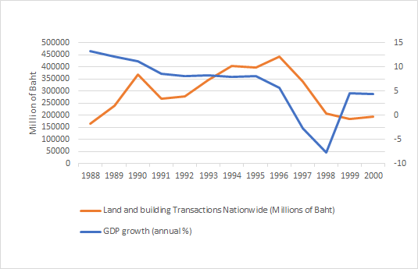
Prologue: The Asset Bubble
Source: Bank of Thailand and World Bank
Notes:
the high economic growth boosts the price of property and stock before they collapse in 1997. the excessive external funds which come from financial liberalisation can be productive in case that it go into trade sector. (non-trade sector: commercial and residential construction, as well as inward-oriented services) However, in case of Asian crisis, It did not. Thailand had bubble pricing in real estate sector and property sector of other Asian countries also indicate the same

Slide 14
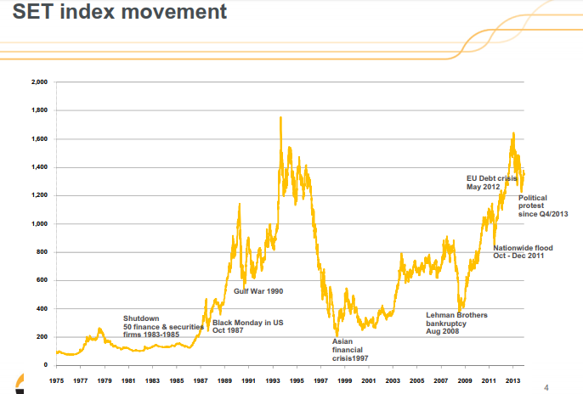
Prologue: The Asset Bubble
Source: SET
Notes:
the high economic growth boosts the price of property and stock before they collapse in 1997. the excessive external funds which come from financial liberalisation can be productive in case that it go into trade sector. (non-trade sector: commercial and residential construction, as well as inward-oriented services) However, in case of Asian crisis, It did not. Thailand had bubble pricing in real estate sector and property sector of other Asian countries also indicate the same

Slide 15
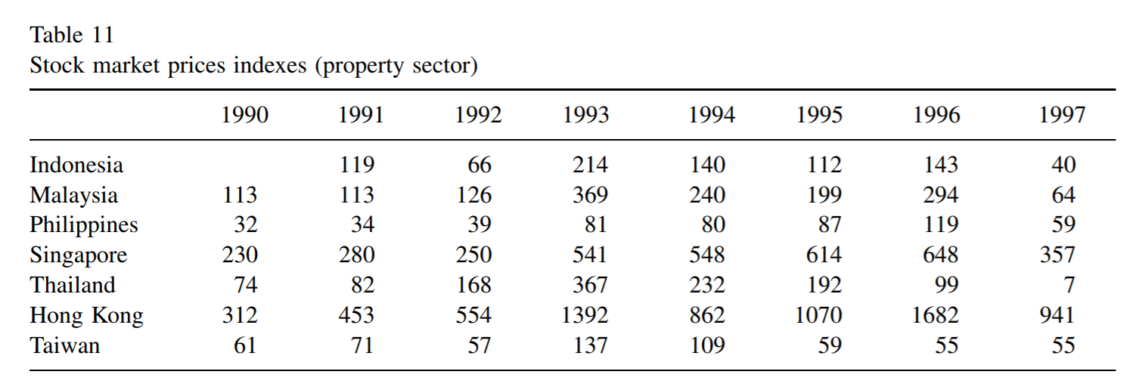
Prologue: The Asset Bubble
“evidence consistent with speculative overinvestment in land and real estate is provided by data on stock market prices, which in many countries rose more rapidly in the property sector than in the other sectors over the 1990–1996 period.”
Source: Giancarlo Corsetti et al. (1999)

Slide 16
Collapse: Exchange rate regime
During 1990s
Malaysia:
The currency moved in a 10 percent range of 2.7 – 2.5 ringgit to the US dollar
Thailand:
The baht was effectively fixed between 25.2 and 25.6
Korea:
The Semi-flexible exchange rate policy

Slide 17
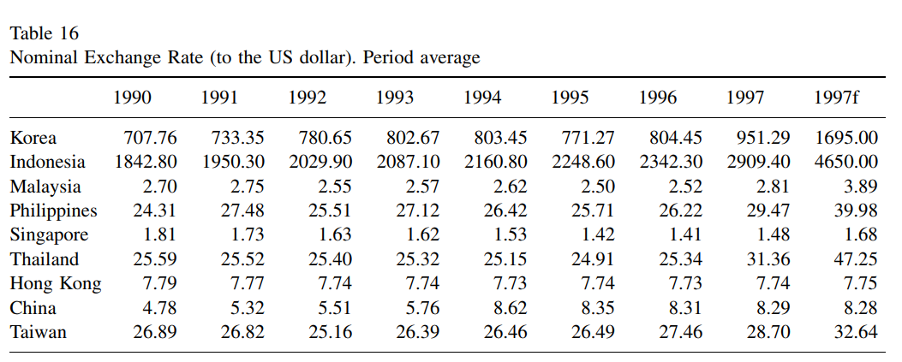
Collapse: Exchange rate regime
Source: Giancarlo Corsetti et al. (1999)

Slide 18
Collapse: Thai pre-crisis economies
By the end of 1996, Thailand has shaky economy
Large external deficits
Increasing short-term foreign indebtedness
Fragile financial conditions of corporate firms and finance companies
Notes:
Fragile financial conditions of corporate firms and finance companies that had borrowed heavily from abroad to finance the speculative boom in real estate and equity investments.

Slide 19
Collapse: Malaysian pre-crisis economies
By the end of 1996, Malaysian economy had following characteristics:
Unprecedented accumulation of short-term foreign debt.
Export growth fell sharply
The availability of property loans drove up asset prices
Notes:
By the end of 1996, despite the high rate of public investment, growth had marginally slowed down from 8.2 to 8 percent. To a large extent, this slowdown reflected a marked drop in the rate of export growth, which fell from 20.9 percent in 1995 to 7.3 percent in 1996.
But the most important change that materialized toward the end of 1996 was in the market sentiment towards Malaysia as an investment opportunity — foreign fund managers had come to the conclusion that Malaysian interest rates were too attractive to be ignored.
In 1996, short-term capital inflows surged to M $11.3 billion, compared to an inflow of M $2.4 billion in 1995 and an outflow of M $8.4 billion in 1994. Malaysia also experienced an overall increase in bank lending as high as 27.6 percent, with a sharp switch from lending to the manufacturing sector to lending for equity purchases. The availability of property loans drove up asset prices: over the year, the price of up-market properties in major Malaysian cities grew by 25 percent.

Slide 20
Collapse: Korean pre-crisis economies
By the end of 1996, Korean economy had following characteristics:
Growth had marginally slowed
Drop in the rate of export growth
The financial conditions of the conglomerates and their creditor banks were shaky
Notes:
Korea experienced a serious deterioration of the macroeconomic conditions already in 1995–1996. The current account dramatical deficit leading to an unprecedented accumulation of short-term foreign debt.
Export growth fell sharply, especially after negative terms of trade shocks hit the economy in 1996.The 1996 growth rate of industrial production halved relative to the previous year.
The financial conditions of the conglomerates and their creditor banks were shaky, raising the possibility of widespread bankruptcies; reflecting such weaknesses, the stock market fell sharply in the 2-year period 1995–1996, down by 36 percent relative to the 1994 peak. The won also weakened during 1996.

Slide 21
Asian Financial Crisis : Thailand 1996
The Asian Financial Crisis began after the sudden decline export slump from the strengthening of dollar over yen.
In 1996, export growth drop by 1.9% from both the appreciation and the semiconductor shock on Singapore.
The rumor start to spread in Hong Kong about a Baht devaluation in response of poor export performance and large account deficit.

Slide 22
Asian Financial Crisis : Thailand 1996-1997
Foreign speculator start to sell Thai Baht in Hong Kong market result in some Thai banks need to borrowed from the money market to purchase the dollar, sending the interbank rate up to 25%.
On May 14 1997, several hedge fund and large US bank start taking short position.
This forced BOT to sell dollar in the forward market.

Slide 23
Asian Financial Crisis : Thailand 1997
BOT tried to prevent speculator from closing the position.
BOT employed more than US$23.4 billion out of its US$39 billion 60% of its total reserve to defend baht before gave up on 2 July 1997

Slide 24
Asian Financial Crisis : Korea 1997
In early 1997, the crisis large domestic conglomerate began to bankrupt from its heavily borrowed money to finance its investment project.
The crisis spread further from corporate sector to finance sectors.

Slide 25
Asian Financial Crisis : Malaysia 1997
The crisis started from the bubble in real estate sector.
Bank lend money to non-performing sector and the bubble start to form in both real estate and equity market.
Bank Negara (Central bank of Malaysia) wait too long before taking action.
KLCI stock exchange index drop by 17.2% from its peak in Febeuary

Slide 26
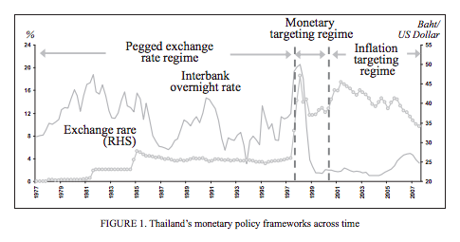
After Crisis: Change in Exchange Rate Regime
Notes:
Before AFC, Thailand applied fixed exchange rate regime pegged to currency basket where 84% are US dollar.
After, BOT Lost in interving THB and exhausted all the reserves, on 2nd of july 1997, Thailand has to float the currency to move freely from 1997-2000 and use monetary targeting regime by controlling the money supply in order to reach the goal of sustainable growth and price stability and also ensure against volatility in interest rate and liquidity in the financial system by performing daily liquidity management.
After that Thailand has applied flexible inflation targeting regime, they saw that targeting money supply would be less effective than targeting inflation since the relationship b/w money supply and Output Growth is not quite stable after the crisis. Thus, they decided to change to flexible inflation targeting regime.

Slide 27
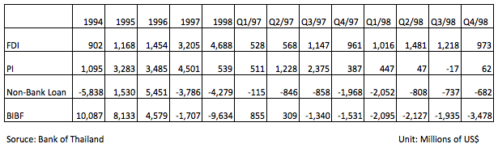
After Crisis: FDI & Portfolio Investment
Notes:
After the crisis you could see that FDI was not affected by the crisis and economics recession since FDI is a long term investment and quite stable in term volatility when comparing to financial assets .FDI also acted as a cushion to help private sector’s net outflow in other capital categories.
This also happaned in portfolio investment which still have net inflow during and after the crisis even the amount is lower.
While by 1997-1998 THailand experienced net massive outflow of both non-bank loan and BIBF due to exchange rate floatation where firstly non-bank loan were the most used way of net inflow until BIBF was introduced with special priviledge to borrower but declined after the constraint from BOT on minimum level of out-int BIBF in order to reduce ST external debt.

Slide 28
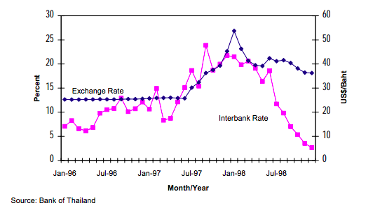
After Crisis: Exchange Rate & Interest Rates Movement
Notes:
After the THB Currency float and massive outflow of capital, THB is losing the stability and credibility and market confidence so that the value of currency depreciated about 50% to 56.75THB/US$ and come back to the new normal of 37-40 THB/US$ Where in the early stage, currency depreciation was accompanied by a very sharp increase in interest rates in exchange for higher risk and later decrease due to monetary expansiaonary policy.

Slide 29
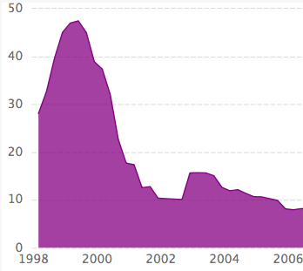
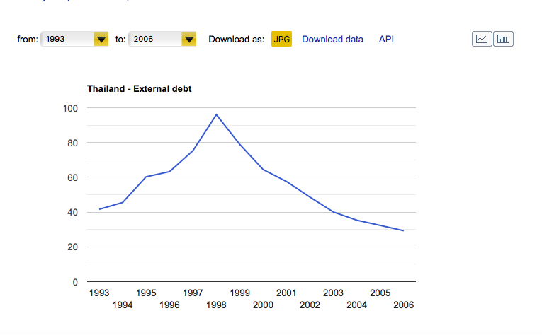
After Crisis: Non-Performing Loan & external debt
Source: CEIC DATA
Notes:
before the crisis, people enjoy BIBF privilege taxes and did a short term loans and roll over instead of doing long term loans because the cost of short term loan was lower. Most people have debt in term of foreign currency. Plus Thai people didnt do hedging. So, after letting Thai Bath float, the value of the debt after Baht devaluation was much more in term of Thai Baht. which turn to non-performing loan in the following years. So the rating agancy lower Thai rating then external debt was reduce after 1998.

Slide 30
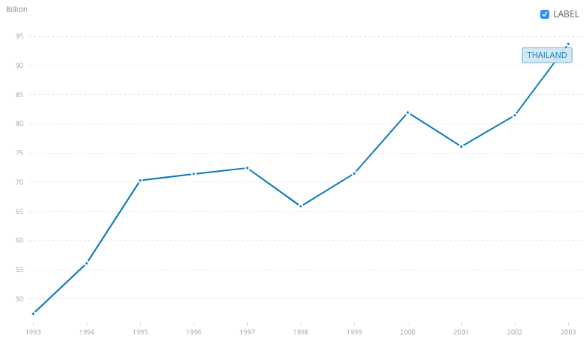
After Crisis: Export Volume
Source: https://data.worldbank.org/indicator/NE.EXP.GNFS.CD?end=2003&locations=TH&start=1993
Notes:
After BOT let Thai Baht float, Thai export volume had increased since Thai product seems less expensive.

Slide 31
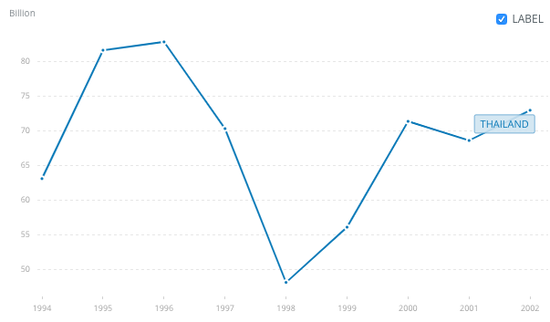
After Crisis: Import Volume
Source: https://data.worldbank.org/indicator/NE.IMP.GNFS.CD?end=2002&locations=TH&start=1994&view=chart
Notes:
during 1997-1998 import volume of Thai kept decreasing due to the recession. There was one article said Thai import has high positive correlation with income. Since there was a recession people consume less and import less plus the devaluation of thai baht make foreign products looks expensive.

Slide 32
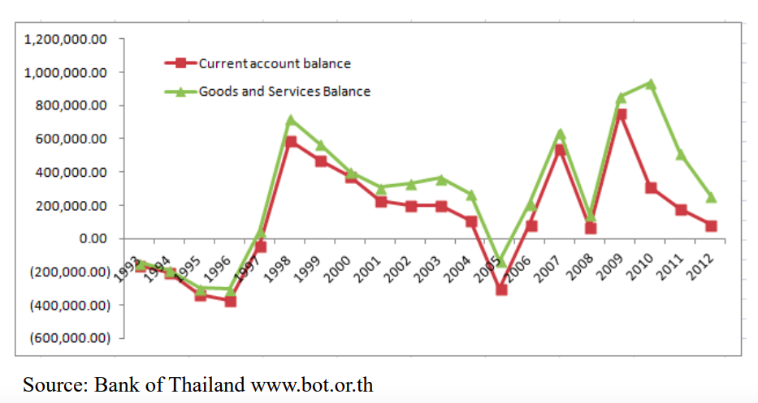
After Crisis: Current Account and Its Implication
Notes:
to make it clear, Thai current account during that period was surplus, due to the increase in export and the decrease in import. However this surplus occured from the bad situation so we could asy that CA surplus doesnt always good

Slide 33
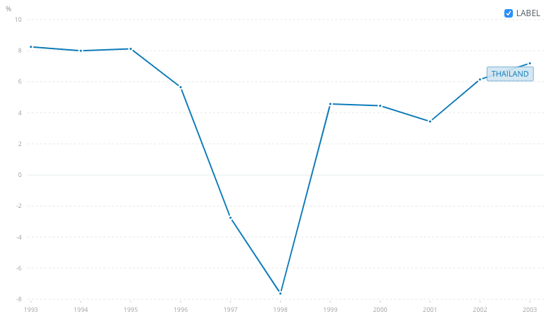
After Crisis: GDP Growth
5.652%
4.572%
4.456%
-2.754%
-7.634%
Source: https://data.worldbank.org/indicator/NY.GDP.MKTP.KD.ZG?end=2007&locations=TH&start=1993
Notes:
the crisis hit gdp to dramatically decrease to reach the lowest point in the beginning of 1998. However, there was a V shape recovery. After Thai Baht devaluation Thai can export a lot more. Usually some other countries may not face the V shape recovery. It depends on the economic structure of each economy. For Thailand, Thai economy is so opend which means it really depend on other countries also. Therefore, increasing in export can occurs the V shape recovery -Plus, the decrease in interest boosted up the economy since the beginning of 1998 therefore people were encouraged to spend and invest. Thai GDP sharply boost up in 1999 again.

Slide 34
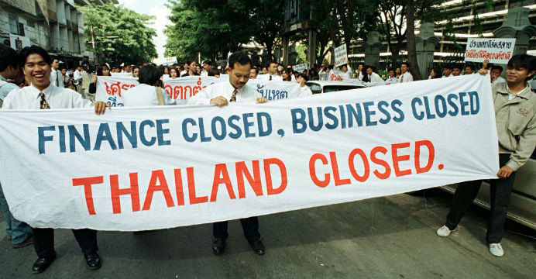
After Crisis: Other Events
IMF financial support of $4 billion
Closure of 56 bankrupt finance companies
Financial institution restruction
(Some survived banks needed to find foreign capital.)
Notes:
1.After THB was under the series of speculative attacks and market lot confidence, IMF approved the Financial support for THailand up to 2.9 billion SDR or around 4 billion Us Dollar.
2.In the early stages of the program, Many finance company are closed due to bankruptcy
3.while some Financial institution restructure their company mostly to find a foreign capital through capital increase where you could see nowadays many CBS’s shareholder are foreign shareholders.

Slide 35
THAILAND -SOCIAL IMPACT
Workers returned to rural areas
The poverty rate increase from 11.4 to 12.9%
Number of underweight children increased from 7.9 to 11.8%
Number of street children increased by 10-15%
A decline of 7.2% in private schools and 1.8% in public school

Slide 36
THAILAND -SOCIAL IMPACT
The suicide rate in Thailand doubled.
Some Thais turned to religion for solace
Temple visits tripled.
Increase in demand for psychological counseling and mental relaxation classes.
Water shortage
Poor soil quality

Slide 37
INDONESIA -SOCIAL IMPACT
The poverty rate nearly doubled from 11.3 to 20.3%
Primary school completion rates declined from 97% in 1997 to 95% in 2001
Secondary school enrollment declined by 11%
School attendance dropped slightly at the beginning of the crisis, but then bounced back and reached levels higher than before the crisis.
Children left school because they could not afford to pay the necessary school fees or because they had to help support their families
The number of street children in Jakarta more than quadrupled from 3,000 to 13,000

Slide 38
INDONESIA -SOCIAL IMPACT
Contraceptive prevalence increased from 56.6 tp 57.3%
Early marriage for women
The proportion of household income spent on health decreased significantly while health costs and waiting times increased.
The use of public health care declined from 7.4 to 5.6% of respondents between 1997 and 1998
The number of children visiting community primary health care centres fell from 47 to 28%

Slide 39
MALAYSIA -SOCIAL IMPACT
The poverty rate increase from 8.2 to 10.4%
The public health care system had to cope with up to 18% more patients who could no longer afford private health care
Routine data for immunization showed slightly decline

Slide 40
MALAYSIA -SOCIAL IMPACT
Education was so badly hit after the government cut spending by 18% at the start of the crisis
Primary school completion rates increased from 92% in 1995 to 94% in 1999
Many of the 54,000 university students studying abroad had to return after the government sponsorship program was temporarily suspended

Slide 41
SOUTH KOREA -SOCIAL IMPACT
The poverty rate double from 9.6 to 19.2%
Primary school completion rates declined from 98% to 92%
Routine data for immunization showed a dramatic decline
14% increase in family planning services provided between the first quarter of 1997 and 1998
Total number of crimes increased by 11.7%

Slide 42
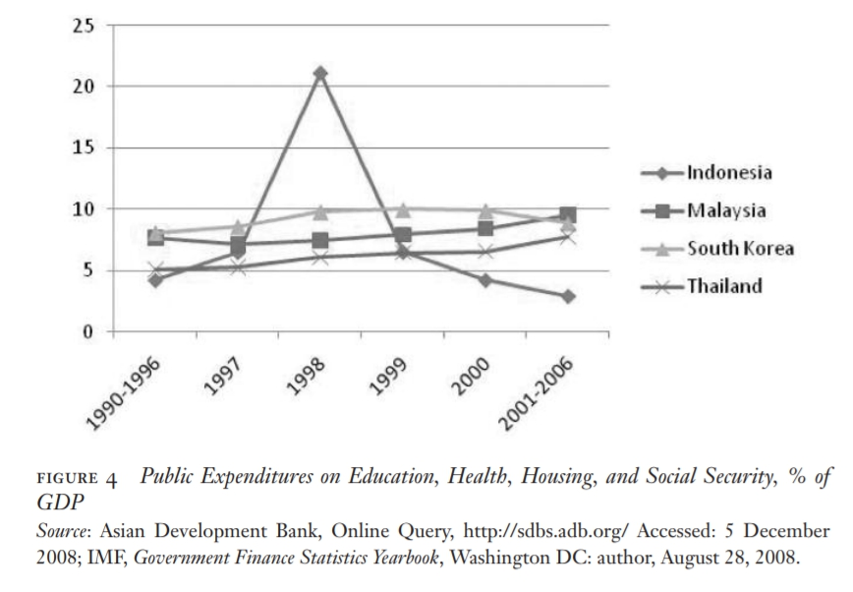
PUBLIC EXPENDITURE

Slide 43
Recovery Policies
Before the crisis
Bank of Thailand tried to prevent the crisis by using “deliberalization” such as
  increasing a liquid asset requirement
  increasing a BIS capital adequacy ratio
  increasing minimum reserve for questionable debt
  preventing banks from extending loans that require foreign borrowing
  introducing credit-to-deposit ratio
  BBIFs must maintain cash reserves of 7% of total short-term foreign borrowing and deposits
  raising first-tier capital fund-to-risk asset ratio
  all commercial banks must submit a monthly report on real estate project worth than 100 million baht

Slide 44
Recovery Policies
Before the crisis
BOT also improved competitiveness and efficiency in financial market such as
  New foreign banks could have licenses to operate in Thailand
  issuing Financial Institutions Development Fund bonds to be used as a liquid asset of commercial banks

Slide 45
Recovery Policies
After the crisis
1997 - 1998
  introducing self-sufficient economy
  Set external stability as the first priority
  Got fianancial support from IMF up to $17.2 billion
  Foreign banks were allowed to take over weak domestic banks
  Deciding to use contractionary fiscal and monetary policies to contract domestic absorption
  improving current account and balance of payment position
  raising VAT rate from 7% to 10%

Slide 46
Recovery Policies
After crisis
1999 - 2000
  managing loose monetary policy for economic recovery
  using easy money policies (easy to give a lend)
  fiscalizing FIDF debts
  encouraging commercial bank to set up its own asset management company (AMC) and agree to transfer NPLs from Krung Thai Bank
  restucting corporate debt under the control of Corporate Debt Restructing Advisory Committee (CDRAC)

Slide 47
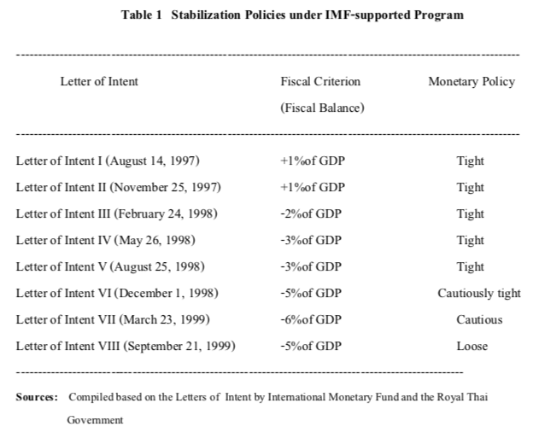

Slide 48
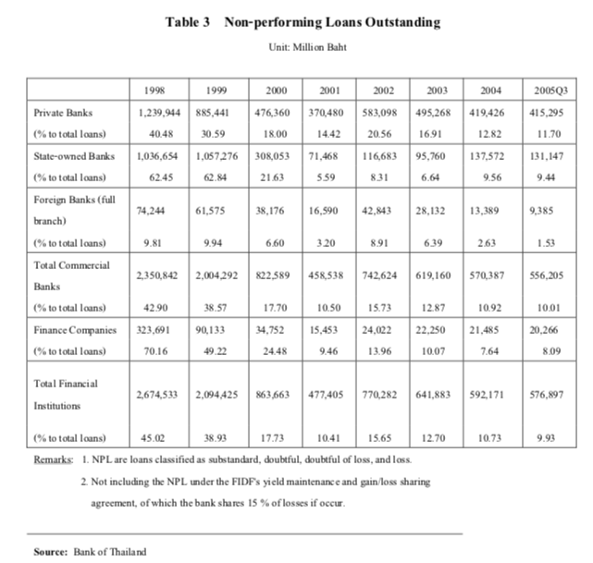

Slide 49
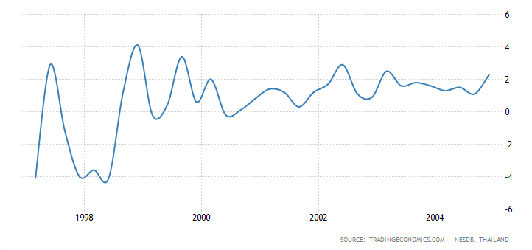
THAILAND GDP GROWTH

