Slide 1
Consumer Behavior:
Advanced topics
EE311
Chayun Tantivasadakarn
Faculty of Economics, Thammasat University

Slide 2
Revealed Preferences
According to the theory, for given preferences, a consumer will choose bundle of goods subject to the budget constraint.
In reality, preferences are unknown.
But if we know the choices a consumer has made, we can determine what their preferences are if we have information about a sufficient number of choices that are made when prices and incomes vary.
[Read Varian, Ch. 7 - 8]
Notes:
93

Slide 3
Revealed Preferences – Two Budget Lines
L₁: Choose A over B ->A is revealed preferred to B. IC tangents at point A
Clothing
(units per
month)
L₁
L₂: Choose B over D ->B is revealed preferred to D. Another IC tangents at B
L₂
A
By transitive:
  A is revealed preferred to D
B
D
Food (units per month)

Slide 4
Revealed Preferences – Two Budget Lines
The pink areas are revealed prefer to A while the yellow areas are revealed less prefer to A.
Clothing
(units per
month)
L₁
L₂
A
B
D
Food (units per month)

Slide 5
Revealed Preference
As you continue to change the budget line, individuals can tell you which basket they prefer to others.
The more the individuals reveal, the more you can discern about their preferences
Eventually you can map out an indifference curve

Slide 6
Revealed preferences and the construction of an IC
Clothing
(units per
month)
L₃
L₁
E
A
G
L₄
B
L₂
D
IC
Food (units per month)

Slide 7
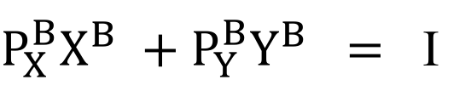

Reveal preference condition
If B is revealed prefer to any bundle affordable by the income I.
We know that
Y
l
l₂
B
$P_{X}^{B}X^{B} +P_{Y}^{B}Y^{B} =$ I
Any other bundle, such as T or C, is affordable by income I, hence
T
C
$P_{X}^{B}X^{T} +P_{Y}^{B}Y^{T} ≤$ I
X

Slide 8

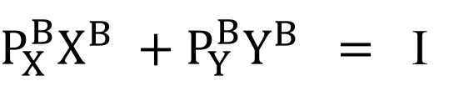
Reveal preference condition
$P_{X}^{B}X^{B} +P_{Y}^{B}Y^{B} =$ I
$P_{X}^{B}X^{T} +P_{Y}^{B}Y^{T} ≤$ I
$P_{X}^{B}X^{T} +P_{Y}^{B}Y^{T} ≤$ $P_{X}^{B}X^{B} +P_{Y}^{B}Y^{B}$
For a given income I, if a consumer chooses bundle B, the expenditure for B must be greater than or equal to the expenditure for any other bundle.
If the expenditure for bundle B is greater than or equal to the expenditure for bundle T and the consumer chooses B, B must be preferred to T.

Slide 9
Reveal preference condition
In the base year, consumer is facing budget line I and chooses bundle B.
In the year T, consumer is facing budget line I_{T} and chooses bundle T.
Y
l
l₂
B
If we know that
l_{T}
T
$P_{X}^{B}X^{T} +P_{Y}^{B}Y^{T} ≤$ $P_{X}^{B}X^{B} +P_{Y}^{B}Y^{B}$
B must be preferred to T or the consumer is worse off in period T compared to B.
X

Slide 10
Reveal preference condition
However, we cannot conclude anything if
Y
(A) Welfare decreases
Y
(B) Welfare increases
M/
M/
IC₁
M
M
B
B
S
S
IC₁
T
IC₂
IC₀
T
X
X
O
N
N/
O
N
N/
R
R
This is because bundle T is not affordable in period B

