Slide 1
Performing Arts Unit:
Theatre Arts & Performance
Instructor:
Dr. Parichat Jungwiwattanaporn (Khru Pat)
Department of Theatre,
Faculty of Fine and Applied Arts,
Thammasat University
Email: jparich2006@gmail.com

Slide 2
Reminders:
1) Always check your syllabus and MOODLE announcement for assignments and activities,
2) Get the Xeroxed copy, and read your assignments,
3) If you have any question, please consult with the instructor via email or appointment.
Dr.Parichat’s email: jparich2006@gmail.com

Slide 3
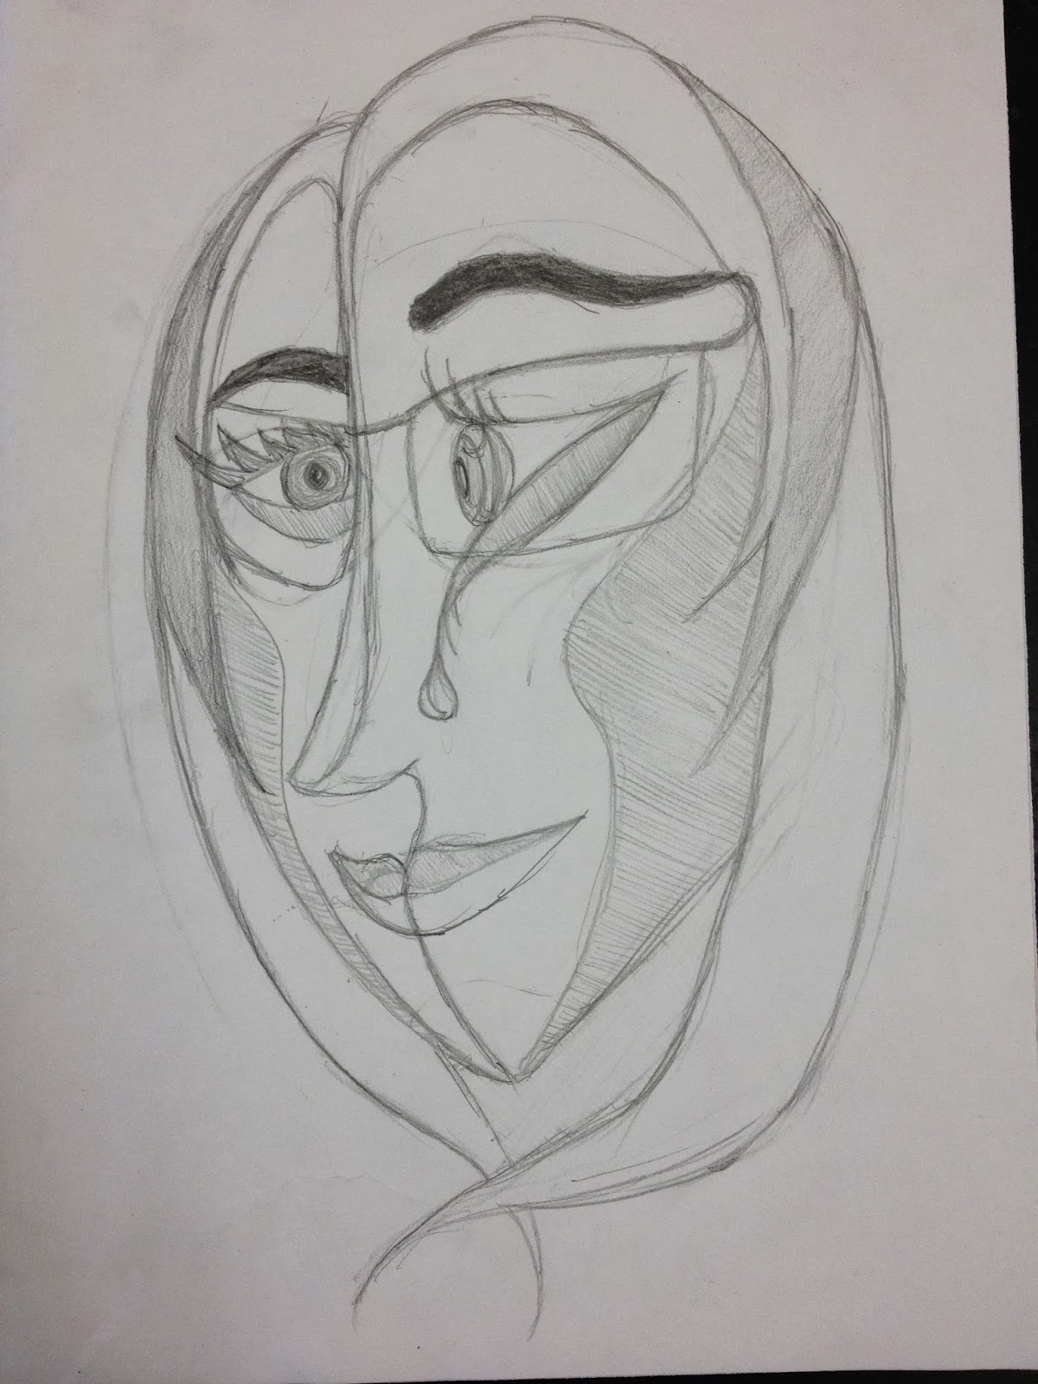
Getting to know your friend
Drawing Abstract Portrait

Slide 4
Have your partner write his/her Nick Name at the bottom of his own portrait drawing.
Interview your friend, on the back of your paper, write down
Topics:
1) Something about you,
2) Your hobbies,
3) 1 happy memory, or moment that makes you feel proud.

Slide 5
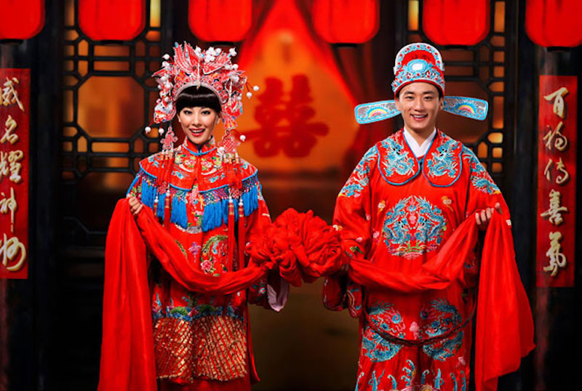
The Royal Wedding https://www.youtube.com/watch?v=yNmVVt43JXU
Thai Wedding: https://www.youtube.com/watch?v=K9Jh9ffabAE
Chinese Traditional Wedding

Slide 6
What is live theatre ?
What is a performance?
What makes a performance?

Slide 7
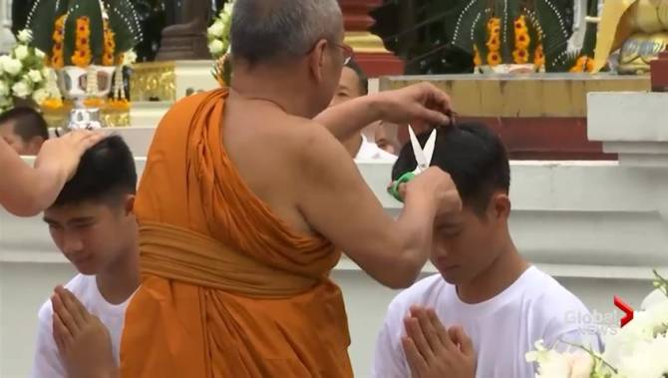
Ordination of a Buddhist Monk in Myanmar: https://www.youtube.com/watch?v=MpKzoH0mTDU
Thai Buddhist Monk Ordination:

Slide 8
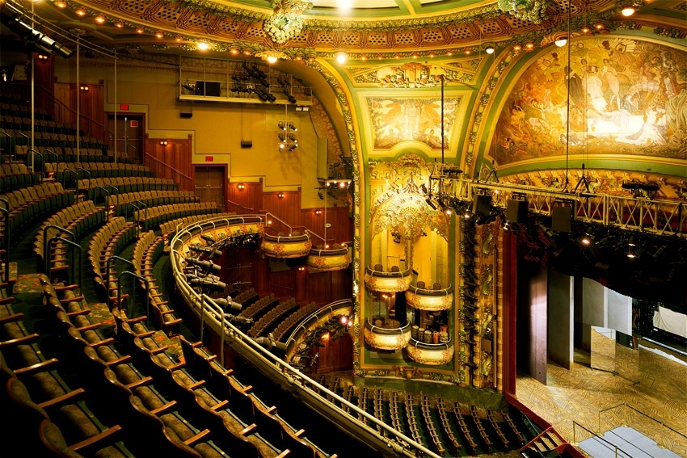
Professional Broadway Productions: https://www.youtube.com/watch?v=npCgALW2eks

Slide 9
Elements of Ritual:
1) Serve specific goal and purposes,
2) Procedure oriented,
3) Conducted by Chief Conductor(s),
4) Involve some kind of verbal and nonverbal rites,
5) Have beginning, middle, and ending.

Slide 10
What rituals have you experienced ?
At home ?
At school ?
At church or temple or mosque ?
At an opening of a business, organization ?

Slide 11

Impulse to Perform: from Personal, community, to professional
Personal Performance:
---- Childhood play

Slide 12
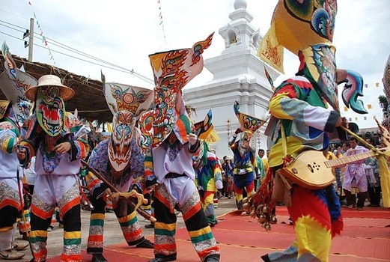
The Impulse to Perform
2) Community Performance:
e.g.
Traditional Wedding,
Traditional Funeral
etc.

Slide 13
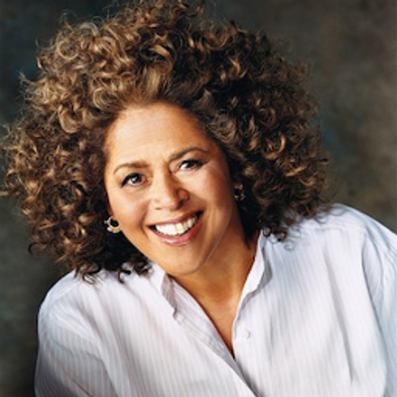
The Impulse to Perform
3) Professional Performances: e.g.
Anna Deavere Smith (Race and rights,1992 upheaval in LA in response to police brutality, plays 30 characters, verbatim from interviews) https://www.youtube.com/watch?v=aD3U7KXNvrQ

Slide 14
Whole-Class Activities:
1) Warm-Up
2) Line Up
3) Pantomime
4) Tug-of-War Pantomime

Slide 15
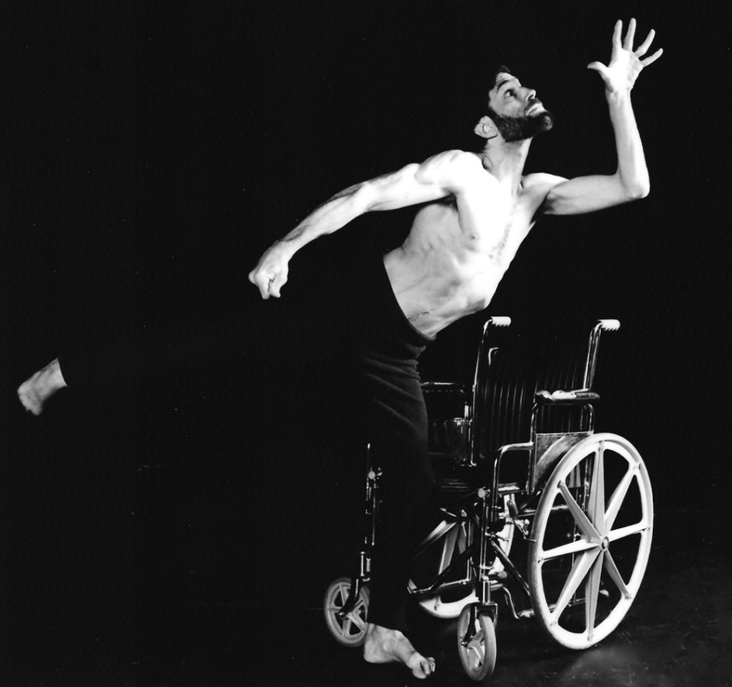
Professional Performances: e.g.
https://www.youtube.com/watch?v=UZHRRHd7xHw
Neil Marcus: Storm Reading:
Based on journals and poetry written by Neil Marcus, who has suffered from “dystonic musculorum deformans” with tremors in his arm, leg turned inward, slurred speech, twisting and jerky spasms, or “dystonia” made him want to hide himself from society, but performing helps him transform into civil rights activist who advocate for people with disabilities
News : celebrating 30th anniversary (Debut 1988)
https://www.noozhawk.com/article/cast_creators_to_return_to_lobero_for_celebrating_storm_reading_20180714

Slide 16
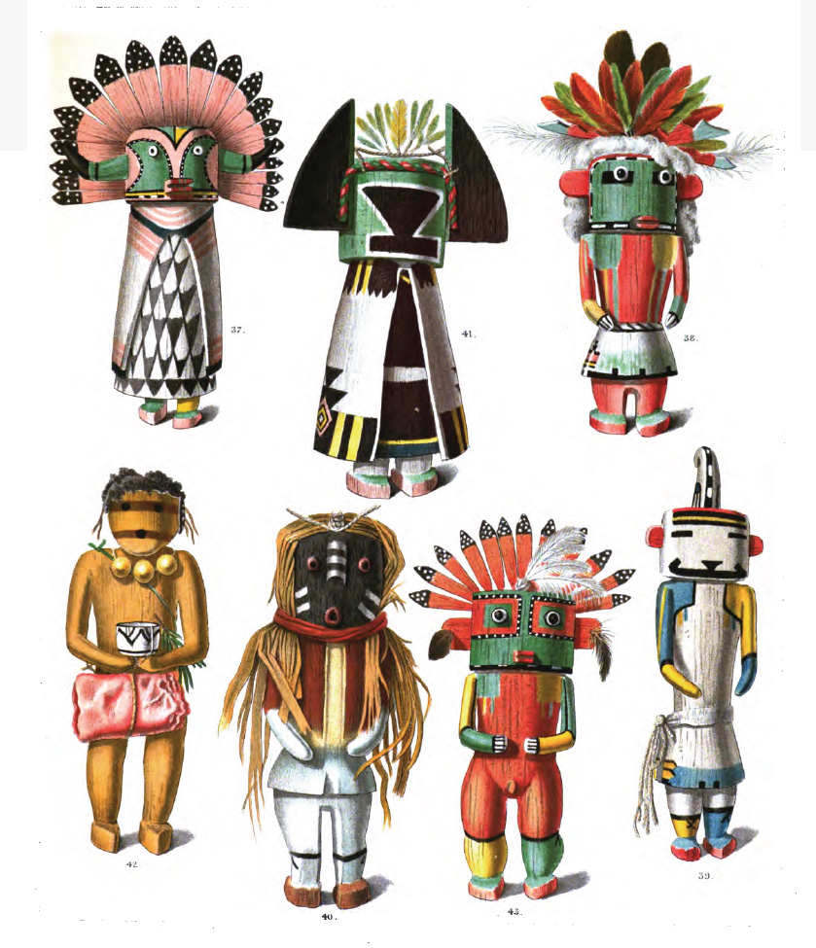
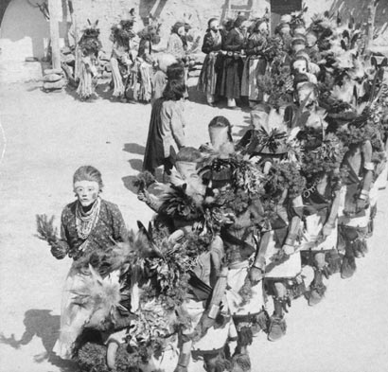
Hopi Kachina Ritual (practiced by Zuni, and Hopi Native American Indians)
(25:12 – 26_22) https://www.youtube.com/watch?v=3TCnoiR82FY

Slide 17
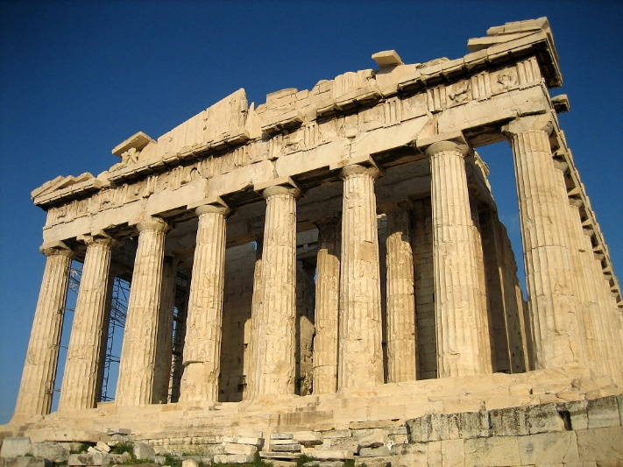
Classical Greek (5th-4th B.C.E.) culture, especially philosophy, had a powerful influence on ancient Rome, which carried a version of it to many parts of the Mediterranean Basin and Europe. For this reason, Classical Greece is generally considered to be the seminal culture which provided the foundation of modern Western culture and is considered the cradle of Western civilization.

Slide 18
Classical Greek culture gave great importance to knowledge. Science and religion were not separate and getting closer to the truth meant getting closer to the gods. In this context, they understood the importance of mathematics as an instrument for obtaining more reliable ("divine") knowledge. Greek culture, in a few centuries and with a limited population, managed to explore and make progress in many fields of science, mathematics, philosophy and knowledge in general.
https://www.youtube.com/watch?v=6bDrYTXQLu8

Slide 19
Context of Greek Society: https://www.youtube.com/watch?v=gZ7cPAnO4po
(notion of Ancient or Classical Greek 5th c. BCE post Greco-Persian War starts 4:42 Min.)
Athenian Democracy (p.36)
Athens practiced a political system of direct democracy in which participating citizens voted directly on legislation and executive bills. Participation was not open to all residents, but was instead limited to adult, male citizens (i.e., not a foreign resident, a slave, or a woman), who "were probably no more than 30 percent of the total adult population.”
Source: Thorley, J., Athenian Democracy, Routledge, 2005, p. 74

Slide 20
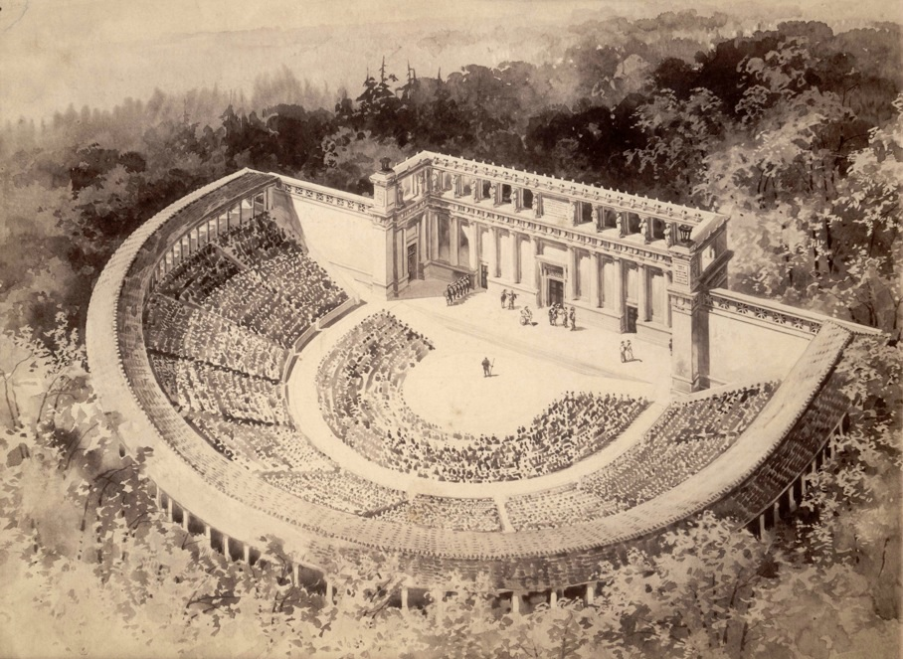
Greek Theatre: https://www.youtube.com/watch?v=2CVO9Vd067U

Slide 21
Oresteia: https://www.youtube.com/watch?v=qj1ojFHj4eg&t=53s
(Summary of Greek theatre convention, what is tragedy ? : https://www.youtube.com/watch?v=nGlQkaoIfBI )
Convention of Greek Drama:
https://www.youtube.com/watch?v=VeTeK9khttps://www.youtube.com/watch?v=nGlQkaoIfBIvxyo
There are only 33 extant Greek plays from the Ancient Greek.

Slide 22
Festival of Dionysus (5th century B.C.)
was a festival presented to honor the god Dionysus,- god of wine and fertility, during the 5th century B.C. Athens.
Every year in the spring (around our March) playwrights would compete to entertain the masses of Athenian citizenry. As many as 16,000 Athenian citizens (this excludes women, slave) would file into the amphitheater to view the newest plays by Aeschylus, Euripides, Sophocles, Aristophanes, and others.
Although the plays changed, this festival of renewal would remain the same. At the start a huge procession, or pompe, would usher the sacred statue of Dionysus from outside the city limits to the theater of Dionysus, located near the Acropolis. Dithyrambs would be sung by choruses and giant phalloi would be carried along the procession route in honor to Dionysus. This would all be accompanied by generous amounts of wine and overall lechery.
After a night of recovery, the day would begin with another procession. The war orphans would parade down the street in honor of their fathers’ who gave their lives for the polis. They then would be privileged front row seats at the theater. This procession would be followed by three tragic works of one playwright and a semi-comedic Satyr play. The Satyr plays were intended to alleviate “womanly emotions” caused by the tragedies and return the “maleness” of the audience with bawdy jokes and even more wine (see Male and Female). The next two days would follow the same pattern of three tragedies followed by a Satyr play. Then a much needed emotional break was provided with a day of five comedic plays. After the comedy day one day was set aside for the recovery from five days of drunkenness and excess. Finally, on the seventh day a winner was announced (Aeschylus was a favorite but Sophocles and Euripides had their moments as well) and the festival would come to a close.

Slide 23
On the first day of the festival there was a grand religious procession, in which the ancient statue of Dionysus was carried through the streets with great pomp and ceremony.
The entertainments provided in the theatre during the City Dionysia were of two kinds. In the first place there were the dramatic competitions, at which tragedies, comedies, and satyric dramas were exhibited. In the second place there were the choral competitions, which consisted of performances of dithyrambs to the accompaniment of the flute

Slide 24
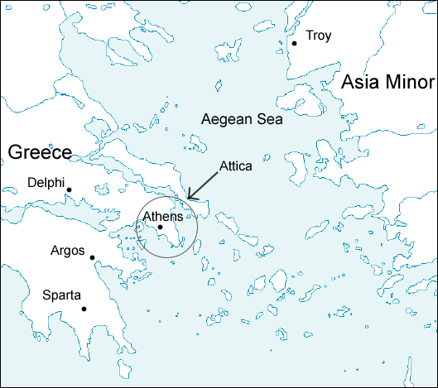
Artist’s sketch of the imagined ancient Greek Theatre.
Original sketch by John Galen Howard (1864–1931)

Slide 25
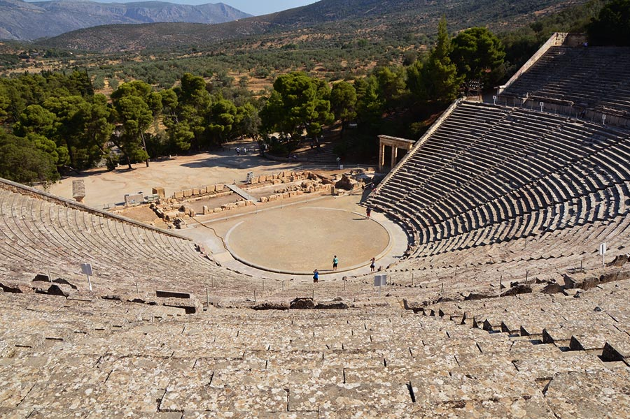
Ancient Greek Theatre: Architecture Features
Theatre of Epidaurus (late 4th century B.C.)
The highest distance of the concave is 58 metres, while the diameter of the stage is 20 metres. Source: www.greeka.com
a large, open-air structure used for dramatic performance.
took advantage of hillsides and naturally sloping terrain and, in general, utilized the panoramic landscape as the backdrop to the stage itself.
is composed of the seating area (theatron), a circular space for the chorus to perform (orchestra), and the stage (skene).

Slide 26
Ancient Greek Theatre
https://www.youtube.com/watch?v=2CVO9Vd067U
1300 -1200 B.C.E. Worship of Dionysus
534 B.C.E. Dramatic Competition Established at City Dionesia
523-456 B.E.C. Life of Aeschylus
508 B.C.E. Athenian Democracy established
496-406 B.C.E. Life of Sophocles
458 B.C.E. The Oresteia Trilogy by Aeschylus
431 B.C.E. Medea by Euripides
430 B.C.E. Oedipus Rex by Sopholces
429-347 B.C.E. Life of Plato
404 B.C.E. Athens defeated in Peloponnesian War
383-322 B.C.E. Life of Aristotle

Slide 27
Greek Theatre Convention
Male actors only (3 main actors)
Off stage violence
-ekkyklema (special wagon to carry dead body of character)
The use of mask (with big gestures)
The use of chorus (12-15) singing choral passage, converse in a dialogue with the main character, narrate the context or story.
Playwright (known as the poet) manages how to perform
Thespis – a chorus who enacts a character, later known as the “1st” actor in the world.

Slide 28
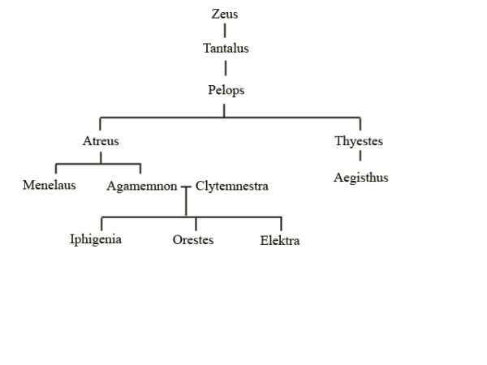
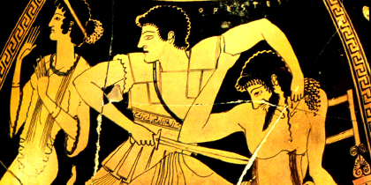
The Oresteia (458 B.C.): a trilogy by Aeschylus: (p.27)
Agamemnon, The Libation Bearers, and The Eumenides

Slide 29
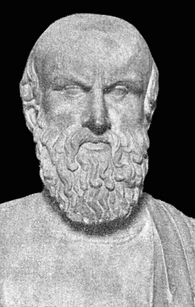
Aeschylus was to establish the basic rules of tragic drama: -1) invented the trilogy, a series of three tragedies that tell one long story,
2) introduced the second actor, making the dramatization of a conflict possible.
Trilogies were performed in sequence over a full day.
At the end of the last play, a satyr play was staged to revive the spirits of the public, possibly depressed by the events of the tragedy.
Seventy-nine titles of Aeschylus' works are known (out of about ninety works), both tragedies and satyr plays. Seven of these have survived, including the only complete trilogy which has come down from antiquity, the Oresteia.
Aschylus 523-456 B.E.C.

Slide 30
Athenian Democracy (p.36)
Athens practiced a political system of direct democracy in which participating citizens voted directly on legislation and executive bills. Participation was not open to all residents, but was instead limited to adult, male citizens (i.e., not a foreign resident, a slave, or a woman), who "were probably no more than 30 percent of the total adult population.”
Source: Thorley, J., Athenian Democracy, Routledge, 2005, p. 74

Slide 31
Quiz:
Group of 4 Activity:
1) Roles: Planner, Researcher, Note Taker
2) Write down the block of passage of the given part of the script
3) Describe who the characters are.
4) Summarize the content within 5-6 sentences.

Slide 32
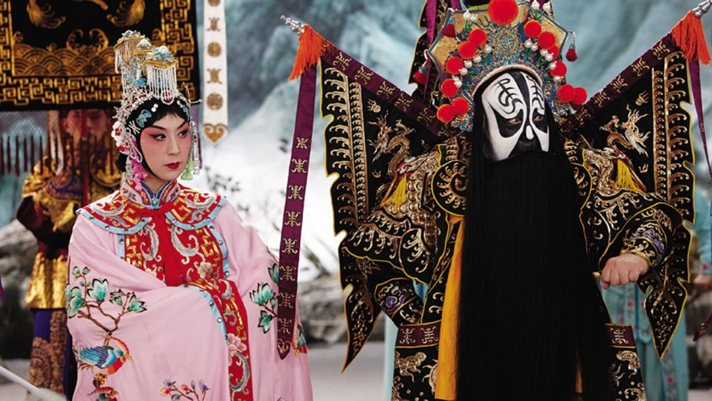
京剧 (pinyin: Jīngjù) Jing Ju (Beijing Opera)
Jingju (18th-19th Century China)
Emphasized elements of singing, dancing, acting https://youtu.be/Z_p4mE-11fk
Introduction to Jing Ju https://www.youtube.com/watch?v=PnMRIzpO4nU

Slide 33
Beijing Opera and Political Context
Beginning of 20th century, there were about 3,000 troupes throughout China. These were private companies operating commercially.
1920-1930, -Mei Lan-Fang and his company toured Japan, US, and Russia.
1942 -Mao Zedong presented his theories of art and theatre as vehicle to serve political cause of the workers, peasants, and soldiers.
1966-1976 - China’s Cultural Revolution led to suppression of all arts deemed to represent the capitalistic west. Only 8 model plays were allowed as they emphasized workers and their revolution. Bejing Opera was manipulated to represent Communist propaganda and resulted in the effect of almost destroyed the theatre itself.
1977 – Present Revival of the nearly diminished Beijing Opera

Slide 34
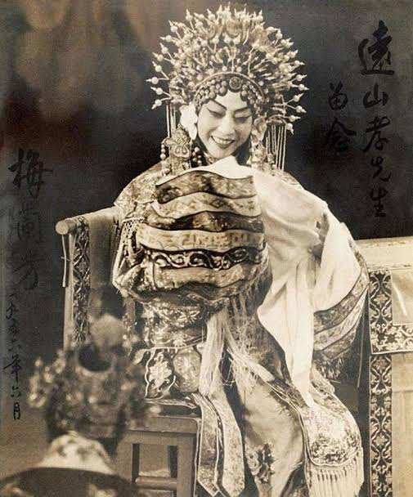
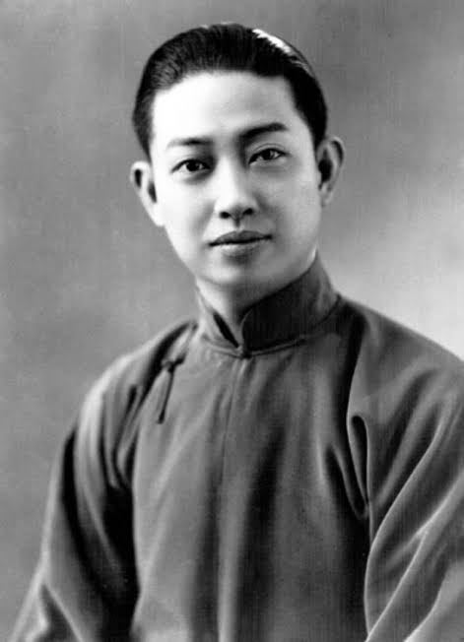
Four main types of characters in 京剧 (pinyin: Jīngjù) Jing Ju (Beijing Opera)
Sheng (male), Dan (female), Jing (powerful male), and Chou (clown), based on the gender, age, evil or kind-hearted nature, handsomeness or uglinessy of the characters played.
Dan is the general name for female roles
Mei Lang Fang (1894-1961)
“Queen of Jing Ju”

Slide 35
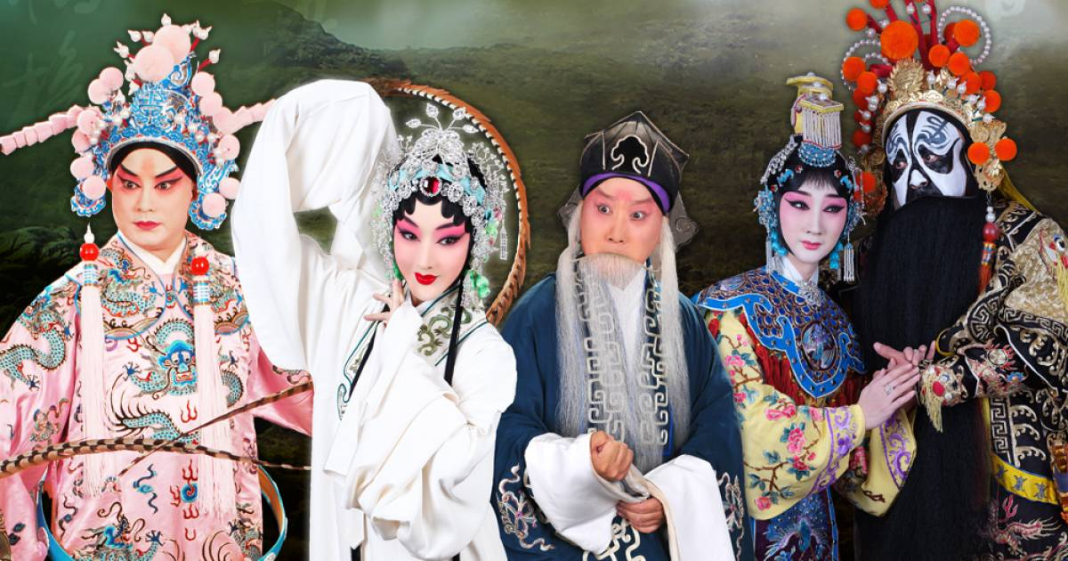
Characteristics of Beijing Opera:
Use stock characters (4 categories): male, female, painted face, comic.
Men played women’s roles.
Female impersonation became very refined.
Appearances are larger than life, with stylized make-up, costume, and headdress.
Stylized gestures conveyed coded meanings
Spectacular display of gymnastics, martial arts, and movements
Stylized speech

Slide 36
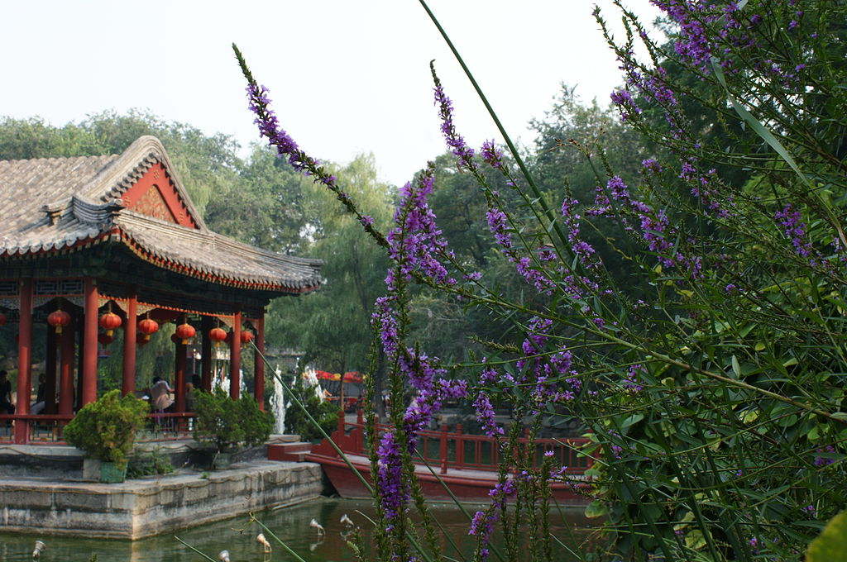
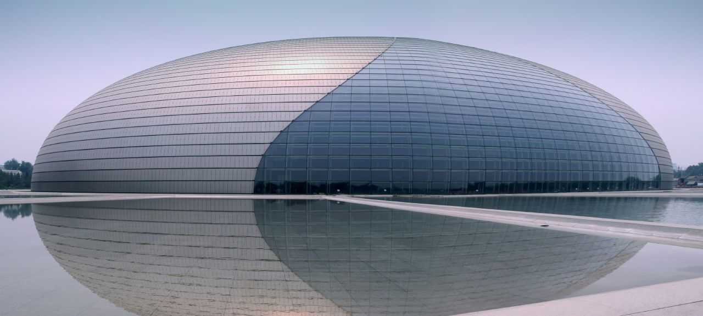
Example of Theatre Venues in Beijing
Prince Gong Mansion
National Grand Theatre

Slide 37
Khon (โขน) Thai classical masked dance-theatre, is based on the tales of the epic Ramakien.
Khon originally could be performed by men only. Women performed only as angels and goddesses. In the past, Khon was performed only by the royal family, with the sons of the king performing as monkeys and demons.
Today women perform as monkeys and demons.
Khon was announced Intangible Cultural Heritage (ICH) on
29 November 2018
https://www.facebook.com/tusocant/posts/10155909288411220?__tn__=K-R

Slide 38
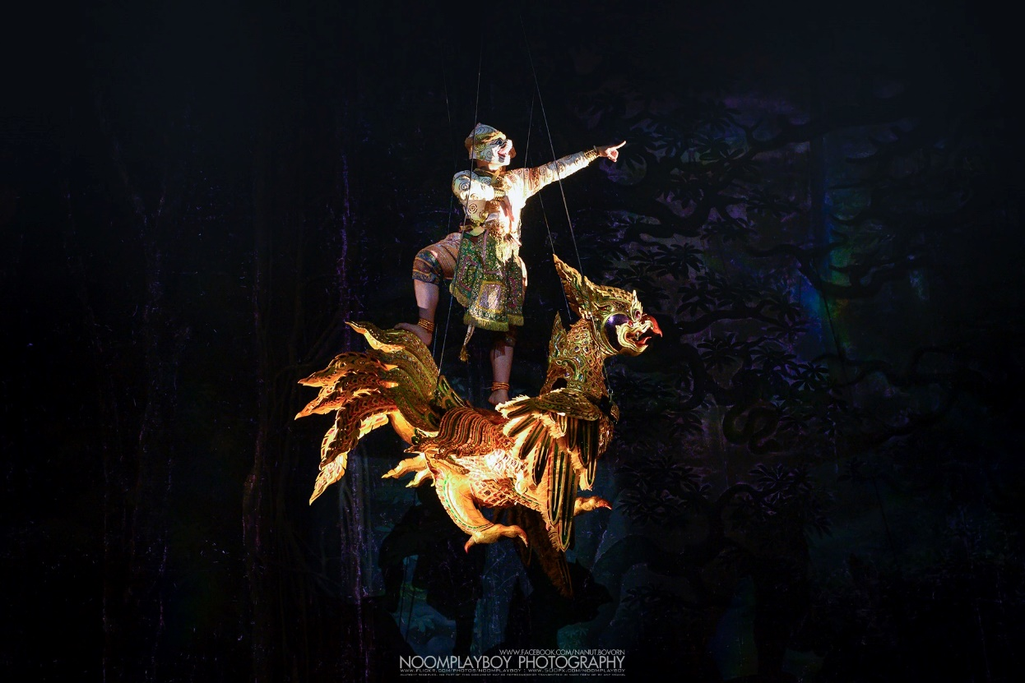
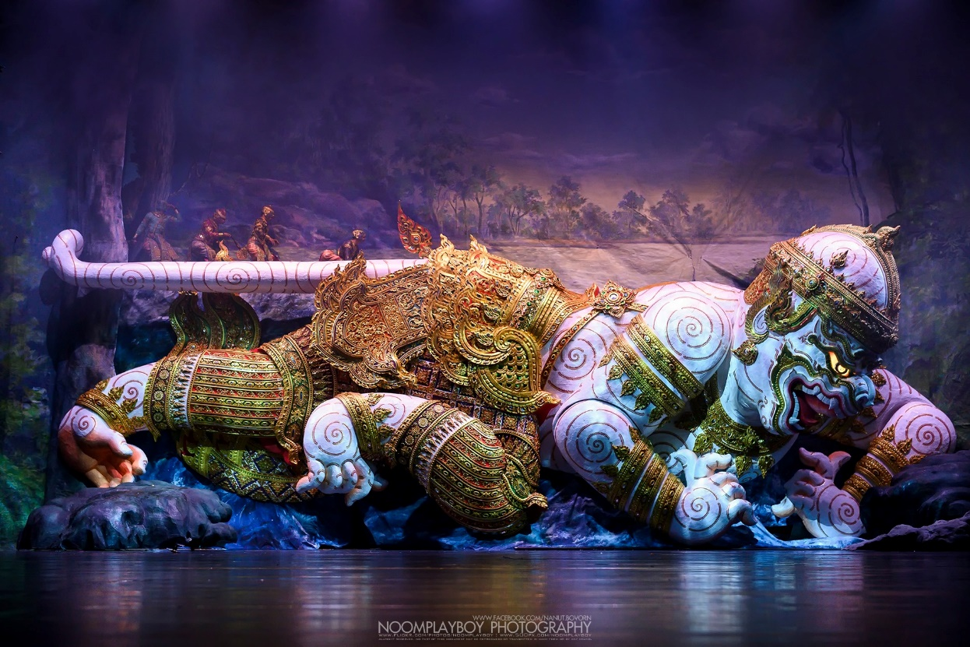
Khon: สืบมรรคา at Thailand Cultural Center
Nov. 6 – Dec 5, 2019.

Slide 39
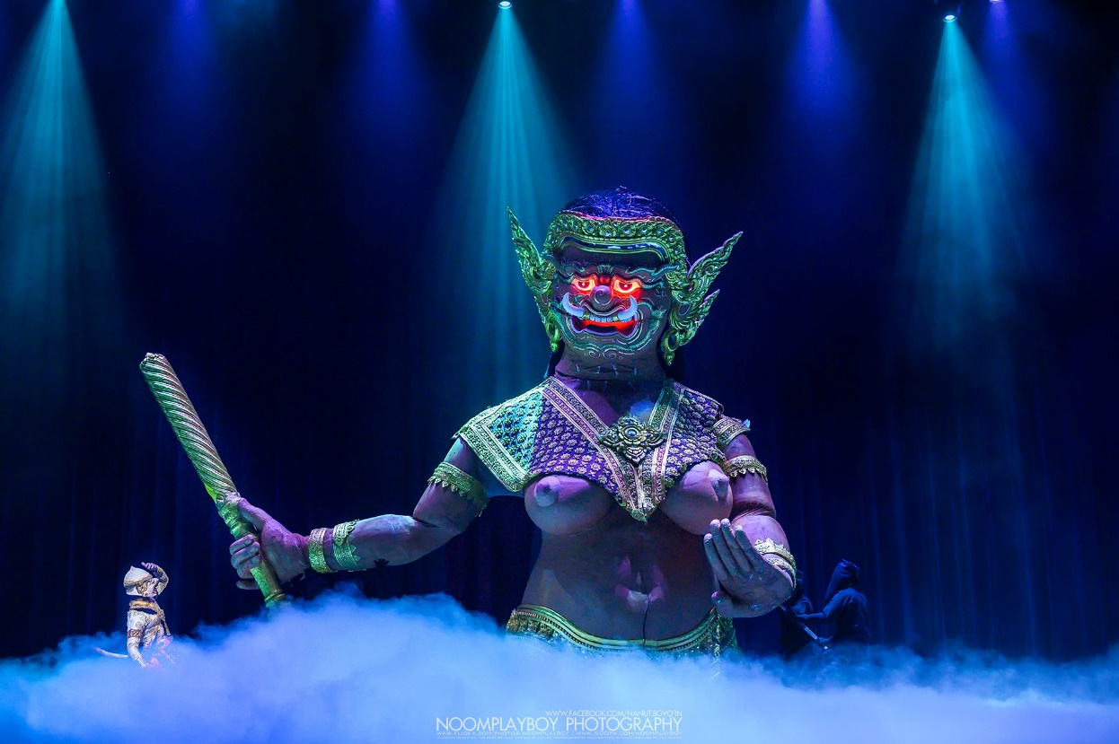
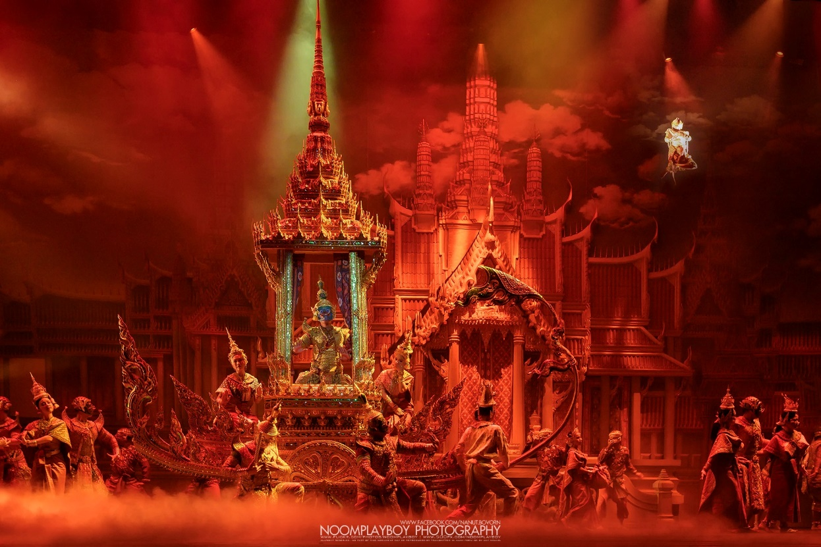

Slide 40
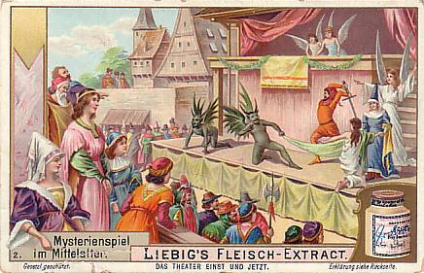
The Medieval Mystery Cycle Plays (13th- 16th century) https://slideplayer.com/slide/12033030/
are among the earliest formally developed plays in medieval Europe. - focused on the representation of Bible stories in churches as tableaux with accompanying antiphonal song. -told of subjects such as the Creation, Adam and Eve, the murder of Abel, and the Last Judgment.
- Often they were performed together in cycles which could last for days.

Slide 41
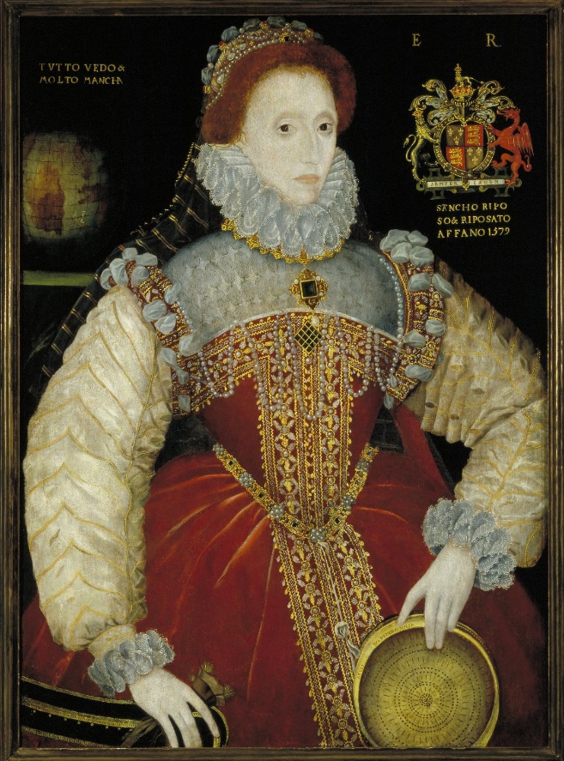
The Elizabethan Theatre (16th-17th C. England)
Reign of Elizabeth I (1558-1603)
Life of Shakespeare (1564-1623)
Queen Elizabeth I (1533-1603) daughter of the daughter of King Henry VIII

Slide 42
Elizabethan Theatre ….its beginning
acting troupes travelled the country and sought lodgings at inns or taverns and before long entrepreneurs, such as James Burbage, started to produce plays at inn-yard
Aside from “inn-yards”, plays were performed in the houses of noblemen, town squares or, on open ground - especially at local fairs.

Slide 43
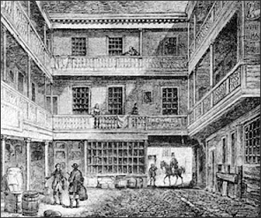
“The Inn-Yards”
Elizabethan Theatre ….its beginning
Women were not allowed on the stage - boy actors played the parts of women
White Hart Inn-yard illustrates a typical inn-yard detailing the courtyard and the balconies and rooms. Travelling minstrels, theatre troupes often entertained in these inns.

Slide 44
Inn-Yard Theatre Performances
- plays were first produced in the yards of inns - the Inn-yards. The very first theater and the development of the amphi-theatre.
the inn-keepers increased their profits by allowing plays to be shown on temporary stages erected in the yards of their inns (inn-yards). Soon purpose-built playhouses and great open theatres were being constructed.

Slide 45
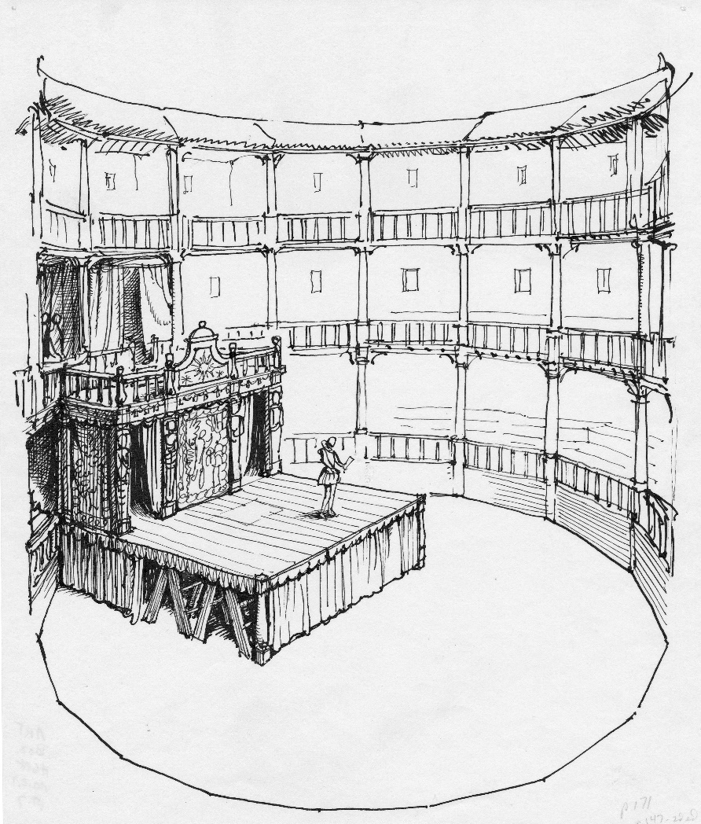
Elizabethan Inn-yards -- at their peak between 1576 - 1594
The plays were performed in the cobblestone yards
The stage was constructed on moveable platforms supported by Trestles
The Audience capacity was up to 500 people
All of the major inns had large cobblestone yards

Slide 46
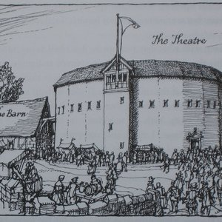
Story of the first theatre in England
After many successful productions at inn-yards, James Burbage wanted to to create a purpose built building designed specifically to produce plays. He achieved his goal in 1576 by building 'The Theatre‘ (the first theatre house in England) in Finsbury Fields, Shoreditch, London. It was designed in the style of a Roman open-air amphitheatre, with three tiers of galleries and a covered stage.
built outside the boundary of the City of London Wall - and out of the clutches of the City of London Officials.
The Inn-yards were the first venues for performing Elizabethan plays and are therefore extremely important to the history of the Globe Theatre.

Slide 47
The Globe Theatre
Built in 1599 and destroyed by fire in 1613, the original Globe Theatre was at the heart of London
used timber from an earlier theatre, The Theatre, which had been built by Richard Burbage's father, James Burbage
Globe shareholders, Richard Burbage and his brother Cuthbert Burbage, owned double shares of the whole, or 25% each; the other four men, Shakespeare, John Heminges, Augustine Phillips, and Thomas Pope,

Slide 48
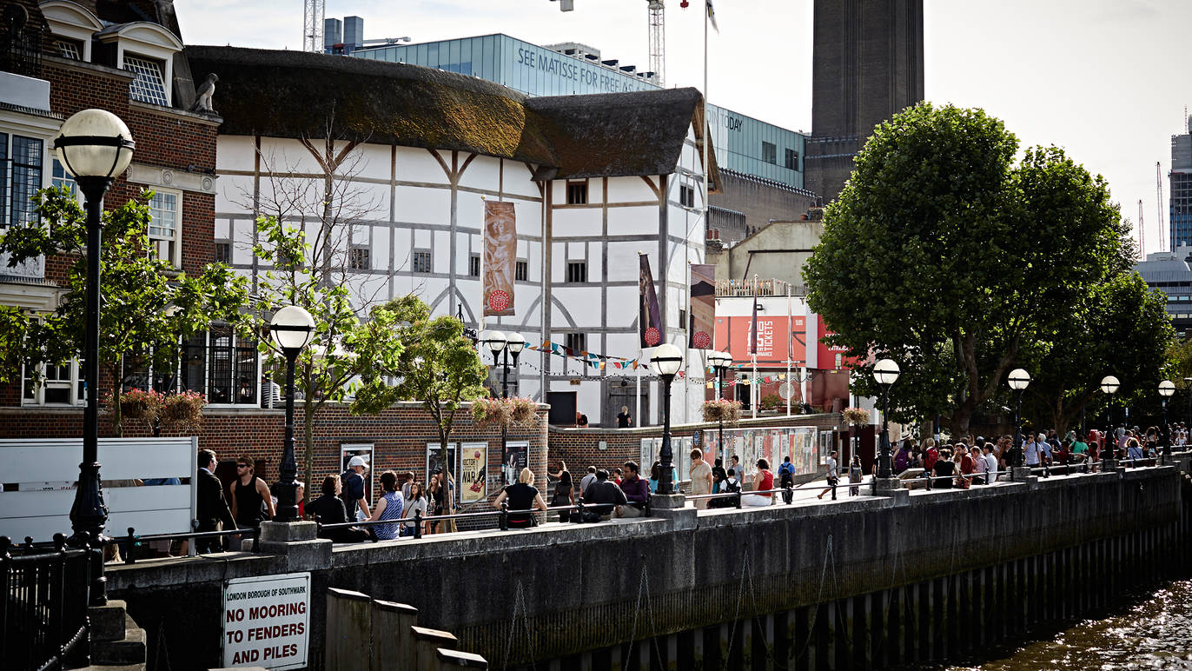
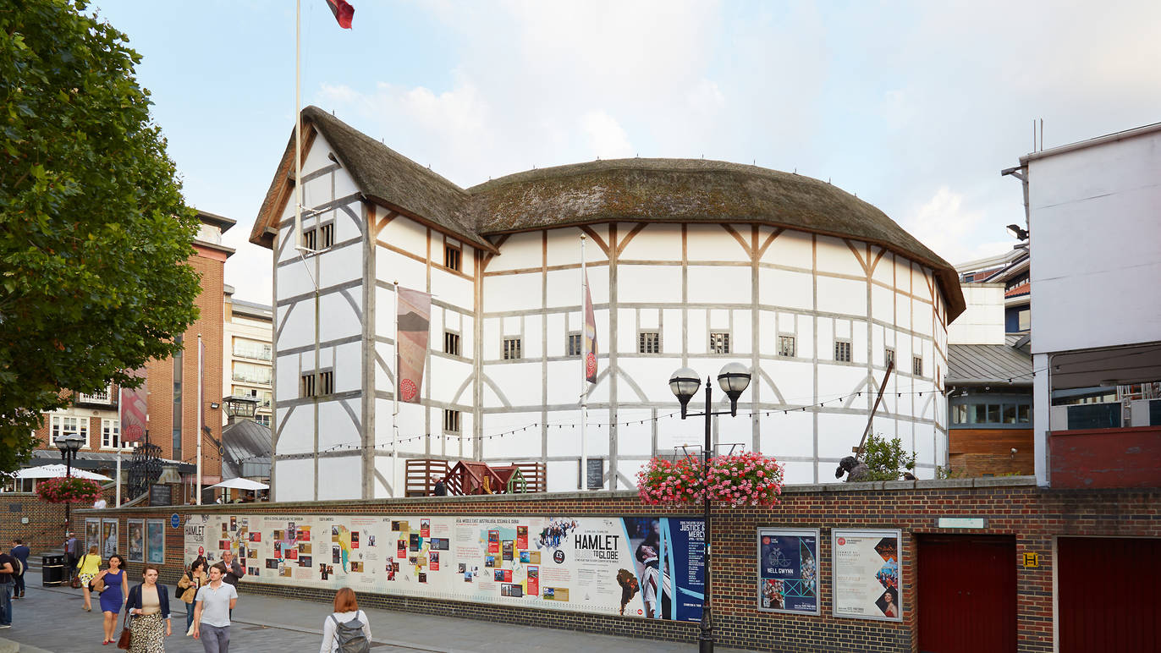
The Shakespeare’s Globe Theatre (1997)

Slide 49
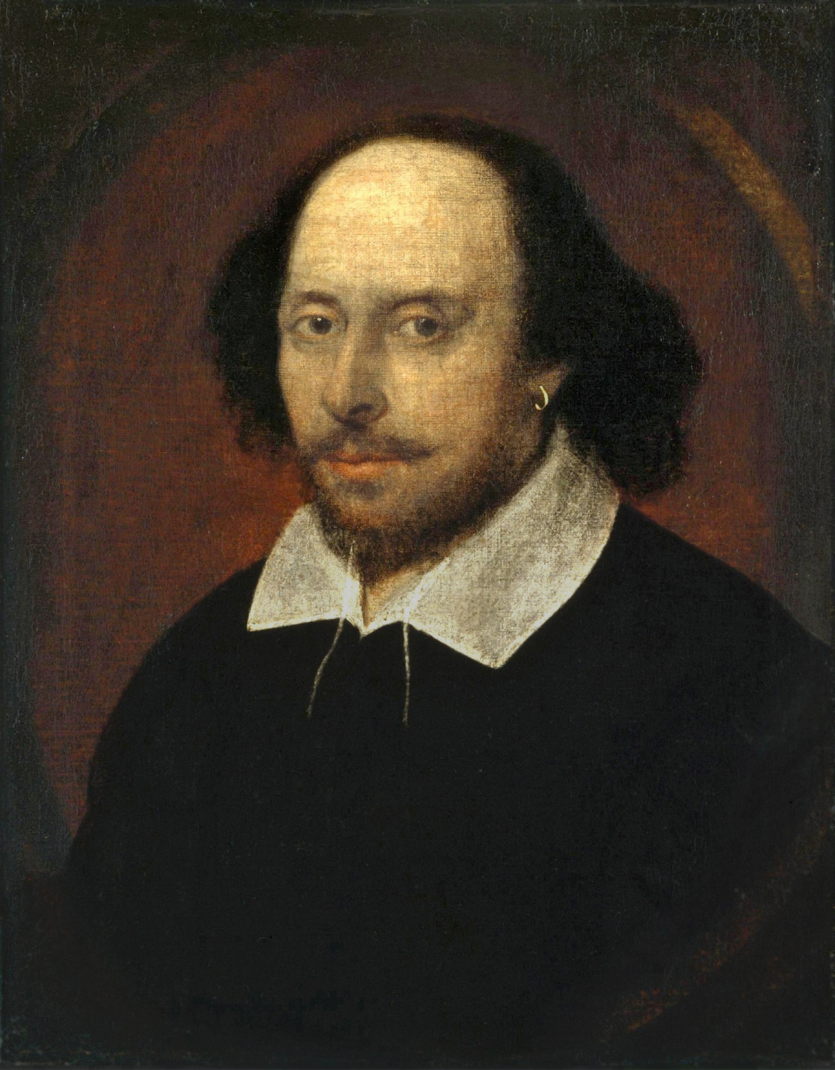
William Shakespeare (1564 – 1616) :English poet, playwright, and actor
Sometime between 1585 and 1592, he began a successful career in London as an actor, writer, and part-owner of a playing company called the Lord Chamberlain's Men, later known as the King's Men. At age 49 (around 1613), he appears to have retired to Stratford, where he died three years later.
Shakespeare's early plays were written in the conventional verse style of the day, with elaborate metaphors and rhetorical phrases.
39 plays 154 sonnets
he plays are divided into the genres of tragedy, history, and comedy.

Slide 50
About Shakespeare: https://www.youtube.com/watch?v=FS2ndY5WJXA
Shakespeare and Performing:
https://www.youtube.com/watch?v=9m5I-HO3w8w
Shakespeare’s female charactes:
https://www.youtube.com/watch?v=ZjAqfh9aY9Y

Slide 51
Hamlet (circa 1599 and 1602) by William Shakespeare
Hamlet quick plot summary:
https://www.youtube.com/watch?v=t0CqUTmwKiM
With English Subtitles from the play:
https://www.youtube.com/watch?v=aZD4_vNUHJU
Why should we read Hamlet ?
https://www.youtube.com/watch?v=QTu39aMg_mU

Slide 52
The Elizabethan Theatre (16th-17th C. England) during the Renaissance
(started during the reign of Queen Elizabeth I (reigned A.D.1558-1603)
London, the largest city in Europe, had approx. 200,000 population
Greek/ Medieval
Elizabethan
Ritual/religious based
Having religious focus
Regular citizens were involved at every level of productions, community-based, amateur in nature
Seasonal
Renaissance Time (-inherited from both Greek and Medieval theatre)
Secular based
Professionals were involved at every level of productions
Year-round
Received patronage from nobility who protected the artists

Slide 53
SUMMARY (From Medieval to Elizabethan) https://slideplayer.com/slide/4208817/

Slide 54
The Functions of Theatre:
Theatre is a major source of learning about issues of religion, politics, science, race, gender identity, ideas or model behaviors.
Theatre is a mirror to society. (Please explain why and how?)
Theatre provides themes (key messages important to the society).
Theatre provides aesthetic expression deemed appropriate and acceptable in the community.

Slide 55
What happened when women were excluded from performing the women’s roles on stage for hundreds of years?
(Since theatre functions as a major source for gender identity, & model behaviors,)
Significant consequences:
Women were misrepresented, their voices were not heard.
Women’s roles and natures were defined by men.
Women had no part in the creation of female representative on stage.
As a result, women may have distorted their own behavior or adopted styles of dress/behavior according to what they have seen on stage.

Slide 56
Theatre has the power to: reinforce, challenge, celebrate, sustain, empower, transform, and etc.

Slide 57
Arthur Miller (1915 – 2005)
WWI: 1914-1918
The Great Depression: 1929-1930s
WWII: 1939-1945
Famous Works:
All My Sons (1947)
Death of a Salesman (1949)
The Crucible (1953)
A View from the Bridge (1955)
Finishing the Picture (2004)
Awards and Honors: Pulitzer Prize, two New York Drama Critics Circle Awards, two Emmy Awards, three Tony Awards
Spouse(s): Mary Slattery, Marilyn Monroe, Inge Morath
Wrote 37 stage plays, 13 Radio Plays, 7 Film Scripts, many novels and non-fictions.
Known as a writer of social plays with a strong emphasis on moral problems in American society and often questioned psychological causes of behavior.

Slide 58
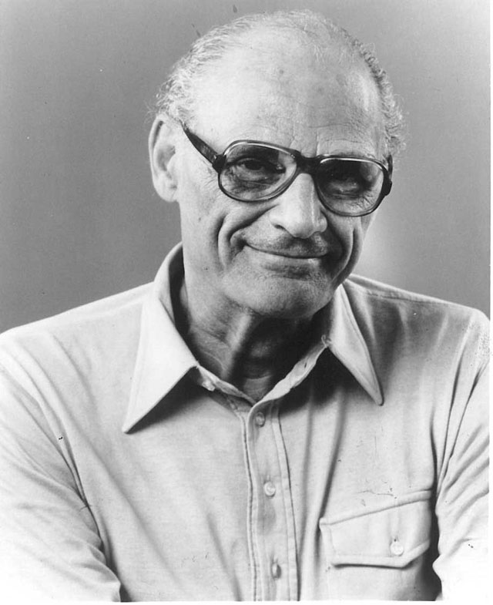
"Well, all the plays that I was trying to write were plays that would grab an audience by the throat and not release them, rather than presenting an emotion which you could observe and walk away from.“
--- Arthur Miller

Slide 59
Death of a Salesman (1949)
Clip from Death of a Salesman
Watch 34:50 min - https://www.youtube.com/watch?v=RMqiCtq5VLs
Written by Arthur Miller
Won Pulitzer Prize for Drama and Tony Award for Best Play.
premiered on Broadway in February 1949, running for 742 performances, and has been revived on Broadway four times.
It is sometimes considered to be one of the greatest plays of the 20th century.
1949 New York Drama Critics' Circle Best Play
1949 Pulitzer Prize for Drama
1949 Tony Award for Best Play
1984 Drama Desk Award Outstanding Revival
1984 Tony Award for Best Reproduction
1999 Tony Award for Best Revival of a Play
1999 Drama Desk Award Outstanding Revival of a Play

Slide 60
อวสานเซลส์แมน
Production in Thailand
(2513 (1970), 2514 (1971))
Directed by Gary Kargin
Produced by Mattani Ruttanin, Liberal Arts Faculty, Thammasat University
Performed at หอประชุมศรีบูรพา

Slide 61
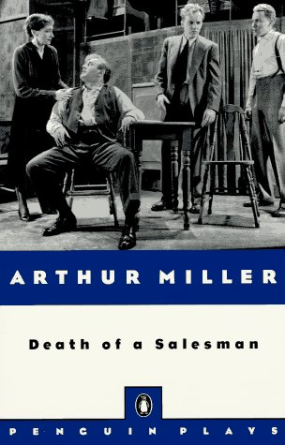
Willy Loman desperately wants to believe that he has succeeded, that he is “well liked” as a great salesman, a fine father, and a devoted husband. That he has not really attracted the admiration and popularity at which he has aimed is evident, however, in the weariness that belabors him from the beginning of the play. Nearing retirement he suffers a drastic decrease in sales work, a dissatisfying marriage, and a turbulent relationship with his sons which inexorably leads to his suicide with the justification that the insurance will finally provide for his family.

Slide 62
Trailer from Les Misérables https://www.youtube.com/watch?v=IuEFm84s4oI
Les Misérables, novel (1862) by Victor Hugo, and the classic Broadway stage show of the same name, Les Misérables is the story of Jean Valjean, a prisoner who breaks parole, and the police inspector, Javert, who tries to hunt him down for breaking parole.
The Broadway production opened 12 March 1987 and ran until 18 May 2003, closing after 6,680 performances. It is the fifth longest-running Broadway show in history and was the second-longest at the time.

Slide 63
Theatre for Social Change: How does theatre affect us ?
From the Ancient Greek to Elizabethan period, or even into the early 20th C., women were excluded in participating in theatre making. Theatre was culturally accepted as model for gender identity, even though women had no part in the creation.
Consequences: women lost opportunities to participate in the life of the community, voices unheard, men created distortion of women images on stage.
Modern society tries to give women (and other genders) platforms
Theatre is a platform where all social issues can be explored, thus theatre becomes a significant way of challenging prevailing point of view thus bring social change.

Slide 64
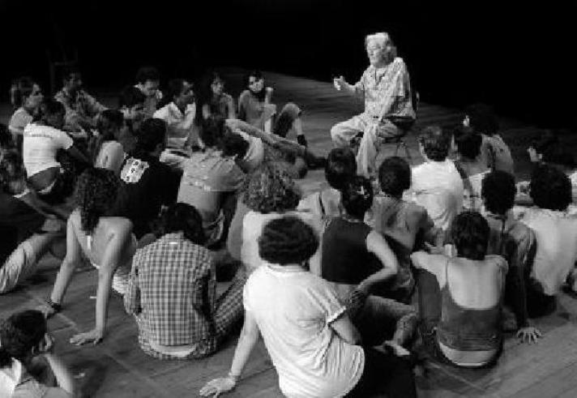
Theatre of the Oppressed (TO): theatrical forms the Brazilian theatre practitioner Augusto Boal established in the 1970s, e.g. Forum Theatre, Image Theatre.
Boal's ideas aimed to wake up the passive spectator, inviting members of the audience on to the stage to act out their real-life problems, turning them into what he called "spect-actors", and empowering them to find strategies for personal and social change.

Slide 65
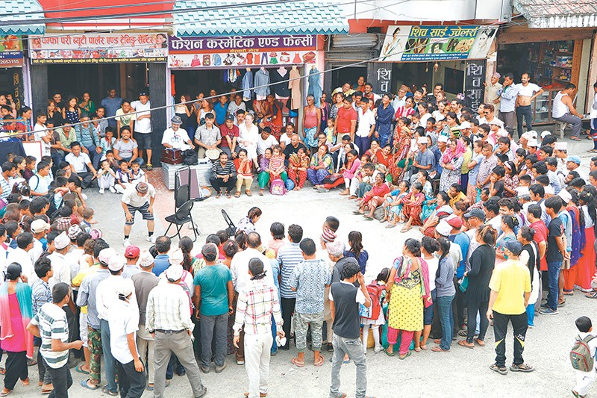
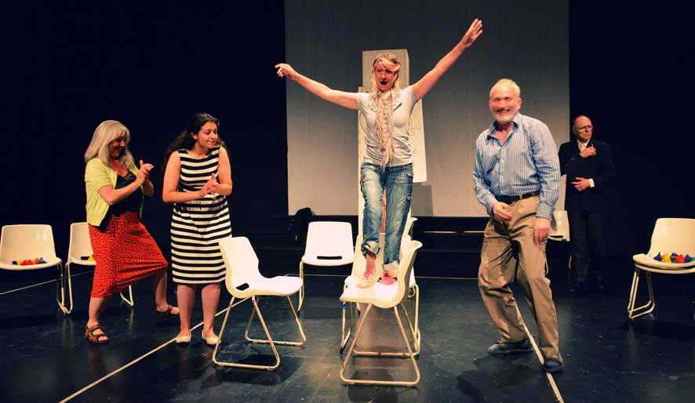
Forum Theatre
https://www.youtube.com/watch?v=srvnPJcLmlM
Image Theatre
https://www.youtube.com/watch?v=iogXYf5_LqU

Slide 66
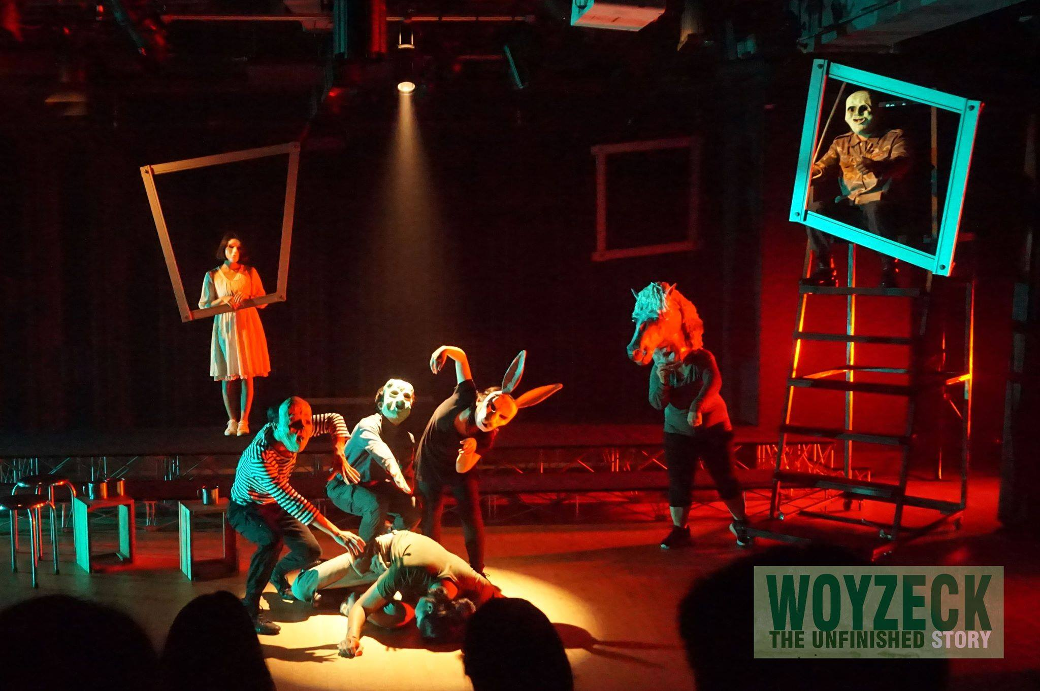
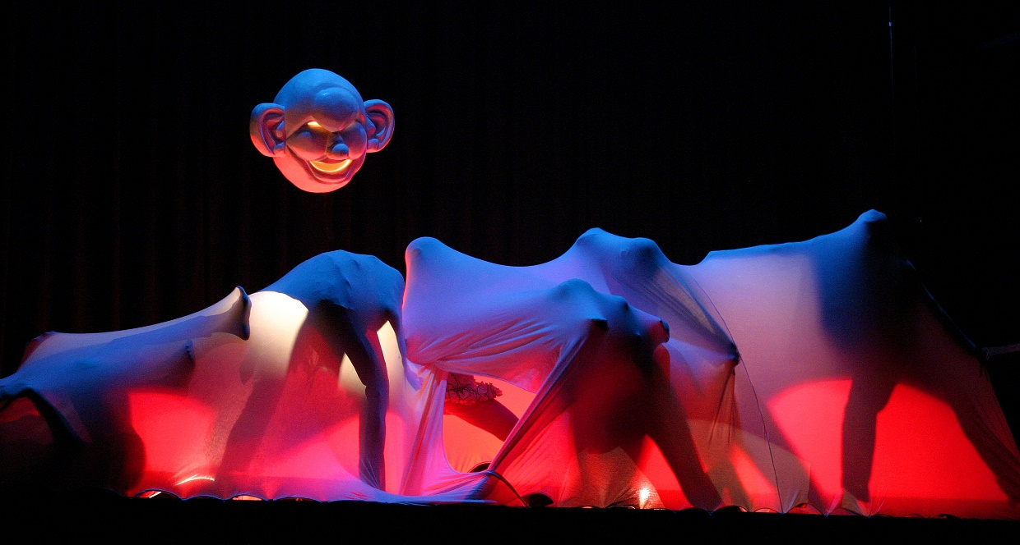
Contemporary Theatre in Thailand
Crescent Moon
B_Floor

Slide 67
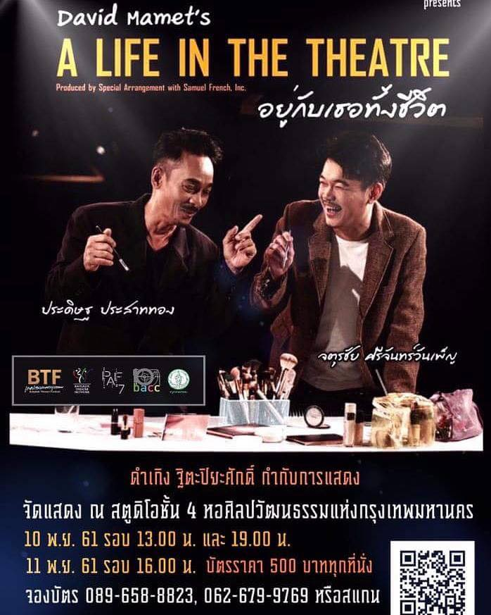
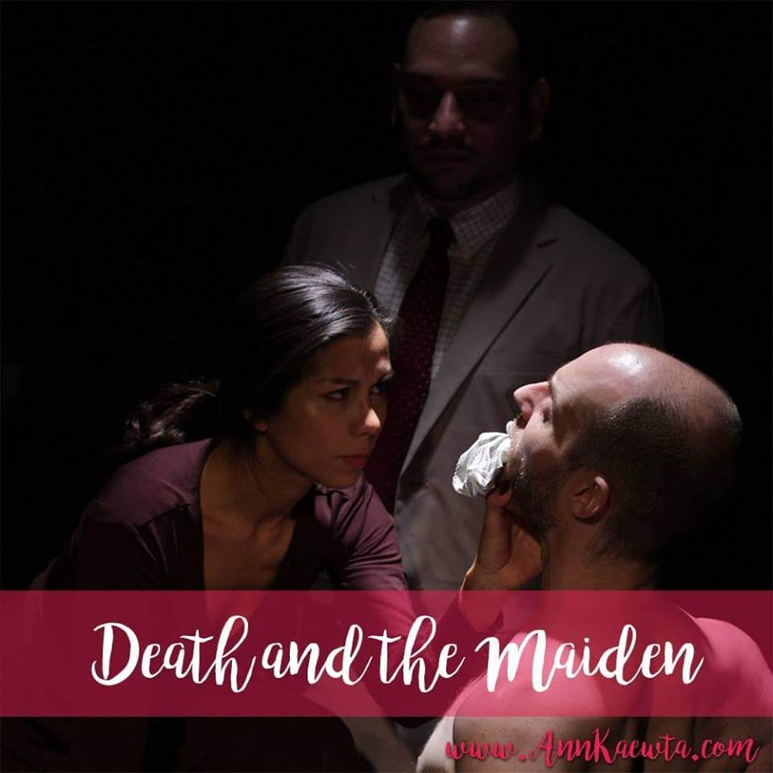
New Theatre Society
Peel the Limelight https://www.facebook.com/peelthelimelight/videos/2282592568448762/

Slide 68
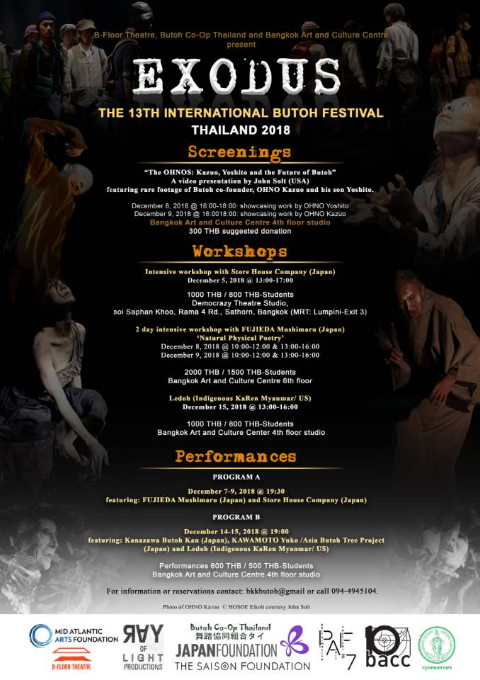
Theatre recommendation 2018: Not on Exam https://thematter.co/rave/10-drama-in-jan-feb-2018/44058
November – December of each year:
Bangkok Theatre Festival
Performative Art Festival
International Butoh Festival

Slide 69
Theatre Production Process: (Not on Exam)
Choosing a play,
Pre-Production Planning,
Production Meetings,
Production Rehearsals,
Technical Production in Progress,
Technical Rehearsal,
Dress Rehearsal,
Production Opens

Slide 70
Useful slides to learn more about Acting: https://www.slideshare.net/garrets/chapter-7-25540270

Slide 71
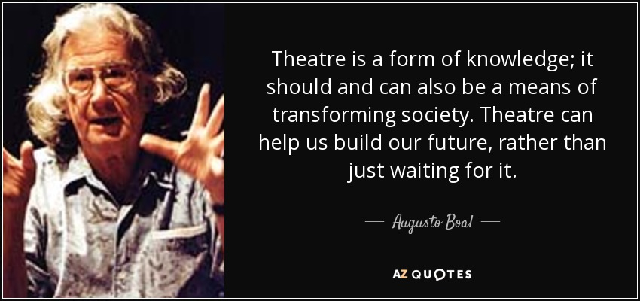

Slide 72
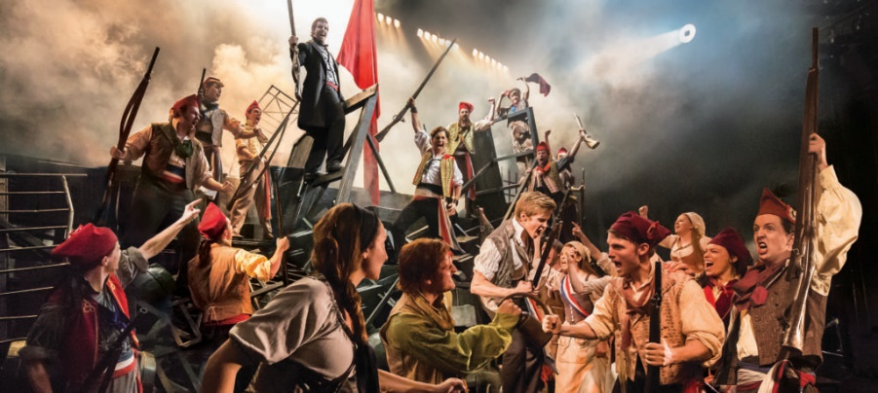
Behind the scene with Les Misérables https://www.youtube.com/watch?v=So2LbUDXTuc

Slide 73
Activities:
Send your ticket stub on a piece of paper with your name to:
ผศ.ดร. ปาริชาติ จึงวิวัฒนาภรณ์
สาขาการละคร คณะศิลปกรรมศาสตร์
มหาวิทยาลัยธรรมศาสตร์
99 หมู่ 17
ถนน พหลโยธิน
อ.คลองหลวง
จ.ปทุมธานี 12121
Warm Up
Sending a Ball and Name Game
Cat and Mouse
Fire Crackers
Sip-Sap-Sup (Left-Right-Front)
Mirror (Concentration)
Parts make a Whole
Walk (Imagination)
“Where” Ending in Frozen Sculpture ( 3 frozen pictures)

Slide 74
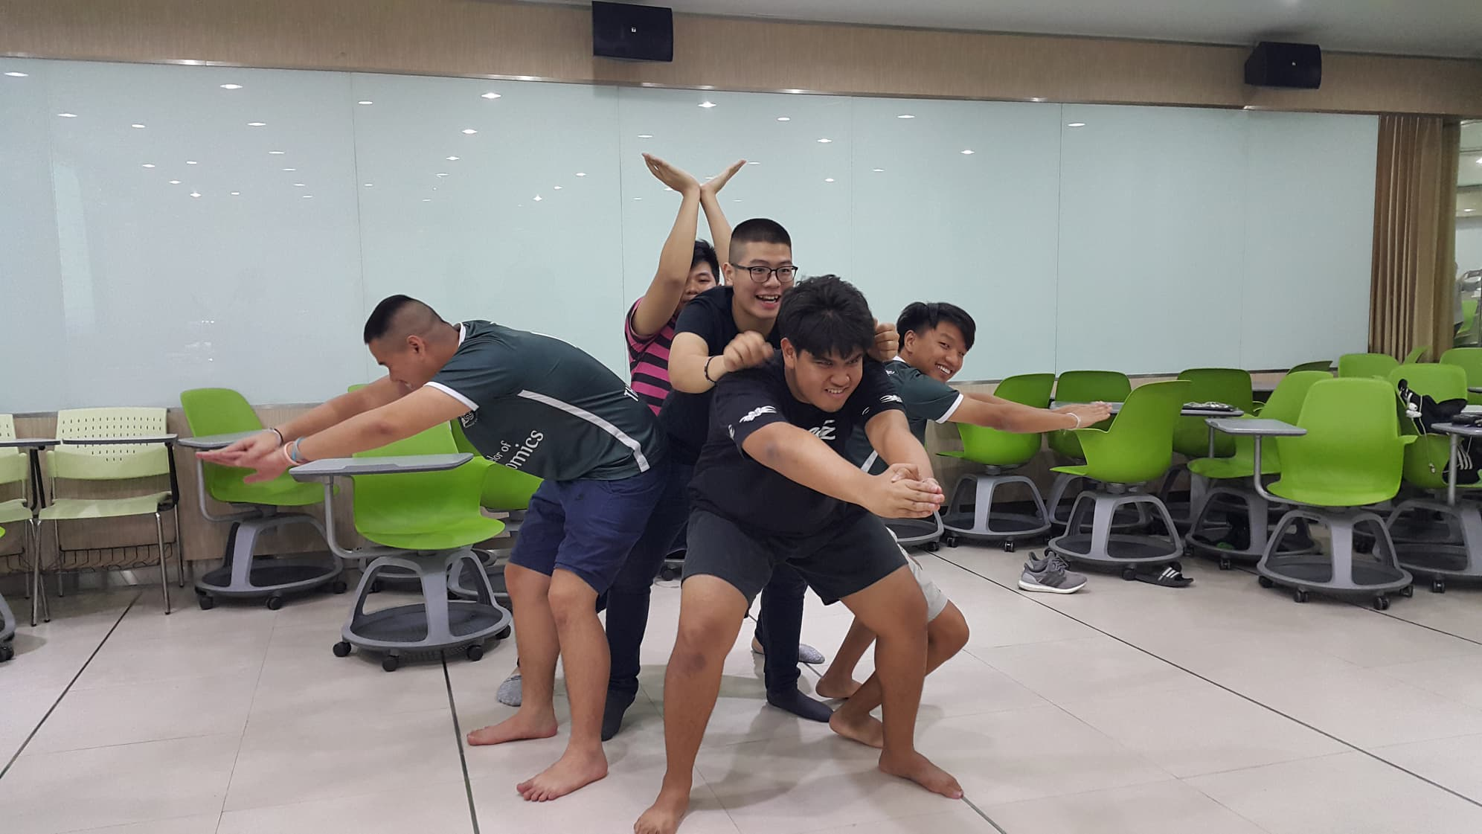
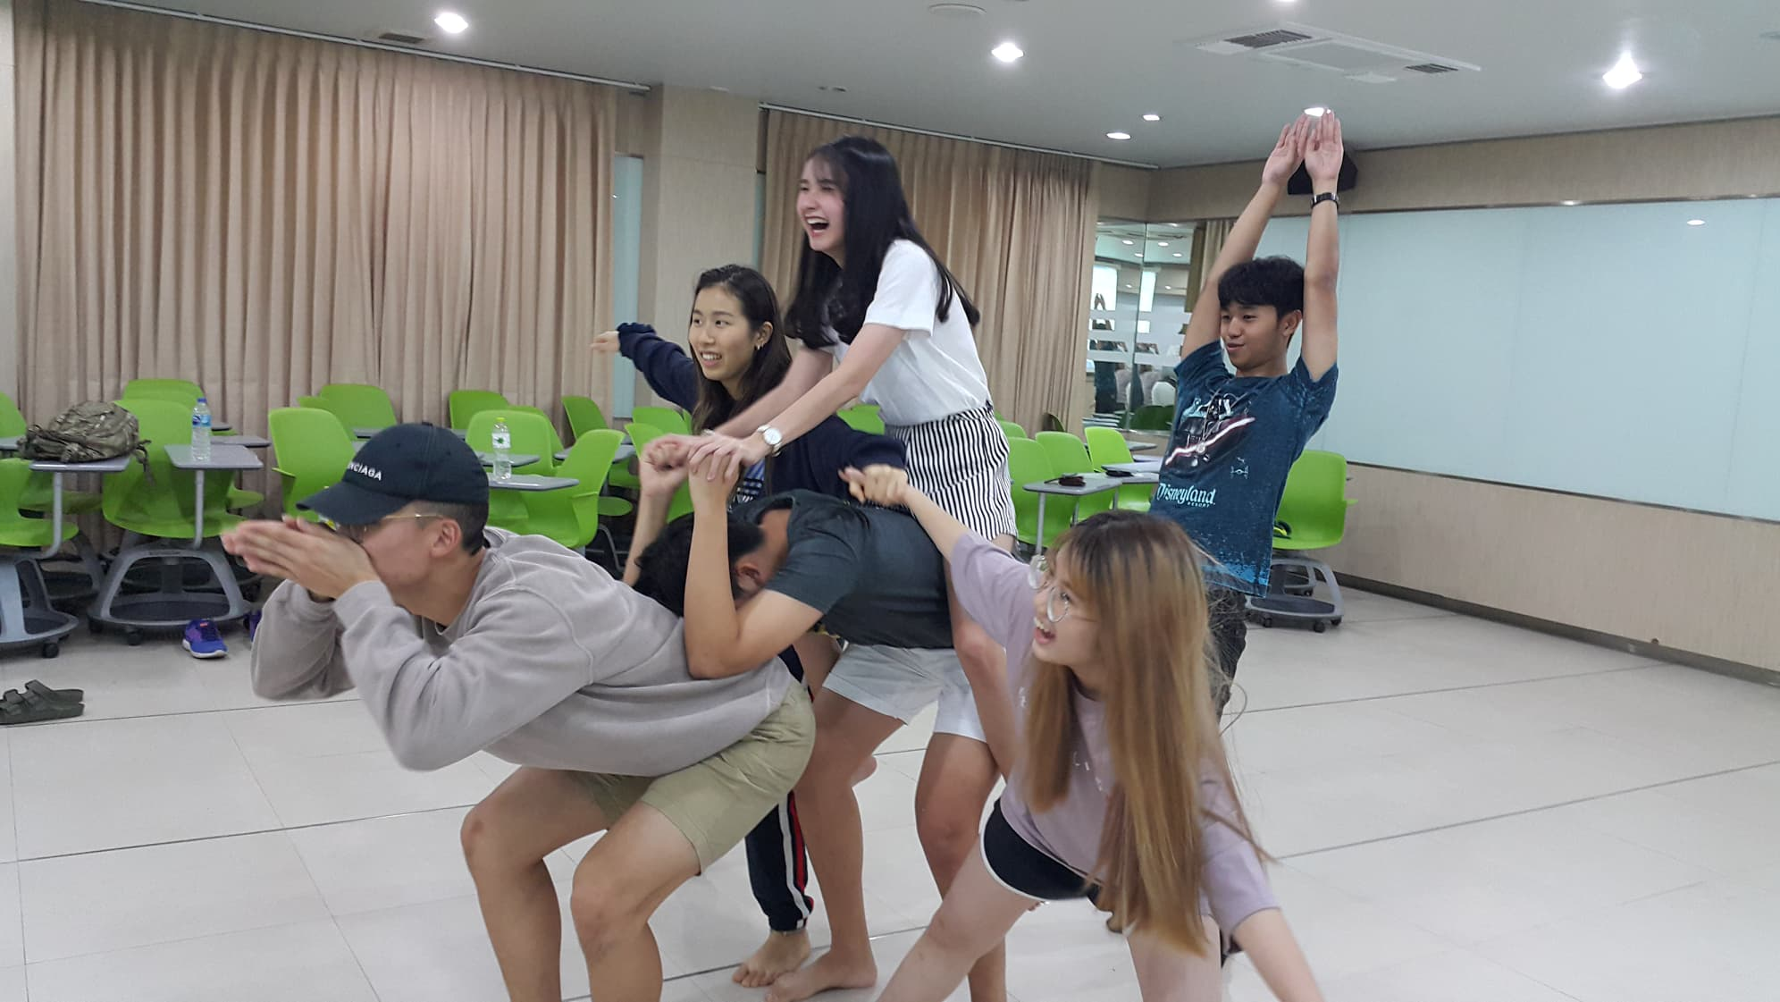
Our Last day of TU 116 Class ☺ ☺ ☺
Beginning Acting Exercise
Using Imgination

Slide 75
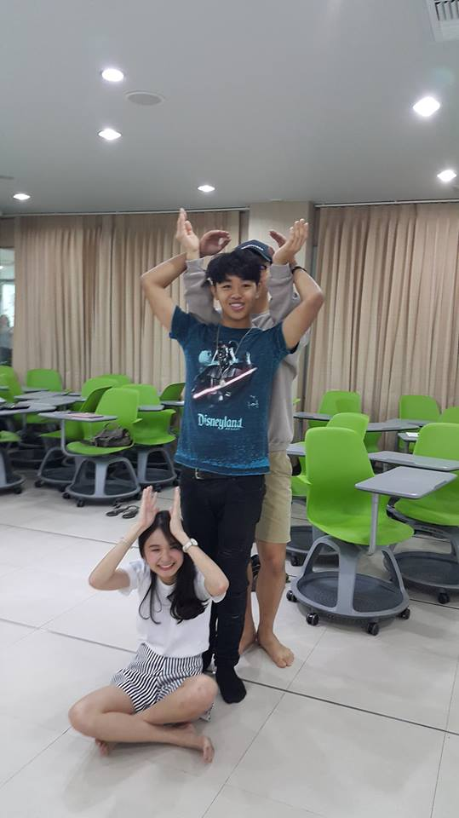
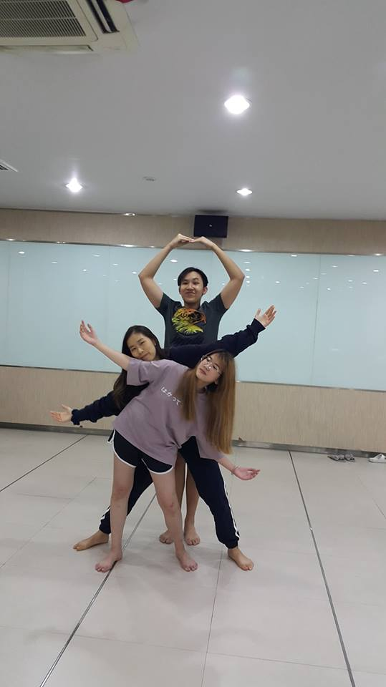


Slide 76


Slide 77

That was so much fun !
Thank you, everyone.

