Slide 1

BA 291 – Accounting and financial statement
By Aj. Parichat Jantori

Slide 2
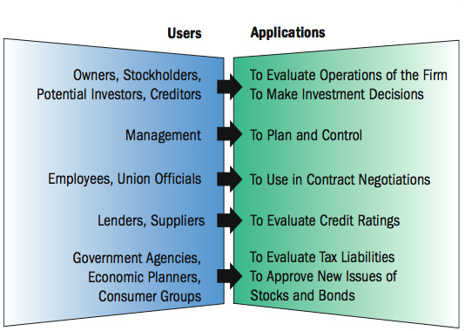
Accounting
Accounting: Process of measuring, interpreting, and communicating financial information to support internal and external business decision making.

Slide 3
User of accounting information
Accounting information
- helps managers to plan and control daily and long-range operations.
- shows how well managers are operating the organizations.
are used by union officials in contract negotiating.
helps employee to understand how their work affects the bottom line.
helps potential investor (external user) to evaluate investment opportunities, whether to invest or buy firm’s securities.
helps bankers and creditors to evaluate a potential borrowers’ financial soundness.
Notes:
Open book management Sharing sensitive financial information with employees and teaching them how to understand and use financial statements.
• Viewing financial information may help them better understand how their work contributes to the company’s success.

Slide 4
Managerial accounting
Managerial accounting refers to the internal use of accounting statements by managers in planning and directing the organization activities.
Cash flow – movement of money through organization over a daily, weekly, or monthly basis
For any business to succeed, it needs to generate enough cash to pay its bills as they fall due.
Budget – the internal financial plan that forecasts expenses and income (cash outflow and inflow) over a set period of time.

Slide 5
Business activities involving accounting
Financing activities provide necessary funds to start a business and expand it after it begins operating.
Investing activities provide valuable assets required to run a business.
Operating activities focus on selling goods and services, but they also consider expenses as important elements of sound financial management.

Slide 6
Accounting professionals
Public Accountants provide accounting services to individuals or business firms for a fee which includes auditing, tax preparation, management consulting
Certified public accountant (CPA): Accountant who meets specified
educational and experiential requirements and has passed a
comprehensive examination on accounting theory and practice
Private accountants (management accountant): accountant employed by large organization to prepare and analyze thier financial statements used by the firm‘s manager in decision making. (controllers, tax accountant, internal auditors)

Slide 7

The foundation of accounting system
Local GAAP
Germany (HGB – Handelsgesetzbuch)
Thailand (พระราชบัญญัติการบัญชี Account Acts B.E. 2543 )

Slide 8
The foundation of accounting system
US GAAP (Generally accepted accounting standards)
widely used in USA
The US GAAP provisions differ somewhat from International Financial Reporting Standards (IFRS)
all U.S. companies to drop GAAP by 2016, with the largest companies switching to IFRS as early as 2009
IFRS (International Financial Reporting Standards)
adopted by the International Accounting Standards Board (IASB)
tends to be global standard for accounting
Notes:
http://www.ifrs.org/Use+around+the+world/Use+around+the+world.htm

Slide 9
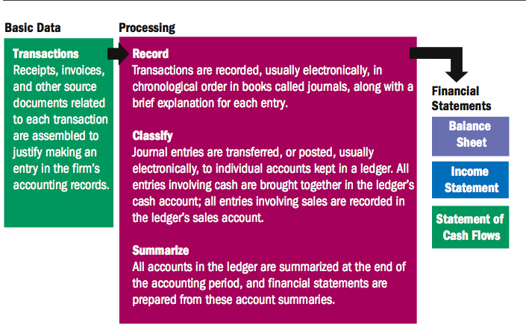
The accounting process
A set of activites involved in converting information about individual transactions into financial statements
Notes:
Journal – a time-ordered list of account transaction
Ledger – a book or computer file with seperate sections for each account

Slide 10
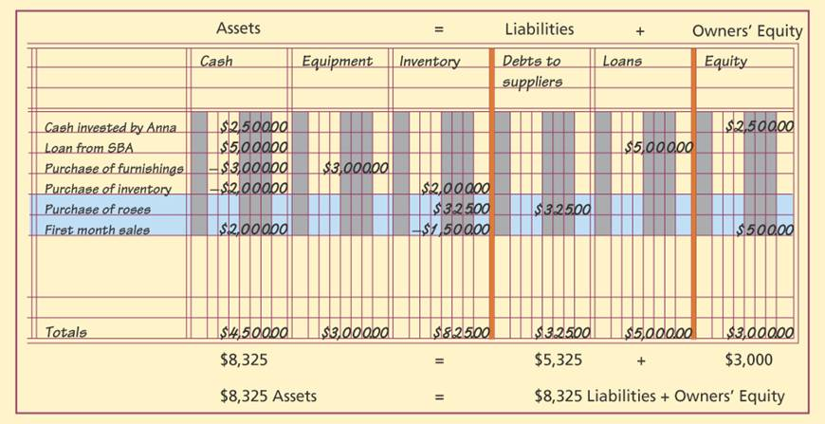
The accounting process
Double-entry bookkeeping
A system of recording and classifying business transactions in separate accounts in order to maintain the balance of the accounting equation
Notes:
Find example: Buchungssätze

Slide 11
The accounting process
The accounting equation
Assets - anything of value owned or leased by a business.
Liability - claim against a firm’s assets by a creditor.
Owner’s equity - all claims of the proprietor, partners, or stockholders against the assets of a firm, equal to the excess of assets over liabilities.
Notes:
http://www.basicaccountinghelp.com/accounting_journal_entries.html
http://www.bookkeeping-financial-accounting-resources.com/sample-general-ledger-journal-entry.html

Slide 12
Financial statement
Financial statements provide managers with essential information they need to evaluate liquidity position of an organization – its ability to meet current obligations and needs by converting assets into cash, the firm’s profitability and its overall financial health.
The balance sheet
Income statement
Statement of cash flow
(statement of changes in shareholders, financial statement notes)

Slide 13
Financial statement
Who has to provide the financial statement according to Thai law?
Type of business | Balance sheet | Income statement | Statement of changes in shareholders | Statement of cash flows | Financial statement notes
Registered partnership | X | X |  |  | X
Limited liablity company | X | X | X |  | X
Public company | X | X | X | X | X
Legal entity based on foreign law | X | X | X |  | X
Joint venture | X | X | X | X | X

Slide 14
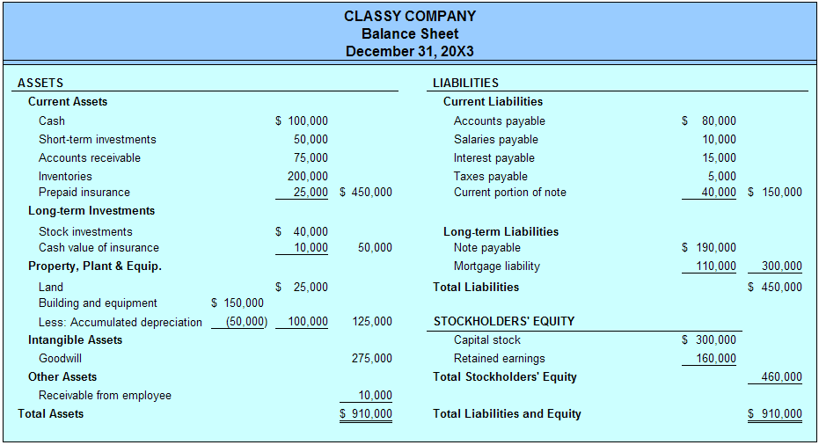
The balance sheet
A “snapshot” of an organization’s financial position
The balance sheet indicate what the organization owns or controls and the various source of funds used to pay for these assets.
The balance sheet takes its name from its reliance on the accounting equation.

Slide 15
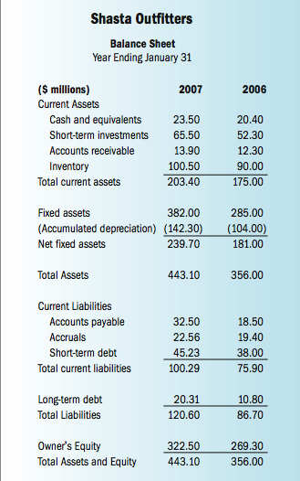

Slide 16
The balance sheet
Assets: The major category for all physical, monetary or intangible goods that have some value
Current assets: Assets that are either cash or are expected to be turned into cash within the next 12 months.
Cash and cash equivalent: cash or checking account
marketable securities: Short-term investment in securities that can be converted into cash quickly (liquid asset)
accounts receivable: Cash due from customers in payment for goods received. (sales on credit)
inventory: Finished goods ready for sale, goods in process, or raw materials
prepaid expense: A future expense item that has already been paid.

Slide 17
The balance sheet
Non-current assets (fix asset): Assets that are long term in nature or have a minimum life expectancy that exceeds one year
long-term investment: assets held as investment in bonds or small ownership in other companies
gross property, plant and equipment: Land, buildings and other fix assets listed at original cost
Intangible assets: non-monetary assets that cannot be seen, touched or physically measured (trade secret, copyright, patents, trademarks, knowhow, goodwill)
Other assets: any other asset that is long term and does not fit into above categories

Slide 18
The balance sheet
Liabilities and stockholders’ equity
Liabilities refer to all indebtedness and loans of both long-term and short-term nature. Stockholders’ equity is all money that has been contributed to the company over the life of the firm by the owners
Current liabilities
Accounts payable: money owned to suppliers for goods ordered. Firms usually have between 30-90 days to pay this account.
Wages payable: money owned to employees for hours worked or salary.
Note payable: short-term loans from banks or other lenders.
Unearned revenue for services paid for by customers but not yet provided
accrued expense: all unpaid financial obligations incurred by the organization
Other current liabilities: other short-term debts that do not fit above categories

Slide 19
The balance sheet
Long-term liabilities: All long-term debt that will not be paid in the next 12 months
Long term debt: loans of more than one year from banks, pension funds, insurance companies or other lenders (debenture, loan, mortgage)
Stockholders’ equity: owners’ initial amount of investment in the company
Common stock: The tangible evidence of ownership is a security called common stock. The par value is sated value and does not indicate the company’s worth.
Capital in excess of par
Retain earnings: reinvestment of earnings into company assets

Slide 20
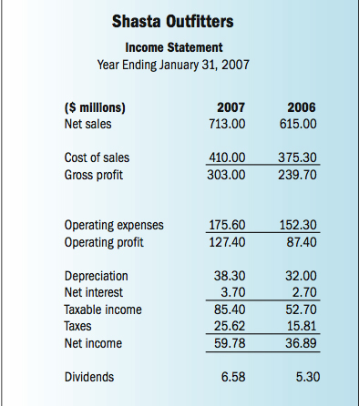
The income statement
The income statement is a financial record of a company’s revenues, expenses, and profits over a period of time (month, quarter, year)

Slide 21
The income statement
Revenues (sales): Total amount of products and service sold over a specific period of time
Cost of goods sold: the cost of producing the goods and services, including the cost of labor and raw material and other expenses associated with production
Operating expense: the cost of promoting, advertising and selling products as well as the overhead cost of managing the company.
Interest expense: A cost of borrowing money
Taxes: The tax rate is specified in the tax law
Depreciation: The process of spreading the costs of long-lived assets over the total number of accounting periods
Net income: Sales minus total expenses, profit after tax

Slide 22

The statement of cash flows
Statement of cash flows provide the information about firm’s cash receipts and cash payments for its operations, investments and financing activities during an accounting period.
Many investors and other users of financial statements want more information about the cash flowing into and out of the firm in order to better understand the company’s financial health.
Notes:
Where the cash is used and where it‘s from

Slide 23

The statement of cash flows
Cash from operating activities:
This section shows how much cash comes from sales of the company's goods and services, less the amount of cash needed to make and sell those goods and services. Investors tend to prefer companies that produce a net positive cash flow from operating activities. But negative cash flow is not always a bad thing. This may indicate that a business is growing. Technology firms, tend to show negative cash flow from operations in their formative years.

Slide 24
The statement of cash flows
Cash from investing activities
This section largely reflects the amount of cash the company has spent on capital expenditures, such as new equipment or anything else that needed to keep the business going. It also includes acquisitions of other businesses and monetary investments such as money market funds.
It is negative, when the company is purchasing long-term assets for future growth. And positive figure indicate that a business is selling off existing long-term assets and reducing its capacity.

Slide 25
The statement of cash flows
Cash from financing activities
This section describes the goings-on of cash associated with outside financing activities. Typical sources of cash inflow would be cash raised by selling stock and bonds or by bank borrowings (positive). Likewise, paying back a bank loan would show up as a use of cash flow, as would dividend payments or contributing capital to investors and common stock repurchases (negative).

Slide 26
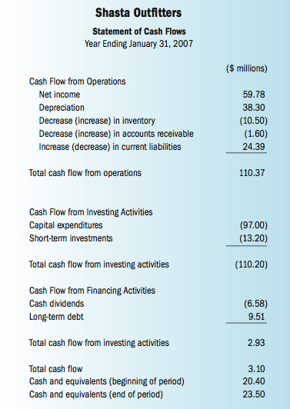
The statement of cash flows

Slide 27
Statement of cash-flow
 | Company A | CompanyB | Company C
Cash from operating activities | 500000 | 0 | 0
Cash from investing activities | 0 | 500000 | 0
Cash from financing activities | 0 | 0 | 500000
Total cash-flow | 500000 | 500000 | 500000

Slide 28

Financial analysis
The process of evaluating businesses, projects, budgets and other finance-related entities to determine their suitability for investment. Financial analysis is used to analyse whether an entity is stable, solvent, liquid, or profitable enough to be invested in. It indicates the past performance of an organization, the ability to gain profits and ability to manage organizational assets. It helps investors to predict the risks within an organization.

Slide 29
Financial analysis
- Trend analysis: analysis that tries to predict the future movement of a stock based on past data. Trend analysis is based on the idea that what has happened in the past gives traders an idea of what will happen in the future.
- Ratio analysis Tool for measuring a firm’s liquidity, profitability, and reliance on debt financing, as well as the effectiveness of management’s resource utilization.

Slide 30
Liquidity Ratios
Liquidity ratio is used to measure the ability of a firm to meet its short-term obligations when they must be paid.
Current ratio | = | Current assets
 |  | Current liabilities
Quick ratio | = | Current assets - inventory
 |  | Current liabilities

Slide 31
Profitability Ratios
Ratio that measure the ability to generate revenues in excess of operating costs and other expenses.
Profit margin | = | Net income
 |  | Sales
Return on assets | = | Net income
 |  | Assets
Return on equity | = | Net income
 |  | Equity
Notes:
Profit margin (gross, net)
Earning per share

Slide 32
Asset Utilization Ratios (Activity ratio)
Ratios that measure how well a firm uses its assets to generate each 1$ of sales
Receivables turnover | = | Sales
 |  | Receivables
Inventory turnover | = | Sales
 |  | Inventory
Total asset turnover | = | Sales
 |  | Total assets

Slide 33
Debt Utilization Ratios (Leverage ratio)
Ratios that measure how much debt an organization is using relative to other sources of capital. It shows the extent to which a firm relies on debt financing.
Debt to total assets | = | Total debt
 |  | Total assets
Times interest earned | = | Income before interest & taxes
 |  | Interest expense

Slide 34
Budget
Planning and control tool that reflects a firm’s expected sales revenues, operating expenses, and cash receipts and outlays.
Management estimates of expected sales, cash inflows and outflows, and costs.
Budgets are a financial blueprint that serves as a financial plan.

Slide 35
Budget
Sales volume
Production volume
Material cost
Labour cost (directly associated with production)
Production cost
Inventory
Sales and overhead cost
Cost of good sold
Approximated income statement
Cash budget
Approx. Statement of cashflow
Approx. Balance sheet

Slide 36
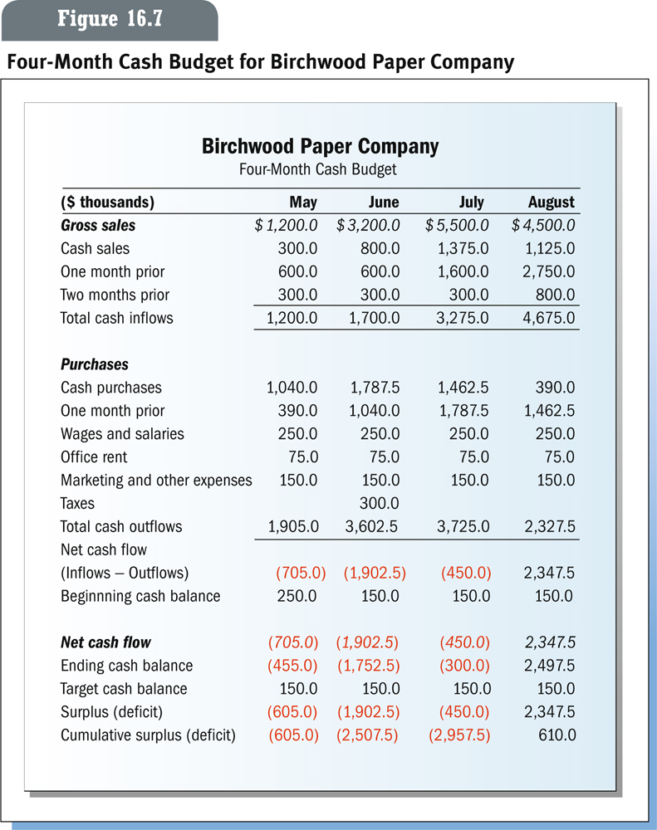
Budget

Slide 37
Profitability ratios
Ratio | 2001 | 2002 | 2003 | 2004
Gross margin | 46 | 44 | 39 | 39
Net profit margin | 26 | 24 | 18 | 12
ROE | 23 | 14 | 11 | 8
ROA | 9 | 6 | 4 | 6

Slide 38
Liquidity ratio
Ratio | 2000 | 2001 | 2002 | 2003
Current ratio | 2.61 | 2.94 | 1.69 | 2.3
Quick ratio | 0.13 | 0.11 | 0.07 | 0.08

