Slide 1
Import Substitution, Export promotion, and Industrial Policy
02/09/2015
Akira Suehiro in Catch-Up Industrialisation

Slide 2
Introduction
Two possible paths of industrialisation
NAIC (Newly Agro-Industrializing Country)
  Gradual steps
Industrial Upgrading Policy
  Heavy intervention

Slide 3
Myint’s Observation
Vicious cycle of poverty
  Low growth is an result of low saving and investment.
The capacity to use resource productively
  Vent for surplus: going beyond subsistent consumption
Three required conditions
  Economic incentives
    Balanced growth relationship between agricultural sector and consumer goods
  Provision of capital goods
    Irrigation
    Power
    Machinery
  Export substitution: Going away from export raw material to semi processed goods

Slide 4
Primary Product Exports, Import Substitutions, and Export Promotion
Why can’t we rely only on export of primary product ?
  Monoculture economy
  Heavy and Light industry in developed country
  Rising share of services
  Income elasticity
  Agricultural protectionism
  Industrial use of natural resources lead to higher growth
  Replacing natural with synthetic
  Tariff structure

Slide 5
Import substitution
Planning
Industry to be developed
Strong leadership
Policy
  Trade
  Domestic

Slide 6
Export Promotion
Less centrally planned
More fundamental
Leadership
Policy
  Trade
  Domestic
Notes:
Show Table 6-2 6-3

Slide 7
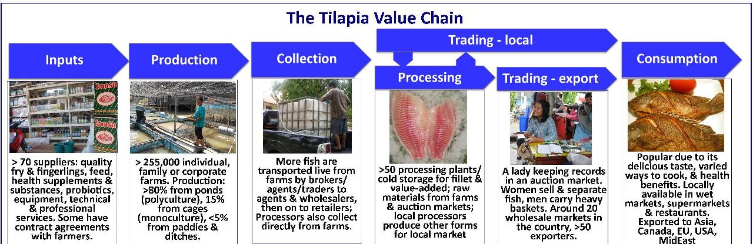
NAIC
Source: SEAT KU
Notes:
Show the Figures 6-1

Slide 8
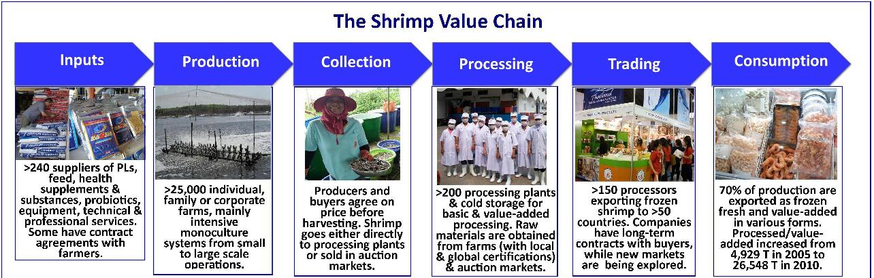
NAIC
Source: SEAT KU

Slide 9
NAIC problems
Monoculture
Environment
Will you upgrade the infrastructure?
And Technology

Slide 10
Upgrading Import substitution and Industrial Policy
Policies aim at alter the industrial structure
  Subsidies
  Taxes
Technological Development
  Market failures
Improve Economic Utility
  Diversification
  Trim of the excess
Miscellaneous Policies
  SMEs
  Rice Pledging Program
  Energy Saving

Slide 11
Tools
New legislation and measures
Administrative guidance
Maintenance of infrastructure
Special taxation measures
Subsidies
Government Finance
Bigness VS. Failure

Slide 12
East Asian Approaches to Industrial Policy
Export promotion after import substitution: incentive taxation and import refunds
Protect and cultivate specified industries: heavy and chemical industries
Promote industry that supports export drive: metal, molds, and machines
Technological development
Protect and cultivate SMEs
Notes:
Show Table 6-5-7

Slide 13
Liberalization Policies
How far should we go?
Thailand
Korea
Japan

Slide 14
Industrial Adjustment after Crises
Nothing lasts forever
Too big too fail or too fail
Economic crises
Industrial adjustment and policy adjustment
Conductors or Facilitators

