Slide 1
Chapter 5
The Theory of Demand

Slide 2

Chapter Five Overview
Individual Demand Curves
Income and Substitution Effects & the Slope of Demand
  Applications:
    The Work-Leisure Trade-off
    Consumer Surplus
Constructing Market Demand
Chapter Five

Slide 3
Chapter Five Overview
The Effects of a Change in Price
  Optimal Choice
  Demand Curve
Chapter Five

Slide 4
Individual Demand Curves
In Chapter 4, consumer’s optimal basket was determined.
Thus, we can tell – for a given income and prices of other goods – how much a consumer will demand of X for a given price of X.
This is a point on the consumer’s demand curve.
We can find more points on the demand curve for X by changing the price of X and determining how much of X the consumer will demand – prices of other goods and income are held constant.
Chapter Five

Slide 5
Individual Demand Curves
The Price Consumption Curve of Good X:
Is the set of optimal baskets for every possible price of good x, holding all other prices and income constant.
Chapter Five

Slide 6
Price Consumption Curves
Y (units)
The price consumption curve for good x can be written as the quantity consumed of good x for any price of x. This is the individual’s demand curve for good x.
P_{Y} = $4
I = $40
10
•
Price Consumption Curve
•
•
P_{X} = 1
P_{X} = 4
P_{X} = 2
0
X_{A}=2
X_{B}=10
X_{C}=16
20
X (units)
Chapter Five

Slide 7
Individual Demand Curve
P_{X}
Individual Demand Curve
For X
•
P_{X} = 4
•
P_{X} = 2
U increasing
•
P_{X} = 1
X
X_{A} X_{B} X_{C}
Chapter Five

Slide 8
Individual Demand Curve
Key Points
The consumer is maximizing utility at every point along the demand curve
The marginal rate of substitution falls along the demand curve as the price of x falls (if there was an interior solution).
As the price of x falls, it causes the consumer to move down and to the right along the demand curve as utility increases in that direction.
The demand curve is also the “willingness to pay” curve – and willingness to pay for an additional unit of X falls as more X is consumed.
Chapter Five

Slide 9
Demand Curve for “X”
Algebraically, we can solve for the individual’s demand using the following equations:
1. p_{x}x + p_{y}y = I
2. MU_{x}/p_{x} = MU_{y}/p_{y} – at a tangency.
(If this never holds, a corner point may be substituted where x = 0 or y = 0)
Chapter Five

Slide 10
Demand Curve with an Interior Solution
Suppose that U(x,y) = xy. MUx = y and MUy = x. The prices of x and y are px and py, respectively and income = I.
We Have:
  1. p_{x}x + p_{y}y = I
  2. x/p_{y} = y/p_{x}
Substituting the second condition into the budget constraint, we then have:
3. p_{x}x + p_{y}(p_{x}/p_{y})x = I or…x = I/2p_{x}
Chapter Five

Slide 11
Change in Income & Demand
Income Consumption Curve
The income consumption curve of good x is the set of optimal baskets for every possible level of income.
We can graph the points on the income consumption curve as points on a shifting demand curve.
Chapter Five

Slide 12
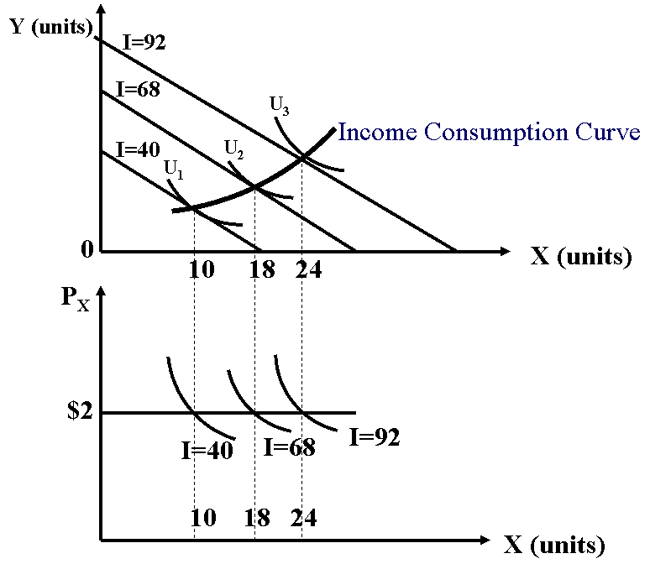
Income Consumption Curve
Chapter Five

Slide 13
Engel Curves
The income consumption curve for good x also can be written as the quantity consumed of good x for any income level. This is the individual’s Engel Curve for good x. When the income consumption curve is positively sloped, the slope of the Engel Curve is positive.
Chapter Five

Slide 14
Engel Curves
I ($)
Engel Curve
“X is a normal good”
92
68
40
0
X (units)
10 18 24
Chapter Five

Slide 15
Definitions of Goods
• If the income consumption curve shows that the consumer purchases more of good x as her income rises, good x is a normal good.
• Equivalently, if the slope of the Engel curve is positive, the good is a normal good.
• If the income consumption curve shows that the consumer purchases less of good x as her income rises, good x is an inferior good.
• Equivalently, if the slope of the Engel curve is negative, the good is an inferior good.
Chapter Five

Slide 16
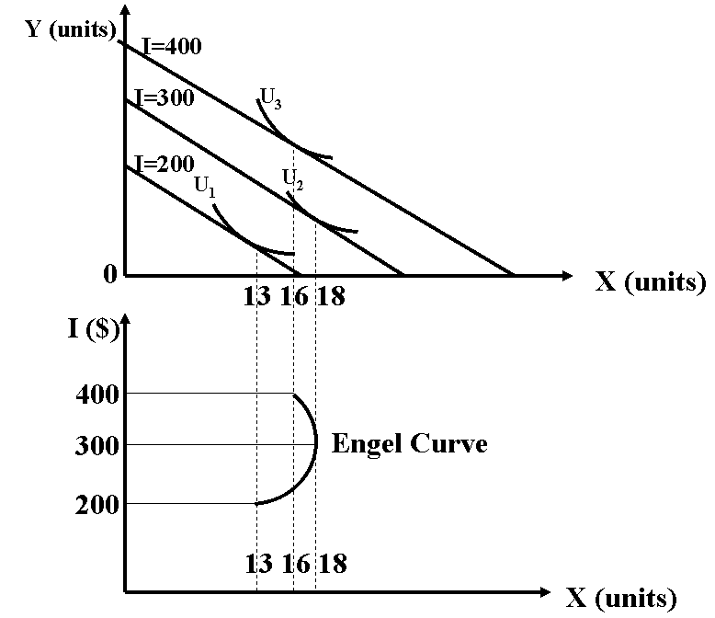
Definitions of Goods
Example: Backward Bending Engel Curve – a good can be normal over some ranges and inferior over others
Chapter Five

Slide 17
Impact of Change in the Price of a Good
Substitution Effect: Relative change in price affects the amount of good that is bought as consumer tries to achieve the same level of utility
Income Effect: Consumer’s purchasing power changes and affects the consumer in a way similar to effect of a change in income
Chapter Five

Slide 18
The Substitution Effect
As the price of x falls, all else constant, good x becomes cheaper relative to good y.
This change in relative prices alone causes the consumer to adjust his/ her consumption basket.
This effect is called the substitution effect.
The substitution effect always is negative.
Usually, a move along a demand curve will be composed of both effects.
Chapter Five

Slide 19
Impact of Change in the Price of a Good
Definition: As the price of x falls, all else constant, purchasing power rises. As the price of x rises, all else constant, purchasing power falls.
This is called the income effect of a change in price.
The income effect may be positive (normal good) or negative (inferior good).
Chapter Five

Slide 20
Impact of Change in the Price of a Good
If price of a good falls – consumer substitutes into the good to achieve the same level of utility
When price falls – purchasing power increases the consumer can buy the same amount and still have money left
Chapter Five

Slide 21
The Substitution and Income Effects
Y
Clothing
Initial Basket
Final Basket
Decomposition Basket
A
C
BL_{d}
B
U2
U1
BL1
BL2
X_{A}
X
Food
X_{B}
X_{C}

Slide 22
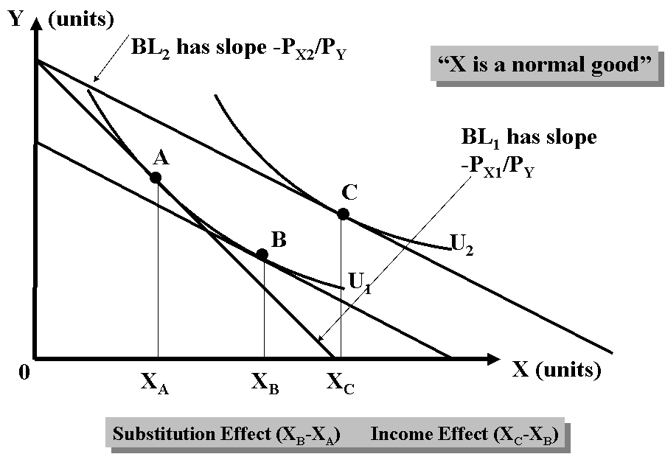
The Substitution and Income Effects
Chapter Five

Slide 23
The Substitution and Income Effects
Initial Basket A
Final Basket C
Decomposition Basket B
Y
Clothing
A
C
BL_{d}
B
U2
U1
BL1
BL2
X_{A}
X
Food
X_{B}
X_{C}

Slide 24
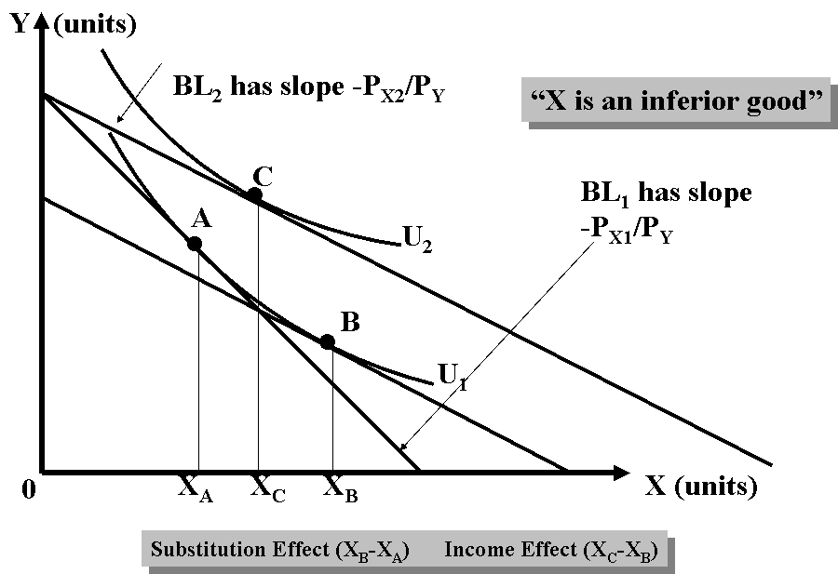
The Substitution and Income Effects
Chapter Five

Slide 25
Giffen Goods
If a good is so inferior that the net effect of a price decrease of good x, all else constant, is a decrease in consumption of good x, good x is a Giffen good.
For Giffen goods, demand does not slope down.
When might an income effect be large enough to offset the substitution effect? The good would have to represent a very large proportion of the budget.
Chapter Five

Slide 26
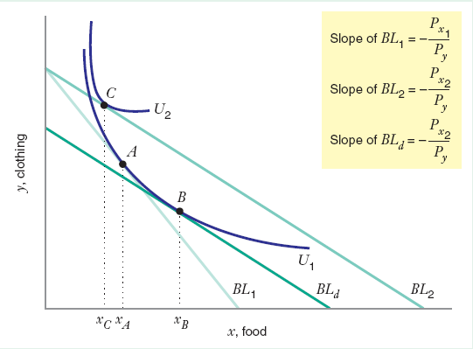
Giffen Goods – Income and Substitution Effects
Chapter Five

Slide 27
Example – Income and Substitution Effects
Example:
Suppose U(x,y) = xy ➔ MU_{x} = y, MU_{y} = x
P_{y} = $1/unit and I = $72
Suppose that P_{x1} = $9/unit. What is the (initial) optimal consumption basket?
Tangency Condition: MU_{x}/MU_{y} = P_{x}/P_{y} ➔ y = 9x
Constraint: P_{x}x + P_{y}y = I ➔ 9x + y = 72
Solving: x = 4 and y = 36
Chapter Five

Slide 28
Example – Income and Substitution Effects
Example:
Suppose U(x,y) = XY ➔ MU_{x} = y, MU_{y} = x
P_{y} = $1/unit and I = $72
Suppose that price of x falls and P_{x2} = $4/unit. What is the (final) optimal consumption basket?
Tangency Condition: MU_{x}/MU_{y} = P_{x}/P_{y} ➔ y = 4x
Constraint: P_{x}x + P_{y}y = I ➔ 4x + y = 72
Solving: x = 9 and y = 36
Chapter Five

Slide 29
Example – Income and Substitution Effects
Find the decomposition basket B.
It must lie on the original indifference curve U₁ along with basket A ➔ U₁ = XY = 4(36) = 144.
It must lie at the point where the decomposition budget line is tangent to the indifference curve.
Price of X (P_{X}) on the decomposition budget line is final price of $4.
Tangency Condition: MU_{x}/MU_{y} = P_{x}/P_{y} ➔ y = 4x
Combined with XY = 144 ➔ x = 6, y = 24
Substitution Effect: 6 – 4 = 2 units of X
Income Effect: 9 – 6 = 3 units of X
Chapter Five

Slide 30
Consumer Surplus
The individual’s demand curve can be seen as the individual’s willingness to pay curve.
On the other hand, the individual must only actually pay the market price for (all) the units consumed.
Consumer Surplus is the difference between what the consumer is willing to pay and what the consumer actually pays.
Chapter Five

Slide 31
Consumer Surplus
Definition: The net economic benefit to the consumer due to a purchase (i.e. the willingness to pay of the consumer net of the actual expenditure on the good) is called consumer surplus.
The area under an ordinary demand curve and above the market price provides a measure of consumer surplus
Chapter Five

Slide 32
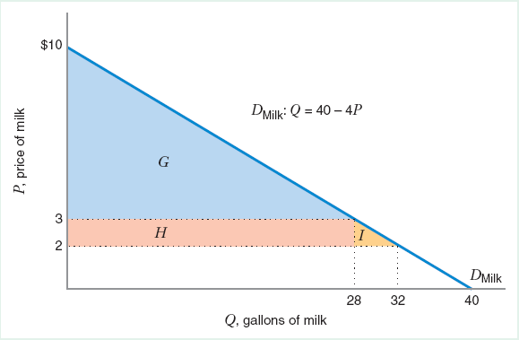
Consumer Surplus
G = .5(10-3)(28) = 98
H+I= 28 +2 = 30
CS₂ = .5(10-2)(32) = 128
CS_{P} = (10-P)(40-4P)
Chapter Five

Slide 33
Market Demand
The market demand function is the horizontal sum of the individual (or segment) demands.
In other words, market demand is obtained by adding the quantities demanded by the individuals (or segments) at each price and plotting this total quantity for all possible prices.
Chapter Five

Slide 34
Market Demand
P
P
P
10
Q = 10 - P
Q = 20 – 5P
4
Q
Q
Q
Segment 1
Segment 2
Market demand
Chapter Five

Slide 35
Network Externalities
If one consumer's demand for a good changes with the number of other consumers who buy the good, there are network externalities.

Slide 36
Network Externalities
Bandwagon effect: A positive network externality that refers to the increase in each consumer’s demand for a good as more consumers buy the good

Slide 37
Network Externalities
P_{X}
D₆₀
Bandwagon Effect:
(increased quantity demanded when more consumers purchase)
D₃₀
A
20
•
B
C
•
•
10
Pure
Price
Effect
Market Demand
Bandwagon Effect
60

Slide 38
Network Externalities
Snob effect: A negative network externality that refers to the decrease in each consumer’s demand as more consumers buy the good

Slide 39
Network Externalities
P_{X}
Market Demand
Snob Effect:
(decreased quantity demanded when more consumers purchase)
A
•
C
B
•
•
D₁₀₀₀
900
D₁₃₀₀
Snob Effect
Pure Price Effect
X (units)

Slide 40
Labor-Leisure Trade-off
Divide the day into two parts: Work hours and leisure (non work) hours.
Earns income during work hours and uses the income to pay for activities he enjoys in his leisure time.

Slide 41
Defining Labor Supply
Total Daily income:
w(24-L)
where w is the hourly wage rate
L is the leisure hours
24 is the 24 hours in a day

Slide 42
Supply of Labor
An increase in wage rate reduces the amount of labor required to buy a unit of the composite good
This leads to both a Substitution effect and Income effect.

Slide 43
Labor Supply Curve
The labor supply curve slopes upward over the region where the substitution effect associated with the wage increase outweighs the income effect, but bends backward over the region where the income effect outweighs the substitution effect.

Slide 44
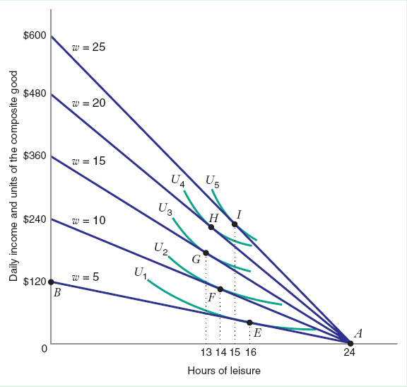
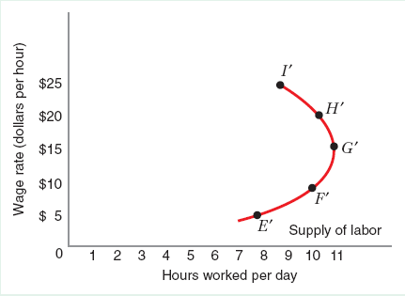
Labor Supply Curve

