Slide 1
MK 322
Additional Handouts on KPI's for Retail
By Ajarn Suwalya K.

Slide 2
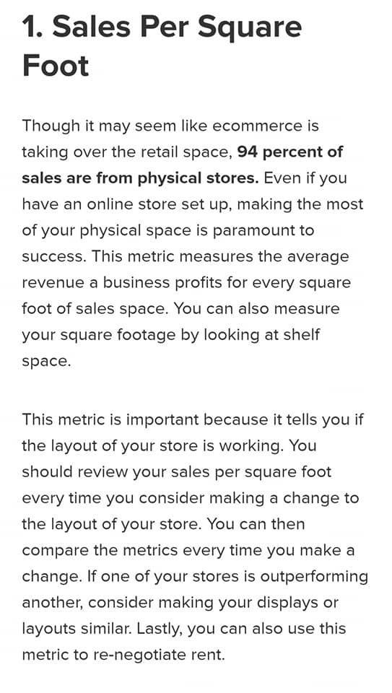
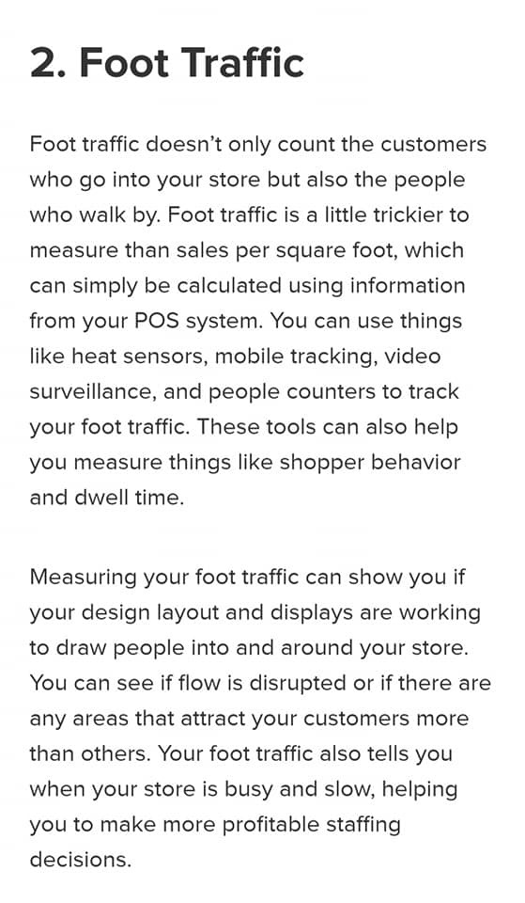

Slide 3


