Slide 1
We have been crafting beautiful products & services, making consumers happy for years.
  IDEATION

Slide 2
Innovation is not ideation: it is a process that enables ideas to flow towards impact
Ideation is defined as the process of creating, developing and communicating ideas. Ideas are visual, concrete or abstract base elements of a thought.
Design is a plan for arranging [ideas] in such a way as best to accomplish a particular purpose.
Design thinking is a human-centered approach to innovation that draws from a toolkit to integrate the needs of people, the possibilities of technology, and the requirements for business success.
Invention is the creation of a product, method, or process that is better than a similar product, method, or process which exists today.
Innovation is the process of introducing this invention — product, service, or platform — into the world in such a way that it addresses a need and creates value to the company and customers. Innovation is invention or an idea applied.

Slide 3
Why ideation matters in innovation process?
Innovation is the lifeblood of organizations
  84 % of executives say innovations is extremely or very important.
Innovation often fails
  “Over 30,000 new consumer products hit store shelves each year. 90% of them fail. “
Innovation works better if we start from consumer insights
  “To build brands that mean something to customers, you need to attach them to products that mean something to customers. And to do that, you need to segment markets in ways that reflect how customers actually live their lives.”

Slide 4
Ideation collides winning insights with lateral thinking techniques and/or live consumer co-creation (in person or community).
Insights are starting point to brainstorm quick fire ideas
Lateral thinking and brainstorm techniques used to ensure ideas are both new and breakthrough. Divergent thinking – no judgement or evaluation
Quick fire ideas prioritized and best ones fine tuned into High Performance ideas. Option for illustrator to draw ideas to bring them to life.
‘Speed dating’ with consumers or ‘live’ community co-creation to fine tune ideas

Slide 5
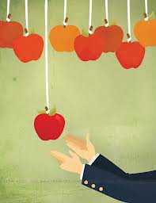
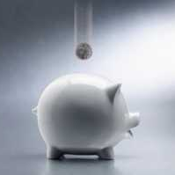

Ideation session – different kind of wins
MEDIUM TERM WINS
(Require some investment)
LONG TERM WINS
(Require big investment)
SHORT TERM (Easy Wins)

Slide 6
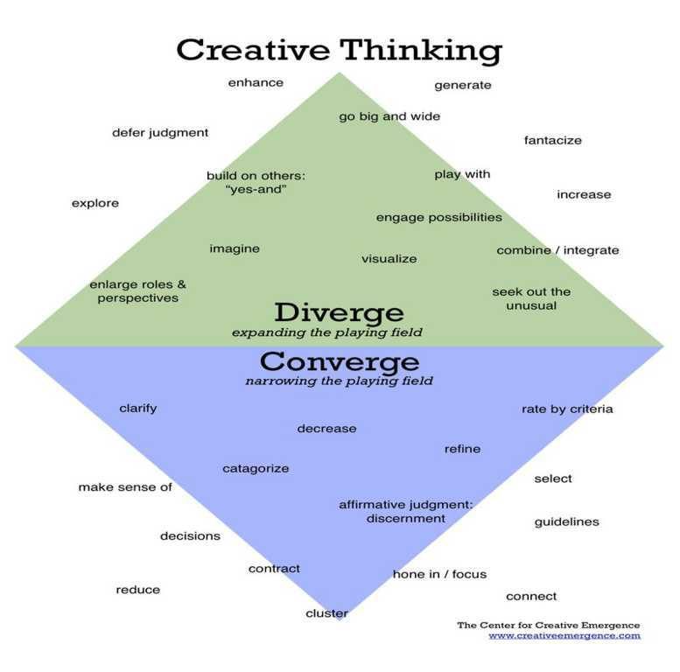

Slide 7
The Process
Diverge
open up
Converge:
cluster, prioritize
and refine
These are quick fire, initial early product, service or innovation ideas generated from the insights.
These are early NPD product ideas derived from High Calibre Insights.

Slide 8
Ideation behavior
?
?
?
?
?
?
DELAY
?
?
?
Create lots and lots of ideas first
Every idea is a good idea because it leads somewhere new
Anything is
possible
No premature
evaluation

£
+
Say “yes and ...” or “to build on that...”
Write it down first then improve it
Use consumer
language
Don’t say: We’ve tried that before, that’s too expensive, that will never work, that’s a bad idea

Slide 9


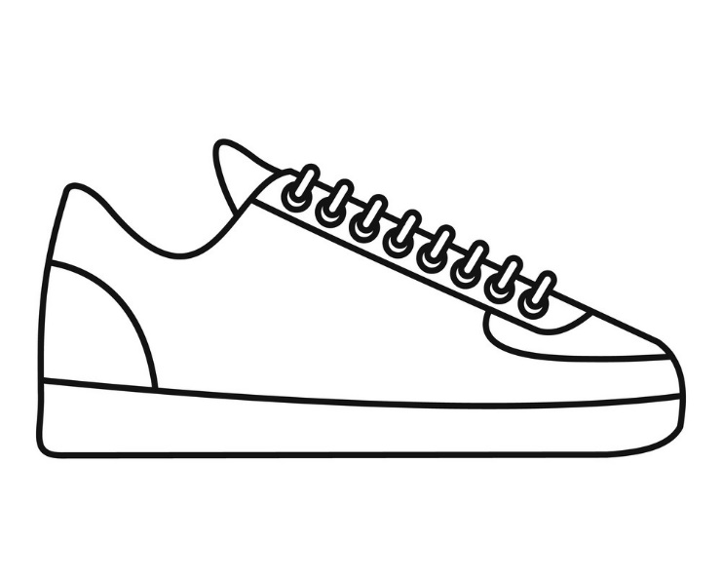
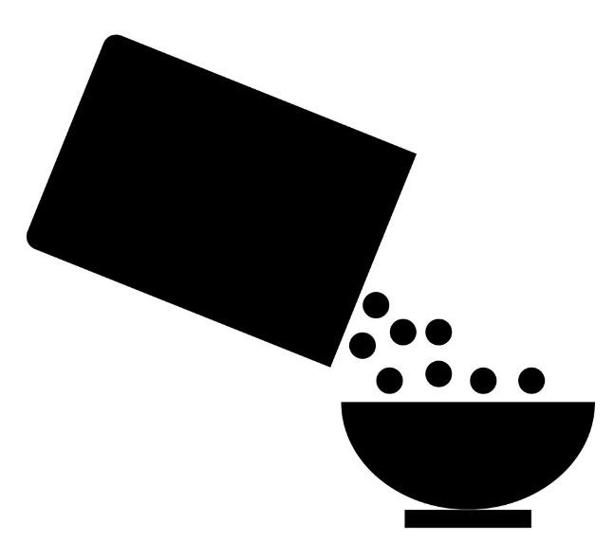
Topics to cover
SNEAKERS COSMETICS BUBBLE TEA CEREALS

Slide 10
Top 3 Idea Themes Template
Idea Title
Idea numbers that contribute to the theme
Idea Theme (explanation and more details)
Instructions
Read all of the ideas in the room and note 3 main themes that you feel are emerging and are important for your product
Write each theme on the template provided, (1 separate sheet per theme) adding the numbers of the ideas you feel contribute to that theme

Slide 11
The Winning Idea
Idea Title
Idea numbers that contribute to the theme
Idea Theme (explanation and more details)

