Slide 1

MK 322 Retail Management
Chapter 12: Merchandise Planograms Handouts
By Ajarn Suwalya K.

Slide 2
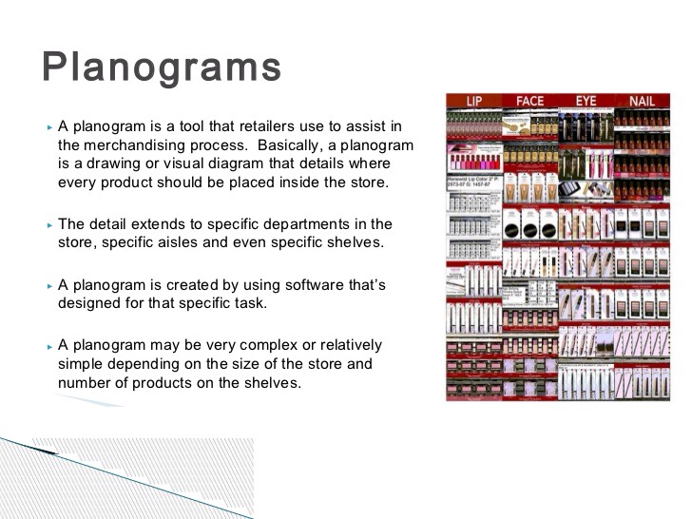
Notes:
1

Slide 3
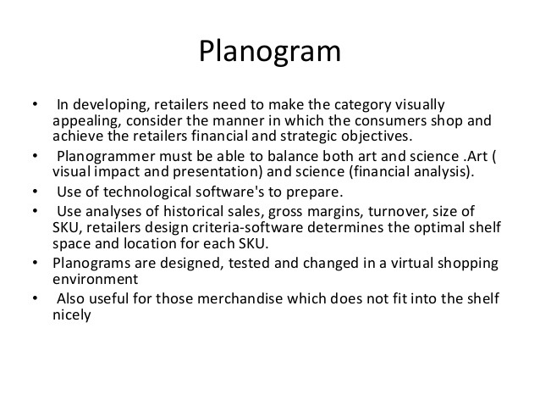
Notes:
1

Slide 4
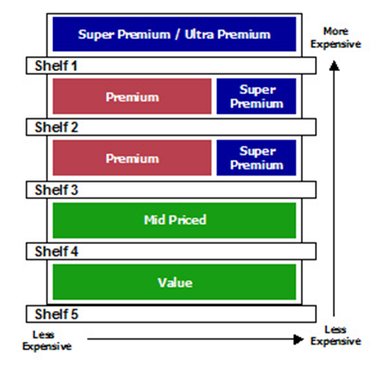
Notes:
1

Slide 5

The Merchandising Planogram Examples

Slide 6
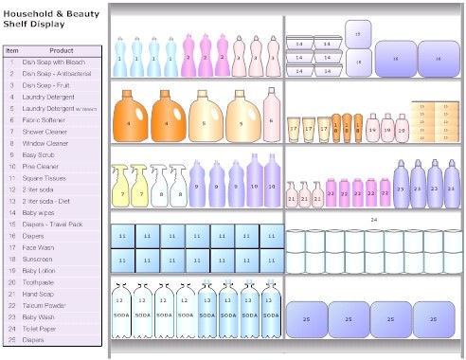

Slide 7
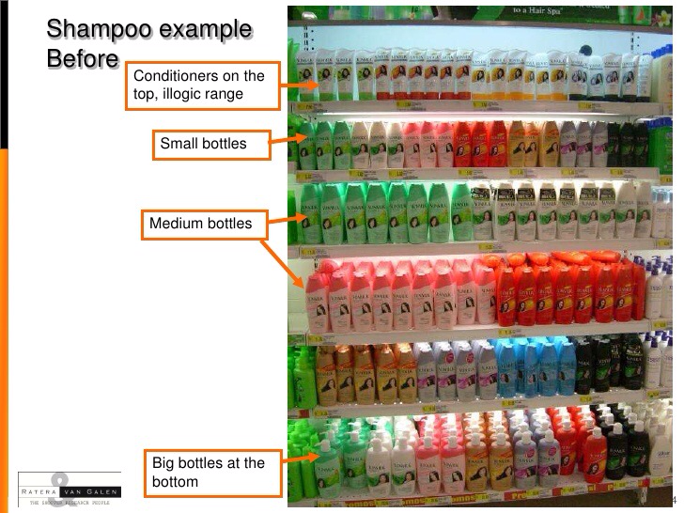

Slide 8


Slide 9


Slide 10
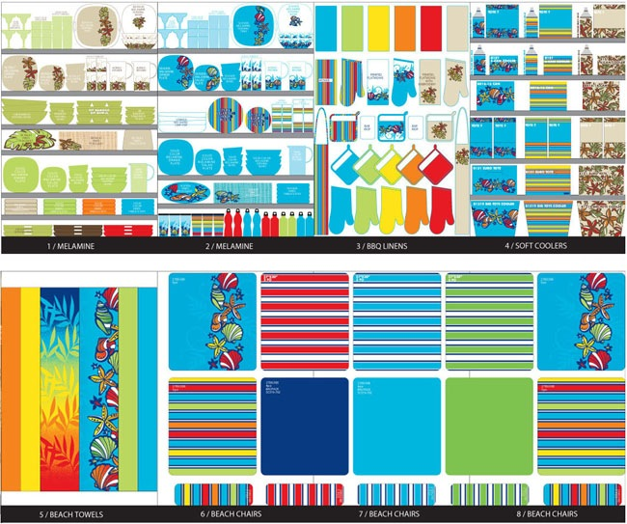

Slide 11


Slide 12
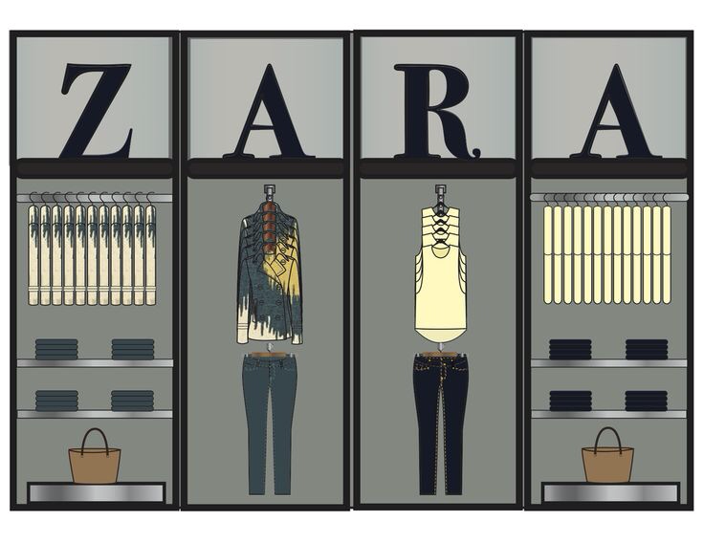

Slide 13
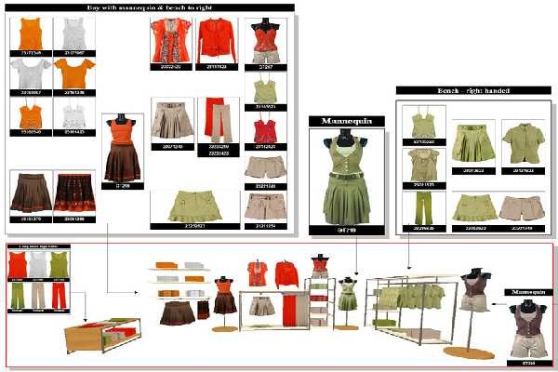

Slide 14
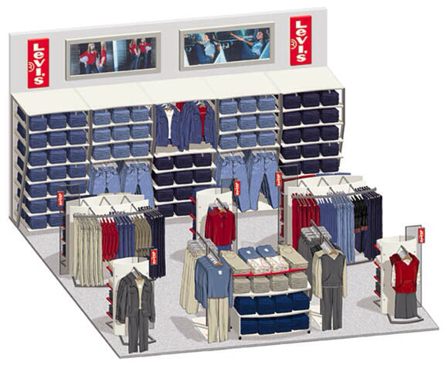

Slide 15
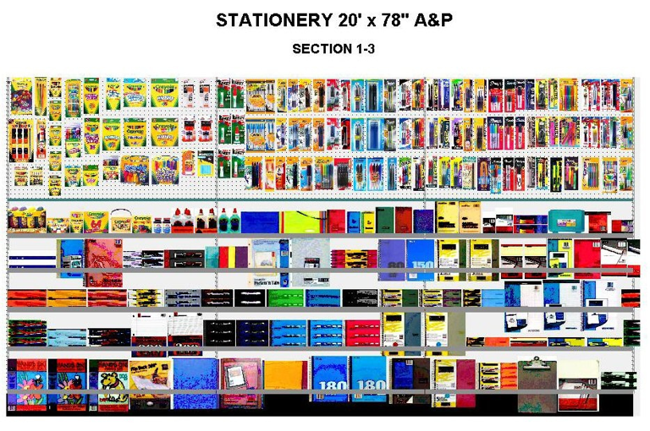

Slide 16
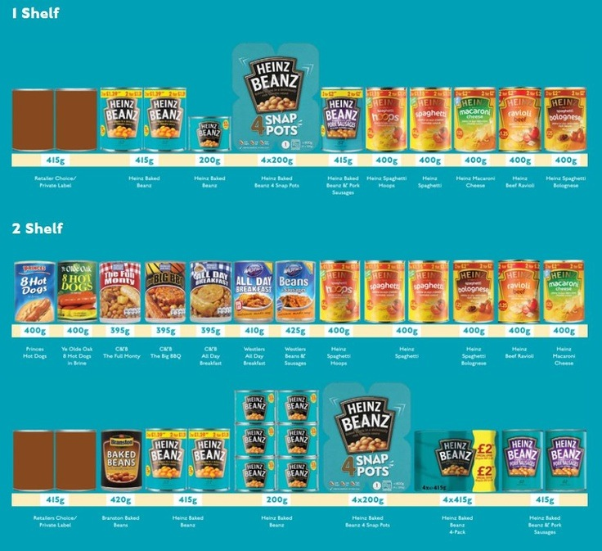

Slide 17


