Slide 1
Economy of Cambodia
EE361 ECONOMIES of CLMV
Faculty of economics
Thammasat university

Slide 2
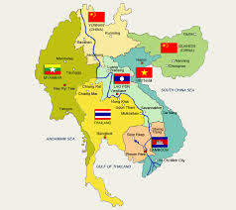
Cambodia within the Greater Mekong Subregion
 | 2000 | 2018
Population | 12.2 million | 16.5 million
GDP per capita | $236 | $1,600
Under 5 mortality (per 100,000 births) | 83 | 35
Infant mortality (per 100,000 births) | 66 | 28
Primary education | 82% | 97%
Poverty rate | 34.2% | 17.7%

Slide 3
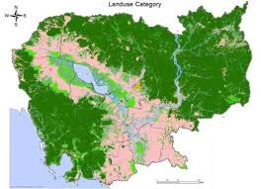
geography
Land area: 180,000 square km
90% of Cambodian population live in the fertile, flat lowlands around the Tonle Sap lake; constitutes 40% of the total land area
Cambodia’s main towns and cities are located in this area
Sihanoukville is the only seaport in Cambodia
Siem Reap
Battambang
Pursat
Kampong Cham
Phnom Penh
Sihanoukville

Slide 4

Economic Milestones
Late 1980s: Cambodia transitions to a market economy and embarks on economic reforms
1990s: Cambodia receives large foreign direct investment flows; official development assistance; and preferential market access to the European Union and the United States
1998: National Assembly endorses Rectangular Strategy and the first five-year National Strategic Development Plan, followed by successive NSDPs
2015: Cambodia graduates from low income country to lower middle-income status

Slide 5
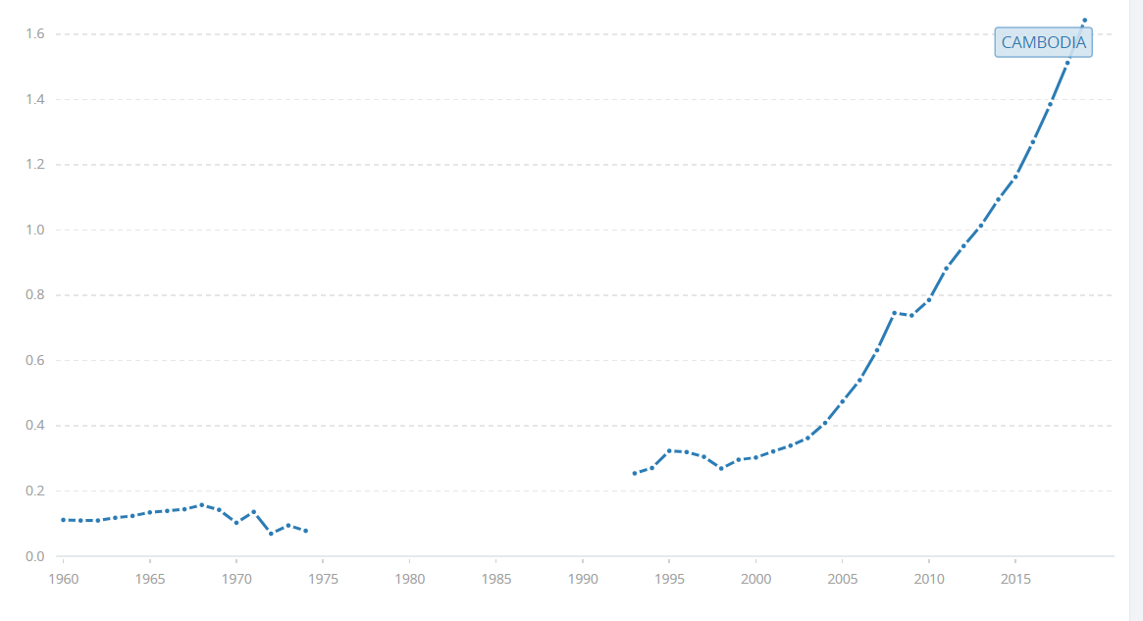
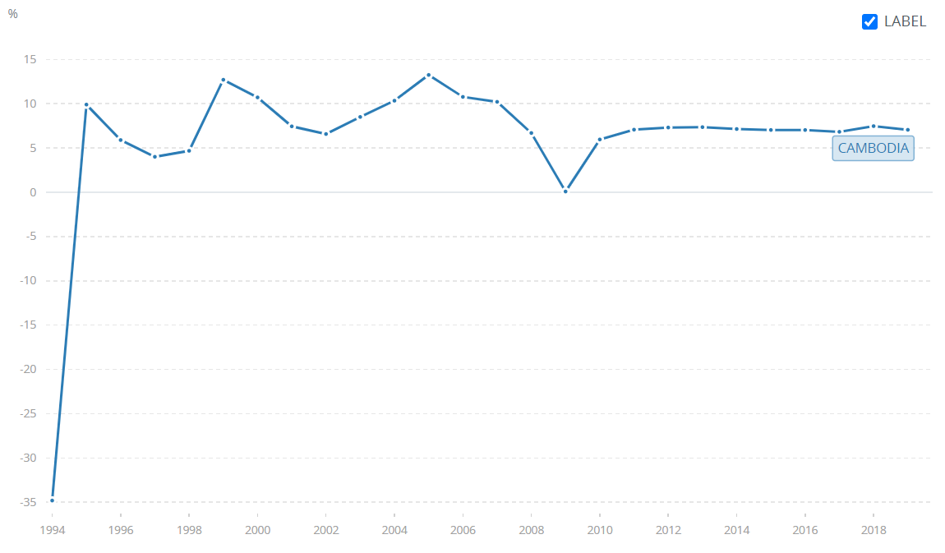
economy
GDP growth averaged 8% between 1998 and 2018, making it one of the fastest-growing economies in the world
GDP per capita increased from $236 in 2000 to $1,600 in 2018
Main income generating sectors: garment, tourism, construction, agriculture
GDP per capita, 1960-2015
GDP growth 1960-2015

Slide 6
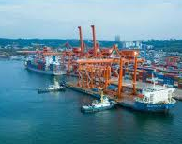
Development performance
Cambodia has made progress in economic growth and poverty reduction. Gross national income per capita rose from $236 in 2000 to $1,600 in 2018
The percentage of people living below the national income poverty line declined from 34.2% in 2007 to 17.7% in 2018. Cambodia’s income inequality is also low
Having undergone a significant transition, Cambodia reaches lower middle-income status and aspiring to attain upper middle-income status by 2030

Slide 7
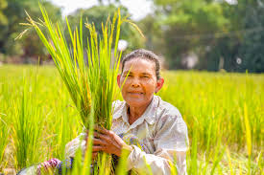
agriculture
The agricultural transformation: declining share of agriculture in value addition and employment; agriculture still contributes 22% of GDP. Reasons for the sector’s low productivity:
poor and climate vulnerable agricultural production and service infrastructure
underdeveloped agricultural value chains
unsustainable natural resources management and water resources management exacerbated by climate change
Flood and drought remain perennial challenges in the agricultural sector

Slide 8

Human development
While net enrollment in primary education increased from 82% in 1997 to 97% in 2016, lower secondary completion rates, at 57% in 2017, are significantly below the average for lower middle-income countries
Currently only 30% of the working-age population have completed lower secondary education
The technical and vocational training system lacks the needed links to industry to make training relevant; skills gaps in almost all employment categories, particularly higher level skills
Maternal and child health, early childhood development, and primary education have improved in rural areas

Slide 9
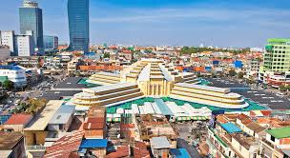
Urban development
76% of Cambodians live in rural areas; however urbanization rate is moving rapidly averaging 7% per year; moreover 50% of the national GDP is produced in urban areas.
The construction sector has grown rapidly, partly fueled by demand in Phnom Penh and Sihanoukville
While considerable progress has been made in providing roads, water supply, sanitation, and solid waste management services, large gaps remain. In 2017, 21% of Cambodia’s population (3.4 million people) did not have access to improved water, and 34% (5.4 million people) did not have access to improved sanitation

Slide 10
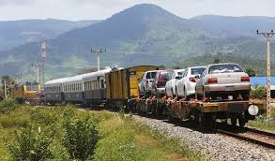
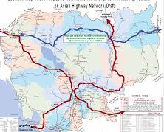
transport
Lack of access to year-round all-weather roads impacts food value-chains and access to health, education and other public services.
By 2030, Cambodia’s firms are projected to move 4.1 times more goods through country’s highways, ports, airports and warehouses, but the transportation network has not kept pace with rapid economic growth.

Slide 11
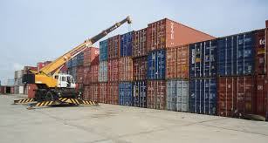
Trade
Cambodia’s overall export basket is dominated by manufacturing products, mainly garments. Relocation of garment factories from South Korea, Taiwan, and PR China to Cambodia helped stimulate garment exports from Cambodia.
However, composition of Cambodia’s export basket differs by destination; in 2009 exports to GMS comprised largely of primary products (90%) while primary products accounted for only 10% of the total exports to the rest of the world

Slide 12
Development challenges
Uncertain global trading environment and increased regional competition means that Cambodia cannot continue to rely on its past sources of growth; Value addition in agriculture, tourism, and construction also remains limited
Although exports from the garment sector account for 70% of total exports, they remain geared to a low-quality and therefore, low-priced market segment in the European Union and the United States
While there has been some diversification in light manufacturing towards higher-value products, such as electrical appliances, these constitute about 5% of exports so this transition is still at an early stage.

Slide 13
Development challenges
The quality of human capital will be of utmost importance to achieve Cambodia’s ambitious goal of reaching middle-income status by 2030
Accountable and responsive public institutions will also be critical to meeting the evolving needs of citizens and the private sector.
The COVID-19 pandemic caused sharp deceleration in most of Cambodia’s main engines of growth—tourism, manufacturing exports, and construction—which together account for more than 70% of the country’s growth and almost 40% of paid employment

