Slide 1
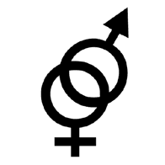
Gender-Role Expectations
PY 228 Psychology of Interpersonal Relations

Slide 2
Outline
Role Expectations for Males
Problems with the Male Role
Role Expectations for Females
Problems with the Female Role
https://www.youtube.com/watch?v=iGoC8FTLKSI

Slide 3
Role expectations for males
Traditional male role – based on the theme of anti-femininity
“Real men” should not act in any way that might be perceived as feminine
For example, men should not publicly display vulnerable emotions, avoid feminine occupations, not show obvious interest in relationships
Male’s Role
Male’s Problems
Female’s Role
Female’s Problems

Slide 4


5 key attributes of traditional male role
Achievement
Men need to beat other men at work and sports to prove their masculinity
For example, having high-status job, driving expensive car, making lots of money
Male’s Role
Male’s Problems
Female’s Role
Female’s Problems

Slide 5



5 key attributes of traditional male role
2. Aggression
Men should be tough and fight for what they believe is right.
They should aggressively defend themselves and those they love against threats.
Male’s Role
Male’s Problems
Female’s Role
Female’s Problems

Slide 6

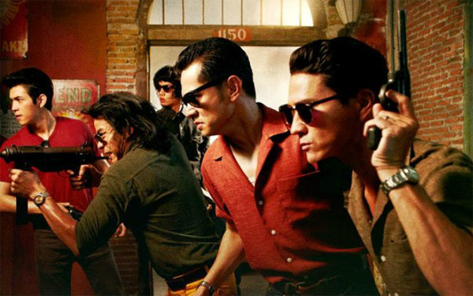
Aggression

Slide 7

5 key attributes of traditional male role
3. Autonomy
Men should be self-reliant and not admit to being dependent on others.
Male’s Role
Male’s Problems
Female’s Role
Female’s Problems

Slide 8

5 key attributes of traditional male role
4. Sexuality
Real men are heterosexual and are highly motivated to pursue sexual activities and conquests.
Male’s Role
Male’s Problems
Female’s Role
Female’s Problems

Slide 9

5 key attributes of traditional male role
5. Stoicism
Men should not share their pain or express their “soft” feelings. They should be cool and calm under pressure.
Male’s Role
Male’s Problems
Female’s Role
Female’s Problems

Slide 10

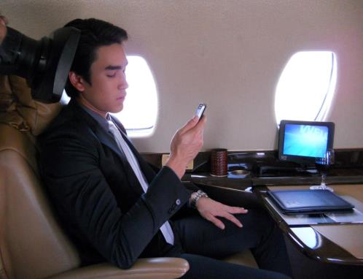
Traditional vs. modern male roles
In traditional male role, masculinity is validated by individual physical strengths, aggressiveness and emotional inexpressiveness.
In modern male role, masculinity is validated by economic achievement, organizational power, emotional control (even over anger) and emotional sensitivity and self-expression but only with women.
Male’s Role
Male’s Problems
Female’s Role
Female’s Problems

Slide 11
Problems with Male Role
1. Pressure to Succeed
2. The Emotional Realm
3. Sexual Problems
Male’s Role
Male’s Problems
Female’s Role
Female’s Problems

Slide 12

Problems with the Male Role
Socially constructed,
not psychological nor biologically
Influence of culture on
gender-role stress
Male’s Role
Male’s Problems
Female’s Role
Female’s Problems

Slide 13
1. Pressure to Succeed
“ There is always another man who has more money, higher status, a more attractive partner, or a bigger house. The traditional man…must constantly work harder and faster”
                Christopher Kilmartin
Male’s Role
Male’s Problems
Female’s Role
Female’s Problems

Slide 14

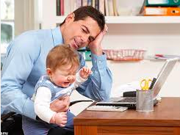


1. Pressure to Succeed
Expectations ….
Job
Finance
Family
Leader
Competition
Housework?
Male’s Role
Male’s Problems
Female’s Role
Female’s Problems

Slide 15
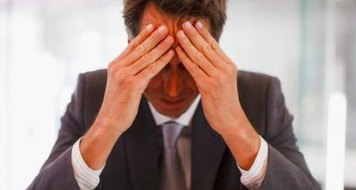
1. Pressure to Succeed
Inability to adjust
Shame & low self-esteem
Long hours working
Less time for family
More burdens on partner:
  housework & child care
Male’s Role
Male’s Problems
Female’s Role
Female’s Problems

Slide 16
1. Pressure to Succeed
Findings…
18-37: Smaller work focused than 38 and older
More worries on achievement?
  Perception: Males > Females
  Own worry: Females > Males
  Or males do not want to express their own worries?
Threatened by female partners’ success
  My partner is successful= my partner is more successful than me
Male’s Role
Male’s Problems
Female’s Role
Female’s Problems

Slide 17




2. The Emotional Realm
VS
Most of the boy are trained to believe that men should be strong, cool, and detached. So, men seem to hide vulnerable emotion such as love, joy, and sadness because they believe that such feeling are feminine and imply weakness.
CAN'T EXPRESS REAL EMOTION!
- contribute stress related disorders
- cause problem in their relationships with partners and children
Male’s Role
Male’s Problems
Female’s Role
Female’s Problems

Slide 18

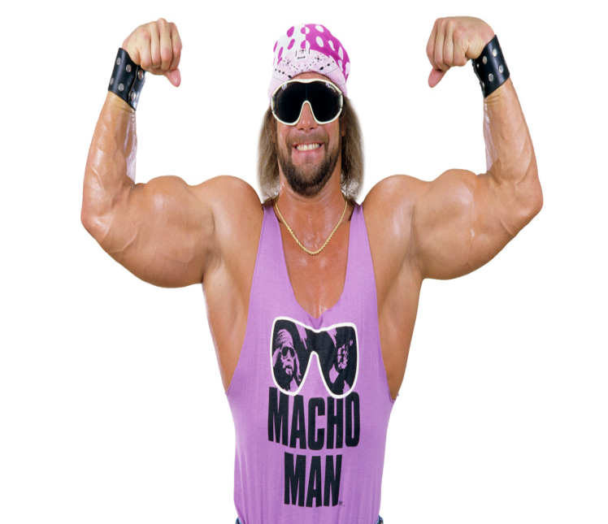

3. Sexual Problems
Men often experiences sexual problem that derive partly from their gender role socialization which give them a “MACHO” sexual image.
Male’s Role
Male’s Problems
Female’s Role
Female’s Problems

Slide 19
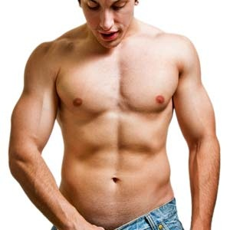
3. Sexual Problems
There are only few things that men fear more than a sexual encounter
1. unable to achieve an erection : men's obsession with sexual performance can produce anxiety that may interfere with their sexual responsiveness.
Male’s Role
Male’s Problems
Female’s Role
Female’s Problems

Slide 20

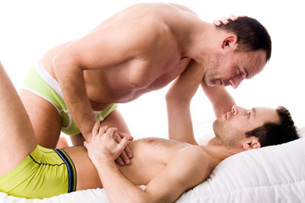
3. Sexual Problems
2. many men learn to confuse feeling of intimacy and sex.
3. sexualization of intimate feelings cause inappropriate anxiety when men feel affection of another man : homophobia
Male’s Role
Male’s Problems
Female’s Role
Female’s Problems

Slide 21
Role Expectations for females
Generally in these past decades, there are a dynamic of female gender expectations.
Before these decades, female role was expected to be housewives.
For example in oriental culture, females should taking care of their children instead of going out to look for any profession.
Male’s Role
Male’s Problems
Female’s Role
Female’s Problems

Slide 22
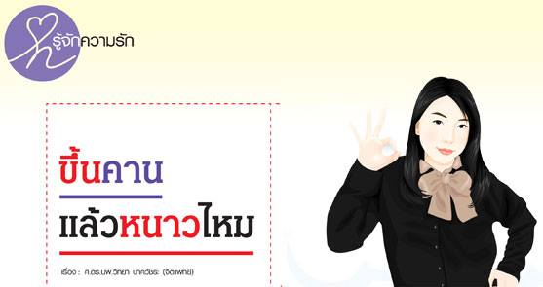
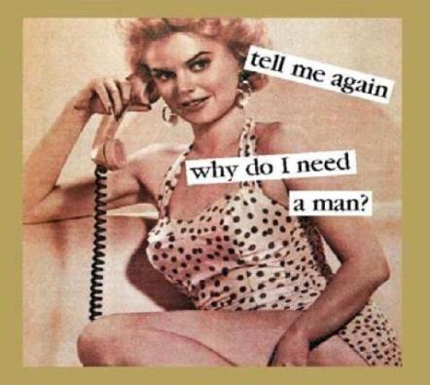
3 Key attributes of female role
Marriage Mandate
For recent decades, trend of remaining single in female population is constantly on the increase. However in accordance with the social norm, females lives will not be fulfilled without proper marriage
Male’s Role
Male’s Problems
Female’s Role
Female’s Problems

Slide 23
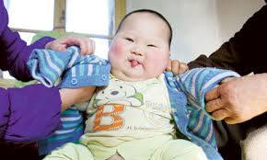
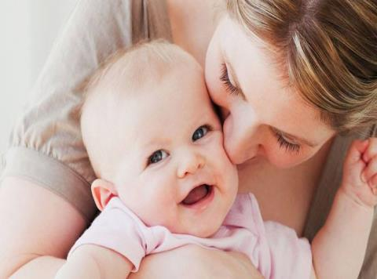
3 Key attributes of female role
2. Motherhood Mandate
In accordance with social context, it was believed that females at the proper age must having children and wholeheartedly devoting to child-nurturing issues rather than satisfying her own needs.
Male’s Role
Male’s Problems
Female’s Role
Female’s Problems

Slide 24

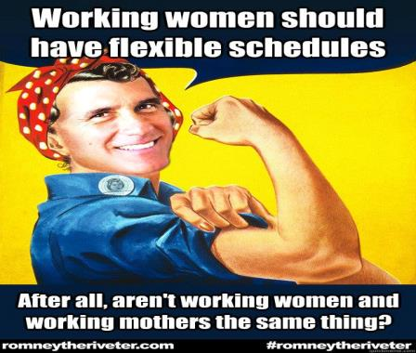
3 Key attributes of female role
3. Work outside the home
Presently, women can command higher level of education in relative to those in past days causing female proportion in labor market to be higher over the last decades.
Male’s Role
Male’s Problems
Female’s Role
Female’s Problems

Slide 25
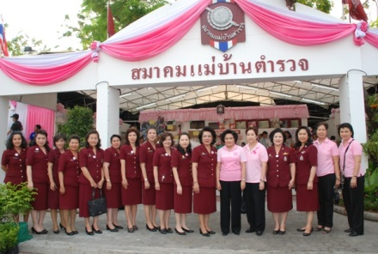

Traditional vs modern female role
In traditional female role, feminity can be achieved through marriage mandate, motherhood mandate, and housekeeping.
In modern female role, feminity can be achieved through working outside the home, voting for gender equality, and standing on one’s own effort.
Male’s Role
Male’s Problems
Female’s Role
Female’s Problems

Slide 26
Problems with the female role
Diminished Career Aspirations
Juggling Multiple Roles
Ambivalence About Sexuality
Sexism: A Special Problem for Females
      Economic Discrimination
      Aggression Toward Females
Male’s Role
Male’s Problems
Female’s Role
Female’s Problems

Slide 27


Problems with the female role
1. Diminished Career Aspirations
Lower career aspirations with backgrounds
and abilities
Underestimate the achievement
Traditional Female Role
“ Femininity ”
Lower
self-efficacy
Ability -
Achievement
Gap
Male’s Role
Male’s Problems
Female’s Role
Female’s Problems
Notes:
Women: B/c women are more likely to underestimate(lower self-efficacy) their own achievement than boys do especially on “Masculine task” such as math and science(women lack of this one) → contribute to inferior performance of some women.
BUT good foundations w/ math and science would lead to better performance → high-paying → high-status career
Ability-achievement gap = Discrepancy/conflict btw women’s achievement and femininity that is built into traditional female role. (conflict btw craving for high achievement and low self-efficacy which leads to lower career aspirations in its traditional female.)
In another aspect → Traditional Females: Heterosexual success = learning how to attract and interest male as prospective males
Resulting emphasis on dating and marriage lead some women away from a challenging career
→ Worry that striving for success will be seen as unfeminine.

Slide 28
Problems with the female role
2. Juggling Multiple Roles – societal institution
Worker
Parent
Spouse
Women:
Role
Men:
Given three-role reality of their lives, they trade off worker role and income in slower
pace and less stress to take care young children.
HOWEVER, some evidence has shown that multiple roles can be beneficial for
mental health. And greater participation would alleviate women’s stress.
Male’s Role
Male’s Problems
Female’s Role
Female’s Problems

Slide 29
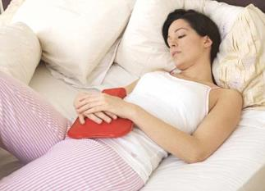
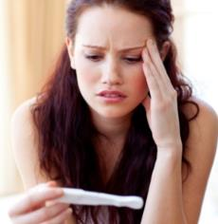

Problems with the female role
3. Ambivalence About Sexuality
Ambivalence in term of either positive or negative feeling**
“Sexual Problem; Dysfunction” - Difficulty in enjoying sex
Menstruation – Blood and pain
Fear of pregnancy
Sexual exploitation and Rape
Male’s Role
Male’s Problems
Female’s Role
Female’s Problems
Notes:
********Women are likely to have ambivalent feelings instead of positive feelings that men have.
Girls are taught to suppress or deny their sexual feelings and told woman’s role in sex is passive one. Also, girls associate shame and guilt w/ sex more than boys do.
Menstruation(on period) and fear of pregnancy added another dimensions of negativity to sex.
Sexual exploitation and rape also foster neg. emotions

Slide 30
Sexism : A Special Problems for female role
Definition: Prejudiced or discrimination against person based on their sex or gender.
Sexism affects men and women, but especially women.
Based on the belief that one sex or gender is intrinsically superior to another.
Economics
Discrimination
Aggression Toward Females
Male’s Role
Male’s Problems
Female’s Role
Female’s Problems
Notes:
When talking about the gender role or the stereotype, we might face the issue of sex discrimination. It is based on the belief that one sex is intrinsically superior to another.
Normally, sexism refer to discrimination by men against women. Actually, some women discriminate against other women and men also can the victim of this kind of dismination. We will discuss these two specific problem.

Slide 31

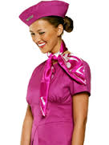

Economics Discrimination
Sexism : A Special Problems for female role
Differential in job access
Men are more likely to hold positions with decision-making authority while women are overpresented in “ pink-collar ghetto”, service-oriented job.
Male dominated occupation: women still lack of employment opportunity as men
Motherhood: pregnancy or having kids are concerned to be obstacle on working competency.
Male’s Role
Male’s Problems
Female’s Role
Female’s Problems
Notes:
There are two forms of women victimizing in economics discrination
The reason why occupational sexism exists is unclear but there are some assumption that say because in Historical women’s place was in the home, while the males were in the workforce. This division consequently formed social role and gender stroeotype for both men and women from time to time.
Motherhood can be a liability on job market. And women are more likely than men to fall off the career track when they have children. They take time off and lose skills, or they opt for less-demanding jobs so they can spend more time at home. Most fathers, in contrast, manage to skate through parenthood without the slightest harm to their careers.

Slide 32
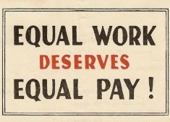

Economics Discrimination
Sexism : A Special Problems for female role
Differential treatment on the job
Gender Pay Gap: Women typically earn lower salary than men for the same position.
Career path: When women demonstrate leadership qualities such as confidence, ambitiousness, and assertiveness, they are evaluated less favorable than men. -> Glass ceiling
Male’s Role
Male’s Problems
Female’s Role
Female’s Problems
Notes:
-- in many workplaces, discussing pay is frowned upon; in some, it’s a dismissible offense. So, like Ledbetter, women often don’t know when they’re getting paid less than men. So they don’t complain. So the problem continues.
Men crowd into high-paying fields like engineering, while women dominate lower-paying fields like education and social service.
The perception by boosses that female subordinates have greater family-work conflict than male. So, men are promoted more quickly than women.

Slide 33


Aggression toward women
Sexism : A Special Problems for female role
Definition: Sexual Harassment = unwelcome conduct on the basis of gender
Out of 500 people surveyed: 54% experienced some form of sexual harassment in workplace.
Quid Pro Quo sexual harassment
Employee are expected to give in to sexual demands in exchange for employment, raise, promotion and so forth.
Hostile Sexual Harassment
Employee are exposed to sexist or sexually oriented comments, cartoons, posters and so forth.
Male’s Role
Male’s Problems
Female’s Role
Female’s Problems
Notes:
(meaning “this for that”) sexual harassment occurs when it is stated or implied that an academic or employment decision about a student or employee depends upon whether the student or employee submits to conduct of a sexual nature. Quid pro quo sexual harassment also occurs when it is stated or implied that an individual must submit to conduct of a sexual nature in order to participate in a University program or activity. So, for example, if an employee is made to believe that a promotion is likely if the employee goes on a date with the employee’s supervisor, the employee is possibly being subjected to “quid pro quo” sexual harassment. (Office of Institutional Equity, University of Michigan)
This continue major problem in workplace and related to poorer outcome.

Slide 34
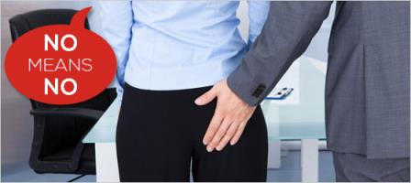
Aggression toward women
Sexism : A Special Problems for female role
Dealing with sexual harassment
Indicate CLEARLY that you are not uncomfortable with the behavior. Say NO effectively and emphatically
Collect evidence – start a log note down dates, times, places who was present and detailed accounts of the unwelcomes sexual behavior.
Alert or inform someone whom you trust at the workplace so that he or she can help you observe or monitor the condition.
Consult your HR department and give them a chance to help you resolve the situation. If possible, provide them with some concrete evidence of harassment, including written evidence or a witness.
Male’s Role
Male’s Problems
Female’s Role
Female’s Problems
Notes:
(meaning “this for that”) sexual harassment occurs when it is stated or implied that an academic or employment decision about a student or employee depends upon whether the student or employee submits to conduct of a sexual nature. Quid pro quo sexual harassment also occurs when it is stated or implied that an individual must submit to conduct of a sexual nature in order to participate in a University program or activity. So, for example, if an employee is made to believe that a promotion is likely if the employee goes on a date with the employee’s supervisor, the employee is possibly being subjected to “quid pro quo” sexual harassment. (Office of Institutional Equity, University of Michigan)
This continue major problem in workplace and related to poorer outcome.

Slide 35
Q & A
Chidchanok Vimuktanon 5404640160
Nalintip Piyaseth 5404640483
Oranit Sankaew 5404640665
Peranut Plitponkarnpim 5404640764
Pichaya Patamatamkul 5404640822
Rasita Kriangkrairat 5404640939
Salisa woraphan 5404640962
Siriporn Panaputtikul 5404641085
Chaiyasit wuthinitikornkit 5604640184

