Slide 1
CHAPTER 4: FISCAL POLICY

Slide 2
4.1 Meaning of Fiscal Policy
Fiscal Policy: Government’s spending and taxing policy

Slide 3
4.2 Objectives
Efficient resource allocation
Fair income distribution
Economic growth
Economic stability

Slide 4
4.3 Fiscal policy tools
Government Expenditure (G)
Government transfer payment (R)
Government Revenue (T)
Public Debt

Slide 5
4.3.1 Government expenditure
Government consumption expenditure
Government investment expenditure
Loan and interest payment expenditure

Slide 6
4.3.2 Government Transfer payment
Social insurance payment
Unemployment compensation
Welfare payment
Veterans’ benefits
Retirement benefits

Slide 7
4.3.3 Government revenue
4.3.3 (a) Tax Revenue
Direct Tax: Tax that tax payers are responsible for all or part of tax payment and cannot alter their responsibility to others
For example: personal income tax, corporate income tax
inheritance tax, property tax

Slide 8
4.3.3 Government revenue
4.3.3 (a) Tax Revenue
Indirect Tax: Tax that tax payers are not responsible for all tax payment and can alter all or part of their responsibility to others.
For example: sales tax, excise tax, custom duty

Slide 9
4.3.3 Government revenue
4.3.3 (b) Non Tax Revenue
For example
State enterprises revenue
Revenue from selling government’s G&S
Fee and Fine

Slide 10
3 Types of tax structure (Progressive tax rate)
Level of tax base | Tax Rate | Tax Base (Income) (Y) | Tax payment (T) | Average Tax Rate (T/Y) | Marginal Tax Rate (∆T/∆Y)
0 – 1,000 | 10% | 1,000 |  |  | ___
1,001 – 2,000 | 12% | 2,000
2,001 – 3,000 | 15% | 3,000
= 1,000*0.1
= (100/1,000)
= 100
= 0.1
= (1,000*0.1) + (1000 * 0.12)
= (220/2,000)
= (220 - 100)/1,000
= 0.11
= (120/1,000)
= 100+120 = 220
= 0.12
= (1,000*0.1) + (1000 * 0.12) + (1,000 * 0.15)
= (370/3,000)
= (370 - 220)/1,000
= 0.123
= (150/1,000)
= 0.15
= 100+120+150
= 370

Slide 11
Summarize (progressive tax rate)
When tax base (in this case income) increases, tax rate ……
When tax base (in this case income) increases,
Marginal tax rate ……… Average tax rate
>

Slide 12
3 Types of tax structure (constant tax rate)
Level of tax base | Tax Rate | Tax Base (Income) (Y) | Tax payment (T) | Average Tax Rate (T/Y) | Marginal Tax Rate (∆T/∆Y)
0 – 1,000 | 10% | 1,000 |  |  | ___
1,001 – 2,000 | 10% | 2,000
2,001 – 3,000 | 10% | 3,000
= 1,000*0.1
= (100/1,000)
= 100
= 0.1
= (1,000*0.1) + (1000 * 0.1)
= (200/2,000)
= (200 - 100)/1,000
= 0.1
= (100/1,000)
= 100+100 = 200
= 0.1
= (1,000*0.1) + (1000 * 0.1) + (1,000 * 0.1)
= (300/3,000)
= (300 - 200)/1,000
= 0.1
= (100/1,000)
= 0.1
= 100+100+100
= 300

Slide 13
Summarize (constant tax rate)
When tax base (in this case income) increases or decrease, tax rate …………………
When tax base (in this case income) increases,
Marginal tax rate ……… Average tax rate
Constant
=

Slide 14
3 Types of tax structure (regressive tax rate)
Level of tax base | Tax Rate | Tax Base (Income) (Y) | Tax payment (T) | Average Tax Rate (T/Y) | Marginal Tax Rate (∆T/∆Y)
0 – 1,000 | 15% | 1,000 |  |  | ___
1,001 – 2,000 | 12% | 2,000
2,001 – 3,000 | 10% | 3,000
= 1,000*0.15
= (150/1,000)
= 150
= 0.15
= (1,000*0.15) + (1000 * 0.12)
= (270/2,000)
= (270 - 150)/1,000
= 0.135
= (120/1,000)
= 150+120 = 270
= 0.12
= (1,000*0.15) + (1000 * 0.12) + (1,000 * 0.1)
= (370/3,000)
= (370 - 270)/1,000
= 0.123
= (100/1,000)
= 0.1
= 150+120+100
= 370

Slide 15
Summarize (REgressive tax rate)
When tax base (in this case income) increases, tax rate ………
When tax base (in this case income) increases,
Marginal tax rate ……… Average tax rate
<

Slide 16
4.3.4 Public Debt
Government debt to finance budget deficit, which can be categorized by
Length of time
  Short term debt (payback period less than 1 year)
  Long term debt (payback period more than 5 years)
Source of Debt
  Domestic debt
  International debt

Slide 17
4.3.4 Public Debt
Effects of public debt
Price stability
Resource allocation
Distribution of income
Government project operation

Slide 18
4.3.4 Public Debt
Regulation on public debt
For example
Ministry of Finance can not borrow more than
20% of government’s spending budget +
80% of government spending on principal payback

Slide 19
Types of Government Budget
  Budget Deficit: G + R > T
  Budget Surplus: G + R < T
  Balance Budget: G + R = T
In accounting sense
Total government spending = Total government revenue
Total government spending = Government revenue + public debt +
treasury reserves

Slide 20
4.4 Types of government policy
Categorized by
Operation
Nondiscretionary Fiscal Policy (Built-in Stabilizer, automatic stabilizer)
Discretionary Fiscal Policy
Economic problem
Expansionary Fiscal Policy
Contractionary Fiscal Policy

Slide 21
4.4.1 Non-discretionary Fiscal Policy
(Built-in Stabilizer, automatic stabilizer)
Fiscal policy that can be adjusted according to state of economy. That is,
  When economy expands, this fiscal policy will alleviate economic growth
  When economy shrinks, this fiscal policy will alleviate the shrink
  According to Keynesian theory on equilibrium national income, to keep economy stable, adjustment on fiscal policy and consumer consumption are needed (the adjustment is through multiplier effect).

Slide 22
4.4.1 Non-discretionary Fiscal Policy tools
Income tax
    Constant tax rate
    Progressive tax rate
Government transfer payment

Slide 23
Income Tax T = T_{a} + tY ----- constant tax rate
When economy in bad condition (low level of Y)
Small Y
T
C
DAE
Y
C = C_{a} + bY^{d}
Can stabilize economy
(Automatic stabilizer)
C = C_{a} + b(Y - T)
When economy in good condition (high level of Y)
Large Y
T
C
DAE
Y
Can stabilize economy
(Automatic stabilizer)

Slide 24
Government transfer payment (R) --- R = R_{a} - gY
R = R_{a} - gY
where
R = Government transfer payment
R_{a} = Transfer payment that does not depend on national
income
Y = National income
g = Changes in transfer payment when national income
change one unit

Slide 25
Government transfer payment (R) --- R = R_{a} - gY
When economy in bad condition (low level of Y)
Small Y
R
More money to spend
C
DAE
Y
Can stabilize economy
(Automatic stabilizer)
When economy in good condition (high level of Y)
Large Y
R
less money to spend
C
DAE
Y
Can stabilize economy
(Automatic stabilizer)

Slide 26
4.4.2 discretionary Fiscal Policy tools
In the case that economy fluctuate a lot and occurred for a long time, and non-discretionary fiscal policy (automatic stabilizer) cannot solve the problem, Government needs to use discretionary fiscal policy.
Discretionary fiscal policy tools: Types of tax, tax rate, and government spending

Slide 27
TAX RATE
When economy in bad condition (low level of Y)
Government needs to increase Y to stabilize economy
Gov’t can tax rate
C
DAE
Y
Can stabilize economy
When economy in good condition (high level of Y)
Government needs to decrease Y to stabilize economy
Gov’t can tax rate
C
DAE
Y
Can stabilize economy

Slide 28
Government Spending
When economy in bad condition (low level of Y)
Government needs to increase Y to stabilize economy
Gov’t can G
DAE
Y
Can stabilize economy
When economy in good condition (high level of Y)
Government needs to decrease Y to stabilize economy
Gov’t can G
DAE
Y
Can stabilize economy

Slide 29
Problems when using discretionary fiscal policy
Lag in the system
    Recognition Lag
    Decision Lag
    Execution Lag
    Response Lag
Irreversible of the policy after the problem solved

Slide 30
Problems when using discretionary fiscal policy
3. Consumer expectation about the length of policy enforced
4. Political objective contradicts with the economic stability objective
5. Expansion fiscal policy may not stimulate economy if the policy causes households to save more
6. Crowding-out effect

Slide 31
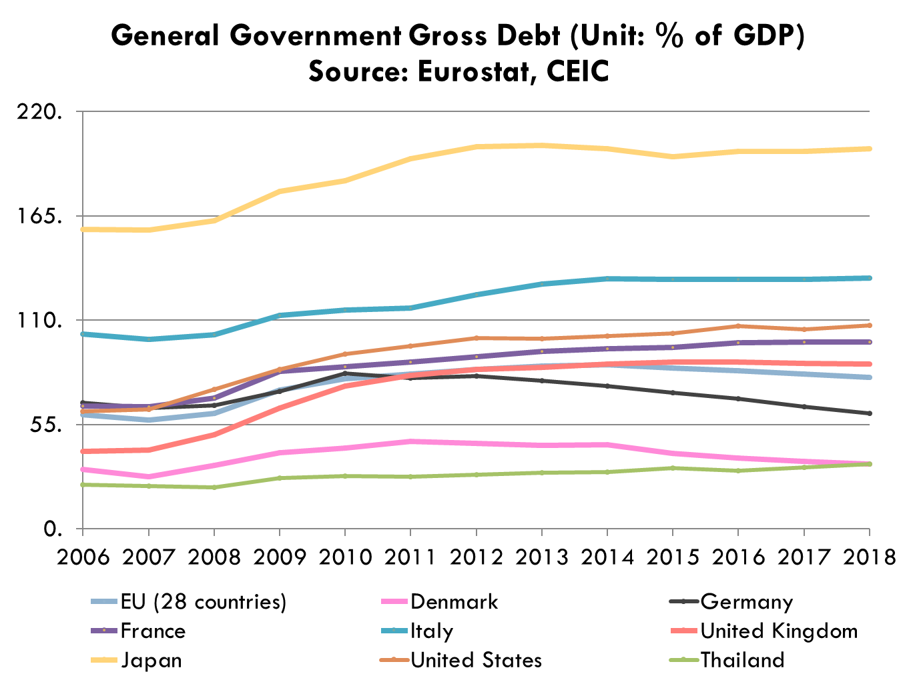

Slide 32
Sustainable Fiscal Policy Framework
Goal | Tentative performance 2555-2559
(Public Debt/GDP) < 60% | Can achieve the goal
(Public Debt/Government spending budget) < 15% | Can achieve the goal
Balance budget | Cannot achieve the goal since government plan to stimulate economy
(Government investment spending/Total government spending) > 25% | Cannot achieve the goal
Source: Fiscal Policy Office

Slide 33
Sustainable Fiscal Policy Framework
 | 2556 | 2557 | 2558 | 2559 | 2560 | 2561 | 2562 | 2563
Public Debt/GDP | 42.19% | 43.33% | 42.56% | 41.75% | 41.78% | 41.95% | 41.04% | 49.36%
Public Debt/Government spending budget | 7.41% | 7.36% | 7.12% | 7.18% | 8.33% | 8.99%
Balance budget | (300,000) | (250,000) | (250,000) | (390,000) | (552,921) | (550,358) | (450,000) | (469,000)
Government investment spending/Total government spending | 18.7% | 17.5% | 17.5% | 20.3% | 22.5% | 22.2% | 21.6% | 20.1%
Net Government Revenue/GDP | 17.6% | 18.3% | 18.4% | 17.0% | 15.6% | 15.2% | 15.1% | 17.5%
Source: Fiscal Policy Office

