Slide 1
Health and Education – 1
EE361/363 Economic development in CLMV
Faculty of Economics
Thammasat university

Slide 2
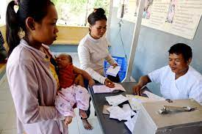
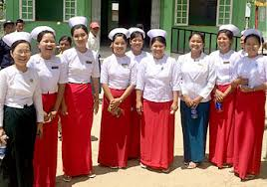
The Roles of health and Education
Health and education are basic objectives of development; both are fundamental to the broader notion of expanded human capabilities and both comprise human capital
Health is a prerequisite for increases in productivity. Greater health capital improves returns to investment in education and lowers the rate of depreciation of educational capital; greater education capital may improve returns to investment in health for example basic health skills learned at school, sanitation and hygiene and education of health personnel

Slide 3
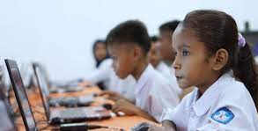

The Roles of health and Education
Education is essential for a satisfying and rewarding life; plays a key role in the ability to absorb technology and develop capacity for sustainable development

Slide 4
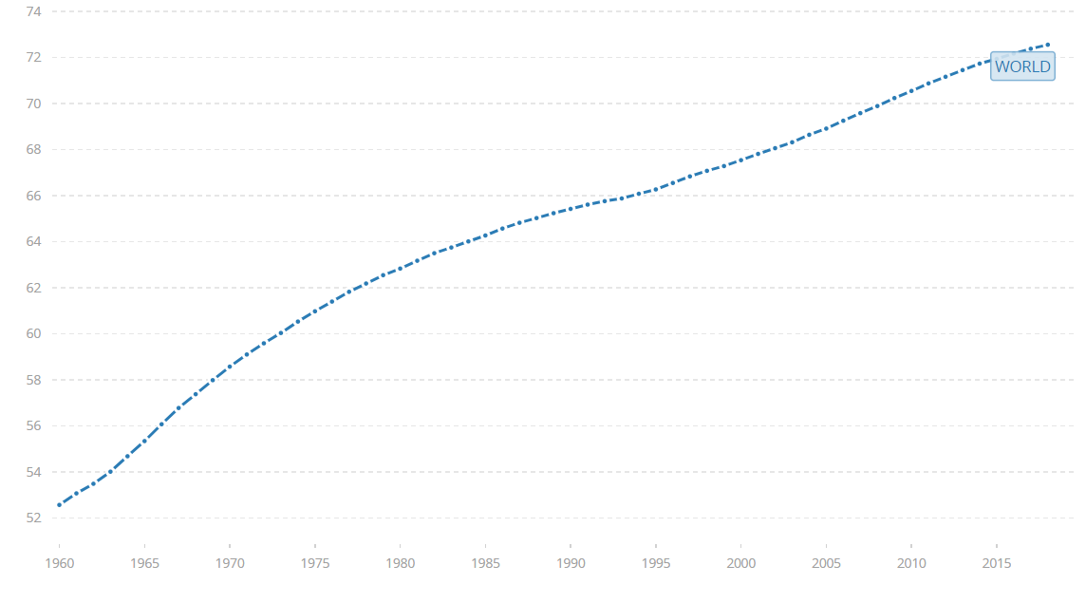
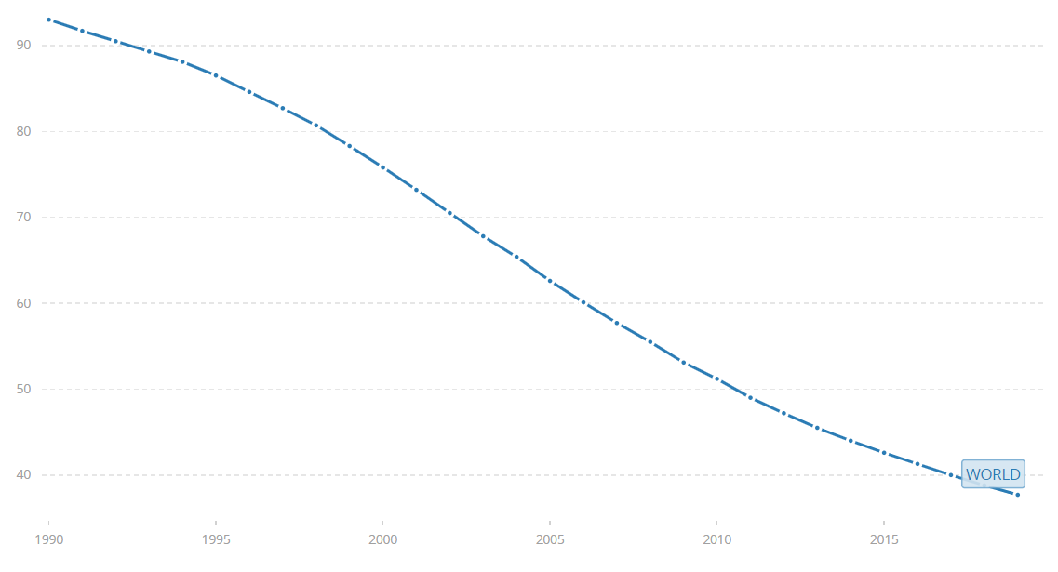
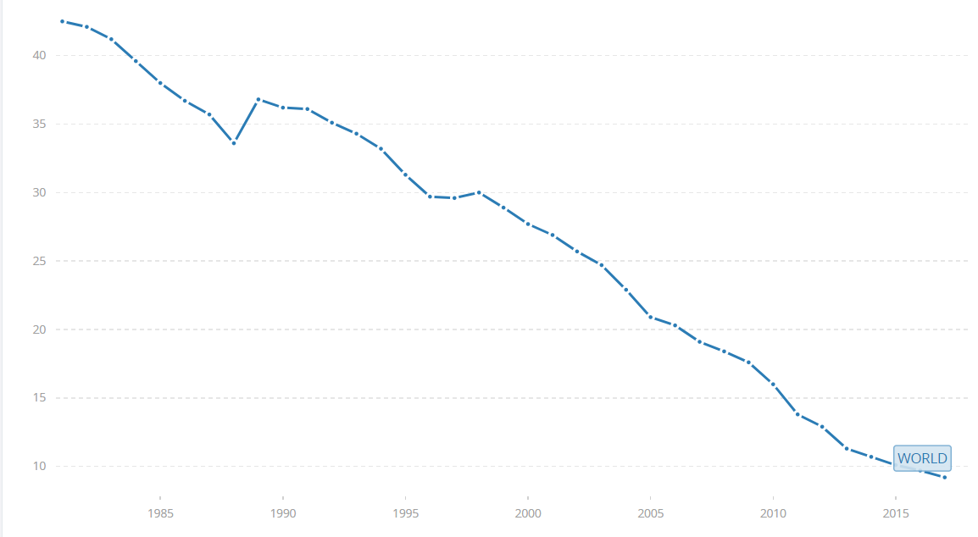
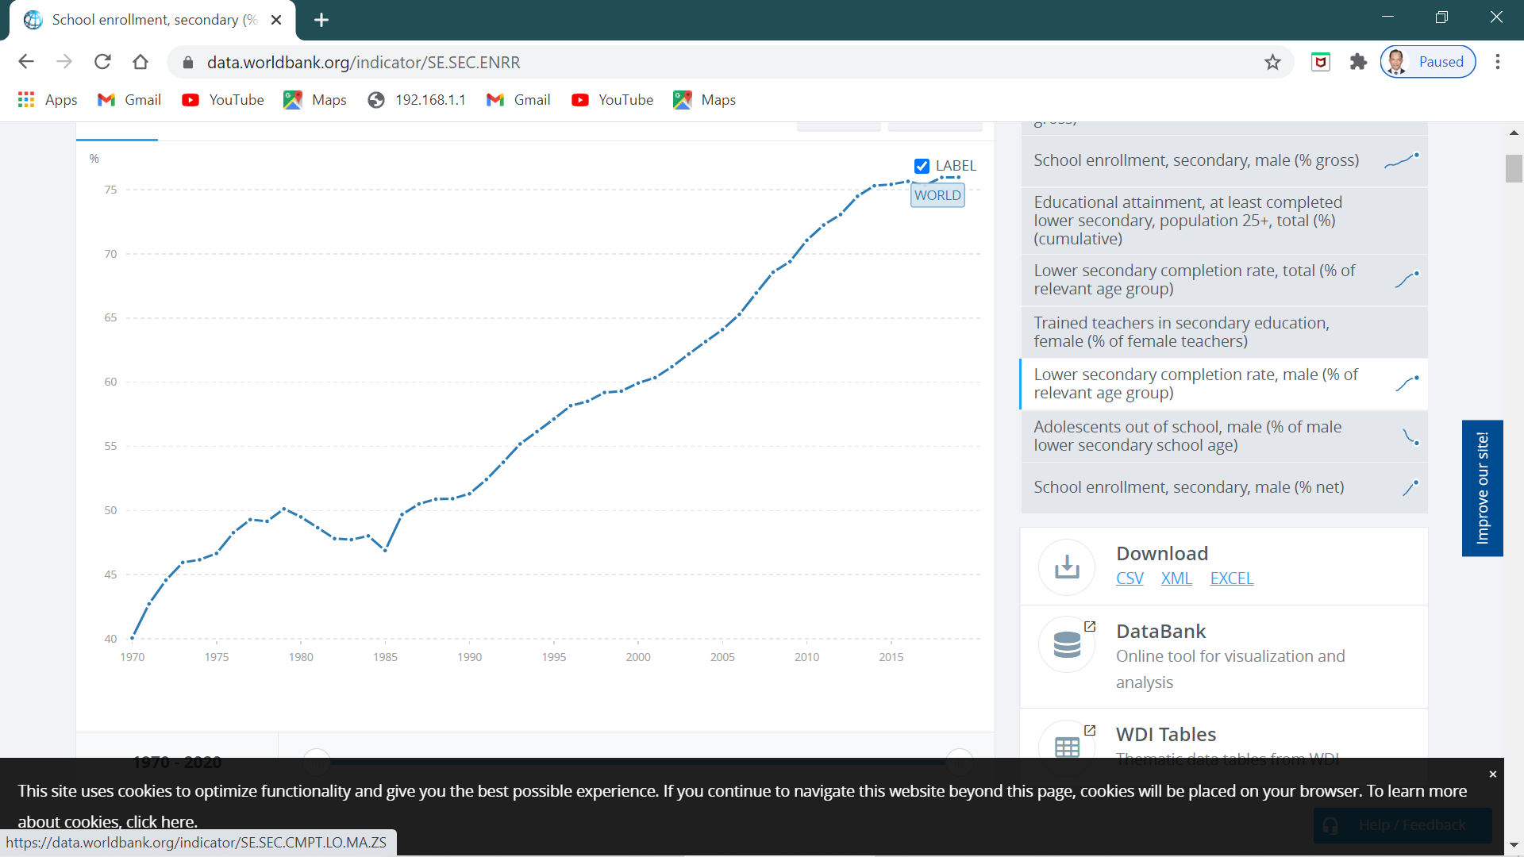
Improvements in health and education, 1960-2018
Life expectancy
Under 5 mortality rate
Poverty reduction
Secondary school enrollment
Poverty reduction

Slide 5
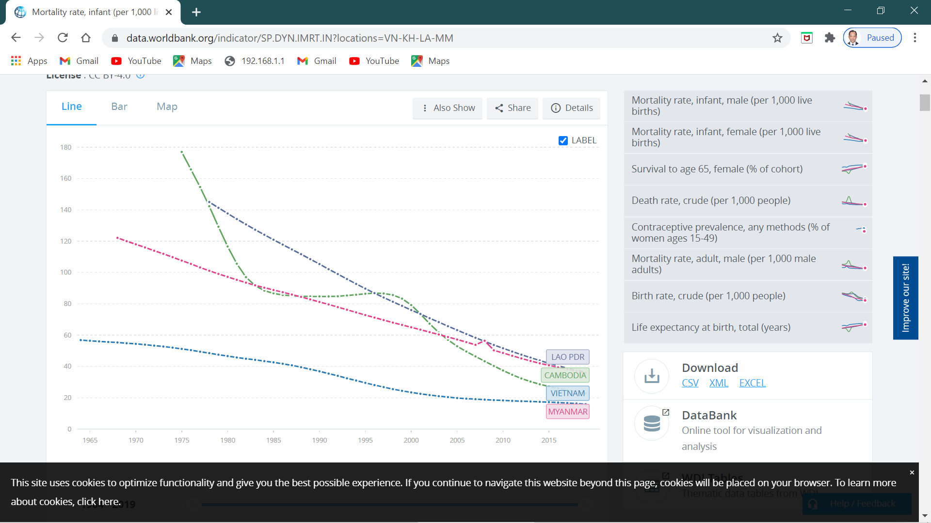
Under 5 mortality rates for CLMV

Slide 6
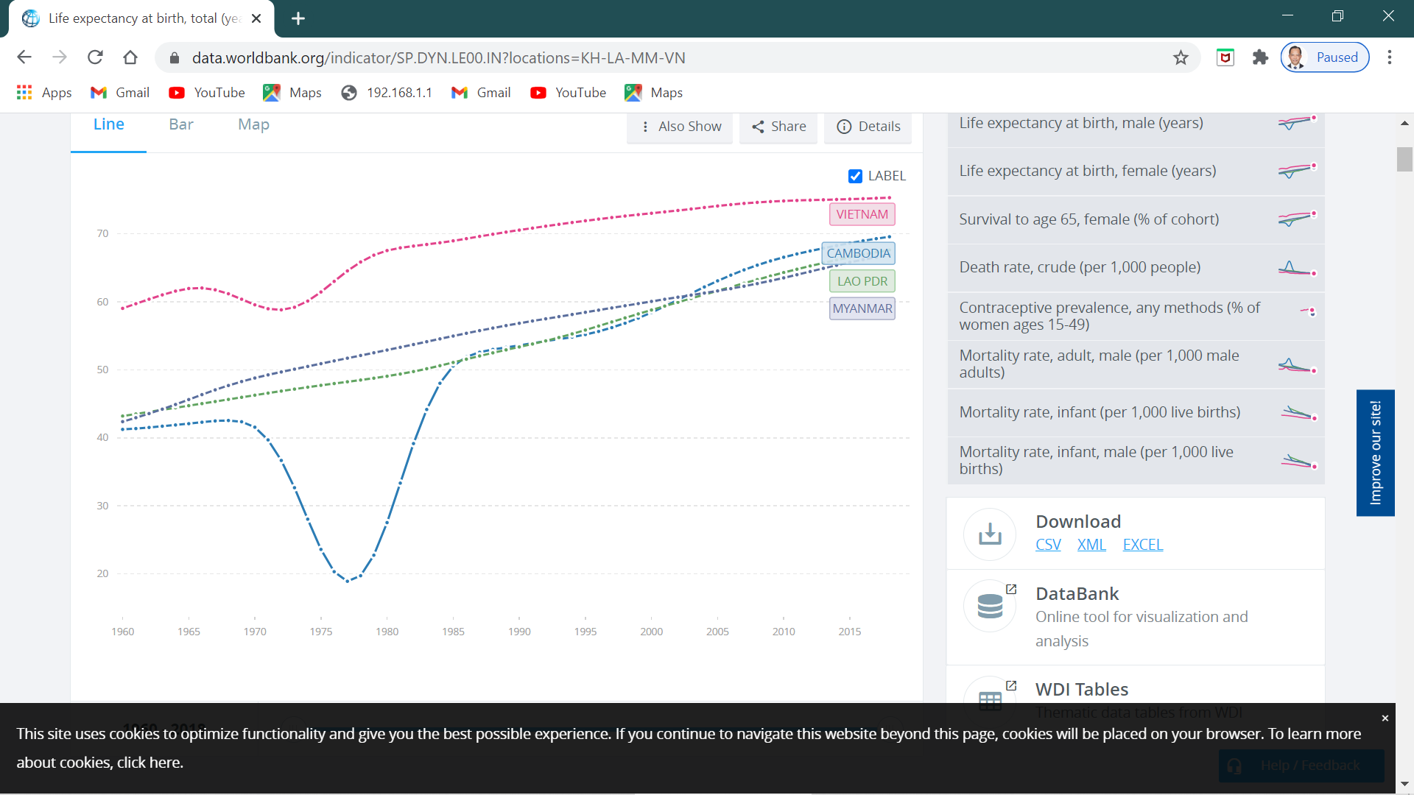
Life expectancy for CLMV

Slide 7
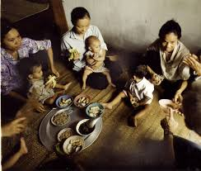
Challenges
Despite significant improvements in health and education, developing countries still face numerous challenges
Currently 775 million people are still illiterate, of which two-thirds are women
Even within countries, there exist variations in health and educational conditions
Many poor children suffer from malnutrition, parasitic infections and communicable diseases that could be precented

Slide 8
Quick facts
A rise in income does not necessarily lead to improved health or education. The excess income may be used to purchase non-productive goods (games, tv)
The better the education of the mother, the better the health of her children
Health status effects school performance
Better health and nutrition lead to longer school enrollment, better school attendance and more effective learning
An educated person provides benefits of those around him/her

Slide 9
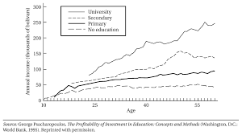
Age earning profiles by level of education
People with higher levels of education tend to earn more at the same age level

Slide 10
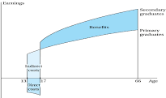

Earnings
Secondary graduates
Benefits
Primary graduates
Financial tradeoffs in the decision to continue school
Indirect costs
Indirect costs
16
17
66
Age
Direct costs

Slide 11
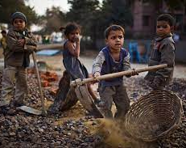
Child Labor
Child labor is a widespread problem in developing countries; their labor time disrupts or even prevents them from schooling
ILO estimates that worldwide there are 306 million children aged 5-17 that are doing work
Roughly one third of child laborers are doing hazardous work
Worse forms of child labaor: sexual exploitation, trafficking

Slide 12
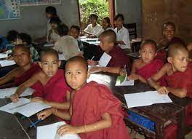
Keeping children in school
Compulsory education is not necessarily effective; without complementary activities there would be no incentive to take out children from work and enforcement is likely weak
Providing conditional cash transfers as incentives for parents to keep their children in school
School nutrition programs for school children

Slide 13
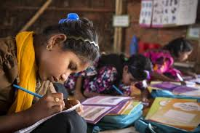
The gender gap in education
In many developing countries, younfg females receive less education than young males
While youth literacy has much improved, girls still lag behind boys
Evidence shows that discrimination against women hinders economic development in addition to reinforcing social inequality
Increasing women’s education not only increases their productivity but also results in greater labor force participation, later marriage, lower fertility and greatly improved child health and nutrition

Slide 14
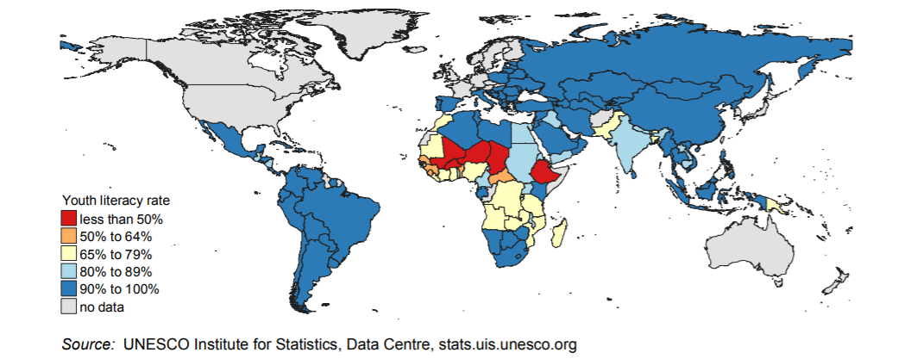
Proportion of youth who could read and write

Slide 15
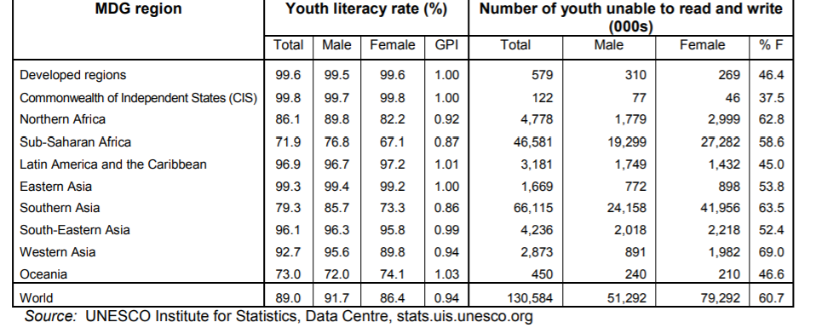
Youth Literacy Rate by Region and Gender, 2008

Slide 16
Health and gender
Girls face discrimination in health; families are more likely to take an ill boy rather than an ill girl to a health center
Education of girls is one of the cost effective means of improving health standards
Asa many families prefer a baby boy over a baby girl, there is a tendency towards a smaller portion of women; in the future, males will have difficult time seeking for a partner, and marry

