Slide 1
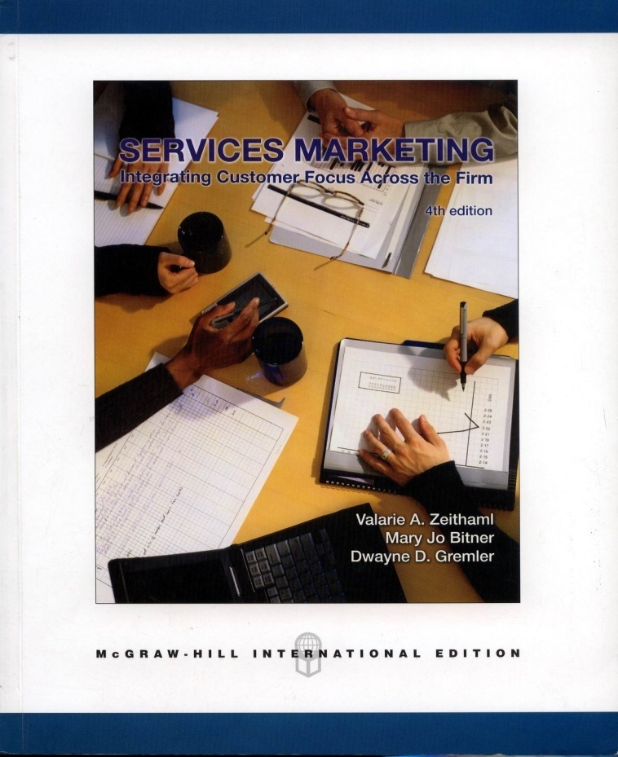
MK 324/352
Chapter 5: Customer Perceptions of Service
Ajarn Suwalya K.

Slide 2
Customer Perceptions of Service
1. Provide a solid basis for understanding what influences customer perceptions of service and the relationships among customer satisfaction, service quality, and individual service encounters.
2. Demonstrate the importance of customer satisfaction – what it is, the factors that influence it, and the significant outcomes resulting from it.
3. Develop critical knowledge of service quality and its five key dimensions: reliability, responsive, empathy, assurance, and tangibles.
4. Show that service encounters or the “moments of truth” are the essential building blocks form which customer form their perceptions.

Slide 3
Customer Perceptions
In this chapter, we will be focusing through the perceived service box in the gaps model.
The entire discussion of quality and satisfaction is based on customers’ perceptions of the service – not some predetermined objective criteria of what service is or should be.
Customer perceive services in terms of the quality of service and how satisfied they are overall with their experiences.
Case on Coors Field pg. 105-106.

Slide 4

Satisfaction vs. Service Quality
Practioners, writers and popular press tend to use the terms satisfaction and quality interchangeably, but researchers tend to be more precise about the meanings and measurements of these 2 concepts.

Slide 5

Satisfaction vs. Quality
Satisfaction: Is viewed as a broader concept.
Service quality focuses on dimensions of service.
Perceived service quality: is a component of customer satisfaction.
Exhibit 5.1 pg.107

Slide 6
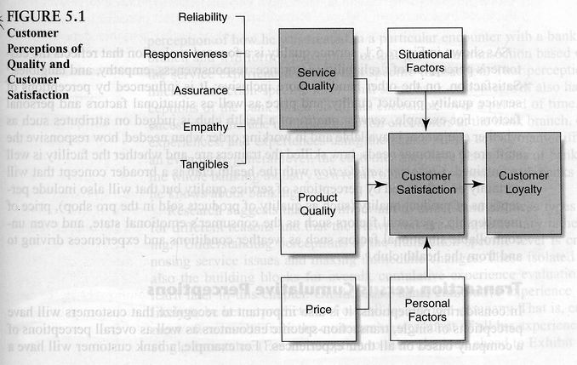
Figure 5.1

Slide 7
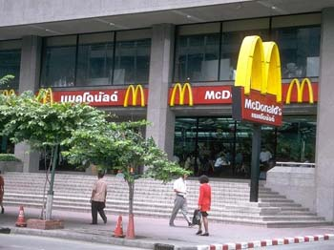
Transaction versus Cumulative Perceptions
In considering perceptions, it is also important to recognize that customers will have perceptions of single, transaction-specific encounters as well as overall perceptions of a company based on all their experiences.

Slide 8
Transaction versus Cumulative Perceptions
Research suggests that it is important to understand all these types of perceptions for different reasons and that the viewpoints are complementary rather than competing.
Understanding perceptions at the transaction-specific level is critical for diagnosing service issues and making immediate changes.
These isolated encounters are also the building blocks for overall, cumulative experience evaluations as you will learn later in this chapter.
On the other hand, cumulative experience are likely to be better predictors of overall loyalty to a company.

Slide 9

Customer Satisfaction
What is Customer Satisfaction?
  Satisfaction is the customer’s evaluation of a product or service in terms of whether that product or service has met the customer needs and expectations.
  Failure to meet needs and expectations is assumed to result in dissatisfaction with the product or service.

Slide 10
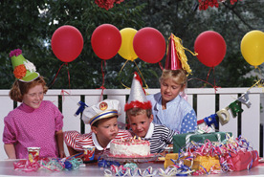
Customer Satisfaction
In addition to a sense of fulfillment in the knowledge that one’s needs have been met, satisfaction can be related to other types of feelings, depending on the particular context or type of service.
Satisfaction can be viewed as contentment or associated with feelings of pleasure for services, or really surprise- delight; removal of negative feelings- relief or mix of negative and positive feelings of ambivalence.

Slide 11

What Determines Customer Satisfaction?
Product and Service Features
Consumer Emotions
Attributions for Service Success or Failure
Perceptions of Equity or Fairness
Other Consumers, Family Members, and Coworkers

Slide 12
Measurements of Customer Satisfaction
National Customer Satisfaction Indexes
  Customer satisfaction indexes begin to get at the quality of economic output, wheareas more traditional economic indicators tend to focus only on quantity. The firs such measure was the Swedish Customer Satisfaction Barometer introduced in 1989.
The American Customer Satisfaction Indexes
  ACSI is developed by researchers at the National Quality Research Center at the University of Michigan, is a measure of quality of goods and services as experiences by consumers.
Outcomes of Customer Satisfaction
  Why all this attention to customer satisfaction? Some policy makers believe that customer satisfaction is an important indicator of national economic health.

Slide 13

Figure 5.2

Slide 14
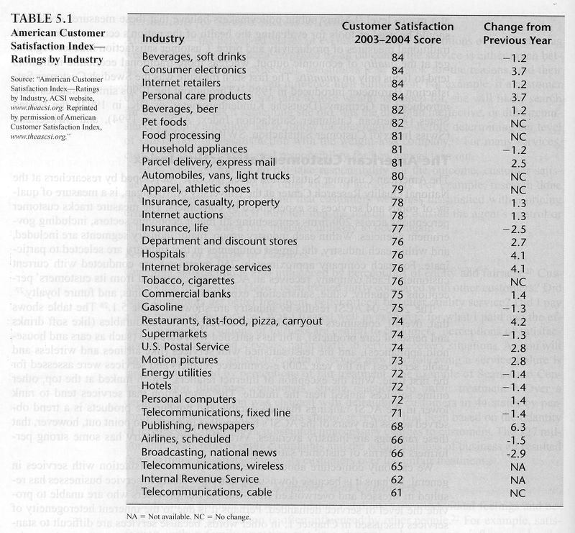
Table 5.1

Slide 15
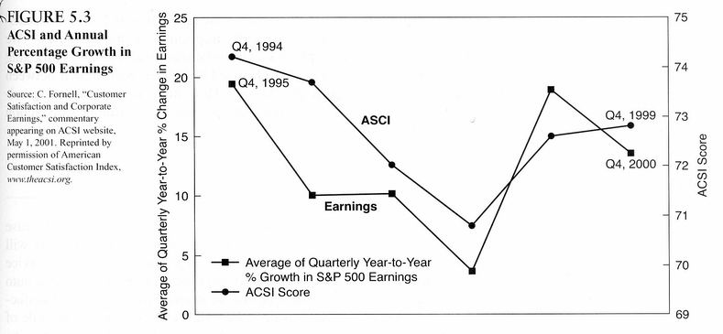
Figure 5.3

Slide 16
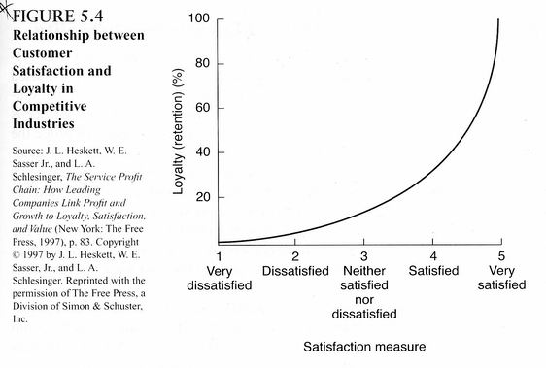
Figure 5.4

Slide 17

Service Quality
Service Quality is a critical element of customer perceptions.
In the case of pure services (eg. Health care, financial services, education) service quality will be the dominant element in customers’ evaluations.

Slide 18

Service Quality Dimensions
Customers do not perceive quality a unidimensional way.
Service Quality Dimensions:
  Reliability: ability to perform the promised service dependably and accurately.
  Responsiveness: willingness to help customers and provide prompt service.
  Assurance: employees’ knowledge and courtesy and their ability to inspire trust and confidence.
  Empathy: caring, individualized attention given to customers.
  Tangible: appearance of physical facilities, equipment, personnel, and written materials.
Global Features pg. 118-119

Slide 19
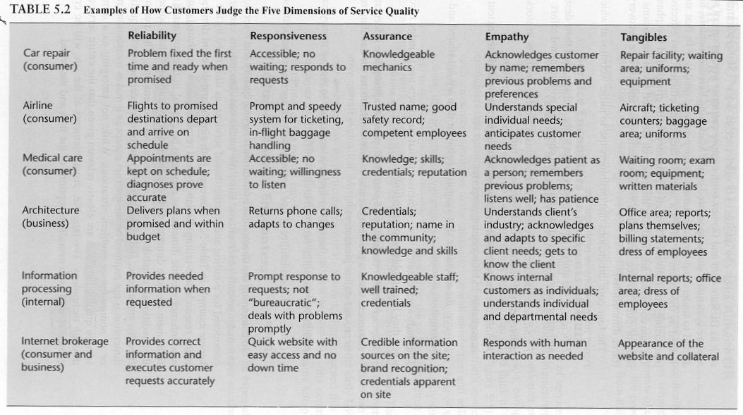
Table 5.2

Slide 20
E-Service Quality
The four core dimensions that customer use to judge websites at which they experience no questions or problems are:
  Efficiency: the ability of customers to get to the website, find their desired product and information associated with it, and check out with minimal effort.
  Fulfillment: the accuracy of service promises, having products in stock, and delivering the products in the promised time.
  Reliability: the technical functioning of the site, particularly the extent to which it is available and functioning properly.
  Privacy: the assurance that shopping behavior data are not shared and that credit information is secure.

Slide 21
E-Service Quality
The study also revealed three dimensions that customers use to judge recovery service when they have problems or questions.
  Responsiveness: the ability of e-tailers to provide appropriate information to customers when a problem occurs, to have mechanisms for handing returns and to provide online guarantees.
  Compensation: the degree to which customers are to receive money back and are reimbursed for shipping and handling costs.
  Contact: the availability of live customer service agents onine or through the phone.

Slide 22

Service Encounters: The Building Blocks for Customer Perceptions
Service Encounters or Moments of Truth
  From the customer’s point of view, the most vivid impression of service occurs in the service encounter or moment of truth, when the customer interacts with the service firm
  Example: The Disney Corporation estimates that each of its amusement park customers experiences about 74 service encounters and that negative experiences in any one of them can lead to a negative overall evaluation.

Slide 23
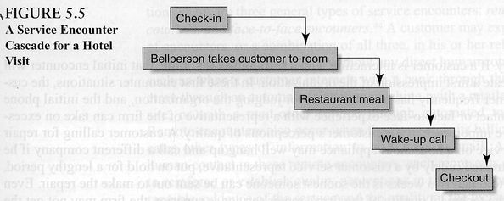
Figure 5.5

Slide 24

Types of Service Encounters
Remote encounters: Encounters without any direct human contact ex. ATM machines,etc.
Phone encounters: The most frequent type ex. Insurance companies, utilities, telecommunications.
Face-to-face: Occurs when employees and customers in direct contact. Ex. Disney theme parks, IBM business to business
Exhbit 5.2 pg. 126 and Technology Spotlight pg.127

Slide 25
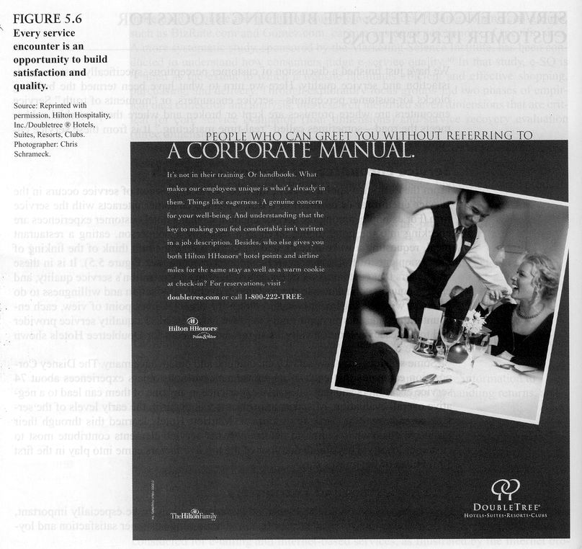
Figure 5.6

Slide 26
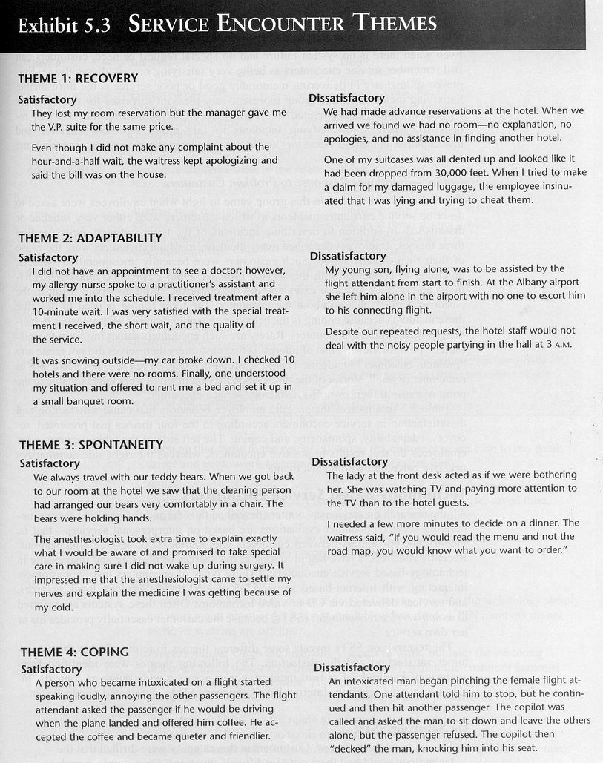

Slide 27
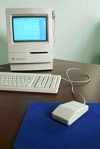
Technology-Bases Service Encounters
These types involve customers interacting with Internet-based services, automated phone services, kiosk services and services delivered via CD or video technology.
They are often referred to as self service technologies (SSTs) because the customer essentially provides his or her own service.

Slide 28

For Satisfying SSTs
Solved and intensified need: Cash machine that came to the rescue
Better than alternative: easy to use, save time (available when and where the customer needed it, saved money.
Did its job: SST works as it should

Slide 29
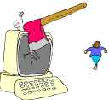
For Dissatisfying SSTs
Technology failure: SST may not work- PIN numbers do not work
Process Failure: later customer discovers that a back-office or follow up process which customer assume was connected does not work.
Poor design: Technical process (technology is confusing, menu options are unclear) or the actual service design (delivery takes too long, service is inflexible)
Customer-driven failures: customers own inability to use the technology properly

Slide 30
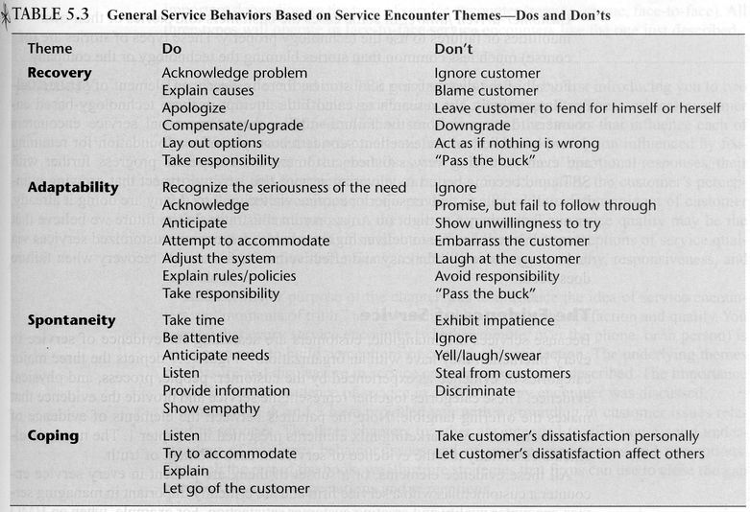
Table 5.3

Slide 31
Evidence of Service
Because services are intangible, customers are searching for evidence of service in every interaction they have with an organization.
The categories in fig.5.7 together represent the service and provide evidence that makes the offering tangible.
The new mix elements essentially are the evidence of service in each moment of truth.
Example: Doctors Office

Slide 32
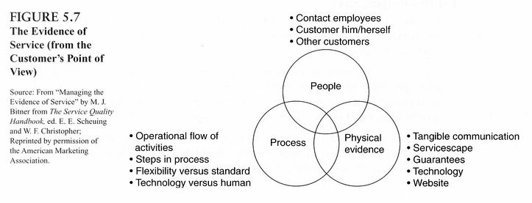
Figure 5.7

