Slide 1
The Greater Mekong Subregion Cooperation Programme
YOUR LOGO
FACULTY OF ECONOMICS, THAMMASAT UNIVERSITY MODULE 3: Building Connectivity, Competitiveness
and Community
Notes:
© Copyright Showeet.com – Creative & Free PowerPoint Templates

Slide 2
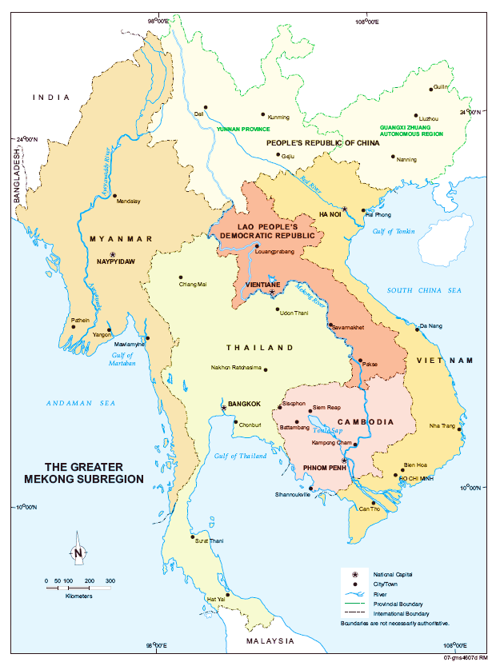
The GMS Programme
Established in 1992 to enhance economic relations and cooperation within the region
Comprises CLMV plus Thailand and PR China (Yunnan Province and Guangxi)
Identifies and implements high-priority subregional projects in nine priority sectors
Area of 2.6 million km²; population 340 million

Slide 3
GDP per Capita, 1984-2019
Economic reforms
GMS Programme
Period of economic growth

Slide 4

Key Challenges in 1992
Economic differences within GMS
CLMV had just started to open up to PR China and ASEAN
Inability to cope with emerging political, technological, climatic and health challenges
Global trends: energy, financial, food, pandemic and other crises
Poor physical and social infrastructure

Slide 5

Vision and Purpose
Vision: A region that is more prosperous, integrated, and harmonious
Purpose: Create an enabling policy environment and infrastructure:
  facilitate cross-border trade and economic cooperation
  develop human resources and skills
  ensure sustainable environment and social development

Slide 6
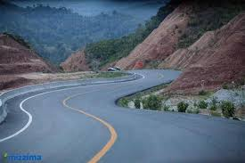
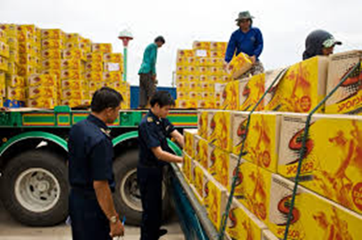
Development Strategy
• Increase connectivity: develop sustainable infrastructure and transformation transport corridors into economic corridors
• Improve competitiveness: facilitate cross-border movement of people and goods and integrate markets
• Build a greater sense of community through projects and programs that address shared social and environmental concerns

Slide 7
Translating Strategy into Actions
Connectivity
Multimodal transport (highways, toll roads, public transportation, MRTs)
Information technology
Policy and regulatory reforms
Competitiveness
Cross-border economic corridor development
Regional value chains/SMEs
Regional capital market development
Community
Regional health
Climate change and disaster preparedness
Cross-border energy trade
Natural resource management

Slide 8
Economic Corridor Development
What are economic corridors?
Integrated networks of “hard” and “soft” infrastructure within a geographic area, designed to accelerate economic development in countries and regions
These include, among others, factories, tourism, trade, environmental protection activities and other aspects of the economy and social development
Purpose: catalyze economic activities, develop special economic zones
Coordinate across multiple sectors; “hard” transport infrastructure would spur economic activity
Maximize the benefits of economic corridors through projects involving public and private sector investments

Slide 9
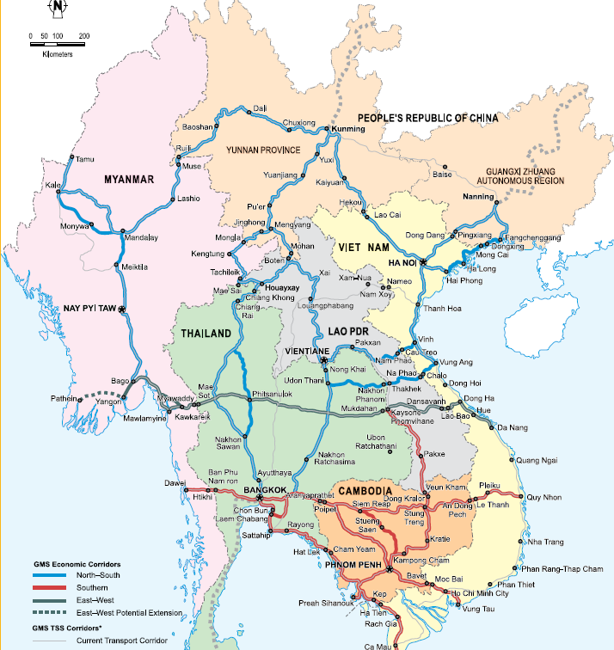
Economic Corridor Development
Since 1992, $20.4 billion invested in transport and energy infrastructure
Originally 3 economic corridors: North-South, East-West and Southern
Expanded to 9 corridors

Slide 10

Key areas of cooperation
Photo credit: padrinan via Pixabay (Creative Commons Zero license)
Notes:
© Copyright Showeet.com – Creative & Free PowerPoint Templates

Slide 11
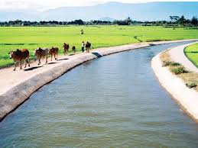

Agriculture
GMS is one of the world’s most important agricultural regions, main producer of rice, rubber and cassava; home to about 200 million farmers
Most farmers live on subsistence; there is a need to improve agricultural productivity
There is a need to produce safe food using climate-friendly agricultural practices and integrated into global markets
Implement the GMS Core Agriculture Support Program

Slide 12


Energy
The GMS has a wealth of energy resources, including coal, oil, and natural gas, in addition to water for hydropower.
There is a need to establish a competitive and integrated regional power market that will sustainably develop energy resources
Need to improve the subregion’s energy security and the people’s access to modern and affordable energy supplies

Slide 13


Environment
The GMS is one of the world’s most important biodiversity areas; however development has occurred at the expense of environmental resources
There is a need to improve environmental management capacity and policies, access financing, and address transboundary environmental challenges
Priorities for environmental collaboration include disaster risk management, green technologies, and sustainable infrastructure.

Slide 14


Human Development
Impressive progress in human development
Education is improving; primary education is almost universal
Health is improving; decreased infant mortality and rising life expectancy
Need to promote cooperation in health, education, labor and migration, and social development
Need to provide training on technical and vocational training and managing communicable diseases

Slide 15


Information Technology
More and more people have access to phones and the internet, enabling people to connect and collaborate
There is a need to improve telecommunications linkages, promote information and invest in communications technology to improve productivity and efficiency
Facilitate increased access to information and communications to lower transaction costs and build knowledge based economies

Slide 16


Tourism
More than 60 million visit GMS per year; tourism employs 10 million people
Minimize adverse impacts of tourism
Invest in infrastructure that supports tourism
Capacity building and training and community-based tourism development
Promote GMS as a single destination, offering a diversity of good quality and high-yielding products

Slide 17
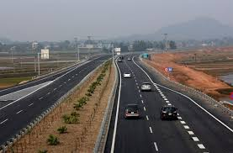
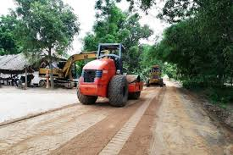
Transport
New road construction and upgrading has greatly improved connectivity in GMS
Transport promotes trade, tourism, investment, and access to social and other services
Transport corridors link urban centers, agricultural production, markets and tourist destinations
Current priorities: construction of integrated railway networks and building environmentally friendly, climate-resilient, safe, andsustainable transport systems

Slide 18

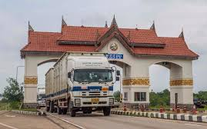
Trade Facilitation
Nonphysical or “software” to enhance connectivity and linkages within GMS
Enable efficient cross-border movement of goods, vehicles, and people; and investments
GMS Cross-Border Transport Facilitation Agreement signed by GMS countries:
1999: Lao PDR, Thailand, Viet Nam)
2001: Cambodia
2002: PR China
2003: Myanmar

Slide 19
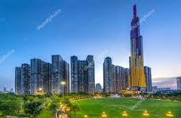
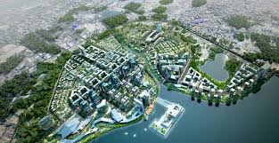
Urban Development
Cities are undergoing rapid urbanization and becoming hubs of economic activity
This increases demand for urban infrastructure and services
Need to invest in priority urban infrastructure and services in small and medium-sized cities
Assist in preparing strategies for sustainable, competitive and livable cities

Slide 20
Achievements so far (1992-2021)
5.4%
GDP growth (2021)
3
Economic corridors
200+
Projects in the pipeline
12,500km
Roads constructed and rehabilitated; 1,000km railways
2,700km
Power transmission/ distribution lines constructed
$641 billion
Annual trade in GMS
($2 billion in 1992)

Slide 21
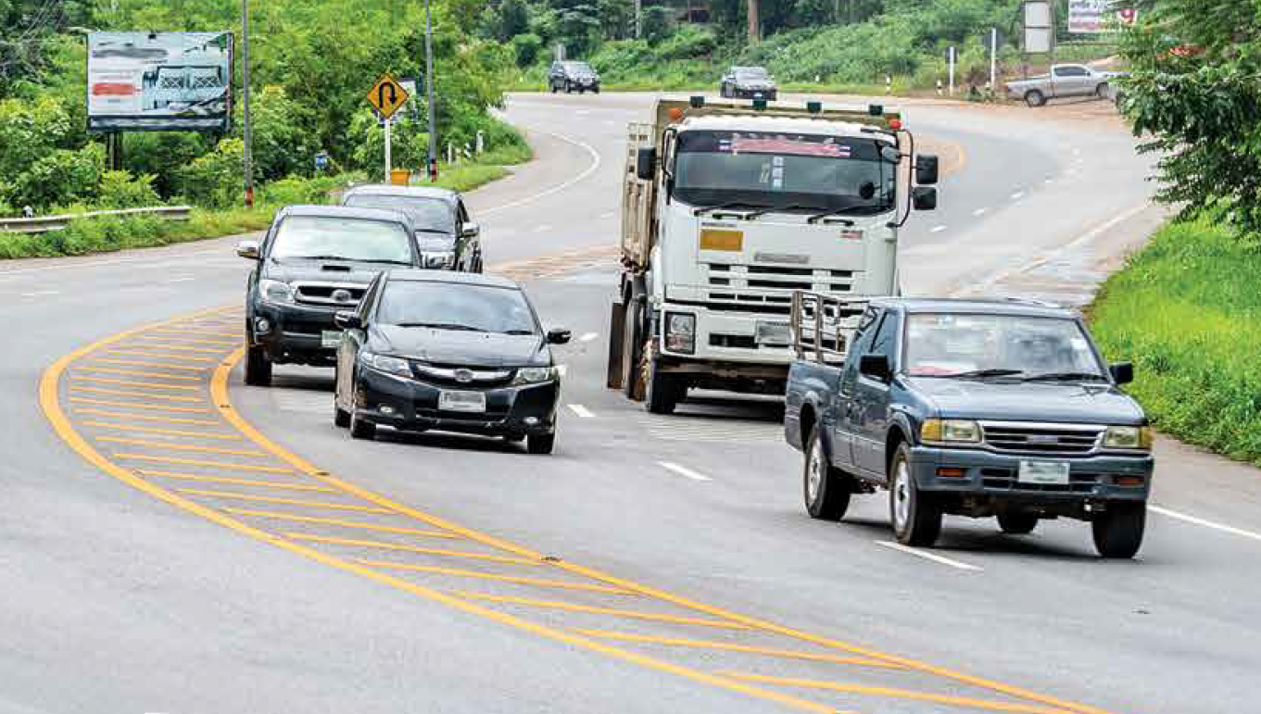
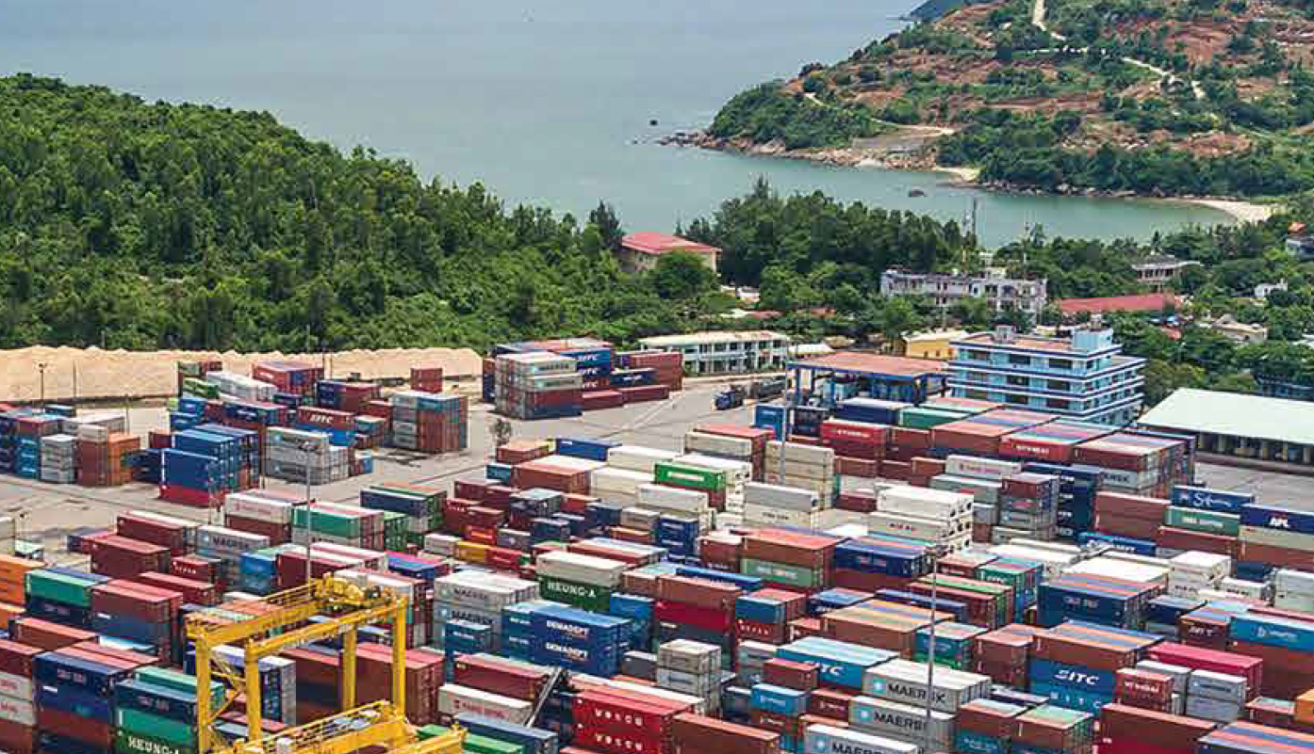
The present and future
More integration into the global economy; however benefits are not equal
CLM relies on intra-region trade within GMS and rely on primary commodity exports
Vietnam exports are mostly processed goods and moving to higher value goods; are more global in nature

Slide 22
Opportunities
Growth spillovers from neighboring countries: Increased demand from, richer, neighboring countries provide opportunities for cooperation and trade
CLM will need to diversify their economies and move towards higher value goods
Vietnam will need to continue its economic momentum; environmental sustainability and human resource development is key

Slide 23
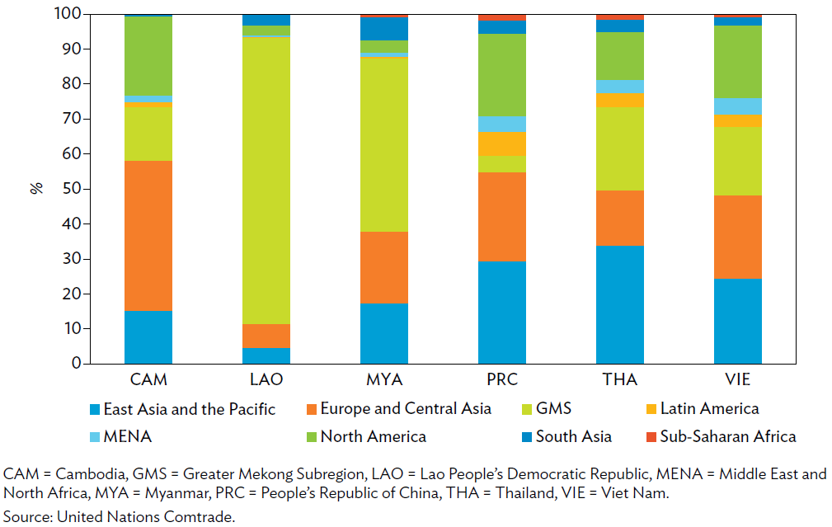
GMS exports by region of destination
A large percentage of Cambodia’s exports go to Europe and Central Asia (mainly garments)
Most of Laos’ and Myanmar’s exports are within GMS (mostly primary commodities)
Vietnam’s exports are relatively balanced (its structure is similar to Thailand’s)

Slide 24
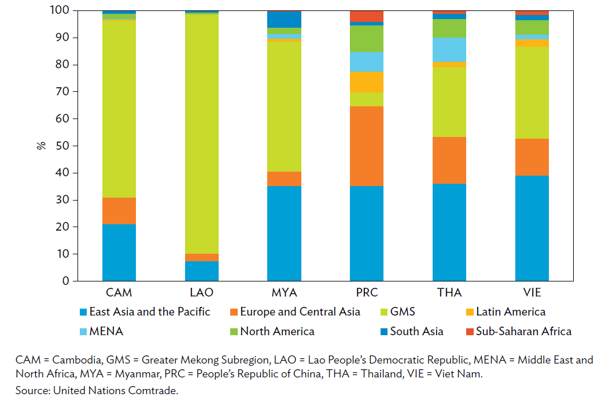
GMS imports by region of origin
Most of Cambodia, Laos and Myanmar’s imports are from within GMS
Vietnam, Thailand and PR China’s source of imports are more balanced (from Europe, East Asia and within GMS)

Slide 25
Conclusion
GMS Program has achieved success in fostering regional cooperation. At the inception of the program, the region was just emerging from a period of prolonged regional conflict.
The GMS Program is flexible yet results-oriented, delivering projects to promote regional cooperation and thereby contributing to growth and poverty reduction as well as addressing regional public goods

Slide 26
Conclusion
As of December 2021, the GMS Program had implemented and planned for 200 investment programs and projects totaling $641 billion
Projects include subregional roads, airport and railway improvements, agricultural production, electricity generation and transmission, cross-border trade facilitation, tourism infrastructure development, vocational and educational training and communicable disease control.

Slide 27
Thank You !
Merry Christmas!
Notes:
© Copyright Showeet.com – Creative & Free PowerPoint Templates

