Slide 1
Chapter 15
Risk and Information

Slide 2
Chapter Fifteen Overview
Introduction: Amazon.com
Describing Risky Outcome – Basic Tools
  Lotteries and Probabilities
  Expected Values
  Variance
Evaluating Risky Outcomes
  Risk Preferences and the Utility Function
Avoiding and Bearing Risk
  The Demand for Insurance and the Risk Premium
  Asymmetric Information and Insurance
  The Value of Information and Decision Trees

Slide 3
Tools for Describing Risky Outcomes
Definition: A lottery is any event with an uncertain outcome.
Examples: Investment, Roulette, Football Game.
Definition: A probability of an outcome (of a lottery) is the likelihood that this outcome occurs.
Example: The probability often is estimated by the historical frequency of the outcome.

Slide 4
Probability Distribution
Definition: The probability distribution of the lottery depicts all possible payoffs in the lottery and their associated probabilities.
Property:
    The probability of any particular outcome is between 0 and 1
    The sum of the probabilities of all possible outcomes equals 1.
Definition: Probabilities that reflect subjective beliefs about risky events are called subjective probabilities.

Slide 5
Probability Distribution
Probability
1
.90
.80
.70
.60
.50
.40
.30
.20
.10
0
67% chance of losing
33% chance of winning
Payoff
$25 $100

Slide 6
Expected Value and Expected Utility
Definition: The expected value of a lottery is a measure of the average payoff that the lottery will generate.
Let X be a lottery with three possible outcomes A, B, and C.
E[X] = Pr(A)∙A + Pr(B)∙B + Pr(C)∙C
Definition: The expected utility of a lottery is the average value of the utility levels that the lottery will generate.
E[U(X)] = Pr(A)∙U(A) + Pr(B)∙U(B) + Pr(C)∙U(C)

Slide 7
Expected Value
In our example lottery, which pays $25 with probability .67 and $100 with probability 0.33, the expected value is:
EV = .67 x $25 + .33 x 100 = $50.
Notice that the expected value need not be one of the outcomes of the lottery.

Slide 8
Variance & Standard Deviation
Definition: The variance of a lottery is the sum of the probability-weighted squared deviations between the possible outcomes of the lottery and the expected value of the lottery. It is a measure of the lottery's riskiness.
Var = (A - EV)²(Pr(A)) + (B - EV)²(Pr(B)) + (C - EV)²(Pr(C))
Definition: The standard deviation of a lottery is the square root of the variance. It is an alternative measure of risk

Slide 9
Variance & Standard Deviation
For the example lottery
The squared deviation of winning is:
($100 - $50)² = 50² = 2500
The squared deviation of losing is:
($25 - $50)² = 25² = 625
The variance is:
(2500 x .33)+ (625 x .67) = 1250

Slide 10
Evaluating Risky Outcomes
Example: Work for IBM or Amazon.com?
Suppose that individuals facing risky alternatives attempt to maximize expected utility, i.e., the probability-weighted average of the utility from each possible outcome they face.
U(IBM) = U($54,000) = 230
U(Amazon) =
.5xU($4,000) + .5xU($104,000) = .5(60) + .5(320) = 190
Note:
EV(Amazon) = .5($4000)+.5($104,000) = $54,000

Slide 11
Evaluating Risky Outcomes
Utility
Utility function
U(104) = 320
U(54) = 230
.5u(4) + .5U(104)
= 190
U(4) = 60
0
4
54
104
Income (000 $ per year)

Slide 12
Risk Preferences
Notes:
Utility as a function of yearly income only
Diminishing marginal utility of income
Definition: The risk preferences can be classified as follows:
An individual who prefers a sure thing to a lottery with the same expected value is risk averse
An individual who is indifferent about a sure thing or a lottery with the same expected value is risk neutral
An individual who prefers a lottery to a sure thing that equals the expected value of the lottery is risk loving (or risk preferring)

Slide 13
Risk Preferences
Definition: The risk preferences can be classified as follows:
An individual who prefers a sure thing to a lottery with the same expected value is risk-averse.
An individual who is indifferent about a sure thing or a lottery with the same expected value is risk-neutral.
An individual who prefers a lottery to a sure thing that equals the expected value of the lottery is risk-loving.

Slide 14
Risk Preferences
Let X be a lottery.
U(E[X]) denotes Utility of the EV (sure thing) of the lottery X.
E[U(X)] denotes Expected Utility of the lottery X.
risk-averse: U(E[X]) > E[U(X)]
happiness from sure thing > expected happiness from lottery
risk-neutral: U(E[X]) = E[U(X)]
happiness from sure thing = expected happiness from lottery
risk-loving: U(E[X]) < E[U(X)]
happiness from sure thing < expected happiness from lottery

Slide 15
Utility Function – Risk Averse Decision Maker
Utility
Utility function
ΔU₂
ΔU₁
ΔI
Income
0
ΔI

Slide 16
Utility Function – Risk Averse Decision Maker
Utility
Utility function
U(100)
U(50)
•
A
U(25)
0
$100
Income
$25
$50

Slide 17
Risk-Neutral Individuals
risk-neutral: U(E[X]) = E[U(X)]
happiness from sure thing = expected happiness from lottery
Utility
0
Income

Slide 18
Risk-Loving Individuals
risk-loving: U(E[X]) < E[U(X)]
happiness from sure thing < expected happiness from lottery
Utility
0
Income

Slide 19
Risk Preferences
Examples
Suppose that an individual must decide between buying one of two stocks: the stock of an Internet firm and the stock of a Public Utility. The values that the shares of the stock may take (and, hence, the income from the stock, I) and the associated probability of the stock taking each value are:
Internet firm Public Utility
I Probability I Probability
$80 .3 $80 .1
$100 .4 $100 .8
$120 .3 $120 .1

Slide 20
Risk Preferences
Examples
Which stock should the individual buy if she has utility function U = (100I)1/2? Which stock should she buy if she has utility function U = I?
EU(Internet) = .3U(80) + .4U(100) + .3U(120)
EU(P.U.) = .1U(80) + .8U(100) + .1U(120)
a. U = (100I)1/2:
U(80) = (8000)1/2 = 89.40
U(100) = (10000)1/2 = 100
U(120) = (12000)1/2 = 109.5

Slide 21
Risk Preferences
Examples
→ EU(Internet) = .3(89.40)+.4(100)+.3(109.50) = 99.70
→ EU(P.U.) =
.1(89.40) + .8(100) + .1(109.50) = 99.9
The individual should purchase the public utility stock

Slide 22
Risk Preferences
Examples
U = I:
→ EU(Internet) = .3(80)+.4(100)+.3(120)=100
→ EU(P.U.)
.1(80) + .8(100) + .3(120) = 100
This individual is indifferent between the two stocks.

Slide 25
Risk Premium
Definition: The risk premium of a lottery is the necessary difference between the expected value of a lottery and the sure thing so that the decision maker is indifferent between the lottery and the sure thing.
pU(I₁) + (1-p)U(I₂) = U(pI₁ + (1-p)I₂ - RP)
The larger the variance of the lottery, the larger the risk premium

Slide 26
Avoiding Risk - Insurance
Utility
Risk premium = horizontal distance $17000
Utility function
U(104) = 320
U(54) = 230
E
•
•
17000
.5u(4) + .5U(104)
= 190
D
U(4) = 60
0
4
37
54
104
Income (000 $ per year)

Slide 27
Computing Risk Premium
Example: Computing a Risk Premium
U = I(1/2); p = .5
I₁ = $104,000
I₂ = $4,000

Slide 28
Computing Risk Premium
pU(I₁) + (1-p)U(I₂) = U(pI₁ + (1-p)I₂ - RP)
Verify that the risk premium for this lottery is approximately $17,000
.5(104,000)1/2 + .5(4,000)1/2 = (.5(104,000) + .5(4,000) - RP)1/2
$192.87 = ($54,000 - RP)1/2
$37,198 = $54,000 - RP
RP = $16,802

Slide 29
Computing Risk Premium
Let I₁ = $108,000 and I₂ = $0. What is the risk premium now?
.5(108,000)1/2 + 0 = (.5(108,000) + 0 - RP)1/2
.5(108,000)1/2 = (54,000 - RP)1/2
RP = $27,000
(Risk premium rises when variance rises, EV the same…)

Slide 30
The Demand for Insurance
Lottery (If you do not buy the insurance)
$50,000 if no accident (p = .95)
$40,000 if accident (1-p = .05)
(i.e. "Endowment" is that income in the good state is 50,000 and income in the bad state is 40,000)
EV = .95($50000)+.05($40000) = $49,500

Slide 31
The Demand for Insurance
    Insurance:
Coverage = $10,000
Price = $500
$49,500 sure thing.
    Why?
In a good state, receive 50000-500 = 49500
In a bad state, receive 50000-500-10000+10000=49500

Slide 32
The Demand for Insurance
If you are risk averse, you prefer to insure this way over no insurance. Why?
Full coverage (⬄ no risk so prefer all else equal)
Definition: A fairly priced insurance policy is one in which the insurance premium (price) equals the expected value of the promised payment. i.e.,
500 = .05(10,000) + .95(0)

Slide 34
The Supply of Insurance
Insurance company expects to break even and assumes all risk – why would an insurance company ever offer this policy?
Definition: Asymmetric Information is a situation in which one party knows more about its own actions or characteristics than another party.

Slide 35
Adverse Selection & Moral Hazard
Definition: Adverse Selection is opportunism characterized by an informed person's benefiting from trading or otherwise contracting with a less informed person who does not know about an unobserved characteristic of the informed person.
Definition: Moral Hazard is opportunism characterized by an informed person's taking advantage of a less informed person through an unobserved action.

Slide 36
Adverse Selection & Moral Hazard
Adverse Selection / Hidden Information:
Good and Bad cars in second-hand garages.
Healthy and Unhealthy people in health insurance markets.
Moral Hazard / Hidden Action:
People drive carelessly after buying car insurances.
Employers fails to observe lazing employees.
Doctors over-prescribe treatments for patients with health insurances.

Slide 37
Decision Trees
Definition: A decision tree is a diagram that describes the options available to a decision maker, as well as the risky events that can occur at each point in time.
Key Elements
1. Decision Nodes
2. Chance Nodes
3. Probabilities
4. Payoffs
We analyze decision problems by working backward along the decision tree to decide what the optimal decision would Be.

Slide 38
Decision Trees
An oil company is considering whether it should build a large facility (good if the oil reservoir is large) or a small facility (good if the oil reservoir is small).
Pr(Small Reservoir) = 0.5 and Pr(Large Reservoir) = 0.5.
However, it can implement “free seismic test” before building a facility to determine if the reservoir is large or small.

Slide 39
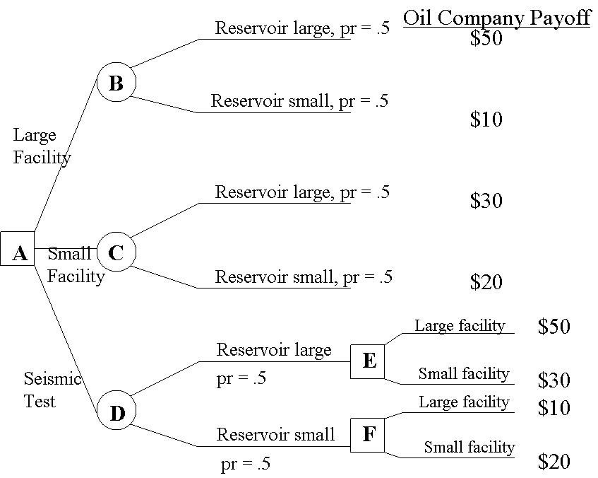
Decision Trees
EV = 30
EV = 25

Slide 40
Decision Trees

Slide 41
Decision Trees
Steps in constructing and analyzing the tree:
1. Map out the decision and event sequence
2. Identify the alternatives available for each decision
3. Identify the possible outcomes for each risky event
4. Assign probabilities to the events
5. Identify payoffs to all the decision/event combinations
6. Find the optimal sequence of decisions

Slide 42
Perfect Information
Definition: The value of perfect information is the increase in the decision maker's expected payoff when the decision maker can -- at no cost -- obtain information that reveals the outcome of the risky event.

Slide 43
Perfect Information
Example:
Expected payoff to conducting test: $35M
Expected payoff to not conducting test: $30M
The value of information: $5M
The value of information reflects the value of being able to tailor your decisions to the conditions that will actually prevail in the future. It should represent the agent's willingness to pay for a "crystal ball".

Slide 44
Summary
1. We can think of risky decisions as lotteries.
2. We can think of individuals maximizing expected utility when faced with risk.
3. Individuals differ in their attitudes towards risk: those who prefer a sure thing are risk averse. Those who are indifferent about risk are risk neutral. Those who prefer risk are risk loving.
4. Insurance can help to avoid risk. The optimal amount to insure depends on risk attitudes.

Slide 45
Summary
5. The provision of insurance by individuals does not require risk lovers.
6. Adverse Selection and Moral Hazard can cause inefficiency in insurance markets.
7. We can calculate the value of obtaining information in order to reduce risk by analyzing the expected payoff to eliminating risk from a decision tree and comparing this to the expected payoff of maintaining risk.
8. The main types of auctions are private values auctions and common values auctions.

