Slide 1
Transportation and physical connectivity
EE361/363 economic development in clmv
Faculty of economics
Thammasat university

Slide 2

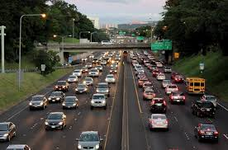
transportation
Transportation: a means by which people and goods move from one location to another by:
Air
Land
Waterways

Slide 3
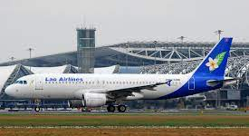
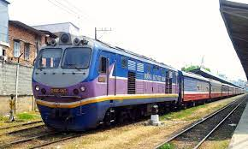
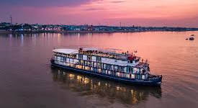
Transportation system
A transportation system comprises:
Physical infrastructure: roads, bridges, railways, waterways,
Vehicles: cars, trains, buses,
Operations: regulations, standard procedures
Supporting facilities: bus stations, airports, seaports, warehouses, trucking terminals, fuel stations logistics centers and maintenance facilities

Slide 4
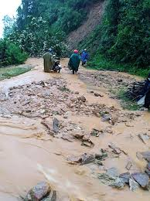
Issues in transportation
Lack of connectivity among and within CLMV countries: poor quality of road, railway and water transportation networks
Poor condition of physical transportation infrastructure:
  poor quality of roads and incomplete road networks
  missing railway links
  inadequate maritime and port infrastructure

Slide 5
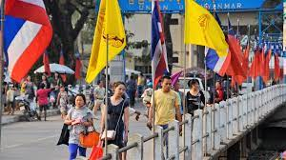
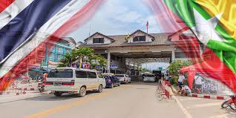
Issues in transportation
Increased traffic and traffic jams in large cities increases travel time and fuel costs
Lack of awareness towards public safety when operating vehicles; 74% of road traffic accidents in the world take place in low income countries
Lack of coordination on how to better facilitate transportation of goods and people

Slide 6
Issues in transportation
Difficulties in cross-border traffic and movements due to institutional and political challenges such as non-tariff barriers, lack of harmonized standards
With the opening of isolated and border areas, there is increased risk of human trafficking and prostitution

Slide 7
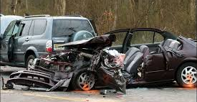
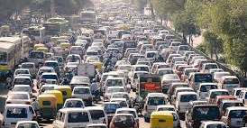
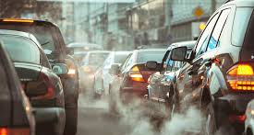
Traffic issues
Seventy-four percent of road traffic accidents in the world take place in low income countries. In particular, the number of accidents in Southeast Asian countries has been rapidly increasing
Traffic congestion may cause adverse human behavior such as frustration and road rage
Road transport contributes to air pollution through carbon monoxide and other harmful chemicals that produce greenhouse gas and pollute the atmosphere

Slide 8
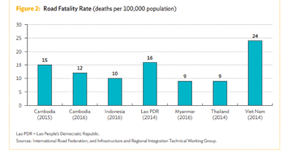
Road fatalities in selected countries

Slide 9
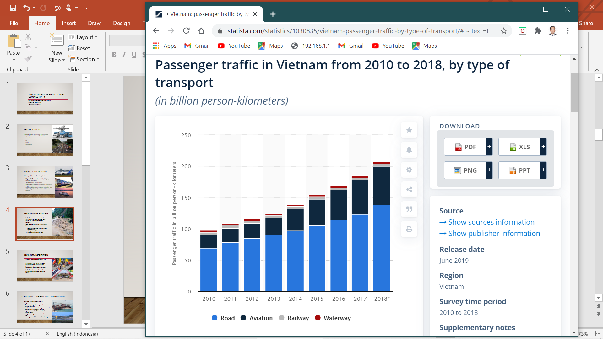
Transportation in CLMV
Viet Nam
Passenger traffic in Vietnam has grown significantly. In 2010, the number of passengers (all modes of transport) as $100 million. In 2018 the figure increased to $210 billion.
Most common mode of transportation: motorbikes, cars, bus, train and airplanes

Slide 10
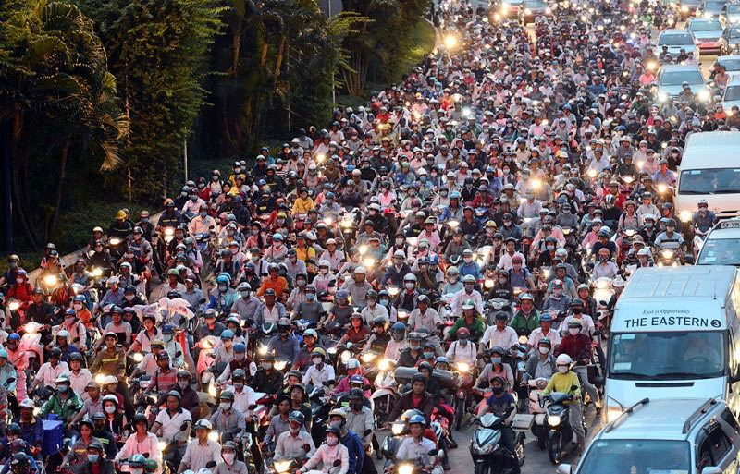
Transportation in CLMV
By the end of 2016, Vietnam had 52 million motorbikes, an increase of 4 million compared to 1995. The motorbike ownership rate is 565 per 1,000 people, and 2.4 per household.
There is a need to focus on dealing with lack of emission standards, developing awareness of traffic safety traffic laws

Slide 11
Transportation in CLMV
Myanmar
Transport service markets are experiencing destabilizing changes after decades of isolation. Previously transport markets highly controlled whereby government subsidized state-owned transport companies, which charged users rates below their costs.
Car and truck ownership doubled from 2012 to 2015, a sign of quick economic growth. A competitive private transport market has appeared.
According to hospital data, 31%–36% of injured people admitted to Myanmar’s hospitals were injured in crashes.

Slide 12
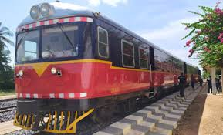
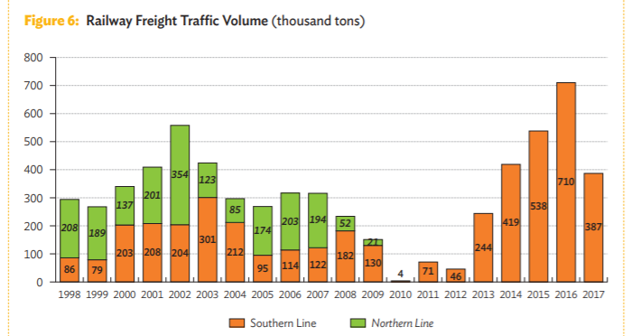
Transportation in CLMV
Cambodia
Cambodia has two railway lines with a total length of 652 km: the Southern Line built in the 1960s and the Northern Line, built in the 1930s. The system deterioriated during the war and period of social conflict.
Rehabilitation of the railway system is improving movements of goods and people.

Slide 13
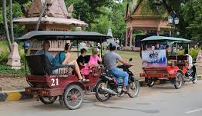
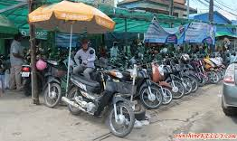
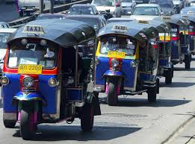
Informal Transportation
Motos, bajajs and tuk-tuks are important forms of informal transportation for day-to-day movement of people and goods in many GMS countries, particularly for short trips
These complement the formal modes of urban transportation such as buses, rail, and taxis

Slide 14
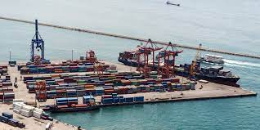
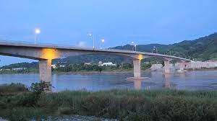
Regional cooperation in transportation
Benefits of regional cooperation in transportation:
develops synergies in transportation and enhance its impacts: upgrade existing infrastructure and construct new ones
enables movement toward an open market and open borders for transport services
improves economic efficiency and reduces transport costs
completes transport networks and improves links
harmonize regulatory framework
encourages use of different modes of transport

Slide 15
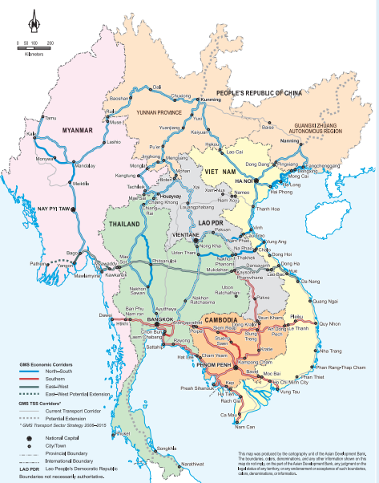
GMS Economic corridors
In 1998, the GMS Program identified several priority areas for development:
East–West Economic Corridor
North–South Economic Corridor
Southern Economic Corridor

Slide 16
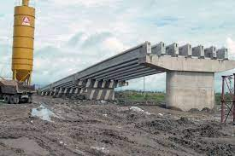
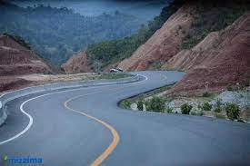
Some achievements
Improvement in physical connectivity in the GMS countries, with the road transport projects in the East-West, North-South and Southern economic corridors
Completion of priority transport investment projects by governments and international financing institutions
  in border areas
  along economic corridors
  in strategic towns and cities

Slide 17
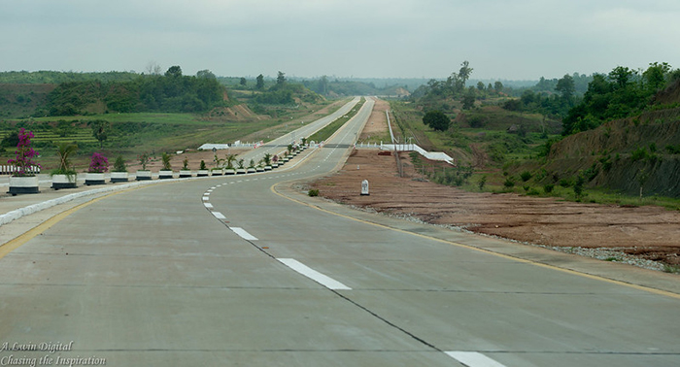
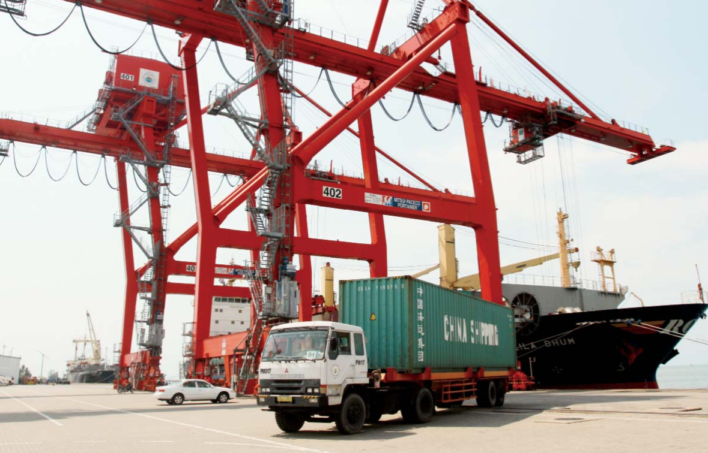
Some achievements
Opening up of Myanmar, including $484 million ADB loan for the expressway project connecting Bago and Kyaikto
Initiation of the Belt and Road Initiative and associated fund commitments for infrastructure by PR China
Growing number of regional cooperation and integration initiatives in Asia

Slide 18
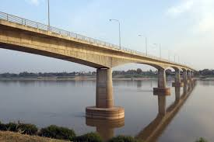
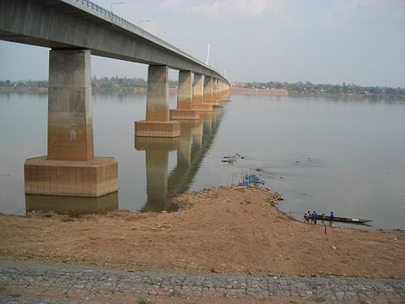
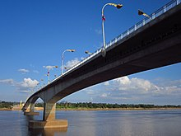
Some achievements
Lao-Thai friendship bridges
  1st Lao-Thai friendship bridge: Vientiane and Nong Khai
  2nd Lao-Thai friendship bridge: Savannakhet and Mukdahan
  3rd Lao-Thai friendship bridge: Thakhek with Nakhon Phanom
  4 Lao-Thai friendship bridge: Houayxay and Chiang Khong
  5th Lao-Thai friendship bridge: Bolikhamxay and Bueng Khan

Slide 19
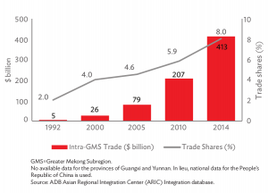
Some Achievements
Increased intra-regional trade; volume of trade has increased from roughly $5 billion in 1992 to $413 billion in 2014
Trade shares have increased from $2 billion in 1992 to $8 billion in 2014

Slide 20
Lessons learned
Development of transport infrastructure reduces cost, travel time of travel, and savings in vehicle operating costs
Improved transportation can create negative externalities, such as accidents, environmental pollution and human trafficking
With increased construction of transport infrastructure, more emphasis will need to be made on operation and maintenance, more specifically road maintenance
Regional cooperation in the transportation can lead to mutual benefits among participating countries

Slide 21
Lessons learned
Policy and regulatory reforms are needed to facilitate cross-border transport and trade. Reforms, however are more difficult to implement than infrastructure projects, and require patience, persistence, and intensive policy dialogue
The distribution of costs and benefits is important. Due to the small population, level of development, and location of Cambodia and Lao PDR between GMS countries with much larger markets, towns along the economic corridors could become mainly a transit point for trade among their neighboring countries.

