Slide 1

INTEGRATED BRAND COMMUNICATION
Massimiliano La Franca
Lesson 4
YAWP

Slide 2
COMMUNICATION PROCESS

Slide 3
A bit of recap
IMC part of mktg mix
IMC influences behaviours
Behaviours are results of decision process
Need to know decision process P2P
Influence key stages through IMC
Communication and response to it
TODAY
P2P lets me understand how people take decisions, what is crucial to know, when, from who.
Advertising tells things that will influence people’s behaviours. I need to understand how it works and how people respond to it.

Slide 4
today
We talk about advertising starting from general communication models.
Once analysed how communication models work, we will focus on one of the most relevant elements: the response to it.
The response models look what happens after we are exposed to a specific message, from the awareness of it, up to a specific behaviour (ex. from knowing that a new product is available to the point we decide to buy it).

Slide 5

Communication model
Receiver’s field of experience
Response
or
Feedback
Decoding
Sender’s field of experience
Message
Encoding
Noise

Slide 6
Communication model
A source (a person or an organization)
encoding information
in the form of a message (visual, symbols, words, sounds)
through a channel (TV, print, billboard, word of mouth, radio, internet…)
a receiver decoding it and sending feedback (response)

Slide 7

Encoding and decoding battles

Slide 8

Let’s look at it from Advertising pov
Message
Source
Channel (print )

Slide 9
So what?

Slide 10
When sender and receiver don’t speak the same language…
https://www.youtube.com/watch?v=m1TnzCiUSI0

Slide 11
That’s why is so important to know about
1. the receiver (the target)
2. how does it decodes information
3.HOW it responds to it (response process)

Slide 12
We will talk about the target in the session about “brief”.
For now, let’s start understanding the response process

Slide 13
The response process
The process which moves people to behave in a specific way as response to a stimulus (ex. advertising). In other words: what happens in our heads when we receive adv? How do we decide to behave in a specific way? And why?
One of the most debated topics since ADV was created
In real life response is quite immediate but this is not the case for ADV
Number of different models in literature, will go through them and focus on “Hierarchy of effects”
All of them can be related to 3 major steps:
  Cognitive (Learn): getting to know, understanding
  Affective (Feel) : attitudes forming, like-dislike, preferences, conviction
  Behavioral (Do): leading to a specific behavior
Note: they are a simplification of reality, not the reality themselves

Slide 14
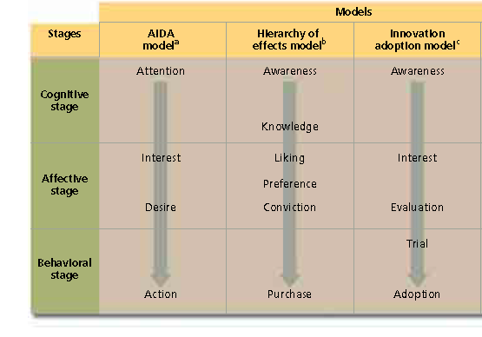
The response models
LEARN
FEEL
DO

Slide 15
The practical usage of the Hierarchy of needs model:
Millward Brown Brand Equity for Unilever

Slide 16

Definition of BHC Pyramid
Conviction
Do they buy your brand? Are they loyal?
Advantage
Is the brand better than competition?
Acceptable
Performance
Does your brand satisfy their needs?
Relevance
Is it relevant for them?
Presence
Do people know your brand?
Notes:
4

Slide 17
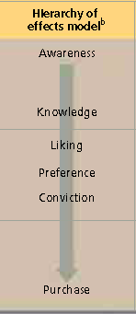
Conviction
Advantage
Acceptable
Performance
Relevance
Presence
Notes:
4

Slide 18
New models
Traditional models have been criticized for a sequential step-approach and because don’t consider different natures of products
New models have been theorized considering 2 dimensions: involvement and differentiation
Involvement in buying a product (high/low)
  how much the decision impacts our life?
  How much effort will we put in understanding the different options?
  How long will be the decision process?
  What phases of the path to purchase are going to be most/least important?
Degree of differentiation
  Can you clearly identify what are product characteristics and key discriminators?
  Are products/brands all similar?

Slide 19
3 new models
Involvement in buying a product
Degree of differentiation

Slide 20
New models
Standard learning
Dissonance learning
Low involvement
Learn
Do
Learn
Feel
Feel
Do
Do
Learn
Feel

Slide 21
High involvement – High Differentiation
Typical for high involvement products where people want to invest time and effort in understanding before making a choice (cars, electronics, house)
Consumer is an active participant in the process
High differentiation amongst brands
Knowledge and understanding lead
EXECUTION: Details and information, long bodycopies
Standard learning
Learn
Feel
Do

Slide 22
High Involvement – low differentiation
Typical for high involvement products but low differentiation amongst brands. Difficult to choose as everything looks pretty the same
Take decision first and feel after, if dissonance they will invest time in learning more
EXECUTION: Importance of post purchase and reassurance that it is the right choice
Dissonance learning
Do
Feel
Learn

Slide 23
Low involvement
Typical for low involvement products
No time and effort in understanding before making a choice (toothpaste)
From TV studies - Mass media have power of influencing needstates and this seems enough to cause purchase. Once purchase happens we form an opinion
EXECUTION: Repetition of simple messages, usually low involvement media (ex. TV)
Low involvement
Learn
Do
Feel

Slide 24
Response models: implications
Why is this important for us? What are the implications? 3 major points to remember:
  Models help planners understanding where is the crucial problem and what stage that they want to influence with their activities
    Example: is there a problem with this new product because people don’t understand how it works (knowledge) or because they don’t know that the product exist (awareness). Implication: 2 different message/activities to solve the 2 above problems
  Force marketer to think ahead what response they want from their activities. This clarifies the brief for agencies
  Given the type of the category marketers work on, different type of messages, executions and channels will be relevant (ex. high involvement vs. low involvement products)

Slide 25

Decision process & response model
Two similar tools with similar purpose but refer to different things, don’t confuse them.
The decision process helps us understanding how people decide in different situations, focus what to say, in what stage in order to influence a specific behaviour.
It is usually analysed at category level.
The response model helps understand what do people know and feel about a specific brand. It is done at category and brand levels and helps understanding what I have and can do with advertising in order to influence that specific behaviour.
purchase a specific brand
Defines the MKTG objectives
Defines the communication objectives

Slide 26
EXERCISE TOGETHER: WHAT IS THE PROBLEM BRAND A VS. BRAND B?
Conviction
Advantage
Performance
Relevance
Presence
Conviction
Advantage
Performance
Relevance
Presence
BRAND A
BRAND A
BRAND B

