Slide 1

Marketing Mix (Fit)

Slide 2
PRODUCT
IMAGE/
POSITIONING
RISK
CHOICES
BRANDING
DIFFEREN-
TIATION
PRODUCT
DECISIONS
BRAND
EXTENSIONS
IDEAS
AND
EVALUATIONS
TEST
MARKETING
COMPETITIVE
RESPONSE
DISTRIBUTION
PRODUCT
LINES

Slide 3
price
Optimal quality
price
p₂
p₁
0
q₁
q₂
quantity
D₁(s₁)
D₂(s₂)
Stuck in the middle?
quantity
0
q₀
q₁
q₂
Target customer

Slide 4
Consumer Surplus
Consumer surplus
Price
Price
Consumer surplus
Demand
MC
P_{A}
MC
P_{B}*
D
Product A
Product B
Notes:
79

Slide 5
Firm’s Value Creation and Profit
Cost
Total Value – Price –Consumer Cost = Consumer Surplus
Prices or tariffs;
User costs; Transaction costs; Search costs; Psychic costs
Profit
Profit
Firm
Value
Price
Buyers
Suppliers
Cost of Production
Value of Product/Service

Slide 6
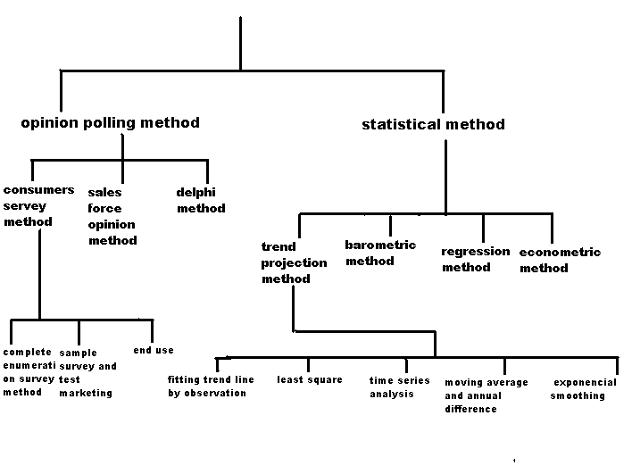
Methods Of Demand Forecasting

Slide 7
PRICE: Value, Cost, and Price ➔Profit
Minimum
willingness to sell
Maximum
willingness to pay
A
B
Scope of Price
Value creation

Slide 8
Some Approaches to Pricing
Cost-plus: Add fixed percentage markup ⬅ Competitive market
Buyer-based ⬅ Service
  perceived value
  going-rate (competition)
---> Balancing cost and market considerations
Penetration pricing: low intro price ---> volume
Skimming: high intro price ---> take advantage of price insensitive consumers
Seasonal / Peak-load pricing
Notes:
8

Slide 9
Service: Two-Part Tariff with Two Consumers
$/Q
The price, P*, will be
greater than MC. Set T*
at the surplus value of D_{2.}
T*
Entrant fee
A
Scope of business
P*
MC
B
C
D₁ = consumer 1
D₂ = consumer 2
Q₂
Q₁
Quantity
Notes:
83

Slide 10
PLACE: Approaches to Distribution
These strategies require tradeoffs:➔Cost
  Wide--essential to low involvement goods
  Selective--desire to maintain image
  Exclusive--very high prestige needed or very high service requirements
Direct-to-Customer Sales
  High need for customization—especially if the work can be done by the customer
  Rapid decline in the value of inventory
  High value/bulk ratio
  Low need for customer to manually inspect the product
  Highly specialized product requiring a very large assortment of inventory
Notes:
10

Slide 11
PROMOTION⬅ profit margin
Advertising Options
  Local Press
  General Press
  Brochures
  Catalogues/Letterbox drops
  Direct Mail
  Trade Journals
  Magazines
  Directories
  Yellow Pages Directory
  Radio
  Television
  Cinema
  Telephone
  Outdoor Advertising
  Billboards
  Business Cards
  Internet
Personal selling
Public relations
Direct marketing
Sales Promotion
  Sales
  Coupons
  Rebates
  Premiums

Slide 12
Advertising➔ discount
A Rule of Thumb for Advertising
The proportion of sales revenue that a profit-maximizing monopolist spends on advertising is thus determined by a simple elasticity ratio.
The advertising intensity must equal the ratio of elasticities of demand with respect to advertising and price
The demand function is more price inelastic (i.e., when εP is smaller), a monopolist chooses a high advertising intensity and a large markup.
Notes:
139

Slide 13
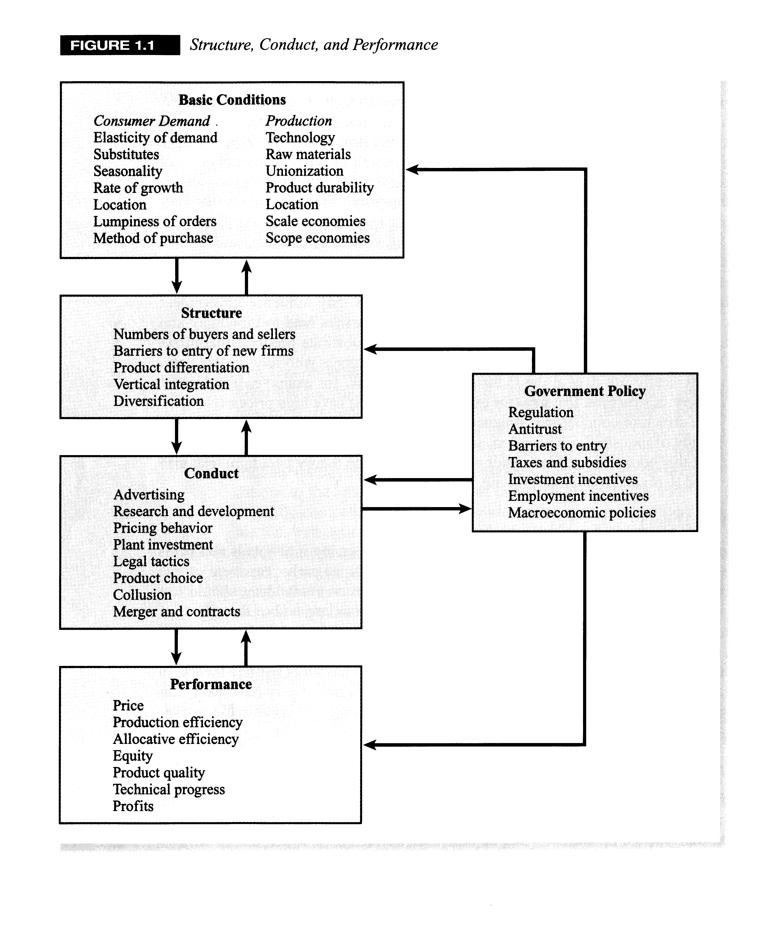
Law & Regulation
SCP

Slide 14
Year = 0 | 1 | 2 | 3 | 4
Sale (Revenue)= (P x Q) Quantity Demand (PRODUCT) (PRICE) – in the pocket | Size? Growth? Seasonal?
Cost of goods sold (Expense) Production (Make or Buy) Fixed Cost Machineries/Equipment Factory/ Land –rent or buy Variable Cost Raw Material Overhead Cost Transportation cost | % of Sale Growth? |  | New ! | Salvage Value
HR (Salary x Person)---month/day/job
Shelf/ Office Rental (PLACE)
Advertising exp (PROMOTION) Commission
Gross Profit
Free Cash Flow—cash vs. accounting

Slide 15
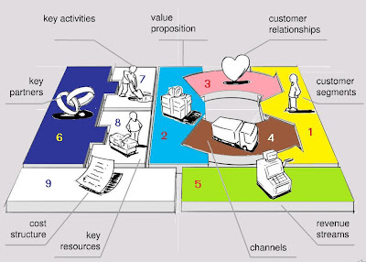

Slide 16
Business Plan
21 : 63

