Slide 1

A-T-A-R Model
MK 312 Additional Handouts by Ajarn Suwalya K.

Slide 2
The ATAR model provides a framework to help estimate the adoption rate in each year. The ATAR model (Awareness, Trial, Availability, Repeat), is based on concept of ‘Diffusion of Innovation’. In order for a person to be a regular purchaser of the new product they must first become ‘Aware’ that it exists. Once they have become aware of it they must make the decision to ‘Try’ it out. In order to be able to try it out, it must be ‘Available’ for them to purchase. If they are happy with the trial, then they may decide to adopt the product, that is, ‘Repeat’ the purchase again.

Slide 3
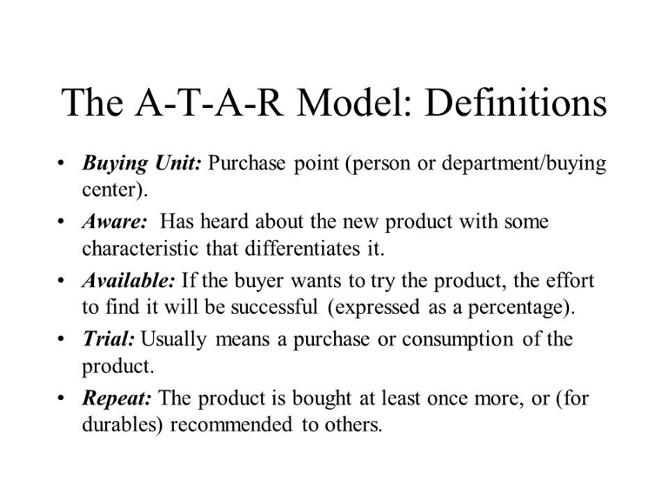

Slide 4
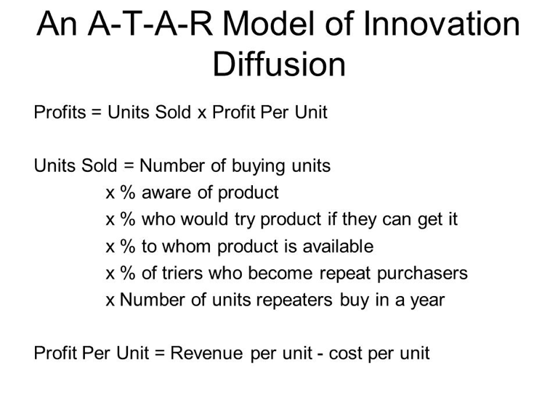

Slide 5
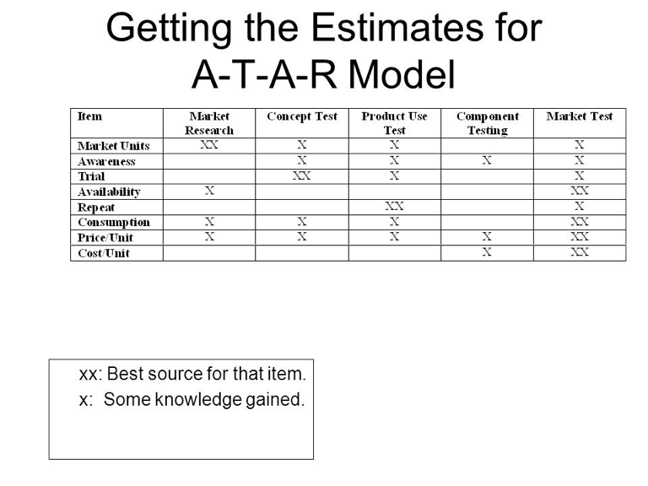

Slide 6
Application of the A-T-A-R Model of Ice-cream cones
2 million Consumers age 17-39 in Madrid area
x30% Percent aware after one year (Awareness)
x20% Percent of "aware" owners who try (Trial)
x10% Percent product availability at stores (Availability)
x50% Percent trier who buy again (Repeat)
x10 Units a typical trier buys per year
x $1.10 Unit price ($3.00) less unit cost ($1.90)
= $66,000 Total profits

Slide 7
Notes about A-T-A-R Model
1. Estimate each A-T-A-R factor using various assumptions (realistic, optimistic, pessimistic)
2. Estimate accuracies improve with eash step in the development phase.
3. If profit forecast is low, look at each A-T-A-R factor and see which can be improved at what cost.
4. The A-T-A-R works best in frequently purchased product categories.

