Slide 1
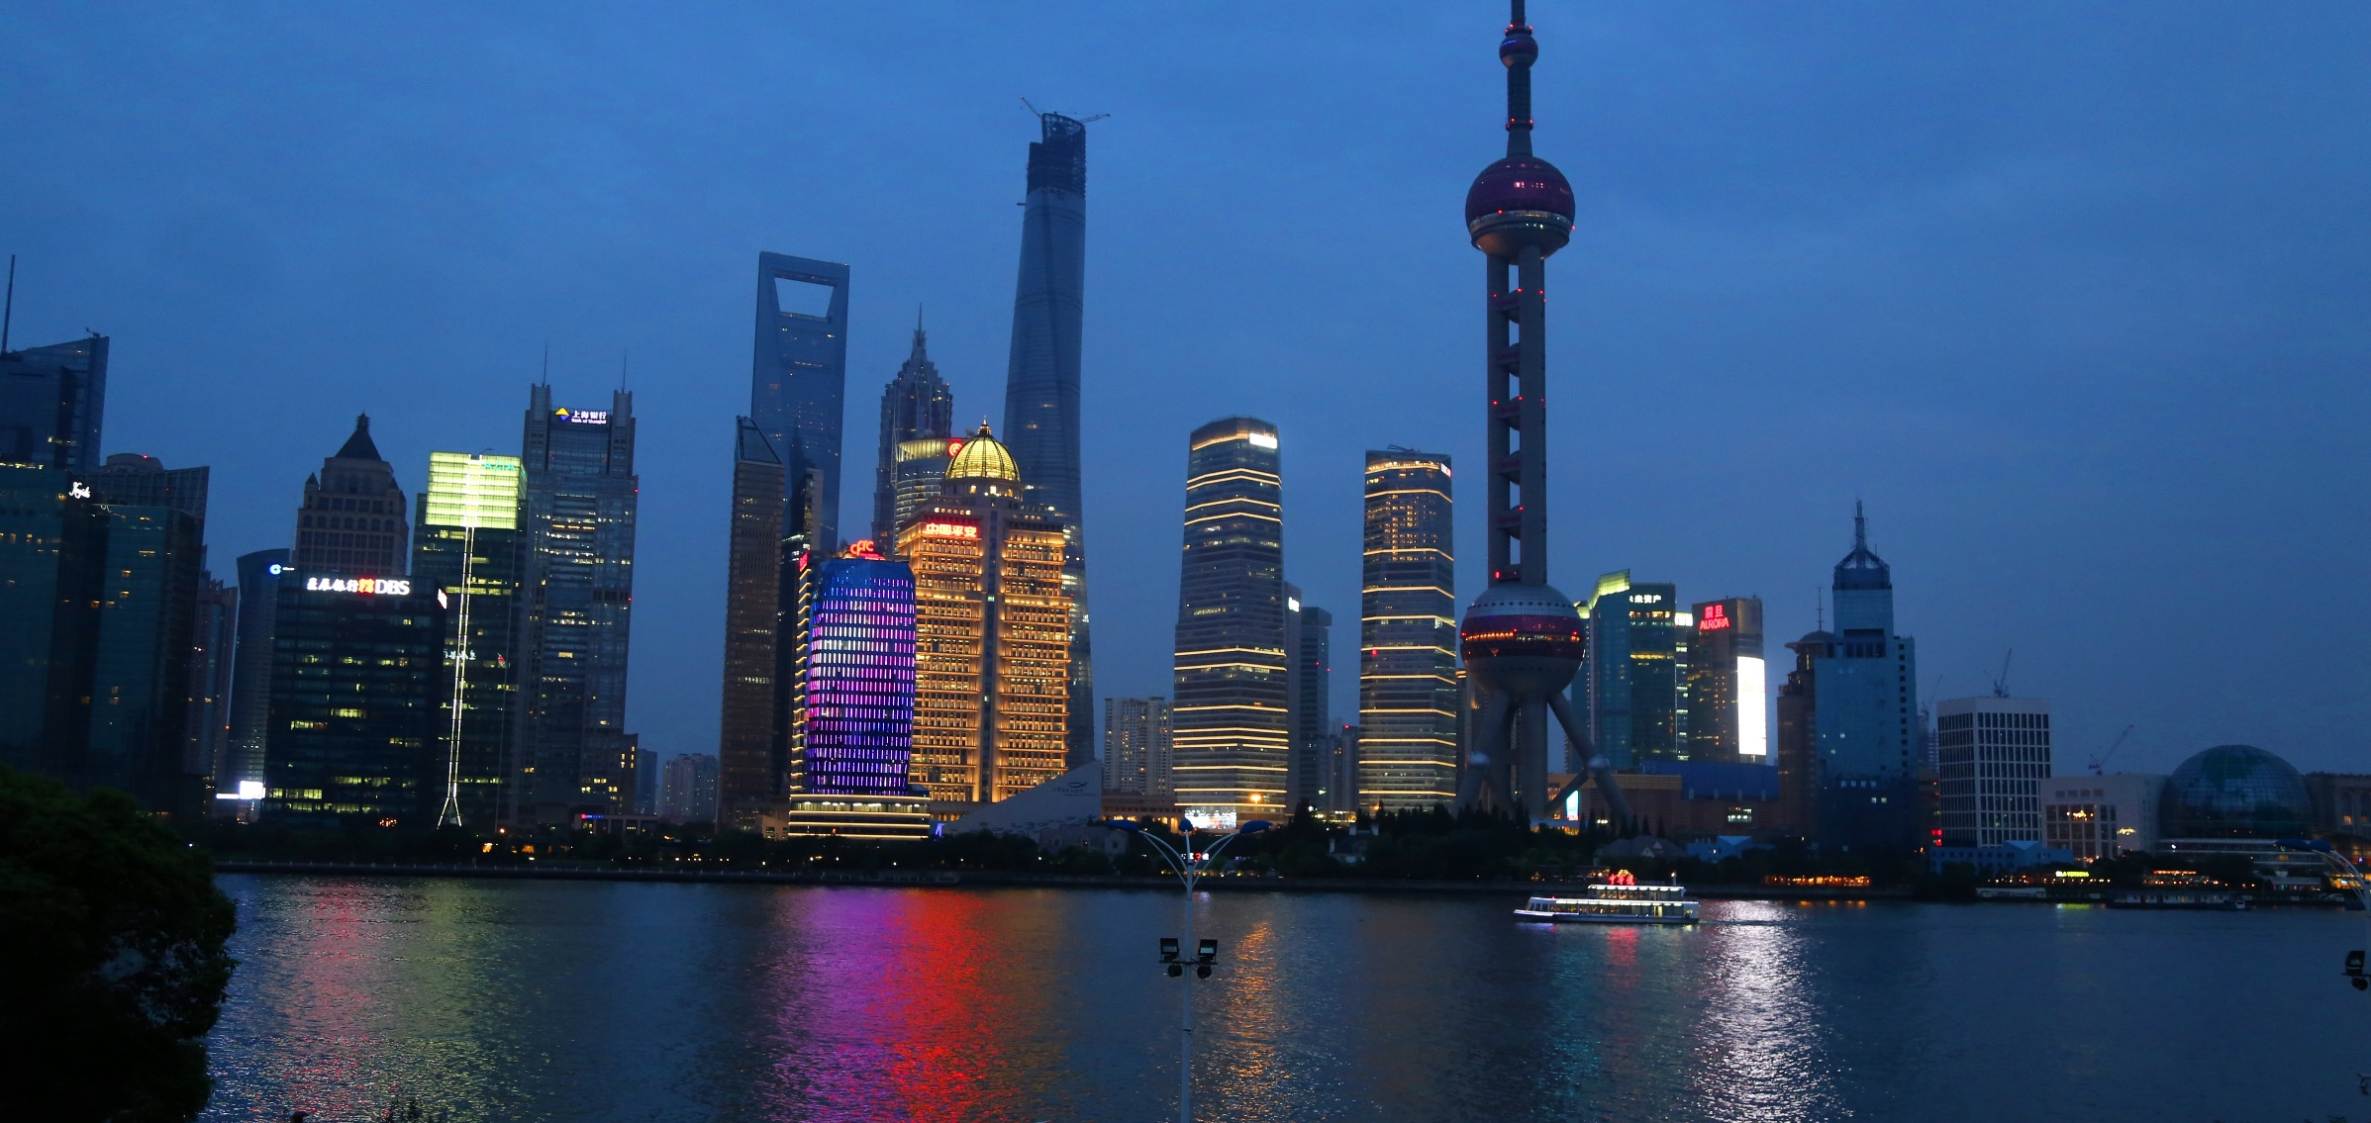
MEASURING ECONOMIC GROWTH and development
YOUR LOGO
FACULTY OF ECONOMICS, THAMMASAT UNIVERSITY
MODULE 2
Notes:
© Copyright Showeet.com – Free PowerPoint Templates

Slide 2
Economic growth
is contingent upon:
factor accumulation: increasing the size of the capital stock and/or increasing the labor force
productivity growth: improving efficiency and introducing technological change
Notes:
© Copyright Showeet.com – Free PowerPoint Templates

Slide 3
Link between economic growth and development
Economic growth is a necessary but not sufficient condition for economic development
Economic development includes having education, a healthy life, not being poor, safe from crime, citizen participation
Notes:
© Copyright Showeet.com – Free PowerPoint Templates

Slide 4


Economic growth and development
Economic growth
a rise in national output (or per capita income)
Economic development
a rise in national output and improvements in human well-being

Slide 5
Development indicators
National/
individual income/output
% population able to read and write
GDP, GNP, GNI
Literacy rate
UNDP Human development index
Human Development Index
DEVELOP- MENT
Mortality rate
Infant deaths per 100 thousand births
% population below the poverty line
Poverty rate
Education enrolment
% school age children enrolled

Slide 6
What is GDP? How is it calculated?
GDP = sum of value of finished goods and services produced by society within a given year
GDP per capita = GDP/population
Contribution of a sector of GDP = measured by the value added by the sector
GDP = C + I + G + (X – M)
whereby:
GDP = gross domestic product (national income)
C = consumption
I = investment
G = government spending
X = exports
M = imports

Slide 7

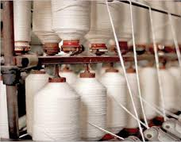


Value added
Incremental gain to the price of a product at a particular stage of production
Cotton balls
Cotton threads
Cotton shirts
Packaged product
tax
tax
tax

Slide 8
Difference between GDP, GNP, GNI, and HDI
GDP
GNP
GNI
HDI
Total value of goods produced within the country;
includes foreign investments but excludes citizens living abroad
Total value of goods produced by citizens of a country; includes remittances from abroad; excludes foreign investments
GNP + product taxes (minus subsidies) not included in the valuation of output + net receipts of primary income from abroad
Developed by the United Nations to quantify the essential elements of human development, which are not captured in GDP

Slide 9
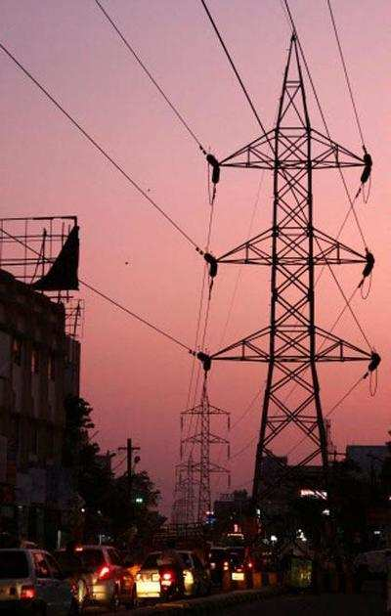
Limitations of GDP and HDI
GDP does not measure non-market activities, negative externalities and quality of life
HDI captures only three dimensions of human development and difficult to compare across countries

Slide 10
Economic growth
Economic growth = rise in national output
Rapid economic growth is a relatively recent phenomenon; until 500 years ago, most people in the world were poor

Slide 11
Economic growth: rise of GDP/capita over time
USA
Japan
Rep of Korea
PR China
1960
2020

Slide 12
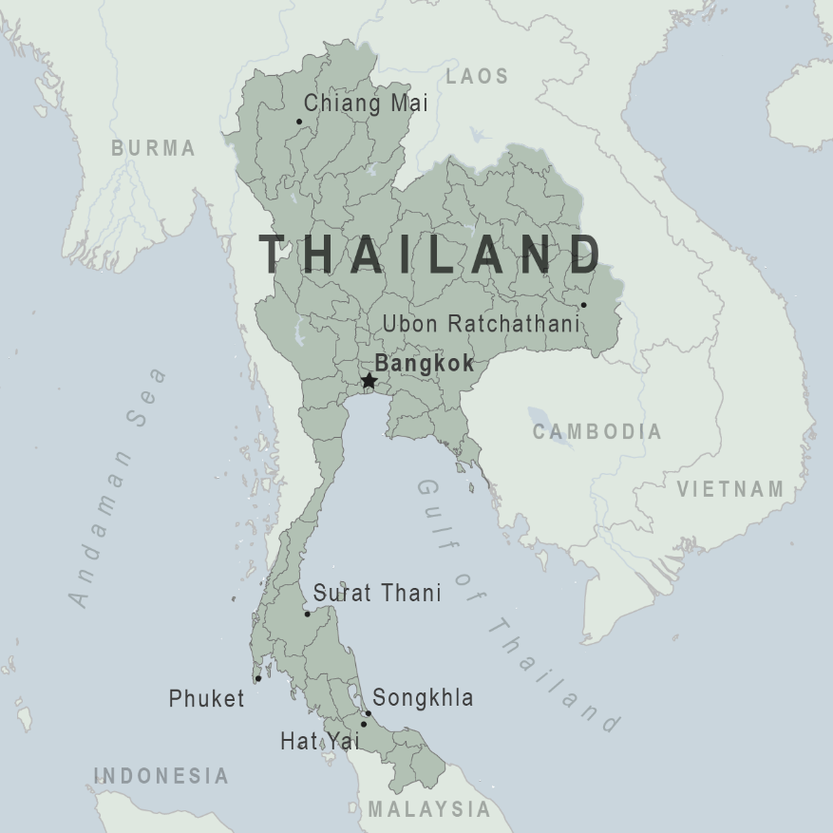
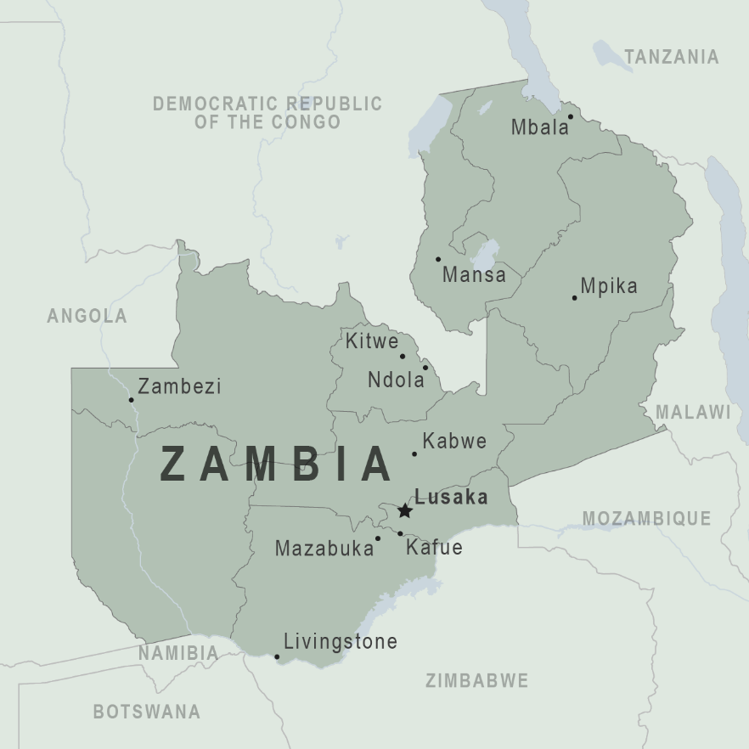
Case study: two countries, different experiences
Thailand
Zambia

Slide 13


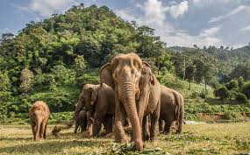
Thailand

Slide 14

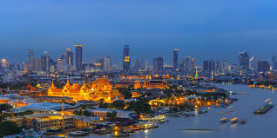
Thailand
Indicator | 1970 | 2020
GDP per capita | $929 | $7,189
Life expectancy | 54 years | 69 years
Infant mortality (per 1,000 births) | 103 | 12
Literacy rate | 80 | 94

Slide 15

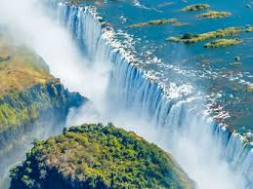
Zambia

Slide 16
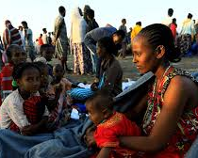
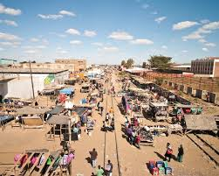
Zambia
Indicator | 1970 | 2020
GDP per capita | $1,581 | $1,051
Life expectancy | 45 years | 45 years
Infant mortality (per 1,000 births) | 126 | 86
Literacy rate | 48 | 71

Slide 17
Economic growth comparisons
GDP per capita, constant US$ 2010
Thailand
Zambia
1970
1980
1990
2000
2010
2020
Source: World Bank Open Data

Slide 18
Summary
Economic growth is the rise in national output
GDP, GNP or GNI can be used to measure economic growth; each measure has its limitations
Development: measured through: economic output, health, education, reduction poverty and HDI
Development = output growth + improved human well-being

Slide 19
Notes:
© Copyright Showeet.com – Free PowerPoint Templates

